Slide 1
Promotion and Firing Policy
MBE B4;
Kieran Nellist Alexey Trush
Karthik Kuppuswamy Kalin Pipatanantakurn
Panji Sukma Majid Zabihi

Slide 2
Todays Agenda
Introduction
Promoting and Hiring Policy
GE Case & policy
Deming’ System of Profound knowledge
Impact of Behaviours
Conclusion

Slide 3

Introduction
Promoting and Firing policy is the part of Performance Appraisal
According to Jack Welch:
“A company that bets its future on its people must remove the lower 10%...and keep removing it every year.”

Slide 4
General Electric Case
His policy was that for every 10 people in an organization 2 should be promoted, 7 should stay where they are, and 1 should be sacked on an annual basis.
“The top 20% and middle 70% are not permanent labels. People move between them all the time. However, the bottom 10%, in our experience, tend to remain there“ See Appendix 1
GE Annual Report 2010

Slide 5
Deming’s SoPK
Appreciation of the system
Knowledge about variation
Theory of Knowledge
Knowledge of Psychology

Slide 6
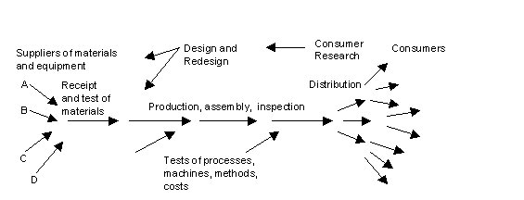
Appreciation of the system
The cause of variation could be a part of the individual performance or the system as a whole. Identification of this requires systemic knowledge in order to understand the root cause.
Deming, W. E. (1986). Out of the crisis

Slide 7
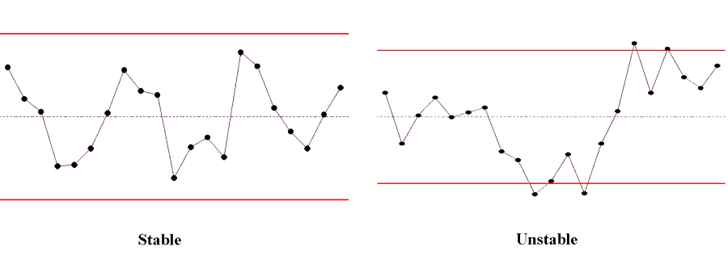
Knowledge about Variation
UCL
Promotion and firing can be seen as a method of removing special cause variation in employee performance.
LCL

Slide 8
Knowledge about Variation
UCL2
The promoted employees moving to the next level of the hierarchy where the performance level expected to be higher (UCL2).
UCL
LCL

Slide 9
Knowledge about Variation
But how do we know that the performance of this 10% is inside or outside the control limits?
Requirement of dismissing an employee when no “low performance” exists is subjective to bias.
UCL
LCL

Slide 10
Theory of Knowledge
Knowledge is accumulated in the organisation through the identification and resolution of root causes of low performance.
The dismissal of these individual prevents knowledge accumulation.
Firing bottom 10th percentile of performers wastes investment into training.
Improving performance through continued training gives a better return on human capital investment and knowledge accumulation.

Slide 11
Psychology
This approach make threats, which leads to fear and resentment towards policy makers (1)
The employees focusing not on what they are doing but the consequences of the individual failure, rather than pursuing the goal of the company or a team
Subjective judgment on individual performance
Employees will become demotivated and demoralized
1) Kohn, A. (1993). Punished by rewards p.172
Notes:
Negative and positive competitiveness

Slide 12
Resulting Effects on Behavior
This approach creates a damaging competitiveness within the working environment
“Game play” situations arise
Target oriented performance is promoted.
Employee loyalty towards the organisation is broken.
Breakdown of management employee relations.

Slide 13
Conclusion
While some aspects of the approach may be considered to be inline with the system of profound knowledge, we believe that overall this approach does not fit the system of profound knowledge.
The failure of this approach to take a holistic view of the organisation when employee performance is considered in relation to the promotion and firing policy means that this method does not have valid reasoning behind its implementation.

Slide 14
References
Deming, W.E (1986) Out of The Crisis, MIT Center for Advanced Engineering Study, Boston, MA
http://www.ge.com/annual00/letter/page4.html
Kohn, A. (1993). Punished by rewards. Boston: Houghton Mifflin.

Slide 15
GE Annual Report 2010
The top 20% must be loved, nurtured and rewarded in the soul and wallet because they are the ones who make magic happen. Losing one of these people must be held up as a leadership sin—a real failing.
The top 20% and middle 70% are not permanent labels. People move between them all the time. However, the bottom 10%, in our experience, tend to remain there. A Company that bets its future on its people must remove that lower 10%, and keep removing it every year—always raising the bar of performance and increasing the quality of its leadership.
Not removing that bottom 10% early in their careers is not only a management failure, but false kindness as well—a form of cruelty—because inevitably a new leader will come into a business and take out that bottom 10% right away, leaving them—sometimes midway through a career—stranded and having to start over somewhere else. Removing marginal performers early in their careers is doing the right thing for them; leaving them in place to settle into a career that will inevitably be terminated is not. GE leaders must not only understand the necessity to encourage, inspire and reward that top 20%, and be sure that the high-performance 70% is always energized to improve and move upward; they must develop the determination to change out, always humanely, that bottom 10%, and do it every year. That is how real meritocracies are created and thrive.

