Slide 1

Definition of Leadership
Team 2:
Vagelis Kitsos , Aditi Mittal, Usama Nadeem, Nandia Ntikou, Lucy Wan, Zain Waseem

Slide 2
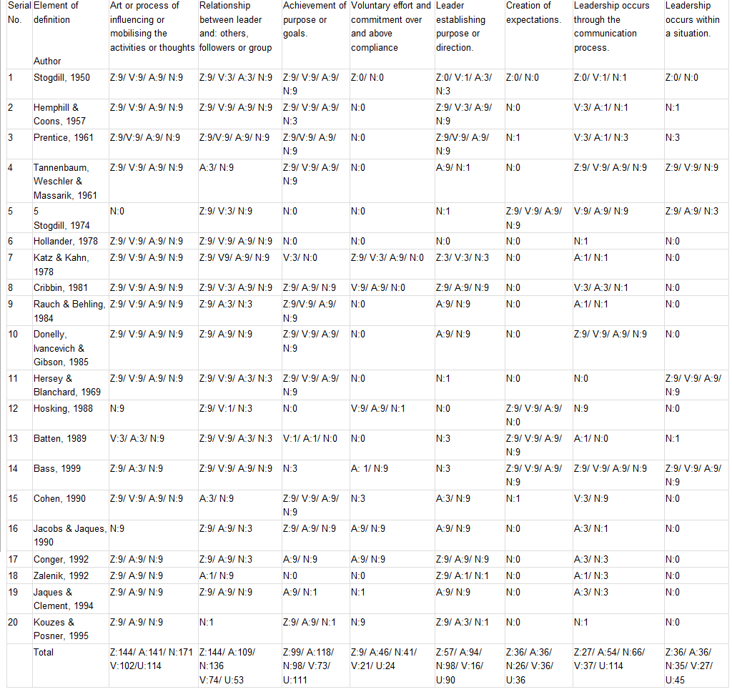
Analysis Matrix – 20 Definitions of Leadership

Slide 3
Elements of Definition
Art of process of influencing or mobilizing the activities or thoughts : 642 (1st) INFLUENCE
Relationship between leader and others, followers or group : 516 (2nd) RELATIONSHIP
Achievement of purpose or goals : 499 (3rd)
PURPOSE (be effective)
Leader establishing purpose or direction : 355 (4th)
ESTABLISHMENT OF VISION
Leadership occurs through the communication process: 298 (5th) COMMUNICATION
Voluntary effort and commitment over and above compliance : 141 (6th) COMMITMENT

Slide 4
Our Definition
Leadership is an art of establishing a shared vision and influencing people through interdependence and commitment towards achievement of a common purpose.

Slide 5
Thank you !

Slide 6
References
Warwick Manufacturing Group. (2011, February). Leadership and Excellence module notes. Unpublished document.
Figure 1. Gold egg. (2011). HR professional. Retrieved February 8, 2011, from: www.hrpro.gr

