Slide 1
HOSHIN KANRI
Team A1

Slide 2
Definition
A step-by-step planning implementation, and review process for managed changed. It is a system approach to management of change in critical business processes (Akao, Y, 1992)

Slide 3
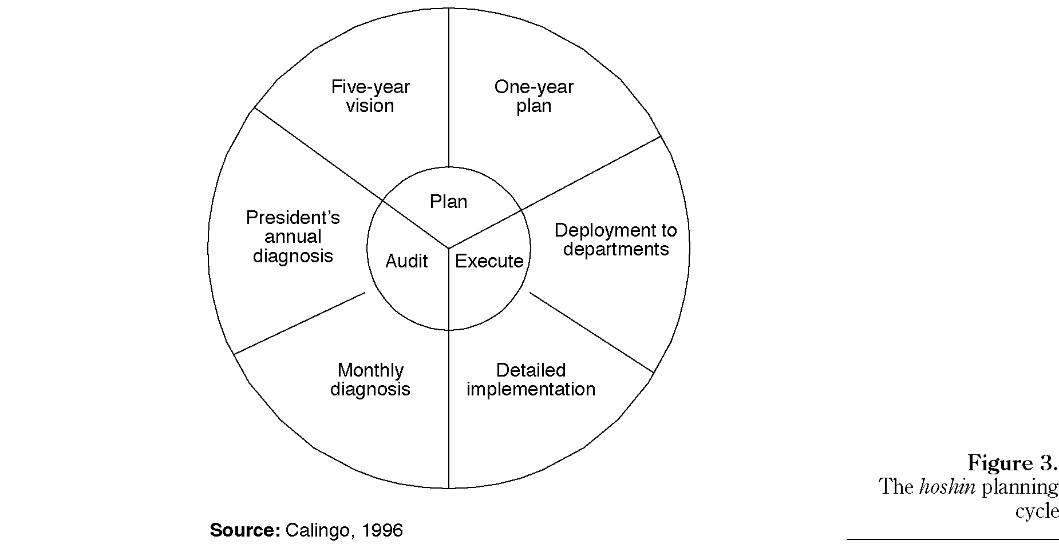
The Hoshin planning system

Slide 4
Advantages and Disadvantages
Advantages
Uses systematic planning (Lee and Dale, 1998)
Bottom-up approach (Tennant and Roberts, 2001) that is cohesive cross-functional cooperation
It is relatively simple in context and disciplined(Tennant and Roberts, 2001) .
It develops long-tem vision for improvement(Tennant and Roberts, 2001).
Planning is systematic-It puts emphasis on processes for deployment and improvement.
Integration of strategic objectives with tactical daily management.
Parallel planning and execution methodology (Witcher, B. J., & Chau, V. S, 2007).
Disadvantages
Slow (Gunasekaran and Kobu,2002) and requires long term commitment
No connections with process management (Munshi, 1993; cited in Roberts and Tennant 2001) .
Inadequate cross-functional Management (Munshi, 1993; cited in Roberts and Tennant 2001).
It is argued that its not a strategic planning tool in itself but more of an execution tool for deploying an existing strategic plan throughout the organisation (Witcher, B. J., & Chau, V. S, 2007).
Does not aid policy formulation (Witcher, B. J., & Chau, V. S, 2007) .

Slide 5
SWOT Analysis
Strength | Threat
Good products Hiring us is showing they know the need | Market is becoming more competitive Market is unstable Market is stagnate in UK Decline in public spending
Increase price because of the non elasticity Going abroad UK market Reduce cost for production Product development, new range of products More money will be spend in the future public sections | Production setup, coping with the demand Old fashion sales techniques Link between production setup and forecast
Opportunity | Weakness

Slide 6
VISION
To be No.1 in the European Market

Slide 7
Strategic Objectives
Evaluate the European market
Establish market strategy for Europe
To increase profitability
Re-structure organization to fit the strategy

Slide 8
Goals
Strategy | 2012 | 2017
1. Evaluate the European market | Completing marker research with suggestions within 1st three months. Prioritizing the countries for penetration | Evaluation to be carried out every year to keep up with the market trend.
2. Establish market strategy for Europe | Deciding on the pricing, promotions and distributions within 14 days after getting the details. Launching the both the product in another 3 months. To penetrate 3 countries only. | To be no. 1 in all of Europe

Slide 9
Goals
Strategy | 2012 | 2017
3. To increase profitability | Promoting brand image and asking for premium price. Decrease cost by 15% due to the introduction of new technologies. Reducing admin. Cost by 10%. | Established as premium brand. 30% cost reduction in direct production cost. Total admin cost to be reduced by 20-25%.
4. Re-structure Organization to fit strategy | Re-org. Fin & HR department within 1 month. Creating new European sales department within 1 month.

Slide 10
What needs to be done?

Slide 11
One:
Make a two-member team from sales (One production personnel, One distribution personnel)
Hire an external consultancy and advisory agent
Conduct weekly reviews led by the Marketing
Director with participation of finance Director and Productions director
Two:
Have the same team led by Productions Director
Three:
Accountant, Sales Manager (Pricing)
Design Manager (Pricing and Banding)
Work manager and Research, Development Manager and Draughtsmen
Four:
Human Resource Director (Champion) and Finance Director (Funds)
Training and Development Manager (3 external, 3 internal and 1 sale representative(s) for Europe

Slide 12
How Should we do it?
Implement the plans as the strategies and the time frame decided
The person responsible for each task ensures that progress is made and deadlines and target is achieved.

Slide 13
Review the progress
One: Weekly Reviews
Two: Once in 2 weeks
Three: Monthly
Four: Daily Management

Slide 14
References
Gunasekaran, A and Kobu, B (2002), ‘Modelling and analysis of business process reengineering’, International Journal of Production Research, Vol. 40, No. 11, 460-468
Hunt, R. A; Xavier, F. B. (2003). The leading edge in strategic QFD. The International Journal of Quality & Reliability Management. 20 (1), 56-73.
Lee, G. R and Dale, G. B (1998), ‘Policy Deployment: An examination of the theory’, International Journal of Quality, Vol. 15, No.5, 520-540
Roberts, P and Tennant, C (2001), Hoshin Kanri: A tool for strategic policy deployment, Knowledge and Process Management, Vol. 8, No. 4, 262-269
Witcher, B. J., & Chau, V. S. (2007). Balanced scorecard and hoshin kanri: dynamic capabilities for managing strategic fit. Management Decision , 518-538.

Slide 15

Thank you
Any Q?

