Slide 1


Winning Strategy 2 CSR plan
Team A2

Slide 2
Agenda
Introduction
CSR Definition
Waveriders’ CSR Policy & Core Values
CSR Best practices
CSR Departmental Objectives
Conclusion
References

Slide 3
Definition
Open and transparent business practices that are based on ethical values and respect for employees, communities, and the environment. It is designed to deliver sustainable value to society at large, as well as to shareholders. (Aaronson 2003, p. 310)

Slide 4
Introduction
Why we need CSR?
Improve the brand image of Waveriders
Boost the Waveriders’ customer value and shareholder value
Reduce the risk of doing business.

Slide 5
Waveriders’ Corporate Vision
To be the first choice for clients where high quality meets affordability and set high level standards in the military marine industry.

Slide 6
Waveriders’ CSR Policy
Waveriders’ recognizes CSR as a pivotal part of corporate activity.
We believe it is more than sponsorship – it is a collective and individual commitment to improving the cultural, social and physical environment in which we live and work.
Our CSR policy has core values that all Waveriders’ stakeholders including managers and employees should share and be committed to implement.
Core Values:
Contribution to society through our business
Responsible Partnership with Business Partners
A Reliable company

Slide 7
Waveriders ‘ CSR Core Values
Contribution to society through our business
Waveriders will contribute to the building of a prosperous community by providing safe, high-quality products and services through business activities based on its innovation, technology and product development.
Responsible Partnership with Business Partners
Waveriders will make every effort to promote fair and sound business practices among our business partners by fostering a common awareness of social responsibility. We will ensure our business practices are ethical and encourage positive relationships with all of our stakeholders.

Slide 8
Waveriders’ CSR Core Values
A Reliable company
Our primary mission is to supply products and services that meet customers' requirements by integrating a wide range of innovative technologies.
Waveriders’ will make every effort to create a pleasant and motivating working environment for all its employees and to fully support those employees who desire self-fulfillment and self-development through their work in order to match their professional careers with their personal goals.

Slide 9
Best practices
Yellowfin
Issue
Engine design is very inefficient and misses the opportunity to reduce the impact on the environment in terms of fuel emissions and energy use. In 2002, marine service and shipping consumed £1.14 trillion pounds of oil. Improving efficiency is recognised as key to environmental sustainability in shipping and makes economic sense, with volatile oil prices and concern about the impact of using fossil fuels on climate change. (Article 13, 2006)
Notes:
The aim of the company is to increase the leisure appeal of boating and bring it to a wider public, improving the quality of life, as well as creating a cleaner environment for both sea transport and leisure craft and making products safer and easier to use.

Slide 10
Best practices
Yellowfin
CSR
One of the challenges in getting a drive system to market is to convince the industry and investors that it has a market place. Yellowfin has got an assessment from a university to validate the claims.
The company went to private equity groups and business angels to fundraise throughout the development stage. Yellowfin was keen to use local suppliers, supporting local and regional companies.
To get this far in the development in the development of the drive technology. A new product that has the potential to revolutionize its industry – the culture of the organization has been important role.
(Article 13, 2006)
Notes:
Why is it CSR?
The idea behind Yellowfin is to bring to market a commercially viable new product which will reduce the environmental impacts of the marine industry.Managing a company’s impact on the environment, for example by lowering energy use, fuel emissions and pollution levels is a key component of CSR. Yellowfin’s VSD technology will mean that, when operational, the company will go beyond the required legal requirements for current stern drives.

Slide 11
Best practices
Yellowfin
Benefits
The technology produces 100% more effective power from the same size engine as conventional inboards, so giving enhanced speed, acceleration and desirability. The drive system reduces fuel consumption by 50%, lowering operating costs and increasing range. It also reduces emissions by 50%, materially improving environmental impact and ‘sociability’
(Article 13, 2006)

Slide 12
Production Department
Strategic Goals:
Improve efficiency
Improve production safety specifications
Increase innovation interventions
How to Achieve?
By recyclable plastics, waste reduction
Visual guidelines, UK & EU production safety laws
Green innovative and safe technology

Slide 13
Finance Department
Strategic Goals:
Invest in new technology
Investing in new finance system
To achieve higher return
How to achieve ?
To invest in green technology
Efficient use of technology.
Effective use of energy and renewable energy
Decreasing in paper work by using new finance system.

Slide 14
Marketing & Sales Department
Strategic Goal:
Increase Market share by 30% by 2017.
10% for Leisure and 20% for the marine industry
How to achieve it?
Marketing campaign on CSR policy
Join Green and Innovative Technology fares.
Marine life preservation awareness.

Slide 15
HR CSR Policy
Waveriders will make every effort to create a pleasant and motivating working environment for all its employees and to fully support those employees who desire self-fulfillment and self-development through their work in order to match their professional careers with their personal goals.
Training HR redundant employees for improving their employability skills.
Employment Equal opportunities.

Slide 16
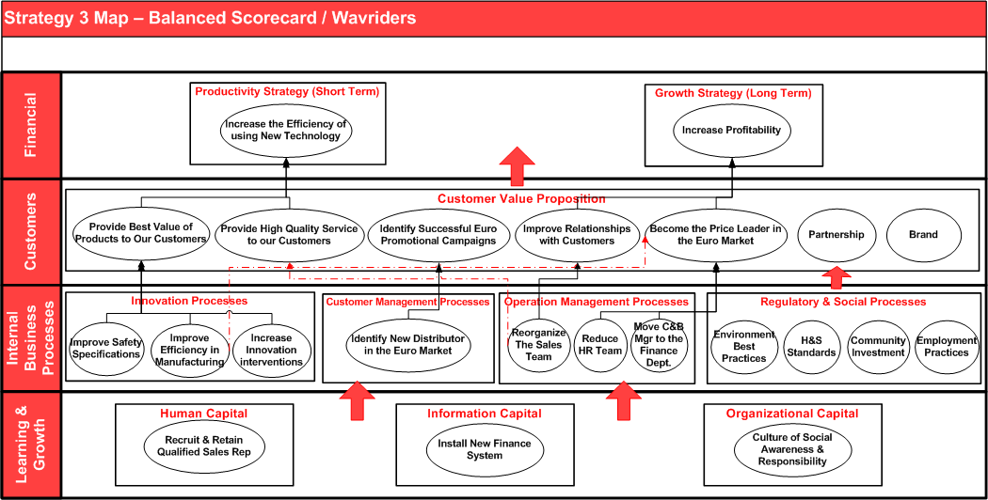

Slide 17

Conclusion
The proposed CSR Vision (Policy & Core Values) according to Strategy Number 3 will enhance the customer value and therefore improvig the sharholder value (long term objective) while at the same time reduce the risk of doing business , i.e. ensure that the business is a « going concern «(Short term).

Slide 18

References
Aaronson, S. (2003) Corporate responsibility in the global village: The British role model and the American laggard. Business and Society Review, vol. 108, no.3, pp. 309-38.
Duncan, A. (2006) CSR Case Study. http://www.article13.com/A13_ContentList.asp?strAction=GetPublication&PNID=1363
Kaplan, S. , Norton, D. (2004) Strategy Maps: Converting Intangible Assets into Tangible Outcomes. Massachusetts: Harvard Business School Press.

