Slide 1
Promotions and Firing Policy
Team A2
Nikunj
Emre
Emre
Aydan
Modar

Slide 2
Agenda
Who is Jack Welch?
Jack Welch’s Statement
Deming’s System of Profound Knowledge
The relation between System of Profound Knowledge & Deming’s 14 principles
Conclusion
References

Slide 3
Jack Welch
Jack Welch was the Chairman and CEO of General Electric between 1981 and 2001
The company’s value rose 4000% during his career in GE and made GE one of the most valuable company in the world.
Known as a Six Sigma Guru
www.cbsnews.com (2005)

Slide 4
Jack Welch
In 2001 Jack Welch, then CEO of GE Corporation and Six Sigma Guru made the following statement: “A company that bets its future on its people must remove the lower 10%...and keep removing it every year “
His policy based on selecting the right people which is called “Forced Ranking System”
(Union, 2011)

Slide 5
Jack Welch’s Statement
Annually out of 10 people;
2 persons should be promoted
7 persons should remain the way they are
1 person (ranked at the bottom) should be fired
(Union, 2011)

Slide 6
Forced Ranking System
GE’s not alone. Ranking employees is everyday practice at highly admired companies like Microsoft, Cisco Systems, Hewlett Packard, and Sun Microsystems
(Grote, 2002)

Slide 7
Deming’s System of Profound Knowledge
SOPK
Appreciation for the system
Knowledge about variation
Knowledge of Psychology
Theory of Knowledge
(Deming, 1994)

Slide 8
Appreciation for The System
Appreciating a system is an understanding of the overall processes involving suppliers, producers, and customers (or recipients/consumers) of goods and services (Management Solutions, LLC, 2010)
Feedback plays a significant role for appreciation

Slide 9
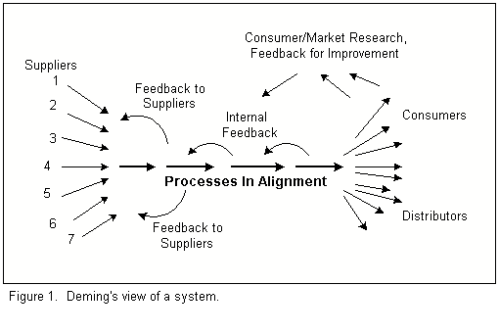
Appreciation for The System

Slide 10
Appreciation for The System & Deming’s Principles
“Create constancy of purpose toward improvement of product and service” (Rule 1), (Deming, 1993)
“Adopt the new philosophy” (Rule 2), (Deming, 1993)
“Cease dependence on inspection to achieve quality” (Rule 3), (Deming, 1993)

Slide 11
Appreciation for The System & Deming’s Principles
“Break down barriers between departments” (Rule 9), (Deming, 1993)
“Remove barriers that rob people in management” (Rule 12), (Deming, 1993)

Slide 12
Knowledge of Psychology
Deming believes that the most important motivation comes from inside the person
Intrinsic motivation is the driving force for people to seek innovation and the improvement
Deming indicates that focusing on extrinsic motivational method has a destructive affect on intrinsic motivation
(Deming, 1994)

Slide 13
Knowledge of Psychology & Deming’s Principles
“Drive out fear” (Rule 8), (Deming, 1986)
According to Deming’s rule 8; “ People are born with a need for relationships with other people, and need for love and esteem by others” (Deming, 1986)
Management by fear as counter- productive in the long term, because it prevents workers from acting in the organization's best interests. (Hillmer, 1997)

Slide 14
Theory of Knowledge
Knowledge is not possible without theory (Deming, 1993)
Theory helps organizations to understand the cause and effect relationship
Without theory experience teaches nothing (Maguad, 2010)
Practice is permanent with theory

Slide 15
Knowledge of Variation
UCL
UCL 2
LCL
UCL
Special causes
UCL
LCL
Promoted Employees
LCL
Common cause/Normal

Slide 16
Conclusion
According to Deming’s deadly diseases, evaluation of performance (annual review) in general has a bad effect on the employee’s moral and the organizational culture as a whole.
However, this approach might not be right for all companies at a particular time, but sometimes it might be the right choice at the right time.

Slide 17
Thank you… Questions?

Slide 18
References
http://www.cbsnews.com/stories/2005/03/24/60II/main682830.shtml
Berry, B. (2011) The link between Deming’s Theory of Profound Knowledge and Systems Thinking
Deming, W. E. (1986) Out of the crisis, Cambridge: Massachusetts Institute of Technology
Deming, W. E. (1994) Out of the crisis, Cambridge: Massachusetts Institute of Technology

Slide 19
References
Grote, D. (2002), Forced Ranking: Behind the Scenes, Published in Across the Board Magazine, December Issue, pp: 2-16
Maguad, B. , A. (2010) Deming’s ‘Profound Knowledge’: Implications for Higher Education, Proceeding of ASBBS, 17, 1, pp: 664-668
Management Solution, LLC (2010), Deming’s System of Profound Knowledge-Appreciation of a System
Unite the Union (2011) Forced Ranking in Performance Management
Steven Hillmer, University of Kansas, Journal of quality management, vol:2 no:2, pp. 171-189, 1997

