Slide 1
Promotions and firing policy
Mini-project 4b
Team 4

Slide 2
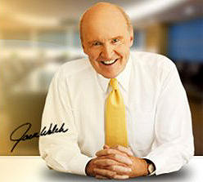
“A company that bets its future on its people must remove the lower 10%...and keep removing it every year.”
----Jack Welch, 2001

Slide 3
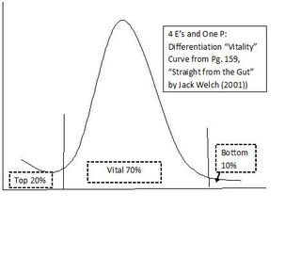
“A
Notes:
One such tool was "forced ranking," in which managers rank employees in their department against others in that department or a designated peer group. The top 20% are rewarded and the bottom 10% are put on probation or possibly terminated. This is much different from the widely used "performance appraisal."

Slide 4
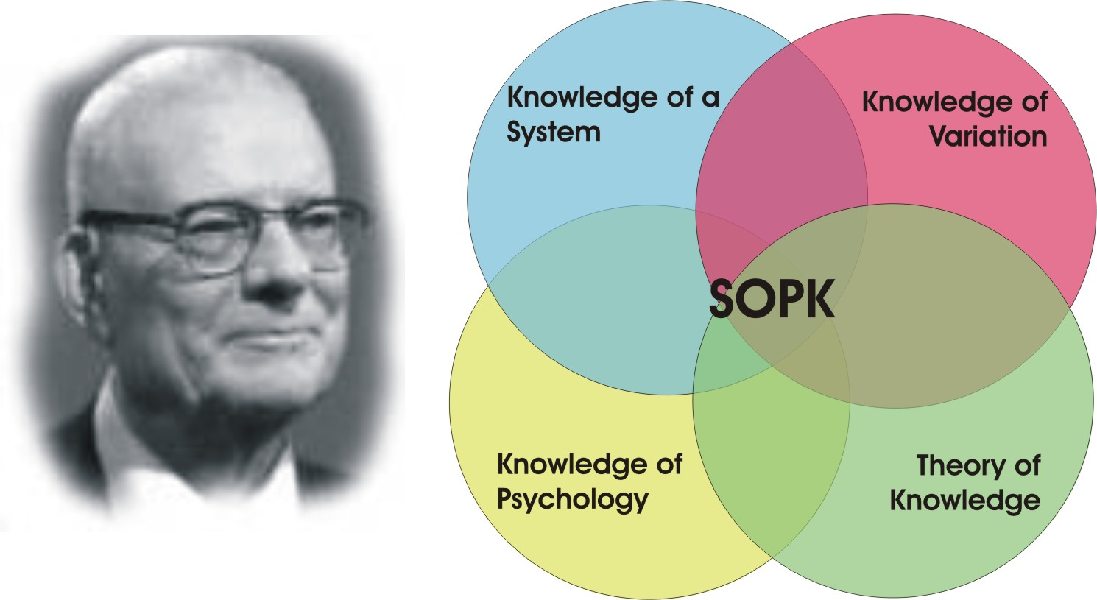
Deming’s system of profound knowledge

Slide 5
Logic? - Yes
Forced ranking is advocated as an effective tool for managers
Dismissing people is a way to keep the company forward.
Prediction can help the organisation to make decision and plan.
Notes:
First, proponents argue that ranking systems force managers to be honest with employees. Without forced ranking, managers are tempted to be too kind and not confront performance problems. Furthermore, it may be difficult for a manager to admit he or she has made a hiring mistake (Grote, 2005; Boyle, 2001).

Slide 6
Validity? - No
Knowledge of a system
Long term objective of a system should decided by everyone (employees, shareholders, customers and suppliers) to win.
It only encourages individual’s performance
Likely effects on behaviours
There is no connection between individual and the whole system.
Knowledge of variation
System perspective:
Common variation may occur due to design and operation of process.
Common variation should be fixed by management level, it is about the system.
Employee’s perspective:
It is vital to look the real situation.
Likely effects on behaviours
Poor management

Slide 7
Validity? - No
Theory of knowledge
Prediction based on past experience
Prediction can not just depend on statistical theory.
Likely effects on behaviours
Making a wrong decision
Knowledge of psychology
Must understand the causes of human behaviour
Extrinsic motivations in employment may smother intrinsic motivation
Likely effects on behaviours
Bad Stress
Damage morale
Decrease job satisfaction
No voluntary contribution
Break teamwork

Slide 8
Conclusion
There are two elements involved in Jack Welch’s statement: force ranking and 10% firing
Jack Welch’s statement is logical but invalid

Slide 9
References
Julian (2011), Deming’s “system of profound knowledge”. The Improvement Science Blog. Saturday, February, 2011. file:///Users/bonniechen/Desktop/To%20be%20a%20student/Master%20Degree/LE/Deming’s%20“System%20of%20Profound%20Knowledge”.webarchive - accessed 06/02/2012
Samuel K. H, (1996) “Deming’s system of profound knowledge and the World Cup”. Managing Service Quality. Vol 6, No 3 pp. 43–47
Gary, L. (1990). The controversial practice of forced ranking. Harvard Business Update, 6, 3-4.
Grote, D. (2005). Forced ranking: Making performance management work. Harvard Business School Press.
Boyle, M. (2001, May 28). Performance reviews: Perilous curves ahead. Fortune, 143, 187.

Slide 10

Thank You & Question?

