Slide 1
Winning Strategies
By,
A4

Slide 2
Contents
Overview of Balanced Scorecard
Advantages of Balance Scorecard
Disadvantages of Balance
Comparison
Vision
Usage of the Scorecard

Slide 3
Overview
The balanced scorecard is a strategic planning and management system that is used extensively in business and industry, government, and nonprofit organizations worldwide to align business activities to the vision and strategy of the organization, improve internal and external communications, and monitor organization performance against strategic goals. Drs. Robert Kaplan and Norton (Robert et al, 1996)
Notes:
More cynically, and in some cases realistically, a Balanced Scorecard attempts to translate the sometimes vague, pious hopes of a company's vision/mission statement into the practicalities of managing the business better at every level.

Slide 4
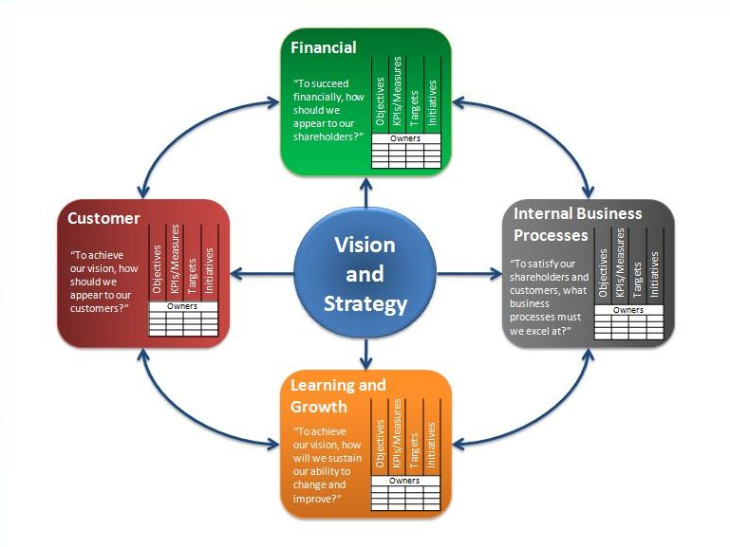

Slide 5
Advantages
Acts like the snapshot for the companies present and future performance
Short term, Medium term and Long term planning
Increases Communication
Increase Innovation and learning
Measures both numerical as well as non-numerical processes and integrates both financial and business plans
It aligns work to the critical success factors
Notes:
by using a balanced scorecard approach, the immediate future isn't the only thing being evaluated. Often, when an accountant sees the financial bottom line (perhaps the company isn't doing well), suggestions are given that are immediate, but do not look at the long-term. Using balanced scorecards allows for stakeholders to determine the health of short, medium, and long term objectives at a glance.

Slide 6
Disadvantages
Time consuming- Learn by practice
Many companies use metrics that are not applicable to their own situation. – Looking the real situation and hiring experts
Difficulty in measuring non-financial indicators -includes meticulous accounting methods
Gives targets but not methodology to reach them
Notes:
Finally, many companies use metrics that are not applicable to their own situation. It is vitally important when using balanced scorecards to make the information being tracked applicable to your needs. Otherwise, the metrics will be meaningless.

Slide 7
Comparison
Unlike Hoshin Kanri, the Balanced Scorecard does not involve any specification of an annual vital few and there is no recognized organizing framework for its deployment or use in daily management. The Balanced Scorecard is used to clarify at a senior and middle management level the key strategic goals and it is used effectively to help align the annual policies with corporate goals
Notes:
http://www.kcg.com.sg/hoshin-kanri-balanced-scorecard.html

Slide 8
Comparison
Management by Objectives – It focuses on short term performance and demolishes team work whereas Balance scorecard focuses on short, medium and long term performance, encourages team work as well as innovation.

Slide 9
Comparison
Business Process Reengineering focuses on the process and helps to rebuild them whereas balanced scorecard does not tell you how to rebuild the processes and how to get there.

Slide 10
Vision
To be the leader that provides quality product and strive to grow in boat industry .

Slide 11
Strategy 3 increase market share in EU
Research European market
Identify a distributor who could take on the European sales and handle any future expansion of the market.
Need new computerised finance package for Euros
Identify successful European promotional campaigns and put together a winning promotions strategy. Increase marketing spend.
Increase price of both products
Continue to invest in new technology costing an estimated £150k on capital expenditure.
Reorganise people

Slide 12
 | Finance | Clients | Internal Process | Learning and Growth
Objective | Increase ROCE and profitable growth | Increase market penetration and customer loyalty | Increase in productivity Utilise technology | Increase know how through out the company.
Measures/KPI’s | % of Reduced operating cost % increased ROCE | No. of new customer / distributor No. of repeated business Competitive price | Lead time No. of defect Turnover of Inventory | % employee satisfaction No. of new product/ patent
Targets | Reduce operating cost by 20 % Increase ROCE to 25 % | acquire market share by 30% Customer loyalty On time delivery Monopolize Europe. | Reduce redundancy and bring in robustness and reliability. Optimise sales team | Learning organization with employee satisfaction.
Initiatives | Install finance software Increase price of the product | Spend more on marketing Distributor development Initiate after sales services Loyalty program | Invest in R&D. RFID Start training of production engineers. Resource Planning | Career Development programs, Investments in knowledge-base for new technology

Slide 13
References
Roberts, R. (2011), Weighing the Pros and Cons of Balanced Scorecards (Updated Apr 8, 2011), http://www.brighthub.com/office/finance/articles/70687.aspx - accessed 01/02/2012
Cohen, B. (2012), The Disadvantages of Balanced Scorecards. eHow Contributor. http://www.ehow.com/list_6630586_disadvantages-balanced-scorecards.html - accessed 01/02/2012
Robert S. K and David P. N, “Using the Balanced Scorecard as a Strategic Management System,” Harvard Business Review (January-February 1996): 76.

Slide 14
Thank You

