Slide 1
CSR
Corporate social Responsibility
Winning Strategy Part II
WaveRiders

Slide 2
Definition of CSR
Carroll’s four parts definition
“the social responsibility of business encompasses the economic, legal, ethical, and discretionary expectations that society has of organizations at a given point in time” (Carroll, 1979)

Slide 3
Pyramid
Philanthropic Responsibilities
Be a good corporate citizen.
Ethical Responsibilities
Be ethical.
Legal Responsibilities
Obey the law.
Economic Responsibilities
Be profitable.

Slide 4
Before embarking on CSR
Compliance: What are the firm’s legal and regulatory requirements?
Choice: Which codes of conduct and other expectations govern the choices of business in this context?
Strategic: What problems can be tackled that will enhance the value, brand, or profits of a specific firm?
Structural: What are the problems that no business can solve alone?

Slide 5
Potential benefits
Achievement of Competitive Advantage
Value-Added to Products and Services
Achievement of Organisational Commitment
Equal Opportunity Compliance, Diversity and Their Inherent Benefits
Enhanced Corporate Financial Performance
Prevention of or Exit Strategies to Organisational Crises

Slide 6
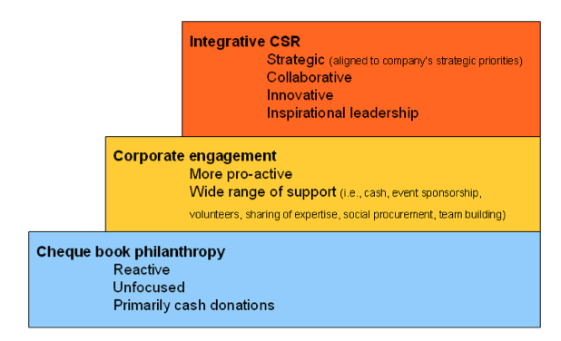
Best Practices

Slide 7
WaveRiders’ CSR Statement
We will constantly look into our business conduct and processes to identify ways that help us bring about harmony among people, society and environment.

Slide 8
New Vision
To be the leader that provides quality product and strive to grow in boat industry and take pride in conducting business in the way that bring about harmony among people, society and environment.

Slide 9
Finance
Goal | CSR | Stakeholder | Impact
Increase ROCE and profitable growth | Install computerised software to reduce workload, waste (paper) more systematic and transparency (reduce paper by 30%) encourage transparency- published CSR-related finance report (quarterly published) | Shareholder Customer Employee | Economical Legal Environment

Slide 10
Customer
Goal | CSR | Stakeholder | Impact
Increased market penetration Customer loyalty | Business Ethics – produce quality product with competitive (reasonable) price (reduce no. of defect by 20%) Consumer’s Right – provide good after sales service warranty hotline/customer service (90% satisfaction on survey) | Customer | Economical Ethical

Slide 11
Internal Process
Goal | CSR | Stakeholder | Impact
Increased Productivity Decreased Inventory Maintain quality | Resource planning & management adopt lean philosophy reduce waste, time (Reduce waste by 20%) develop partnership with supplier base on good relationship with mutual benefit (80% of positive feedback from monthly casual meeting) | Customer Employee Community | Economic Philanthropic
Cont.

Slide 12
Internal Process
Goal | CSR | Stakeholder | Impact
Increased Productivity Decreased Inventory Maintain quality | Introduce ergonomics concern employee’s health produce productivity (bi-annually session, 5 industrial injury/ year) Invest in R&D design for less/robust new raw material used- environmental friendly (5 solution/projects a year) | Customer Employee Community | Economic Philanthropic

Slide 13
Learning and Growth
Goal | CSR | Stakeholder | Impact
Increase know-how throughout the company | Career development (90% retention) Training (2 annually) Welfare Labour Law Provident fund (15% from salary) Develop relationship with community communicate, exchange ideas, collaboration (volunteer activity bi-annually) (forum/ town hall meeting quarterly) (5 solutions/innovation projects) | Employee Customer Community | Philanthropic Legal Ethical Economic

Slide 14
Role of Leadership
Proactive leadership
Cultural architect
Clear vision
Instill CSR value
Corporate brand

Slide 15
References
Carroll, A. B. 1979. A three-dimensional model of corporate performance. Academy of Man- agement Review, 4: 497-505.
Best Practices in Corporate Social Responsibility: Qfinance
retrieve from [http://www.qfinance.com/business-ethics-best-practice/best-practices-in-corporate-social-responsibility?full]
Horizon Policy Research Initiative
: CSR: Not Just Another Charitable Donation
retrieve at [http://www.horizons.gc.ca/doclib/2011_0061_Graupner_e.pdf]

