Slide 1
Policy Deployment
Wave Riders Inc.
By
Fawaz Iqbal
Gurbani Dassan
Farhaan Mirza
Nikhil Nair
Sophie Bellone

Slide 2
Wave Riders
Current Situation (SWOT Analysis)
Strengths
Established brand name & market presence in the UK.
Initiative penetration into the European Market.
Specialty in Rigid inflatable boat segment.
Stable position in the military sector.
Current products reputable.

Slide 3
Weaknesses
Declining Profits & Sales figures.
Ineffective forecasting of sales resulting in over production.
High Production & Distribution Costs.
High Inventory levels
Inefficient work force – Low ROCE
Lack of strategic approach.
Limited product range which is on the higher end of the market price range.
Rigid & bureaucratic discount structure.
High reaction time to market fluctuations.

Slide 4
Threats
Technological advancements.
Growing rigidity in safety norms.
Trend in the UK Market indicates decreasing prices.
No price elasticity in the leisure sector.
Well established competitors with broader product range & lower pricing.

Slide 5
Opportunities
Increase market share in Europe as prices of products increasing.
Expansion of Product Range
Worldwide economic growth of 6%
Military sector – Establish good relations with government as price is not a key factor in this market.
Leisure sector expected to grow.

Slide 6
Balanced Score Card
Strategic Planning, Implementation and Performance Measurement System
“The balanced scorecard is like the dials in airplane cockpit : It gives managers complex information at a glance.” (Kaplan & Norton, 1992).

Slide 7
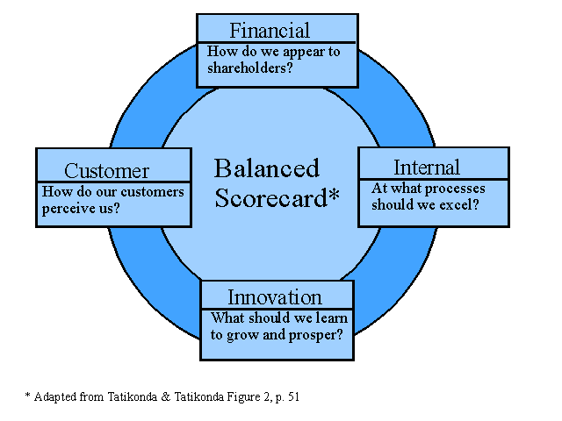
The 4 Core Performance Perspectives for establishing Goals & Measures :

Slide 8
Importance & Advantages (Kaplan & Norton, 1992 & Kaplan & Norton, 1996)
Focuses on implementation of Strategy .
Provides a balanced overview of the entire company at a glance.
Translates & breaks down long term strategy objectives into simple steps that can implemented into individual daily operations.
Integration & Communication of core strategy and its consequent applications to all levels & functions of the organization.

Slide 9
Demerits
Lack of citations & substantiation of sources for the basis of the initial research & core model developed by Kaplan & Norton.
Does not include all elements that may be important to the strategy of an organization.
Only determines cause-effect chain & establishes empirical correlation between perspectives without aiming at the bottom line.
Only Bottom-Up Approach with single sided feedback.

Slide 10
What is BPR ?
(Business Process Re-engineering)
Aikins - Business Process Re-engineering means to examine an organization's business processes and recommending automation or changes to achieve strategic goals
Harrington - A systematic methodology developed to help an organization make significant advances in the way in which its business processes operate.

Slide 11
Advantages:
Define business processes and their internal or external customers;
Highlight opportunities for both radical and incremental business improvements through the identification and removal of waste and inefficiency
Disadvantages:
Some BPR methodologies are quite expensive to implement.
BPR assumes that the problem is with the inefficiency of the processes of the company which is difficult to confirm or deny.

Slide 12
Hoshin Kanri/ Policy Deployment
In the early 1960s, Hoshin Kanri was first used in Japan to communicate a company’s goals, polices and objectives throughout the organizational hierarchy with the aim of focusing attention on the key activities that would lead to success (Lee & Dale, 1998).
Definition
Policy deployment is also known as Hoshin Kanri. Hoshin Kanri is basically an application of Deming's Plan-Do-Check-Act (PDCA) cycle to the management process. The PDCA cycle represents a generic approach to continual improvement of activities and processes (Lee & Dale, 1998).
Mizunode explained the concept of Hoshin Kanri in Eureka and Ryan (1990) as “Deploy and share the direction, goals and approaches of corporate management from top management to employees, and for each unit of the organization to conduct work according to the plan. Then, evaluate, investigate and feed back the results, or go through the cycle of PDCA continuously and attempt to continuously improve the performance of the organization”.

Slide 13
Strengths
Creates cohesiveness within an organization providing a consensus of the company’s objectives at all levels.
Integrates and arranges organizational efforts into actions so that organizational objectives are met
Encourages interdepartmental co-operation and creates alignment through participation
Creates responsive and flexible planning and implementations
identifies key problem areas within an organization enabling prioritization
Limitations
Strict implementation is necessary
Long term commitment is essential
Relatively Static – the breakthrough objective must be stable during a 5 year period

Slide 14
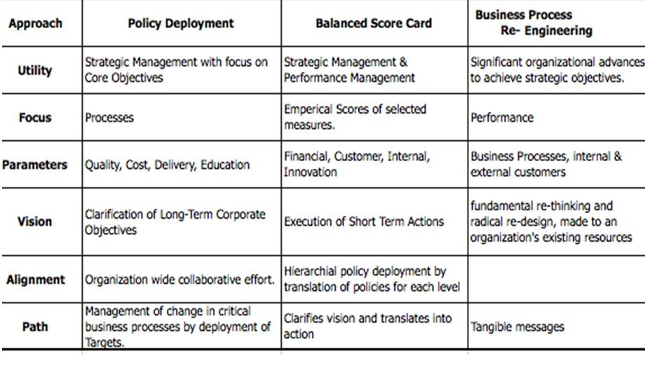
COMPARISION OF ALL THE THREE TECHNIQUES
(Roberts & Tennant, 2001 & Witcher & Chau, 2007)

Slide 15
POLICY DEPLOYMENT
PLAN = a plan of action is developed to address a problem.
DO = the plan is implemented.
CHECK = information is collected on the control parameters.
ACT = the results are analyzed. Corrective action is identified.

Slide 16
VISION
To become the number one company of selling rafts for both the leisure and the military sectors in the next five years.

Slide 17
GOALS
Goal 1 - Establish a strong market hold in Europe.
Goal 2 - Increase return on sales.
Goal 3 - Ensure appropriate stock management.
Goal 4 – Try and reduce operation costs.

Slide 18
DEPARTMENT SPECIFIC GOALS
Marketing Department
Ensure rigorous marketing techniques inside Europe.
Employ advertising through magazines, newspapers, fliers, billboards etc mainly for the leisure market.
Make the advertisements fun and attractive (keeping in mind how it is better than the competitors).
Appoint team leaders for appropriate sales management techniques.
Improve Accuracy of Forecasting.

Slide 19
Financial Department
Increase price of the products to sell in Europe.
Ensure the correct utilization of the return on capital employed.
Increase the gross margin as much as possible.
Properly manage the accountants and assign jobs efficiently.

Slide 20
Production Department
Communicate and discuss problems before taking action.
Assign only the right amount of workers for the correct jobs and avoid materials wastage.
Make exact assumptions about the amount of raw materials required – Improve Forecasting.

Slide 21
Human Resource Department
Provide convenient incentives to the workers for proper motivation.
Avoid resources wastage and reorganize the human resources.
Accommodate employee costs within the system.
Use motivational techniques in order to get the maximum benefits from the employees.

Slide 22
PLAN FOR WAVE RIDERS
(STRATEGY 3- MARKET DEVELOPMENT)
5% of leisure business already established in Europe, therefore, Expand base in the European market.
Communicate the problems before taking actions.
Decrease hold in the UK market for the time being.
Research European market pricing structure, discounts, distribution, competition, product and safety specifications before trying to exploit the markets completely.
Employ the Catch ball approach from the policy deployment technique.

Slide 23
Implementation
Implement the catch ball technique by making sure that all the employees understand the techniques before implementing them.
Use aggressive selling techniques especially in Europe by advertising
Increase 2.5% of the selling cost of the products for both the sectors in Europe.
Continue investment in technology to have a winning edge over the competitors.
Reorganize the HR and the Financial departments by moving the employees where they are required most. Get rid of all the remaining staff in the HR department and assign just one person to do the job.
Make contacts with higher government officials to sell the products into the military sectors.
Provide the customers with extensive after sales services (Warranty).

Slide 24
Review of Plan
Conduct monthly and annual reviews for the strategies implemented and collect the information.
Taking satisfaction surveys from the customers and work on the short comings.
Implement the changes from the previous year to make continual improvements.

Slide 25
References
S.J. Childe, R.S. Maull, J. Bennett, (1994) "Frameworks for Understanding Business Process Re-engineering", International Journal of Operations & Production Management, Vol. 14 Iss: 12, pp.22 - 34.
R.G. Lee, B.G. Dale, (1998) “Policy Deployment: an examination of the theory”, International Journal of Quality & Reliability Management, Vol. 15 Iss:5, pp.520- 540
Tennant, C. and Roberts, P. (2001), Hoshin Kanri: a tool for strategic policy deployment. Knowledge and Process Management, Iss:8, pp. 262- 269
Kaplan, R. S. & Norton, D.P. (1992), The Balanced Score Card – Measures that drive performance. Harvard Business Review, Vol. 70 Iss:1, pp. 71- 79
Witcher, B. J. & Chau, V. S. (2007), Balanced Score Card and Hoshin Kanri : Dynamic Capabilities for Managing Strategic Fit, Management Decision, Vol. 45 Iss:3, pp. 518 – 538

