Slide 1
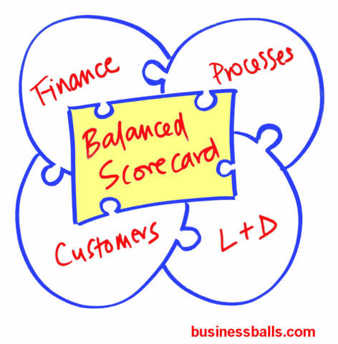
Winning Strategies Part I: Vision and deployment plan through Balanced Scorecard
By Team B2

Slide 2
Contents
Balanced Scorecard Overview
Advantages
Disadvantages & how to overcome them
Comparison to MBO & BPR
Deployment
Timeline
Four perspective
Conclusion
Q & A

Slide 3
Balanced Scorecard Overview
“BSC is a set of measures that gives top management a fast but comprehensive view of the business” (Kaplan & Norton 1992)
Illustrate the links between today’s actions and tomorrow’s goals (Kaplan & Norton 1996)
4 Perspectives – Financial, Internal business, innovation & Learning, and Customers
Created to tackle the overreliance on financial performance indicators
Notes:
Illustrate the links between today’s actions and tomorrow’s goals → Feed forward

Slide 4
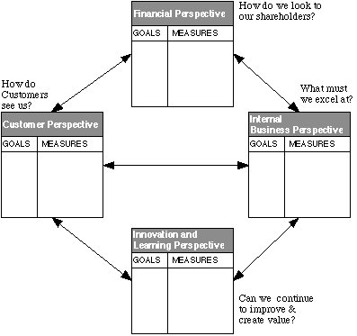
Balanced Scorecard
Learning
Internal Business
Customer
Financial
Business Goals
(Norreklit et al 2008)
Kaplan & Norton 1992
Notes:
Measurements of 4 perspective linking together in a causal chain:
The measures of learning & growth drive the measures of the internal business processes. They, in turn, drive the measures used for the
customer perspective; similarly, customer measures are themselves the drivers of the financial outcome measures.
A well-designed BSC should include a mix of outcome measures (lag indicators) and performance drivers (lead indicators). For example, one lag
indicator is an increase in sales, while order execution time is a lead indicator for sales growth. Each perspective should have lead and lag indicators, thus yielding two-directional cause and effect chains. Lead and lag indicators apply horizontally within measurement perspectives
and vertically between measurement perspectives. The causal paths from the scorecard variables should be linked to the financial targets of
The organization. This procedure implies that strategy is translated into a set of hypotheses about cause and effect
Without the characteristic of cause and effect, a true BSC does not exist.

Slide 5
Advantages
Comprehensive & balanced view
Framework - what to be done and measured
Links between measurements & cause-and-effect relationships to business strategy
Corporate vision & strategy ➔ meaningful measures for both manages and employees
Long term approach
Notes:
Comprehensive & balance view on strategic planning, management system and, organization performance
Framework to identify what should be done and measured
Links measurements and cause-and-effect relationships to business strategy
Translate corporate vision and strategy into meaningful measures for both manages and employees
Long term approach

Slide 6
Disadvantages & Overcoming
Implementation – complicated:
BSC → top management tool; learning hindered (Johanson et al 2006)
Partial implementation – selective and shorten time requirement
Treat BSC as a broad learning approach and not mechanically
Management isolation (Norreklit et al 2008)
Managers need to be familiar with business operations
Oversimplification
Careful study of circumstances and modify accordingly
Notes:
Implementation – complicated: BSC acts as a top management tool and learning might not be adequately promoted (Johanson et al 2006)
Time lagging – different perspective require different time scales
Management isolation – managers become remote from processes they are responsible for (Norreklut et al 2008)
Oversimplification – doesn’t fit all business situations or sizes

Slide 7
Disadvantages & Overcoming
Time lagging – different perspective require different time scales
Set a time-frame/ timeline
Measurement prone to manipulation
Clearly define measuring process
Emphasis on the ‘learning approach’ as opposed to promoting/ firing appraisal

Slide 8
Comparisons
 | Advantages | Disadvantages
BSC | Clear goals & Measurements with links to strategy Comprehensive & Balanced View Long-term structured approach | Management isolation Time consuming Complex Manipulation
MBO | Managers & employees - collaborative goals defining (including time-frame → best way to obtain goals to improve performance Less time consuming | Open-ended system → too much focus on easily quantifiable financial; overlooking other equally important measures Short-term looking Less comprehensive/ imbalanced
BPR | Clear framework to measure organizational performance Systematic approach Innovation orientated – improved productivity | Lack of shared vision and goals Lack of interaction within workforce Focus on short term financial criteria
Notes:
Despite BSC disadvantages, the measurement still proving beneficial as not only BSC addresses the financial measurements, it also integrates innovation, customer, and internal business perspectives. Perspectives other than financial will help enhance the company’s performance in both the short term and in the long run.

Slide 9
Four Perspectives - Financial

Slide 10
Four Perspectives - Customer

Slide 11
Four Perspectives - Internal

Slide 12
Four Perspectives - Learning

Slide 13
Deployment of Strategy
Year 1
Increase rescue/military sales team by one person and make two production operatives redundant
Review the SeaSpray and Seahorse markets and target other groups of potential customer in order to develop sales strategy
Year 2
Identify enhancements for customer requirements and their costs – invest 45 000 GBP on technology
Continue new user groups identification
Year 3
Evaluate customer feedback on the recently implemented technology
Review sales strategy and evaluate against sales trend
Year 4
Year 5
Spend 15 000GBP on media to better position our products publicly – TV ads, campaigns, attend exhibitions.
Invest 55 000 GBP on marketing
Further identify new enhancements – invest 60 000 GBP on technology
Invest further 37 000 GBP on marketing
Invest 22 500 GBP on Technology – in reference to customer feedback on past enhancements
Review sales strategy
Invest further 35 500 GBP on marketing
Evaluate business strategy – assess success and rooms for improvements
Invest 22 500 GBP on Technology – in reference to customer feedback on past enhancements
Invest 17 500 GBP on marketing, increase intensity in successful groups

Slide 14
Conclusion
Similarly to other approaches, it has pro’s and con’s. However, for WaveRider’s case, BSC is most suitable as it not only does it provide a comprehensive view of the business, but it also focuses on measures other than financial, which in turn, translate to sustainable long term improvement strategy.

Slide 15
References
Alstyne, M., Brynjolfsson, E., Renshaw, A. (1997). The matrix of change: a tool for BPR. Cambridge: MIT sloan school of management.
Dinesh, D., Palmer, E. (1998). Management by objectives and the balanced scorecard: will rome fall again?.Management decision, 36(6), 363-369.
Gupta, V., Rohe, D. (1997). Houston business process re-engineering share group: a case study. Business process management journal, 3(2), 173.
Johanson, U., Skoog, M., Backlund, A., Almqvist, R. (2006). Balancing dilemmas of balanced scorecard. Accounting, auditing & accountability journal, 19(6), 842-857.
Kaplan, R. S., Norton, D. P. (1992). The balanced scorecard- measures that drive performance. Harvard business review, 83(7/8), 172-180.
Kaplan, R. S., Norton, D. P. (2001). Transforming the balanced scorecard from performance measurement to strategic management part 1. Accounting horizons. 15(1), 87-104.
Larsen, M., Myers, M. (1997). BPR success or failure? a business process reengineering project in the financial services industry. Auckland: association for information system.
Norceklit, H., Jacobsen, M., Mitchell, F. (2008). Pitfalls in using the balanced scorecard. The journal of corporate accounting and finance. 19(6), 65-68.
Norton, D. P., Kaplan, R. S. (1996, January-February). Using the balanced scorecard as a strategic management system. Harvard business review, 75-85.
Pereira, R. (2011). Why HoshinKanri?. Retrieved from http://lssacademy.com/2011/01/03/why-hoshin-kanri/
Rodgers, R., Hunter, J. E. (1991). Impact of management by objectives on organisational productivity. Journal of applied psychology monograph, 76(2), 322-336.
Zairi, M., Al-mashari, M. (1999). BPR implementation process: an analysis of key success and failure factors. Business process management journal, 5(1), 87.

Slide 16
Thank you
Q & a

