Slide 1



CENTS Outreach - Towards Sustainable Living, Transport and a more Circular Economy
Dr Chandrika Nair, CENTS Network Manager

Slide 2

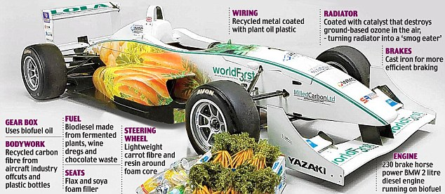

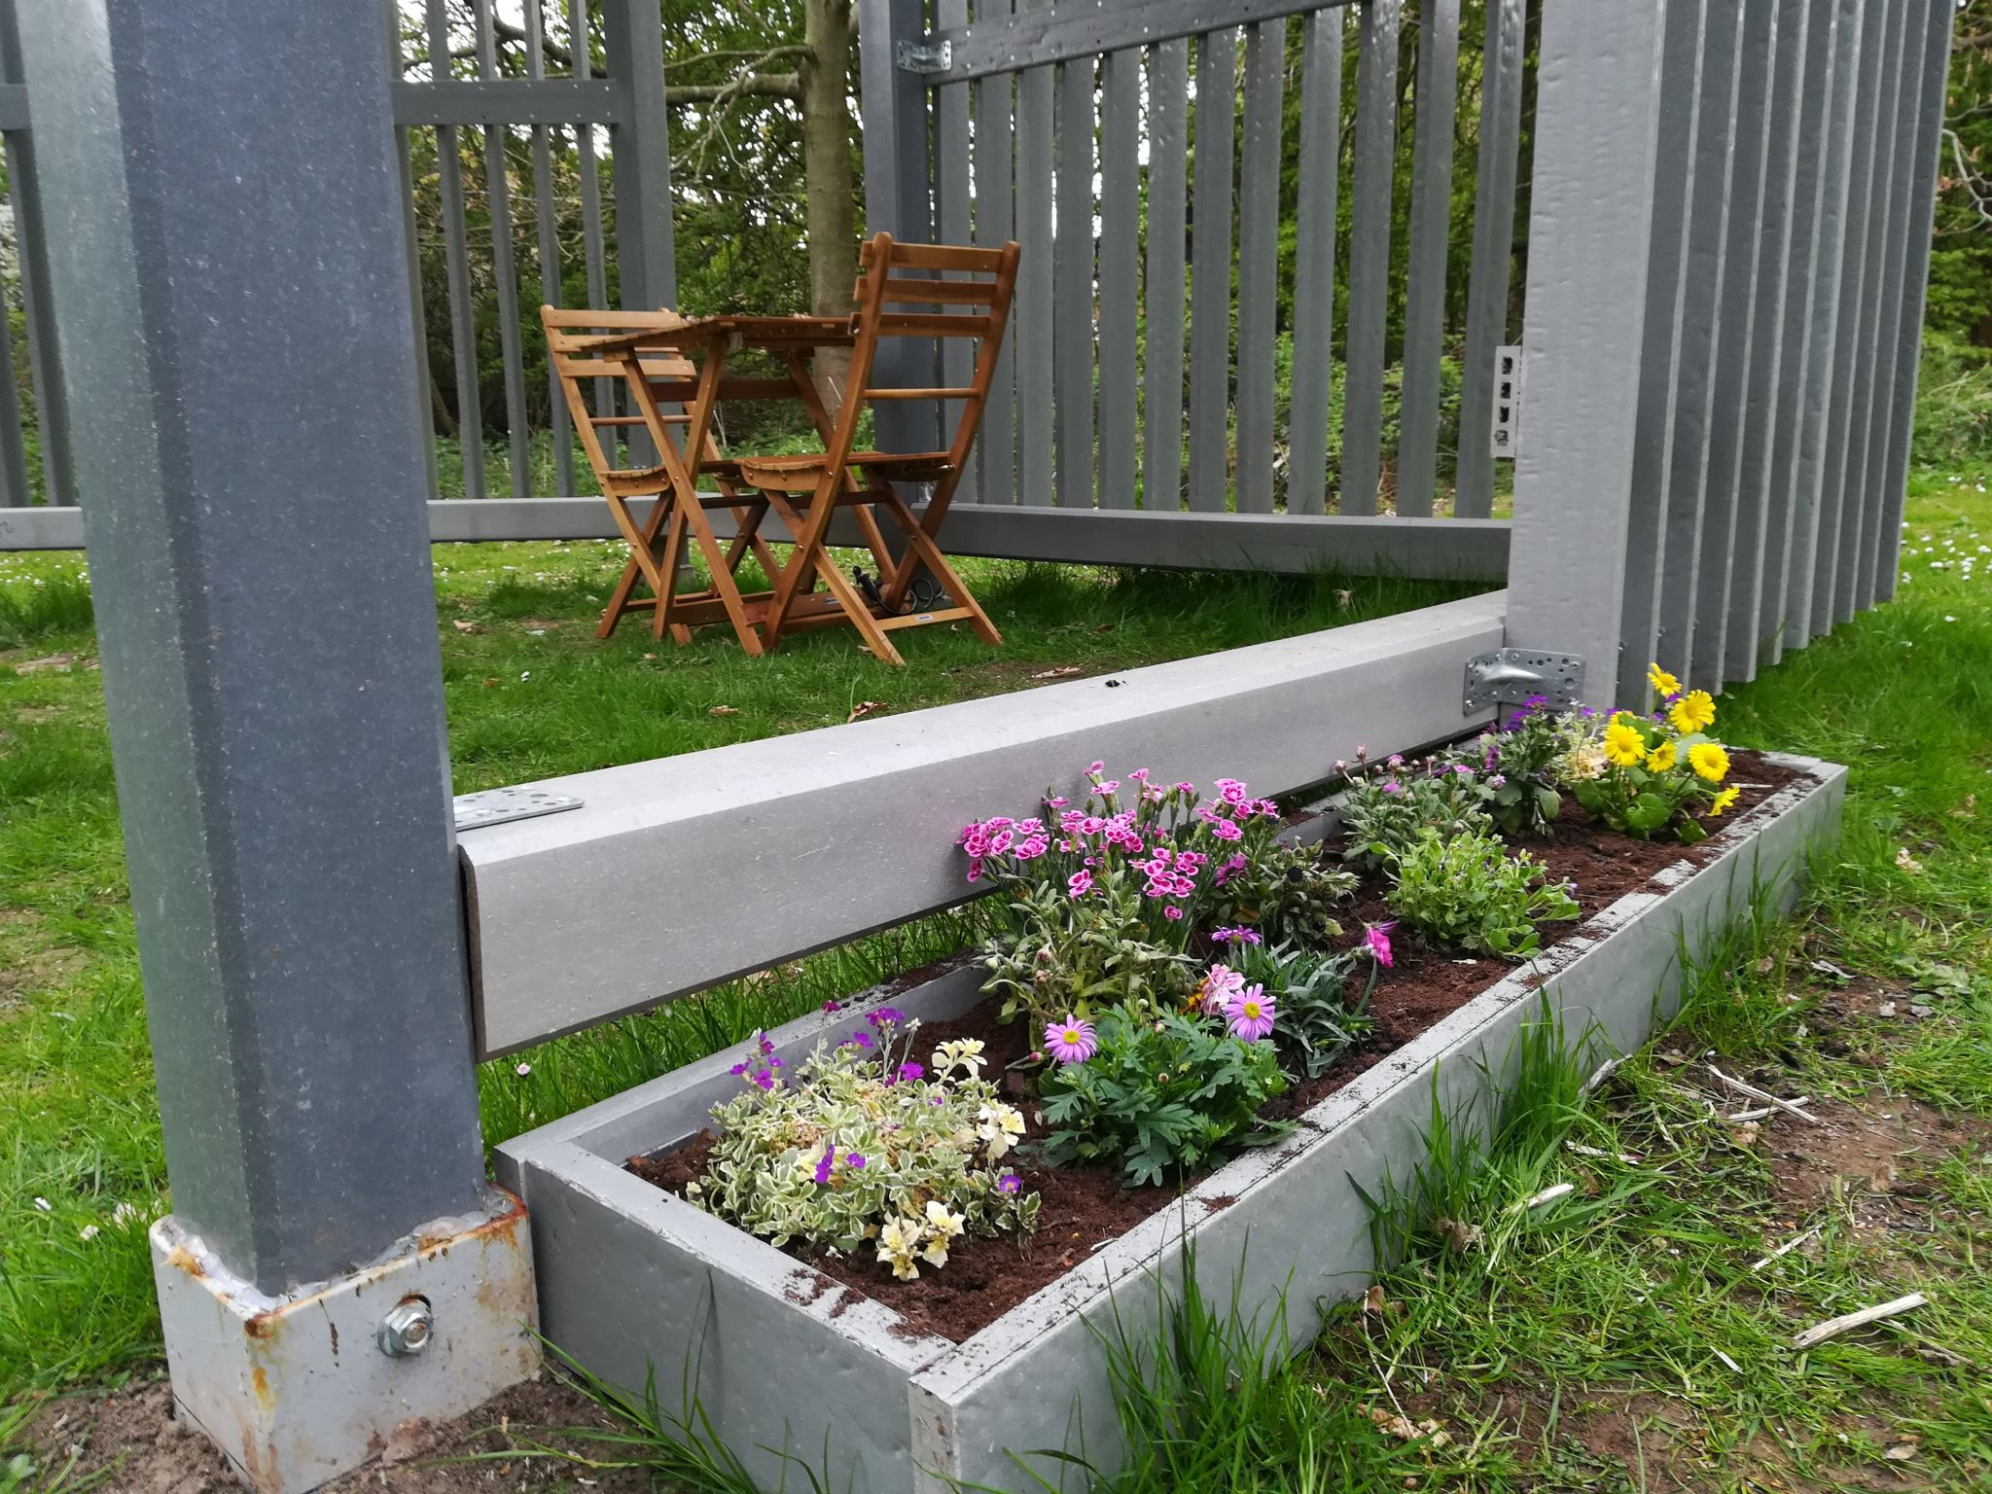
Sustainable Materials and Manufacturing Research Group
135 mph Green Formula 3 Racing Car
ECOBULK.EU

Slide 3

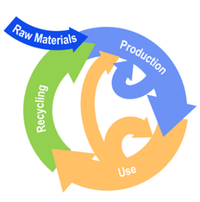



Sustainable Thinking
One product, many lives.
What happens to our transport machines when they get old and/or less useful?
circulartransport.com

