Slide 1
Circular Economy Introduction
What is it and why do we need it?
Russ Hall

Slide 2
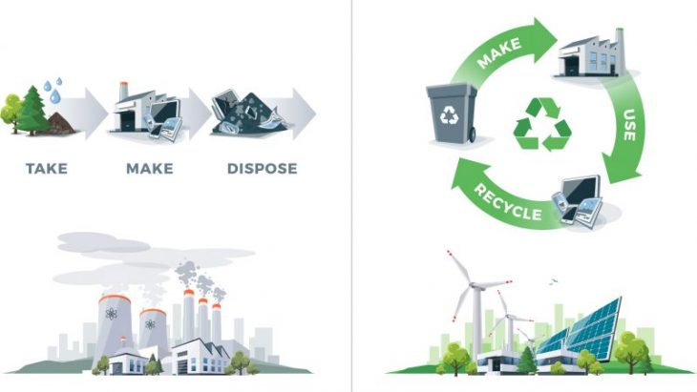
Circular Economy (CE)
A philosophy, a change, a better way
Current linear economy, the throw away economy:
  Extract – refine – manufacture – use – dispose
CE breaks this linear route and in doing so…
  Reduces reliance on fossil fuels and raw material extraction
  Adds value to supply chains and products
  Decreases CO2e emissions

Slide 3
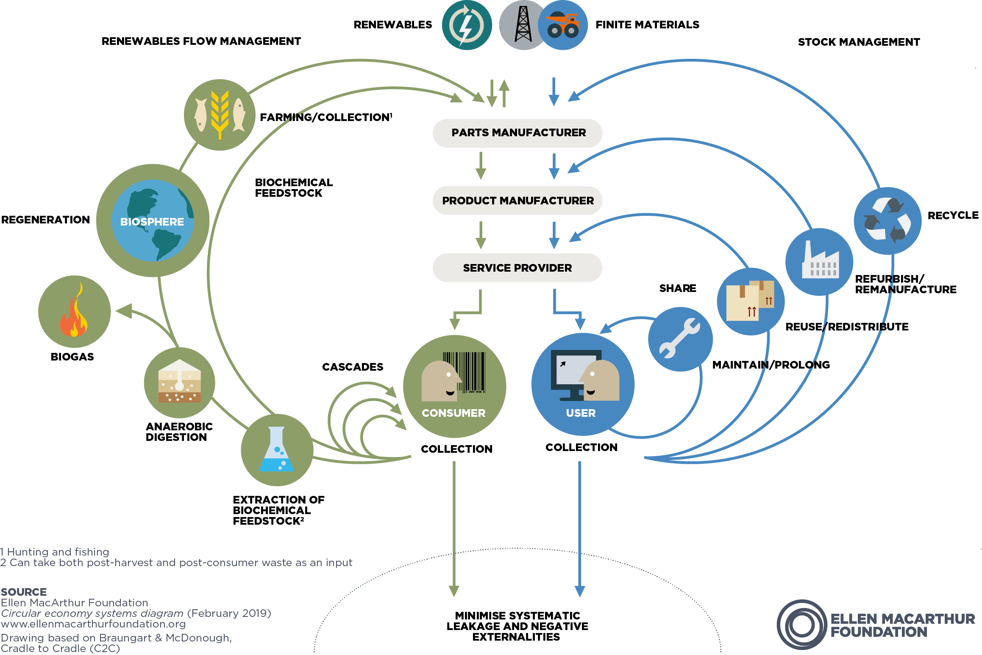
Circular Economy is a way of reducing human impact on the planet:
Eliminate waste and pollution
Circulate products and materials (at their highest value)
Regenerate nature

Slide 4
CE’s relationship with emissions
There are three types of emissions:
  Scope 1: Direct emissions e.g. fuel combustion,
  Scope 2: Indirect emissions from purchased energy
  Scope 3: Indirect emissions from everything else in a supply chain e.g. material manufacture, fabrication, transport of goods, employee travel etc.
Material manufacture represents the bulk of scope 3 emissions
CE reduces emissions, locking them in, decreasing raw material consumption

Slide 5
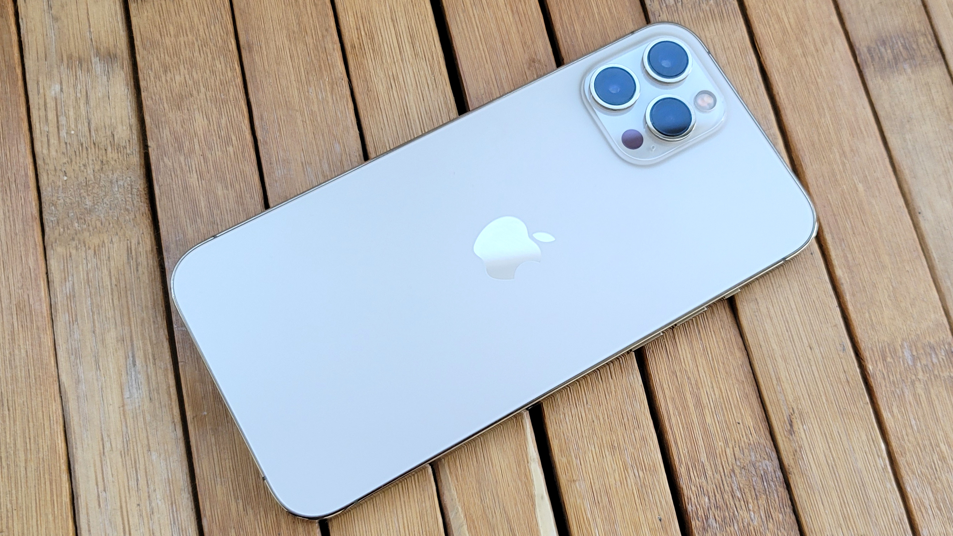
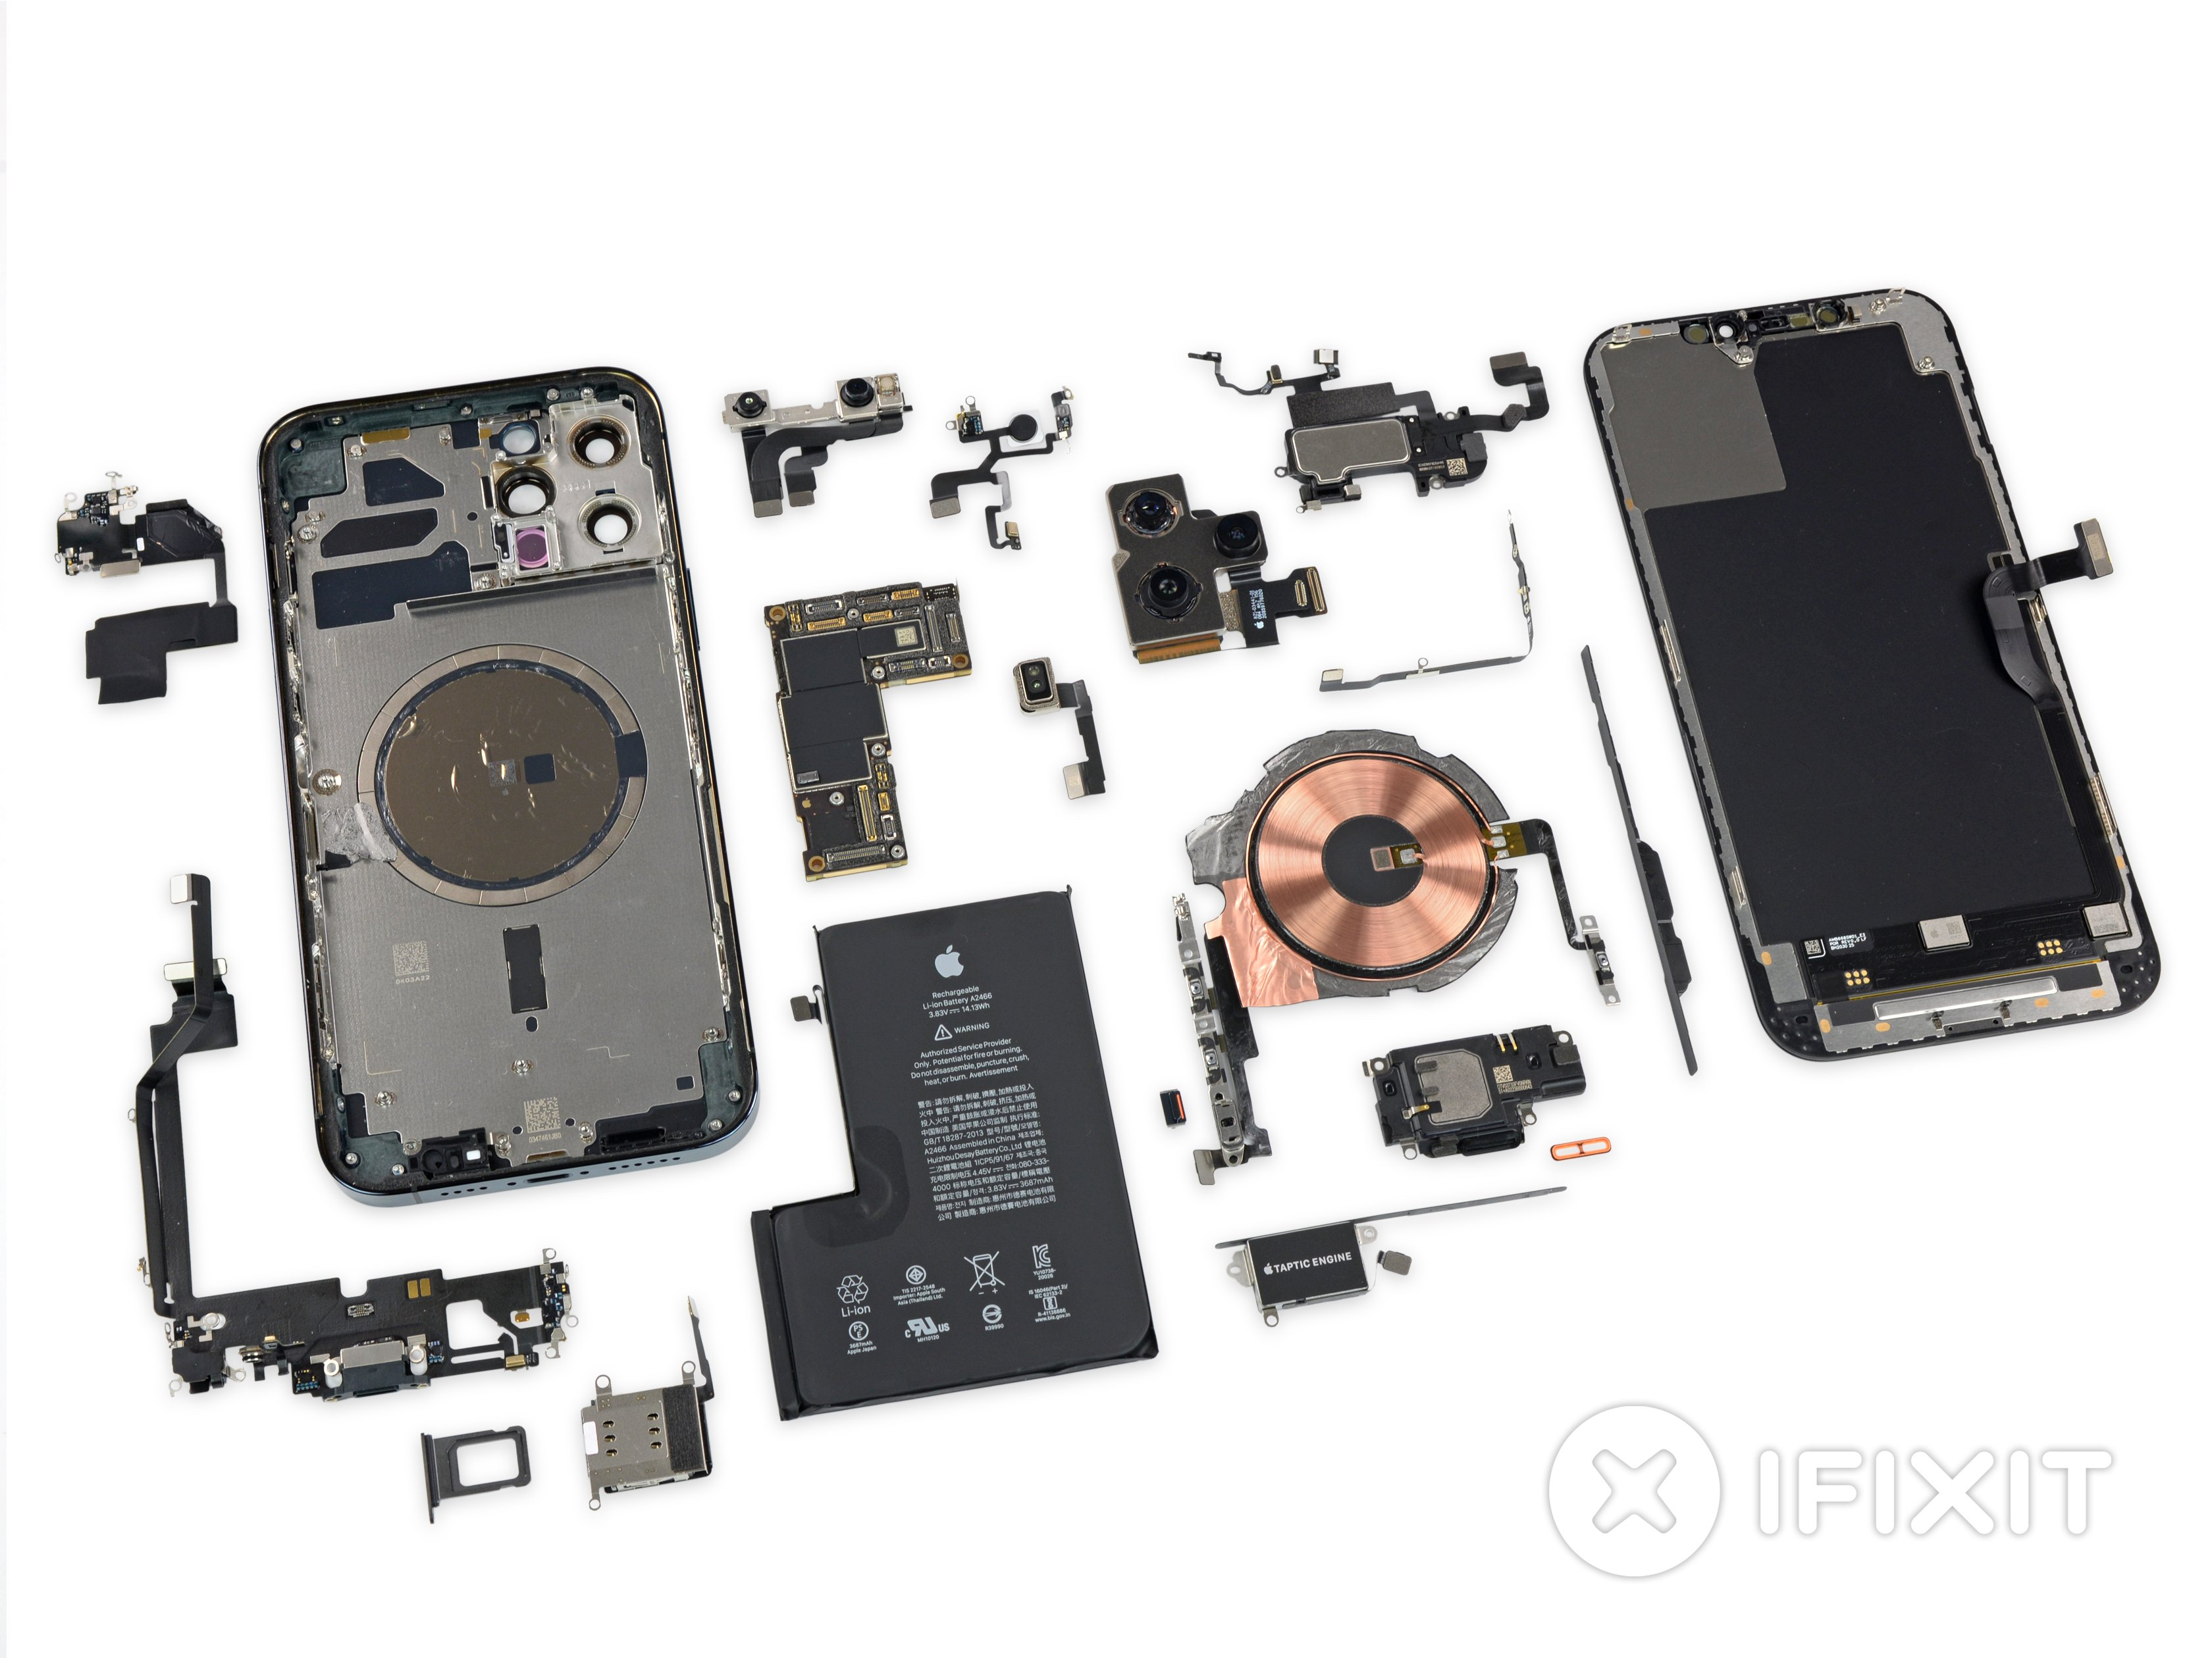
But how?
Maintain and repair – making products last longer, less reliance on new e.g. fixing a phone screen
Reuse and redistribution – most products aren’t useless at disposal and can be reused e.g. selling a phone
Refurbishment and remanufacture – changing a components purpose by remaking it e.g. using parts from a phone to fix another
Recycle – turning old material into new material, e.g. recycling phone materials to make new materials
Reduces CO₂e emissions be reducing the amount of new material needed

Slide 6
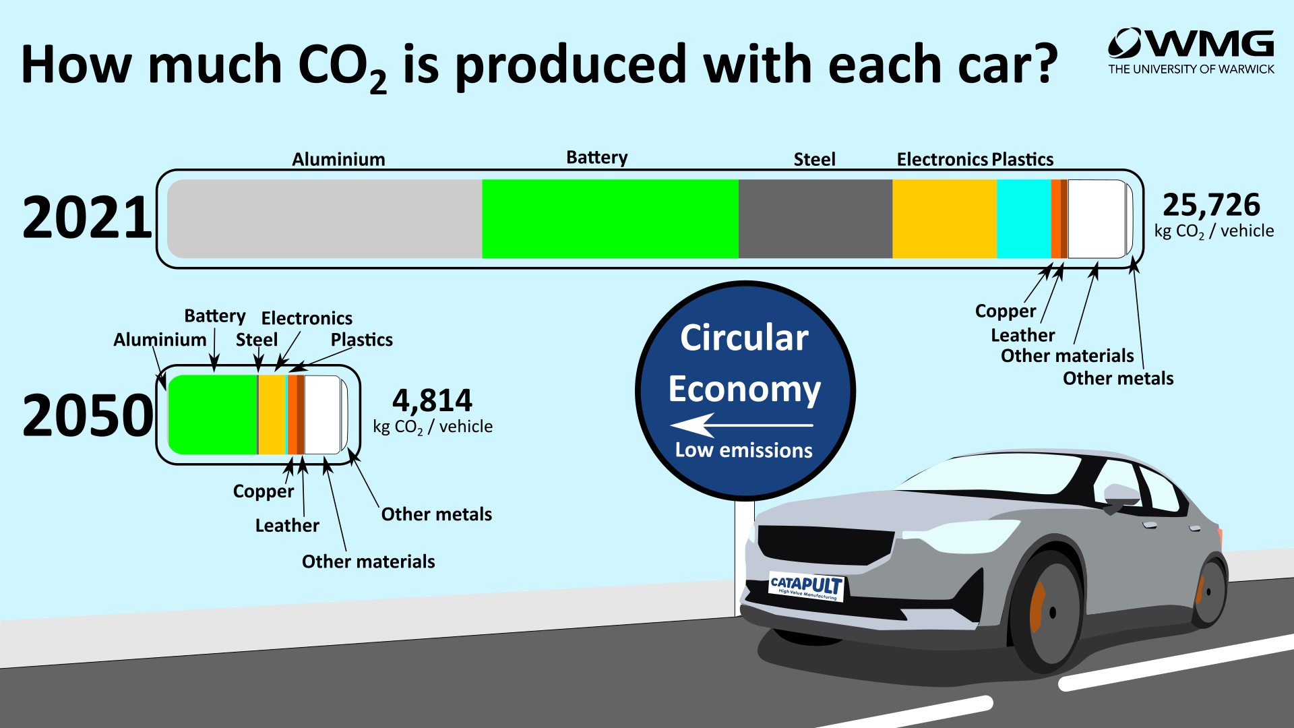
What’s the impact?
Emissions estimates for automotive:
Luxury electric car
Current scope 3 emissions ≈ 26t CO₂ / vehicle
With less material and CE that could be reduced by 81% by 2050

Slide 7
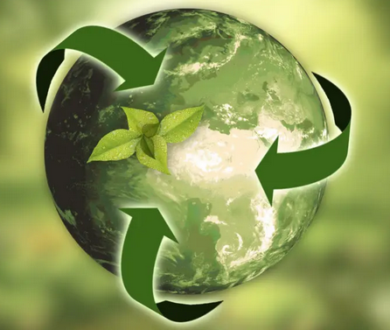
An important piece of a puzzle
Using CE to reduce emissions isn’t always obvious, but it is important and it’s not easy
CE principles can be applied to energy, waste, food, products and raw materials
CE represents a holistic view to reducing emissions
CE is something that everyone can be part of
“If we’re not here to change the world, why are we here?”
Picture from: 5 benefits to a circular economy: https://tontoton.com/5-benefits-of-a-circular-economy/

Slide 8
The rules of the game…
Part 1 – Build your city – build a dirty city, build the city that your parents / grandparents would have built if they didn’t know what you know, get used to the game
Part 2… Clean Coventry up! Save your people
  Build in recycling centres, replace landfill sites and incinerators
  Green power please!
  Light industry to simulate repair / remanufacture
  Green housing
  Make traffic flow!

Slide 9
So what have you learned?

