Slide 1


Closing the loop of rare earth elements in the UK electric vehicle stock
Wan-Ting Hsu and Evi Petavratzi (BGS)

Slide 2







Circular Economy Centre for Technology Metals
~50 project partners (£1.6M cash/in-kind support)
Theme 1: Virtual Data Observatory – Stocks/Flows & Practices
Li, Co, REE, Te, Se, PGM, In, W, Sn, Ta, Ga, Nb, Sb …
Theme 2:
CE Principles for Raw Materials & New Geomodels
Theme 3:
Design, Manufacturing, & Recycling Technologies
Theme 4: Roadmap for a New Technology Metals Circular Economy System
POLICY & GOVERANCE
ENVIRONMENTAL & LCA
SOCIAL SCIENCES & VALUE CHAINS
REPONSIBLE INNOVATION

Slide 3


The UK's targets
The UK government is committed to reaching net zero greenhouse gas emissions by 2050.
End the sale of new petrol and diesel vehicles by 2030
For all new cars and vans to be fully zero emission by 2035
Notes:
The UK has set ambitious targets for the electrification of transport and renewable energy.
High demand of rare earth elements (REE) would be used in low-carbon technologies (electric vehicles and wind turbines).
However, the UK is highly import reliant on REE, which may inhibit the delivery of the net zero strategy.
The circular economy could provide mitigation, but its success depends on understanding the REE flows in the UK economy.

Slide 4
Aims & objectives
This study estimates the current and future stocks and flows of REE embedded in EVs and identifies opportunities and challenges to the development of a circular economy of REEs for UK EVs.
Our analysis comprises a stocks and flows model for four targeted REE, namely neodymium, dysprosium, praseodymium, terbium used in permanent magnets in EVs.
The example of REE illustrates the urgent need to create a circular economy of critical raw materials embedded in EVs.

Slide 5
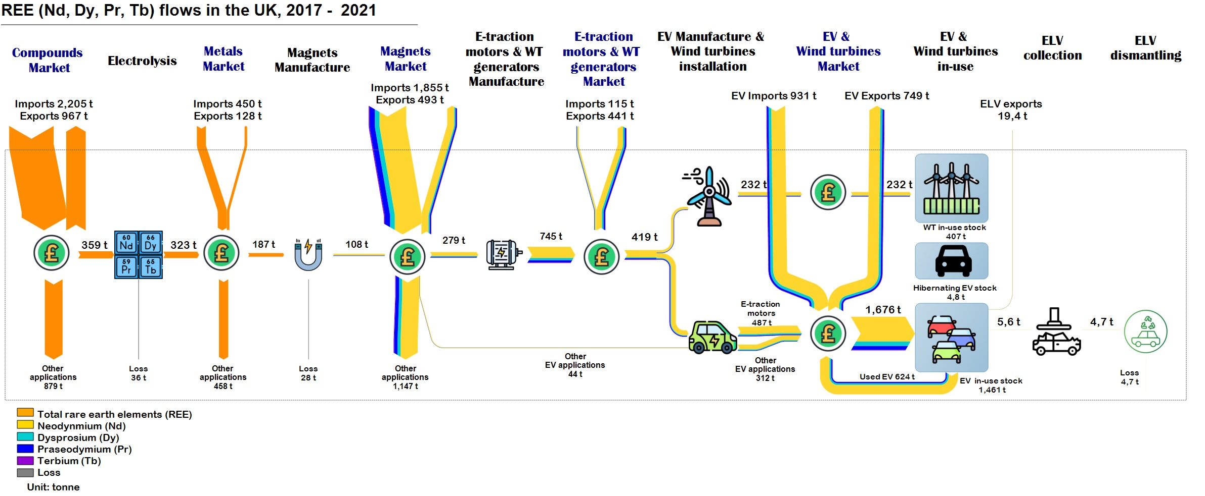
Preliminary results – Current stocks and flows of REE

Slide 6



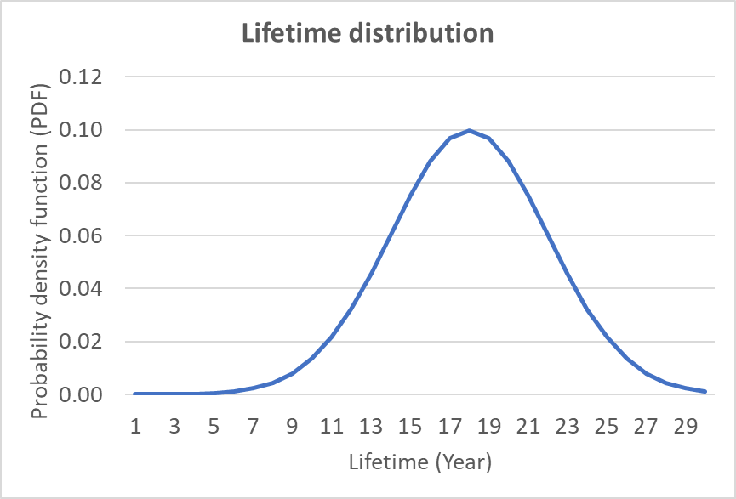




Methodology – Stock-driven approach
System boundary: Stocks and flows of REE in different electric vehicles (EVs) by powertrain type (Battery Electric Vehicles, Hybrid Electric Vehicles, and Plug-in Hybrid Electric Vehicles) in the UK between 2001 and 2050
Use phase
Inflows
In-use stocks
Outflows
Vehicle licensing statistics
National Grid Future Energy Scenarios
Material intensity (kg/vehicle)

Slide 7
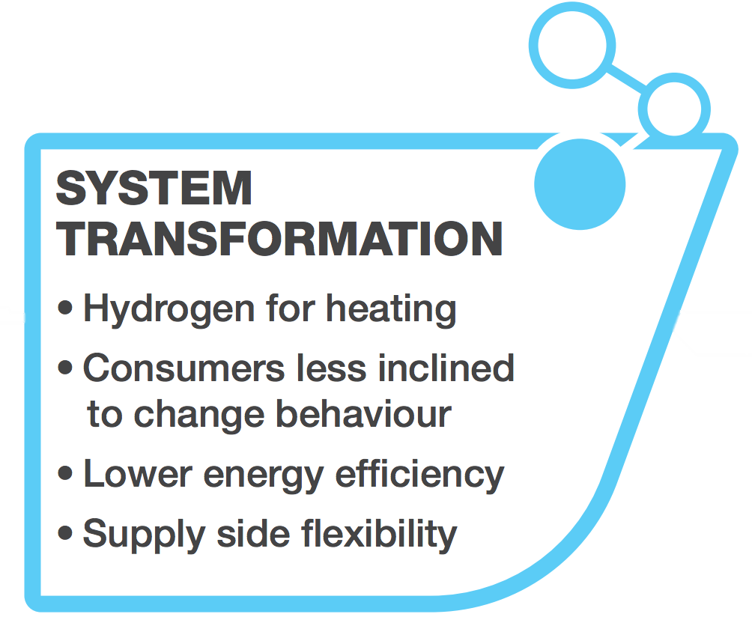
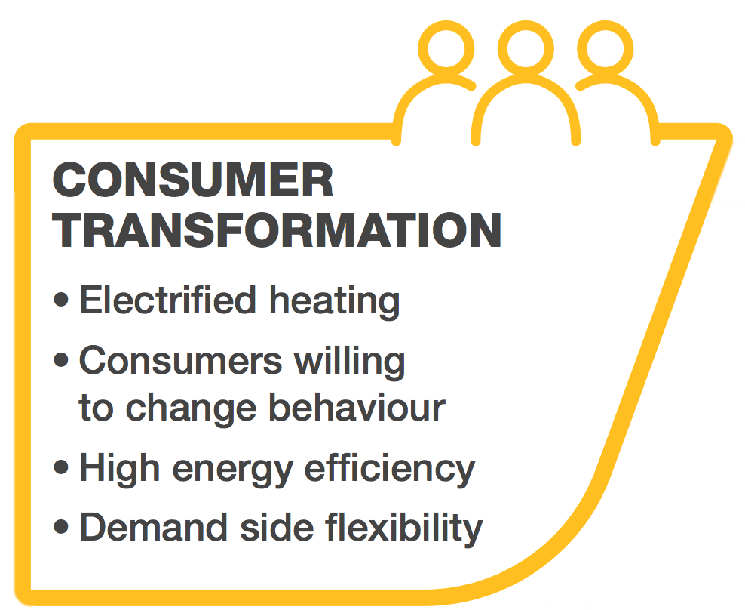
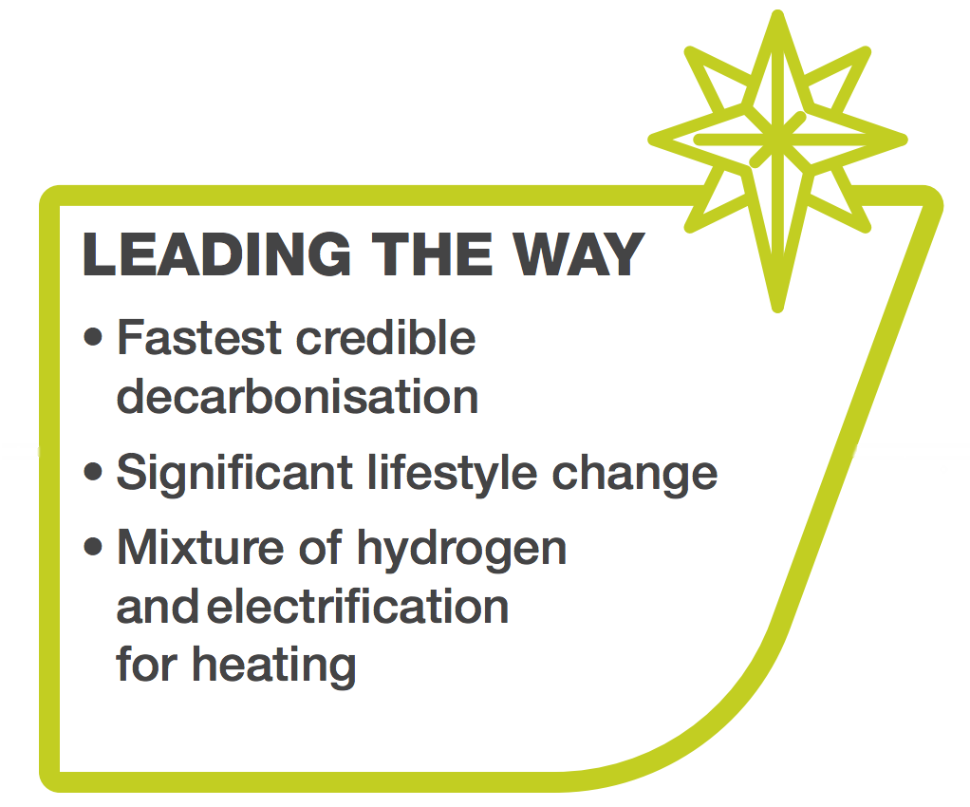
National Grid Future Energy Scenarios 2022
All meet the Net Zero target by 2050
Notes:
Consumer Transformation and System Transformation both meet the target of Net Zero
greenhouse gas emissions by 2050 – as well as meeting all the interim carbon budgets.
The ways they do this are very different and highlight the varying roles of supply and
demand as well as different fuels like electricity and hydrogen.
In Leading the Way, combining high consumer engagement with significant and
innovative investment enables the Net Zero target to be met in 2047 with emissions
net negative in 2050.

Slide 8
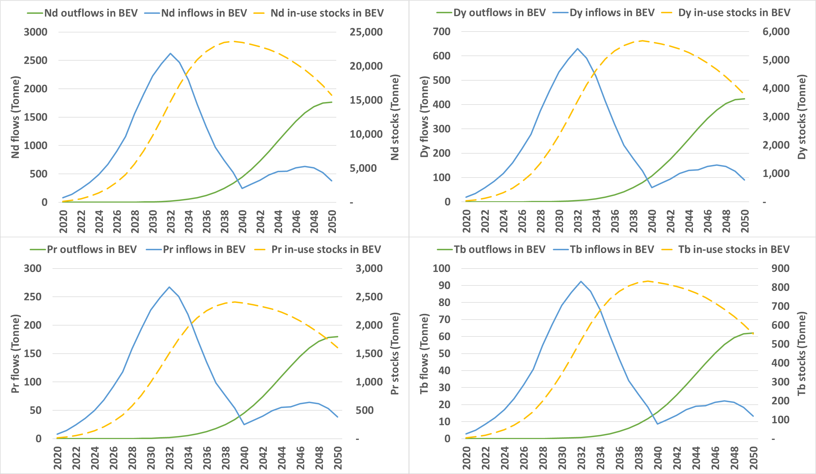
Preliminary results – BEV in Leading the Way scenario

Slide 9
UK potential secondary REE supply in 2030 & 2050
2%
6%
78%
108%
The EU high demand scenario forecast is based on the European Commission Joint Research Centre (2023) Supply chain analysis and material demand forecast in strategic technologies and sectors in the EU – A foresight study.

Slide 10
Take-home messages
Circular economy has a major role to play in supply of REEs
Need more data on material intensities, lifespans, technology evolution etc
Ongoing monitoring of REE flows across multiple products, not just EVs
More foresight and forecasting
How to Develop a Circular Economy Ecosystem for REE in Transport?
Standardise components of transport systems
Extend the lifespan of components and vehicles
Enhance collection systems and reverse logistics
Utilise product passports to improve traceability

Slide 11

Website: https://met4tech.org/
LinkedIn: https://www.linkedin.com/company/met4tech/
Follow us on Twitter: @Met4Tech
THANK YOU

