Slide 1



Integration of Circular Economy Principles into Solid-State Electric Vehicle Batteries
Joshua koch | ICCET 2023

Slide 2


WE ARE A SUSTAINABLE MANUFACTURING CONSULTANCY
Founded | 2012
Size | 37 employees
Offices | London + Birmingham
Notes:
HQ in London
Office in Birmingham
No. of staff.
Year set up

Slide 3
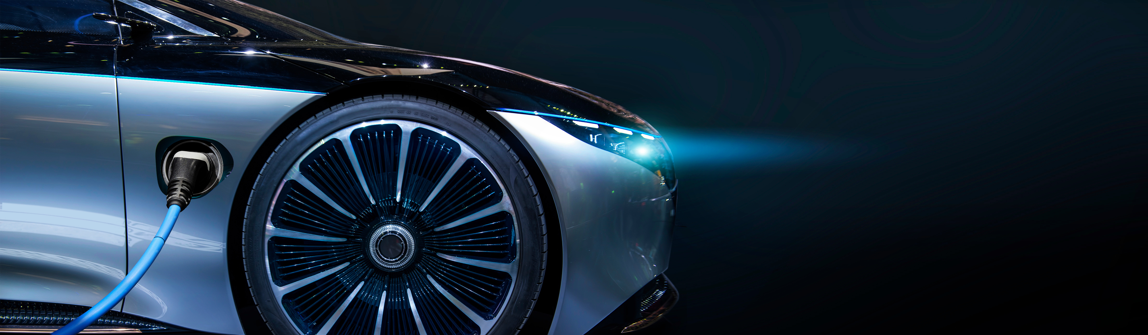

OUR VISION
We aim to transform manufacturing competitiveness towards net zero
we work to accelerate the development of manufacturing, whilst decelerating the negative effects on climate change

Slide 4
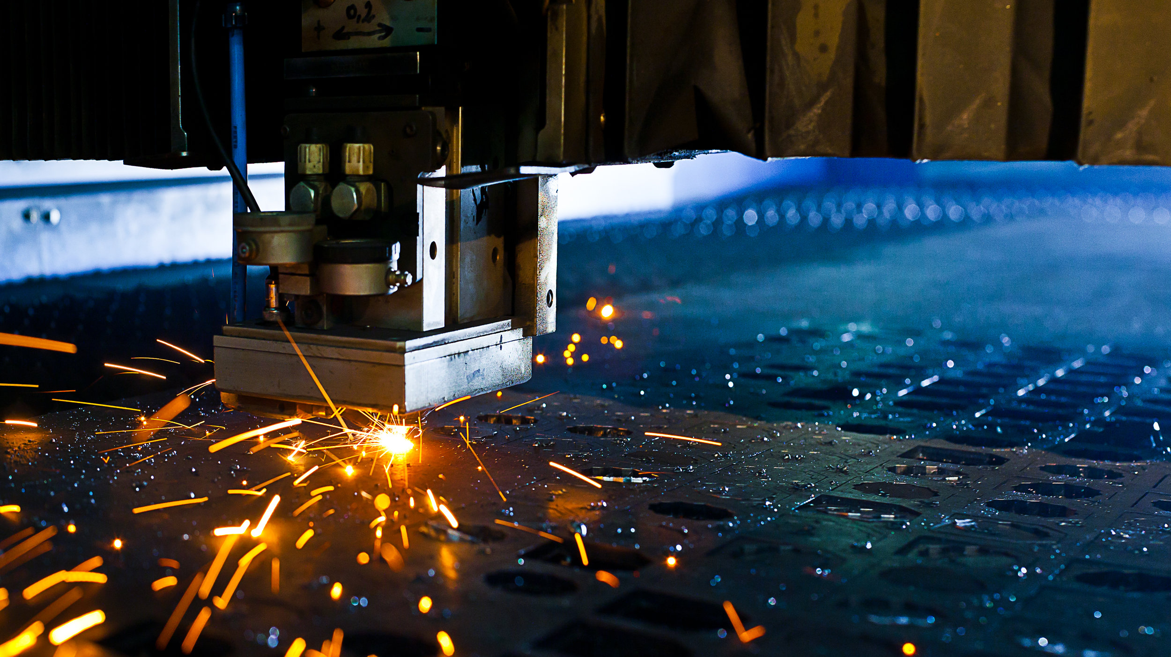
OUR MISSION
We provide expert advice to help manufacturers to scale up, improve productivity and transition to Circular Economy practices.
We enable innovators to manufacture and manufacturers to innovate

Slide 5
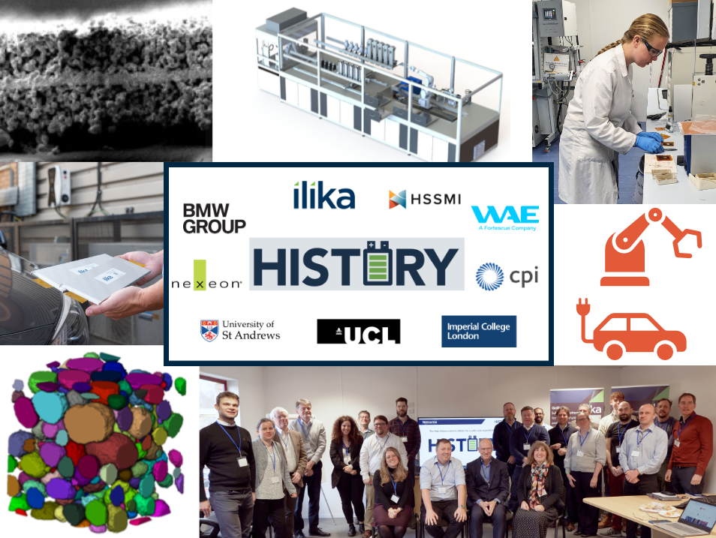


ICCET 2023
HISTORY - HIgh Silicon conTent anOdes for a solid state batteRY
The delivery of a multi-layer, solid state pouch cell with specifications aligned to the requirements of automotive OEMs and EV pack developers
Ilika will design and fabricate the SSB cell ​
Nexeon will develop a high silicon content electrode based on its low expansion NSP-2 material for incorporation into the anode of the SSB cell ​
HSSMI will produce a LCA and EoL white paper
CPI will formulate inks with the silicon powders
University of St Andrews will characterise interface and materials interactions
University College London and Imperial College London will develop a modelling framework to predict electro-mechanical behaviour and failure of cells, and battery stacks for for selected anode materials
BMW Group and WAE Technologies will be part of the project’s steering committee
Project funded by Faraday Battery Challenge, part of UKRI

Slide 6
CIRCULAR ECONOMY IN SOLID STATE EV BATTERIES
ICCET 2023
Solid state battery (SSB) technology is expected to rapidly provide safety and performance improvement compared to LIB.
The impacts on EoL are not currently well understood.
Existing hydrometallurgical recovery processes and equipment for li-ion are likely to be applicable for SSBs, although material recovery rates aren’t clear
A key benefit over li-ion or LFP is that the electrolyte is dry and not liquid based. This means SSBs are less volatile and therefore inherently safer during disassembly or other EoL processes.
It also incorporates a ceramic monolith which can be easily crumbled back into a granular form, to closely mimic the original properties of the raw material.
Sustainability inherently involves trade-offs, one of the criticisms of SSBs is the higher concentration of lithium in comparison to standard li-ion batteries.

Slide 7







HSSMI’S PROJECT WORK
ICCET 2023
CRADLE TO GRAVE
LIFE CYCLE ASSESSMENT
END-OF-LIFE ASSESSMENT
Two primary activities on the HISTORY project are a cradle to grave life cycle assessment (LCA) and a detailed end-of-life (EoL) assessment
These activities will include:
  Identify and quantify embedded carbon hotspots in the design and manufacture of the solid state batteries (SSB).
  Reduce the environmental impact of the product.
  Identifying latest state of the art in emerging recycling technologies
  Explore end of life pathways available for SSBs and make recommendations on design manufacture and optimisation.
  Model the scaled up manufacturing process, identifying further opportunities for optimisation, efficiency maximisation and environmental impact.
Material Extraction
RECOMMENDATION REPORT
CO₂
Material Processing
Recycle
CO₂
Manufacture
Remanufacture
CO₂
Use
Reuse
CO₂
End of first life
Publish White Paper

Slide 8
INSIGHTS TO DATE
ICCET 2023
Project started February 2023
Life Cycle Assessment
Completed literature review, there is no current standard format used across battery LCA’s
Agreed goal and scope definition and the functional unit
Modelled the raw material requirements for the process
Shares approximately 49% of the same input materials as a lithium ion battery
Common materials relatively simple to map, the distinct ones less so
Carried out supply chain mapping
  Large complex supply chains going back to raw materials
  Identified that 31% of the materials contain information gaps with well known LCA databases

Slide 9
SOLID STATE VS LIB
ICCET 2023
Solid state technology will be integrated into a mature battery ecosystem, accustomed to the impacts and processes required for lithium ion batteries.
It is vital to analyse the differences that solid state technology will bring
Material Extraction
New raw materials
Different ratios of raw materials
Material Processing
Altered form of materials
E.g. lithium in electrolyte
Process has differences
E.g. sintering, lamination etc.
Manufacture
Different product specification
Lifecycle, energy density etc.
Use
Requirements for new recycling techniques
Specifications enabling second life options
End of first life

Slide 10
OPPORTUNITIES FOR CIRCULAR ECONOMY
ICCET 2023
Aim of the LCA and end of life assessment is to implement CE and reduce the carbon impact of the new product
The opportunity exists through the design, development and manufacture of this product
Design
Using LCA results to influence design decisions
Development
Material suppliers selection
Manufacture
Equipment selection to reduce waste
Design for end of life
End-of-life of products during the development phase
Process optimisation

Slide 11
Joshua.Koch@hssmi.org

