Slide 1
Repair or Replace – Quantifying GHG Emissions for Insurance Companies
A joint report by Oakdene Hollins, Metsims Sustainability, and Allianz SE

Slide 2


Background
Insurance company motivation for action on climate change is accelerating at a huge rate.
"Climate change presents an existential risk to the insurance industry"
Steve Waygood, Chief Responsible Investment Officer, Aviva

Slide 3

Background
Sustainable Claims are arising as a leading method for reducing emissions in the supply chains of insurance companies.
Economically affordable for the insurer and the customer
Reduce negative impacts on environmental and social capitals
https://www.cisl.cam.ac.uk/system/files/documents/sustainable-claims-management-report.pdf

Slide 4






Background
Circular supplies
Renewable, recoverable, or biodegradable sources serve as inputs in design and production
Product as a service
Product life extention
Selling service or result rather than products or assets
Prolong lifespan, utilisation, and value through repair, remanufacture, resale
Material rationalisaion
Resource recovery
Eliminating unnecessary variation by simplifying, reducing complexicity through approaches like prefabriacation
Acquire additional use and value from existing resources by avoiding disposal and impacts from new extraction
Sharing platforms
Fully utilize assets by maximizing usage and value amongst several users
Notes:
This slide can be read as is, probably won’t need much explanation, might be worth adding animation for each step?
Circular economy business models aim to create sustainable economic systems that promote resource efficiency and waste reduction. In a circular economy, resources are kept in use for as long as possible, and waste is minimized through recycling, reusing, repairing, and remanufacturing.
There are several types of circular economy business models that companies can adopt:
Circular supplies: refer to the sourcing of materials that have been previously used or recycled. This includes recycled materials or products, as well as the use of waste from other industries as a raw material input. By using circular supplies, companies can reduce their reliance on virgin resources and decrease their environmental impact.
Product life extension: aims to prolong the lifespan of products. This can be achieved through repairing and refurbishing products, upgrading or retrofitting them, or repurposing them for a different use. By extending the lifespan of products, companies can reduce waste and resource consumption.
Resource recovery: the process of recovering and reusing materials from products at the end of their life. This includes recycling, but also includes techniques such as composting, biodegradation, or energy recovery. By recovering and reusing materials, companies can reduce waste and the need for virgin resources.
PaaS: Instead of selling products, companies provide them as a service. For example, instead of buying a washing machine, a customer can pay a fee to use a washing machine from the manufacturer. At the end of the product's life, the manufacturer can take it back, repair it, and reuse it.
Material rationalization: nvolves using fewer materials in the design and production of products. This can be achieved through prefabrication. Modular design. By reducing the amount of materials used, companies can decrease their environmental impact and save on costs.
Sharing platforms: allow for the sharing of resources, products, or services between individuals or companies. This can include peer-to-peer sharing platforms, rental services, or access to shared resources such as energy or transportation. By sharing resources, companies can reduce the need for new products to be manufactured, as well as reduce waste and resource consumption.

Slide 5
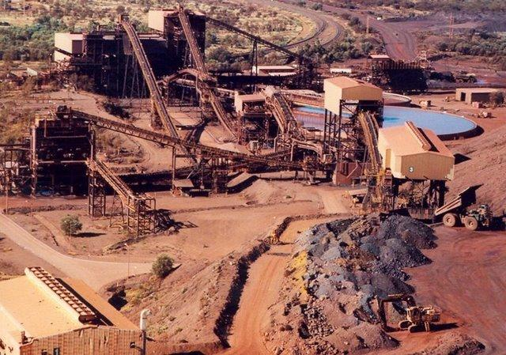
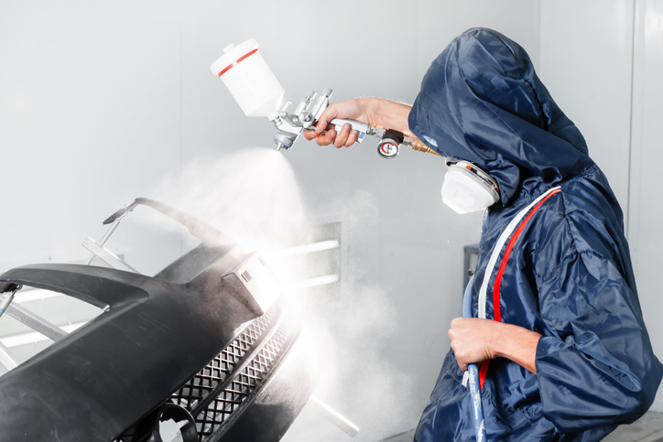
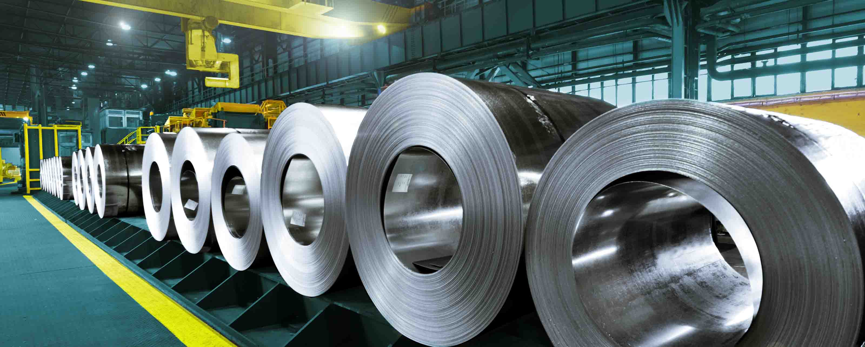
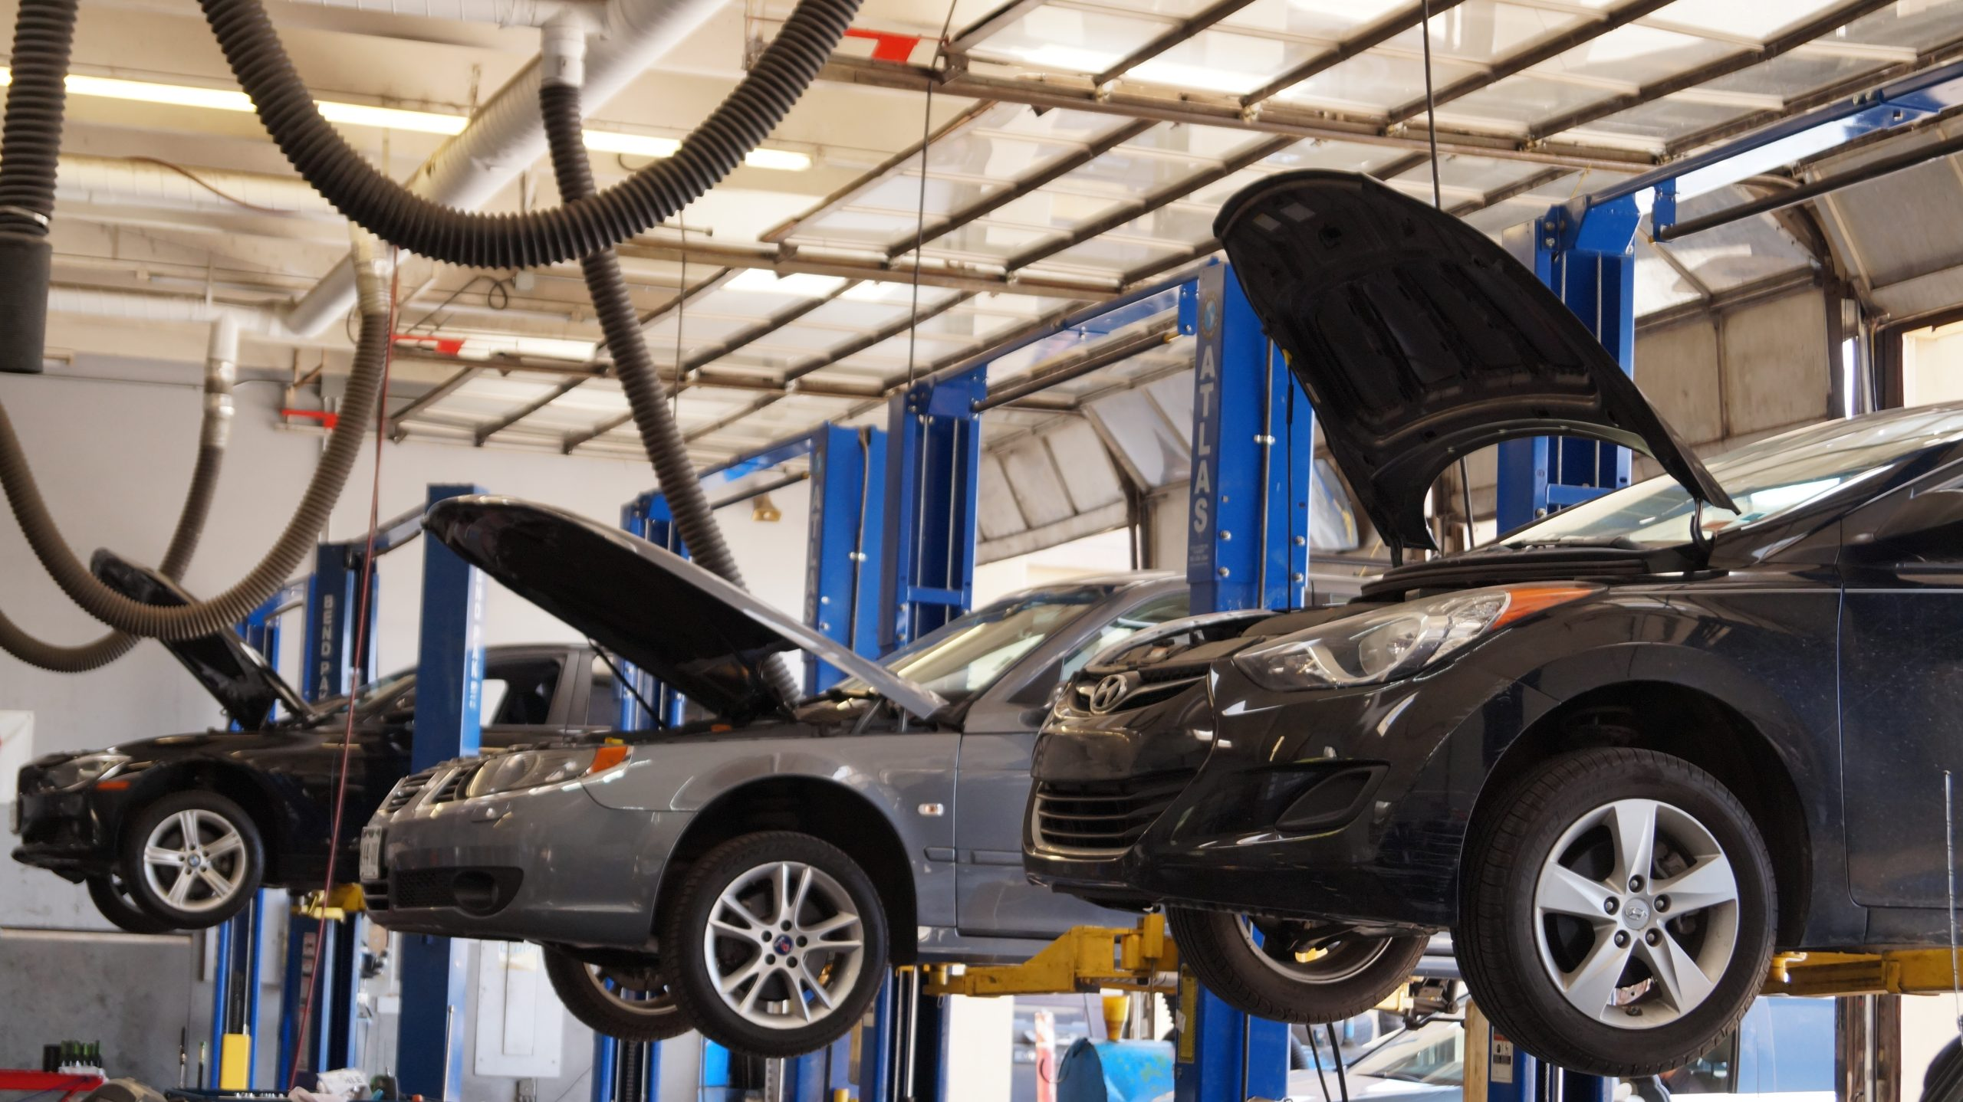
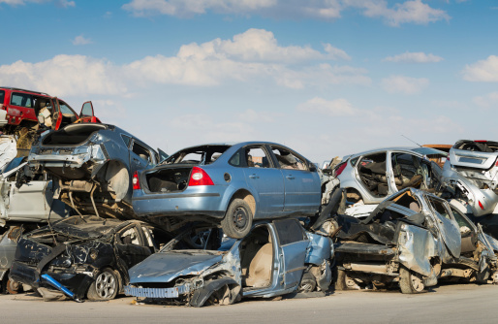
Methodology
Raw Material Production
Transport of Raw Material
Transport to Repair Shop
Production of Product
Painting/
Drying
Assembling
End of Life
Ecoinvent (V3.8)
Ecoinvent (V3.8)
Ecoinvent (V3.8)
Ecoinvent (V3.8)
Allianz Zentrum für Technik
Allianz Zentrum für Technik
Allianz Zentrum für Technik

Slide 6
Methodology
Repair
The resource requirements for the repair process
A characterisation of the material inputs, energy inputs and waste generation from the painting process
Replace
The resource requirements for the repair process
A characterisation of the material inputs, energy inputs and waste generation from the painting process

Slide 7
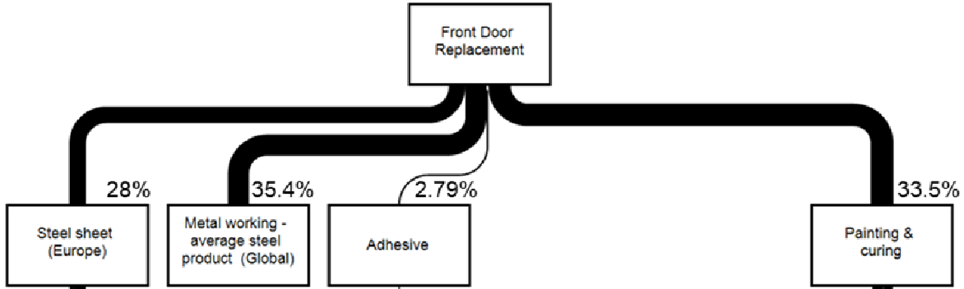
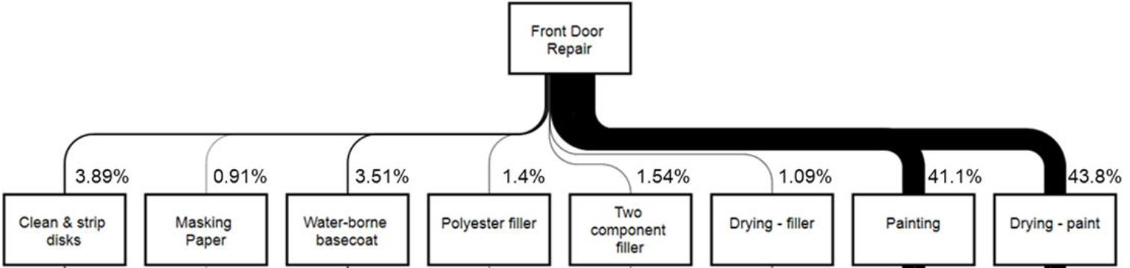
Methodology

Slide 8
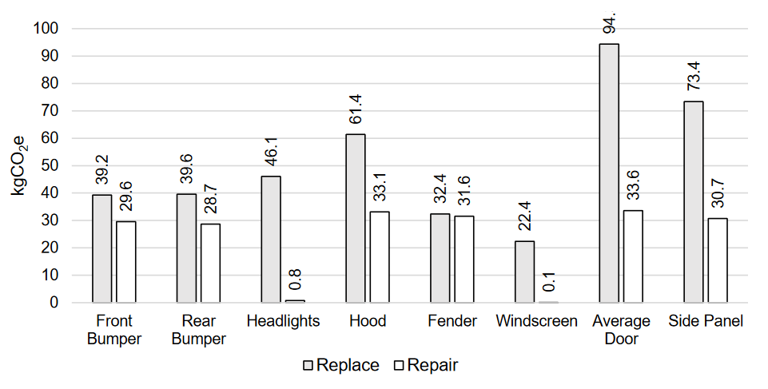
Results
As anticipated, the emissions were lower for the repair scenario than the replace scenario in every case.

Slide 9
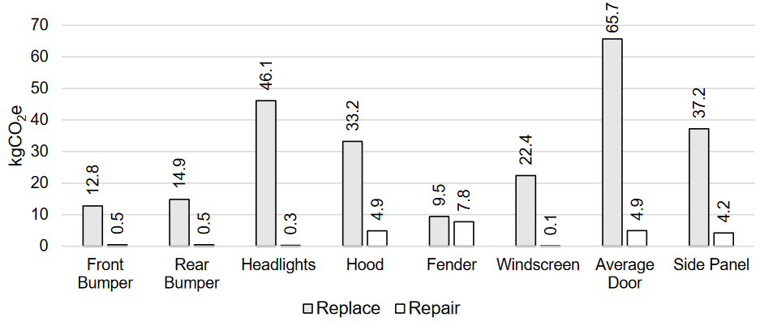
Results
Digging deeper, this shows significant scope 3 savings.

Slide 10
Limitations
Specificity – only one vehicle assessed
Different repair methods for each vehicle
Different materials for vehicles
Different repair methods between workshops
Supply chain data availability
Large reliance on industry average data
No accounting for real end-of-life data
Assumptions carry over across different countries

Slide 11
The Future
Please read and critique the full report!
https://www.azt-automotive.com/en/topics/RepairOrReplaceEn

Slide 12

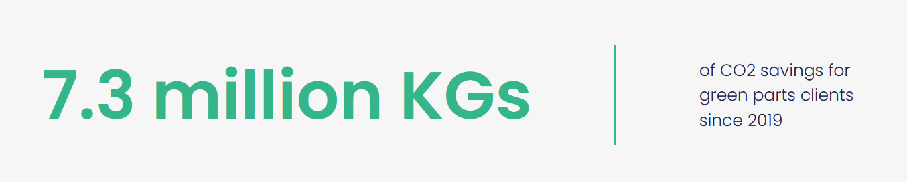
The Future
Moving to include additional scenarios into the comparison, namely the use of second-hand "green parts".
https://www.synetiq.co.uk/green-car-parts/

Slide 13
The Future
Push for inclusion of the full supply chain in any sustainability strategy!
https://www.synetiq.co.uk/green-car-parts/

Slide 14






Contact
Please reach out to us with any questions or comments, we are also open to collaboration in this area.
Oakdene Hollins is responsible for:
Robert Knowles
Senior Carbon Consultant
Robert.knowles@oakdenehollins.com
Member of Global Future Council on Advanced Manufacturing and Production
Member of Executive Management Group and Industrial Advisor to the programme
  www.oakdenehollins.com
  +44 (0)1296 423915
  UK Head Office: Ardenham Court, Oxford Road, Aylesbury, HP19 8HT
  Brussels Office: 37 Square de Meeus - 4th floor, 1000 Brussels, Belgium
Company Registration No 2937129

