Slide 1
WHITE PAPER SHOWCASE
Potential Impact of the Circular Economy Concept in Maritime Transport
Dogancan Okumus (a), Sefer Anil Gunbeyaz (a), Stavros Karamperidis (b)
a) University of Strathclyde; b) University of Plymouth

Slide 2



Background
Maritime transport is the backbone of the global economy as it moves over 80% of the world trade by volume, which is predicted to triple by 2050 (UNCTAD, 2022)
There are over 100,000 merchant vessels worldwide (UNCTAD, 2022), their environmental impact is tremendous not only in terms of operations but also to build them and maintain them.
The average age of a vessel is 20-25 years while its components are valuable (e.g. engines, compressors, etc)
Unfortunately, the maritime industry lags behind other modes of transportation in terms of circular economy, but this also means that there is significant potential to be realised (Okumus et al., 2022)

Slide 3
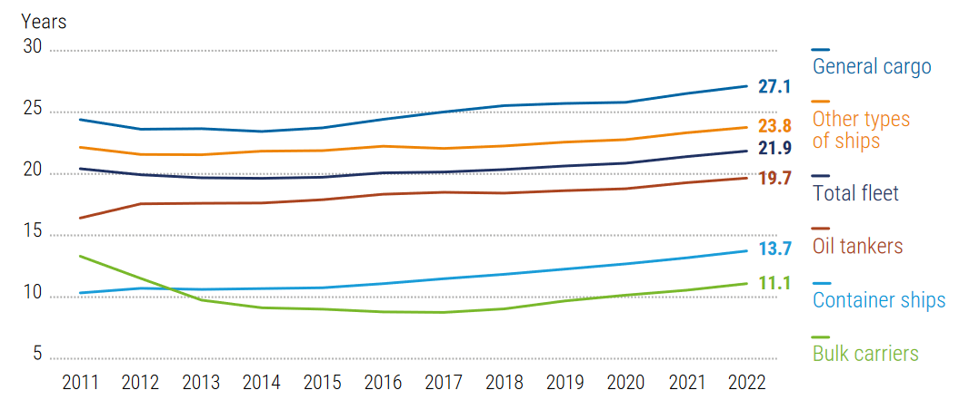
Average age of merchant fleet, 2011-2022
Source: Clarksons, 2022; UNCTAD, 2022
Although the average life is 25 years, we frequently see much younger ships (e.g. 7-8 years) sent to scrapyards for various reasons as some shipowners and operators have difficulties chartering their vessels due to industry competition and the insurance providers' policies on premiums. Therefore, most ship operators tend to renew their fleets earlier than is physically required.

Slide 4

Methods
Three workshops for data collection:
Online webinar
Face to face events in January and February 2023
Step 1
Defining maritime circularity (brainstorming)
Step 2
Gap analysis
Step 3
SWOT analysis
Step 4
Generating future strategies

Slide 5
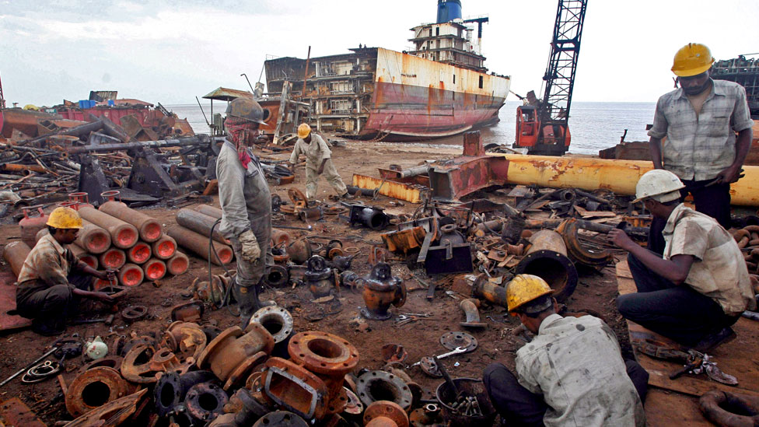
KEY FINDINGS
The (circular economy aspect) link between life cycle stages is missing in the maritime industry for several reasons, including but not limited to:
lack of awareness in the industry,
regulatory barriers,
long-lifetime of the marine assets,
lack of the reverse supply chain
the poor end-of-life practices
A rule of thumb in the initial design stage implies that approximately one-third of the ship acquisition cost is related to main and auxiliary machinery. Okumus et al. (2023) reveals that engines can be remanufactured for half of what a brand-new alternative would cost and provide brand-new performance and reliability. Therefore we could understand that CE could have a bright future in maritime transport sector, a sector with thin margins.

Slide 6

GAP ANALYSIS
WHAT DO YOU NEED TO KNOW AS AN INDUSTRY TO IMPLEMENT CIRCULAR ECONOMY?
C E
Quality and certification
Economical aspect:
Whole-life-cost
Material accountability, certification and equipment quality.
End customers
awareness
Impact of circular economy on whole life cost of vessels.
How will it affect maritime stakeholders?
Clear expectations
and KPIs
Cargo clients should not apply vessel age limit policies which results in capable vessels stands idle and quite underutilised – eventually sold or sent to a scrapyard.
Need to define what is expected from each stakeholder to achieve CE as an industry.
Build a circular economy mentality.
Incentives from policy makers to promote 6R equipment
Industrywide
alignment
Practical examples and cases from other industries
Aligning conflicting goals by defining responsibilities and roles each stakeholder group.

Slide 7
STRENGTHS
WEAKNESSES
CE is not clearly understood by the maritime industry.
Ship operators are in the mercy of regulators.
Frequently changing standards and regulations.
Policies need to be improved. As at the moment ship owners can not use existing circular economy principles.
Alternative fuels are not available for commercial scale. This is affecting the current new shipbuilding activities.
Limited space for fuel tanks on vessels.
Propulsion technologies are not ready for alternative fuels (e.g. engines).
Investment costs are huge, thus the stakeholders need help in financing and strategy to go forward.
Data availability and transparency
is lacking.
Global standards that whole industry can apply.
Global KPIs.
Major ship owners can lead the way for the industry
Shipowners are enthusiastic about re-positioning and repurposing their assets.
Emission free ammonia engines are coming in 2023 and 2024.
Applicability of CE principles to different systems: such as ports, yards,
recyclers, OEM etc.
7
SWOT
ANALYSIS:
6R principles for valuable onboard equipment
THREATS
Lack of universal policies and standardisation.
Lack of consensus between maritime stakeholders and related industries.
Governments changing their policies causing mistrust on the long term investment.
Newer vessel obsession of insurers and customers.
Wide range of products and options exist but maritime stakeholders are not settled on CE & decarbonisation strategies.
Long lifespan of maritime assets.
Long geographic distances between production and dismantling facilities.
Lack of know-how to utilise end-of-life equipment once again by remanufacturing.
OPPORTUNITIES
Variety of future green fuels.
Value of onboard materials and potential 2nd hand use.
Accountability, material passport: tracking the materials, where it can be used, the real value of the assets.
Creating green shipping focused jobs (operation efficiency)
Train people to create awareness in terms of what and how they buy products. That will help decarbonisation.
Most of the maritime OEMs have experience from other sectors as well, since they are serving multiple sectors (power generation, defence etc).
Demonstration of circular economy benefits through similar industry case studies to maritime stakeholders.

Slide 8
STRATEGIES
CONT. SWOT ANALYSIS
Promoting green fuels
Encourage the green supply chain for fuels.
For example: Maersk produces only green fuel, as they are trying to produce it themself.
Asset tracking systems & Remanufacturing hubs
Accounting all materials to be recycled in a radius – approach; optimise repurpose facilities, create jobs, retain the materials.
Green design regulations
Better regulation both on the fuel been used and how the ship is designed.
Holistic approach for emissions
Lifecycle carbon reduction should be included in the calculations.
Certifying reman equipment quality
OEMs and classification societies and other authorities/regulatory bodies in the industry should value remanufactured products and carry out any necessary audits to certify them.
Building industrywide awareness
Educating all stakeholders from ship designers to end customers (shippers), raising awareness towards CE.

Slide 9

NEXT STEPS Essential aspects for future studies
Technical
Safety
Environmental
Financial
Raw material savings
Energy savings
Lifecycle assessment
Ship level circularity
Component level circularity
Bridging enabling technologies
Ships with longer lifespan - failure
Restorative processes - manufacturing safety
Operating the equipment
Longer lifespan feasibility
Cost/benefit analysis
Lifecycle costs
New business models
Overall environmental impact - CO2eq

Slide 10
How we could implement the 6R in maritime transport
The UK needs to take steps to encourage green solutions by first introducing regulation changes and incentives to everyone involved.
The design principles for UK maritime need to change to enhance the asset circularity, and this can only be done with a holistic approach.
UK Centres for maritime circularity in research, production, supply chain and end-of-life support need to be established by the industry stakeholders and government.
Separately, stakeholders alone cannot achieve this without structured collaboration.
Tailored funding would be the catalyst for achieving a wholistic approach and achieve the 6R.

Slide 11




THANK YOU!
Mr Dogancan Okumus
Email: dogancan.okumus@strath.ac.uk
Linedin: https://www.linkedin.com/in/dogancanokumus
Dr Sefer Anil Gunbeyaz
Email: sefer.gundeyaz@strath.ac.uk
LinkedIn: https://uk.linkedin.com/in/gunbeyaz
Dr Stavros Karamperidis
Email: stavros.karamperidis@plymouth.ac.uk
LinkedIn: https://uk.linkedin.com/in/stavros-karamperidis

