Slide 1
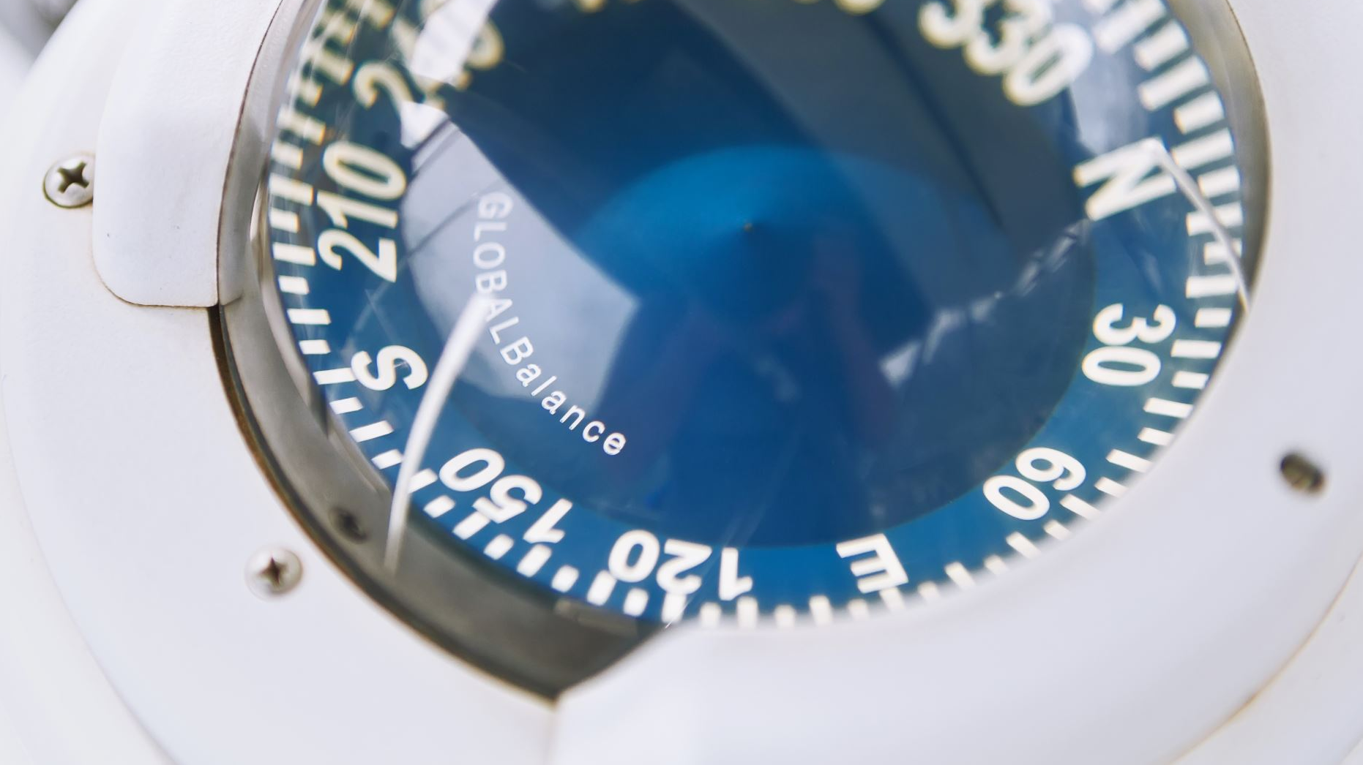
Analysis of company profiles related to transport and circular economy on LinkedIn
Konstantinos P. Tsagarakis, School of Production Engineering and Management, Technical University of Crete, Chania, Greece
George Tsironis, Department of Environmental Engineering, Democritus University, Xanthi, Greece

Slide 2
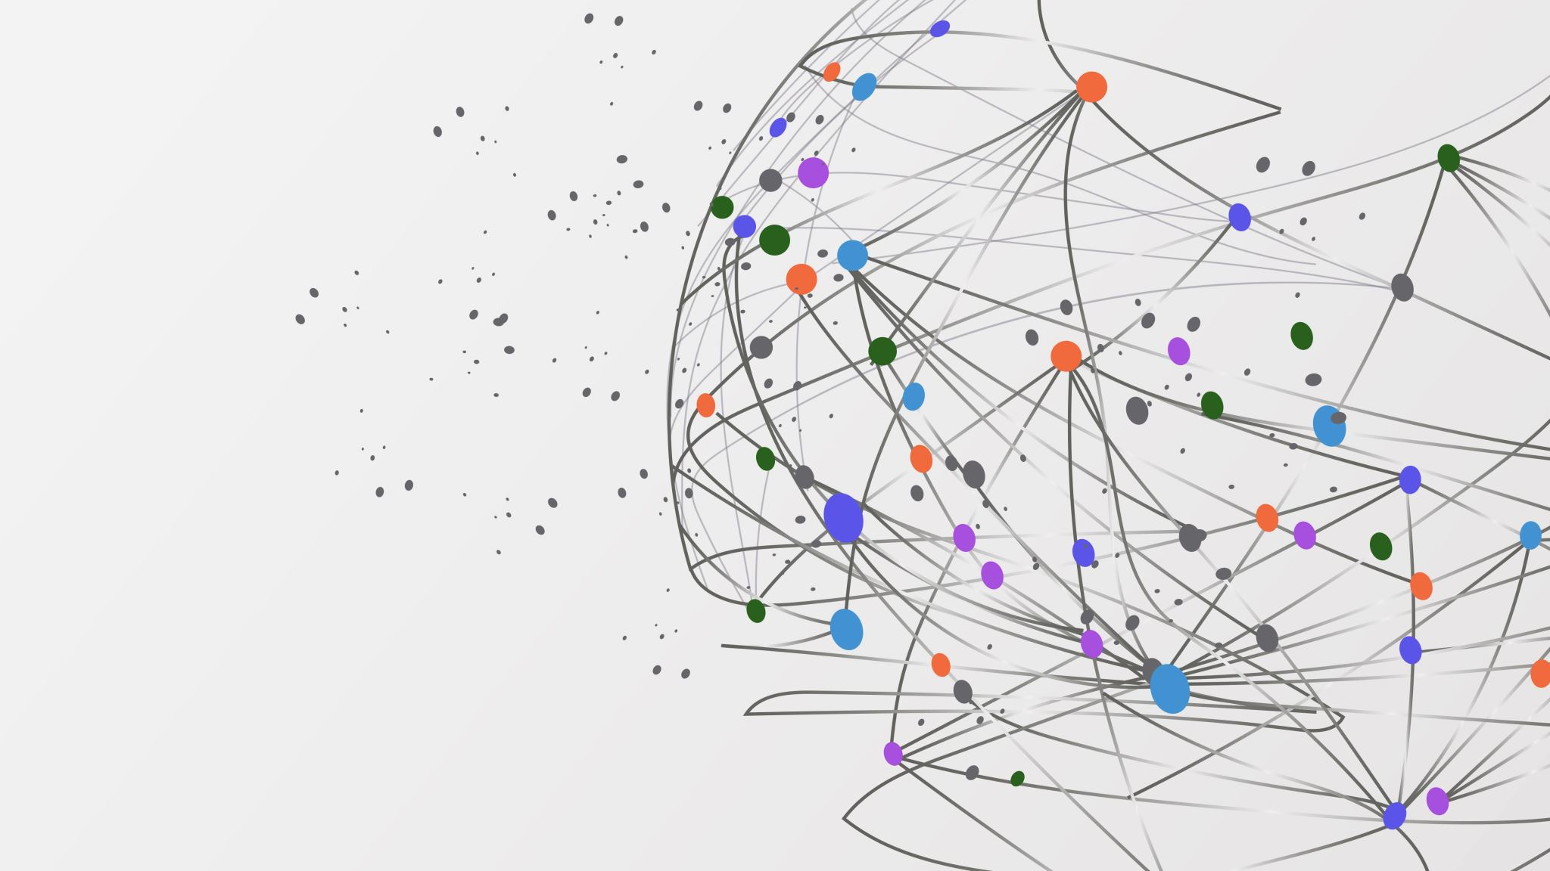
Introduction

Slide 3

LinkedIn and Circular Economy
LinkedIn is an online social media networking platform with significant business orientation
It provides free access, profile creation, and interaction among users
Among the diverse information types, there are “company” profiles (~66 million) containing valuable data
Text-mining tools can help in data acquisition and further DB creation
Different types of analytical methods can lead to very important insights regarding the shaping of various industry and business sectors, regionally or globally
In this presentation we provide some of the most important findings in Circular Economy investigation, so far
Source: Eurostat

Slide 4
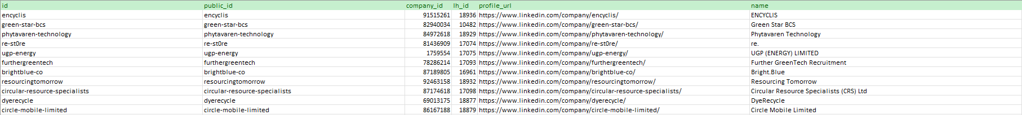
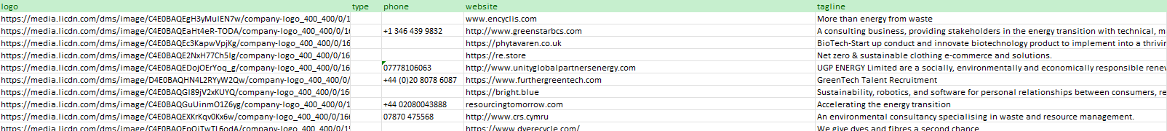
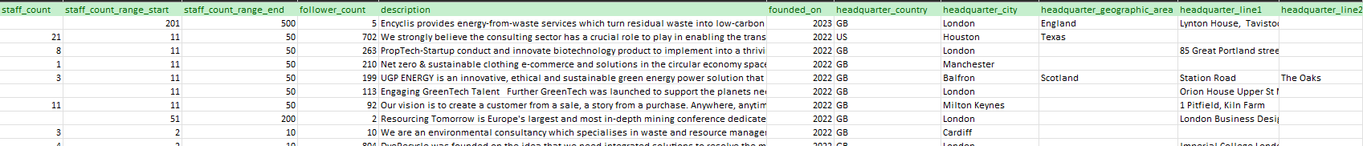
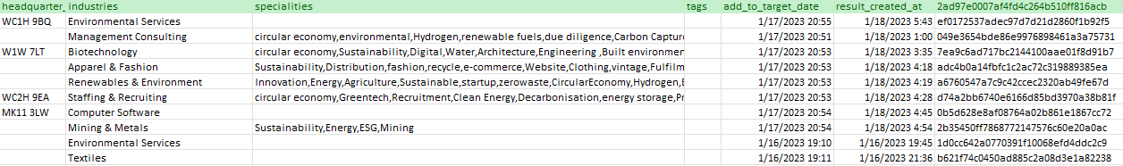
Datasets

Slide 5
Previous research on LinkedIn data
Social media and EU companies' engagement in circular economy: A LinkedIn approach
“Made in Germany” how companies approach Circular Economy on LinkedIn
Global Online networking for Circular economy companies in fashion, apparel, and textiles industries, the LinkedIn platform
“Made in Germany” how companies approach Circular Economy on LinkedIn
The 21 most practiced RE-s from LinkedIn Profiles on a Global Scale

Slide 6
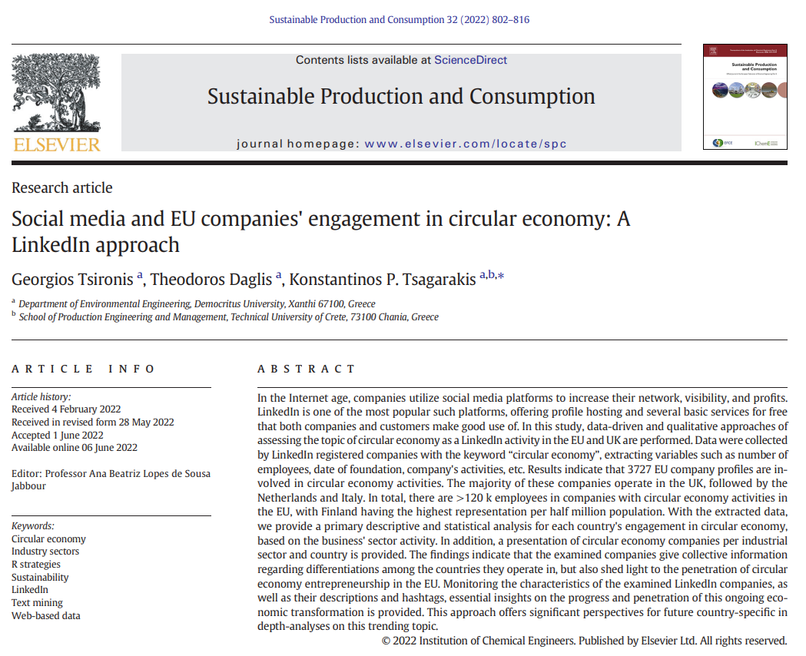
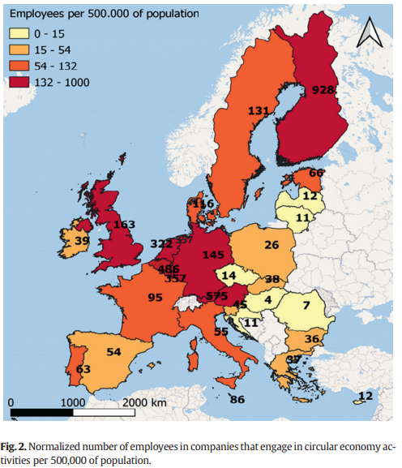

Slide 7
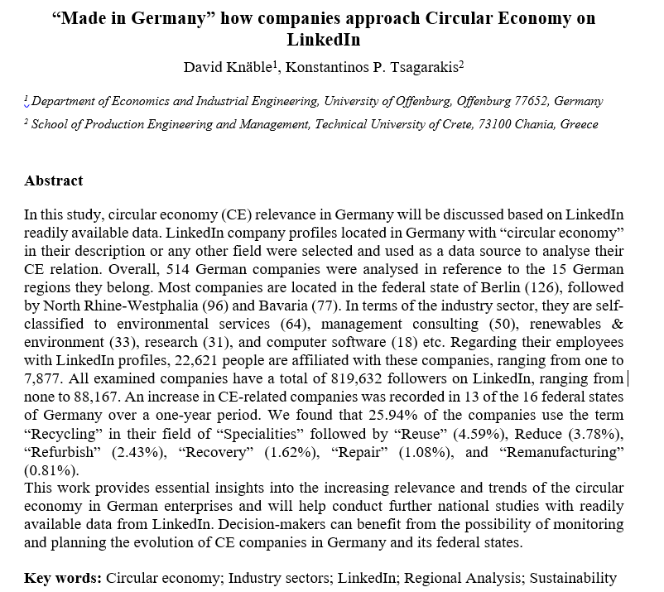
Table 1. Number of companies operating in each region and overall development from January 2022 to January 2023
Accepted in European Planning Studies
Region |  | Companies |  |  | Development (%)
 | January | May | Sept | Jan
Baden-Württemberg | 28 | 32 | 41 | 47 | 67.86
Bavaria | 58 | 64 | 70 | 77 | 32.76
Berlin | 95 | 106 | 122 | 126 | 32.63
Brandenburg | 4 | 5 | 7 | 7 | 75.00
Bremen | 0 | 2 | 2 | 2 | -
Hamburg | 28 | 35 | 40 | 39 | 39.29
Hesse | 29 | 37 | 40 | 43 | 48.28
Lower Saxony | 22 | 20 | 23 | 23 | 4.55
Mecklenburg-Western Pomerania | 4 | 5 | 5 | 5 | 25.00
North Rhine-Westphalia | 70 | 83 | 88 | 96 | 37.14
Rhineland-Palatinate | 9 | 9 | 9 | 10 | 11.11
Saarland | 0 | 0 | 0 | 0 | 0
Saxony | 18 | 18 | 20 | 21 | 16.66
Saxony-Anhalt | 1 | 1 | 2 | 4 | 300.00
Schleswig-Holstein | 8 | 8 | 10 | 11 | 37.50
Thuringia | 3 | 3 | 3 | 3 | 0
Germany (total) | 377 | 428 | 482 | 514 | 36.34

Slide 8
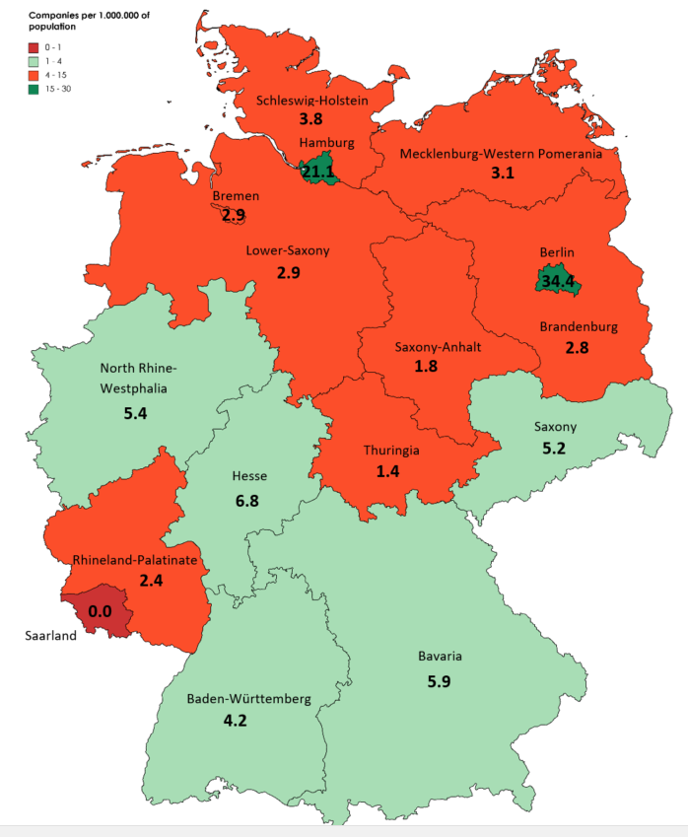
Normalized number of companies per 1.000.000 of population

Slide 9
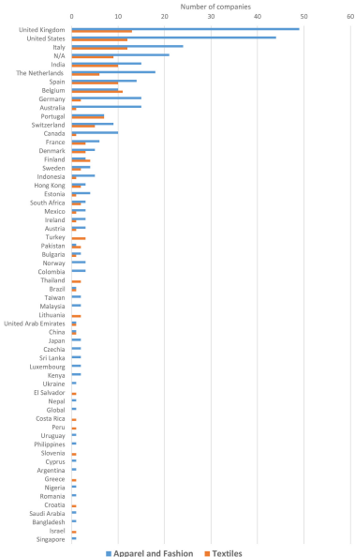
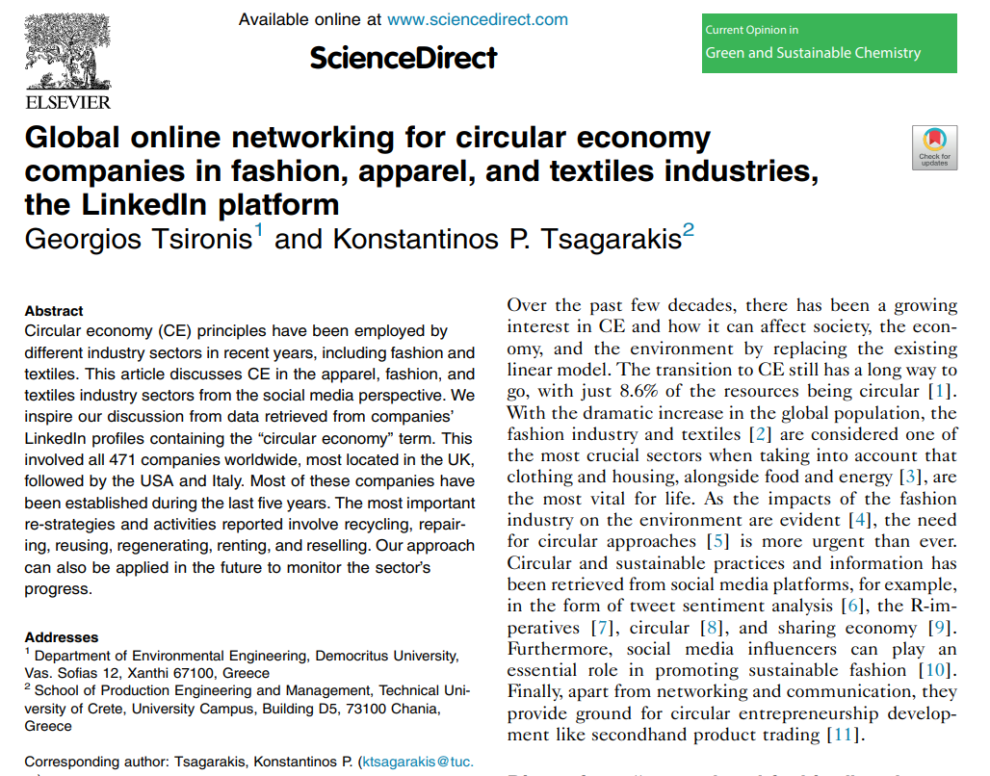

Slide 10
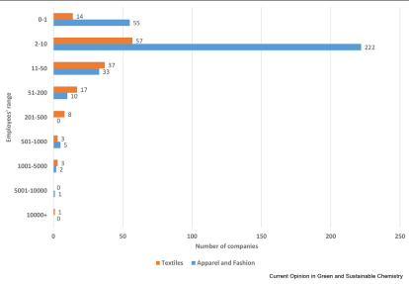
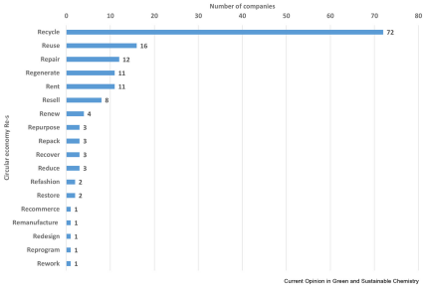

Slide 11
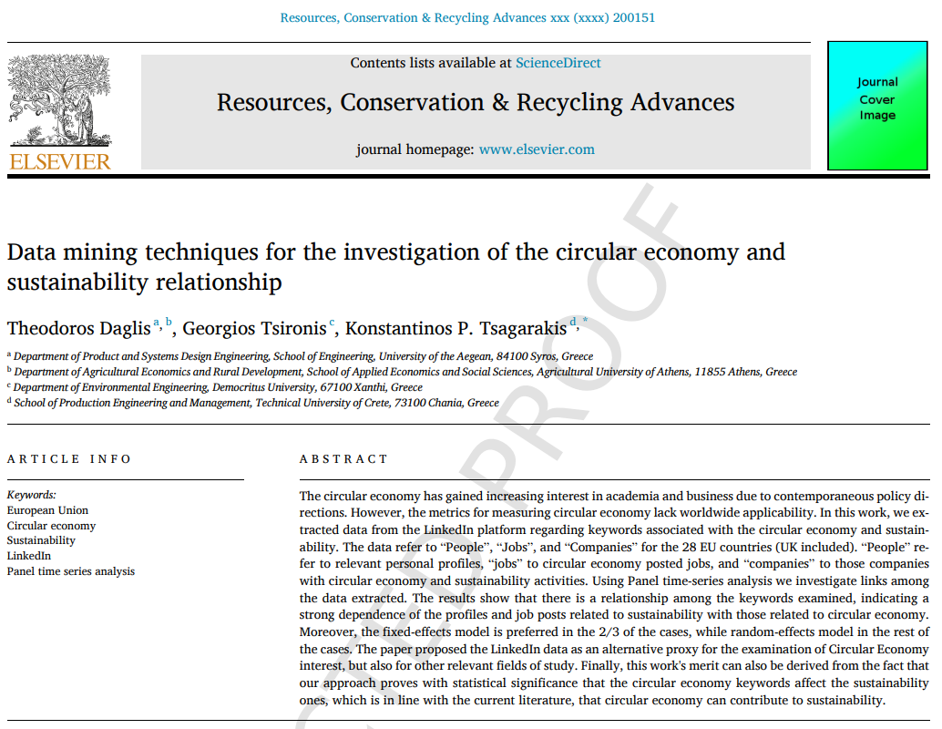
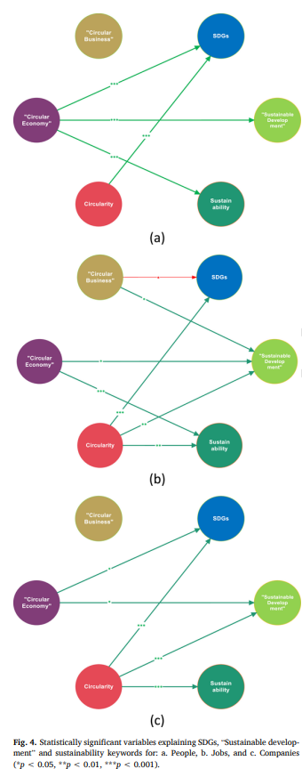
Figure 4. Statistically significant variables explaining SDGs, “Sustainable Development” and Sustainability keywords for: a. People, b. Jobs, and c. Companies (*p<0.05, **p<0.01, ***p<0.001)

Slide 12

Circular Economy on a global scale

Slide 13
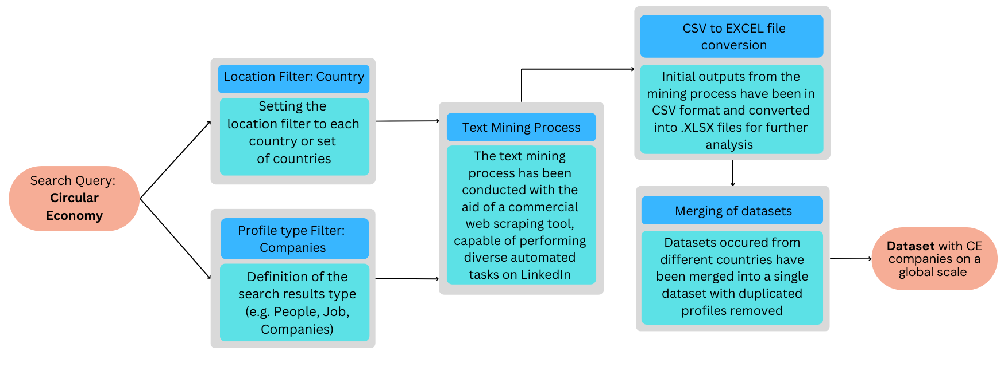
Methodological framework

Slide 14
Company type and Industry sectors

Slide 15
Companies’ critical characteristics
The mapping of organizations’ activity included the investigation of industry sectors and types:
The majority of companies are privately held
“Environmental services”, “Renewables & Environment”, and “Management consulting” are those industry sectors with the highest contribution (sectors are predefined by the platform)
UK is the leading country in terms of established companies with CE mentions, followed by the USA, the Netherlands, Italy, and Germany
The data used for this specific analysis, have been collected in the 1st quarter of 2022 (Feb-Mar)

Slide 16
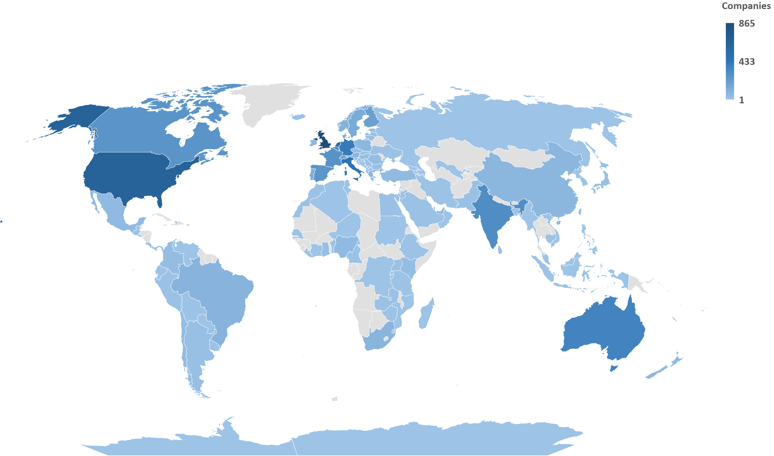
Geographical distribution (Headquarters)

Slide 17
Year of foundation
The global trend in companies’ foundations since 1990, follows the same pattern as the EU27+UK investigation (Tsironis et al., 2022)

Slide 18
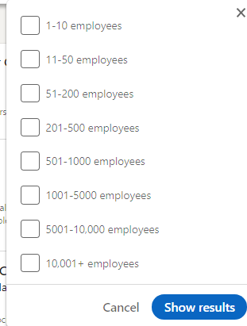
Segmentation according to staff count
Company category | Staff headcount | Turnover | or |  | Balance sheet total
Medium-sized | < 250 | ≤ € 50 m |  | ≤ € 43 m
Small | < 50 | ≤ € 10 m |  | ≤ € 10 m
Micro | < 10 | ≤ € 2 m |  | ≤ € 2 m
99% of all businesses in the EU
90% World wide according to World Bank

Slide 19

21 Circular Economy RE-s
After analysis of the companies’ specialties and descriptions, we propose a framework of 21 RE strategies , practices, functions, conceptualizations, and approache
Those RE-s have been the most frequently occurring in our dataset
Since included every company in our data collection process (worldwide), we consider that the results can be accurate in terms of major strategies, initiatives, and policies
As expected, recycling has been the most popular strategy for CE
It has been encouraging though, the fact that many more strategies appear as important for the transition to circular economy like regenerate, repair, restore, repurpose, refine, rethink, etc.

Slide 20
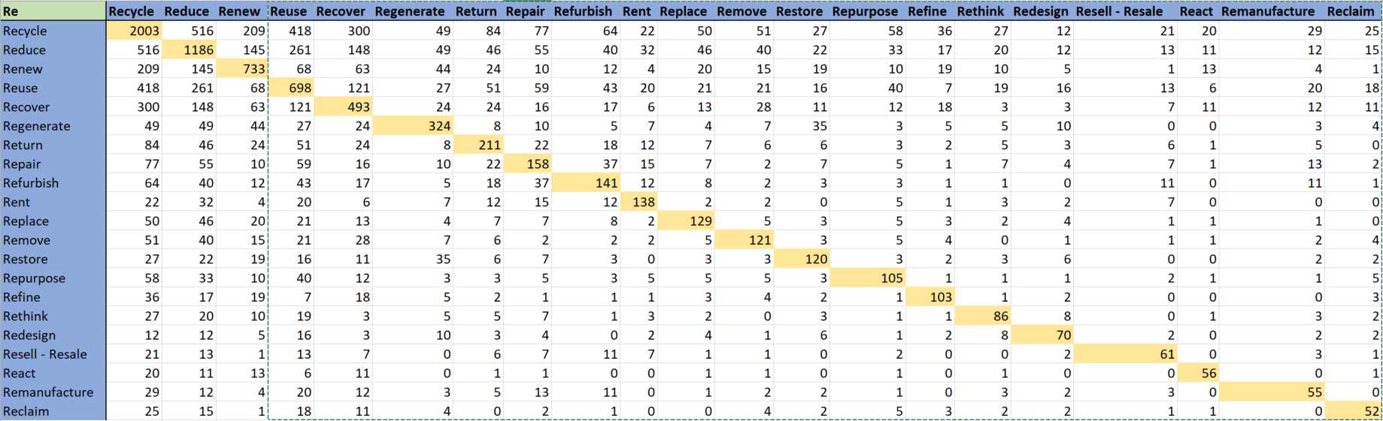

Slide 21
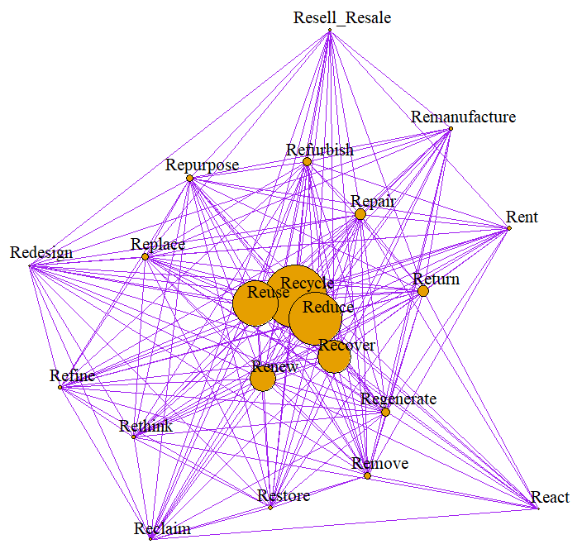
Circular Economy RE-s
CE Re-s | Count | CE Re-s | Count | CE Re-s | Count
Recycle | 2003 | Reinvent | 38 | Rebrand | 9
Reduce | 1186 | Redefine | 37 | Reskill | 9
Renew | 733 | Reinforce | 34 | Revalue | 9
Reuse | 698 | Recommerce | 33 | Redeploy | 8
Recover | 493 | Refill | 28 | Redevelop | 8
Regenerate | 324 | Remarket | 26 | Repack | 8
Return | 211 | Redistribute | 26 | Recharge | 8
Repair | 158 | Recreate | 24 | Rework | 7
Refurbish | 140 | Reform | 23 | Revalorize | 6
Rent | 138 | Reshape | 23 | Regrind | 5
Replace | 129 | Repeat | 18 | Reorganize | 5
Remove | 121 | Recirculate | 17 | Remodel | 4
Restore | 120 | Recondition | 15 | Refashion | 3
Repurpose | 105 | Reforestate | 14 | Regreen | 3
Refine | 103 | Restructure | 13 | Reconstruct | 3
Rethink | 86 | Relocate | 13 | Revert | 3
Redesign | 70 | Remake | 13 | Readapt | 2
Resell - Resale | 61 | Rehabilitate | 12 | Rebanner | 1
React | 56 | Resolve | 12 | Recultivate | 1
Remanufacture | 55 | Reconnect | 11 | Refurnish | 1
Reclaim | 52 | Re-engineer | 11 | Rewild | 1
Renovate | 42 | Reset | 10 | Reprogram | 1
Reprocess | 41 | Reutilize | 10

Slide 22
Followers - descriptive statistics
 | Mean | Standard Deviation | Kurtosis | Skewness | Minimum | 1st quartile | Median | 3rd quartile | Maximum | Sum | Count
Recycle | 1324.95 | 6599.52 | 410.12 | 17.85 | 1 | 46 | 186.5 | 721 | 182860 | 2644602 | 1996
Reduce | 1454.37 | 8341.04 | 281.24 | 15.48 | 1 | 44 | 184 | 676 | 182860 | 1716153 | 1180
Renew | 2971.57 | 27511.71 | 558.69 | 22.50 | 1 | 45 | 201 | 808 | 697183 | 2172220 | 731
Reuse | 1051.42 | 4503.66 | 152.00 | 11.16 | 1 | 43.25 | 180 | 544.5 | 76225 | 729685 | 694
Recover | 1594.28 | 6206.98 | 149.23 | 10.66 | 1 | 73.75 | 242 | 837.75 | 101831 | 784388 | 492
Regenerate | 810.28 | 2135.50 | 29.07 | 5.02 | 1 | 39 | 133 | 506 | 17542 | 259289 | 320
Return | 946.52 | 2131.14 | 25.30 | 4.61 | 1 | 57.5 | 216 | 700 | 15317 | 199715 | 211
Repair | 848.80 | 2246.26 | 23.36 | 4.67 | 1 | 55 | 177 | 569 | 15317 | 133261 | 157
Refurbish | 2258.77 | 6696.54 | 30.68 | 5.24 | 1 | 86 | 282 | 1096 | 48677 | 313969 | 139
Rent | 953.07 | 2447.96 | 25.49 | 4.78 | 1 | 40 | 140 | 805 | 17146 | 130571 | 137
Replace | 871.45 | 2143.33 | 26.62 | 4.75 | 1 | 39.25 | 190 | 625.25 | 15738 | 111546 | 128
Remove | 646.92 | 1794.02 | 66.78 | 7.52 | 1 | 54 | 189 | 580 | 17510 | 78277 | 121
Restore | 935.88 | 2051.23 | 17.30 | 3.88 | 1 | 42.5 | 158 | 774 | 13758 | 111370 | 119
Repurpose | 1043.57 | 3877.27 | 44.60 | 6.36 | 1 | 35.5 | 109 | 497.5 | 32103 | 108531 | 104
Refine | 4360.25 | 20812.77 | 56.97 | 7.22 | 1 | 69.5 | 272 | 964.75 | 182860 | 449106 | 103
Rethink | 2692.64 | 19268.74 | 82.93 | 9.08 | 2 | 37 | 155 | 546.5 | 176653 | 226182 | 84
Redesign | 1018.43 | 3819.95 | 49.79 | 6.75 | 1 | 22.75 | 72 | 427.5 | 29783 | 69253 | 68
Resell-Resale | 3183.13 | 12081.40 | 35.78 | 5.83 | 1 | 62 | 256 | 1110 | 83511 | 194171 | 61
React | 778.87 | 2235.89 | 41.77 | 6.18 | 2 | 28 | 187.5 | 610.75 | 15956 | 42059 | 54
Remanufacture | 2131.84 | 7885.64 | 36.60 | 5.88 | 1 | 65.5 | 237 | 1239.5 | 53850 | 117251 | 55
Reclaim | 672.31 | 1906.68 | 38.72 | 5.93 | 4 | 38.5 | 208 | 445 | 13185 | 34288 | 51

Slide 23
Staff (LinkedIn registered) descriptive statistics
 | Mean | Standard Deviation | Kurtosis | Skewness | Minimum | 1st quartile | Median | 3rd quartile | Maximum | Sum | Count
Recycle | 45.65 | 363.76 | 429.60 | 19.24 | 1 | 2 | 4 | 13 | 9663 | 79022 | 1731
Reduce | 57.81 | 479.28 | 251.28 | 15.04 | 1 | 2 | 4 | 13 | 9663 | 57691 | 998
Renew | 70.60 | 510.45 | 229.68 | 14.01 | 1 | 2 | 4 | 14 | 9663 | 45397 | 643
Reuse | 39.78 | 296.81 | 291.38 | 15.77 | 1 | 2 | 4 | 11 | 6037 | 24069 | 605
Recover | 57.63 | 263.91 | 82.71 | 8.58 | 1 | 2 | 5.5 | 19 | 3013 | 23745 | 412
Regenerate | 16.75 | 115.21 | 249.22 | 15.48 | 1 | 1 | 3 | 9 | 1876 | 4624 | 276
Return | 19.81 | 47.72 | 28.84 | 4.88 | 1 | 3 | 5 | 13 | 406 | 3844 | 194
Repair | 21.44 | 80.17 | 92.14 | 9.05 | 1 | 2 | 4 | 13 | 862 | 2895 | 135
Refurbish | 77.15 | 266.32 | 57.71 | 6.93 | 1 | 3 | 9 | 36.5 | 2514 | 9721 | 126
Rent | 17.79 | 50.59 | 38.27 | 5.87 | 1 | 2 | 4 | 11 | 406 | 2064 | 116
Replace | 16.99 | 46.51 | 34.26 | 5.55 | 1 | 2 | 4.5 | 11 | 360 | 1971 | 116
Remove | 9.45 | 15.24 | 41.06 | 5.50 | 1 | 2 | 5 | 11 | 132 | 973 | 103
Restore | 12.44 | 35.00 | 61.51 | 7.30 | 1 | 1 | 3 | 10.75 | 321 | 1269 | 102
Repurpose | 46.60 | 215.65 | 50.28 | 6.87 | 1 | 2 | 3.5 | 12.5 | 1745 | 3914 | 84
Refine | 179.75 | 895.87 | 52.30 | 6.96 | 1 | 2 | 6 | 23 | 7418 | 15818 | 88
Rethink | 26.67 | 158.06 | 60.60 | 7.77 | 1 | 1 | 3 | 9 | 1239 | 1627 | 61
Redesign | 12.89 | 33.02 | 36.63 | 5.71 | 1 | 1 | 3 | 11 | 230 | 696 | 54
Resell-Resale | 127.89 | 472.09 | 20.64 | 4.58 | 1 | 2 | 6 | 25 | 2514 | 6778 | 53
React | 20.43 | 55.03 | 17.68 | 4.23 | 1 | 2 | 4.5 | 12.25 | 283 | 899 | 44
Remanufacture | 148.83 | 879.43 | 46.57 | 6.81 | 1 | 2 | 5 | 16 | 6037 | 6995 | 47
Reclaim | 16.17 | 52.98 | 34.47 | 5.69 | 1 | 2 | 3 | 9.5 | 344 | 744 | 46

Slide 24
Circular Economy in the United Kingdom

Slide 25
UK companies in LinkedIn with Circular Economy in their profiles
Key figures (2022)
999 companies
41,879 personnel
2,607,339 followers
-> 2023
1280 companies
53,731 personnel
3,511,295 followers

Slide 26
Headquarters’ distribution of non-UK-based companies

Slide 27
Industries (n>10)

Slide 28
Industries (n<10)

Slide 29


Descriptive statistics
Followers
Mean | 2750
Standard Deviation | 22774.03
Median | 239
Mode | 12
Kurtosis | 700.6189
Skewness | 24.22771
Range | 699552
Minimum | 1
Maximum | 699553
Sum | 3511295
Count | 1277
Staff
Mean | 50
Standard Deviation | 374.4011
Median | 4
Mode | 1
Kurtosis | 631.1026
Skewness | 22.96609
Range | 10770
Minimum | 1
Maximum | 10771
Sum | 53731
Count | 1080

Slide 30
Monthly observations of CE-related companies

Slide 31
Monthly observations of Circular Economy-related job posts

Slide 32

Experimental Datasets - Keywords

Slide 33
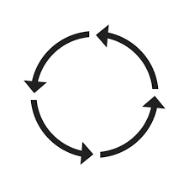

Circular Transport
“Circular Transport” has been searched on the LinkedIn platform
“companies” filter has been applied with no additional location filters
358 profiles have been extracted in CSV files
Further investigation highlighted the main characteristics of those organizations
UK presented the highest number of results according to the HQs location
The most popular industry sectors were those in the “services” cluster

Slide 34
Circular Transport (n=358, worldwide)

Slide 36
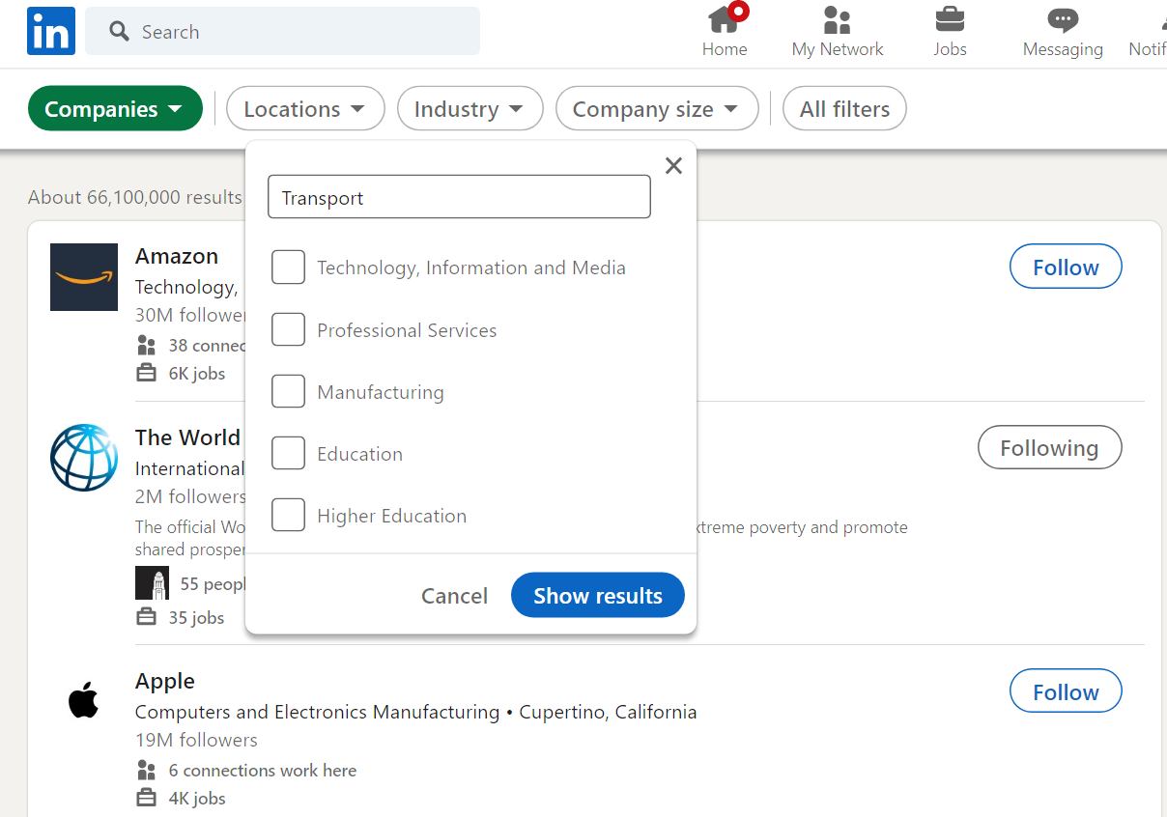
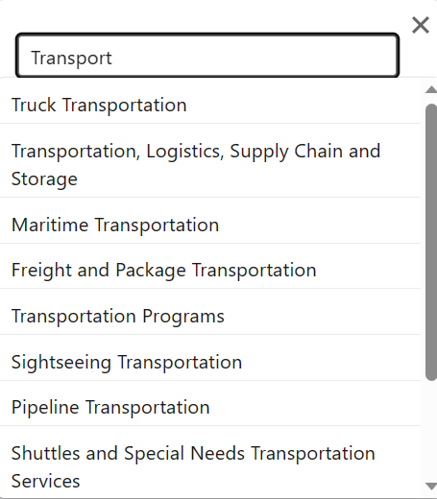
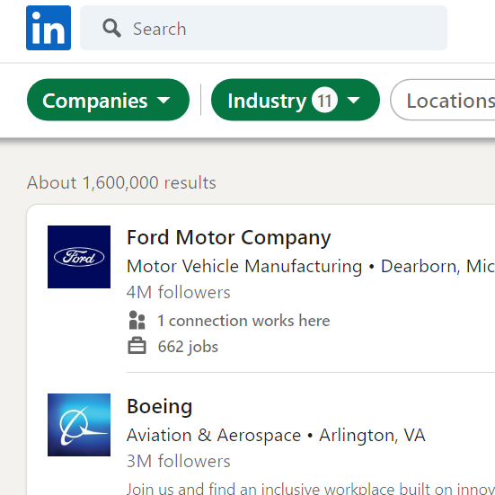
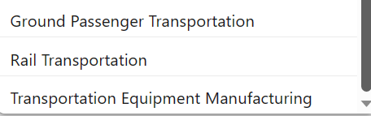
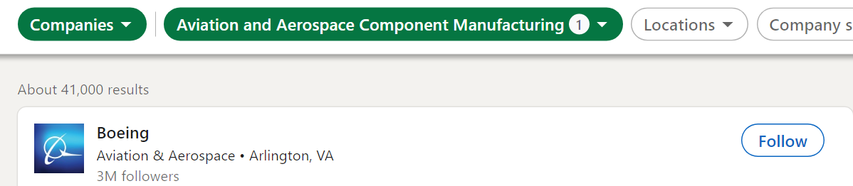
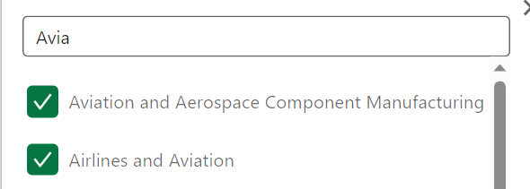
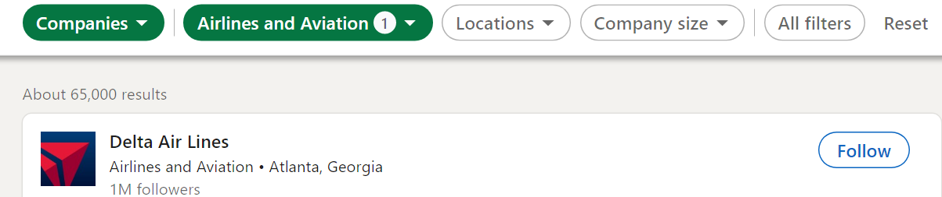

Slide 37
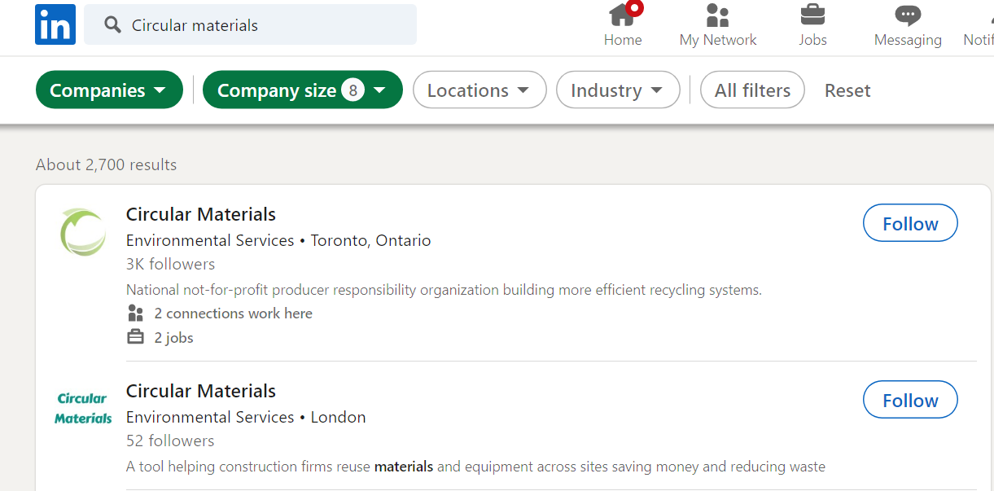

Circular Economy Materials
“Circular Economy Materials” provides 2700 companies with no additional location filters
Further investigation highlighted the main characteristics of those organizations
Further specification per material is necessary limit the number of hits below 1000 or group per company size.

Slide 38
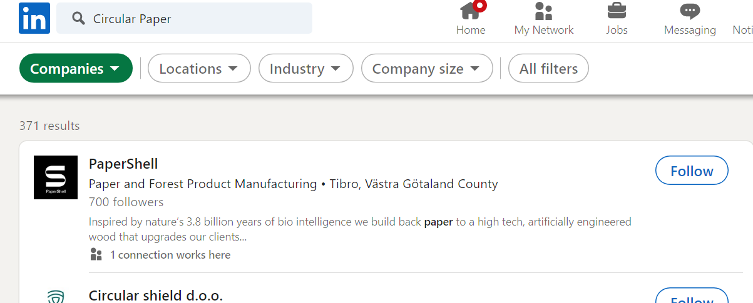
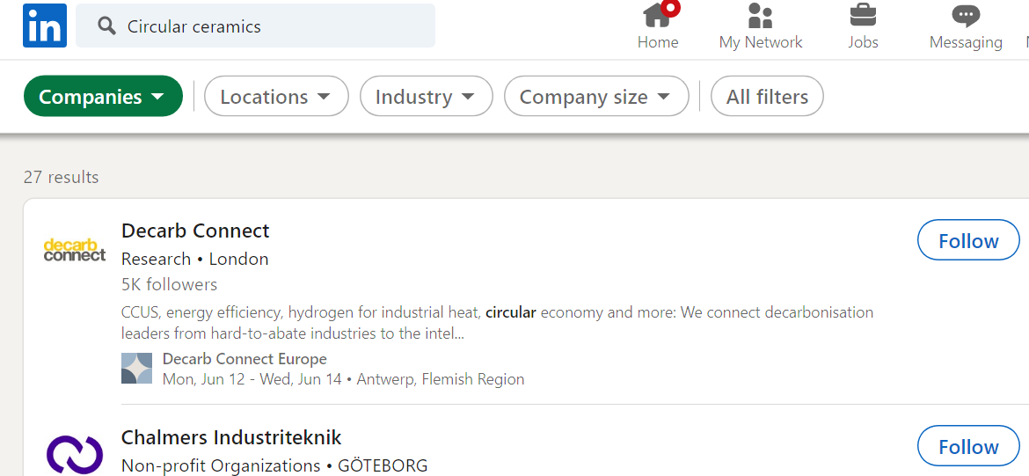
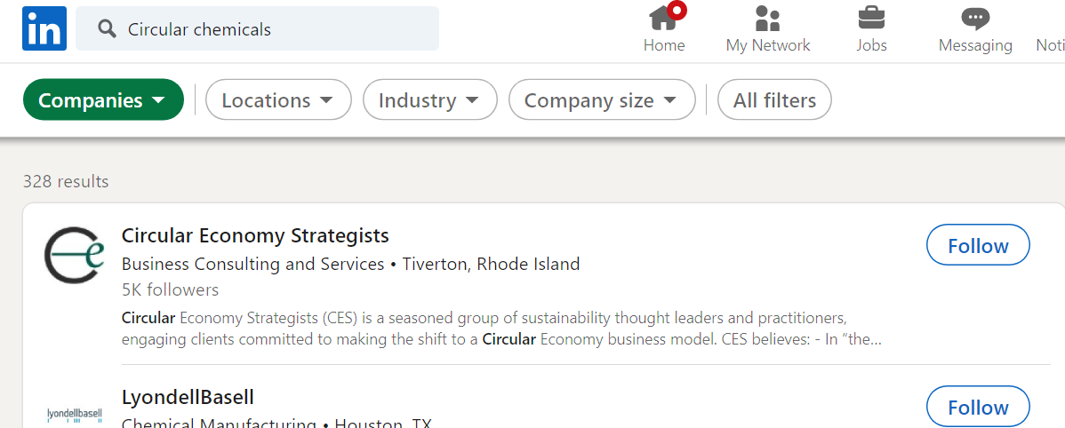
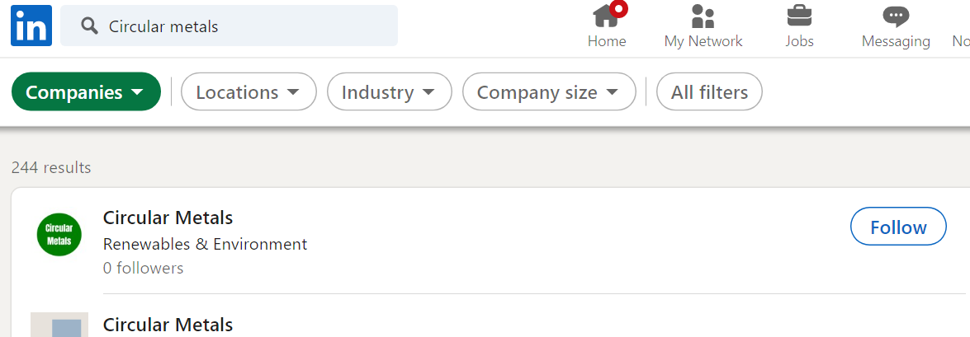
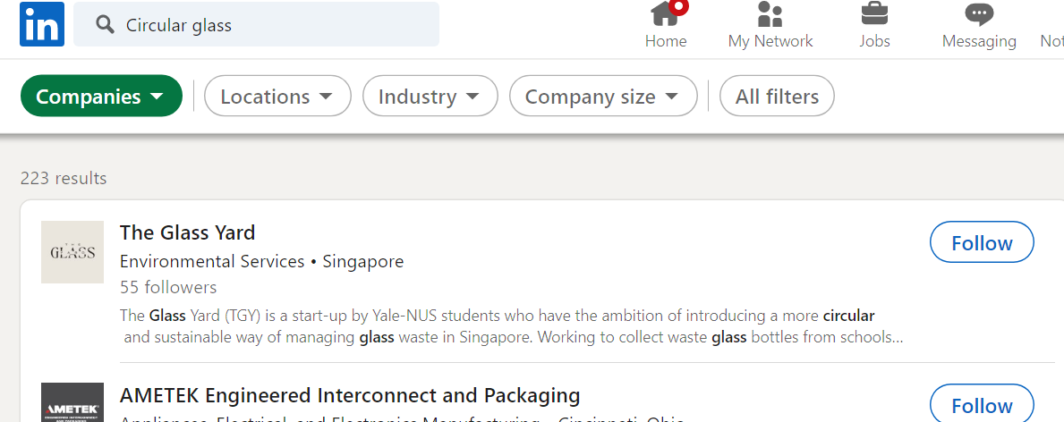
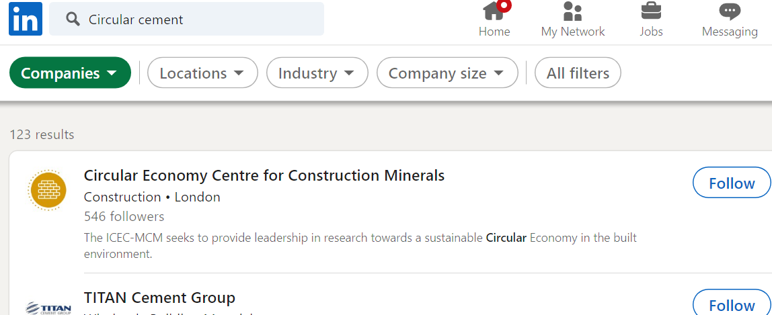

Slide 39

Suggestions for Further Research
Further investigation of topics related to CE, like materials, production, transport, etc., in terms of qualitative or thematic analysis. (search query definition)
Further analysis of already mined datasets (circular economy UK, circular economy materials, circular transport) by utilizing diverse analytics methods on profiles “specialties” and “descriptions” (free text)
Comparative analysis of LinkedIn data with other online data sources or registry data and indicators

Slide 40
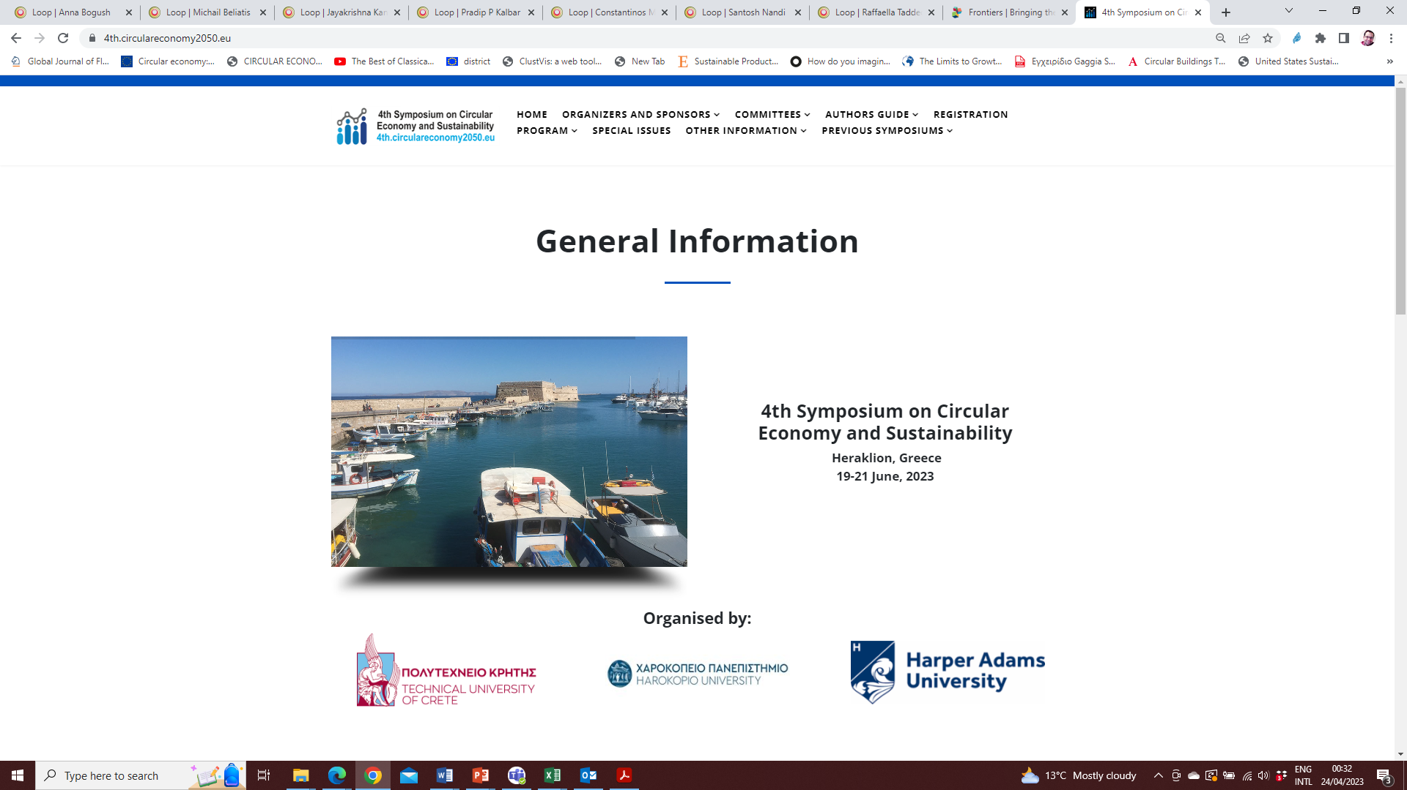
4th Symposium on Circular Economy and Sustainability, Heraklion, Crete, 19-21 June 2023,
https://4th.circulareconomy2050.eu/

Slide 41

Thank you for your attention
Konstantinos P. Tsagarakis ktsagarakis@tuc.gr

