Slide 1
Our Demand Driven Journey
Brian Dooley

Slide 2

Agenda
The case for change
Our approach
Where are we now
Takeaways and myth busters

Slide 3
The Case for Change
Problem statement: Our forecasts are not accurate enough
SKU level forecast accuracy is destroying flow:
Schedule break ins
Expedites
Stock outs and over stocks
Clearly the solution is obvious
Improve forecast accuracy
“If I had asked people what they wanted, they would have said faster horses”
Henry Ford
Or are we solving the wrong problem

Slide 4
DDMRP - Testing the theory with a simulation
Simulation model built using 6 months history of actual daily orders
Two groups of SKUs from the same family modelled that had been historically over and under forecast but at the aggregate level had excellent accuracy
RESULTS
Stock is in balance and total inventory is halved
NOT Dependant on Forecast so decoupled from forecast error
NO Service issues
LESS Inventory
STABLE load on factory
NO costs of failure
Manufacturing Lead Time

Slide 5
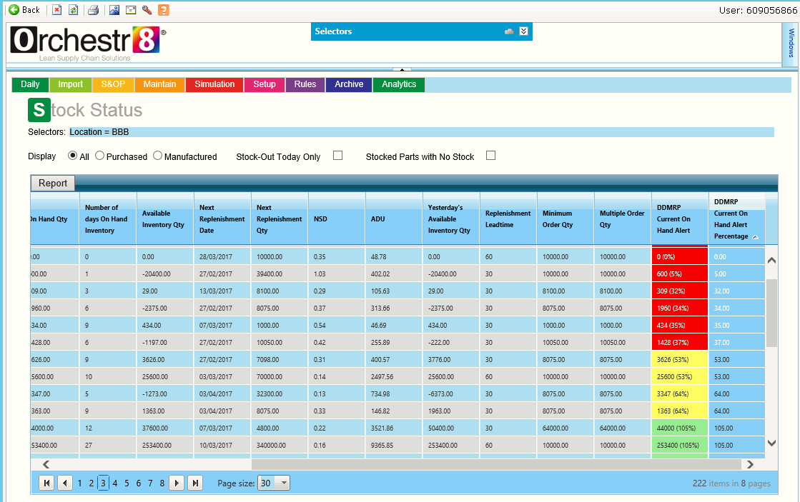
Where are we now - End to End Demand Driven Planning
Agreed operating envelope to support business plan
Demand forecasts
Orchestr8 configuration
& Parameter settings
Actual Demand
DDMRP
daily
DDS&OP
weekly/monthly
Adaptive S&OP
quarterly
Strategy Technology
Variance analysis
Forward projections
Simulation & what-if

Slide 6
Key Takeaways & Myth Busters
Demand Driven has and is delivering
Supply chain ‘de-risked’ from forecast accuracy
Strong positive impact on cash flow and ROCE
Maintained or improved service levels
Significant inventory reduction
Release of supply chain capacity by not producing, buying and storing the wrong stuff
Cost reduction – lower planning effort with improved outcomes – lower expedite costs
Myth Busters
Demand driven is not just DDMRP
It’s not about choosing between forecasting or DDMRP
Equally it does not been better forecasting (or more expensive forecasting tools)
Don’t assume because of it’s elegant simplicity it’s easy to implement – the change management challenge is significant

Slide 7
Supplemental Material

Slide 8






A bit about us

Slide 9
Enabling Demand Driven
DDMRP
Green
Determines supply order generation frequency & size, is the larger of:
MOQ
Desired order cycle
ADU x Lead Time x Lead Time factor
Open Purchase Orders
Open Customer Orders
Supply
Net Flow
Demand
Yellow
The heart of the demand coverage in the buffer
Always sized as 100% ADU x Lead Time
Net Flow = On Hand + Open PO’s
– Open Customer Orders
On Hand Stock
Triggering a Purchase Order
When net flow drops out of the green zone a PO is placed to take the net flow position back to the top of green
Red Safety
The embedded safety in the buffer
Red zone base established based on lead time factor = ADU x Lead Time x Lead Time factor
Red zone safety is determined by variability factor = Red zone base x variability factor
Red
Base
Putting the supply chain capability in place to respond and adapt to ACTUAL customer demand

Slide 10
Strategic Inventory Buffer Positioning
Customer
Supplier
Cables Factory
FSL
Customer
FSL
Customer
C
NDC
Customer
Supplier
Over 125,000 individual Item:Location combinations
Supplier
C
NDC
Customer
Supplier
FSL
Customer
FSL = Forward Stock Location (96)

Slide 11
Planning vs Execution or Net Flow vs On Hand
Net flow zones
Net flow
Net flow
Green
Net flow
Yellow
On hand
On hand
On Hand Alert Zones
Green
On hand
Part1
Part2
Part3
Part | Planning Action | Execution Action
PART1 | No Action | No Action
PART2 | Place New PO | No Action
PART3 | No Action | Expedite Open PO’s
Red Safety
Yellow
Red
Base
Red

Slide 12
DDMRP Excel model – clear plan priorities
Potentially at risk items
Monitor
Check days of cover vs PO due date
Call out any delays
Critical Items
Expedite existing POs
Call out any delays
On Hand / ADU = Days of cover
Index | BT IC | Desc | ADU | MOQ | Order Cycle (days) | + On Order | -Qualified Sales Orders | On Hand | =Available Stock | Recommended Order
1 | Part1 |  | 601.08 | 8100 | 15 | 32,400 | 4,000 | 6,169 | 34,569 | 8100
2 | Part2 |  | 58.69 | 6000 | 102 | 6,000 | 0 | 631 | 6,631 | 0
3 | Part3 |  | 938.25 | 5030 | 15 | 45,270 | 0 | 10,542 | 55,812 | 15090
4 | Part4 |  | 3417.14 | 8100 | 15 | 146,853 | 1,950 | 48,043 | 192,946 | 64800
5 | Part5 |  | 347.85 | 8075 | 23 | 25,089 | 0 | 5,092 | 30,181 | 0
6 | Part6 |  | 213.46 | 4840 | 23 | 10,502 | 1,500 | 4,491 | 13,493 | 0
7 | Part7 |  | 8.63 | 12 | 15 | 415 | 13 | 194 | 596 | 0
8 | Part8 |  | 2569.15 | 10100 | 15 | 125,193 | 2,500 | 67,041 | 189,734 | 0
9 | Part9 |  | 190.77 | 10000 | 52 | 10,400 | 0 | 5,200 | 15,600 | 0
10 | Part10 |  | 1670.35 | 4015 | 15 | 70,506 | 3,975 | 50,872 | 117,403 | 0
11 | Part11 |  | 156.08 | 8100 | 52 | 8,100 | 790 | 4,951 | 12,261 | 0
12 | Part12 |  | 6.66 | 50 | 15 | 250 | 10 | 221 | 461 | 0
13 | Part13 |  | 711.98 | 3040 | 15 | 14,310 | 1,940 | 24,728 | 37,098 | 15200
14 | Part14 |  | 10310.63 | 14050 | 15 | 315,961 | 13,635 | 360,075 | 662,401 | 0
BT IC | Desc | On Hand | ADU | OH Cover | PO NUMBER | PO DATE | QUANTITY ORDERED | QUANTITY DELIVERED | NEED BY DATE
Part1 |  | 6,169 | 601 | 10 | xxxxxxxxxxx | 25/05/2016 | 8100 | 0 | 30/06/2016
 |  |  |  |  | xxxxxxxxxxx | 29/06/2016 | 16200 | 0 | 31/07/2016
 |  |  |  |  | xxxxxxxxxxx | 13/05/2016 | 8100 | 0 | 27/06/2016
Part2 |  | 631 | 59 | 11 | xxxxxxxxxxx | 07/06/2016 | 6000 | 0 | 19/07/2016
Part3 |  | 10,542 | 938 | 11 | xxxxxxxxxxx | 05/07/2016 | 15090 | 0 | 16/08/2016
 |  |  |  |  | xxxxxxxxxxx | 17/06/2016 | 15090 | 0 | 29/07/2016
 |  |  |  |  | xxxxxxxxxxx | 29/06/2016 | 10060 | 0 | 31/07/2016
 |  |  |  |  | xxxxxxxxxxx | 29/06/2016 | 5030 | 0 | 15/08/2016
Part4 |  | 48,043 | 3,417 | 14 | xxxxxxxxxxx | 07/06/2016 | 72900 | 7047 | 19/07/2016
 |  |  |  |  | xxxxxxxxxxx | 29/06/2016 | 48600 | 0 | 31/07/2016
 |  |  |  |  | xxxxxxxxxxx | 29/06/2016 | 32400 | 0 | 15/08/2016
Part5 |  | 5,092 | 348 | 15 | xxxxxxxxxxx | 13/05/2016 | 8075 | 7211 | 27/06/2016
 |  |  |  |  | xxxxxxxxxxx | 17/06/2016 | 8075 | 0 | 29/07/2016
 |  |  |  |  | xxxxxxxxxxx | 05/07/2016 | 16150 | 0 | 16/08/2016
Expedite
Confirm delivery date

Slide 13
Developing DDS&OP
Vision was to review buffers monthly with finance and operations with signoff of buffers the governance & control for PO placement
Too many buffers and external stakeholders unsure of what or how to signoff
Monthly DDS&OP Policy Setting for the DDOM
Monthly DDS&OP to set policies for the DDOM and review the high level impact along with any significant changes
MOQs addressed
Master data integrity – lead times updated
Weekly DDS&OP Tactical adjustments to the DDOM within the agreed policies
Weekly DDS&OP Tactical adjustments to the DDOM within the agreed policies
Weekly DDS&OP Tactical adjustments to the DDOM within the agreed policies
Weekly DDS&OP Tactical adjustments to the DDOM within the agreed policies
Outliers excluded from variability
Lead time variability added in
New ADU rule between forecast and actual

