Slide 1
WMG – Collaborator Forum, Dec 5th
Flex Pulse Center
John Carr, VP Supply Chain Solutions

Slide 2

Flex
8M
Sq. ft. of services facilities
200,000+
employees
44M
Sq. ft. of manufacturing facilities
2,500
design
engineers
100+
sites in over 30 countries

Slide 3


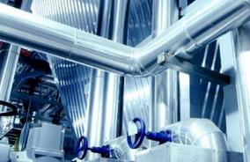
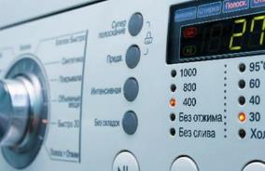
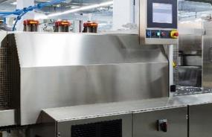







Access to unique insights
Medical
Automotive
Industrial
Goods
Home
Appliances
Capital
Equipment
Energy
$2
Billion
$2
Billion
$1
Billion
$1
Billion
$1
Billion
$2
Billion
Telecom
Networking
Enterprise
Compute
Wearables
Connected
Living
Mobile
$3
Billion
$3
Billion
$2
Billion
$1
Billion
$1
Billion
$2
Billion

Slide 4








Market Forces
Faster Product
Cycles
Increased
Regionalization
Supply Chain
Complexity
Collaborative
Innovation
Cloud
Open
Innovation
Partnerships & ECO Systems
Intelligence of Things
Real Time Information

Slide 5
The Living Supply Chain *
◆ | LIVE – Transparency as a Core Operating Value
◆ | INTERACTIVE – The Emergence of Federated Supply Chain Networks
◆ | VELOCITY – Working Capital: The Overlooked Asset
◆ | INTELLIGENT – Linking the Genomes of Products in Your Supply Chain
◆ | NETWORKED – Co-evolution and Co-innovation in Federated Supply chains
◆ | GOOD – The Ability to Build Balanced Supply Chains
* The Living Supply Chain – The Evolving Imperative of Operating in Real Time – Handfield and Linton, WILEY, 2016

Slide 6
The value of supply chain visibility
Feasibility
Opportunity
Concept
Development
Production
End of Life
Supplier
Lead Time
Raw
Materials
WIP
Finished
Goods
Outbound
~59 days $3.45B in inventory
1 day improvement = $58M

Slide 7
Real-time information
is a requirement
Live.
Fast.
Intelligent.
Notes:
The first is that real-time information is a necessity in order to stay competitive and work in this faster, more disruptive world
Let me Sum it up:
The revolution in Real Time Information has arrived at Flextronics.
Our digital supply chain using building blocks from Elementum is transforming the speed by which our supply chain sees and moves.
This is a mobile system with collaboration at its core.
LIVE – based on Active Tracking vs. batch system
FAST – built on new architecture which is networked, mobile, cloud and multi user
INTELLIGENT by design in a physical space called the SITUATION ROOM where data is visual and actionable as it streams around the planet
Live Fast and Intelligent
And it needs to be with a complex supply chain of 14,000 suppliers in 30 countries and 120 locations.
At Innovation has no boundries and we want a digital supply chain which has not limits.
I believe with these capabilities, the 12 industries Mike showed you at Flextronics with over a billion dollars each, are just the beginning.
Our global TAM might very well be ANYTHING that’s made. And maybe MADE by Flextronics will a significant differentiator as we accelerate time to market and customer satisfaction in the Intelligence of Things.

Slide 8
















The Real Time digital Supply Chain Revolution.
Data
acquisition
Data visualization
Data driven decision making
Notes:
Specifically, Three broad things need to happen to make live information actionable information
The advantages of digital solutions -----→ Data Acquisition
A way to make data delivered in visually usable formats -----→ Data Visualization
Finally, a PLACE where in combination supply chain design, solution, data and visualization come together for data driven decisions.

Slide 9



Powerful technologies are transforming business
Information
free, real-time.
Mobility
anyone, anywhere, anytime.
Cloud
massive power, unlimited scale, low cost.
By 2020, the Intelligence of Things™ will bring
50 billion connected devices to market
(Cisco 2013 & IDC 2014)
By 2025,
$3.9-11.1T potential economic
(McKinsey 2015)

Slide 10
Flex Platform

Slide 11
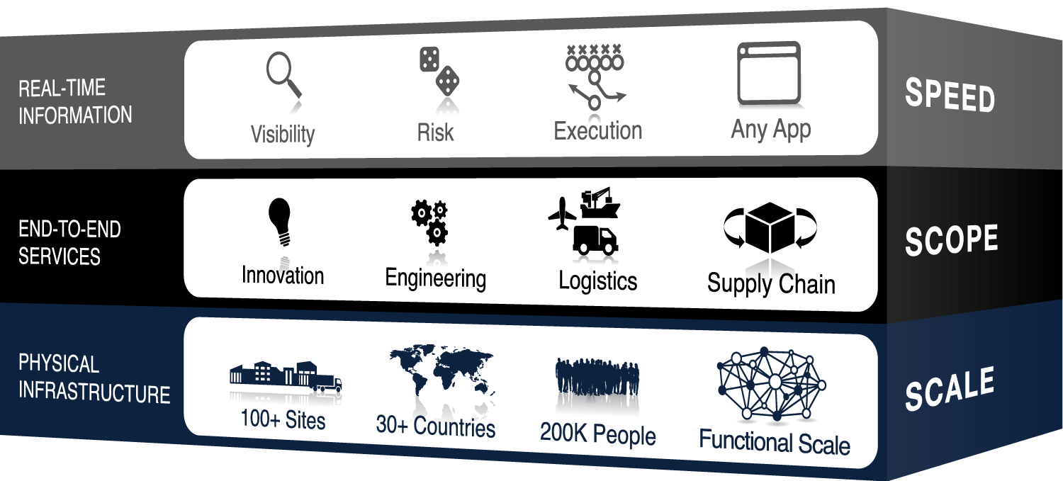
We developed our Platform to
compete in this new world
Notes:
The first is that real-time information is a necessity in order to stay competitive and work in this faster, more disruptive world
Let me Sum it up:
The revolution in Real Time Information has arrived at Flextronics.
Our digital supply chain using building blocks from Elementum is transforming the speed by which our supply chain sees and moves.
This is a mobile system with collaboration at its core.
LIVE – based on Active Tracking vs. batch system
FAST – built on new architecture which is networked, mobile, cloud and multi user
INTELLIGENT by design in a physical space called the SITUATION ROOM where data is visual and actionable as it streams around the planet
Live Fast and Intelligent
And it needs to be with a complex supply chain of 14,000 suppliers in 30 countries and 120 locations.
At Innovation has no boundries and we want a digital supply chain which has not limits.
I believe with these capabilities, the 12 industries Mike showed you at Flextronics with over a billion dollars each, are just the beginning.
Our global TAM might very well be ANYTHING that’s made. And maybe MADE by Flextronics will a significant differentiator as we accelerate time to market and customer satisfaction in the Intelligence of Things.

Slide 12
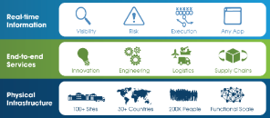

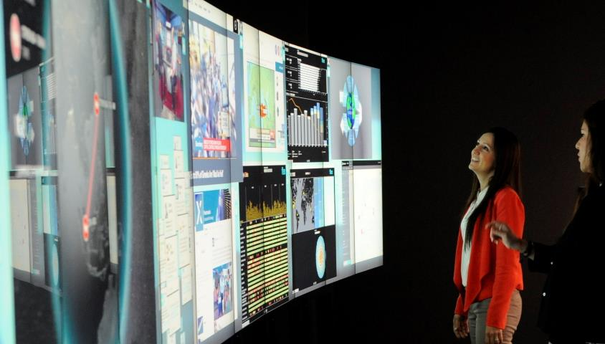



Real Time Management Systems
Workday
Human Resources
Flex Pulse
Supply Chain Health
Elementum
Supply Chain
Healthtap
Health
Workforce Design
Productivity

Slide 13
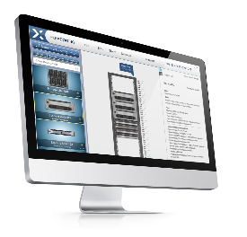
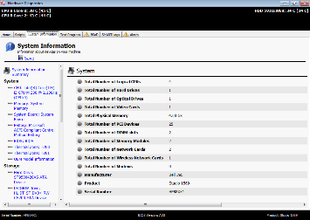
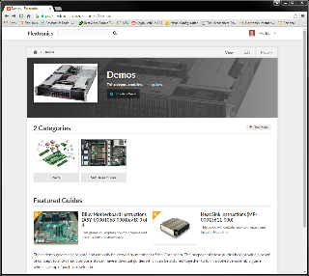
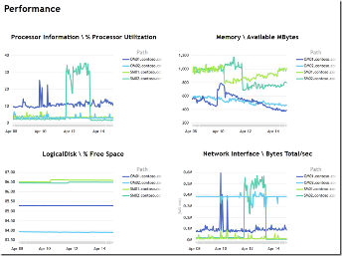
Infrastructure - Software Tools
flexGuide
Next generation, web based, script driven electronic work instructions
flexConfig
2D & 3D Visual Quoting Tool
flexBench
Next generation test, benchmark and performance analysis framework
flexFast
Flexible analytics solution tool - Node and Rack solutions

Slide 14
Real time Information

Slide 15


Pulse Center
Don’t just manage your supply chain, direct it.
“when you get several people together looking at the same data, magical things start to happen…they start to question the data, bounce ideas off each other and day-by-day it strengthens the organization” – Jim Rowan, COO, Dyson

Slide 16










Why Customers Are Interested
The Problem
The Solution
Perspective
Real-time Visibility
“Poor visibility into the state of our operations.”
“Unclear which suppliers put us at risk and when.”
“Don’t know which shipments are late until they don’t arrive.”
“It takes way too long to get commitment on new or changed orders from partners.”
Exposure
Risk Management
Transport
Shipment Tracking
& Carrier Management
Fulfillment
Order Collaboration

Slide 17
Organizations using real-time data visualization achieved 67% greater operational cost reduction.
Aberdeen Group 2013
Notes:
Even more benefits can be realized from real time data. According to Aberdeen Group, companies can significantly reduce operational cost by leveraging real-time data visualization. We have a 6% gross margin, you can bet we are all over this.

Slide 18










Full Visibility on Day One
Pre-integrated to Flex Systems
PRODUCTS & PARTS
ORDERS & SHIPMENTS
SUPPLIERS
DCs
SHOP FLOOR
TERABYTES OF SUPPLY CHAIN DATA PER DAY

Slide 19


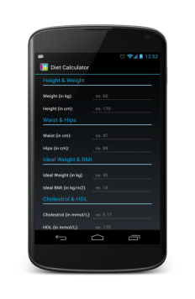
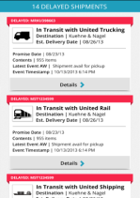
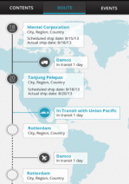
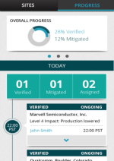
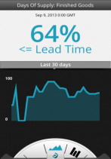
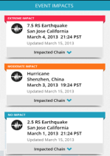
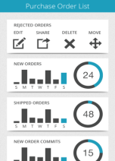
Elementum Apps
Supply chain made simple
REAL-TIME Information
Visibility
Risk
Execution
PERSPECTIVE
REAL-TIME
VISIBILITY
TRANSPORT
SHIPMENT TRACKING
& CARRIER MGMT
EXPOSURE
RISK MONITORING
& MITIGATION
FULFILLMENT
ORDER
COLLABORATION

Slide 20

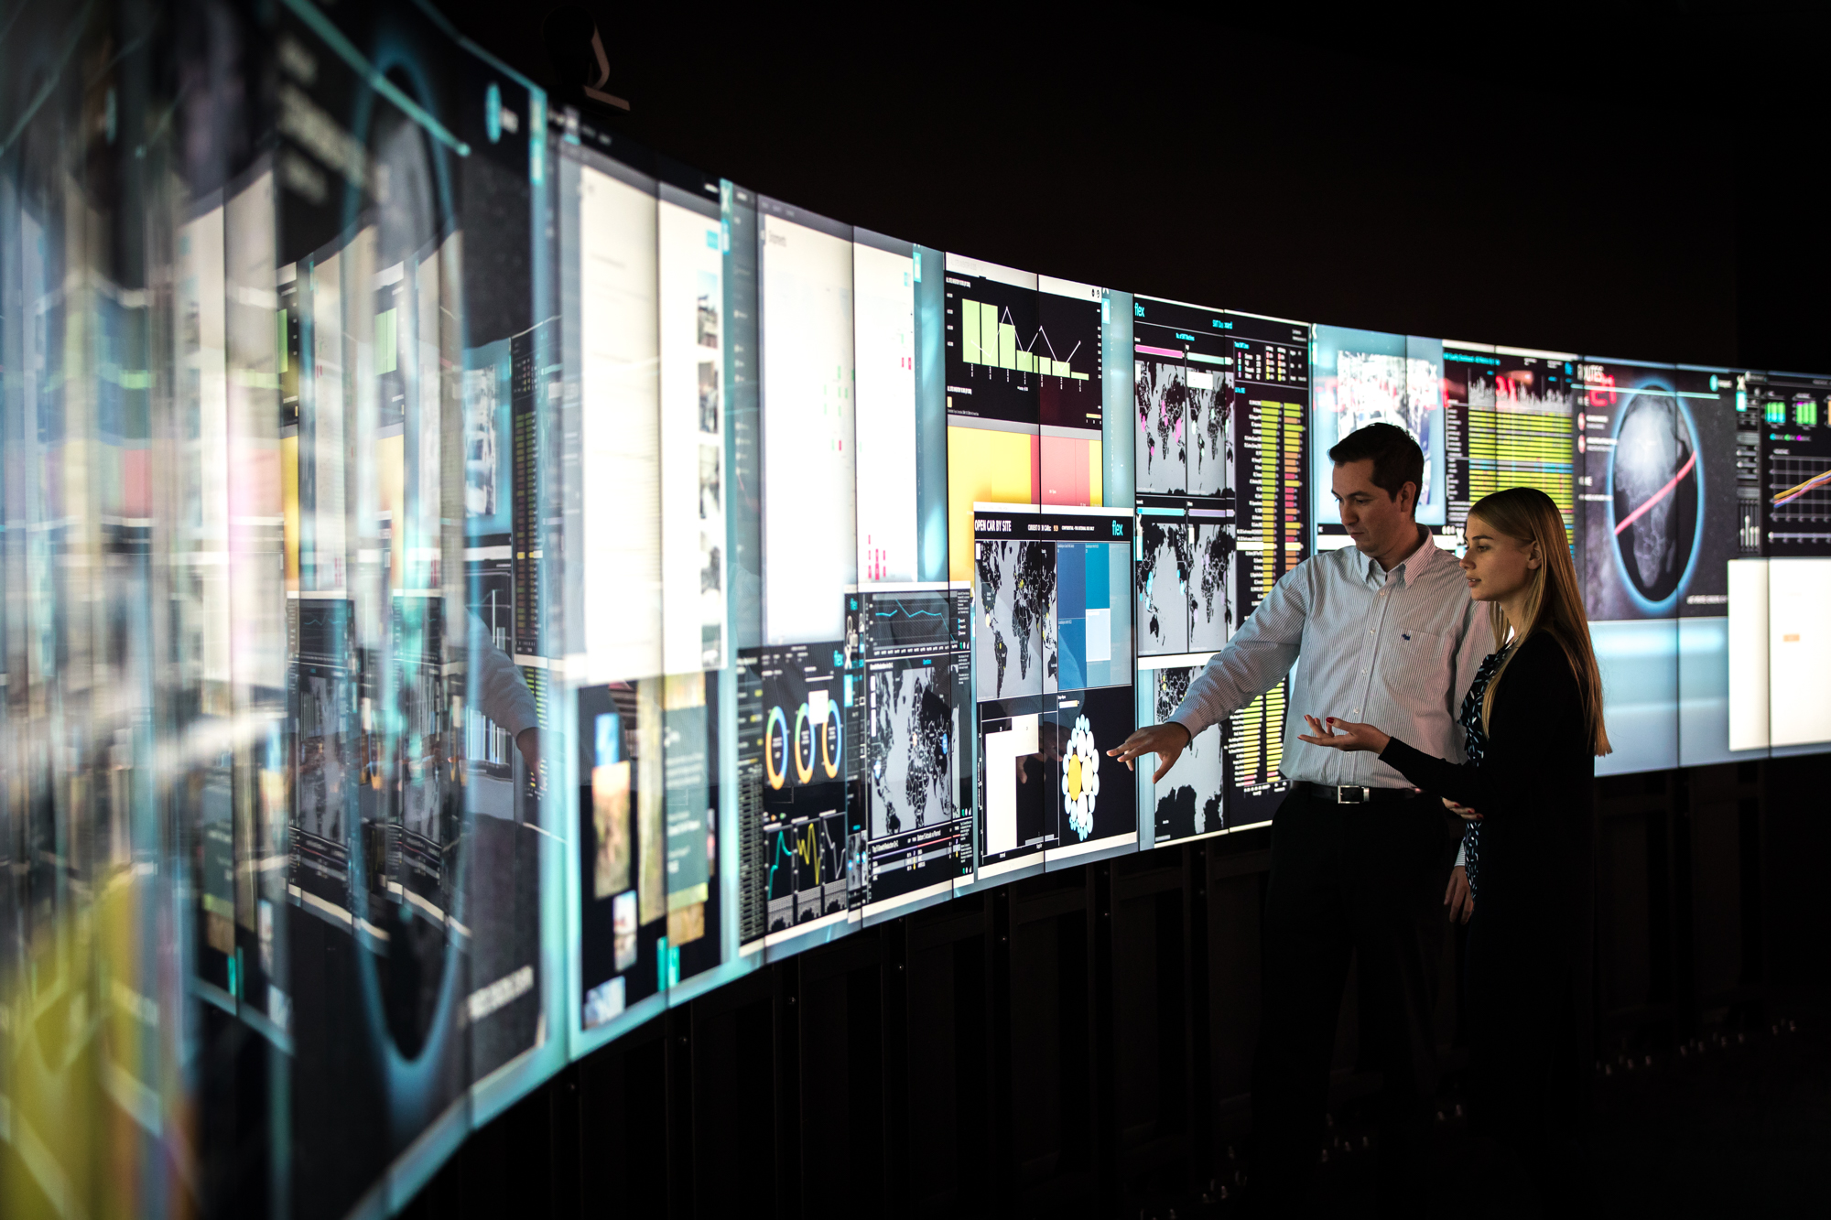
Flex Pulse Center
Notes:
.

Slide 21
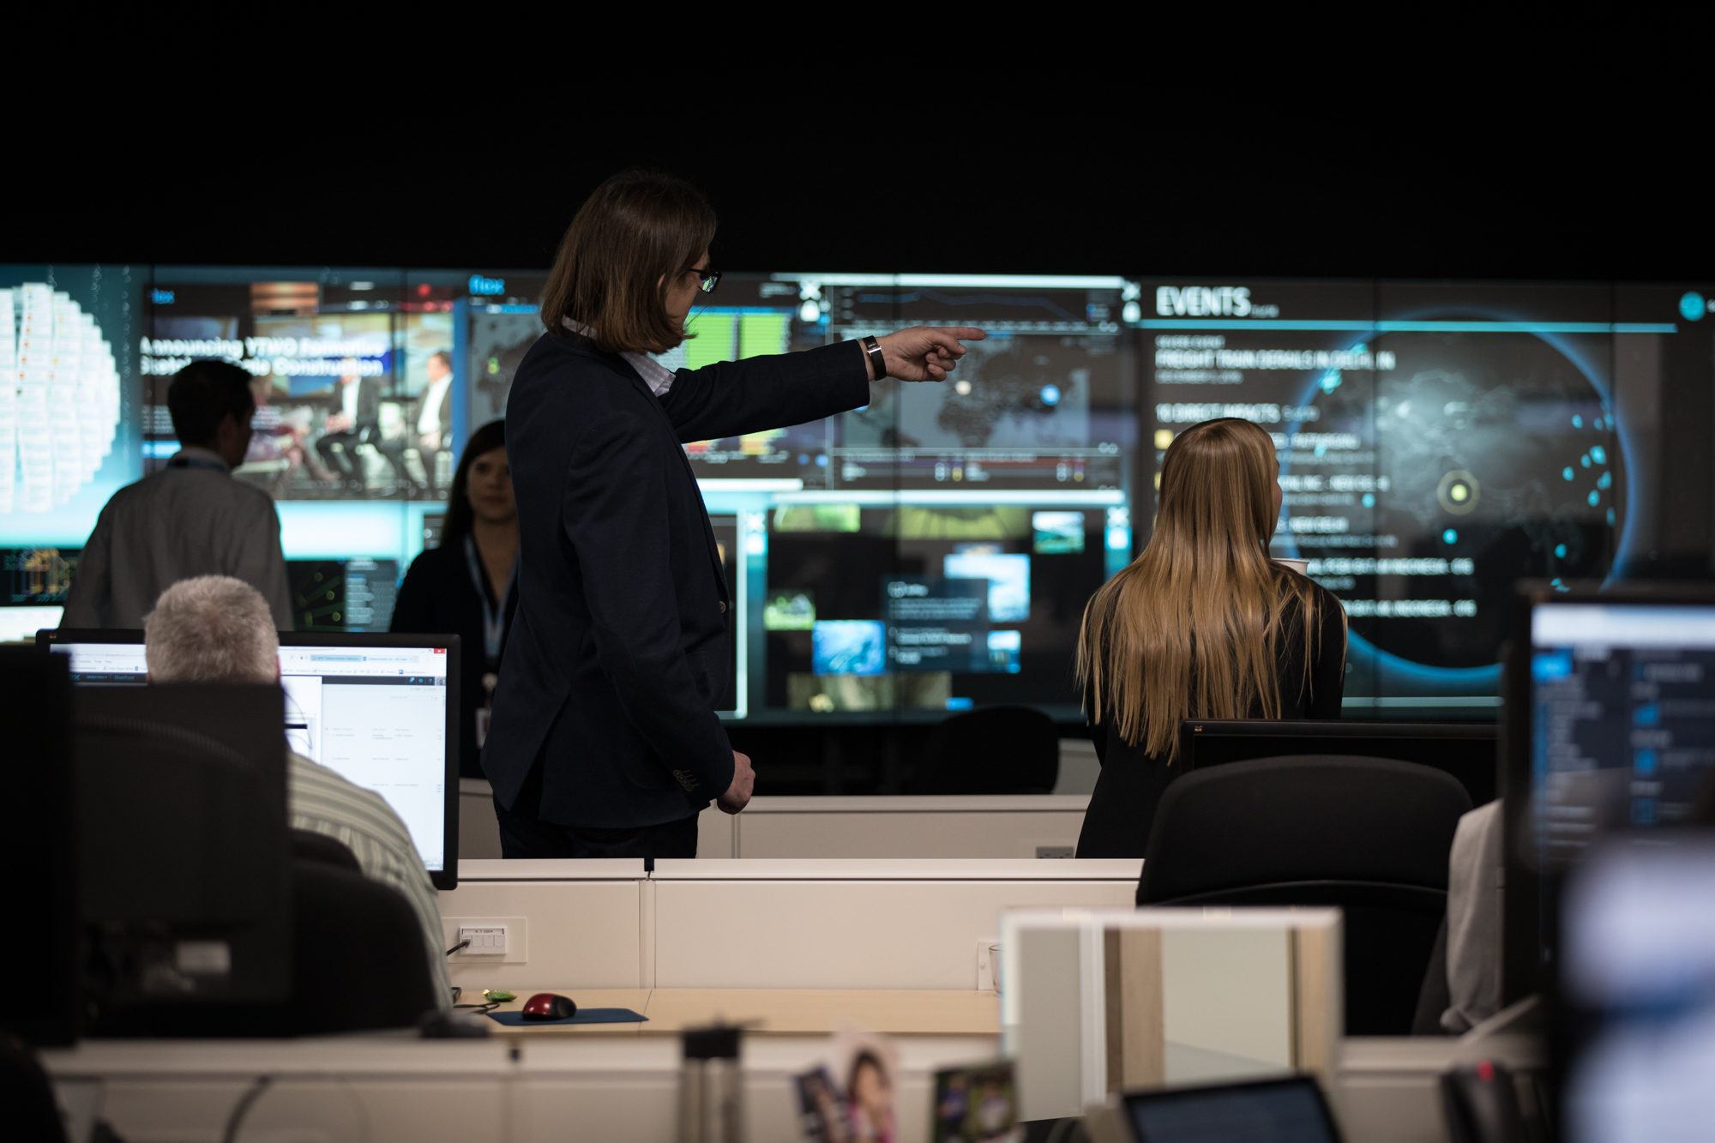
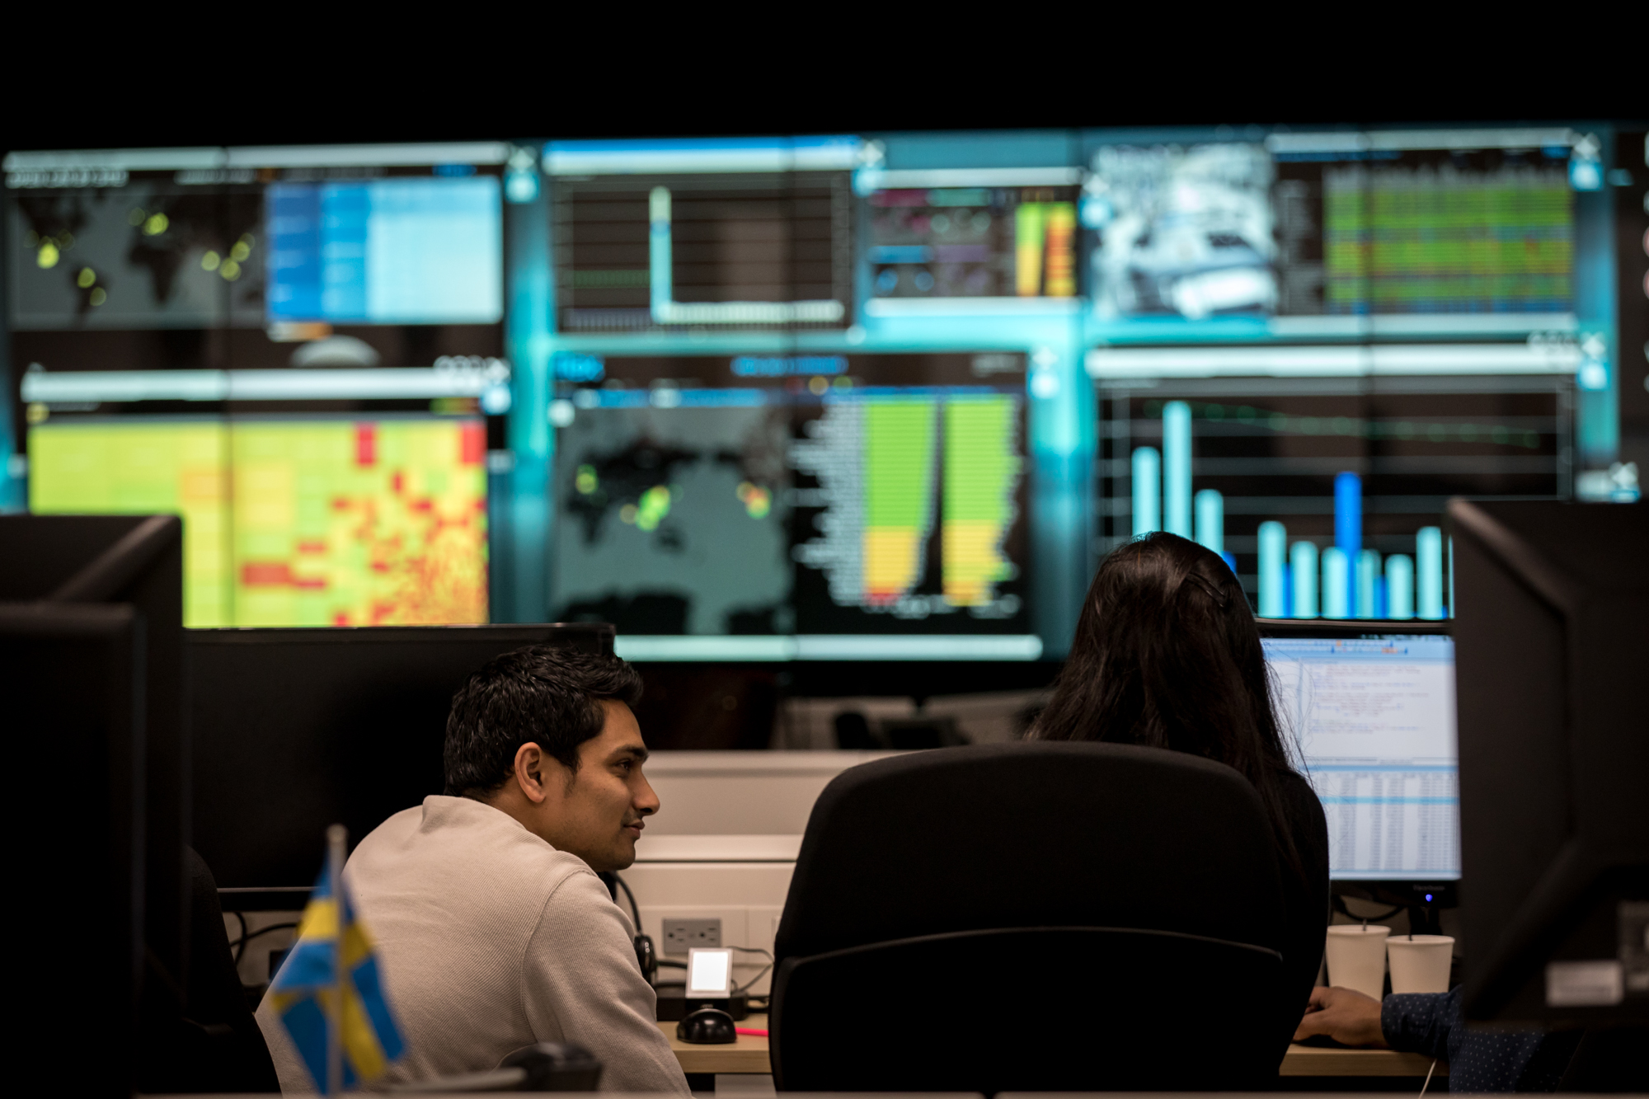
Flex Pulse Center
Notes:
.

Slide 22



Flex Pulse Ecosystem
Information
free
real time
single source
Visualization
identification
prioritization
Mobility
anyone
anywhere
anytime
Multi-enterprise
Architecture
collaboration
E2E supply chain visibility

Slide 23

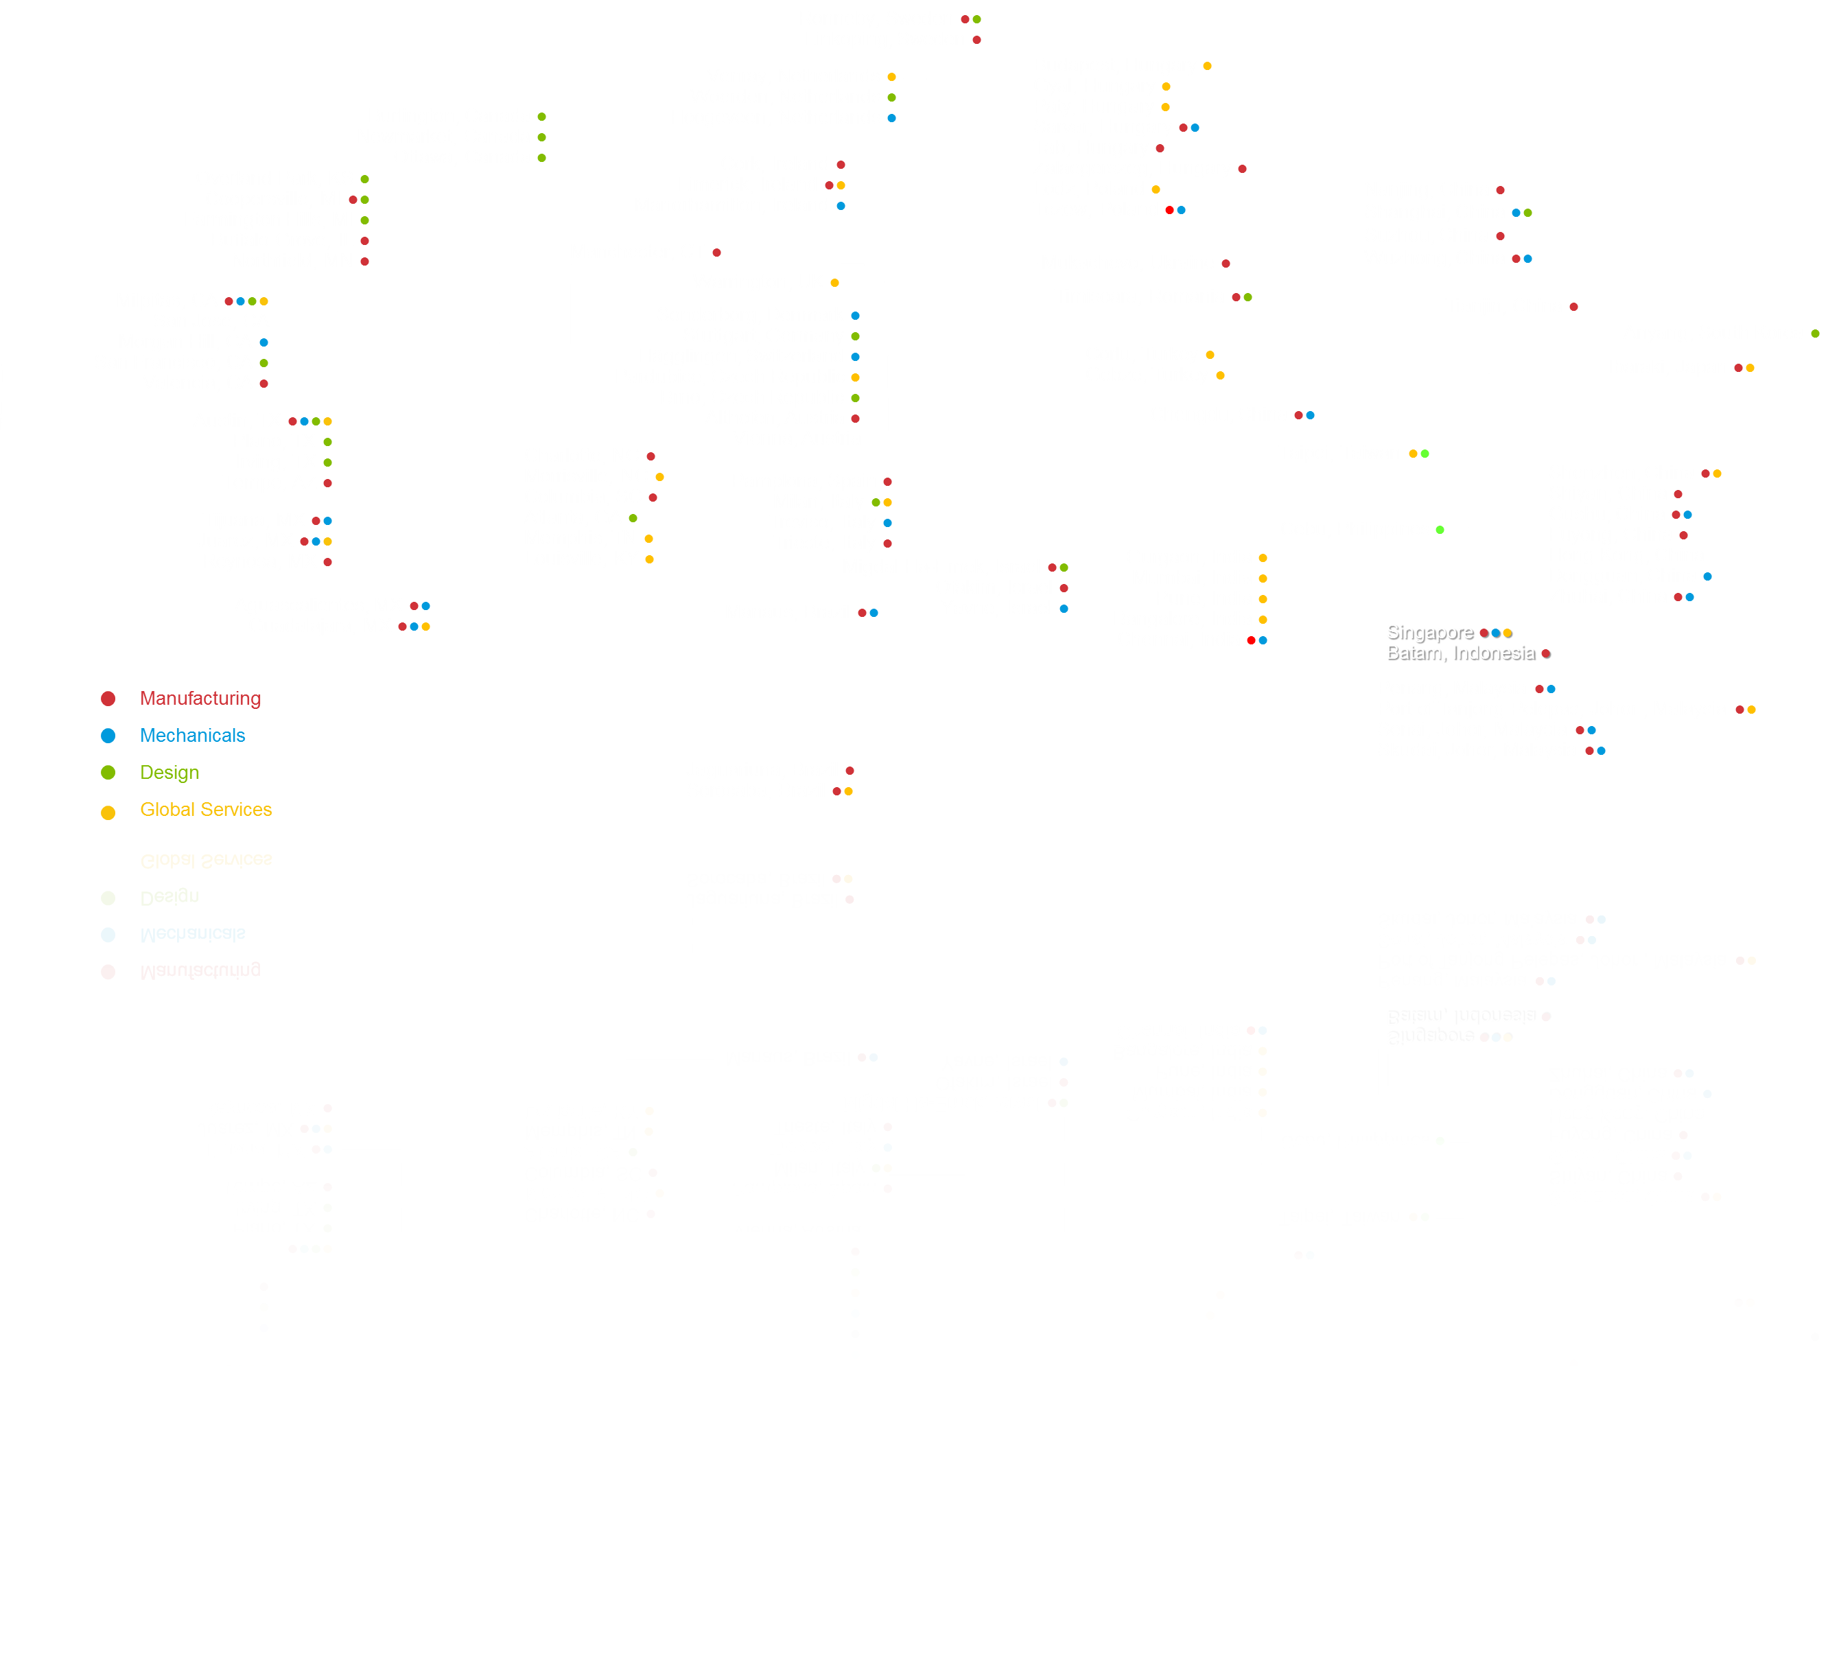
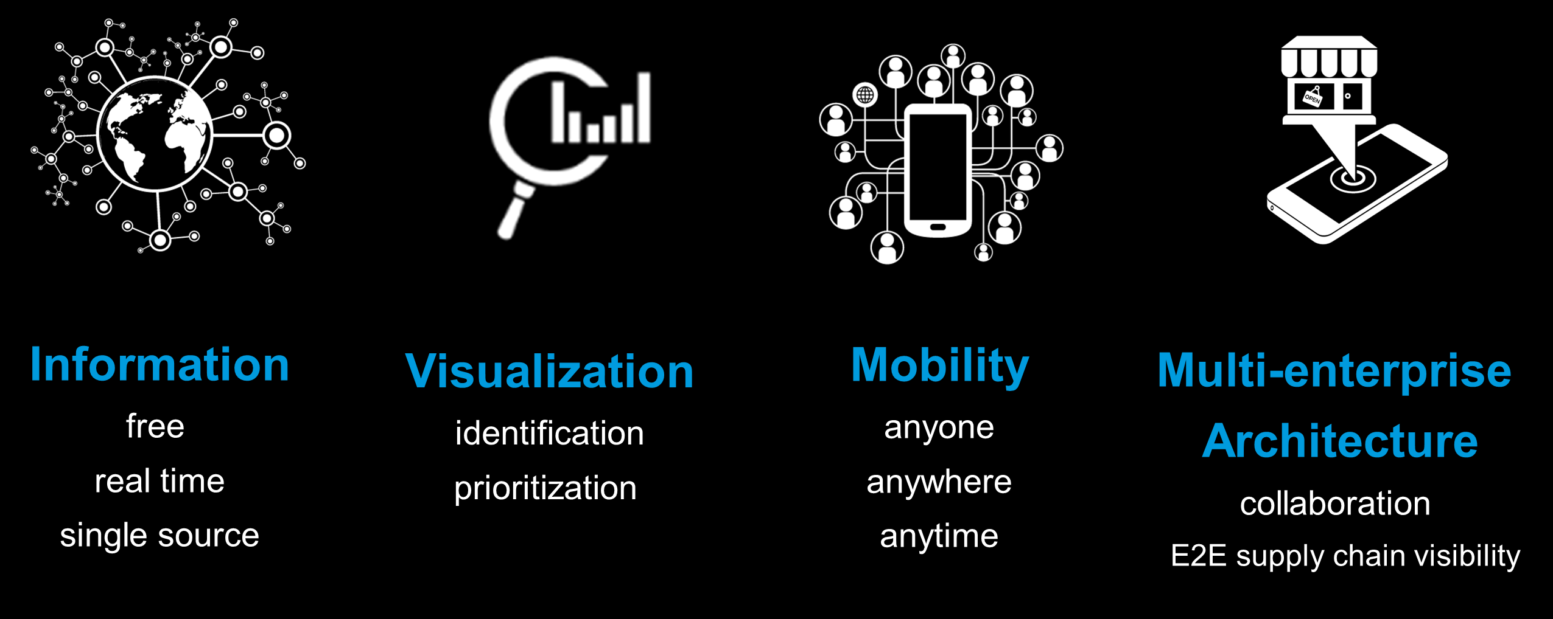
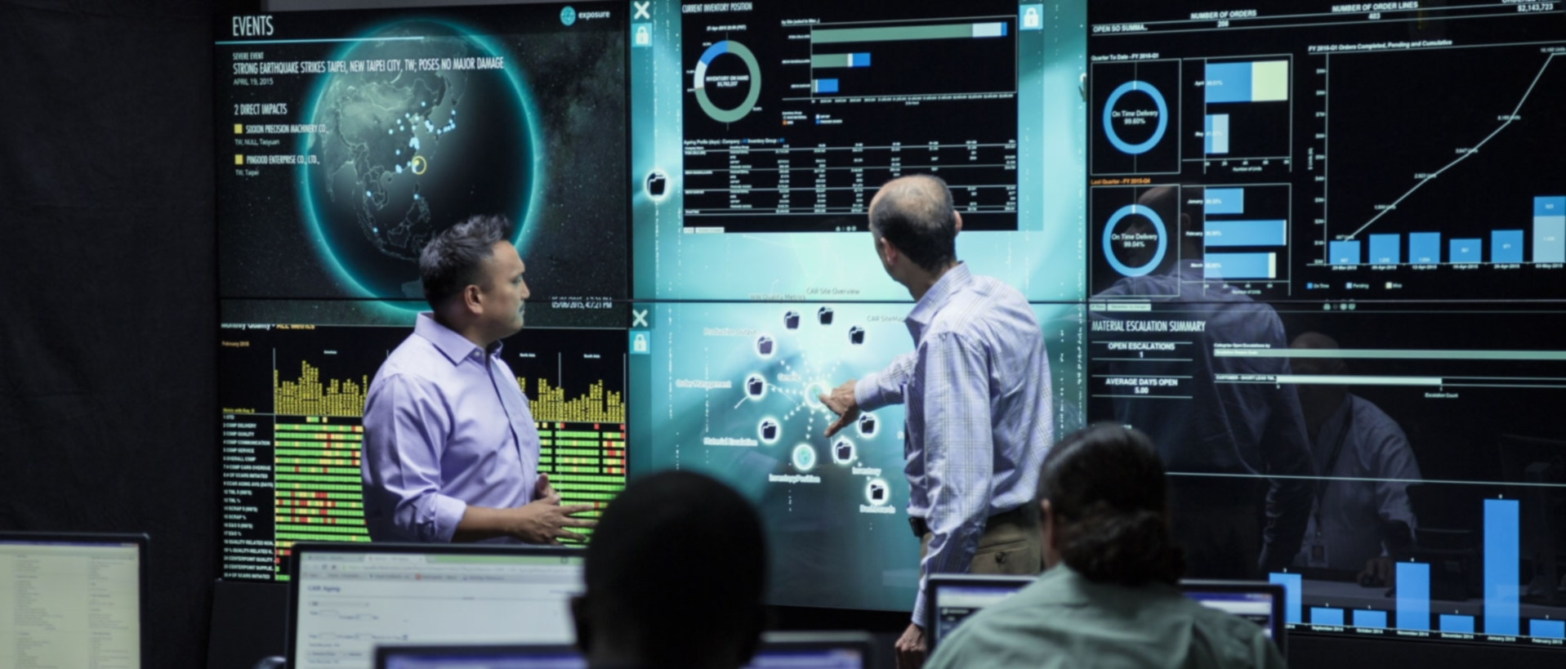
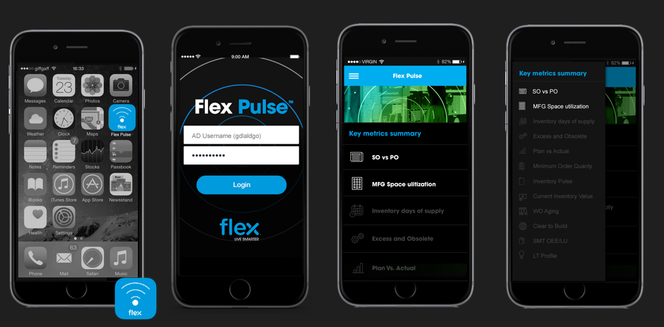
Flex Pulse Solution – as a platform
Available at all Flex Sites with Pulse Navigation Center via Global menu in PCs and Tablets
Flex Pulse Center Locations in San Jose HQ, Althofen, Austin, Chennai Guadalajara, Migdal HaEmek, Tzcew & Wuzhong.
Flex Pulse Mobile Application to available via Mobile Phone
Optional (Only Strategic Locations)
22

Slide 24
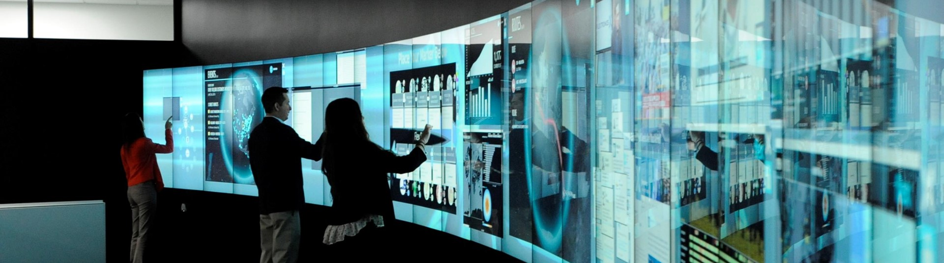
Flex Pulse – an experience and a system
Flex Pulse
8
Pulse
Centers
50+
Enterprise wide Deployed visualizations
+700
Campus
visits
7,000+
Individual
users

Slide 25
“This is the world we live in, if you are not real time, collaborative, mobile and multi-enterprise, you can’t survive”
– Mike McNamara. CEO Flex

Slide 26
Thank You

