Slide 1
Balancing visibility and vulnerability
Hugh Boyes CEng FIET CISSP
WMG Cyber Security Centre

Slide 2
Notes:
http://ltdmanagement.blogspot.co.uk/2015/09/internet-of-things-and-supply-chain.html

Slide 3
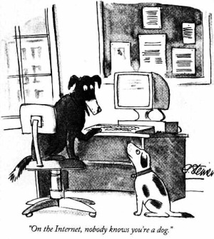
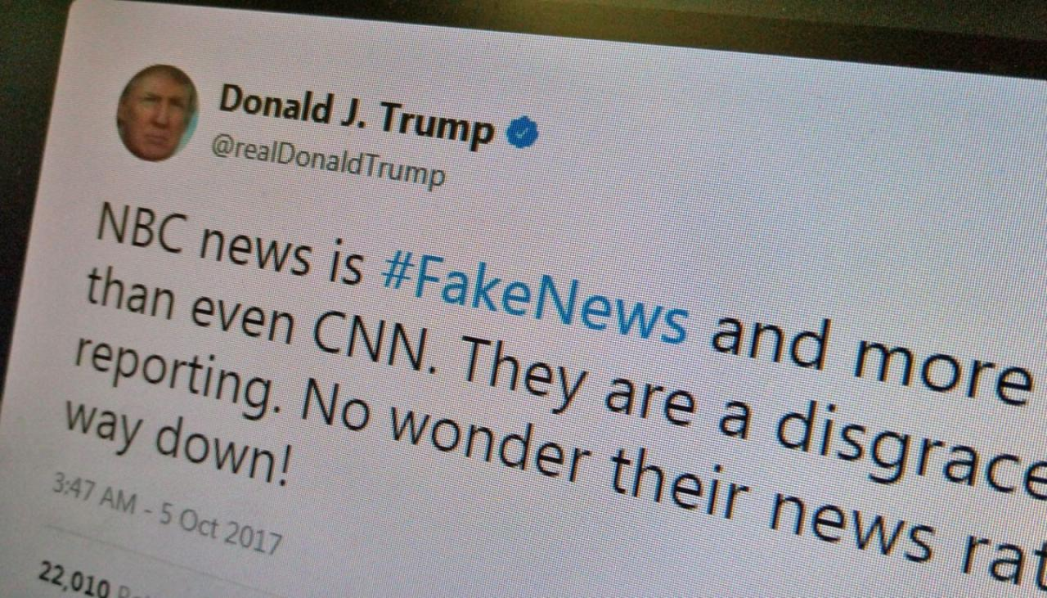
Due diligence required

Slide 4
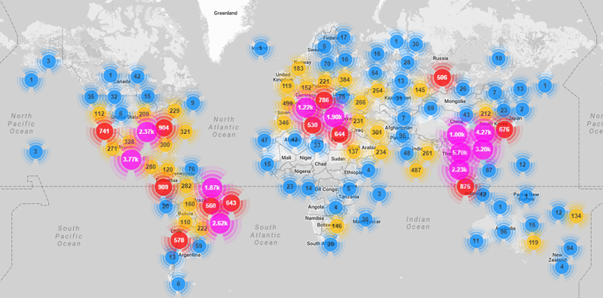
Spread of Malware

Slide 5
The connected supply chain
Notes:
http://www.electrondynamics.co.uk/wp/wp-content/uploads/2015/06/1.jpg

Slide 6
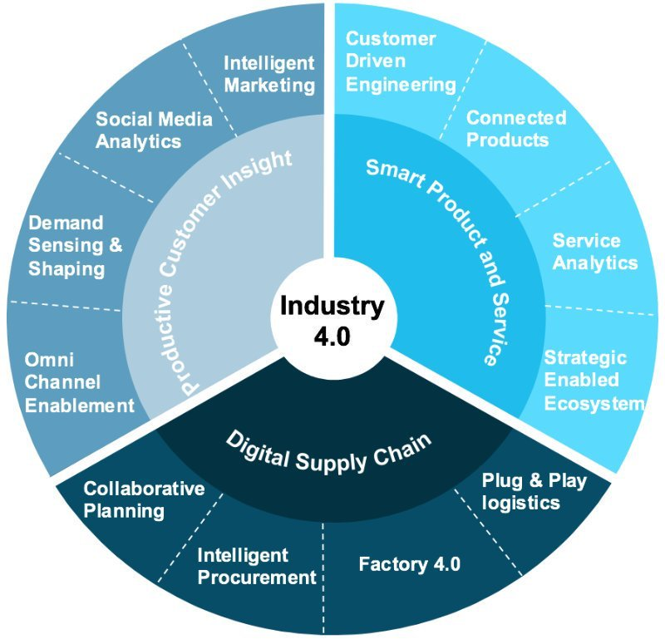
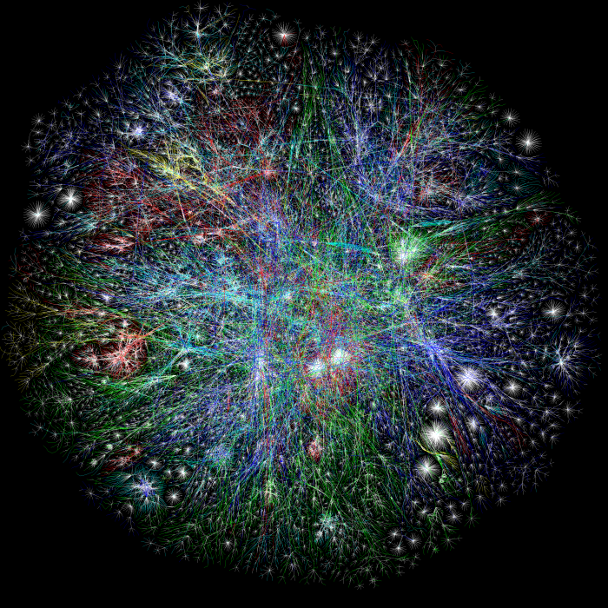
Complexity

Slide 7
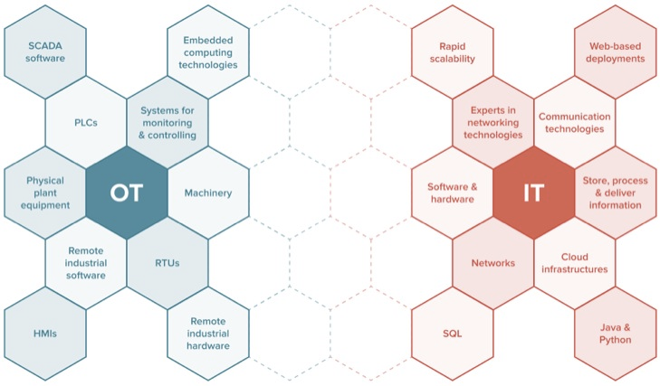
Technology Convergence
© 2010-2017 Published by IEB Media GbR
Source: http://www.iebmedia.com

Slide 8
Digital supply chain challenges
eCrime – phishing, fake website, counterfeit supplies
Protecting Intellectual Property (IP)
Information (Authenticity, Integrity, Availability, Utility) => Safety & Reputation
Insider threat (your company + supplier and partners) => Data protection, fraud,
Resilience & recovery

Slide 9
Hugh Boyes CEng FIET CISSP
Principal Engineer
WMG Cyber Security Centre
hb@warwick.ac.uk

