Slide 1

Weaving your web
Dr Christina Lima
University of Leicester
Linking, developing & supporting ELT professionals around the world

Slide 2


Slide 3
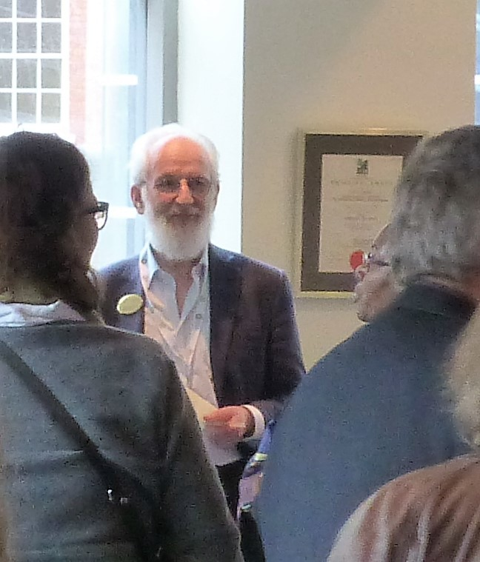
Overview
The importance of networking
Theories of networking
Starting and expanding your network
Associations and societies
IATEFL

Slide 4
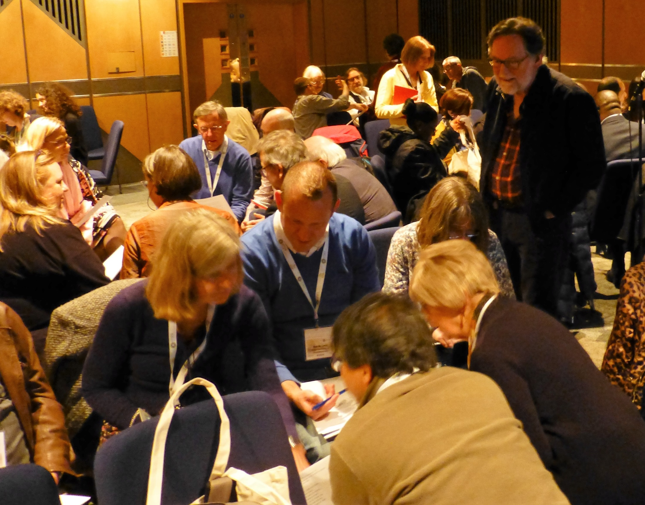
What is ‘networking’?
Why do people network?

Slide 5
The importance of networking
Professional improvement: mentoring, peer support, accountability and responsibility, leadership, innovation
Sharing resources: collaboration, financial feasibility, local and global expertise
Broadening opportunities: career advancement, research collaboration, continuing education

Slide 6

Theories of networking
Social capital (Lin, 1999)
Social movements (Hadfield, 2005)
Constructivist theory (Vygotsky, 1978)
Dialogism (Bakhtin, 1981)

Slide 7


Slide 8
Differences between Vygotsky and Bakhtin
Vygotsky’s sociohistorical approach | Bakhtin’s dialogical approach
Deeply instrumental Implies potential transparency Knowledge gap as deficit Learning through the mediation until independence is achieved | Essentially ontological Based on the principle of the non-transparency of human consciousness Knowledge gap as a necessary condition for learning Deep learning as ontological engagement and never-ending process

Slide 9

Your own network

Slide 10
Getting started
Write down the names of three:
Colleagues in your course
Lecturers in your university
Academics from other institutions
Scholars and experts in your field
Professional and academic networks and associations
New people you met today

Slide 11
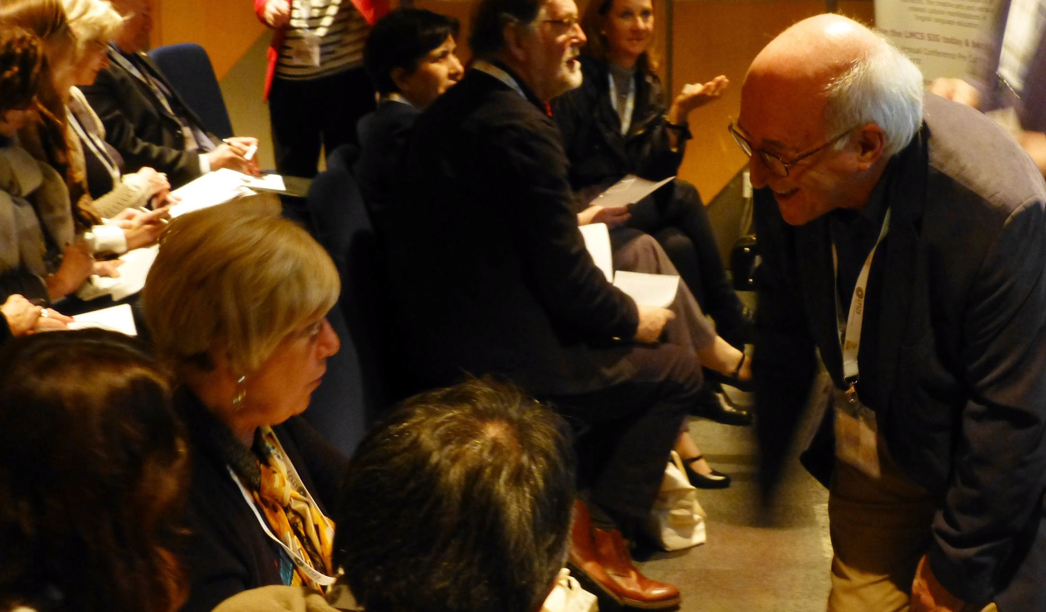
Discuss

Slide 12
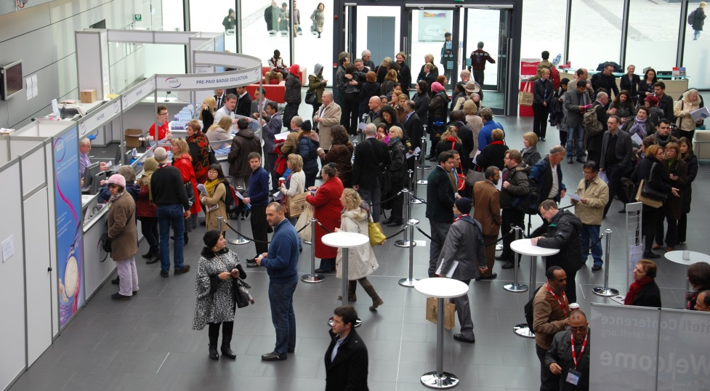

International
Association of
Teachers of
English as a
Foreign
Language

Slide 13

Mission statement
To link, develop and support English language teaching professionals around the world.

Slide 14
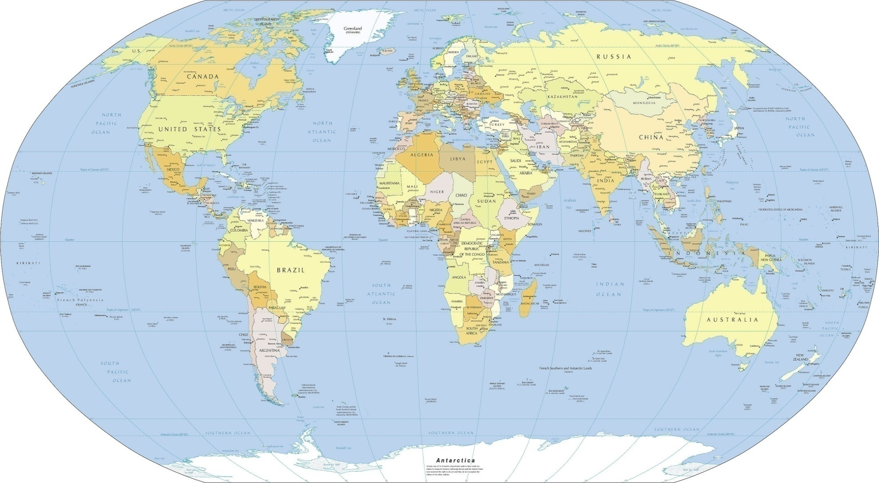
Linking, developing & supporting ELT professionals around the world
Members live in...
Over 100 countries, in every continent - from Australia to Norway, from Poland to Zambia.
Map downloaded from: www.nationsonline.org/

Slide 15
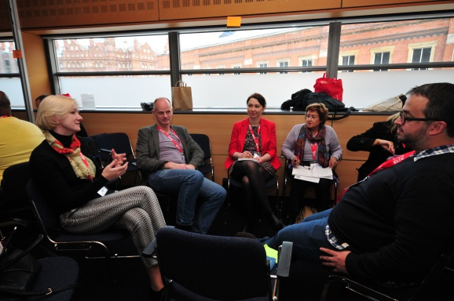
Linking, developing & supporting
Teachers & teacher educators
Researchers
Administrators & academic managers
Writers & publishers
Language assessors
Examination boards
Consultants
You!

Slide 16
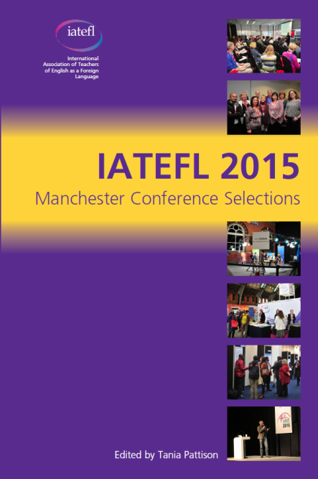

We link, develop & support through
Annual Conference
Scholarships
16 Special Interest Groups (SIGs)
Newsletters & publications
Online webinars & discussion groups
Facebook & Twitter
A monthly eBulletin
Teacher Associations

Slide 17
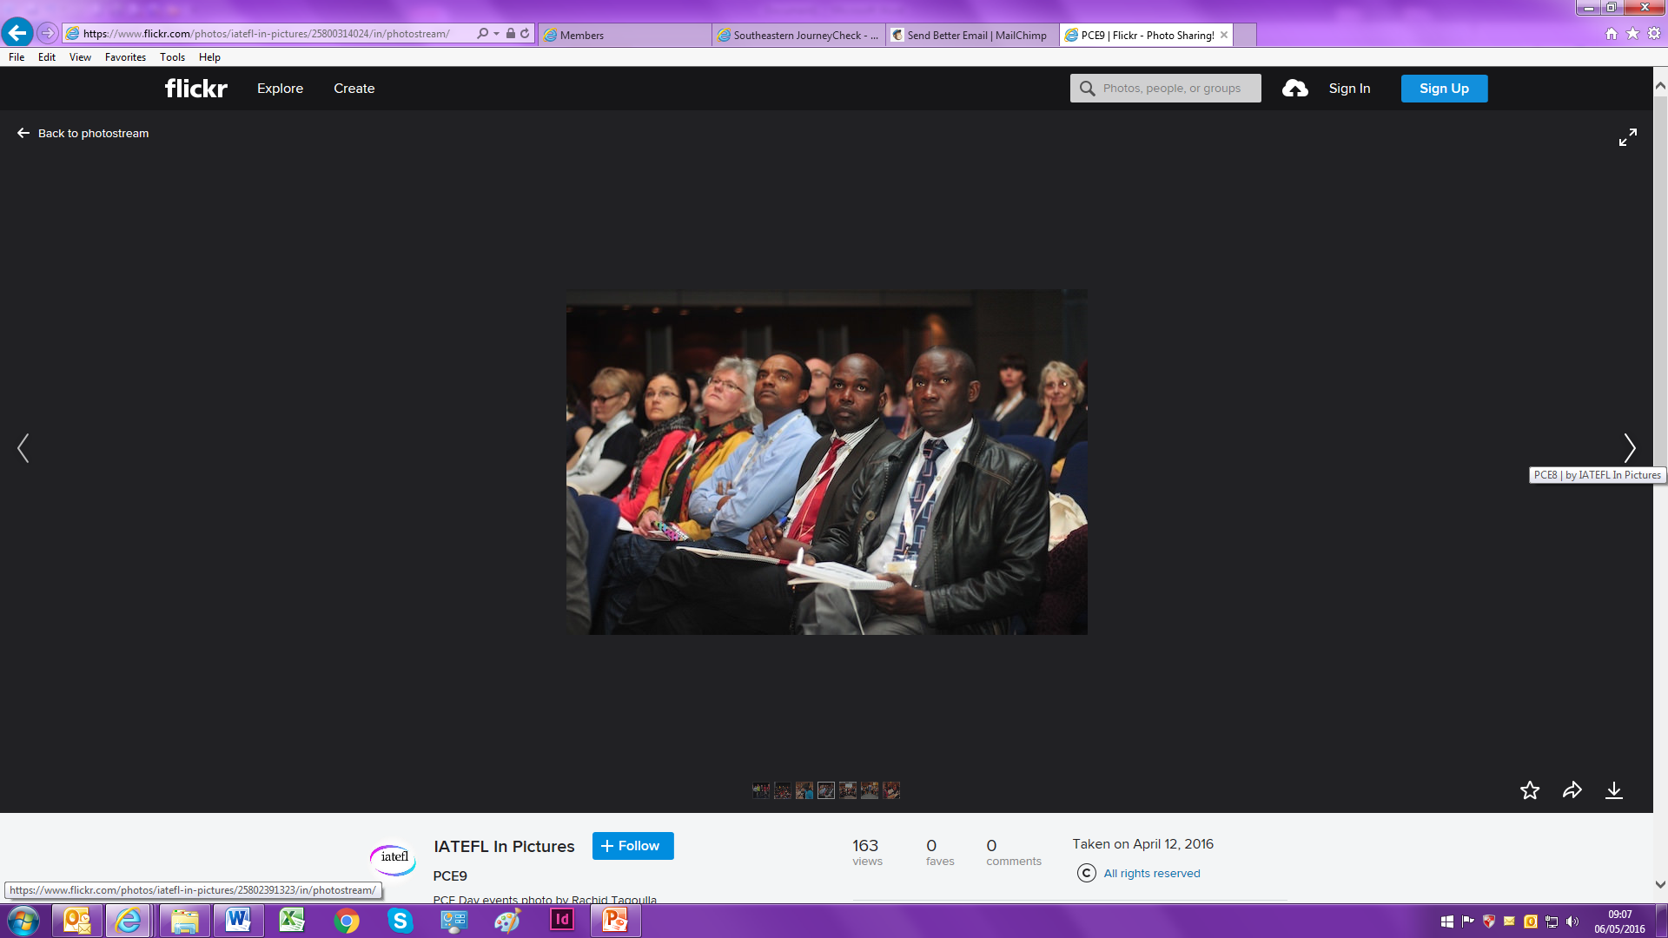
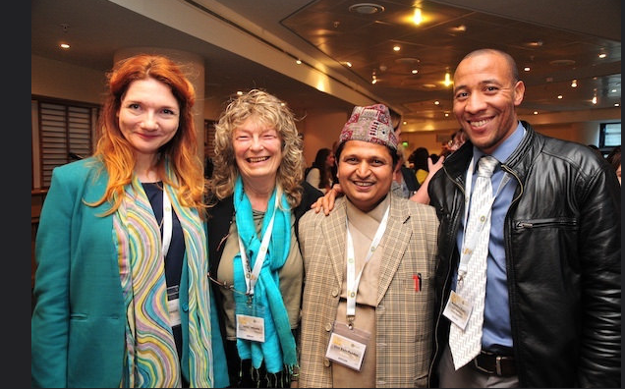
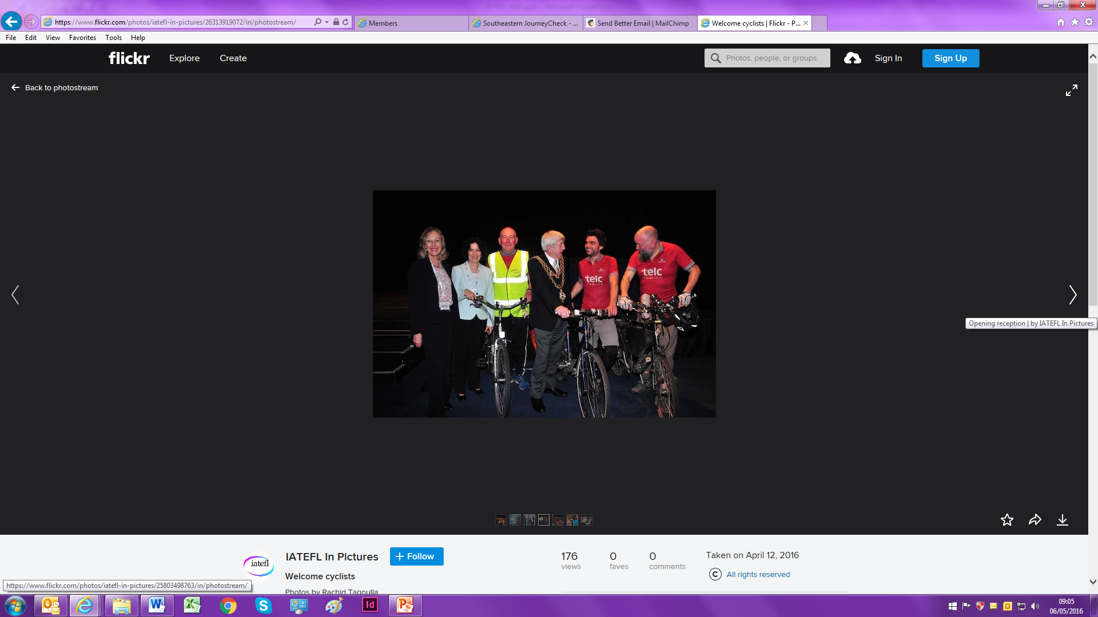
The Annual Conference
Exchange ideas with colleagues from all sectors of ELT
See the latest ELT publications and services from more than 60 exhibitors
Join our online conference
Apply for scholarships to attend

Slide 18
Special Interest Groups (SIGs)
Are an integral part of IATEFL which:
Unite you with other members who share special area(s) of interest
Enable you to benefit from information, news, developments and events in your special area(s) of interest

Slide 19








Special Interest Groups (SIGs)
Business English (BE)
ES(O)L
English for Specific Purposes (ESP)
Global Issues (GI)
Inclusive Practices & SEN (IP&SEN)
Leadership & Management (LAM)
Learner Autonomy (LA)
Learning Technologies (LT)
Literature, Media & Cultural Studies (LMCS)

Slide 20




Special Interest Groups (SIGs)
Materials Writing (MaW)
Pronunciation (Pron)
Research (Res)
Teacher Development (TD)
Teacher Training & Education (TTEd)
Testing, Evaluation & Assessment (TEA)
Young Learners & Teenagers (YLT)

Slide 21
Literature SIG
We focus on teaching and researching in the areas of literature and language, extensive reading and the Arts.
Our objective is to promote the teaching and use of literature, extensive reading, and the creative arts in English language education.

Slide 22

Join us!
Publications
Events
Dedicated websites
Social media interaction
Online teacher training courses
Network opportunities!

Slide 23
IATEFL & Networking
Meet the experts around the world with the biggest say in the development of English language education
Keep in touch with the latest developments in language teaching around the world
Promote and share your own ideas about teaching & learning English around the world

Slide 24
Further reading
Bakhtin, M. M. (1981). The Dialogic Imagination. (M. Holquist, Trans.). Austin, TX: University of Texas Press.
Matusov, E. (2011). Irreconcilable differences in Vygotsky’s and Bakhtin’s approaches to the social and the individual: An educational perspective. Culture & Psychology, 17(1), 99–119.
Muijs, D., West, M., & Ainscow, M. (2010). Why Network? Theoretical Perspectives on Networking. School Effectiveness and School Improvement, 21(1), 5–26.

Slide 25
Thank you!
chrislima90@yahoo.co.uk
http://chrislima90.weebly.com

