Slide 1
What does sustainable teacher development look like now?
Richard Smith, University of Warwick, UK
BELTA 10th International Conference, on ‘Sustainable Approaches to English Language Education in a Changing World’, 18–19 November, ULAB, Dhaka

Slide 2
[planned February 2020 BELTA conference: English Language Education for Sustainable Development]
‘Bangladesh has been going through a period of rapid and apparently successful development and is now pursuing further priorities, related to the United Nations Sustainable Development Goals (SDGs) for 2030.'
[This conference] Sustainable Approaches to English Language Education in a Changing World
’Prior to the pandemic, Bangladesh was going through a period of rapid and apparently successful development. However, the world has faced and is facing various crises, and sustainability of development has become a kind of mantra.’
Khan, R., Bashir, B., Basu, B.L. & Uddin, M.E. (eds.) (in press). Local Research and Glocal Perspectives in English Language Teaching: Teaching in Changing Times. Springer.

Slide 3
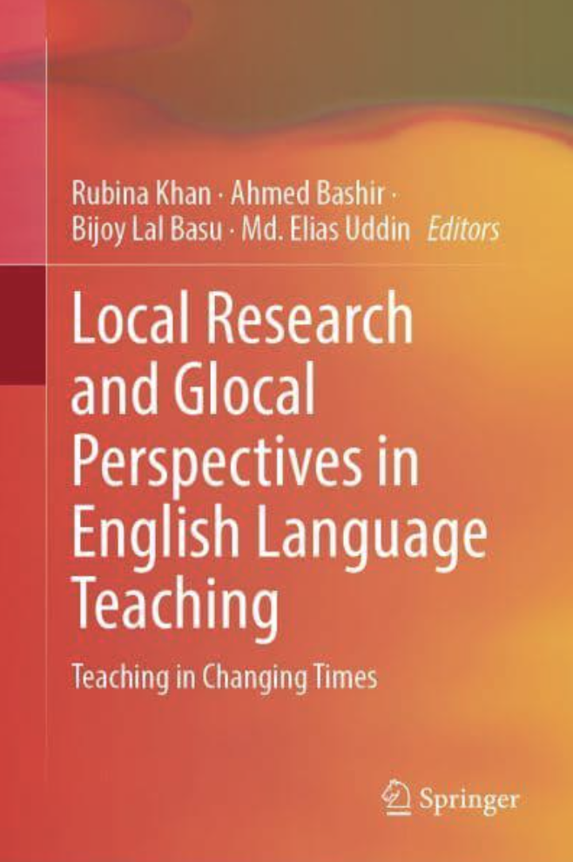

Slide 4
What does sustainable teacher development look like now?
[Conference on ‘Sustainable Approaches to English Language Education in a Changing World’]

Slide 5
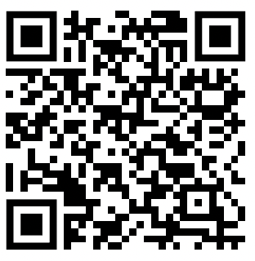
Outline
What is ‘sustainable development’, in relation to English language education?
Teaching in difficult circumstances, revisited
An enhancement approach to teacher development
Promoting teacher-research – and teacher association research
Decentring ELT
https://warwick.ac.uk/richardcsmith/belta/

Slide 6
1. What is ‘sustainable development’, in relation to English language education?

Slide 7
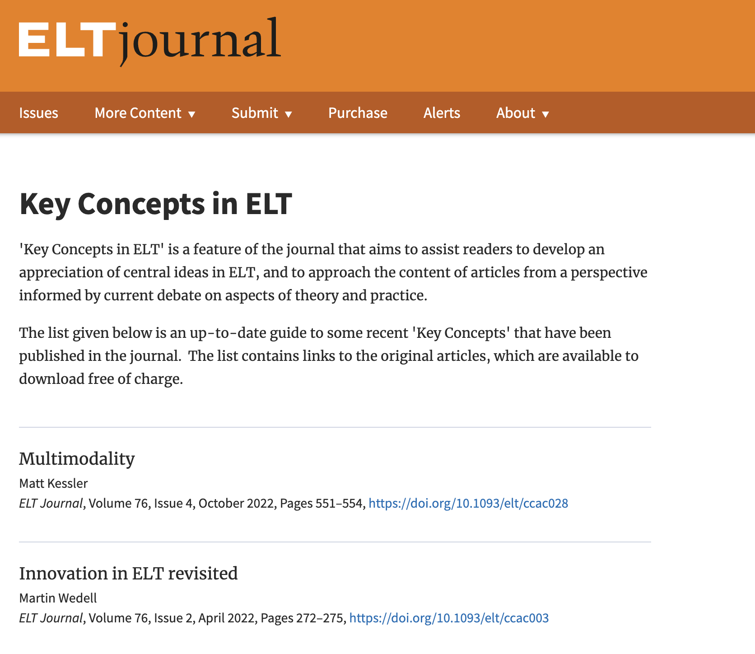
'Sustainability’ – a key concept

Slide 8
From macro- to micro-
Sustainable economic development / UN sustainable development goals
Sustainable ‘international development’ (projects) / Sustainable innovation, in general
Sustainable teacher development

Slide 9
1. Sustainable economic development / UN sustainable development goals (SDGs)
“maximiz[ing] goals across [biological, economic and social] systems through an adaptive process of trade-offs” (Barbier, 1987, p. 104)
“meeting the needs of the present without compromising the ability of future generations to meet their own needs.” (UN, 1987)

Slide 10
The UN SDGs, to be achieved by 2030, include: [1] no poverty; [2] zero hunger; [3] good health and well-being; [4] quality education; [5] gender equality; [6] clean water and sanitation; [7] affordable and clean energy; [8] decent work and economic growth; [9] industry, innovation, and infrastructure; [10] reduced inequality; [11] sustainable cities and communities; [12] responsible consumption and production;[13] climate action; [14] life below water; [15] life on land;[16] peace, justice, and strong institutions;[17] partnership to achieve the goals.

Slide 11
Sustainable ‘international development’ (projects) / Sustainable innovation, in general
Al Amin & Greenwood (2018) discuss SDGs in the Bangladesh context. They summarise that:
“Sustainability is a multi-faceted concept. In contemporary discourses […] it encompasses concern about the future of our planet and its natural resources, concern about the preservation of particular habitats and the life forms within them, preservation of the human race, and the preservation of the quality of life as it is currently experienced. The concept of sustainability also addresses the issue of whether initiatives and practices have the capacity for continuation. Overall sustainability is concerned with the future and with what needs to be done to ensure well-being in the future.” (p. 118)

Slide 12
“The present model of teacher training is arguably unconducive to a system of sustainable teacher development. If the targets nominated in Sustainable Development Goal 4 are to be assessed by any means beyond the statistical reporting of enrolments, then quality systems of preservice education and continuing professional development of teachers are urgently needed.”
Al Amin & Greenwood (2018)

Slide 13
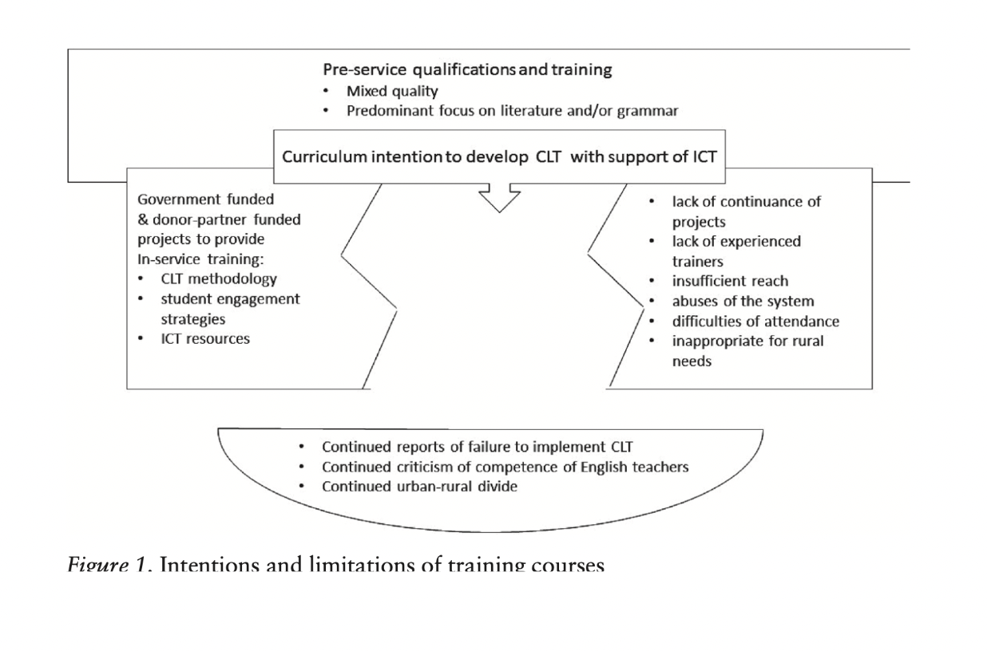
From Al Amin & Greenwood, 2018

Slide 14
3. Sustainable development in English language education / teacher development
being ecologically appropriate, i.e. well-adapted to context (as a precondition for effectiveness)
being constructively resistant to ‘reality checks’ over time / having long-lasting effectiveness
As opposed to … (inappropriate outside-in / top-down reform efforts)?

Slide 15
Zehetmeier & Krainer (2010), writing on mathematics education, argue that the main goal of sustainability is empowerment. They suggest that: “In this sense, sustainability means that individuals and institutions (a) are able to react autonomously to changing conditions and (b) create and use processes and products to meet these conditions.” (p. 878)
Allwright (1997): “without sustainability nothing of value is going to be happening in the long term”. He refers to the importance of teachers developing a “research perspective” as a result of teacher-research, which he defines as “an ongoing concern for understanding” (p. 370)

Slide 16
2. Teaching English in difficult circumstances, revisited (again!)

Slide 17

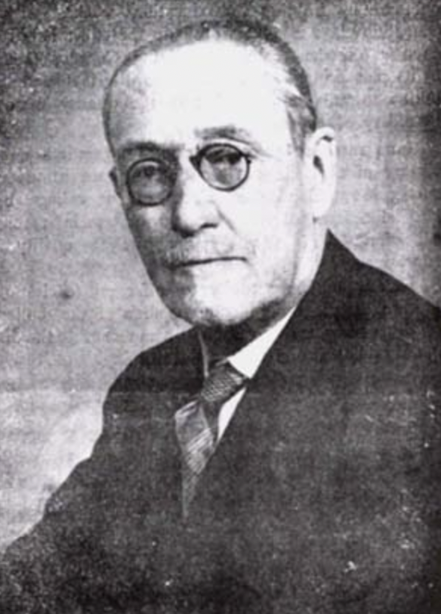
Michael West (1888–1973)

Slide 18
Michael West’s Teaching English in Difficult Circumstances (1960)
“over 30 pupils (more usually 40 or even 50), congested on benches […,] ill-graded, with a teacher who perhaps does not speak English very well […], working in a hot climate.” (p. 1)
“The problem is one which has of late tended to become exacerbated owing to the rapid spread of education in these areas, too rapid for the supply of buildings and teachers to catch up with the number of pupils, and owing to the spread of education over a larger proportion of the population”. (ibid.)

Slide 19
Alternative labels
‘Teaching in low-resource classrooms’
‘Teaching in large classes’
‘Teaching in difficult circumstances’
‘Teaching in challenging contexts’
‘Teaching in public education systems in relatively low-income countries’

Slide 20
From Anderson, Padwad & Smith (2021)
“’Teaching in difficult circumstances’ (TiDC) refers to teaching in contexts where a number of challenging factors are present (cf. West, 1960). These may include:
large classes, typically over 40 learners
a lack of basic resources, including textbooks, furniture, stationery, electricity, and even suitable classrooms
low school readiness of learners
inadequate pre-service and in-service training and support for teachers
excessive workload for teachers and other staff.”

Slide 21
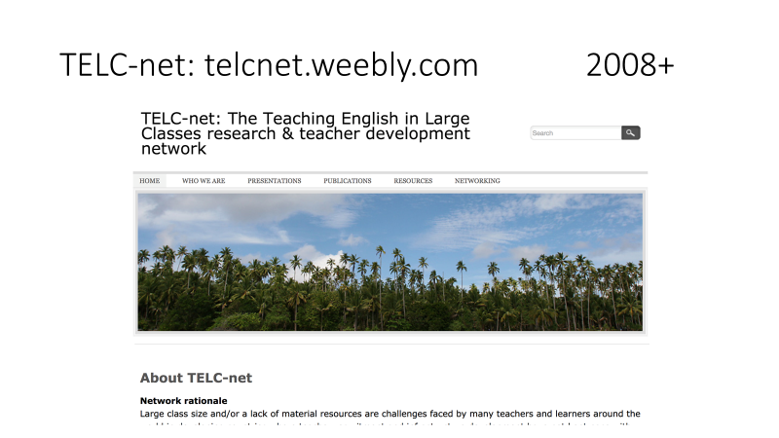

Slide 22
TELCnet research principles
1) Don’t see small-class teaching as the norm and teaching in low-resource contexts / large classes as a ‘problem’. Instead, start with descriptions of practice, in particular ‘good practice’ as perceived by teachers and students themselves
2) Focus on issues of practical concern to teachers themselves – support teachers to develop appropriate methodology ‘from the bottom up’, for example through practitioner research.
3) Qualitative, exploratory ‘case study’ / story-based approach
(Smith 2011)

Slide 24
Source: http://telcnet.weebly.com/

Slide 25
Emergency remote teaching: another form of ‘difficult circumstance’?
Source:
https://www.techedmagazine.com/the-difference-between-emergency-remote-teaching-and-online-learning/

Slide 26
But there are ‘super-difficult circumstances’ (Phyak, 2015)
Source: http://eltchoutari.com/2015/08/the-photography-project-education-in-emergencies/

Slide 27
Source: https://thelogicalindian.com/amp/news/kerala-student-attends-classes-on-roof-for-better-internet-connectivity-21522

Slide 28
3. An enhancement approach to teacher development

Slide 29
'[W]e have to find, not the best that can be done, but what can best be done; and the place of the explorer of this problem is not at the front of the class showing what he can do, but at the back of the class, a big class, in a bad classroom on a hot and steamy day, watching what a not-too-competent teacher can best achieve. If [s]he can do it under these circumstances, others can’.
(West 1960: 5)

Slide 30
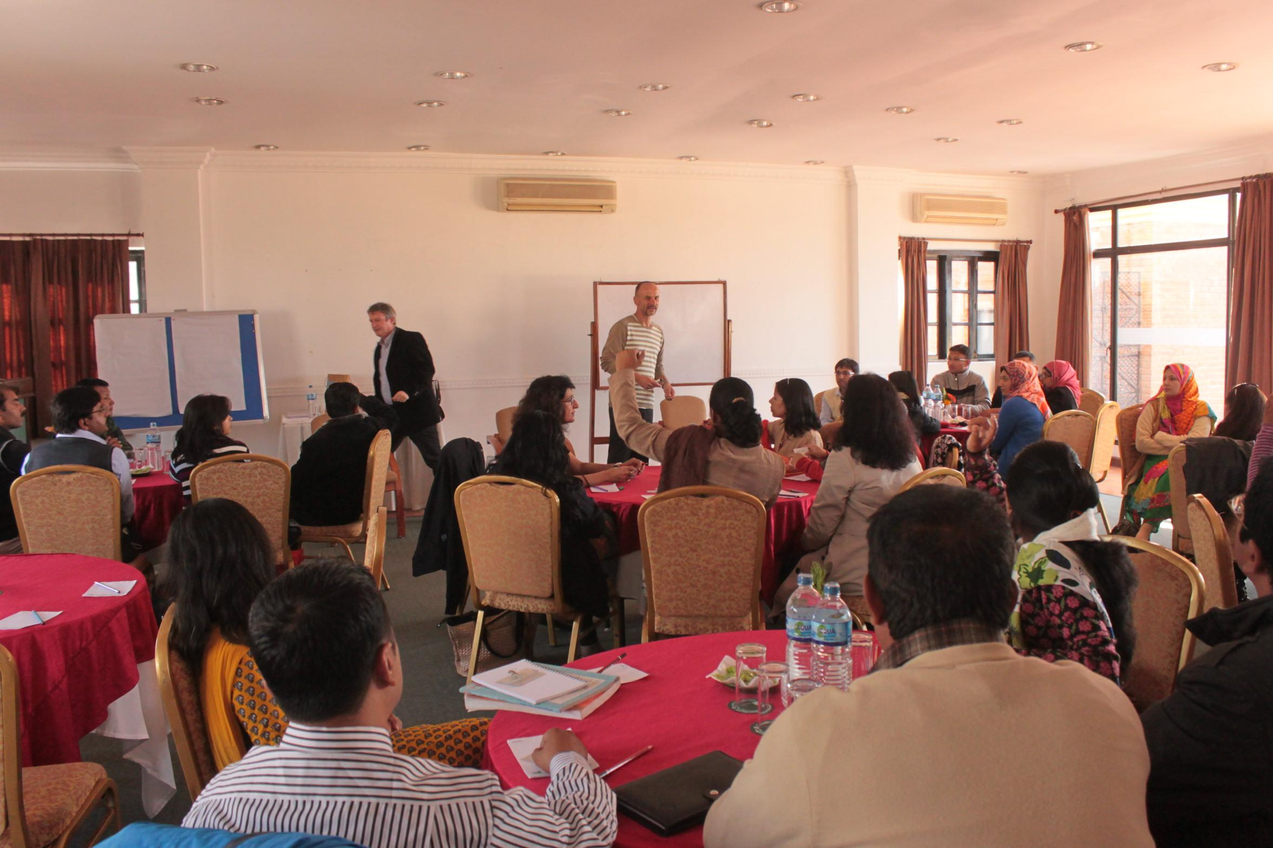
Hornby Regional Workshop on ‘Teaching in low-resource classrooms’, Kathmandu 2013

Slide 31
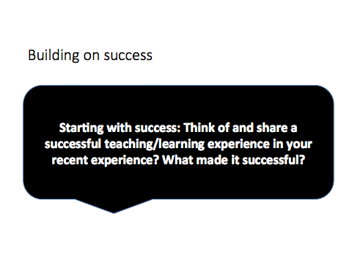

Slide 32
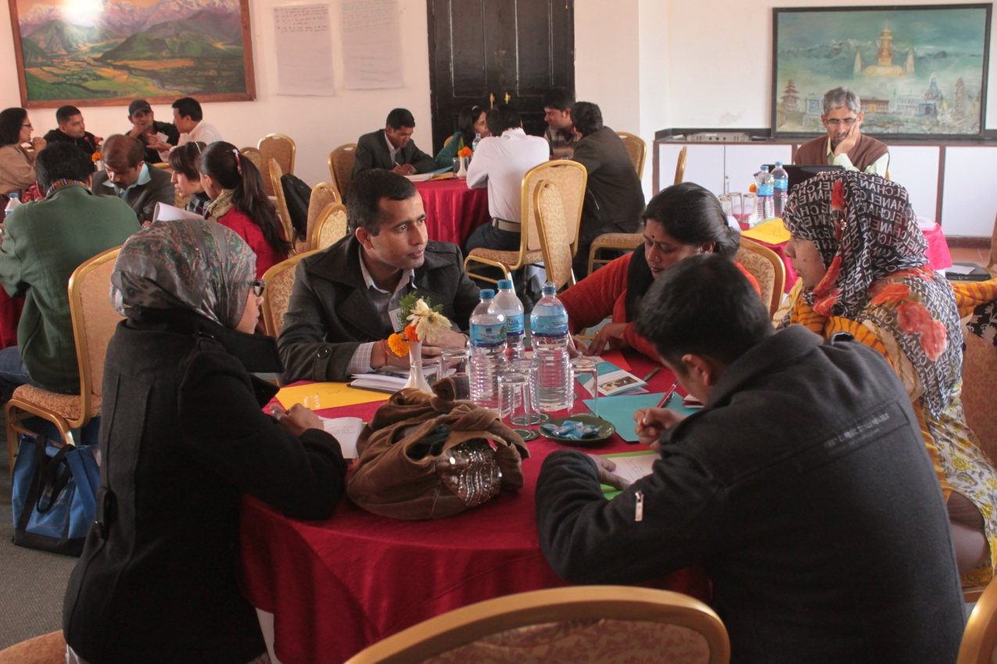

Slide 33
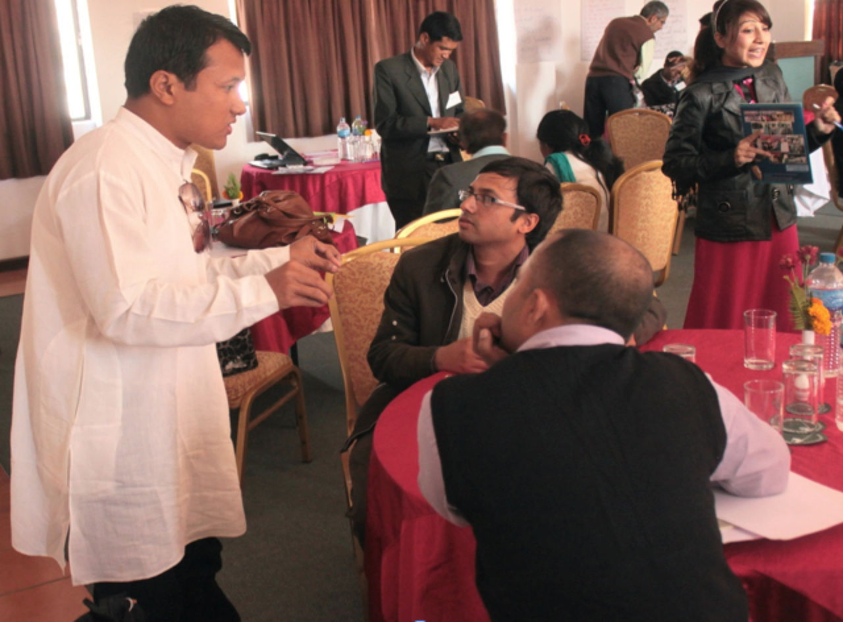

Slide 34
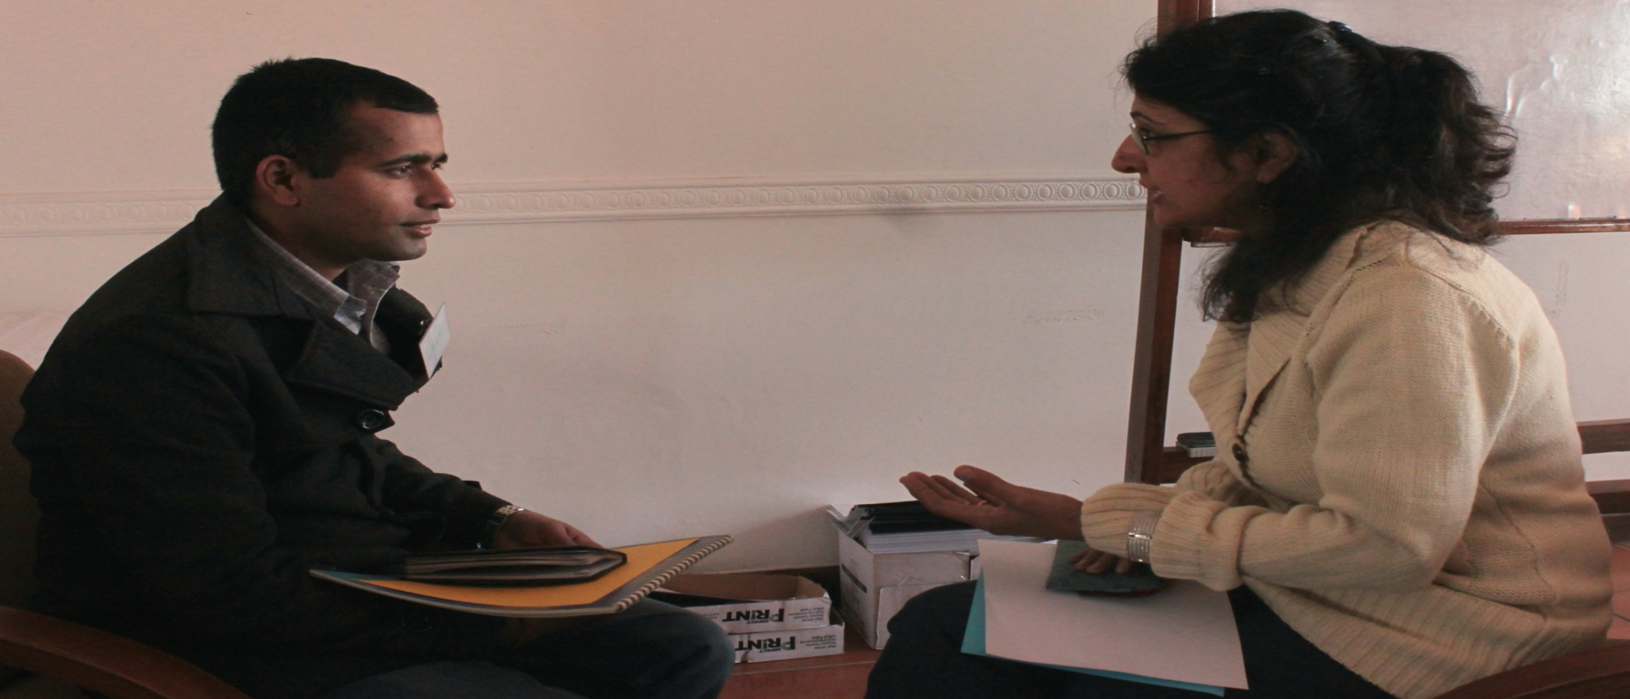

Slide 35
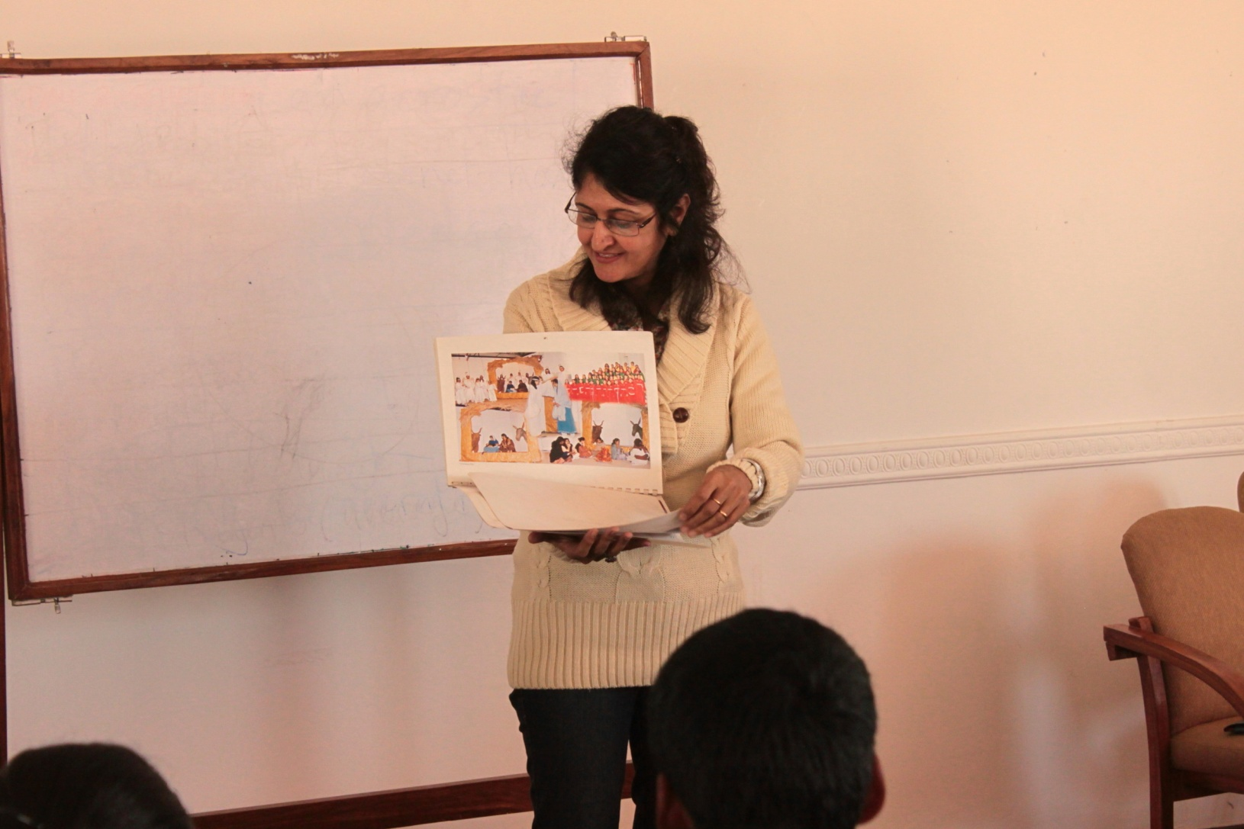

Slide 36
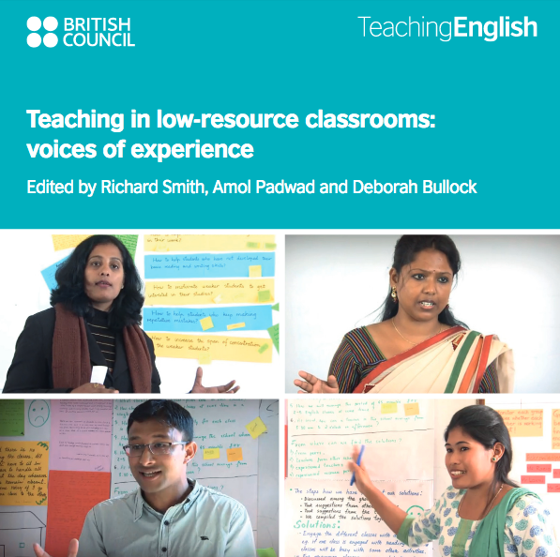

Slide 37
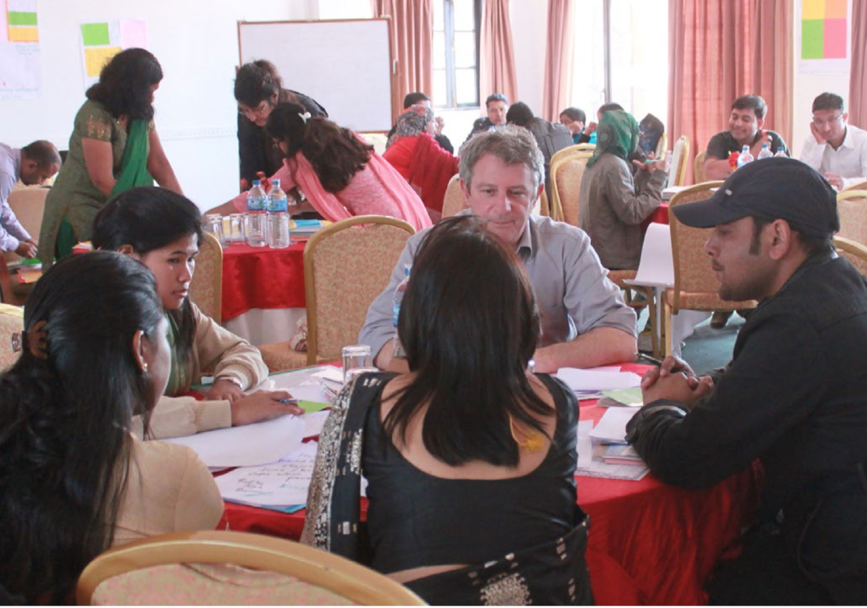
Notes:
I’ll use this to say ‘that’s enough from my perspective’ and what today’s presentation is realy about is how the approach hs taken on a life of its own due to Sagun’s work (Sagun sitting in the back in this photo - now over to you!)
Okay Richard.

Slide 38
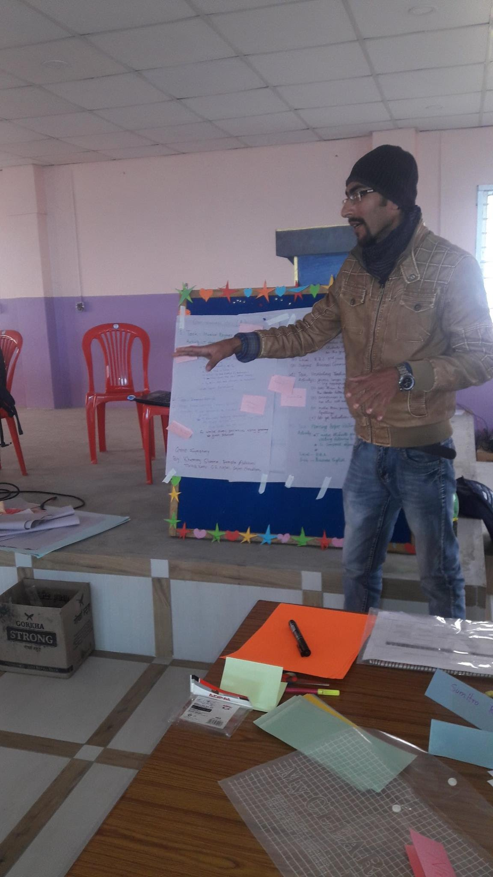
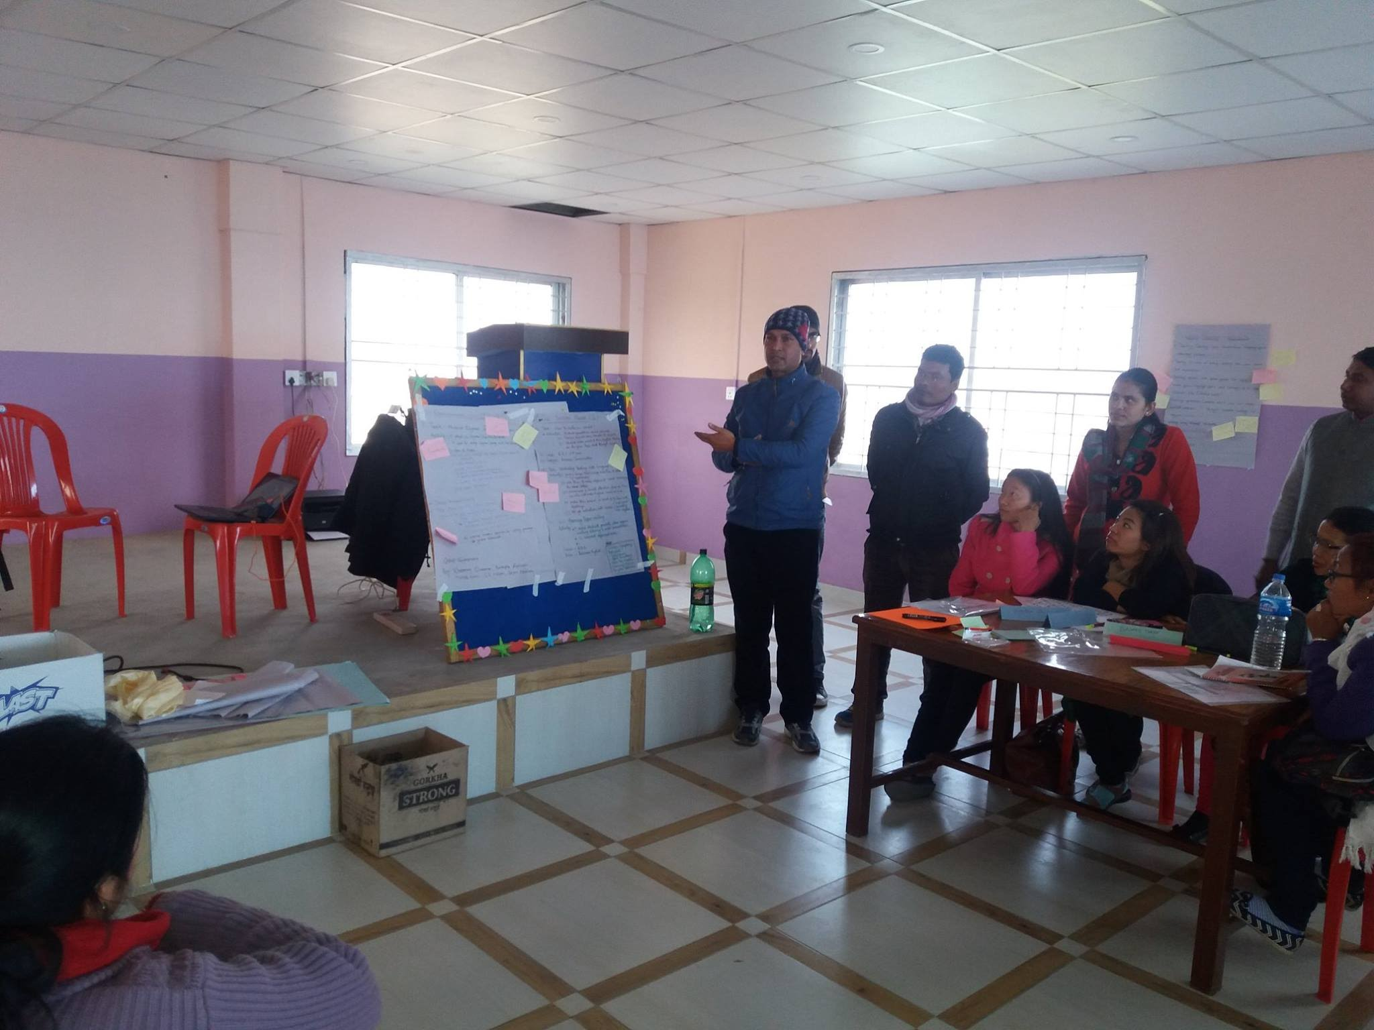
Sagun Shrestha adopted this approach in his teacher training in Nepal
It proved to be an effective model

Slide 39
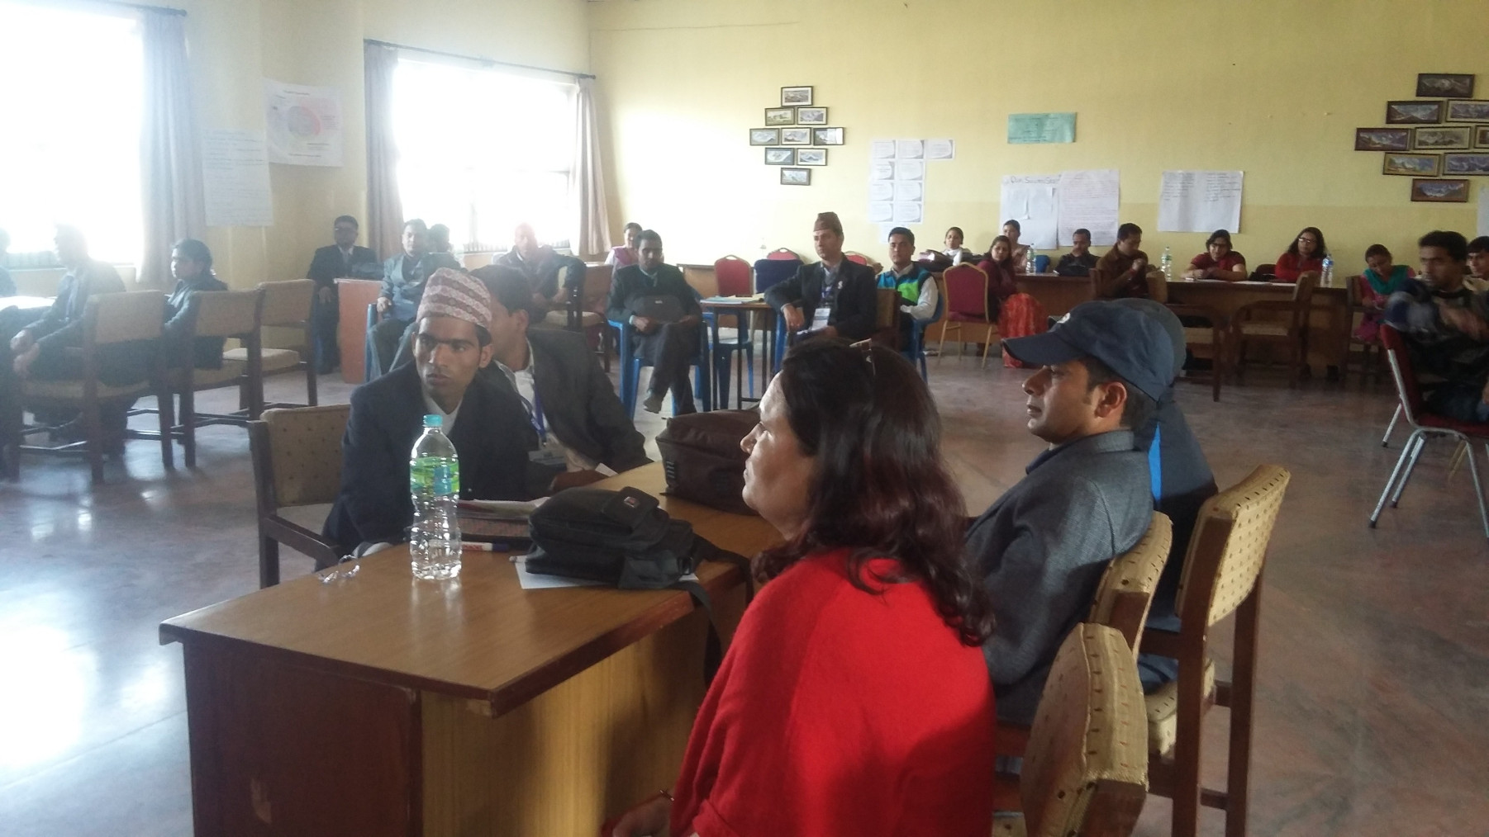
Further developments
‘NELTA ELT Clinic’ at the 23rd International Conference of NELTA (Nepal English Language Teachers Association) - 2015
Notes:
Add year of the conference

Slide 40
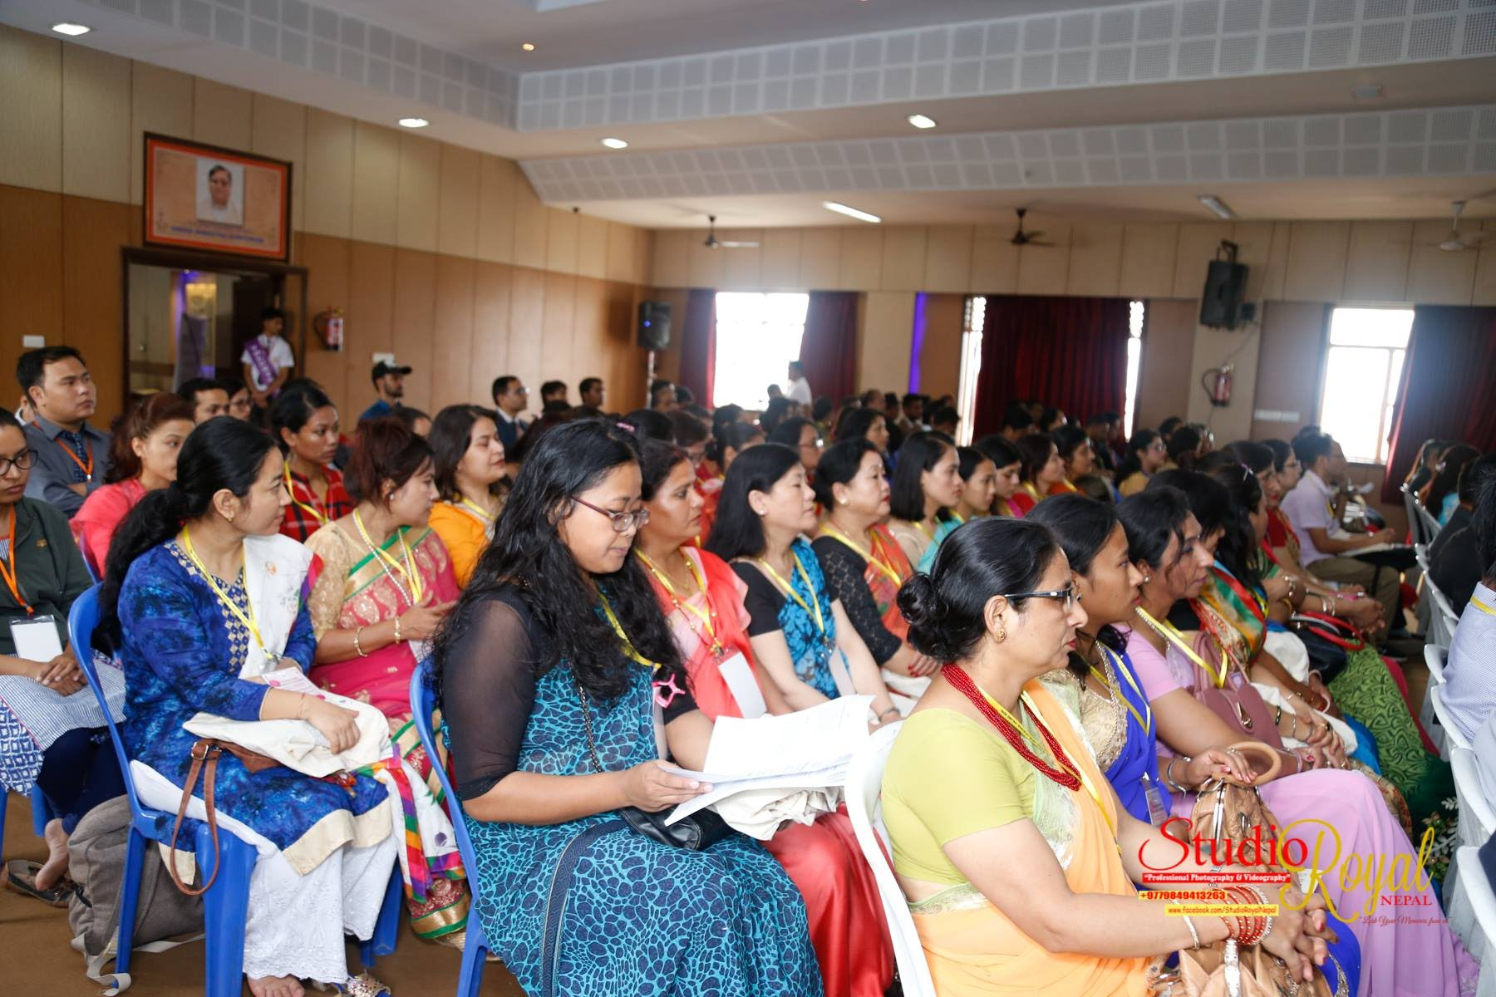
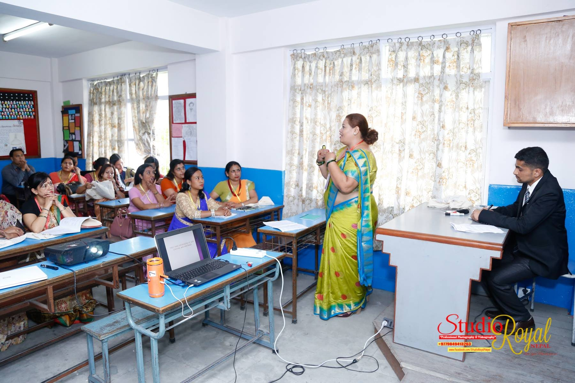
Success story conferences in 2018 and 2019 (Kathmandu)

Slide 41
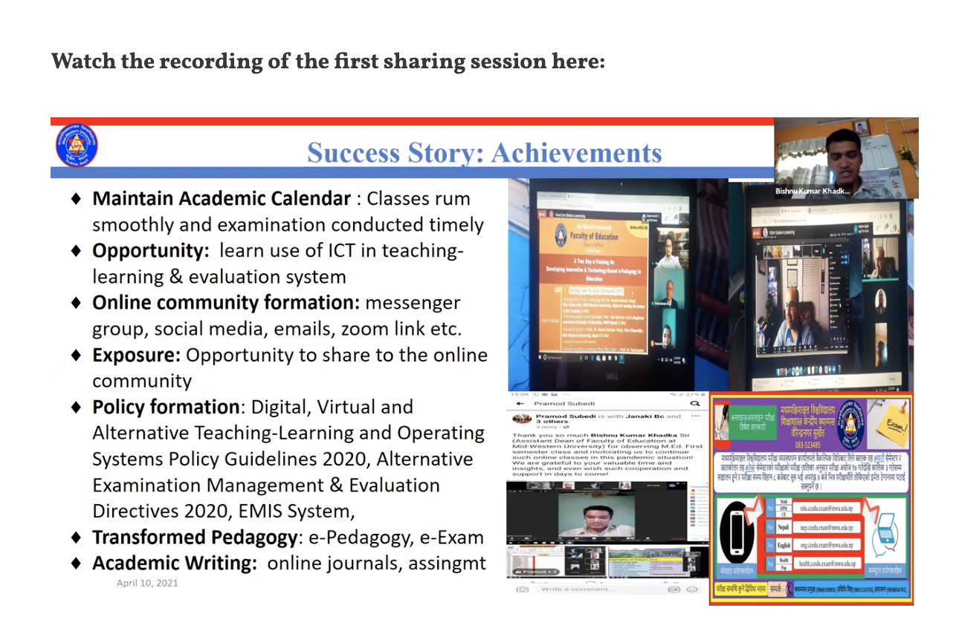
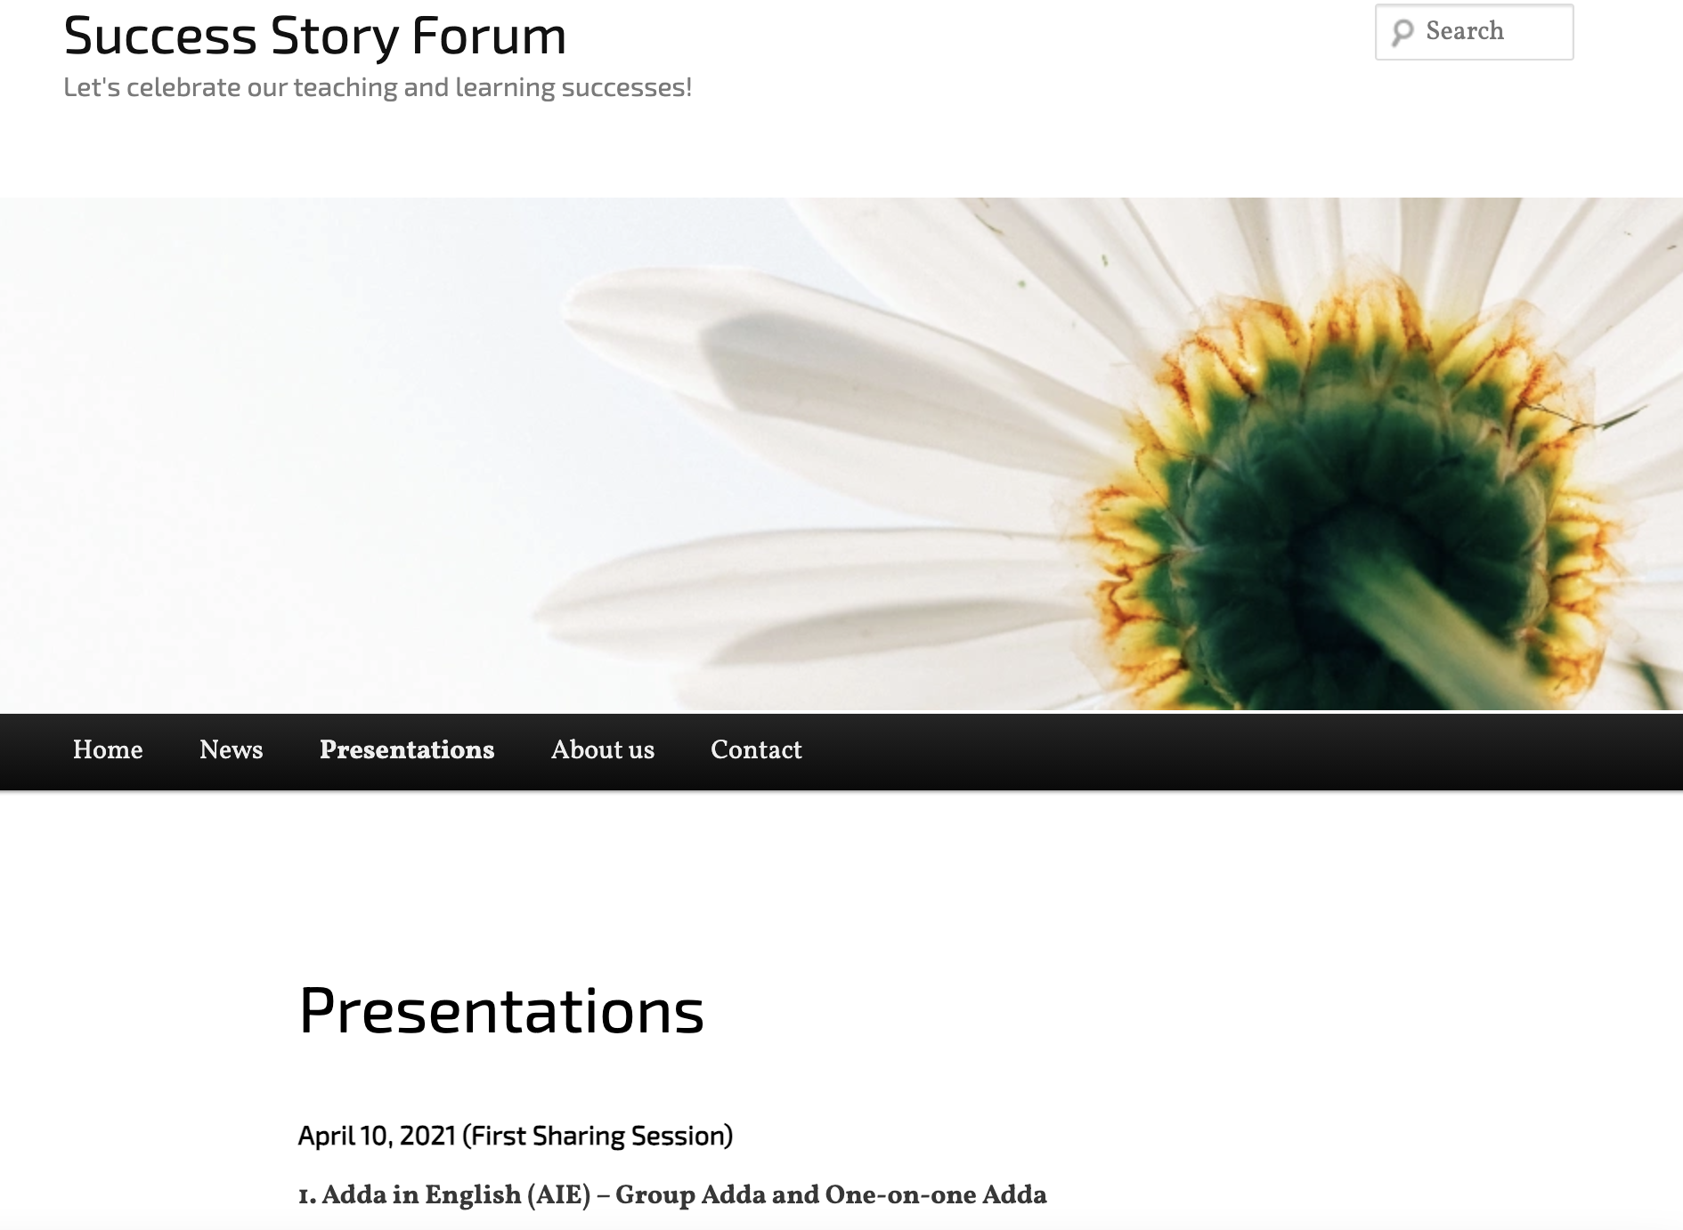
Bi-national (Nepal (NELTA) – Bangladesh (BELTA) Success Story Forum – 2021

Slide 42
4. Promoting teacher-research – and teacher association research

Slide 43
Exploratory Action Research

Slide 44
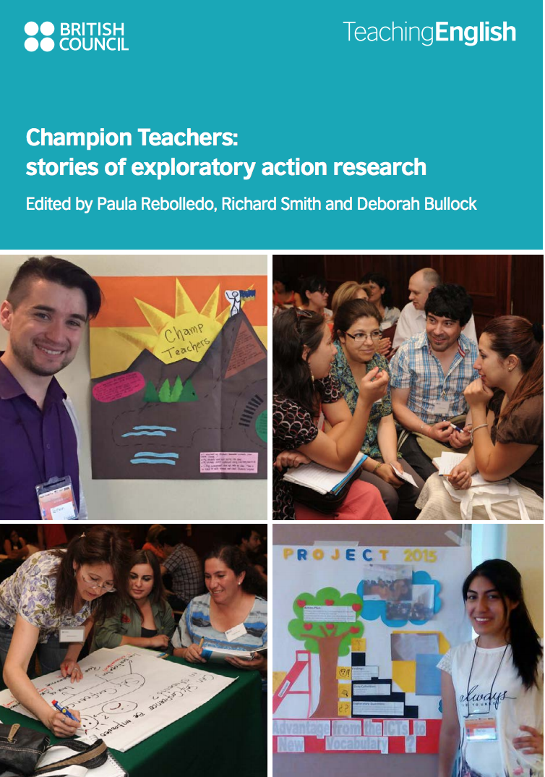
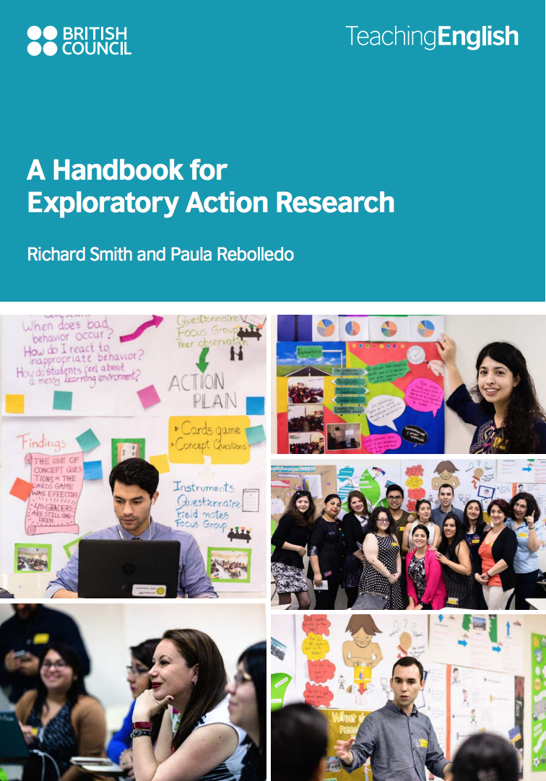

Slide 45
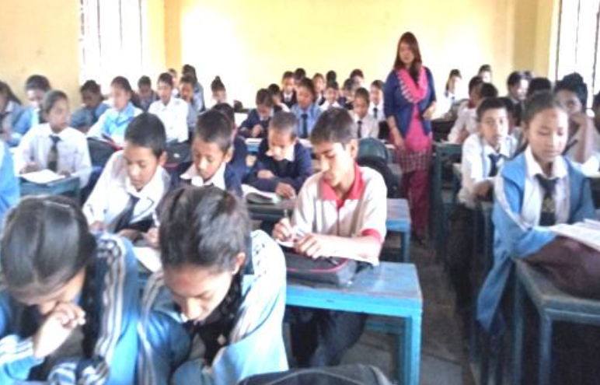

Slide 46
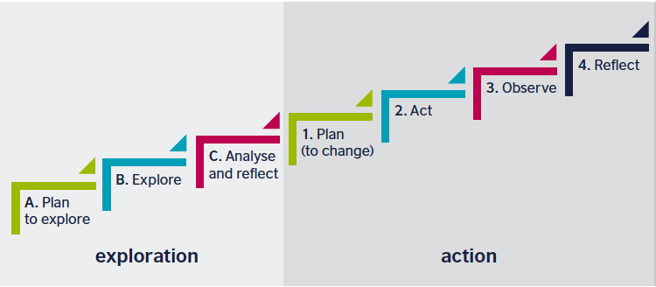


Exploratory action research
Notes:
Richard

Slide 47
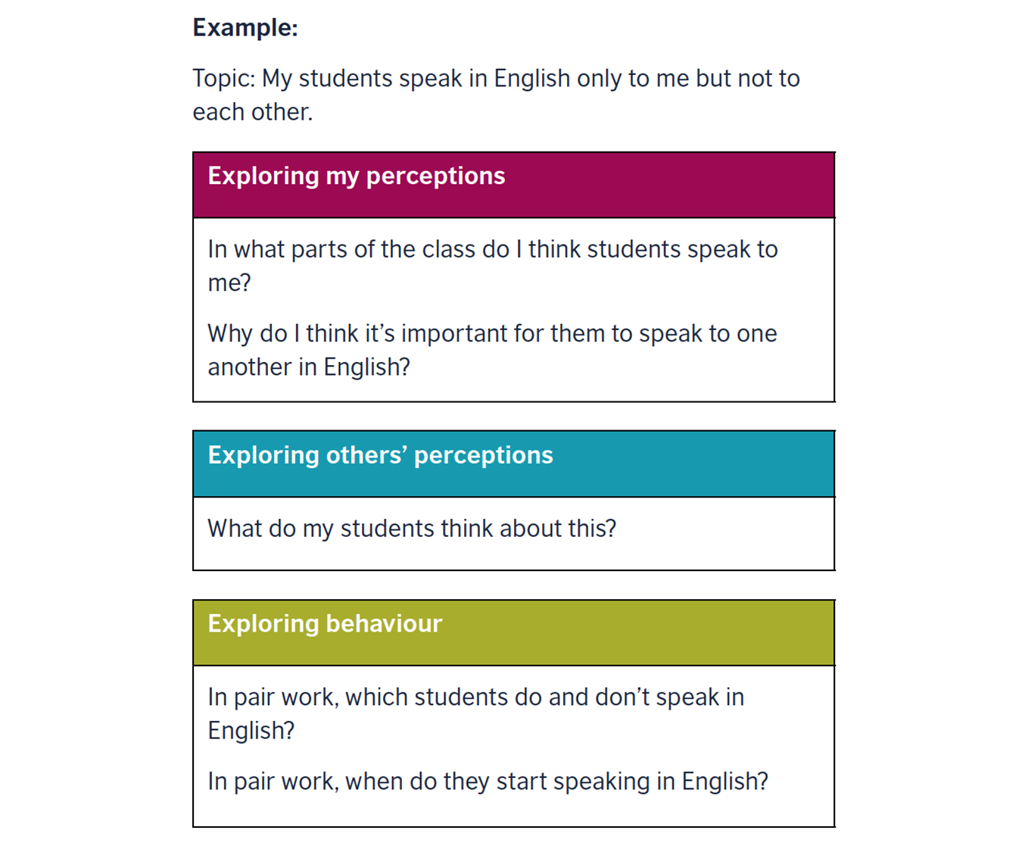

Slide 48
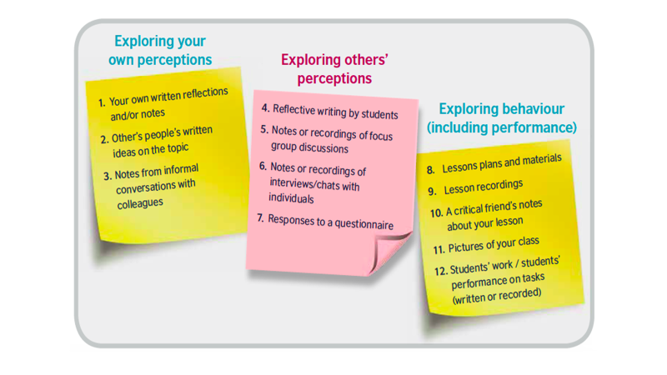

Slide 49
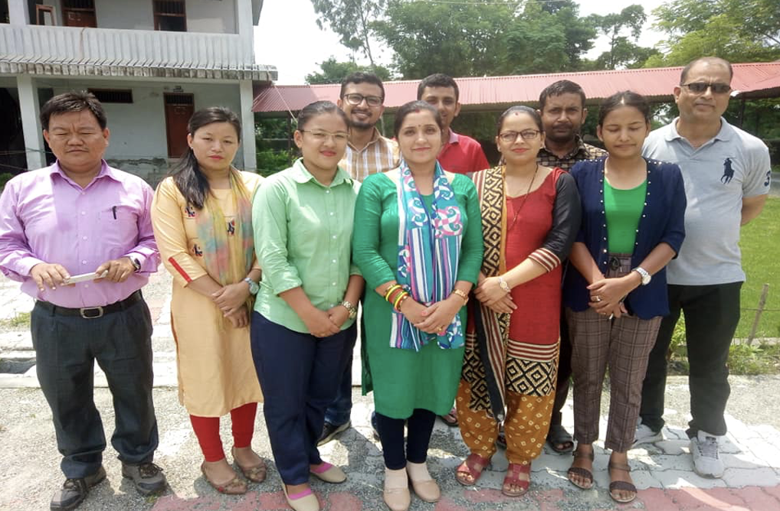
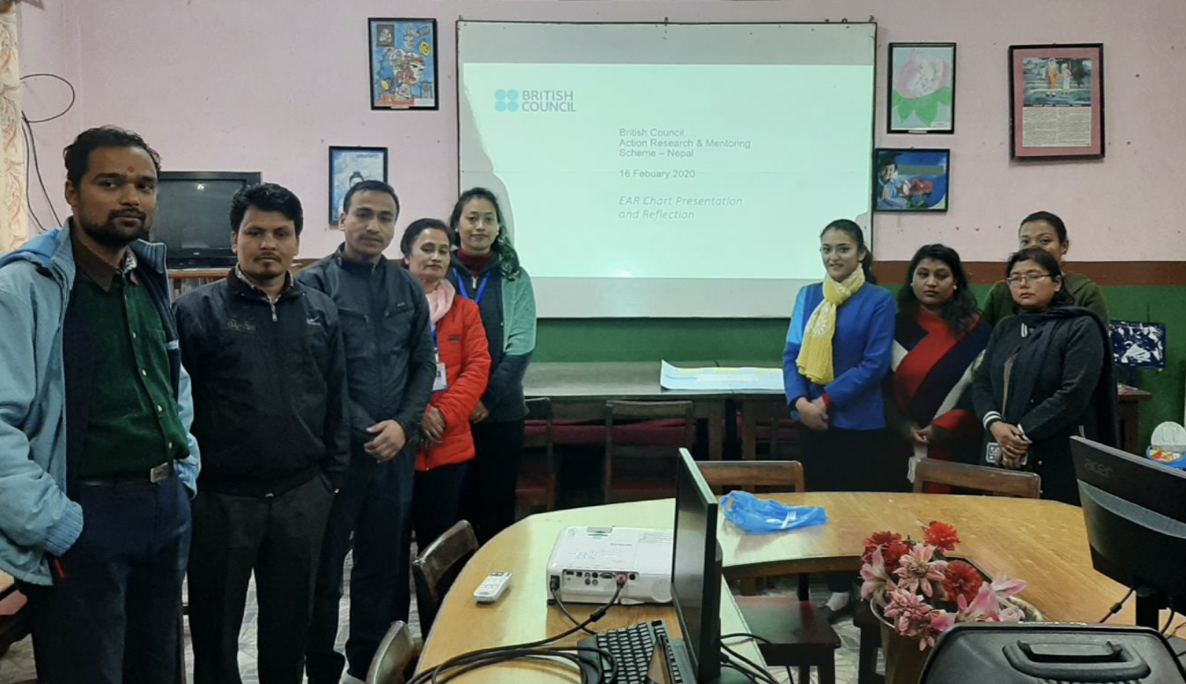
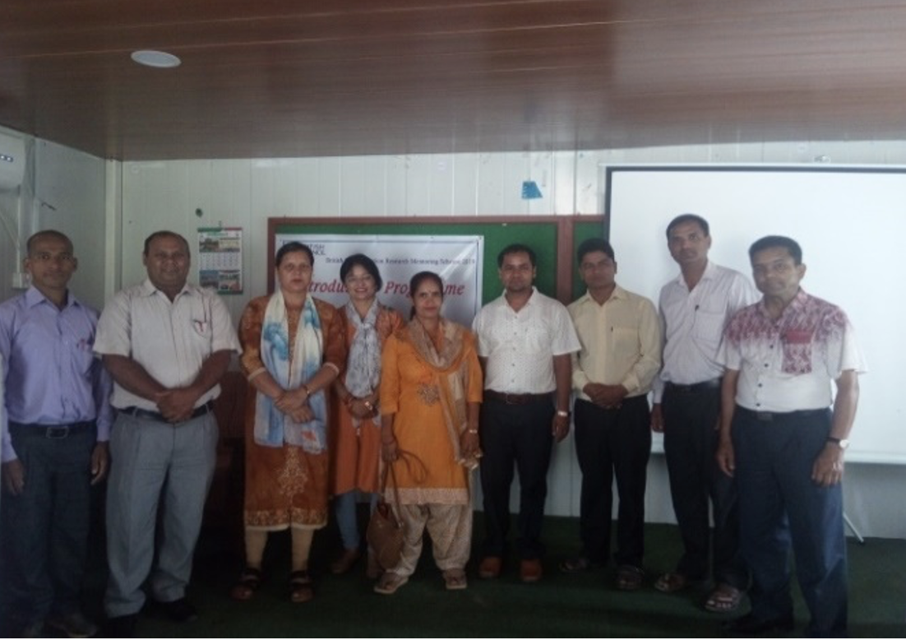
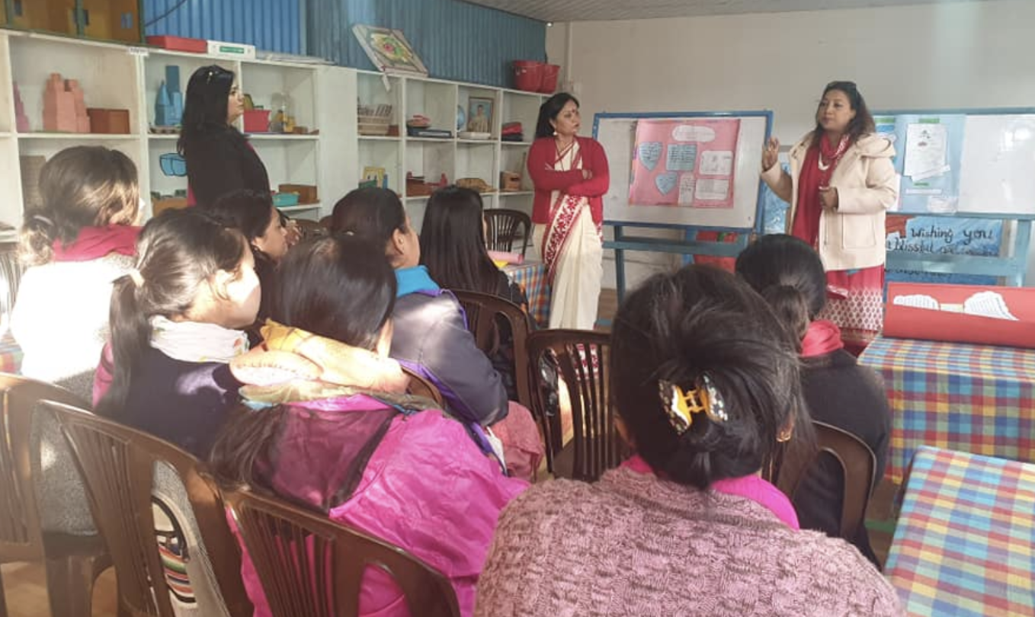
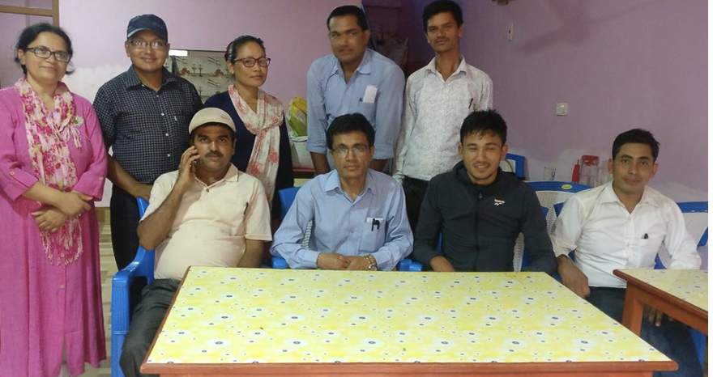
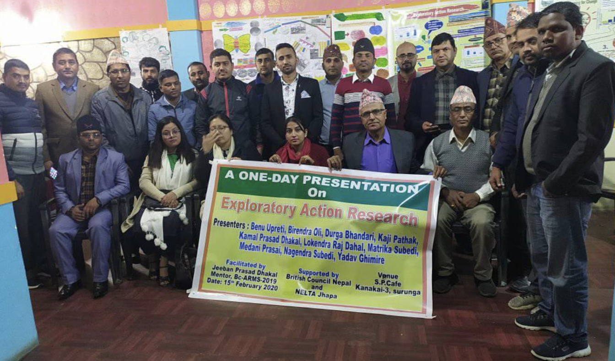
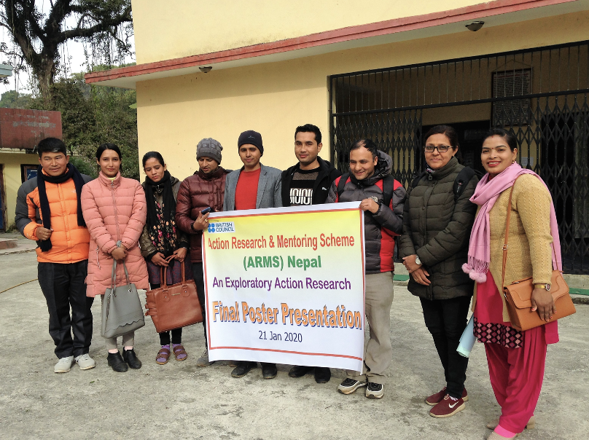
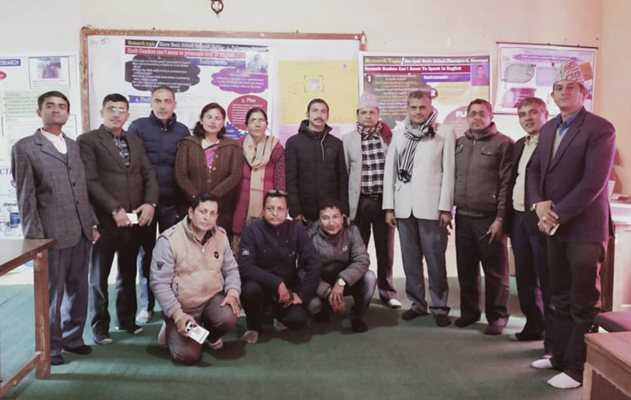
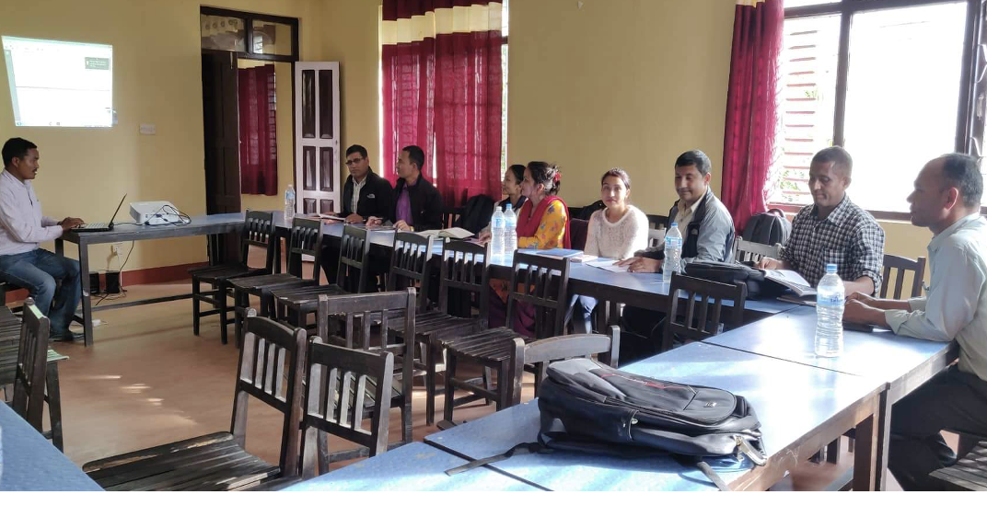
The British Council Action Research Mentoring Scheme (ARMS) (India, Nepal), 2017-20
2017–20 (India): 48 mentors, 235 teachers
2017-20 (Nepal): 26 mentors, 180 teachers

Slide 51
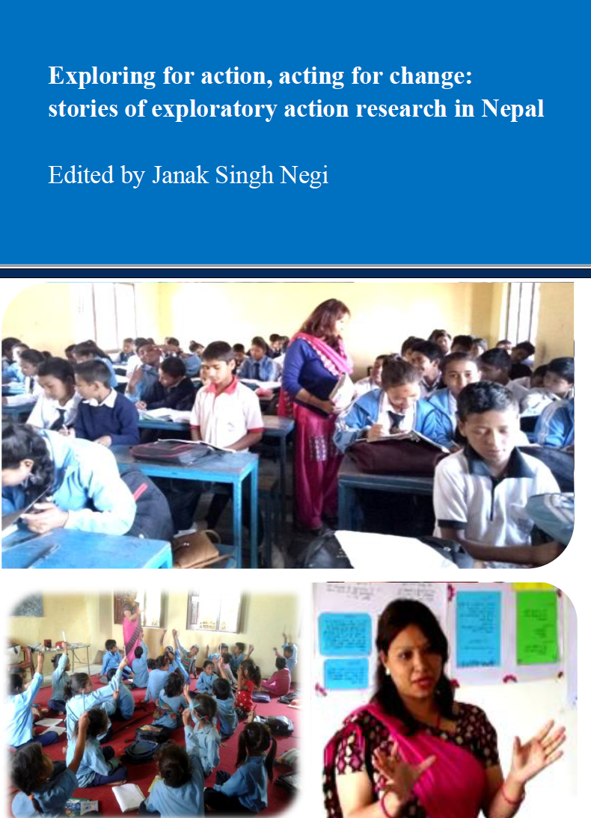
An example of exploratory action research

Slide 52
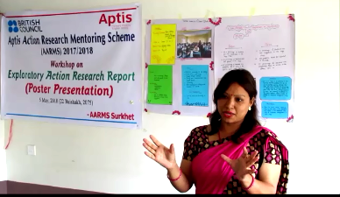
Shova Shahi, mentored by Janak Negi

Slide 53
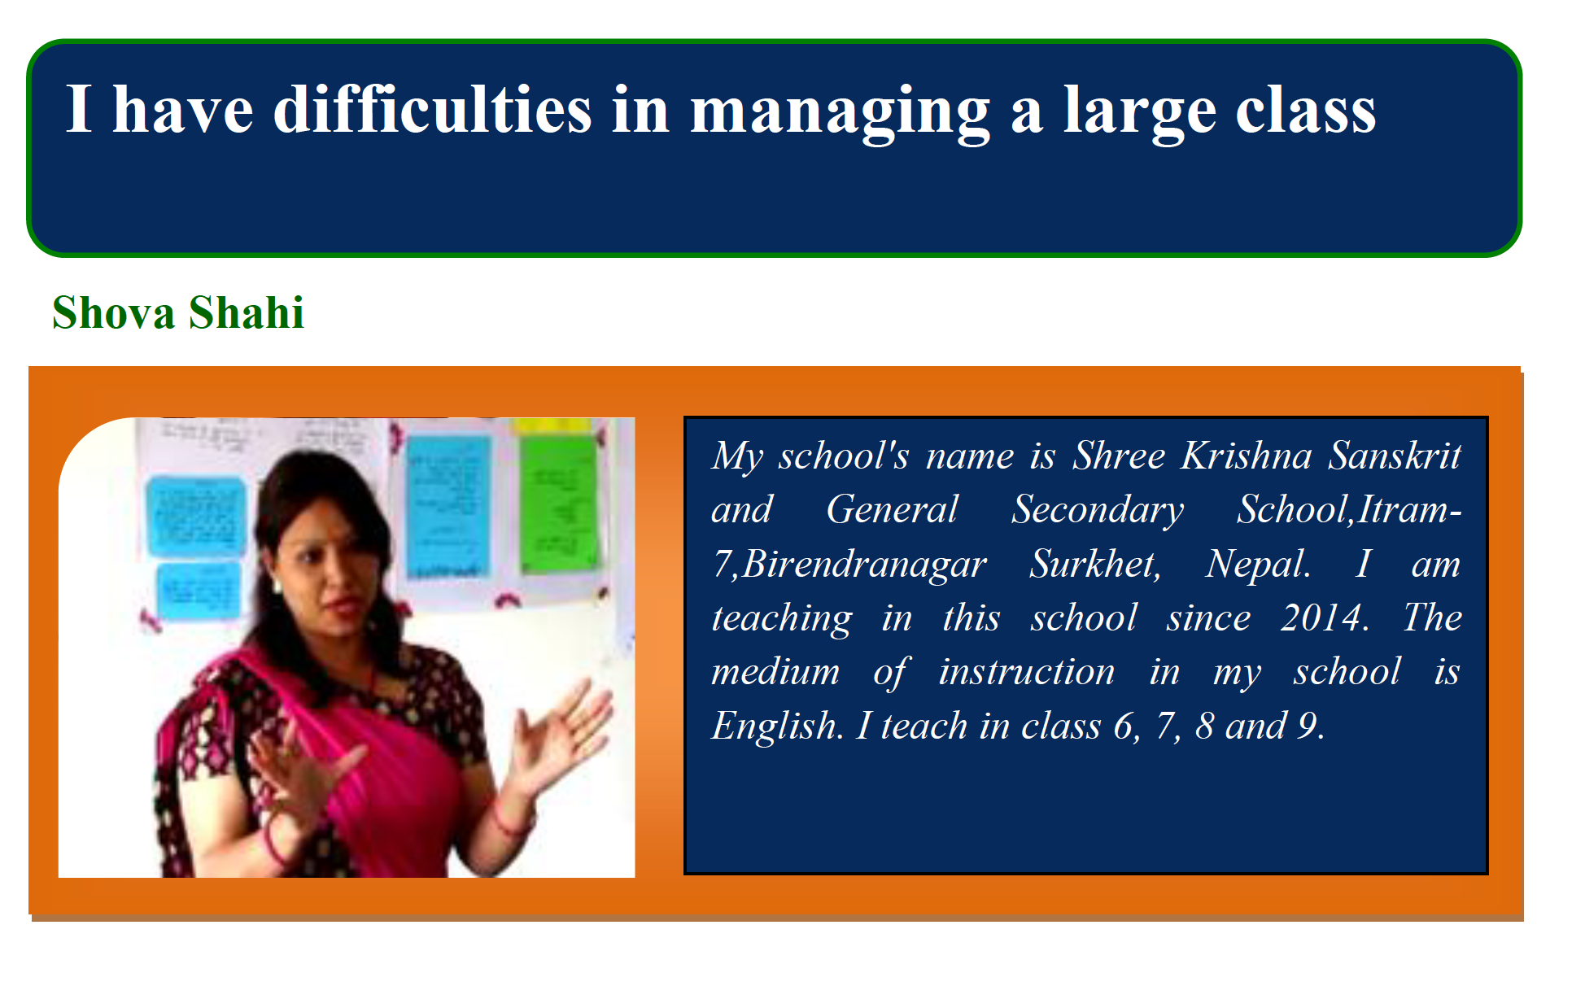

Slide 55

Shova’s problem
Overcrowded classroom - 89 students, very difficult to manage
Students used to make disturbance, talking unnecessarily I tried various techniques
– changing the seats of the students every day
– giving authority to the class monitor,
– dividing students into different groups
… but I could not get success

Slide 56
Shova’s exploratory research questions and methods
Research questions
  What particular difficulties do I have in the class?
  What causes the disturbance? ?classroom?
Research methods
  Observation by a colleague
  ‘Self-observation’ (taking notes)

Slide 57
Exploratory research findings
Most of the students were paying attention
Some sitting near the windows were looking outside and talking to others about what they saw
Some other students were talking about those who were looking outside the windows.

Slide 58
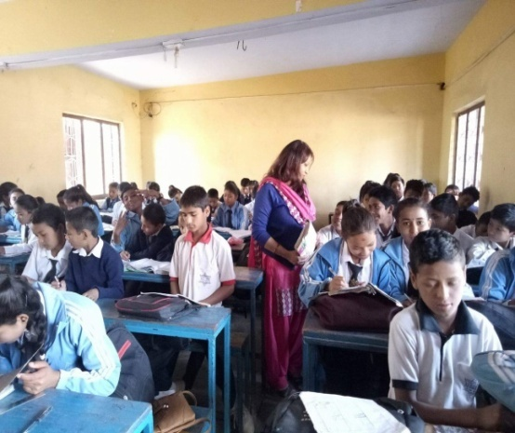
Shova’s plan for action
Give more responsibilities to the students sitting by the windows – and the ‘side talkers’
Move close to the students talking unnecessarily with their friends.

Slide 59
Actions taken
I gave specific tasks to those by the windows:
Taking notes and summarizing the lesson
Writing the answers to the questions by discussing with their friends
Sometimes, I assigned them the role of group leader.
When I noticed students talking unnecessarily, I moved near to them. I did not speak with them individually but just made frequent eye contact with them.

Slide 60
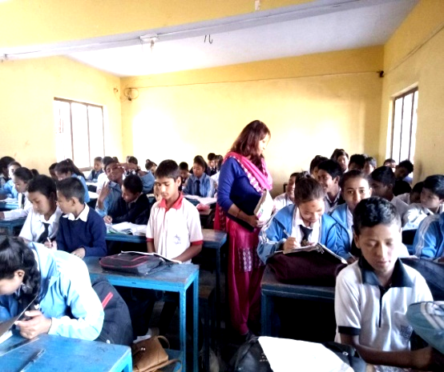

Slide 61

Shova’s action research findings
After the Action: Observation
“Nowadays, the situation has changed drastically. Students do not talk unnecessarily, instead they concentrate more on their study and do the assigned tasks. Although they have not stopped side talking completely, they do not talk unnecessarily. They have started talking about the subject matter, which is a positive sign of learning.”

Slide 62
Teacher Association Research (‘TA-research’)

Slide 63
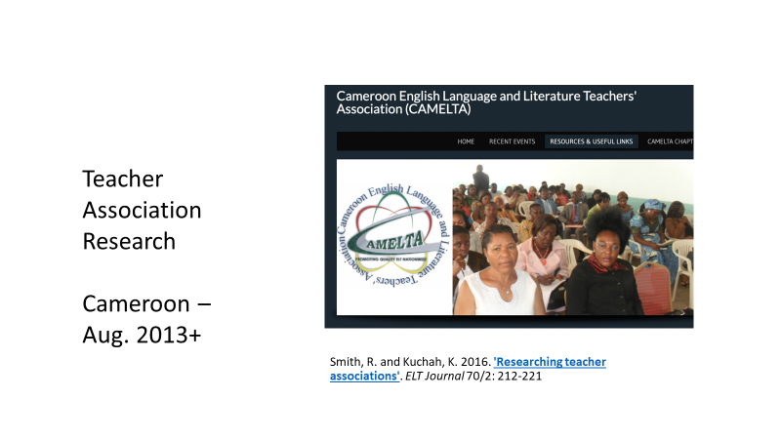
Notes:
Figures checked here: http://www2.warwick.ac.uk/services/spa/businessinformation/academicstatistics/2014-open-access/

Slide 64
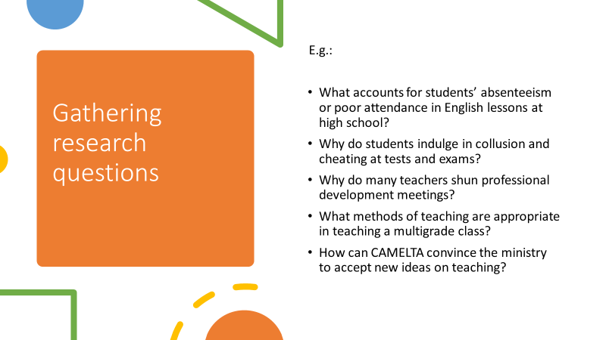
Examples of activities carried out by English language teacher associations in Africa, Latin America, and South Asia which involve:
localization/devolution
encouragement of success-sharing
support for teacher research
investigation of members’ needs and/or capabilities
attempts to bring about wider change

Slide 65
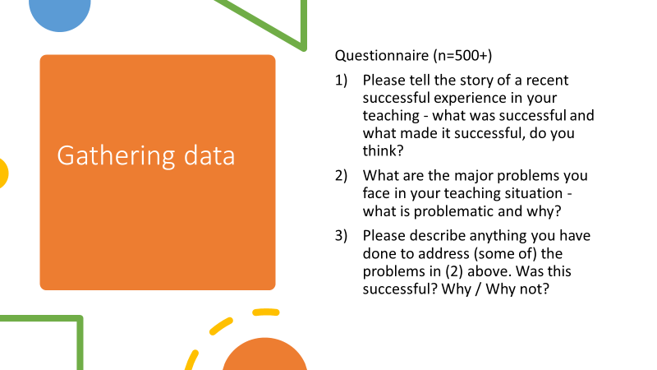

Slide 66
Mentoring teacher-research

Slide 67
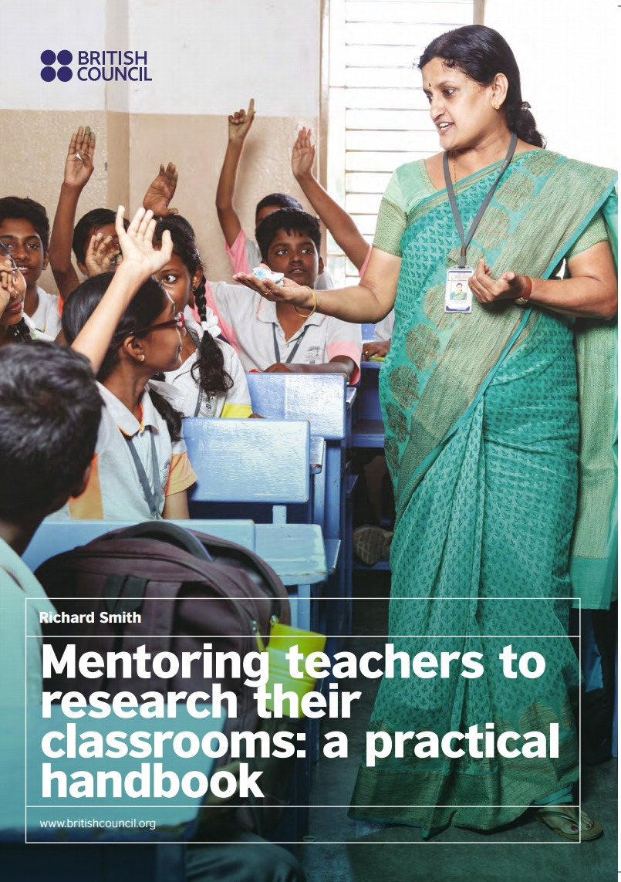
A handbook for mentoring teacher-research
Designed for those who are supporting teacher-researchers
Simple, clear, practical.
Based on extensive experience, mainly in Nepal, India

Slide 68
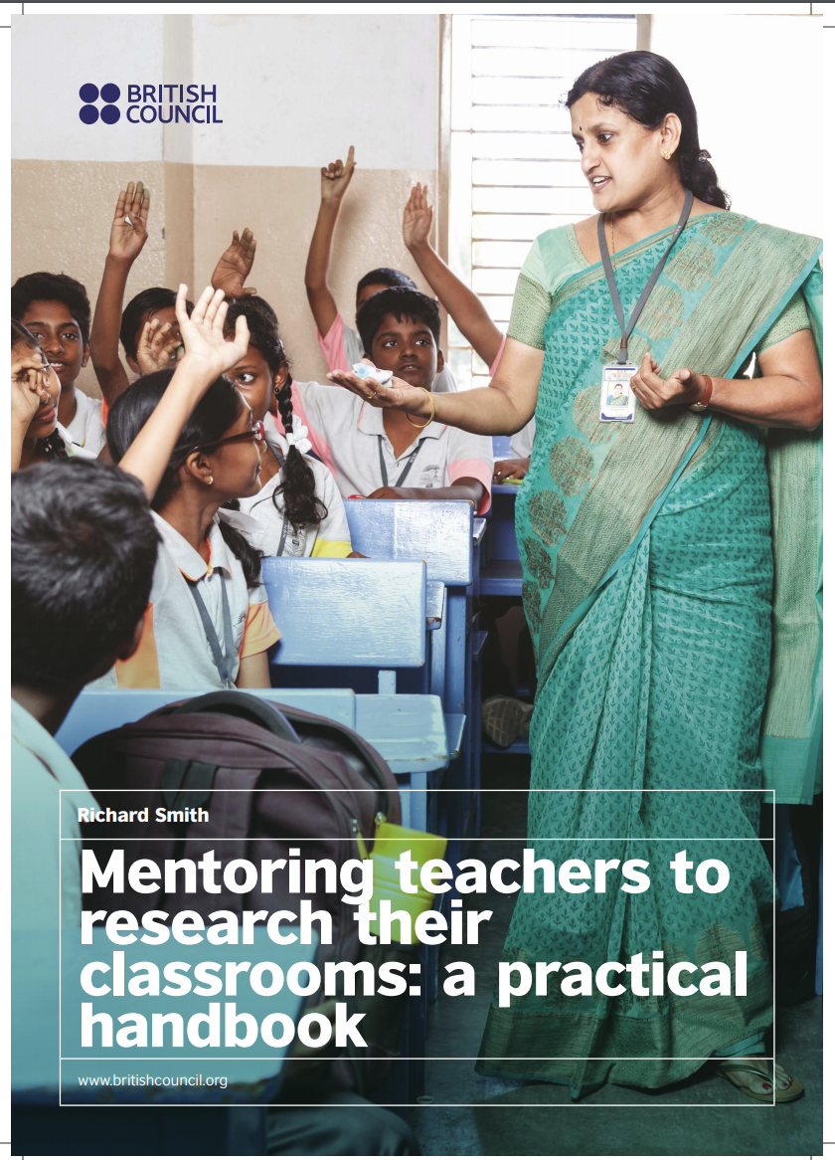
Mentoring teacher-research for difficult circumstances
(to address emergency remote teaching situations)

Slide 69
5. Decentring ELT

Slide 72
Examples of directions forward – ideas carried out by English language teacher associations in Africa, Latin America, and South Asia which involve:
localization/devolution
encouragement of success-sharing
support for teacher research
investigation of members’ needs and/or capabilities
attempts to bring about wider change
D. Banegas, D. Bullock, R. Kiely, K. Kuchah, A. Padwad & M. Wedell (2022). 'Decentring ELT: Teacher Associations as agents of change'. ELT Journal 76/1: 69–76.
Decentring ELT: Challenges and Opportunities (Brief report on The A. S. Hornby Educational Trust's 60th anniversary online conference, in collaboration with AINET and the Centre for English Language Education, Dr. B. R. Ambedkar University Delhi, 3–4 December 2021)

Slide 73
‘Decentring ELT’
‘The world of ELT has been characterised by a hegemony of ‘global’ or ‘centre’ ELT approaches and materials developed outside the teaching contexts in which they are expected to be used. However, these approaches and materials (‘frames for action’) are not necessarily appropriate to and do not recognise teachers’ and other insiders’ experience and expertise in those contexts.
Work needs to be put into empowering teachers to develop contextually appropriate thinking and action (on methodology, materials design, curriculum development, teacher education, etc.), in relation to the needs of their local contexts.’
(Banegas et al. 2022. ‘Decentring ELT’. ELT Journal 76/1)

Slide 74
Final reflections
Sustainable development in English language education / teacher development
being ecologically appropriate, i.e. well-adapted to context (as a precondition for effectiveness)
being constructively resistant to ‘reality checks’ over time / having long-lasting effectiveness

Slide 75

Any comments or questions?
To get in touch: R.C.Smith@warwick.ac.uk
Thank you for listening today!

