Slide 1

Exploratory Action Research: A personal journey
Richard Smith, University of Warwick, UK
https://warwick.ac.uk/richardcsmith/chennai/

Slide 2
Plan
1. Sharing some stories
2. Critiques, concerns, issues and possibilities

Slide 3

1. Sharing some stories

Slide 4
How did we get here (i.e. to there being a conference devoted to teacher-research)? (one story)
Pre-pandemic:
IATEFL Research SIG advocacy for teacher-research (2011+)
’Teachers Research!’ events and conferences 2014 onwards (the last one was in 2018)
TESOL CALL-IS Electronic Village Online
Teachers Research! Facebook group
International Festival of Teacher-research, 2017
AINET International Teacher Research Conference, Nagpur, 2017
While- / Post-pandemic:
International Festival of Teacher-research, 2021
Mentoring teacher-research support group 2021 & 2022
Teachers Research! Online 2021 & forthcoming (2023)
International Conference for Teacher-research 2022, Chennai

Slide 5
How did I get here? (Why teacher-research?)
Teaching in Japan (1990s)
- Teaching listening (and speaking) in a large university class -> project-based work in groups
- Experimental teaching -> a need for teacher research (to develop ‘appropriate methodology’)
- Since then, gathering data as a continuing resource in difficult circumstances (2 examples)

Slide 6
Teacher education (UK, 2000s): avoiding ‘inappropriate methodology’
-> action research based teacher training (pre-service) – aiming for ‘teacher-learner autonomy’ – teachers as experts of own contexts
Other background (2000s):
- Teaching English in difficult circumstances / TELCnet – Teacher-research (TR) as desirable
Identifying/hoping to reconfigure ‘ELT research’ / BC surveys (UK -> India) – lack of TR
IATEFL Research SIG coordinator (2011+) (BC invitation to Chile 2013) – an opportunity, but need to avoid burdensome TR

Slide 7
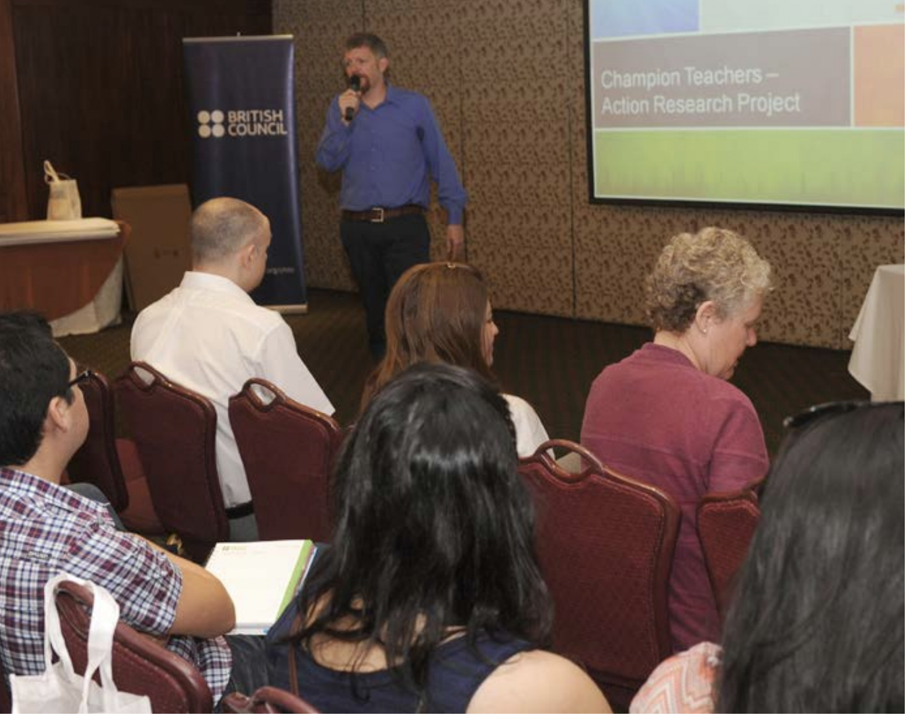
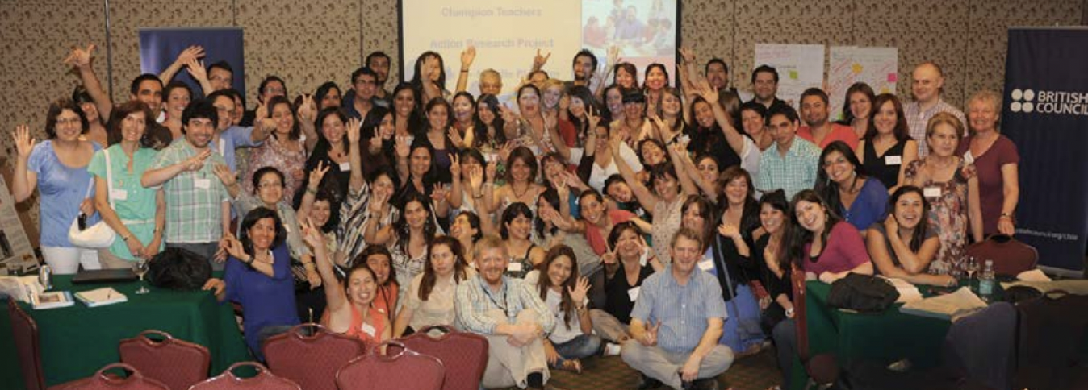
The Champion Teachers Programme (Latin America) / Exploratory Action Research [EAR]
January 2013 workshop

Slide 8
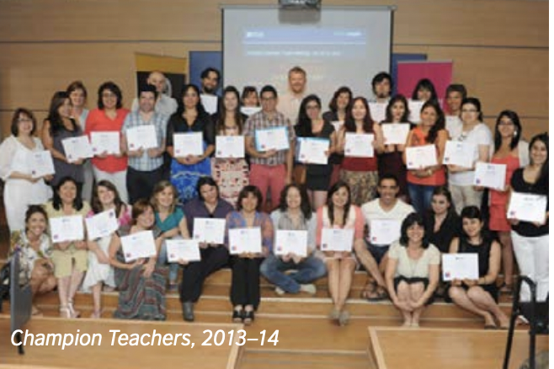
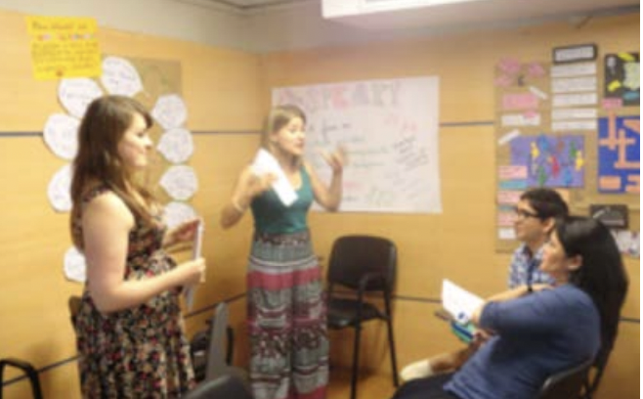
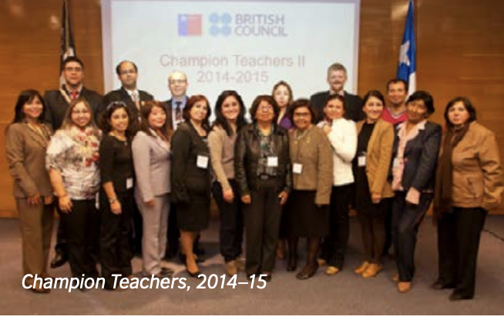


Slide 9
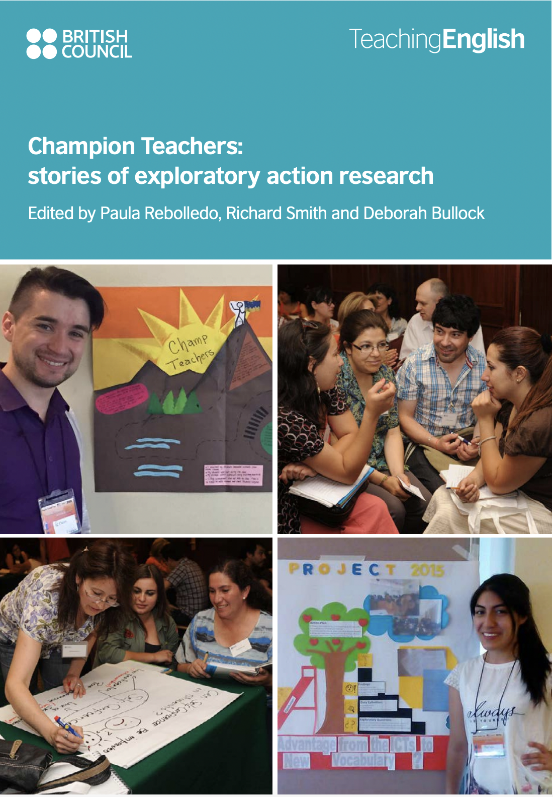
Published in 2016

Slide 10
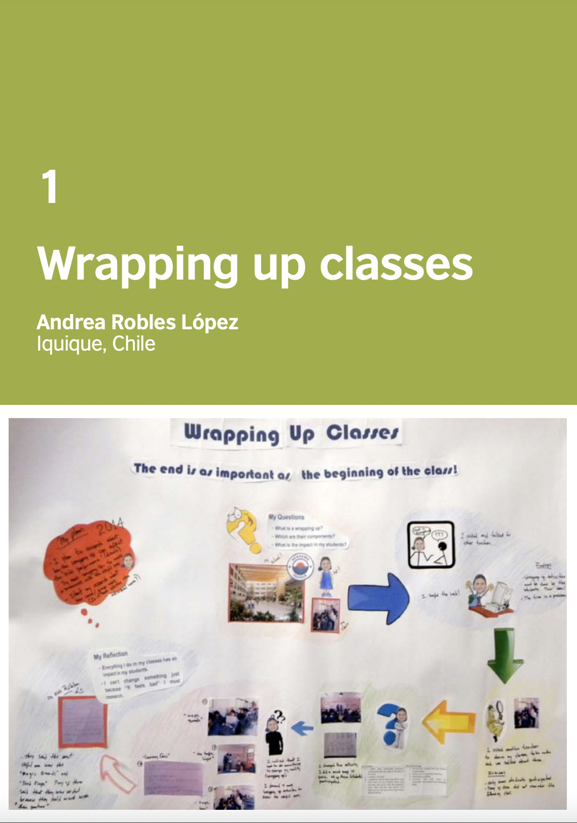
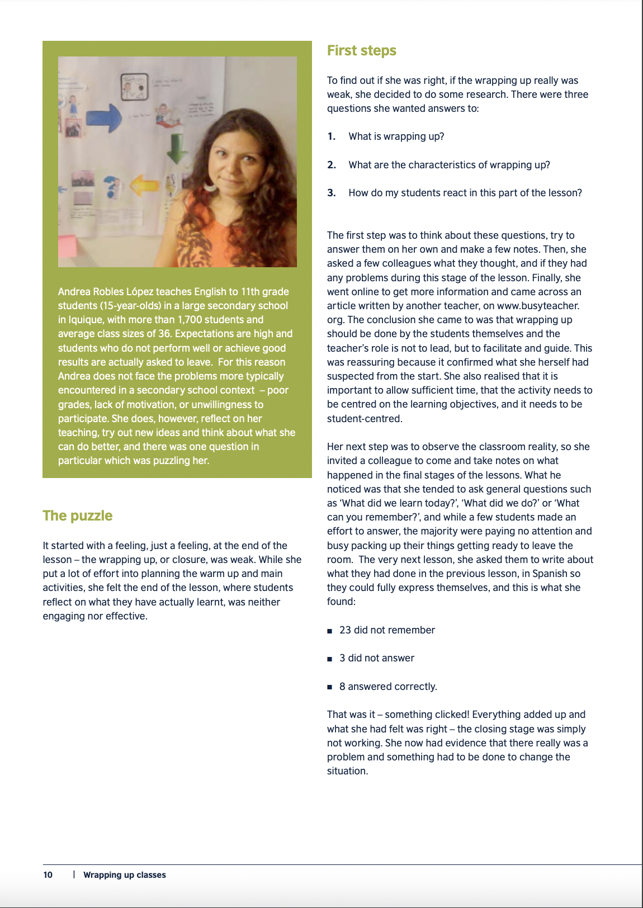

Slide 11
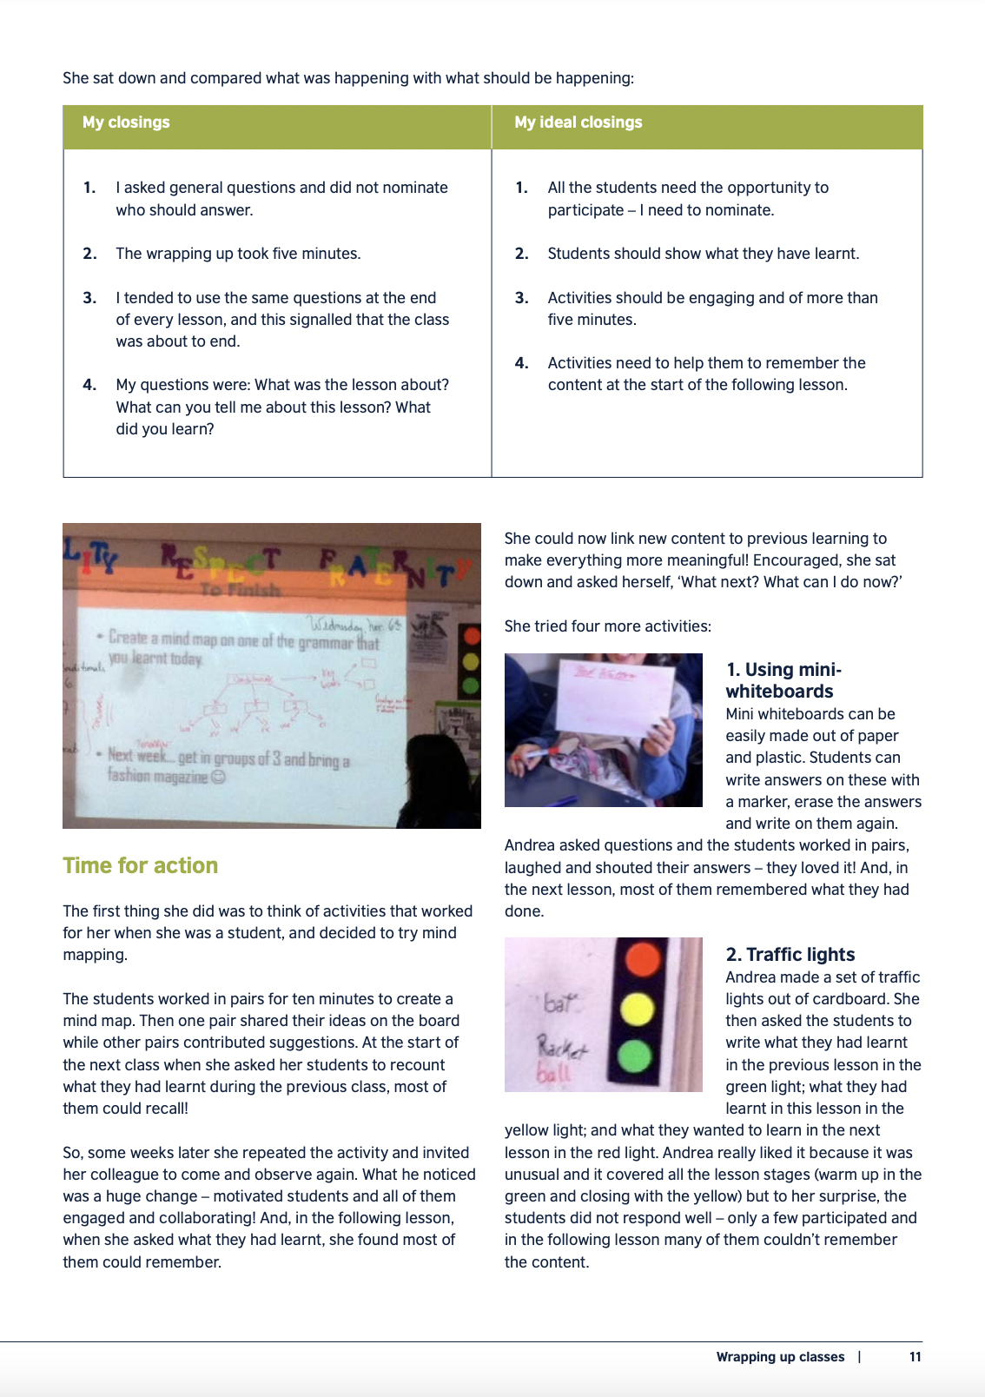
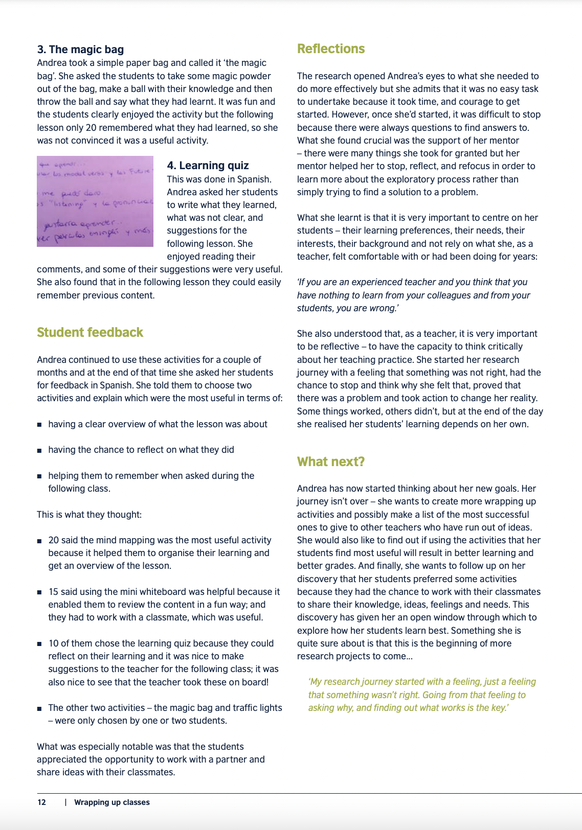

Slide 13



Slide 14
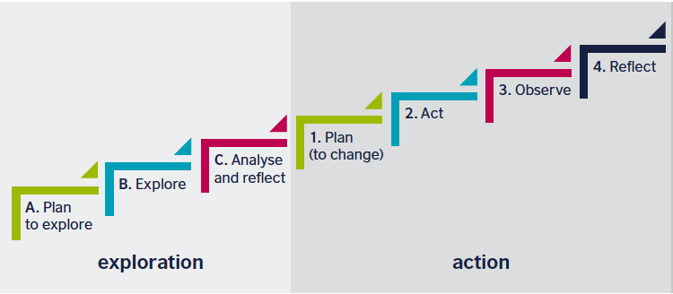


Exploratory action research
Notes:
Richard

Slide 15
Exploratory action research: key features / learnings
Exploratory Action Research involves teachers exploring their classroom situations and improving their practice based on their findings.
• The approach was designed to be practical and useful for public school teachers in challenging situations.
• It helps teachers to gain a greater understanding of issues in their classrooms and to better recognise their students’ needs and interests.
• The process helps to strengthen teachers’ relationships with their students and to improve student engagement in lessons.
• It supports teachers to develop a more inquiry-oriented mindset, an increased sense of agency to effect change and a sense of empowerment.
• Introducing it to teachers involves challenging pre-conceived notions of what research ‘is’ and explaining research in a down-to-earth way.
• It is based on issues grounded in practical experience, not literature.
• It uses a data collection process that ensures the least interference with teaching.
• It relieves the pressure of compiling a final report to share findings – oral poster presentations serve as a basis for later write-ups.
(Smith & Rebolledo, 2022)

Slide 16
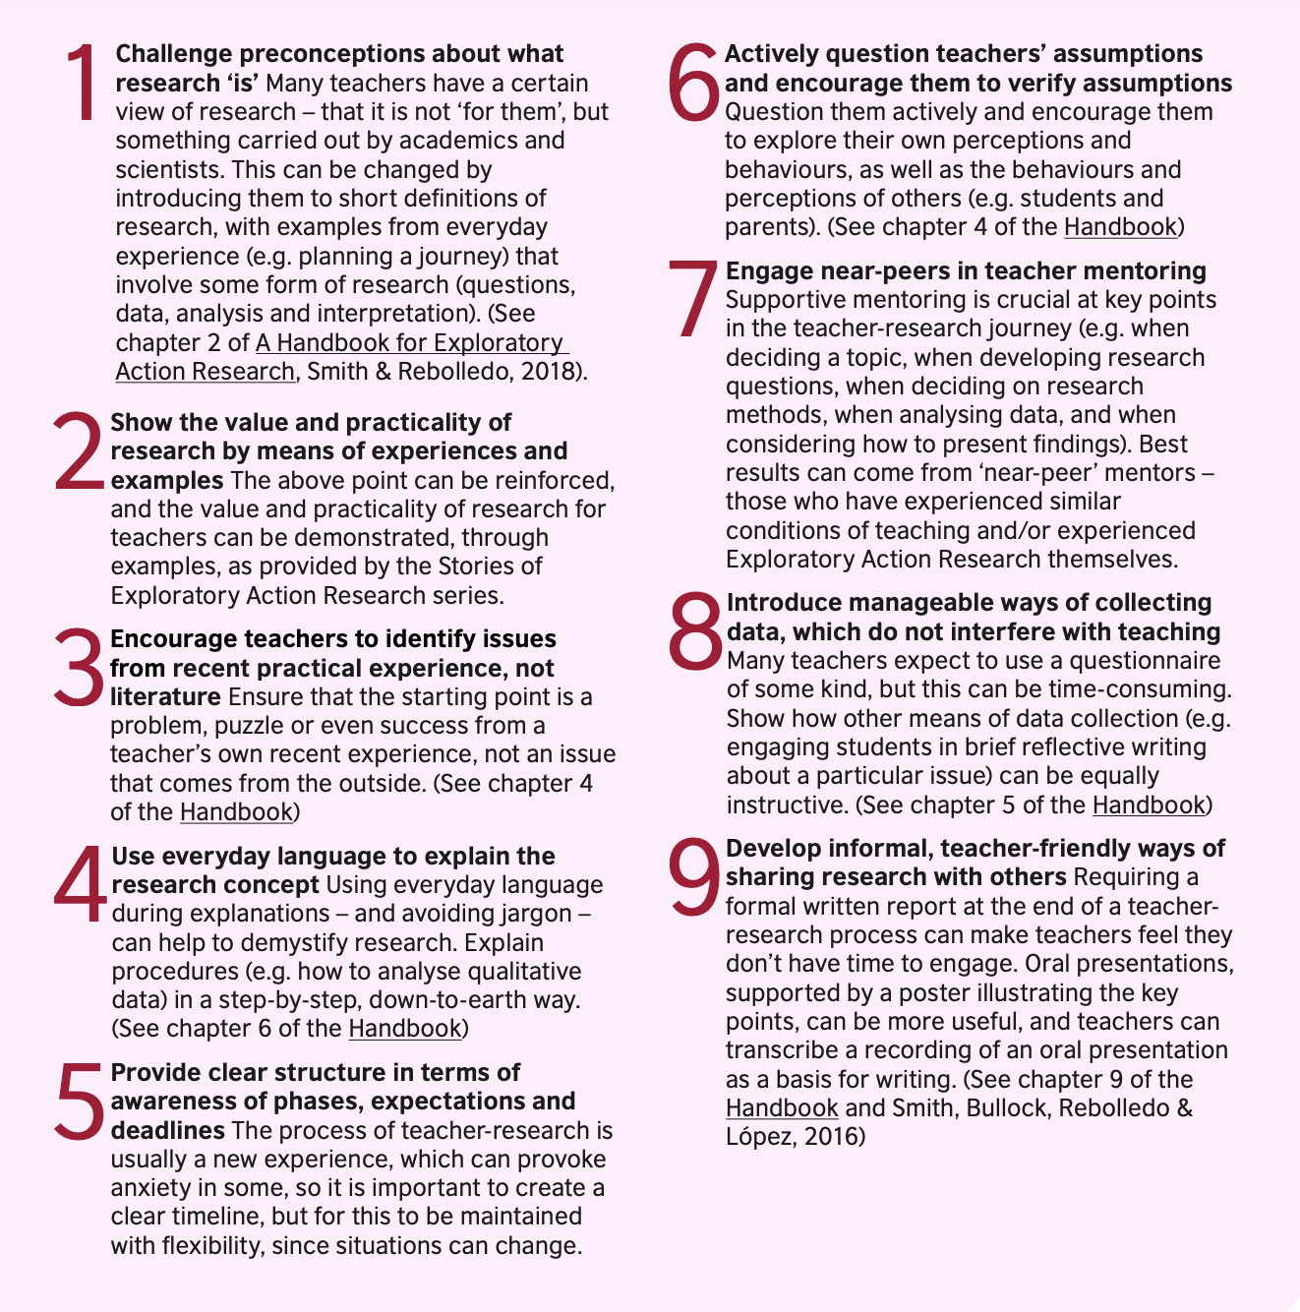
(Smith & Rebolledo, 2022)

Slide 17
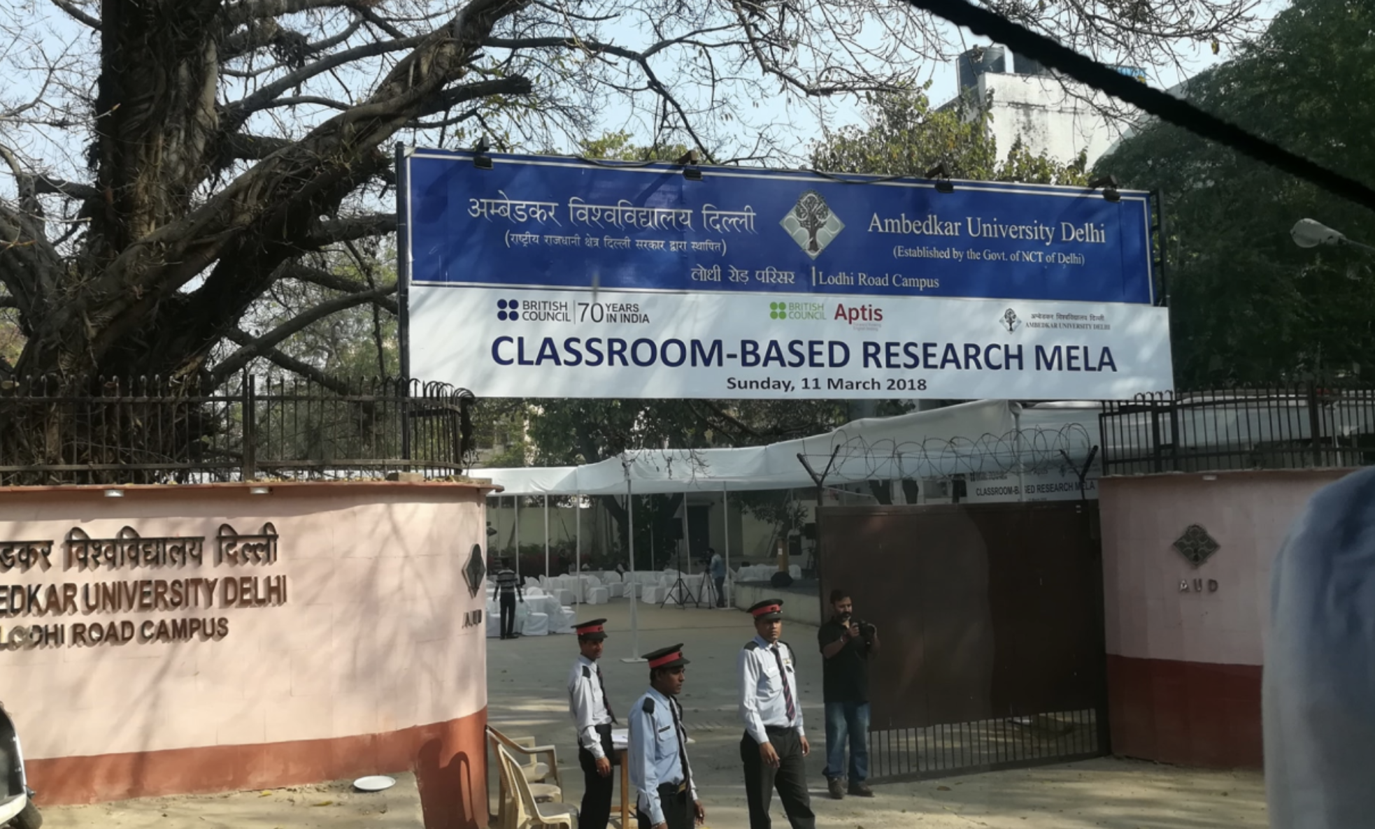
The Action Research Mentoring Scheme [ARMS] (India & Nepal) / Mentoring teacher-research
2018 ‘mela’ in Delhi –
https://fb.watch/h8_cLTosmp/

Slide 18
Survey of ELT Research in India (2013-2016) – BC with EFL-U
BC ELTREP awards in India (mentoring research projects with Rama Mathew)
One of these was the AINET teacher-research support initiative, which helped inspire the idea of ARMS
[AINET organized a teacher-research conference in Nagpur in September 2017]…

Slide 19
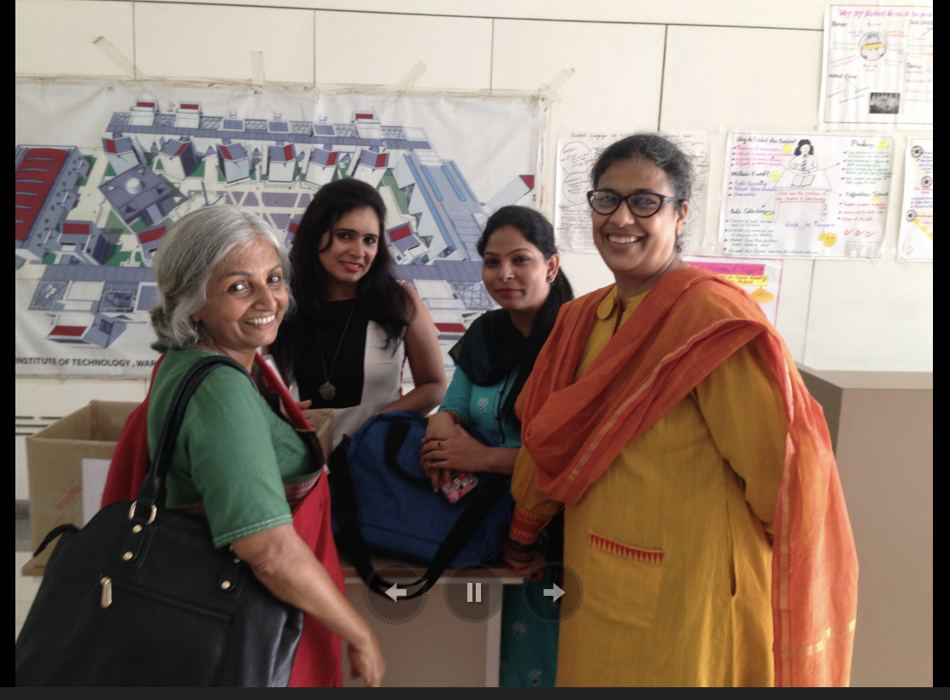

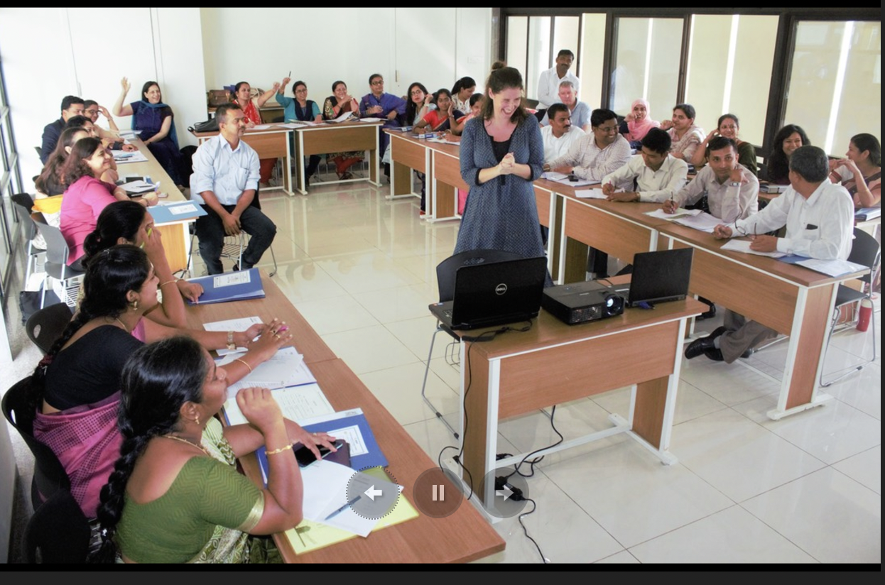
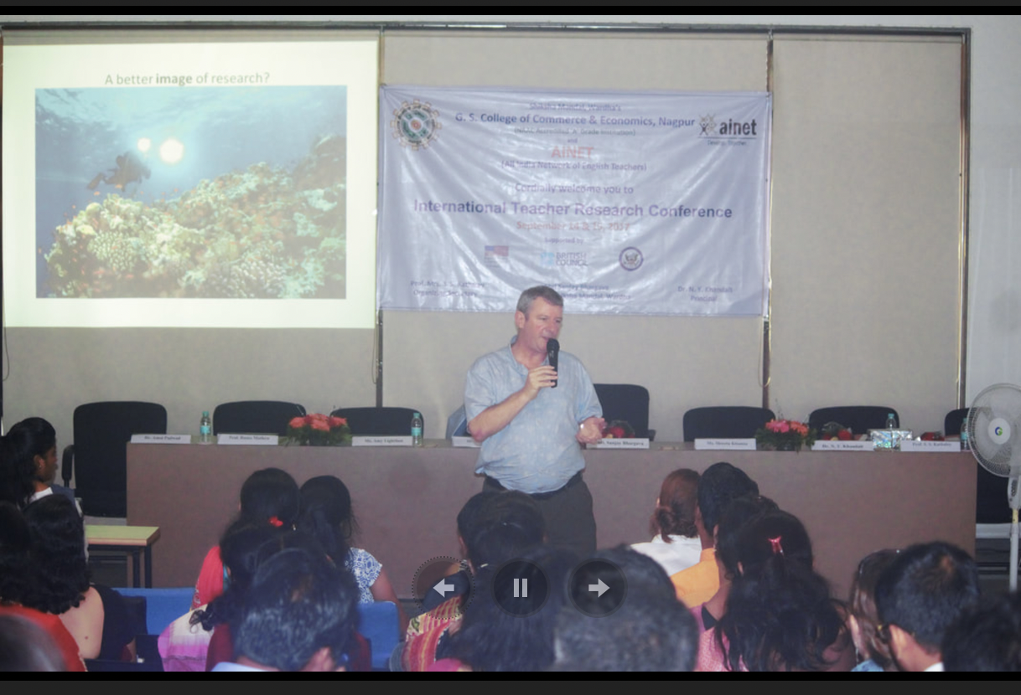
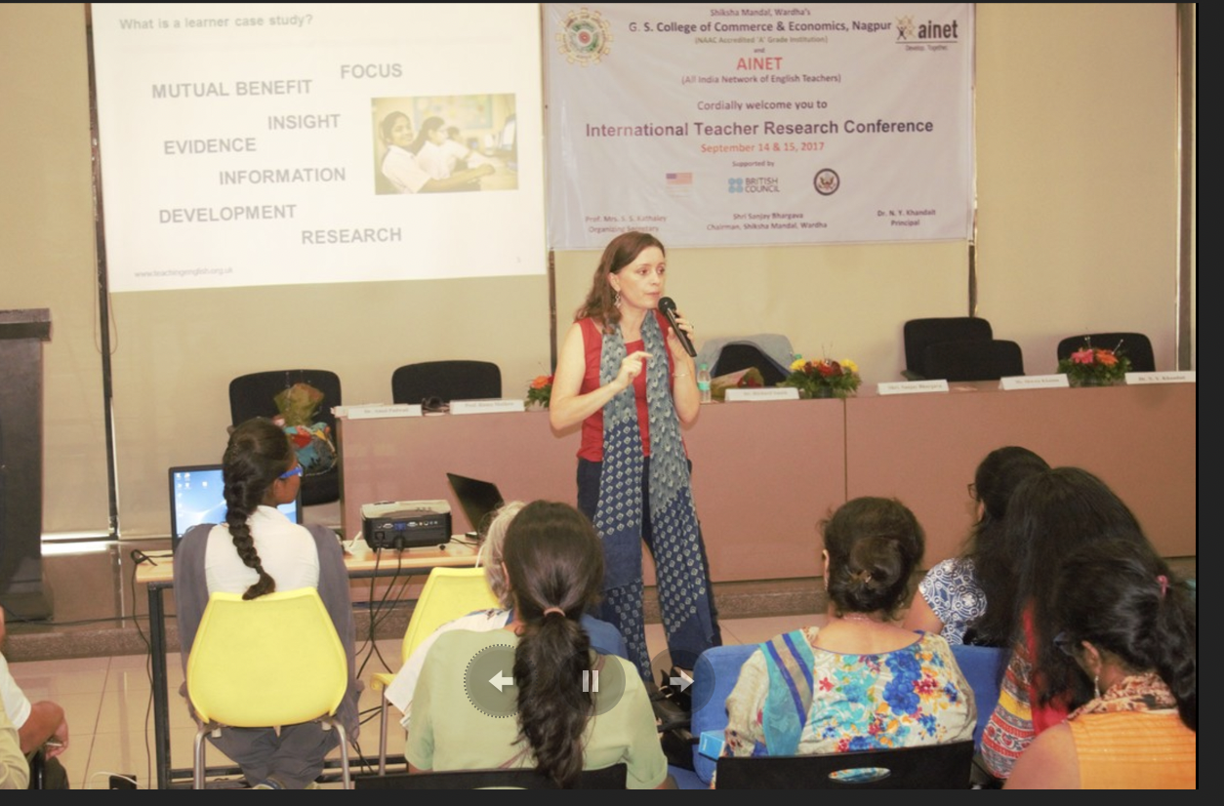
ç

Slide 20
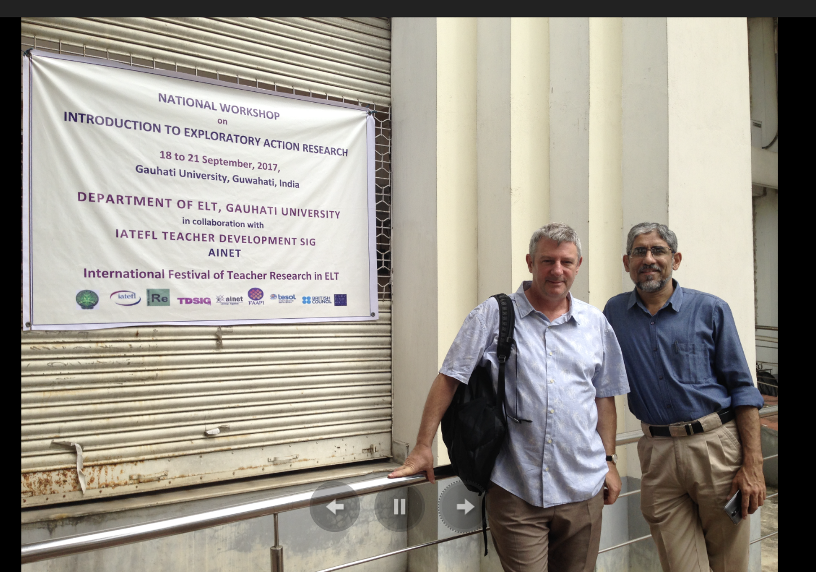
(with Amol Padwad in Guwahati, Assam):
https://trfestival.wordpress.com/past-events/18-21-september-introduction-to-exploratory-action-research-gauhati-university-assam-india/
(September 2017)

Slide 21
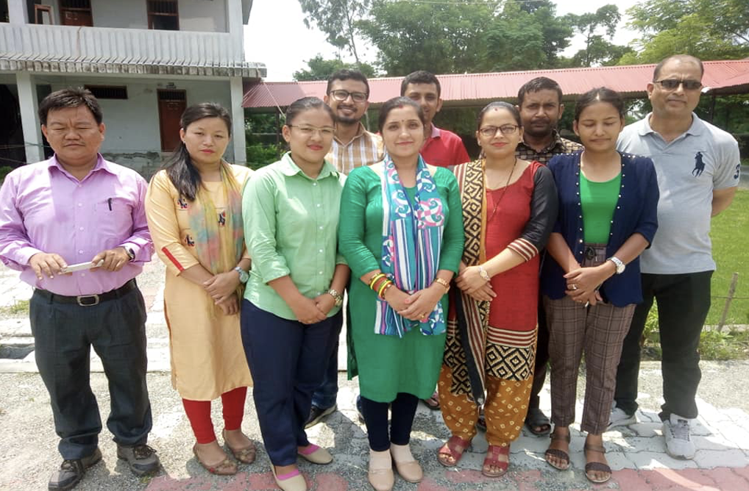
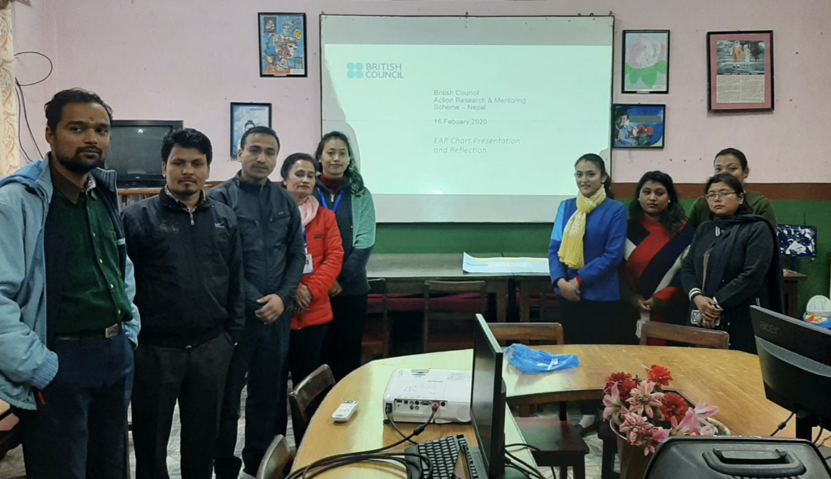
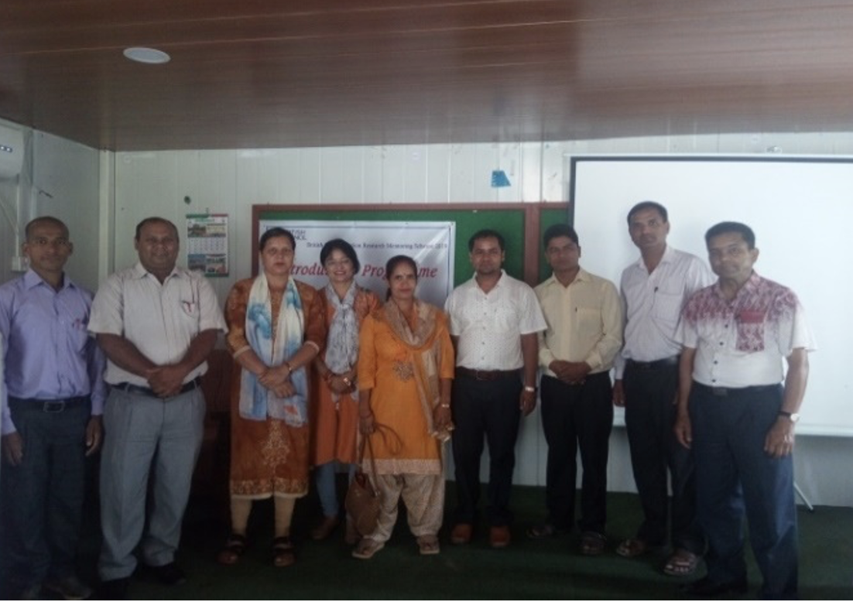
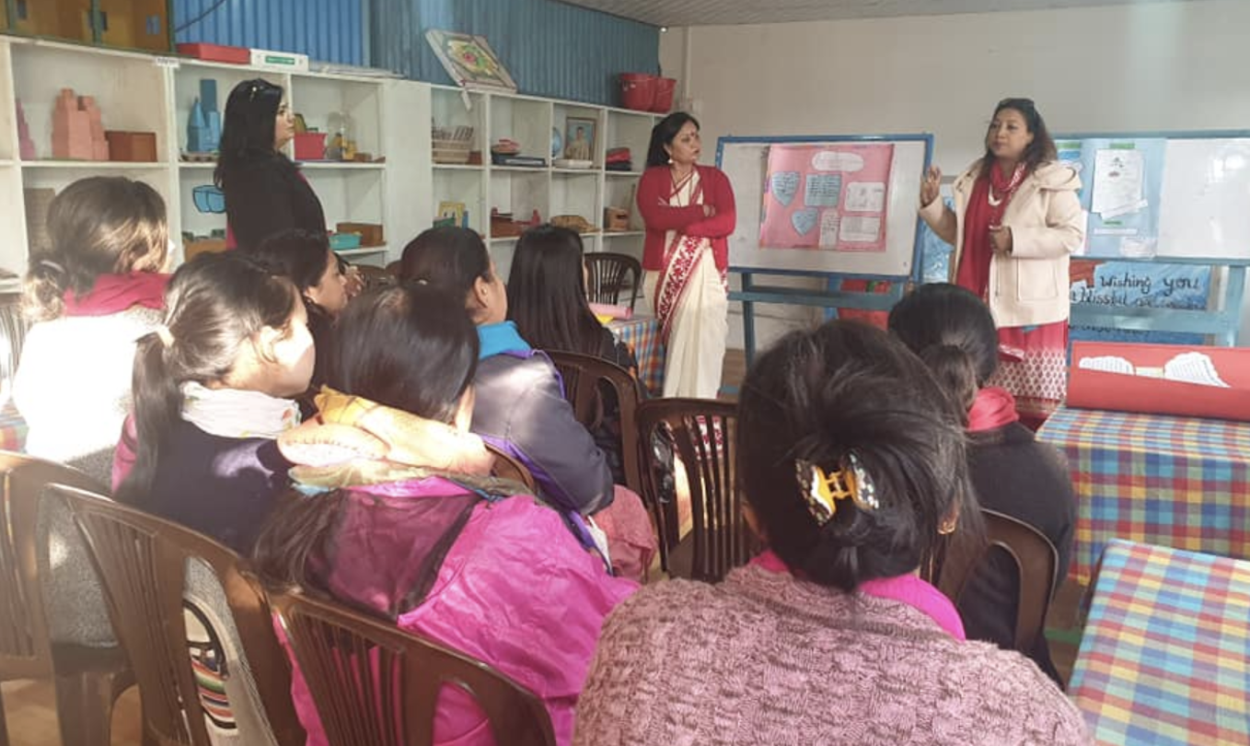
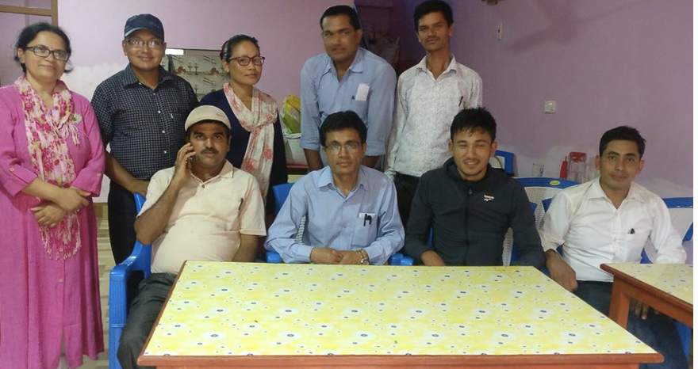
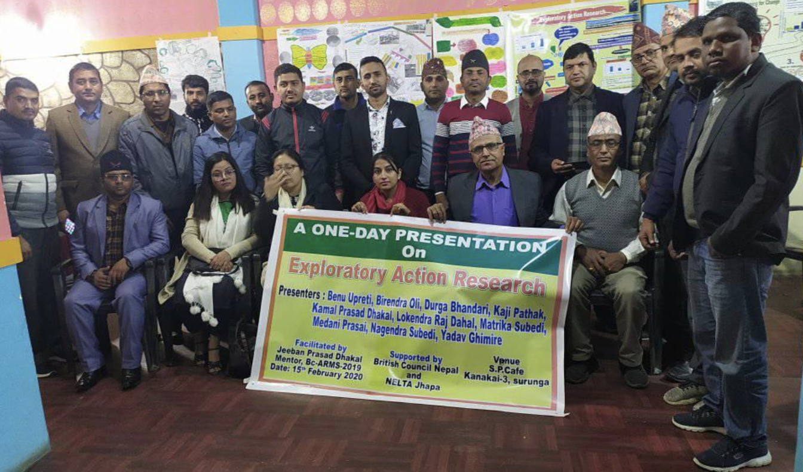
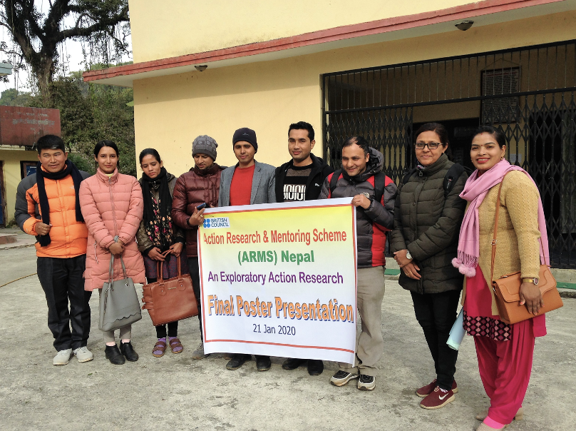
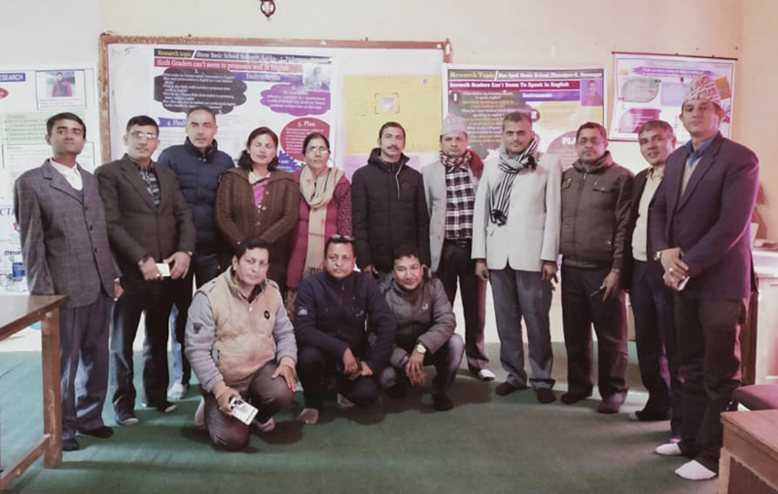
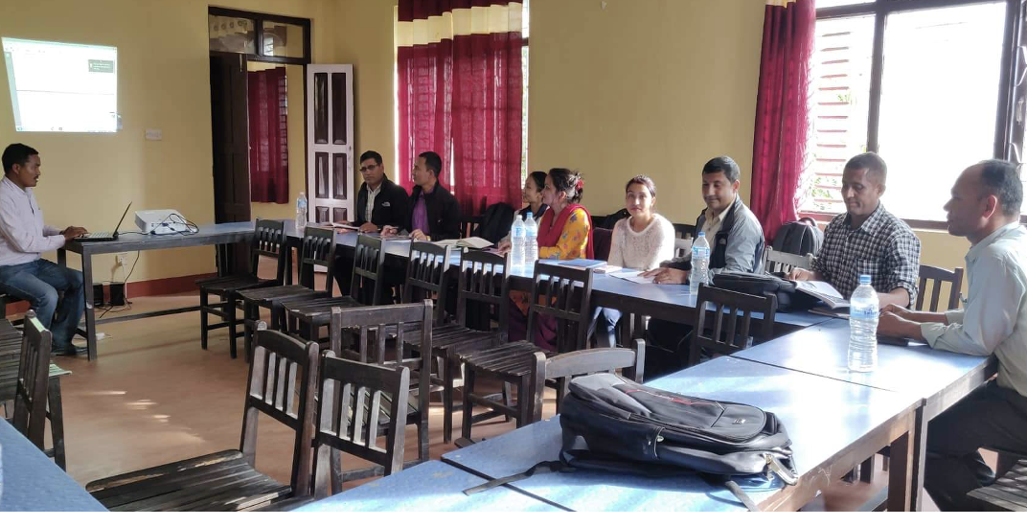
The British Council Action Research Mentoring Scheme (ARMS) (India, Nepal), 2017-20
2017–20 (India): 48 mentors, 235 teachers
2017-20 (Nepal): 26 mentors, 180 teachers
Informing other initiatives in India and Nepal
and elsewhere

Slide 22
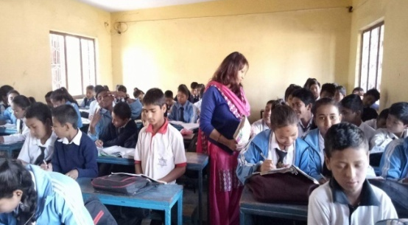

Slide 23


Slide 24
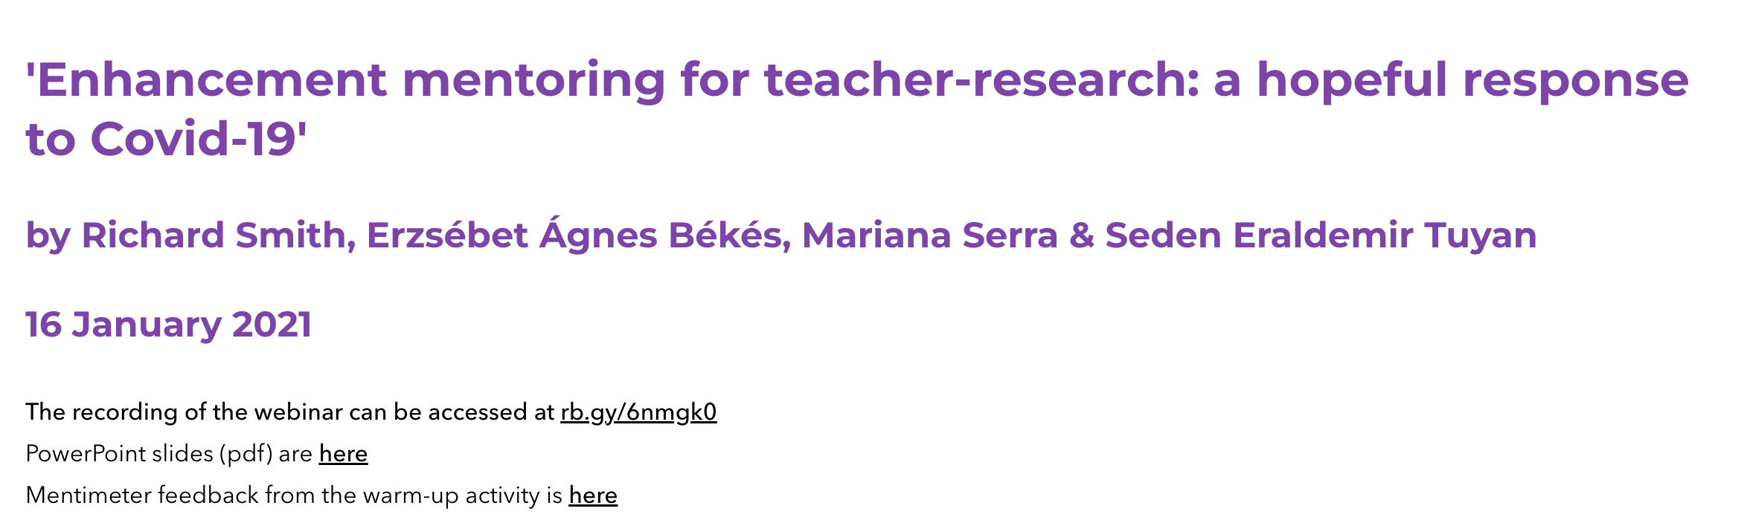
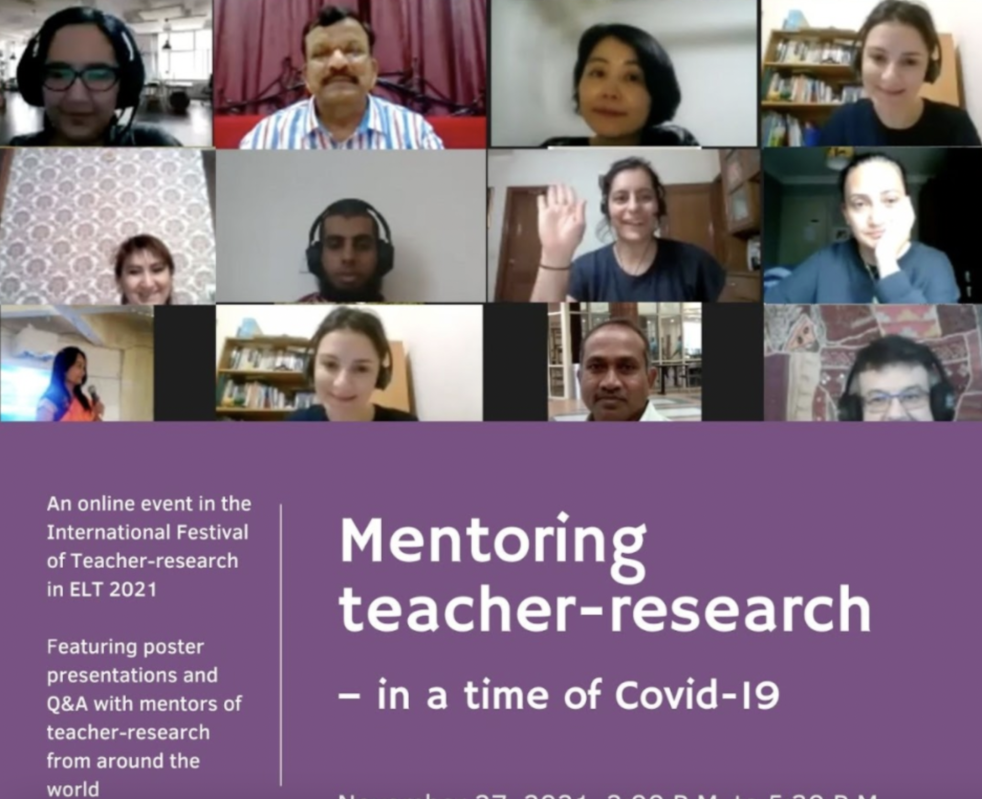

Slide 25

Critiques, concerns, issues and possibilities

Slide 26
Packaging-up / projectifying – EAR / EAR-mentoring as just another British Council ‘global product’?
Questioning quality of research produced – but what is ‘quality research’ for professional development? What can/should be learned from teacher-research by others?
Should the research be more ‘critical’? – would more collaboration between schoolteachers and universities be a good thing or can/should Teacher Associations take on the supporting role?
‘Patenting’ / ‘reifying’ – EAR/EAR-mentoring seen as new ‘recipes’, or are they adaptable/contestable and always under review?
Sustainability – will teacher-research always be a ‘minority pursuit’ or can it become (more) mainstream?

Slide 27

Final thoughts, comments and questions

Slide 28
Why do you value teacher-research / teacher-research mentoring? – sharing more stories
Teacher-research as an ongoing challenge?
Making our motivations, values and goals more explicit – showing why we want to challenge norms with teacher-research …
‘To live outside the law, you must be honest’ (B. Dylan)

