Slide 1
An enhancement approach: Integrating insights from teachers’ own experience
Professor Richard Smith
University of Warwick
warwick.ac.uk/richardcsmith/dakhla

Slide 2
Plan
Introduction: Starting and continuing assumptions
Pre-service training: some initial practical suggestions
Theoretical perspectives: Teacher-learner autonomy’, ‘Teaching in difficult circumstances’ and ‘Decentring’ ELT
An enhancement approach
Teacher-research for difficult circumstances
Teacher-research mentoring
Conclusion: Pre-service proposals (revisited)

Slide 3
1. Introduction: Starting and continuing assumptions
From (too much):
- theory → practice (teacher training)
top → down (reforms / projects)
outside → in (expertise)
To (more):
- practical, local insights in teacher training
bottom-up change
teachers as inquirers and innovators

Slide 4
2. Pre-service training: some initial practical suggestions (from my early experience as a teacher trainer)
Memories of good and bad teachers / good and bad lessons – and discussion
Video of local teachers – and discussion
A community of learning: Trainer + schoolteachers/supervisors + student-teachers
An action research based course

Slide 5
3. Theoretical perspectives: ‘Teacher-learner autonomy’, ‘Teaching in difficult circumstances’ and ‘Decentring ELT’
‘teacher-learner autonomy’: a teacher’s ability to develop themselves professionally, in collaboration with others
‘teaching in difficult circumstances’: teaching in large-class, low-resource contexts typical of public schooling in the Global South
‘Decentring ELT’: English teachers’ own development of contextually appropriate thinking and action in relation to the needs of their local contexts.
warwick.ac.uk/richardcsmith/dakhla

Slide 6


Slide 9
“For too long, the so-called ‘experts’ have been teachers who had little experience of teaching in Africa. […] But all contexts have experts of their own – in our case, those who have been teaching for many years with just a blackboard and chalk. When these local teachers get together and discuss solutions, and when we allow and encourage them to teach in the ways they know are most effective, […] they will then become our own experts” (Lehjef, 2020)

Slide 10
4. An enhancement approach
“setting out to look for positives to build on from within the experiences and from the perspectives of those who know low-resource settings the best – that is, teachers in such settings. This is diametrically opposed to the prevalent ‘deficit model’ of training which is based on preconceptions relating to relatively privileged kinds of classroom; which assumes that practices in small, well-resourced classrooms represent a kind of ‘norm’ that needs to be followed”
warwick.ac.uk/richardcsmith/dakhla

Slide 11


Slide 12
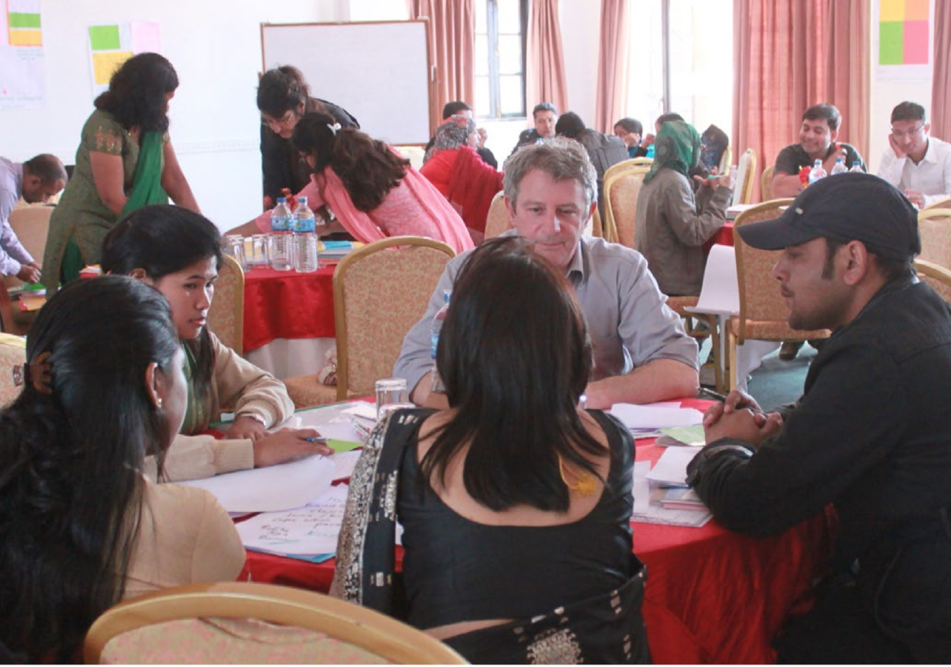
Notes:
I’ll use this to say ‘that’s enough from my perspective’ and what today’s presentation is realy about is how the approach hs taken on a life of its own due to Sagun’s work (Sagun sitting in the back in this photo - now over to you!)
Okay Richard.

Slide 13
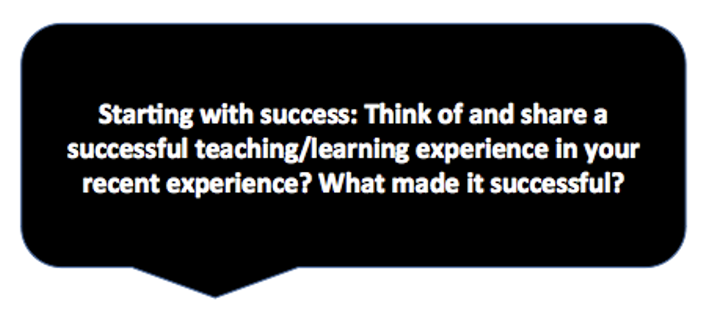

Slide 14
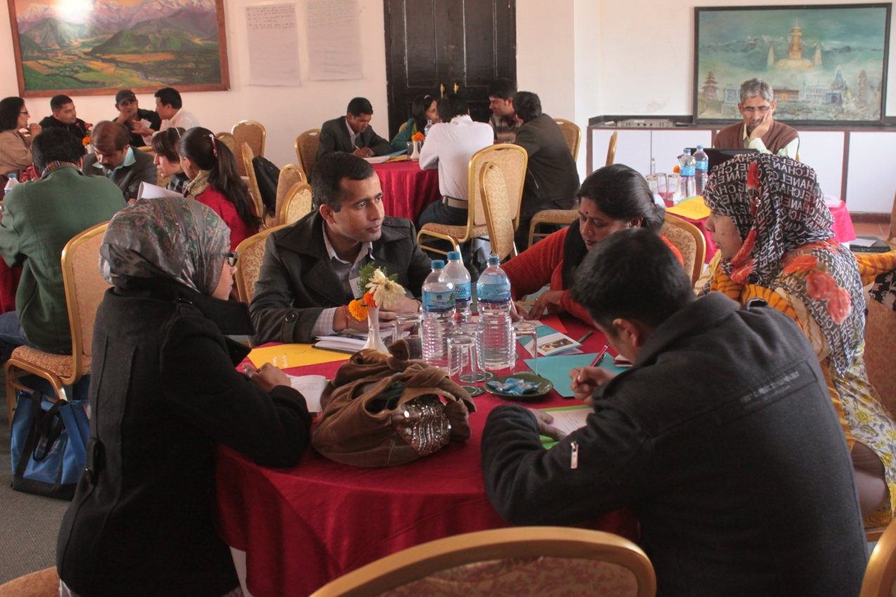

Slide 15
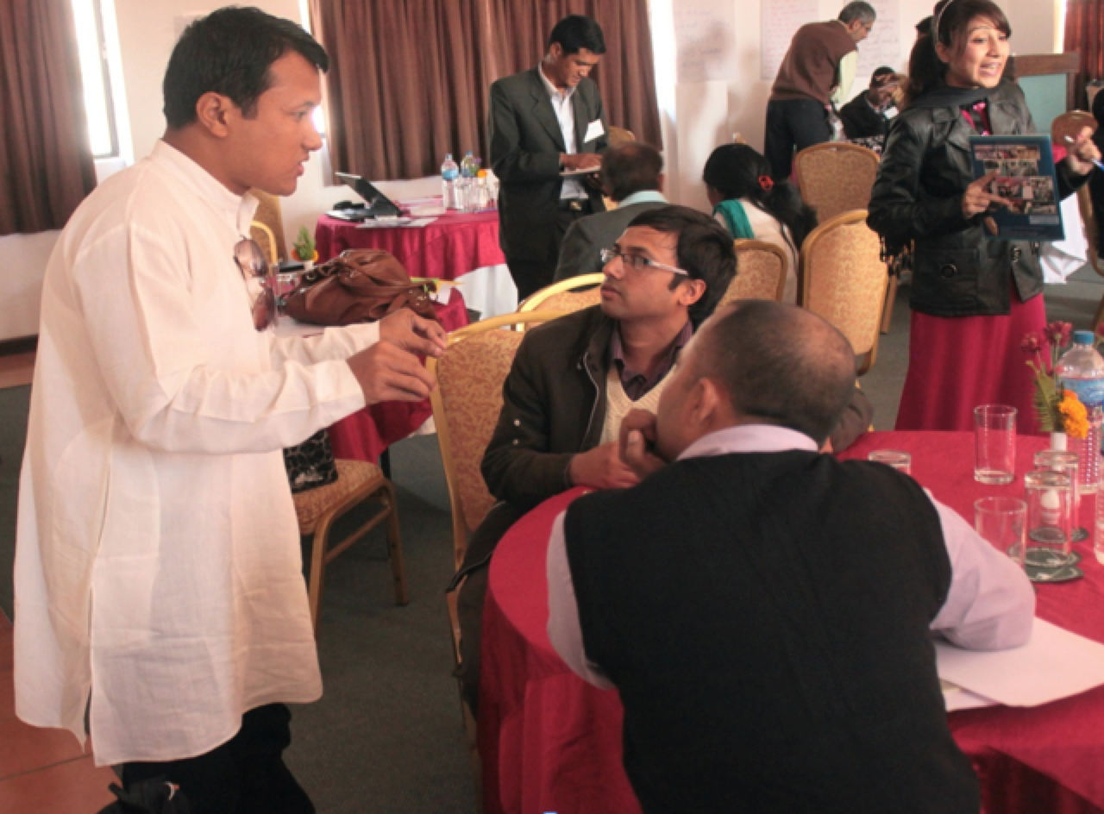

Slide 16
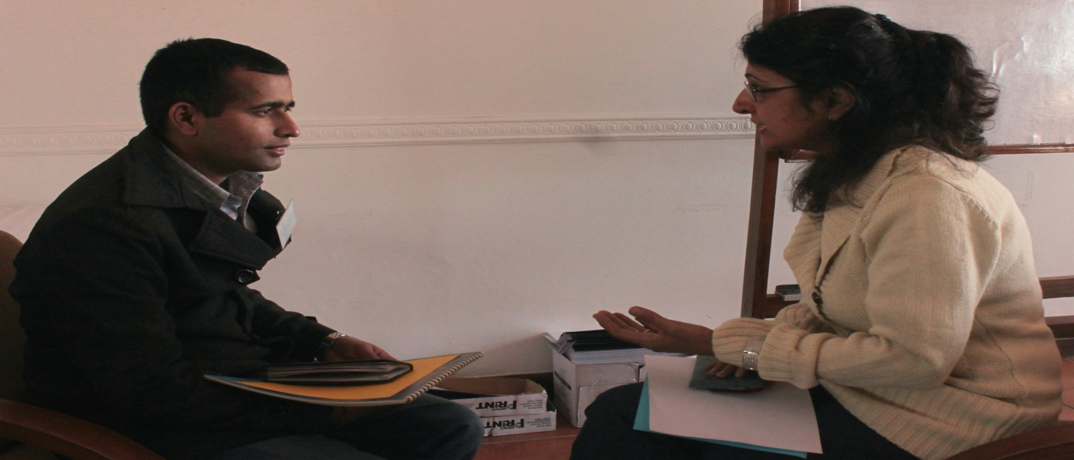

Slide 17
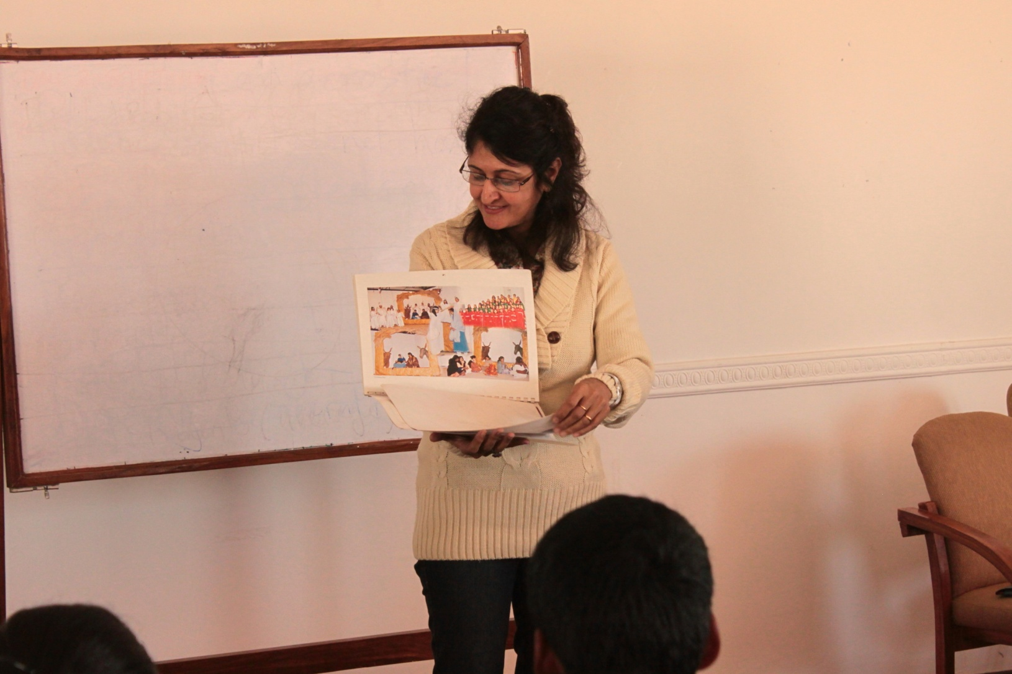

Slide 18

Turning problems into ‘How can I…?’ questions
I have too much homework to mark. It is impossible to give effective feedback to everyone.
How can I provide feedback to students? What are the different forms of feedback can I use?
Not all students participate due to being in a large class.
How can I design activities or group work so all students participate?
It is difficult to promote active learning in large classes when resources such as textbooks, flash cards are limited.
How can I help students to be active in their learning without using resources? What does it mean to be engaged in active learning?
It is difficult to get students’ attention to stop them working on a pair or group task.
How can I attract students’ attention during activities?
Notes:
Examples of problems – with possible questions.

Slide 19
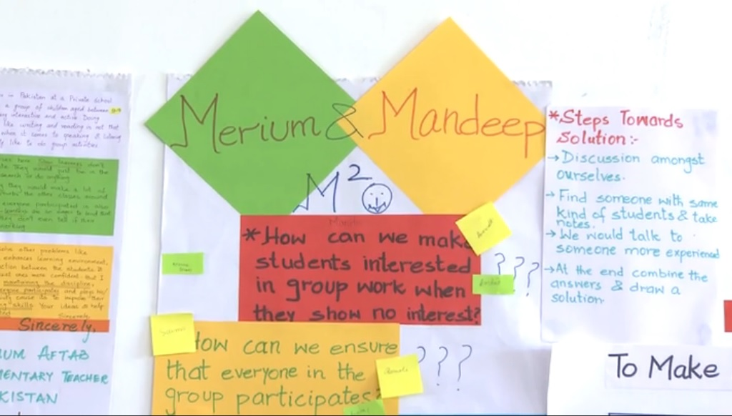
Narrowing down to one main topic and seeking answers to questions from colleagues (building on others’ success)
Notes:
What happened at Hornby School

Slide 20
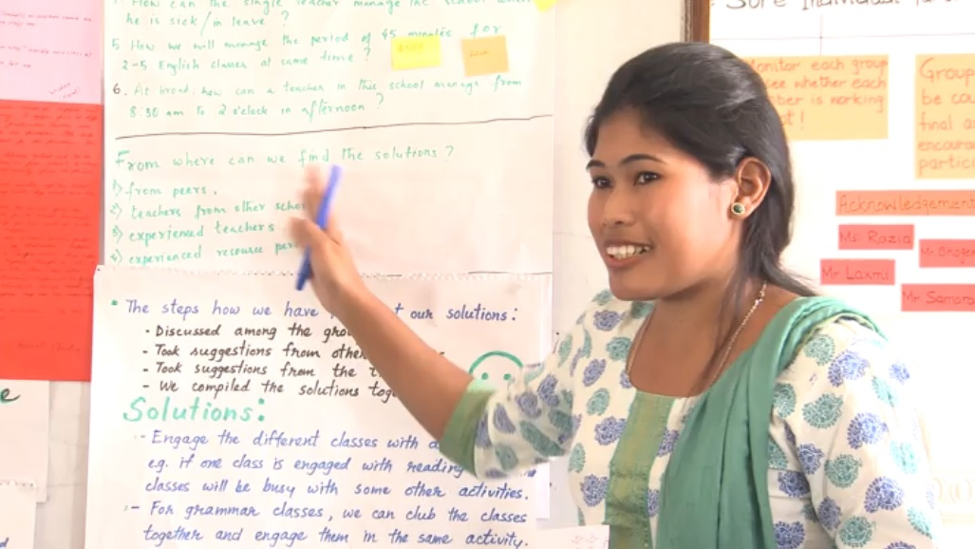
Notes:
Video example of outcome of sharing questions with colleagues. 2 mins 25 secs for solutions to Joya’s problem on slide 9

Slide 21

After the 2013 Kathmandu workshop, teachers tried out ideas gathered from colleagues and evaluated the results (a kind of success-based action research)

Slide 22

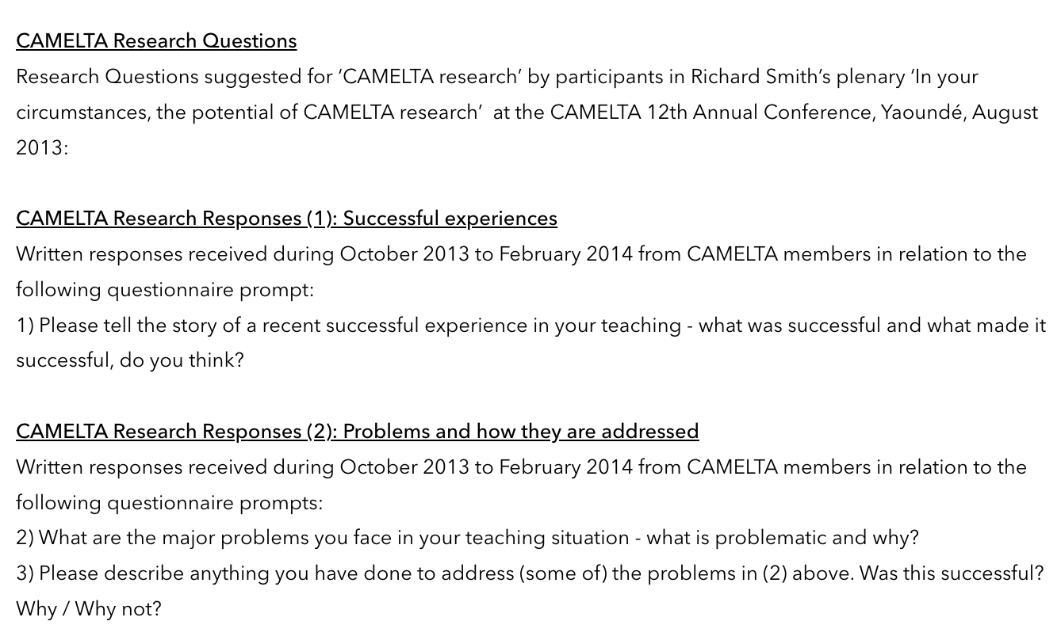

Slide 23
5. Teacher-research for difficult circumstances
“‘How can I as a teacher find time to do research when I don’t even have time to cope with all the normal demands in my classroom?’”
“A particular way of doing teacher-research – Exploratory Action Research – is desirable as well as feasible in relatively difficult circumstances.”
“Exploratory Action Research can in itself be an effective way to address and cope with difficult circumstances (heavy teaching loads, large classes, a lack of material resources, and so on) since it enables teachers to gain a better understanding of their classroom contexts and so develop more appropriate ways of teaching, without waiting for solutions from outside.”
warwick.ac.uk/richardcsmith/dakhla

Slide 24


Slide 25
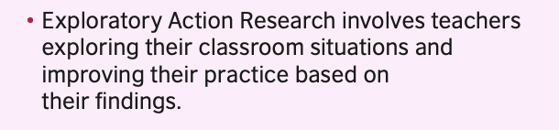




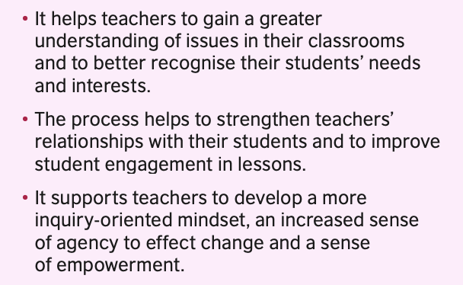

Slide 26


Slide 27
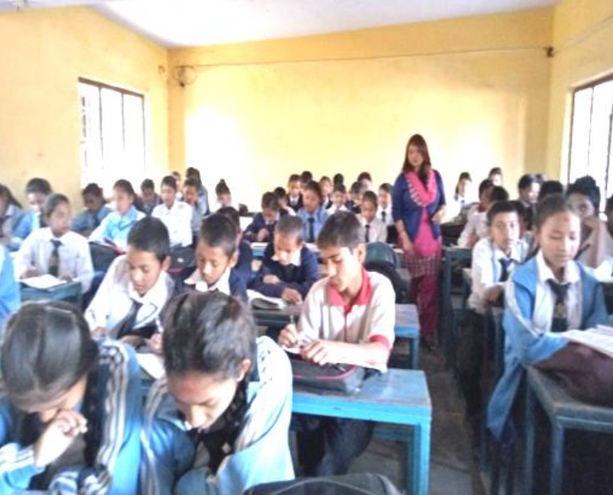

Slide 28

Shova’s problem
Overcrowded classroom - 89 students, very difficult to manage
Students used to make disturbance, talking unnecessarily I tried various techniques
– changing the seats of the students every day
– giving authority to the class monitor,
– dividing students into different groups
… but I could not get success

Slide 29
Shova’s exploratory research questions and methods
Research questions
What particular difficulties do I have in the class?
What causes the disturbance in the classroom?
Research methods
Observation by a colleague
‘Self-observation’ (taking notes)

Slide 30
Exploratory research findings
Most of the students were paying attention
Some sitting near the windows were looking outside and talking to others about what they saw
Some other students were talking about those who were looking outside the windows.

Slide 31
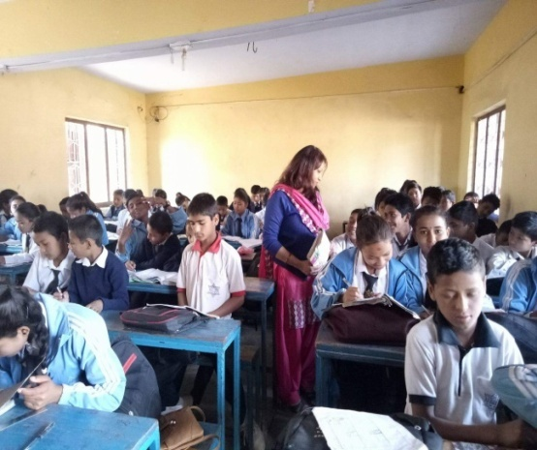
Shova’s plan for action
Give more responsibilities to the students sitting by the windows – and the ‘side talkers’
Move close to the students talking unnecessarily with their friends.

Slide 32

Shova’s action research findings
Observations:
“Nowadays, the situation has changed drastically. Students do not talk unnecessarily, instead they concentrate more on their study and do the assigned tasks. Although they have not stopped side talking completely, they do not talk unnecessarily. They have started talking about the subject matter, which is a positive sign of learning.”

Slide 35
6. Teacher-research mentoring
A mentor is initially needed to motivate and guide teachers to develop a focus and specific questions, gather evidence and thus engage in research to develop their practice.
This process involves enhancing teachers' autonomy to develop for themselves, increasing their ability and willingness to take control of their own learning rather than judging or directly advising them or telling them all the answers.
warwick.ac.uk/richardcsmith/dakhla

Slide 36


Slide 37
Helping teachers / student-teachers to:
decide on a topic (unit 7)
formulate research questions (unit 8)
decide on research tools (unit 9)
engage in data analysis (unit 10)
decide on a way forward (a plan ofor action or further exploration) (unit 11)
decide how to share findings (unit 12)

Slide 38
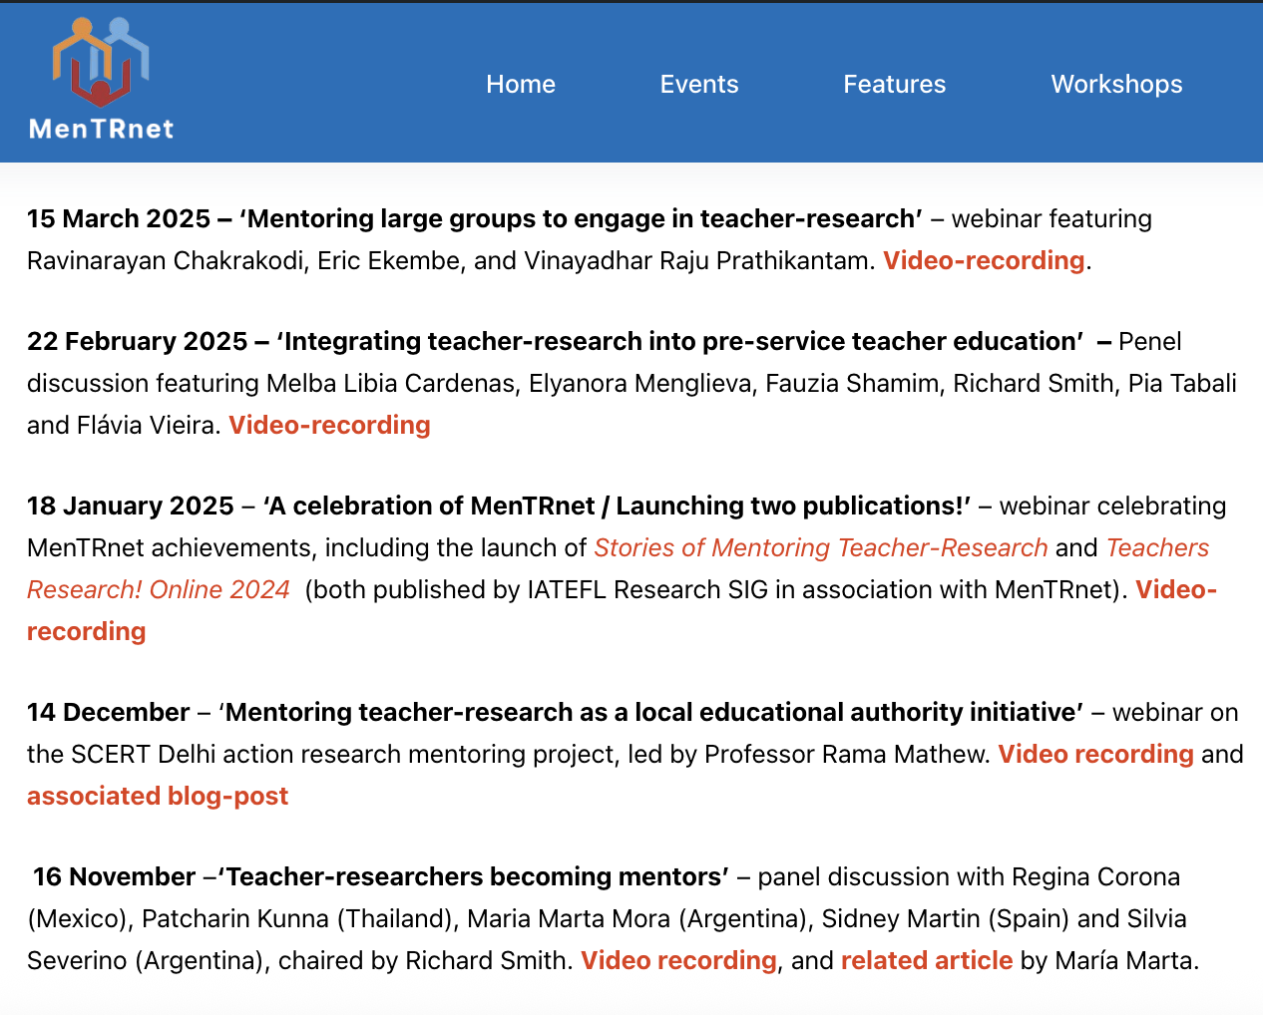

Slide 39
7. Conclusion: Pre-service proposals (revisited) (enhanced dimensions in red)
Reformed contents reflecting an enhancement / decentring approach
Memories of good and bad teachers / good and bad lessons – and discussion
Video of local teachers – and discussion
Research into / identification and sharing of locally successful practices, by academics (?), or via Teacher Association Research / Success Story events.
Reformed processes to enhance teacher-learner autonomy
Communities of learning: Trainer + schoolteachers/supervisors + student-teachers
An exploratory action research based course to develop teacher-learner autonomy. Provide a clear structure, teacher-friendly guidance and supportive mentoring. Reports can be shared to provide positive examples.

Slide 40
Introduction (revisited): Continuing assumptions
From (too much):
- theory → practice (teacher training)
top → down (reforms / projects)
outside → in (expertise)
To (more):
- practical, local insights in teacher training
bottom-up change
teachers as inquirers and innovators

Slide 41
شكرا
ⵜⴰⵏⵎⵎⵉⵔⵜ
Thank you! / Merci!
warwick.ac.uk/richardcsmith/dakhla

