Slide 1




CHALLENGES IN MENTORING TEACHER-RESEARCH, AND HOW TO OVERCOME THEM
Ana García Stone & Richard Smith
IATEFL 2025

Slide 2



PLAN
Introduction / Background (10 mins.)
Discussion activity: Mentoring challenges and possible solutions (25 mins.)
Round-up, resources and next steps (10 mins.)

Slide 3

1. INTRODUCTION / BACKGROUND

Slide 4



Slide 5
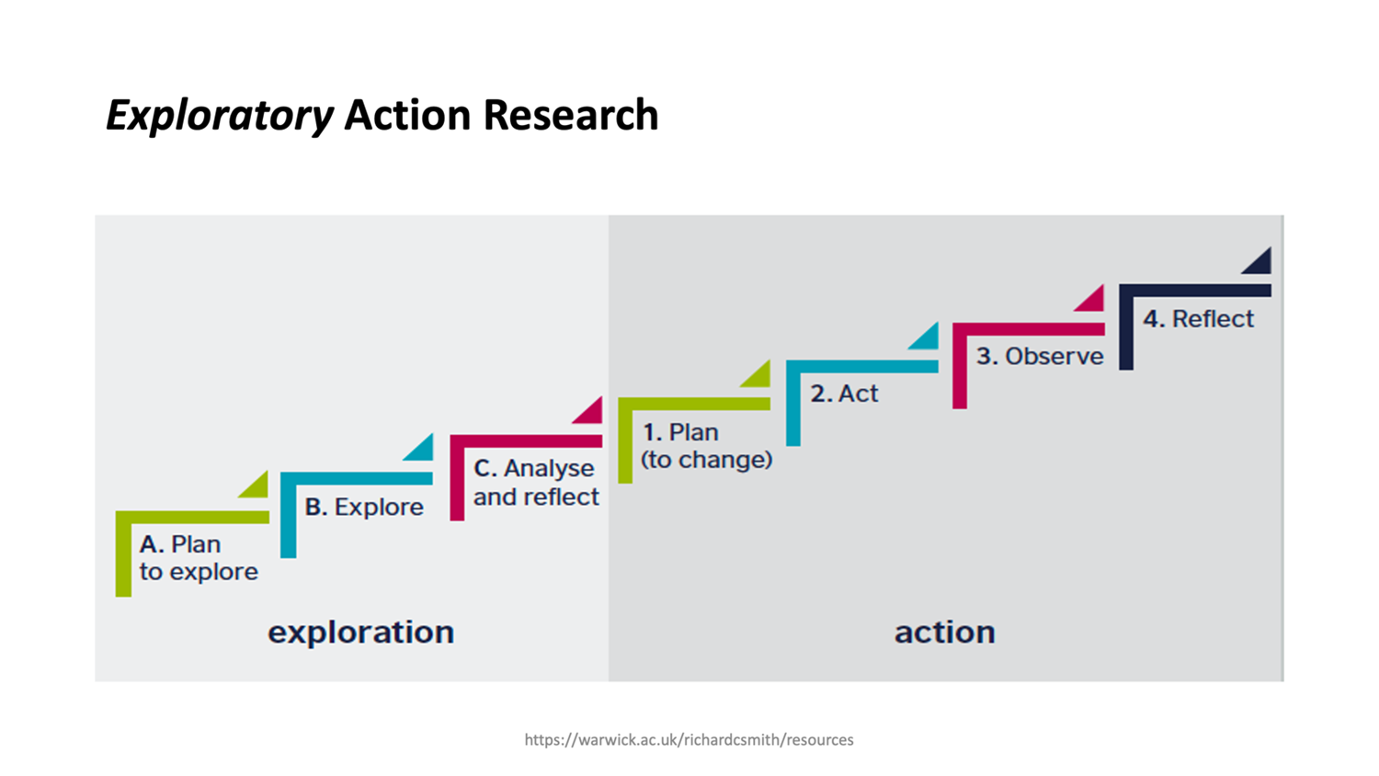

Slide 6
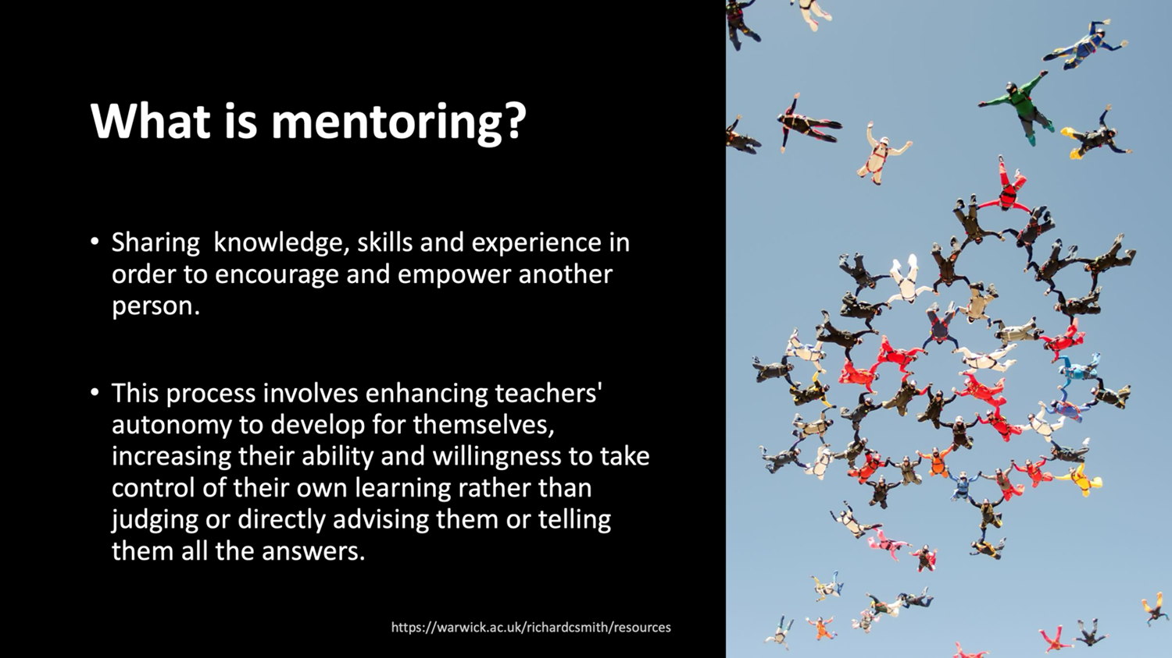

Slide 7
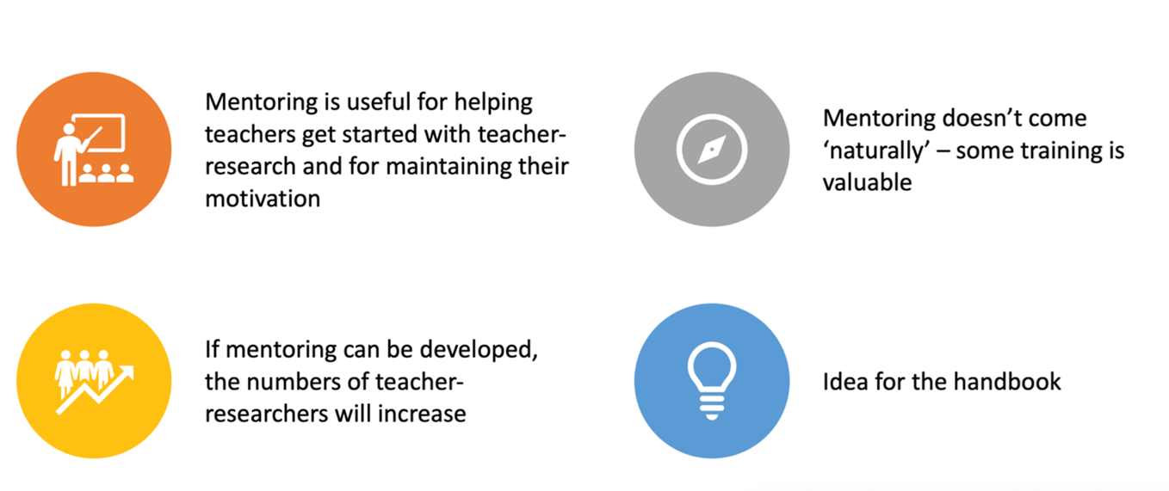

Why teacher-research mentoring?

Slide 8
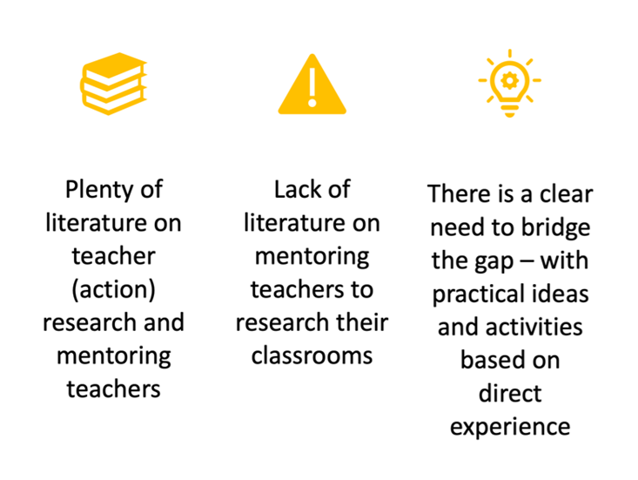

THE IDEA OF A HANDBOOK

Slide 9
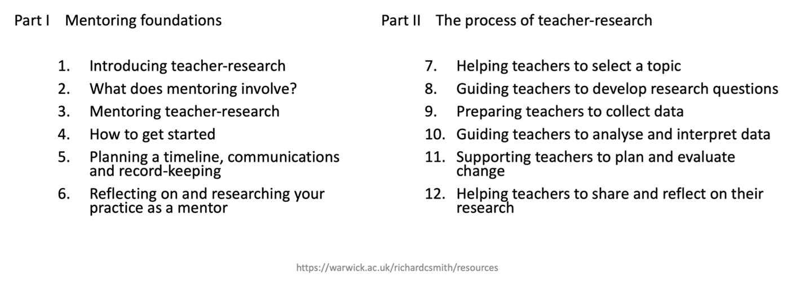

WHAT’S IN THE BOOK? / WHAT A MENTOR NEEDS TO KNOW

Slide 10



Slide 11



Slide 12



Slide 13



Slide 14



Slide 15





Slide 16



Slide 17


MenTRnet

Slide 18


MenTRnet / ReSIG

Slide 19

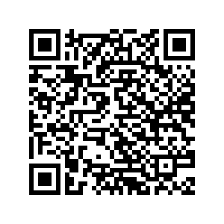



MenTRnet / ReSIG

Slide 20

2. DISCUSSION ACTIVITY:
CHALLENGES AND POSSIBLE SOLUTIONS
Group discussion for 25 minutes
In groups, quickly read about some teacher-research mentoring challenges on the handout. Choose the ones you find most interesting, and discuss possible solutions.
Then look at and discuss the provided responses – any surprises?

Slide 21

3. RESOURCES AND NEXT STEPS
....

Slide 22

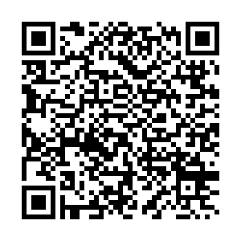

Slide 23
MenTRnet / ReSIG

Slide 24

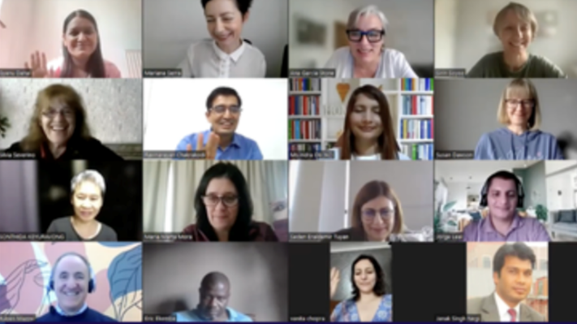
Join us!
MenTRnet

Slide 25


MenTRnet /
ReSIG

Slide 26


MenTRnet /
ReSIG

Slide 27

MenTRnet /
ReSIG

Slide 28
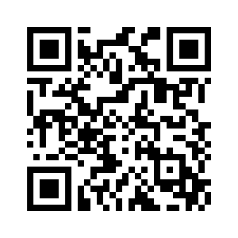



MenTRnet /
ReSIG
Workshops for teachers
mentrnet.net/workshops –
Starting September 29th!

Slide 29
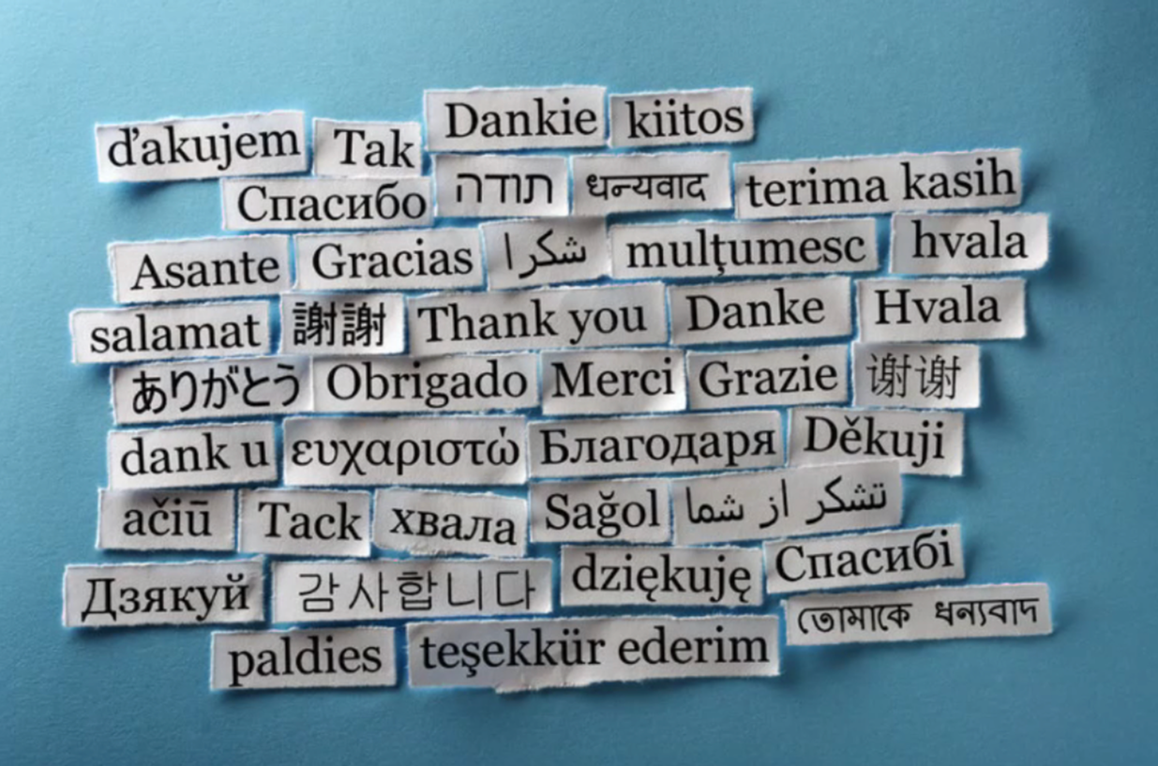

Slide 30




Slide 31
Link for these PowerPoint slides and the handouts:
warwick.ac.uk/richardcsmith/iatefl2025

