Slide 1
Learner and teacher autonomy – or agency?
Professor Richard Smith, University of Warwick
Talk in the University of Limerick ‘Issues In Applied Linguistics’ series

Slide 2
Learner and teacher autonomy – or agency? And what of empowerment, motivation, engagement, identity and wellbeing?

Slide 3
Plan
‘Concepts’ in language learning/teaching research in general – and ‘key concepts’
A narrative of (research) practice and associated key concepts:
- 1. LEARNER AUTONOMY oriented practice (Japan, 1990s)
- 2. TEACHER AUTONOMY oriented practice (UK, 2000s)
- 3. teaching in DIFFICULT CIRCUMSTANCES (international, 2000s,
2010s)
- 4. TEACHER-RESEARCH / teacher AGENCY, MOTIVATION, WELLBEING,
EMPOWERMENT? (LatAm, S. Asia, 2010s)
- 5. teacher-research MENTORING / mentor IDENTITY? (S. Asia,
international, 2010s)
Concluding reflections on ‘concepts’ in research

Slide 4
‘Concepts’ in language learning/teaching research in general – and ‘key concepts’
An overarching ‘issue’ (pseudo-issue?) – lack of engagement by practitioners with applied linguistic research
Or irrelevance/inaccessibility of such research to practitioners? (A problem for applied linguistics more than for practitioners)?
What is applied linguistics/Why applied linguistics (1)? A ‘practice-driven discipline’ to address ‘real-world problems’ around language (Brumfit, 1997).

Slide 5
Why applied linguistics? (2): In the absence of explicit theorization (accompanied by research), there is no principled basis for language teaching. (cf. Stern 1983)
But maybe also: In the absence of a context or contexts of practice in relation to which theorization and research occur, there’s no justification/need for applied linguistics!
-> need to show out of what context our applied linguistic work is coming and into what context can go – being participatory and impact-focused

Slide 6
Why focus here on ‘concepts’?
Because applied linguistic discourse is replete with concepts but, without careful definition and grounding, these may seem inaccessible, indeed exclusionary, and their use can be quite nonsensical (‘just for show’?)
I will illustrate the need for definition and grounding in a more positive way by showing how certain concepts have arisen out of and fed back into my and others’ practice – and discuss how/whether they have been useful
Use this as an opportunity to consider some definitions/clarifications of key concepts and to highlight the value of defining carefully and grounding contextually.

Slide 7
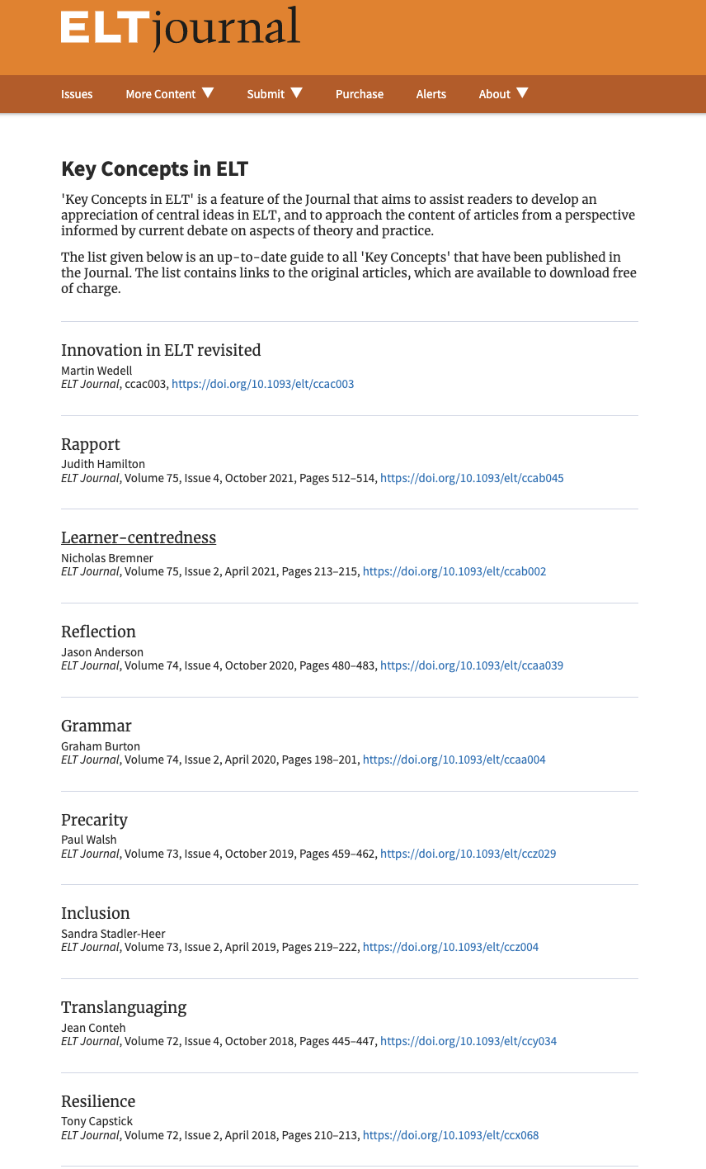

Slide 8
What’s a ‘concept’?
‘an idea or a principle’ [not a practice?]
What’s a ‘key concept’ in ELT?
a concept that is well known to / frequently mentioned by / important to practitioners
Why ‘Key Concepts in ELT’ in ELT Journal?
The meaning of many key concepts can be unclear/ambiguous
Clarifying / ‘unpacking’ what we mean is important to professional development and development of the field

Slide 9
1990s
1. Learner autonomy-oriented practice (Japan)
2000s
2. Teacher autonomy-oriented practice (UK)
2000–2010s
3. Teaching in difficult circumstances (‘Global South’)
2010s
4. Teacher-research / teacher agency, motivation, wellbeing, empowerment? (LatAm, S. Asia)
2010s
5. Teacher-research mentoring / mentor identity? (S. Asia, international)

Slide 10
1990s
1. Learner autonomy-oriented practice (Japan)
2000s
2. Teacher autonomy-oriented practice (UK)
2000–2010s
3. Teaching in difficult circumstances (‘Global South’)
2010s
4. Teacher-research / teacher agency, motivation, wellbeing, empowerment? (LatAm, S. Asia)
2010s
5. Teacher-research mentoring / mentor identity? (S. Asia, international)

Slide 11
Basic teaching procedure (English classes in a university in Tokyo)
Elicit what students do outside class to learn English / share this in class ->
1) Ask what students want to do (1) outside class (2) in class – what, why and how? Draw up written plans ->
2) Engage students in self-directed activity in groups & self-evaluation (for 3 weeks)
3) Presentations in class (4th week) -> Decisions re. ensuing work -> back to (1) or more whole class work
(Smith, 2003)

Slide 12
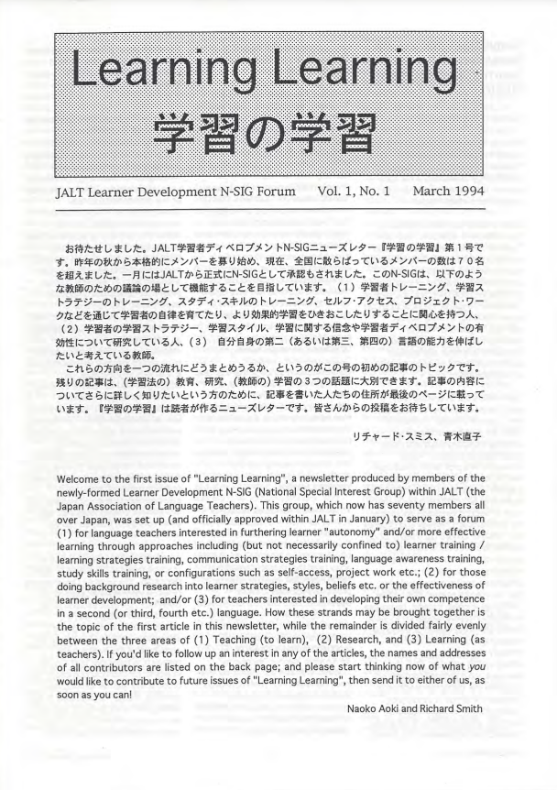


Slide 13
LEARNER AUTONOMY
“the ability to take charge of one’s own learning” (Holec, 1981)
“A capacity and willingness to act independently and in cooperation with others, as a social, responsible person” (Dam et al. 1990)
Individuals’ “capacity to exercise control over their lives” (Benson, 2013)
(vs. ‘self-directed learning’ – actual behaviour)
Benson (1997) identified technical, psychological and political ‘versions’ of learner autonomy
‘strong version’ vs ‘weak version’ of pedagogy for autonomy (Smith, 2003)

Slide 14
A narrative of (research) practice and associated key concepts
1990s
1. Learner autonomy-oriented practice (Japan)
2000s
2. Teacher autonomy-oriented practice (UK)
2000–2010s
3. Teaching in difficult circumstances (‘Global South’)
2010s
4. Teacher-research / teacher agency, motivation, wellbeing, empowerment? (LatAm, S. Asia)
2010s
5. Teacher-research mentoring / mentor identity? (S. Asia, international)

Slide 15
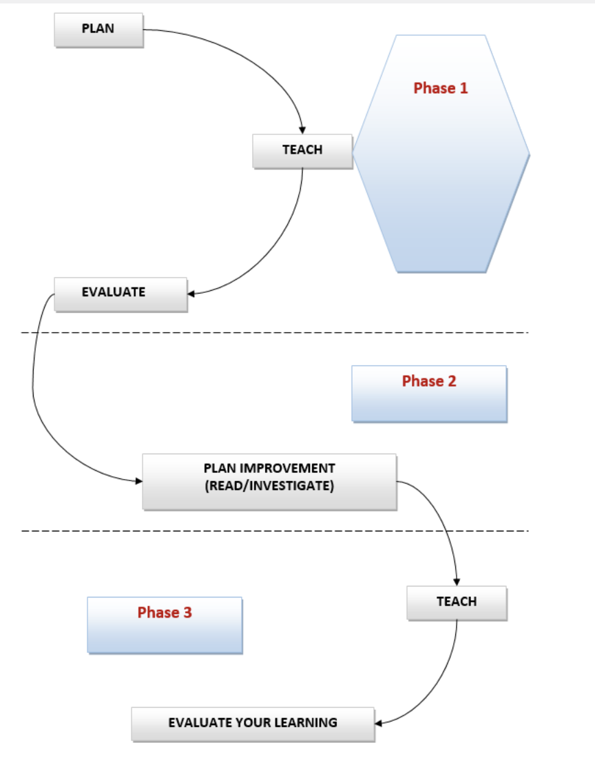


Slide 16
TEACHER AUTONOMY
‘right to freedom from control’ (Benson 2000)
teachers’ capacity to engage in self-directed teaching (Little 1995)
teachers’ autonomy as learners (Smith 2000)
“teacher-learner autonomy” – “the ability to develop appropriate skills, knowledge and attitudes for oneself as a teacher, in cooperation with others” (Smith & Erdogan 2008, p. 83).

Slide 17
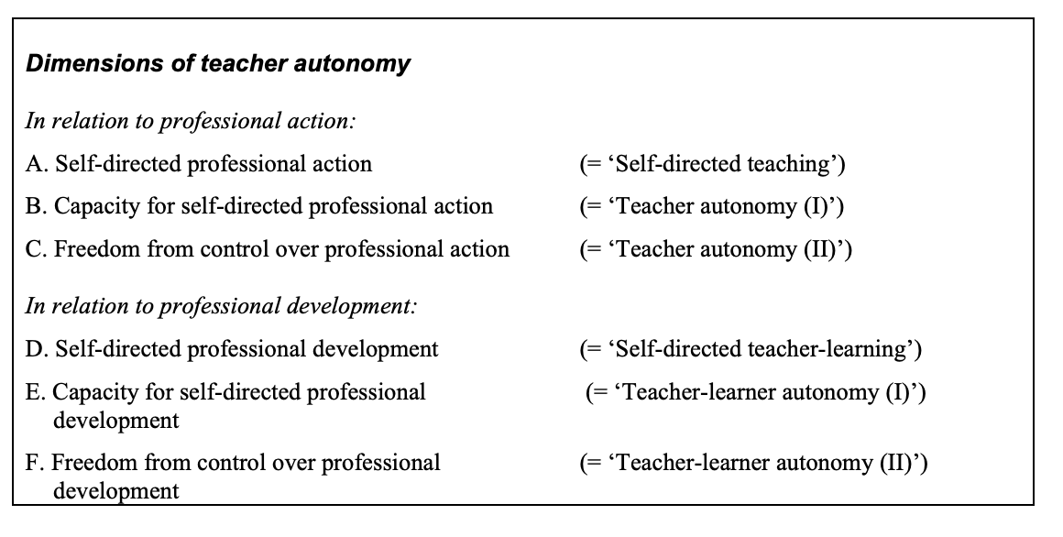

Slide 18
A narrative of (research) practice and associated key concepts
1990s
1. Learner autonomy-oriented practice (Japan)
2000s
2. Teacher autonomy-oriented practice (UK)
2000–2010s
3. Teaching in difficult circumstances (‘Global South’)
2010s
4. Teacher-research / teacher agency, motivation, wellbeing, empowerment? (LatAm, S. Asia)
2010s
5. Teacher-research mentoring / mentor identity? (S. Asia, international)

Slide 19
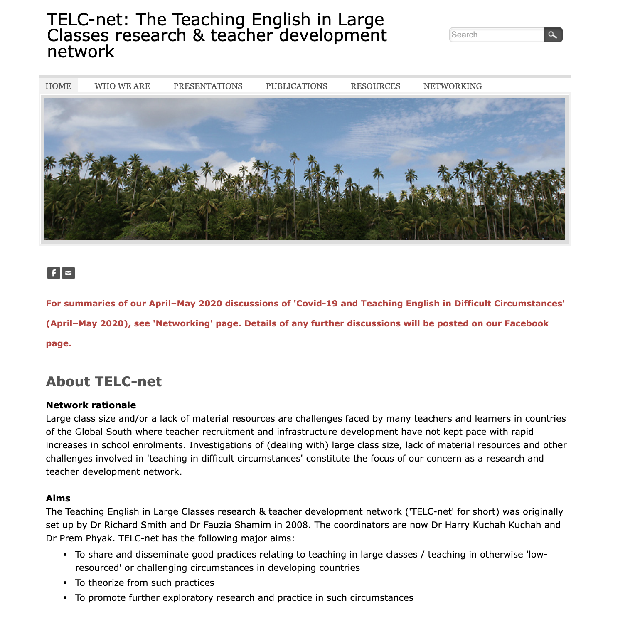
bit.ly/telcnet-home

Slide 20
DIFFICULT CIRCUMSTANCES
“Teaching in difficult circumstances” (TiDC) refers to teaching in contexts where a number of challenging factors are present (cf. West, 1960). These may include:
Large classes, typically over 40 learners;
A lack of basic resources, including textbooks, furniture, stationery, electricity, and even suitable classrooms;
Low school readiness of learners;
Inadequate pre-service and in-service training and support for teachers;
Excessive workload for teachers and other staff.
(Anderson, Padwad & Smith, 2021)

Slide 21
A narrative of (research) practice and associated key concepts
1990s
1. Learner autonomy-oriented practice (Japan)
2000s
2. Teacher autonomy-oriented practice (UK)
2000–2010s
3. Teaching in difficult circumstances (‘Global South’)
2010s
4. Teacher-research / teacher agency, motivation, wellbeing, empowerment? (LatAm, S. Asia)
2010s
5. Teacher-research mentoring / mentor identity? (S. Asia, international)

Slide 22
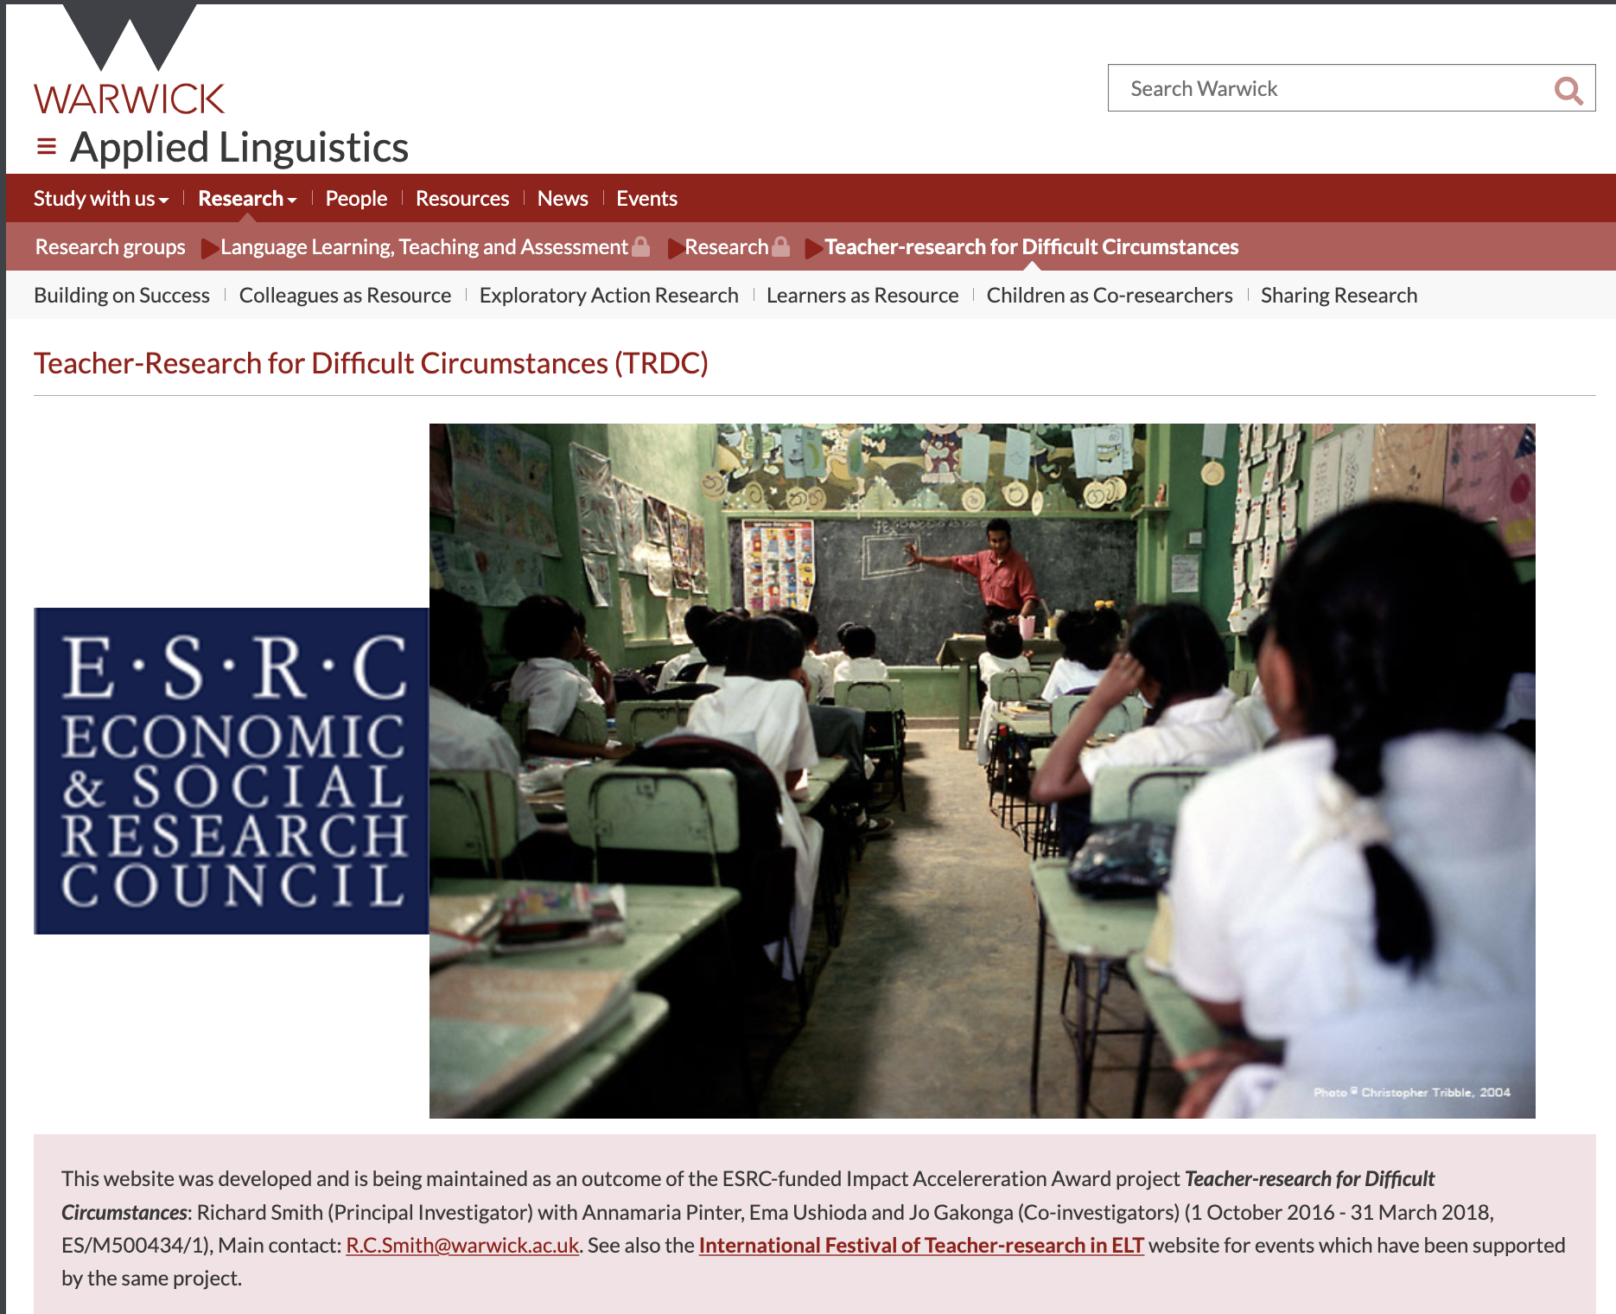
warwick.ac.uk/trdc

Slide 23
TEACHER-RESEARCH
Different labels:
Reflective practice / Reflective teaching
Practitioner inquiry / Teacher inquiry
Practitioner research / Teacher-research
Action research
Exploratory action research

Slide 24
SOME CONFUSING (OFTEN-CONFUSED) TERMS
CLASSROOM (BASED) RESEARCH
TEACHER-RESEARCH
PRACTITIONER RESEARCH
ACTION RESEARCH
REFLECTIVE PRACTICE
TEACHER INQUIRY

Slide 25
RESEARCH
‘Systematic inquiry made public’ (Stenhouse 1978)
‘The organised, systematic search for answers to the questions we ask’ (Hatch & Lazaraton 1991)
‘a process of inquiry consisting of three elements or components: (1) a question, problem, or hypothesis, (2) data, (3) analysis and interpretation of data’ (Nunan 1992)

Slide 26


TEACHER-RESEARCH
Research done by teachers into issues which concern them
Addressing questions that arise from your practice by gathering data, analysing it, and sharing what you find
Research by teachers for teachers (and their students)

Slide 27
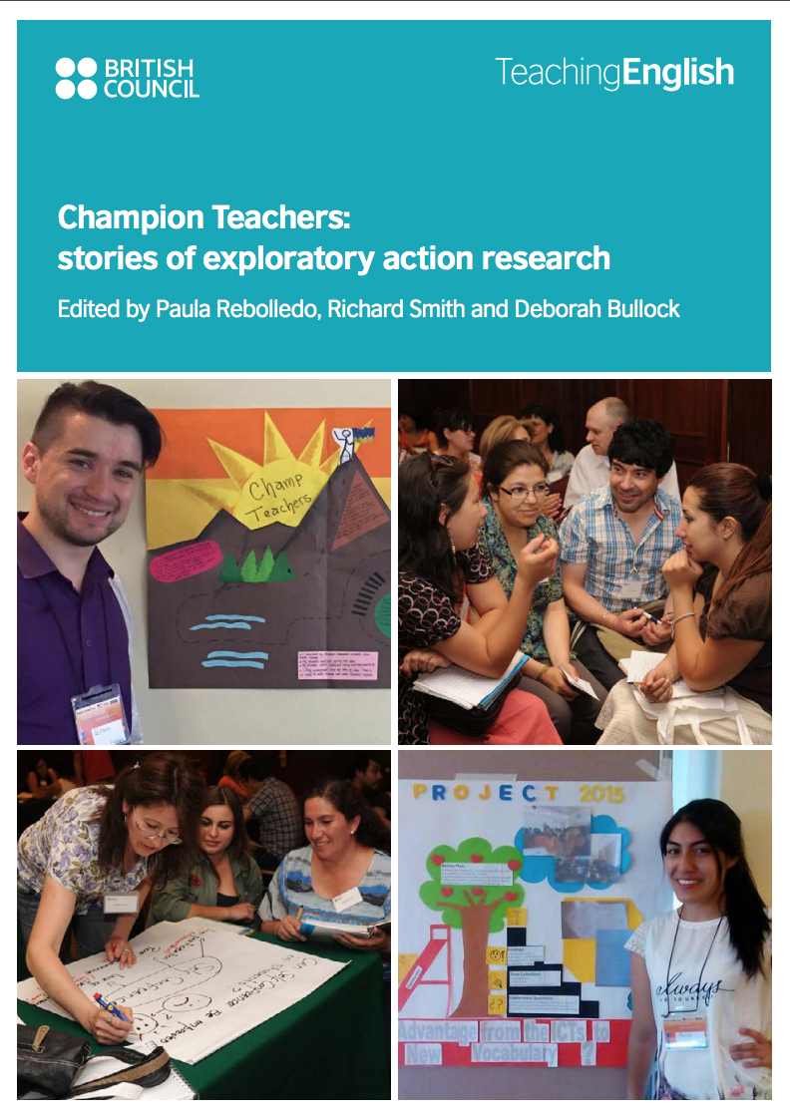

Slide 29
Martha’s teaching context
Public middle school
A class of 35 students
Martha’s problem
Disruptive students
After breaks it took 10 minutes to get students in from outside
Misbehaving, e.g.
Laughing out loud
Hitting things
* Getting up and leaving room (especially at end of class)

Slide 30
’s exploratory research questions and methods
Research questions
When does misbehavior occur in class?
Research methods
Video journal
Student questionnaire
What do I do when misbehavior occurs and how effective are my actions?
Do students agree that they are misbehaving?
Observation by a colleague

Slide 31
Martha’s exploratory research findings
From video journals, she found students misbehaved especially at the beginning and end of lessons
Her main strategy was punishment. But nothing she did worked
Students agreed overall that they misbehaved. However, not all agreed about what constituted bad behaviour – many seemed unaware of how they should behave

Slide 32
Get students to create their own classroom rules
Practise positive reinforcement
Martha’s action plan

Slide 33
Individual reflection on what rules are and why they’re necessary

Slide 34
Groups made posters

Slide 36

Martha’s action research findings
After the Action: Observation
Students had started arriving on time
Students still chatted a lot when they came in but got focused more quickly
The students were working in a more orderly way
Students’ behavior at end of the class totally changed – nobody got up early to leave

Slide 39
AUTONOMY -> AGENCY?
As with autonomy, there are different perspectives…
(1) agency as personal attributes that individuals possess to varying degrees;
(2) seeing agency as capacity that is mediated by the interaction between personal efforts and social forces;
(3) understanding agency as actions influenced by their environment.
In the ecological approach, teacher agency is a situated achievement within “existing cultures of thinking, working, and doing, and on wider structural issues”, rather than “merely . . . a capacity or possession of the individual” (Priestley et al., 2015).

Slide 40
EMPOWERMENT
“a process whereby school participants develop the competence to take charge of their own growth and resolve their own problems. Empowered [= ‘agentive’?] individuals believe they have the skills and knowledge to act on a situation and improve it.”
(Short, 1994)

Slide 41
MOTIVATION
“the dynamically changing cumulative arousal in a person that initiates, directs, coordinates, amplifies, terminates, and evaluates the cognitive and motor processes whereby initial wishes and desires are selected, prioritised, operationalised and (successfully or unsuccessfully) acted out.”
(Dörnyei and Ottó, 1998)

Slide 42
(RE-)ENGAGEMENT
“Constructive, enthusiastic, willing, emotionally positive and cognitively focused participation with learning activities”
(Skinner & Pitzer, 2012, p.22)
“Engagement refers to a state of heightened attention and involvement, in which participation is reflected not only in the cognitive dimension, but in social, behavioral, and affective dimensions as well”
(Phip & Duchesne, 2016)

Slide 43
WELLBEING
Hedonic perspectives: “the presence of pleasant/positive affect, relative lack of unpleasant/negative affect, and life satisfaction” vs.
Eudemonic perspectives concentrate more on individuals’ sense of meaning and self-actualisation: “when individuals have the psychological, social and physical resources they need to meet a particular psychological, social and/or physical challenge.”
(Jin et al., 2021)

Slide 44
A narrative of (research) practice and associated key concepts
1990s
1. Learner autonomy-oriented practice (Japan)
2000s
2. Teacher autonomy-oriented practice (UK)
2000–2010s
3. Teaching in difficult circumstances (‘Global South’)
2010s
4. Teacher-research / teacher agency, motivation, wellbeing, empowerment? (LatAm, S. Asia)
2010s
5. Teacher-research mentoring / mentor identity? (S. Asia, international)

Slide 45

mentoring-tr.weebly.com

Slide 46
MENTORING
“sharing knowledge, skills and experience in order to encourage and empower another person. In contexts of teacher development, this process involves enhancing teachers' autonomy to develop for themselves, increasing their ability and willingness to take control of their own learning rather than judging or directly advising them or telling them all the answers.”
(Smith, 2020)

Slide 47
IDENTITY
“how a person understands his or her relationship to the world, how that relationship is constructed across time and space, and how the person understands possibilities for the future”
(Norton, 2013)

Slide 48
Concluding reflections on ‘concepts’ in research
Challenge to and change in concepts are (particularly?) endemic in applied linguistics – see Hunter & Smith (2012).
Concepts are often ‘bandied about’ without clear definition.
We think meanings are shared but often terms are used by different people with different meanings (or different terms are used for the same ‘thing’).
Definition and contrast/comparison of terms by you (as a researcher) is important, to show critical understanding.
Show how concepts are rooted in practice and can be related back to practice – that’s being ‘applied linguistic’!

Slide 49
References
Anderson, J., Padwad, A., & Smith, R. (2021). Language Teaching in Difficult Circumstances. In Research Questions in Language Education and Applied Linguistics (pp. 111-116). Springer, Cham.
Benson, P. (2000). Autonomy as a learners’ and teachers’ right. In Learner autonomy, teacher autonomy: Future directions (pp. 111-117). Longman.
Benson, P. (2013). Teaching and researching: Autonomy in language learning. Routledge.
Benson, P. (2014). The philosophy and politics of learner autonomy. In Autonomy and independence in language learning (pp. 18-34). Routledge.
Brumfit, C. (1997). How applied linguistics is the same as any other science. International Journal of Applied Linguistics, 7(1), 86-94.
Dam, L., R. Eriksson, D. Little, J. Miliander, and T. Trebbi. 1990. ‘Towards a definition of autonomy’ in T. Trebbi (ed.). Third Nordic Workshop on Developing Autonomous Learning in the FL Classroom. Bergen: University of Bergen.
Dornyei, Z., & Ottó, I. (1998). Motivation in action: A process model of L2 motivation.
Hatch, E. & Lazaraton, A. (1991) The Research Manual: Design and Statistics for Applied Linguistics. Boston: Heinle & Heinle.
Holec, H. 1979/1981. Autonomie et apprentissage deslangues e ́trange`res. Strasbourg: Council of Europe. (English translation published in 1981 as Autonomy in Foreign Language Learning. Oxford: Pergamon.).
Hunter, D., & Smith, R. (2012). Unpackaging the past:‘CLT’through ELTJ keywords. ELT journal, 66(4), 430-439.
Jin, J., Mercer, S., Babic, S., & Mairitsch, A. (2021). Understanding the ecology of foreign language teacher wellbeing. In Positive Psychology in Second and Foreign Language Education (pp. 19-38). Springer, Cham.

Slide 50
References
Little, D. (1995). Learning as dialogue: The dependence of learner autonomy on teacher autonomy. System 23.2, 175–182.
Norton, B. (2013). Identity and language learning. Multilingual matters.
Nunan, D. (1992) Research Methods in Language Learning. Cambridge: Cambridge University Press.
Philp, J. & Duchesne, S. (2016). Exploring engagement in tasks in the language classroom. Annual Review of Applied Linguistics, 36,50-72.
Priestley, M., Priestley, M. R., Biesta, G., & Robinson, S. (2015). Teacher agency: An ecological approach. Bloomsbury Publishing.
Short, P. M. (1994). Defining teacher empowerment. Education, 114(4), 488-493.
Skinner, E. A., & Pitzer, J. R. (2012). Developmental dynamics of student engagement, coping, and everyday resilience. In Handbook of research on student engagement (pp. 21-44). Springer, Boston, MA.
Smith, R. (2000). Starting with ourselves: Teacher-learner autonomy in language learning. Learner autonomy, teacher autonomy: Future directions, 89-99.
Smith, R. (2003) Pedagogy for autonomy as (becoming-)appropriate methodology'. In Smith, R.C. and D. Palfreyman (eds), Learner Autonomy across Cultures. Basingstoke: Palgrave Macmillan
Smith, R. (2020). Mentoring teachers to research their classrooms: A practical handbook. New Delhi, India: British Council India.
Smith, R. & Erdoğan. (2008). Teacher-learner autonomy: Programme goals and student-teacher constructs. In T. Lamb & H. Reinders (Eds.), Learner and Teacher Autonomy: Concepts, realities, and response (pp.83-103). John Benjamins Publishing.
Stern, H.H. (1983) Fundamental Concepts of Language Teaching. Oxford University Press.
West, M. (1960). Teaching English in difficult circumstances. Longmans, Green.
Stenhouse, L. (1980). The study of samples and the study of cases. British Educational Research Journal, 6(1), 1-6.

