Slide 1

Some complex ethical puzzles when working with participants under 18 years of age
Annamaria Pinter
University of Warwick WICAL conference
28 June 2022

Slide 2
Welcome and getting to know the audience
How old are your participants ( current or past study)?
One ethical issue/ problem that you think is specific to this population only?

Slide 3
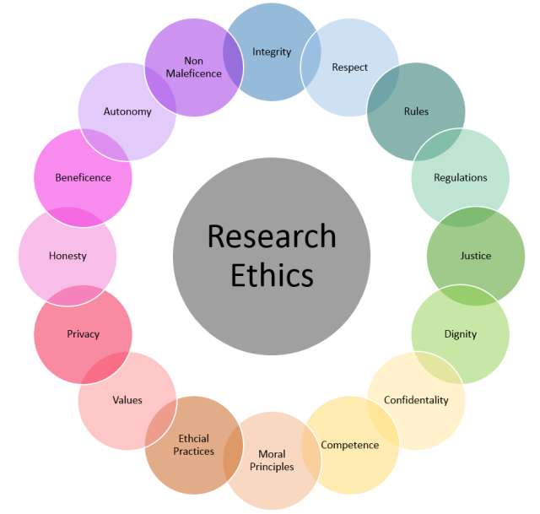
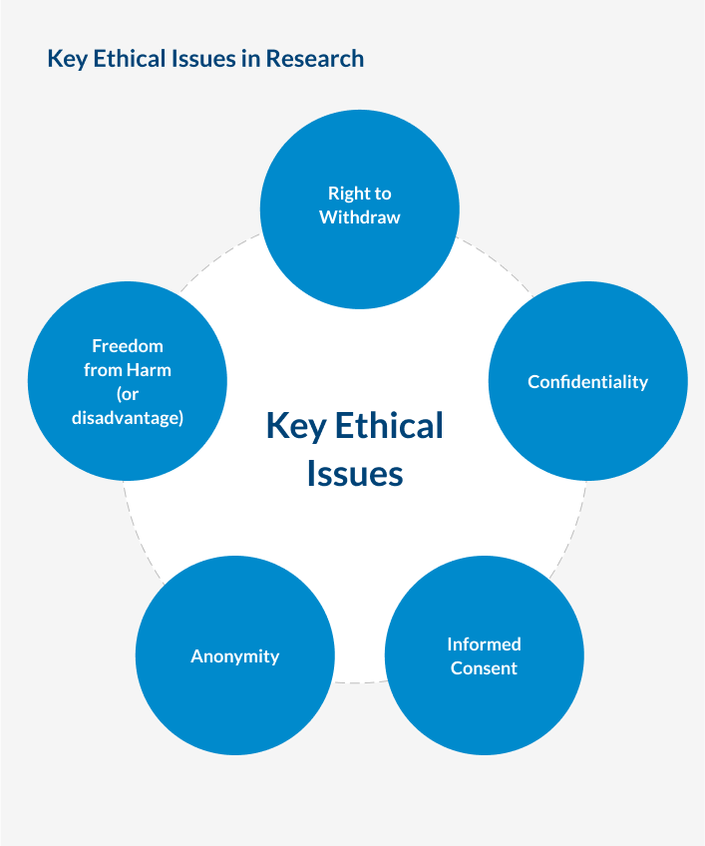
University College Dublin
Public health notes

Slide 4

Research Ethics
Who is a child/ young person?
Who is the researcher?
What is research?
What is right and wrong in ethics?
This Photo by Unknown Author is licensed under CC BY

Slide 5


Child
Teenager
Youth / young people

Slide 6
Should children/under 18s be treated differently to adults?
How is competence understood and viewed?
Children versus parents/ guardians?
The beginnings of child ethics
The ‘Gillick criteria’ of competence

Slide 7
Macro-ethical concerns
National, institutional and international legislation:
  University ethical boards/ committees;
  Ethics guidelines of national/ international organisations such as BAAL BERA, ERIC, APS, etc;
  International, UN, UNICEF, UNCRC (1989);

Slide 8

Micro-ethical concerns
Relationship issues
Unexpected constraints
Important last-minute discoveries
Etc

Slide 9

TENSION between macro and micro-ethics
This Photo by Unknown Author is licensed under C-SA

Slide 10
Tensions and dilemmas
What dilemmas have you faced in your research with under 18s that resulted from a tension between macro- and micro-ethical concerns?

Slide 11

Traditional versus alternative research methods with children
Objects versus subjects or social actor status
Looking down or looking up
Passive or active roles
Ethical practices: emphasis moves from protection to enabling
This Photo by Unknown Author is licensed under CC BY-SA

Slide 12

Where are you on the continuum?
Traditional and alternative paradigm, research ‘on’, ‘about’, ‘with’ and ‘by’ children and young people

Slide 13

The adult researcher
Traditional or alternative paradigm of child-focused research
Mindset
Conception of childhood
Research paradigm and research questions
The context ( e.g. school or outside school)

Slide 14
Practical questions
Is the research necessary?
Who gets to participate? Who decides?
Who benefits?
If participants are at school, how does the research and the school system fit together?
Do parents/ guardians and under 18s agree about participation? What if they don’t ?
How is the research presented to the participants?
What do participants know about their rights in general and in research?
Can informed consent be achieved? Or assent? Oral/ written? Ongoing?

Slide 15

Practical questions
Withdrawal/peer pressure, disclosure of abuse?
Relationships and power dynamics?
Children’s roles (active or passive)?
Feedback and follow-up?
Adult researcher reflexivity;

Slide 16
macro-context
micro-context
RQ
You

Slide 17
Questions, comments and discussion

Slide 18
Reading:
Alderson, P. & Morrow, V. (2020). (2nd edition) The Ethics of Research with Children and Young People (a practical handbook) London: Sage.
Christensen, P., & A. Prout (2002). Working with ethical symmetry in social research with children Childhood 9(4), 477-497.
Coyne, I. (2010). Research with children and young people: the issue of parental proxy consent. Children and Society, 24, 227-237.
Gallagher, M., Haywood, S. L., Jones, M. W., & Milne S. (2010). Negotiating informed consent with children in school-based research: a critical overview Children and Society 24, 471-482.
Pinter, A., & Kuchah, K. (2021). (Eds.) Ethical and methodological issues in researching young language learners in school contexts. Bristol: Multilingual Matters.
Pinter, A ( 2022) Child-centred ethics in second language education Language Teaching for Young Learners 4/1: 4-29.
Sargeant, J., & Harcourt, D. (2012). Doing ethical research with children. Maidenhead: Open University Press.

Slide 19

Thank you!!!
Annamaria.pinter@warwick.ac.uk

