Slide 1
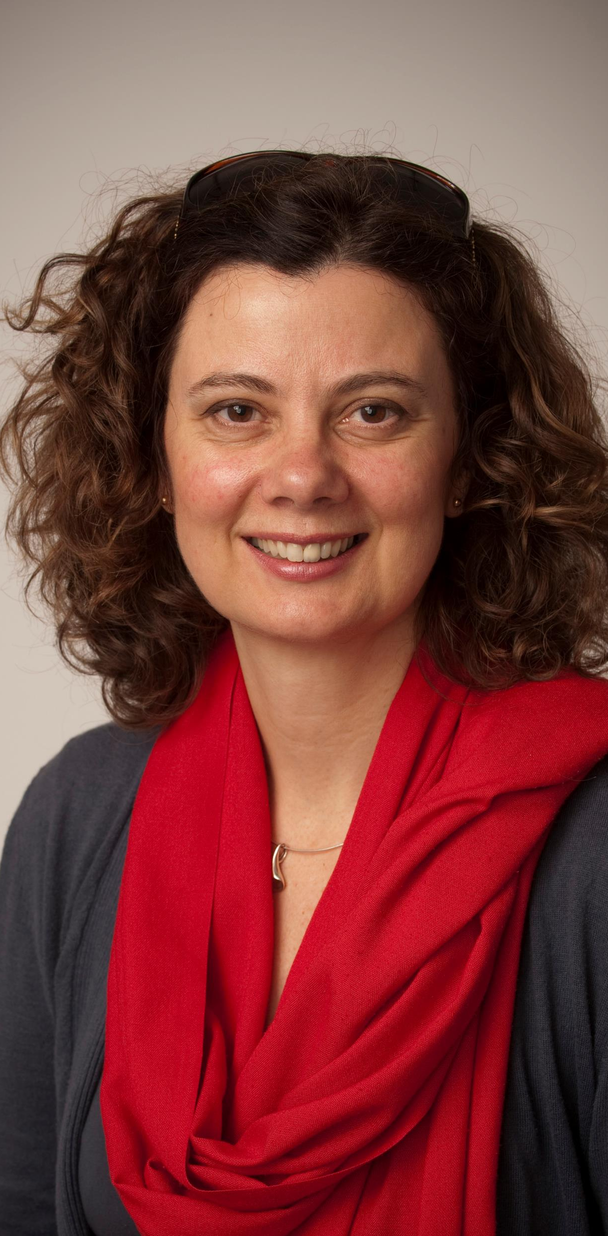
Transcending dialogues in language teacher development (LTD): Exploring practices for wellbeing and quality of life.
Dr Judith Hanks
University of Leeds, UK
WICAL, University of Warwick, 28-30 June 2022

Slide 2
Cascade: Please write in the Chat (don’t press ‘enter’ yet)
What does
Wellbeing
mean to you?

Slide 3
Overview
Unpacking the title: Transcending dialogues
Which dialogues? What is the historical background?
The practitioner research ‘family’ – working for QoL and Wellbeing
Exploring practices: what puzzles teachers?
Some examples of projects (Exploratory Practice; ‘Sticky Objects’)
Concluding remarks
Over to you!

Slide 4

Traditional Hierarchies
Researchers-researched
Researchers
Teachers
Researchers
Teacher educators
Teachers
Researchers
Teacher educators
Teachers
Learners

Slide 5

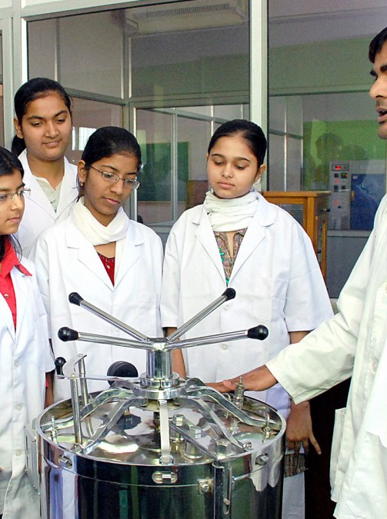
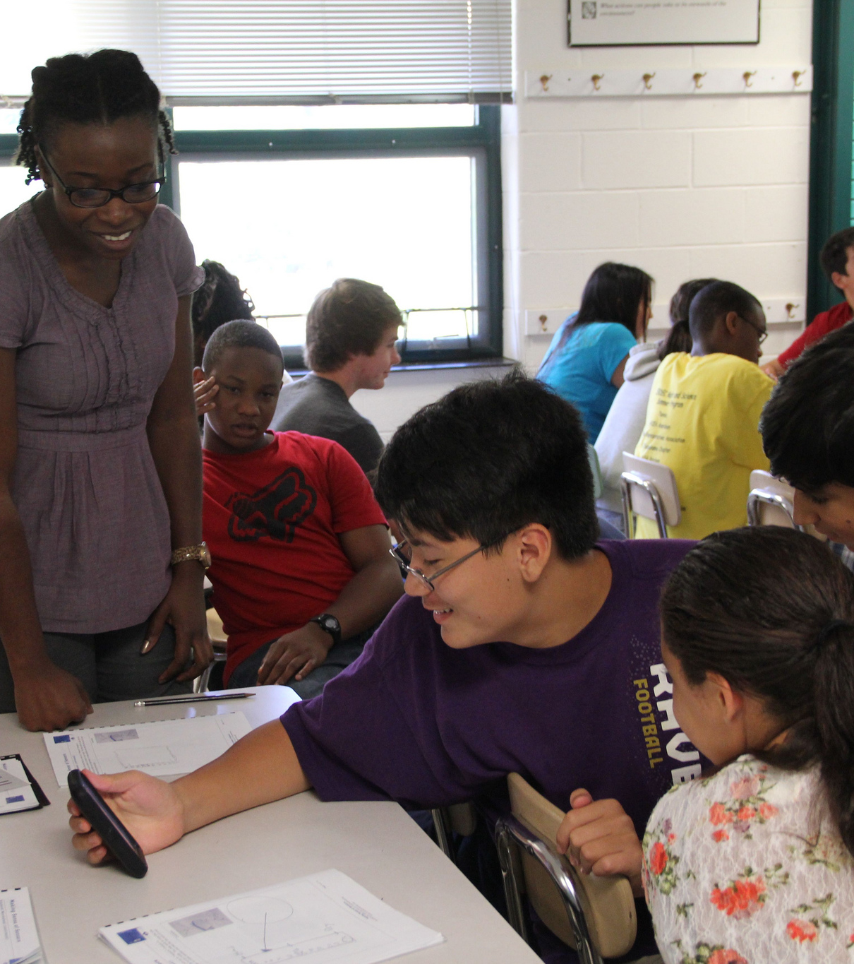
Crossing boundaries (dialogues about who does what?)
Researching ‘belongs’ to researchers (or does it?)
Teaching ‘belongs’ to teachers (or does it?)
Learning ‘belongs’ to learners (or does it?)
“…the power that a language teacher can have in the classroom to shape the emotional self (+moral & political self)” (Kramsch, 29 June 2022)
This Photo by Unknown Author is licensed under CC BY
This Photo by Unknown Author is licensed under CC BY-SA-NC

Slide 6
Transcending dialogues and hierarchies:
Learners
Teachers
Teacher educators
Researchers
Teachers
Teacher educators
Researchers
Teachers as Researchers
Researchers
Researchers-researched-researchers

Slide 7
Teachers as researchers, action research, reflective practice, exploratory practice
Teachers as researchers (Stenhouse, 1975); Lortie (1975), called for a 'cadre of teacher-researchers’ - form a bridge between external researchers (in universities) and classroom teachers (in schools).
Freire (1973) highlighted the potential of learners as researchers.
Carr & Kemmis (1986)﻿﻿﻿﻿ suggested that action (for teaching and learning; for social justice) could be linked to research for and by teachers. Burns (1999, 2010) developed less politicised Action Research for LTD
Schön (1983) suggested reflective practice (by teachers and other professionals), taken forward by Edge (2011), Mann & Walsh (2017)
Allwright (1993, 2003) proposed Exploratory Practice

Slide 8
Practitioner Research: dialogues
“When practitioner researchers choose to make their inquiries available to others, their work becomes a potential source of knowledge
for other researchers and practitioners,
for the curriculum of teacher education and professional development programmes, and
for educational policymakers.”
Zeichner & Noffke (2001: 315)

Slide 9
The ‘family tree’ of Practitioner Research (Hanks 2017, 2019)
Practitioner Research
Action Research (CAR, PAR, EAR)
Exploratory Practice
Reflective Practice
Others… (TR, CR, NI, …)

Slide 10
7 Principles for Practitioner Research
The ‘what’ issues
1. Focus on ‘quality of life’ as the fundamental issue.
2. Work to understand it [QoL].
The ‘who’ issues
3. Involve everybody as practitioners developing their own understandings.
4. Work to bring people together in a common enterprise.
5. Work cooperatively for mutual development.
The ‘how’ issues
6. Make it a continuous enterprise.
7. Minimise the burden by integrating the work for understanding into normal pedagogic practice.
(Allwright & Hanks, 2009: 260)

Slide 11
Puzzles, puzzling, being puzzled
Dervin (29 June 2022) suggests: “ask questions; I don’t know why we have to answer all the questions that we have”
Maybe we can just encourage people to puzzle?? To be puzzled?? To ask ‘why’?
“I wonder why…?”
Exploratory Practice (Allwright & Hanks, 2009; Hanks 2017)
Focus on ‘quality of life’ as the fundamental issue

Slide 12
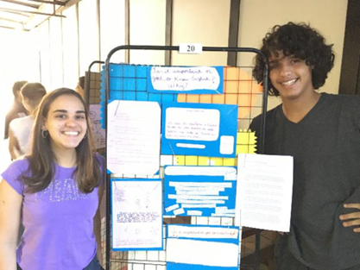
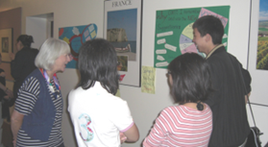
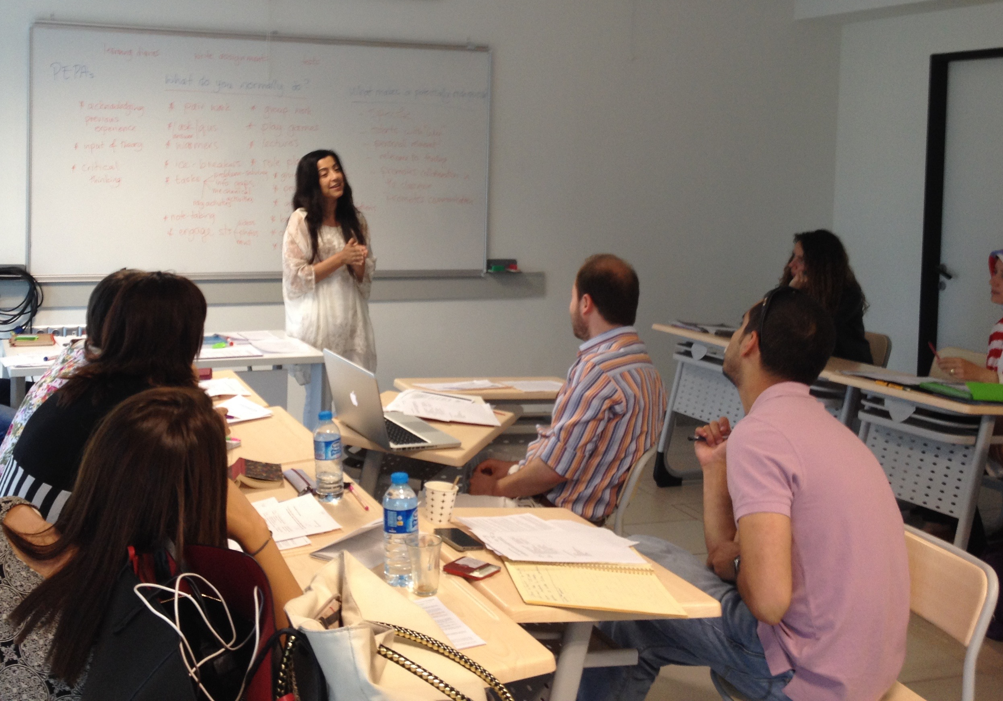
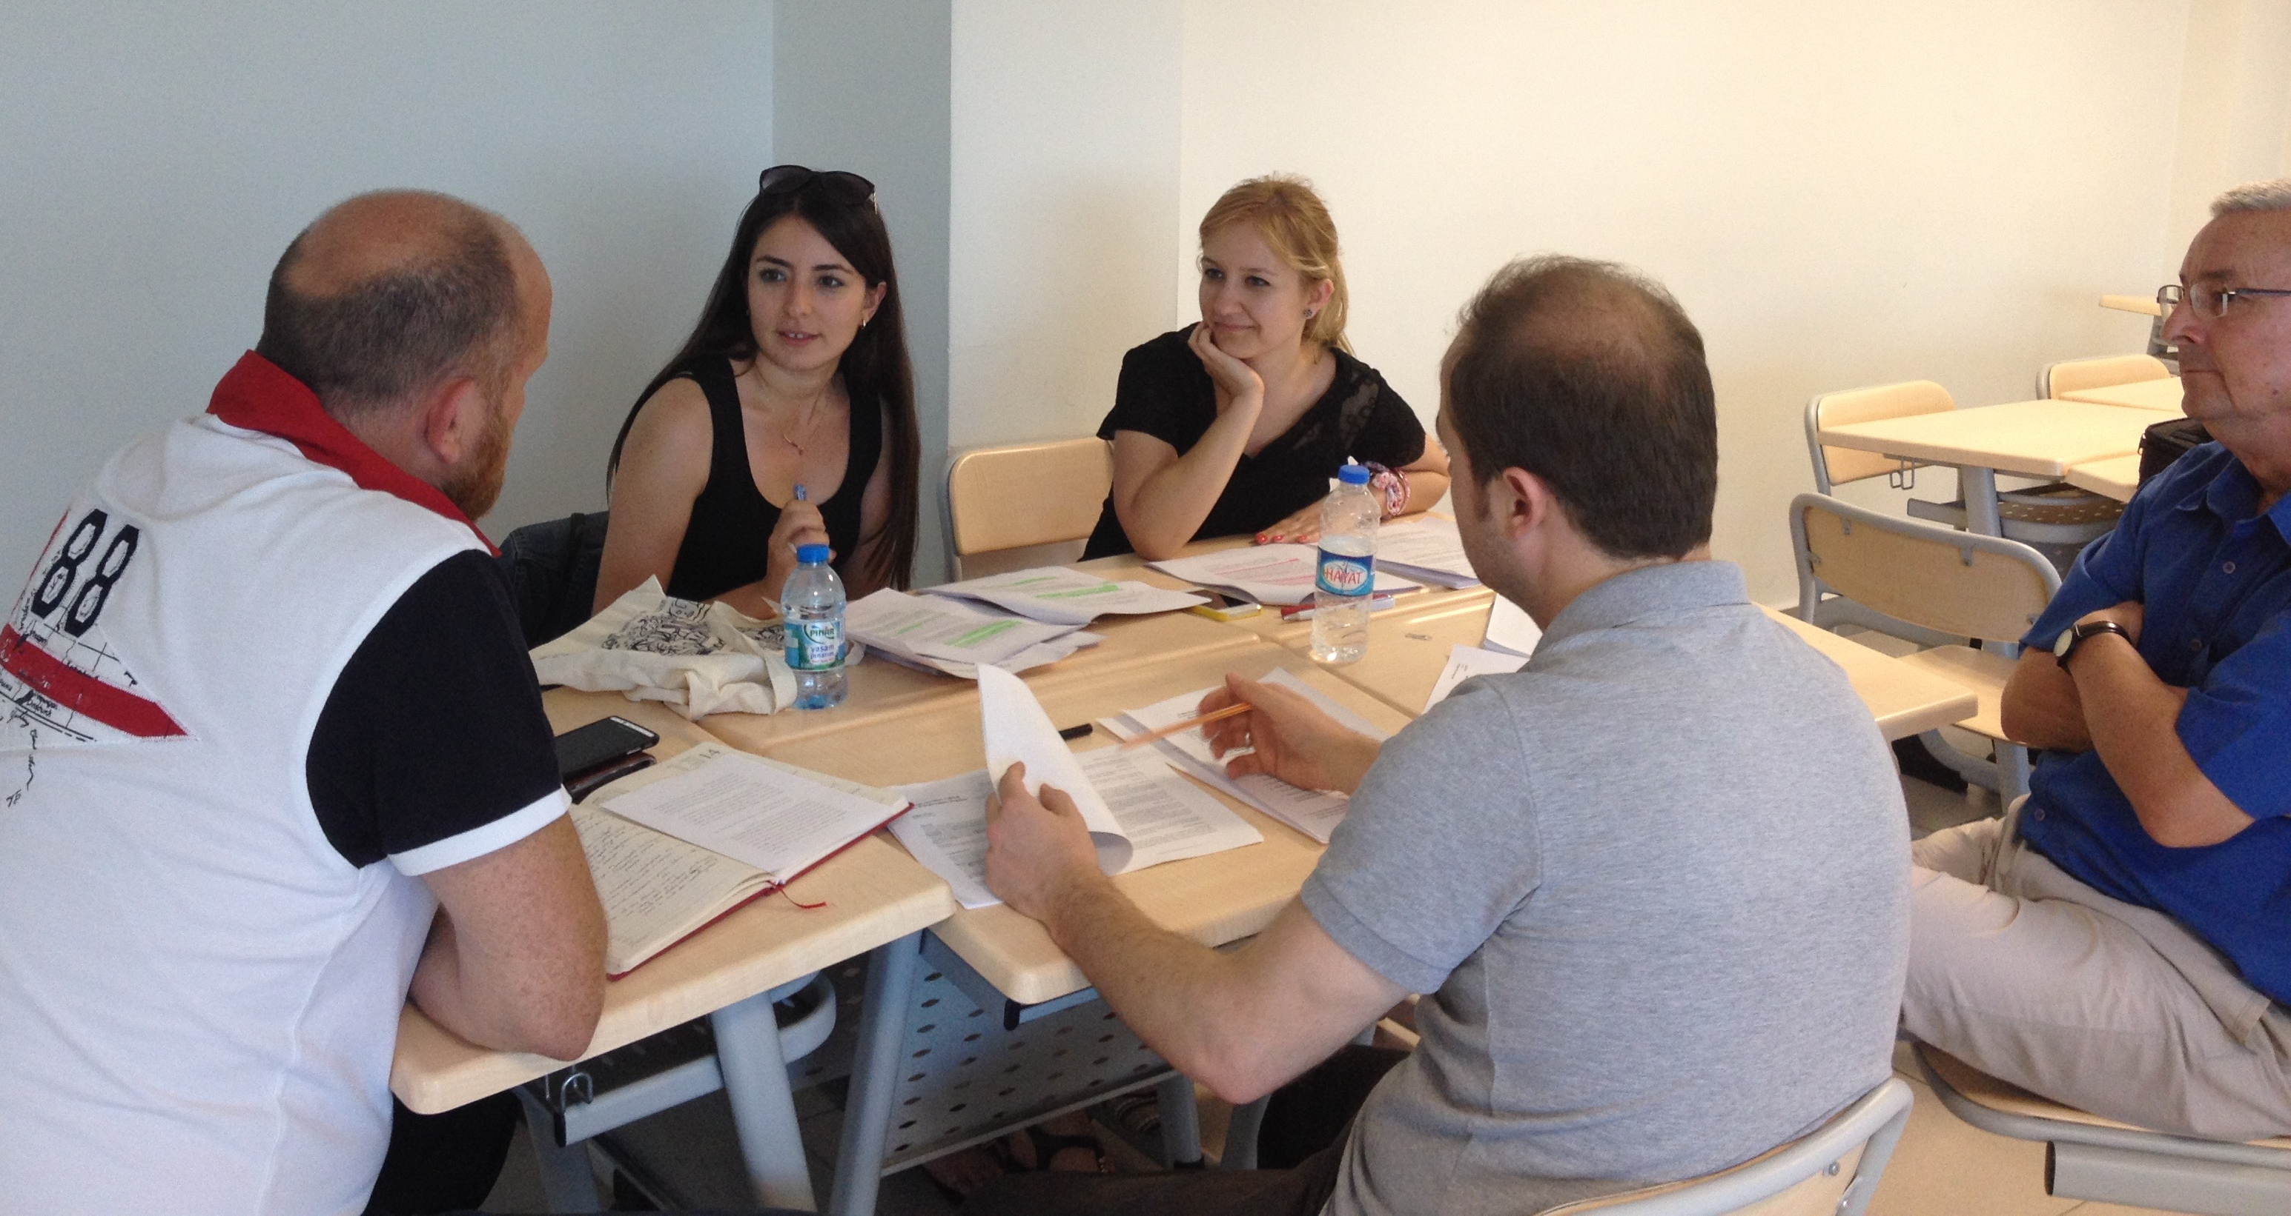

Teacher Research Project (see Dikilitas & Hanks, 2018): Dialogues transcending space?
Teachers, Teacher Trainers, Teacher Educators, and…
Curriculum developers, Educational Psychologists
Network connections: Brazil, China, Japan, UK,
Various educational institutions in Turkey & N. Cyprus
10 CPD workshops in June & September. Written follow up + presentations, publications.

Slide 13
Exploratory Practice: language teacher puzzles
Why do my students have difficulty in learning/ acquiring new vocabulary?
Why are my students unwilling to read?
Why are some language learners more successful than others?
Why don’t we integrate learner training into our curriculum?
Why is it some teachers are resistant to developing themselves?
Why is CPD seen as a burden??
(selected from Hanks & Dikilitas, 2018, pp17-18)

Slide 14
Over to you… Please type in the Chat
What puzzles YOU about your experiences in language teacher development?
(this could be as a learner, student, teacher, or
teacher educator…)

Slide 15
Teacher Puzzles – from the ‘new normal’ (2020)
Why don’t my learners speak in class?
Why do I love face-to-face teaching?
Why are my learners motivated?
Why do I struggle with on-line teaching?
Why don’t my learners turn on their cameras?
Why do learners use Chat more than talking with microphones/cameras?

Slide 16
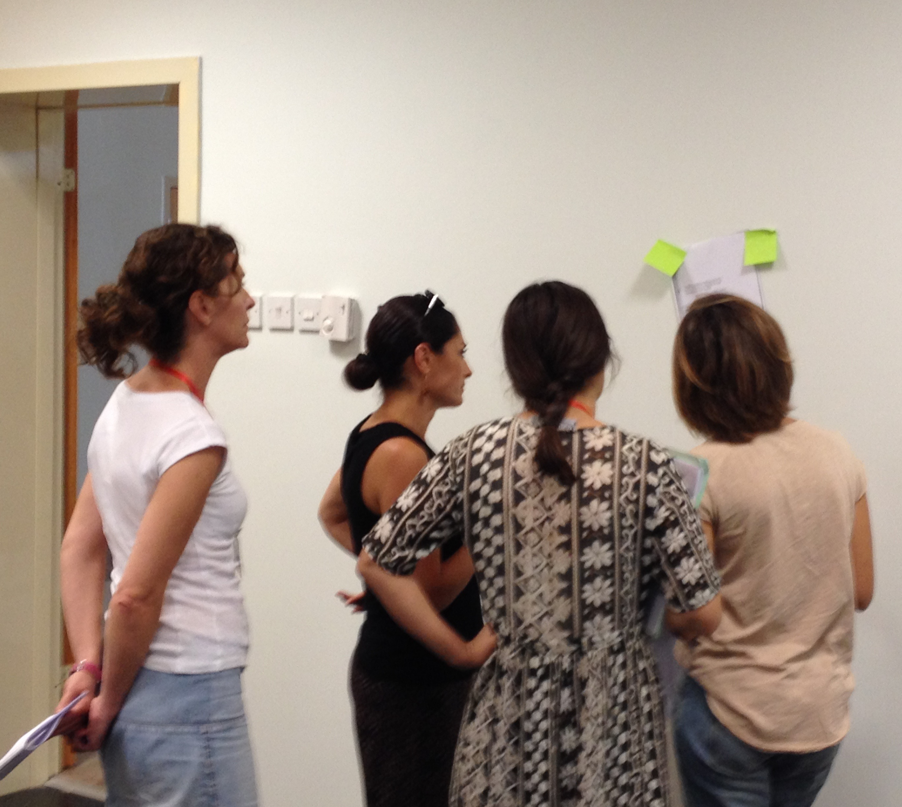
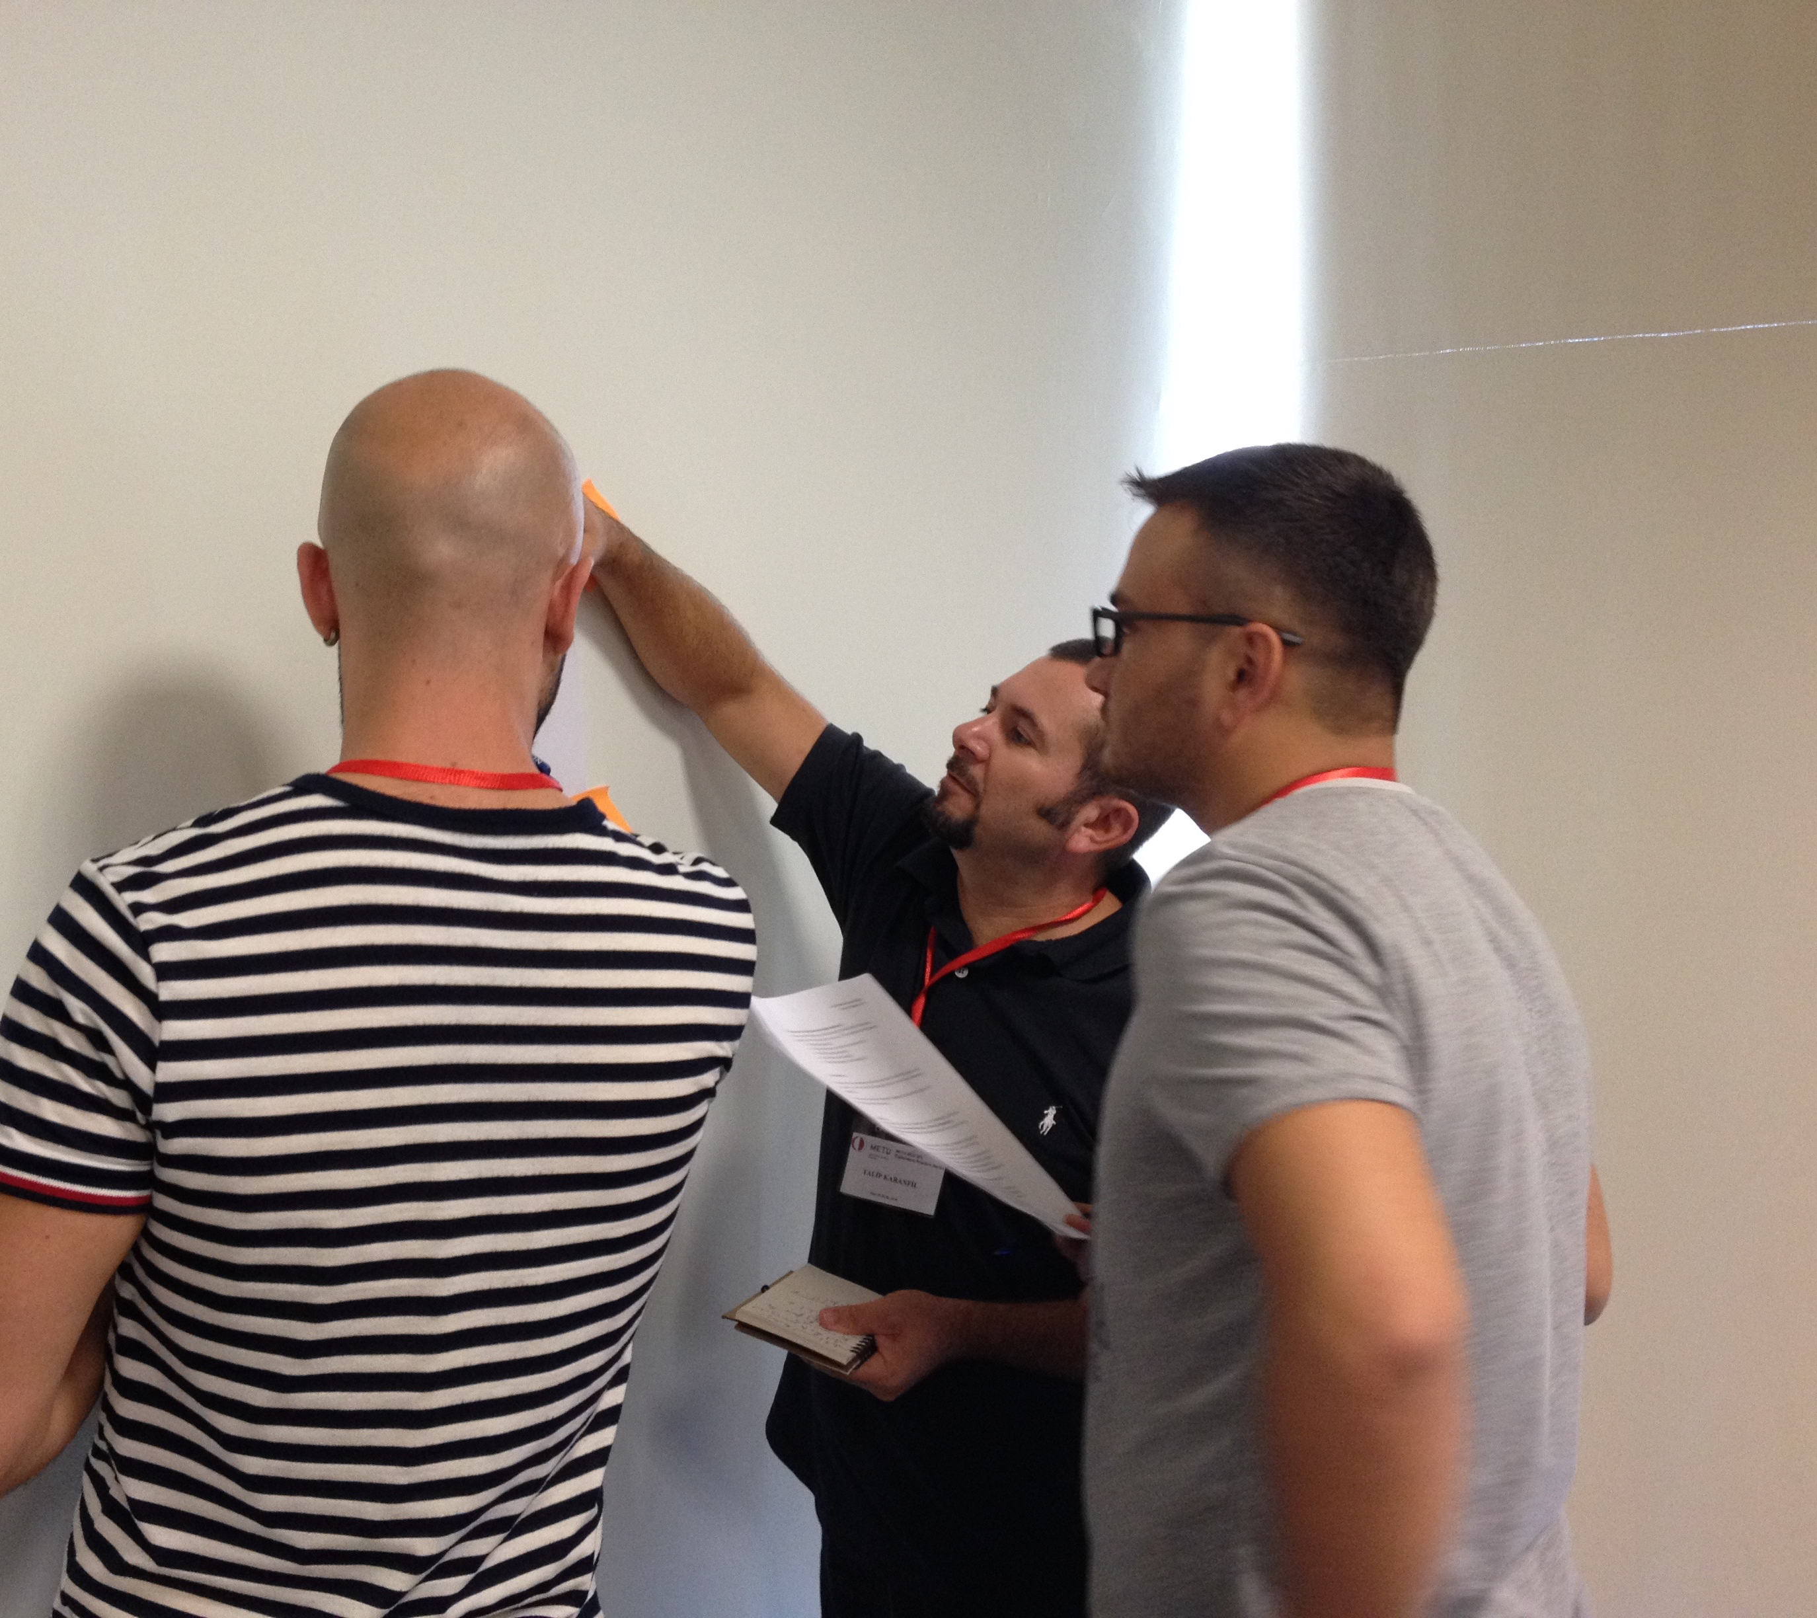
Practitioners transcending dialogues in the exploratory practice-research-practice nexus (see Hanks 2019)
Teachers,
Learners,
Teacher educators
Administrators
Researchers
And anyone else involved…

Slide 17
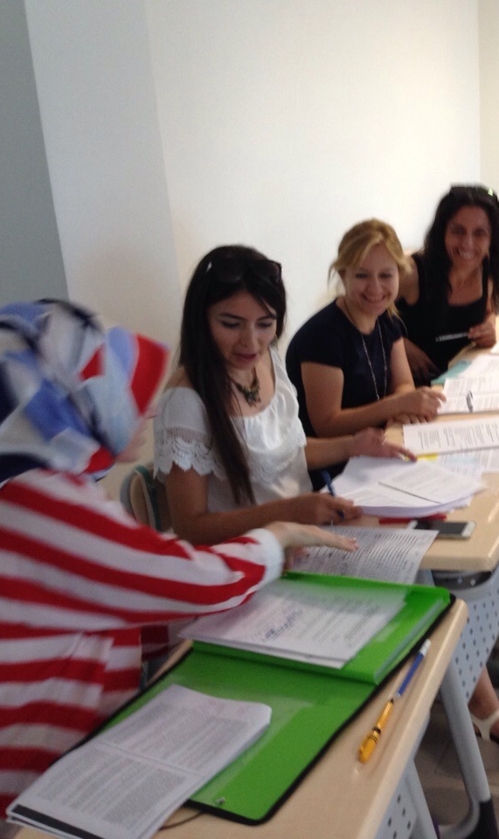
Transcending dialogues in LTD and research
Teachers, teacher educators, learners, are all potential researchers of practice
Puzzling, being curious about practice
Agency, empowerment, creativity
Wellbeing
Enhance quality of life

Slide 18
Another dialogue: The Positive Psychology movement and Exploratory Practice
‘to help people lead better lives’ (MacIntyre & Mercer 2014: 154)
Whatever we do, we need to focus on ‘making life more enjoyable’ (Allwright & Hanks, 2009: 241).
How do we flourish (Seligman, 2011) or attain wellbeing?
What is the role of positive emotions in quality of life?
Not just for individuals, but also for groups and institutions
Notes:
Csikszentmihaly, Mihaliyi -[ˈt͡ʃiːksɛntmihaːji ˈmihaːj]
Mi high, chick sent me high
From focus on sickness and pathology to ‘flourishing’
‘The exclusive focus on pathology that has dominated so much of our discipline results in a model of the human being lacking the positive features that make life worth living.
Hope, wisdom, creativity, future mindedness, courage, spirituality, responsibility, and perseverance are ignored or explained as transformations of more authentic negative impulses.’ (Seligman and Csikszentmihalyi, 2000)

Slide 19
Exploratory Practice: Quality of Life and Wellbeing
“Quality of life (QoL) does not mean that all things are good and/or easy; rather, it may include working very hard, but on something that is interesting, rewarding, and relevant to those working on it.” (Hanks, 2017 p101)
Notes:
JH
“[QoL] is what teachers and learners understand, and/or try to understand about their joint experience in classrooms, and these understandings are of greater importance to them than how productive or efficient classroom outcomes are by external standards.” (Gieve & Miller, 2006: 102)
LINK to next slide: that’s the background to the research project and some of the thinking informing the work– moving on to more detail of the project itself…..

Slide 20
A second project: transcending dialogues
‘Sticky Objects’ and pathways to resilience and wellbeing: teacher understandings of and practices in positive psychology in their classrooms
Teachers working in EAP in universities in UK and Saudi Arabia
Teachers researching their own contexts and developing their own practice and wellbeing
Diaro App and interview data
https://www.teachingenglish.org.uk/article/%E2%80%98sticky-objects%E2%80%99-pathways-well-being-resilience-teacher-understandings-practices-positive
Notes:
17 mins to here
THANK YOU to British Council for funding the work
Project aims: investigate teacher understandings and lived practices in relation to positive emotion, well-being, resilience and quality of life in two contrasting EAP contexts.
Saudi teachers – 7 teachers (all Saudi nationals, all women) All have a Master degree in TESOL or in Applied linguistics.​
The teachers are teaching for 4 or 5 years except Teacher 7GSA who teaches for 2 years.
UK teachers – 5 teachers (not all British nationality- 3 Brits and 2 different national backgrounds; 2 men and 3 women). All have MA TESOL; all have 10 years’ plus experience (except for one not included in this analysis)
Asked Ps to record positive sticky object every day and write a short diary entry for a month (4 weeks of teaching) or 20 entries. Then follow up interviews with guide based on objects plus some standard questions
Different level of diary and image keeping across participants

Slide 21
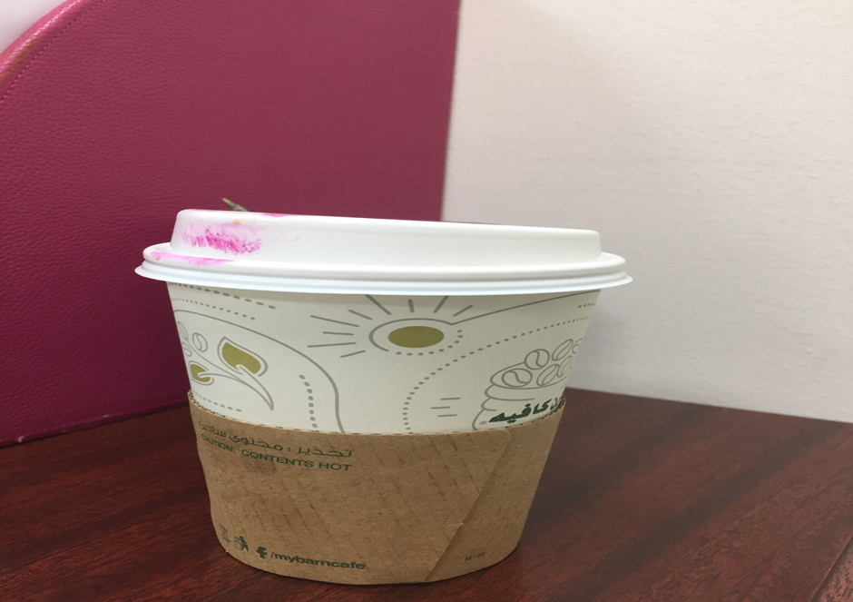

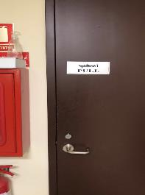
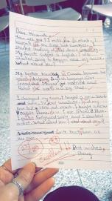
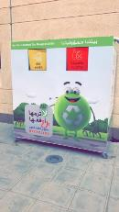
Some sticky objects from Saudi Arabia
Notes:
JH
Just show the pictures – DON’T talk about them at this point!

Slide 22
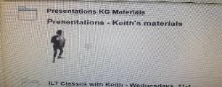
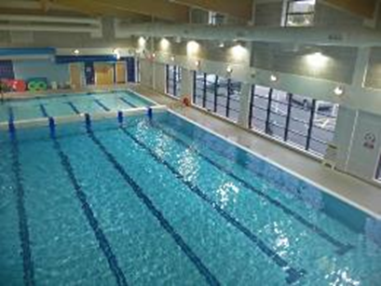
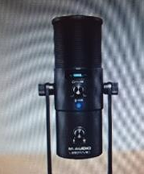
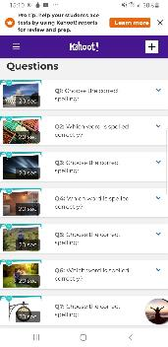
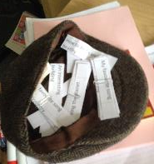
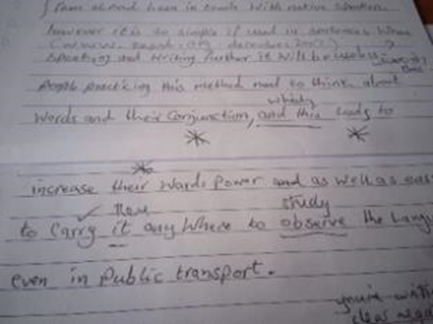
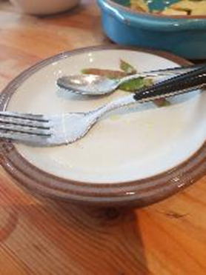
Some sticky objects from the UK
Notes:
SE
Just show the pictures – DON’T TALK ABOUT THEM AT THIS POINT!

Slide 23
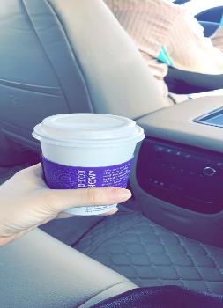
Personal : Teacher self-care
“I feel that this is luxury for me to pass [a particular shop] and get a cup of coffee I mean that I feel this is a luxury so it makes me really happy.”
(Diaro extract)
Notes:
JH

Slide 24
Professional: pride and trust dialogue
“We played kahoot spelling game and I told them the rule ‘i before e except c’. They all looked amazed. One student told me he had always struggle spelling was quite happy to find out about the rule.
His eyes were showing.
I couldn’t believe how such small detail could make a change in the learning process. When students start to learn, they start to trust the teacher. Trust makes learning easier!” Diaro extract
Notes:
SE

Slide 25

It was like I'd discovered gold...
Notes:
Judith – the door – it was like I’d discovered gold

Slide 26

Notes of caution?
‘The tyranny of positive attitude’ (Held 2002)
Neo-liberal discourse of self-reliance
Accountability of emotions
Manipulation of wellbeing to achieve institutional ends
‘Things are not going well’
Notes:
Be here by 30 mins (12.30)
JH
(Management interventions in PP and productivity)
Whose fault if you are not positive – institutional discourses around resilience – agency vs. structure

Slide 27
Enhancing wellbeing through LTD
How can we transcend traditional dialogues about who does what in language teacher development, research and pedagogy?
What do we mean by teacher wellbeing and how can we promote it?
What are the relationships between wellbeing and quality of life in LTD?
Notes:
JH
Secret door ideas – at the moment might be more support needed in terms of ‘social online space’ – coffee mornings/ check ins which are social not instrumental. Showing concern for colleagues as an ongoing practice.
?

Slide 28
Concluding remarks
We are constantly engaged in struggling to understand our classrooms, even in ‘normal’ times. This dialoguing was amplified during the pandemic.
To understand our ‘new normal’ we need to ask questions about, and explore our practices; to engage in dialogues
Exploratory Practice, using Sticky Objects, diaries and photographs can help us to positively connote for wellbeing
Although we are (all – learners, teachers, teacher educators) tired and stressed, there are still some treasures that we can keep from this difficult time: enhancing quality of life by transcending dialogues.

Slide 29

A final positive note …
“Teaching is a radical act of hope. It is an assertion of faith in a better future in an increasingly uncertain and fraught present.
It is a commitment to that future even if we can’t clearly discern its shape….
We teach because we believe it matters.”
Kevin Gannon (2020, p5)
This Photo by Unknown author is licensed under CC BY-NC-ND.
Notes:
SE
Gannon very much influenced by the work of Paulo Friere
LINK – End on a final positive note in a time when we are starting to look to a better future – can’t think of a better way to finish a webinar series
Leaving on a positive note about the value of teaching, the role of teachers and our place in the world – sustain you in emotional elements of life and workplace –and to focus firmly on hope for the future.

Slide 30
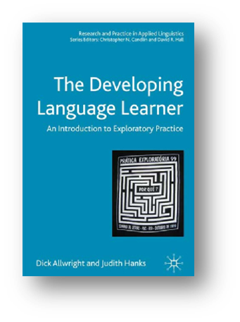
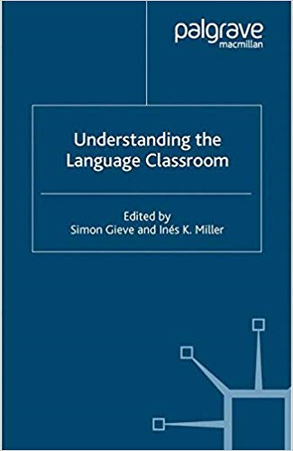


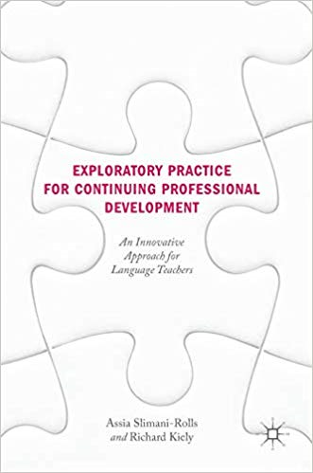
What else can I read?

Slide 31
Two useful websites
Fully Inclusive Practitioner Research:
https://www.fullyinclusivepr.com/
Sticky Objects and pathways to wellbeing (report):
https://www.teachingenglish.org.uk/article/%E2%80%98sticky-objects%E2%80%99-pathways-well-being-resilience-teacher-understandings-practices-positive

Slide 32
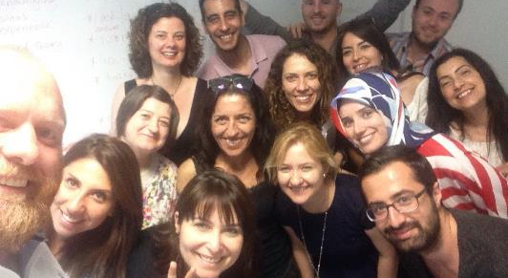
Thank you!
Any questions?
Let’s start dialoguing ☺
Dr Judith Hanks
j.i.hanks@leeds.ac.uk
https://www.fullyinclusivepr.com/

Slide 33
References on positive psychology & emotions
Ahmad, S. (2004). The Cultural Politics of Emotion. Edinburgh University Press.
Benesch, S (2017). Emotions and English Language Teaching : Exploring Teachers' Emotion Labor Routledge
Agudo, J. (ed.) (2018). Emotions in Second Language Teaching: Theory, Research, Teacher Education Springer
Fredrickson, B. L. (2001). ‘The Role of Positive Emotions in Positive Psychology: The Broaden-and-Build Theory of Positive Emotions’. The American Psychologist, 56(3), 218–226.
Etherington, S., Hanks, J., & Al Shehri, E. (2020) ‘Sticky objects’ and pathways to well-being and resilience: Teacher understandings of and practices in positive psychology in their classrooms. https://www.teachingenglish.org.uk/article/%E2%80%98sticky-objects%E2%80%99-pathways-well-being-resilience-teacher-understandings-practices-positive (Accessed 1 November 2020)
Gannon, K. (2020) Radical Hope: A Teaching Manifesto West Virginia University Press
Held, B (2002) ‘The tyranny of the positive attitude in America: Observation and speculation’ Journal of Clinical Psychology, 2002, Vol.58(9), pp.965-991
MacIntyre, P., & Gregersen, T. (2012). ‘Emotions that facilitate language learning: The positive-broadening power of the imagination’. Studies in Second Language Learning and Teaching, 2(2), 193-213.
Seligman M & Csikszentmihalyi M (2000) ‘Positive Psychology: An Introduction’ The American Psychologist 55(1), 5-14. DOI: 10.1037//0003-066X.55.1.5
Seligman, M.E.P. (2011). Flourish, Free Press

Slide 34
References on Exploratory Practice and other forms of Practitioner Research
Allwright, D. (1993). Integrating ‘research’ and ‘pedagogy’: Appropriate criteria and practical possibilities. IN J. Edge & K. Richards (Eds.) Teachers Develop Teachers Research (pp125-135). Heineman.
Allwright, D. (2003). Exploratory Practice: rethinking practitioner research in language teaching. Language Teaching Research, 7(2), 113-141.
Allwright, D. & Hanks, J. (2009). The Developing Language Learner: An introduction to Exploratory Practice. Palgrave Macmillan.
Burns, A. (1999). Collaborative Action Research for English Language Teachers. Cambridge University Press.
Cochran-Smith, M. & Lytle, S.L. (2009). Inquiry as Stance: Practitioner research for the next generation. Teachers College Press.
Dewey, J. (1963) Experience and Education Collier Books
Dikilitaş, K., & Hanks, J. (Eds.). (2018). Developing Language Teachers with Exploratory Practice: Innovations and explorations in language education. Palgrave Macmillan.
Edge, J. (2011) The Reflexive Teacher Educator in TESOL: Roots and wings. Routledge.
Freire, P. (1973). Education for Critical Consciousness. Seabury Press.
Gieve, S. & Miller, I.K. (2006) Understanding the Language Classroom. Palgrave Macmillan.

Slide 35
References on Exploratory Practice and other forms of Practitioner Research
Hanks, J. (2022) 'Integrating research into language teaching and learning: Learners and teachers as co-researchers exploring praxis.' Language Teaching 55(2) pp.217-232. https://doi.org/10.1017/S026144482100032X
Hanks, J. (2021) Co-production and multimodality: learners as co-researchers exploring practice. Educational Action Research 29(3), pp. 462-482 https://dx.doi.org/10.1080/09650792.2020.1812417
Hanks, J. (2019a). From research-as-practice to exploratory practice-as-research in language teaching and beyond. Language Teaching, 52(2), pp.143-187. https://doi.org/10.1017/S0261444819000016
Hanks, J. (2019b). Identity and trust: Issues raised when practitioners engage in researching practice. The European Journal of Applied Linguistics and TEFL, 8(2), pp.3-22.
Hanks, J. (2018). Supporting language teachers as they engage in research. ETAS Special Supplement Research Literacy Part 3: Supporting teacher research in English language teaching, 35(3), pp.48-50.
Hanks, J. (2017a). Exploratory Practice in Language Teaching: Puzzling about principles and practices. Palgrave Macmillan.
Hanks, J. (2017b). Integrating Research and Pedagogy: An Exploratory Practice approach. System 68, pp.38-49

Slide 36
References on Exploratory Practice and other forms of Practitioner Research
Hanks, J. (2015a). 'Education is not just teaching': learner thoughts on Exploratory Practice. ELT Journal, 69(2), pp. 117-128. (Editor’s Choice, April 2015) https://doi.org/10.1093/elt/ccu063
Hanks, J. (2015b). Language teachers making sense of Exploratory Practice. Language Teaching Research, 19(5), pp. 612-633. https://doi.org/10.1177/1362168814567805
Kato, Y. & Hanks, J. (2021). Learner-initiated exploratory practice: Revisiting curiosity. ELT Journal, https://doi.org/10.1093/elt/ccab039
Lave, J. & Wenger, E. (1991) Situated Learning: Legitimate peripheral participation. Cambridge University Press
Lortie, D.C. (1975) Schoolteacher: A sociological study. University of Chicago Press.
Mann, S. & Walsh, S. (2017). Reflective Practice in English Language Teaching: Research-based principles and practices. Routledge.
Schön, D. (1983) The Reflective Practitioner. Temple Smith.
Slimani-Rolls, A. & Kiely, R. (2018). Exploratory Practice for Continuing Professional Development: An innovative approach for language teachers. Palgrave Macmillan.
Stenhouse, L. (1975) An Introduction to Curriculum Research and Development. Heinemann.
Wenger, E. (1998) Communities of Practice: Learning, meaning, and identity. Cambridge University Press.
Zeichner, K.M. & Noffke, S.E. (2001). Practitioner Research. IN V. Richardson (Ed.) Handbook of Research on Teaching. (4th Edn. pp.298-330) American Educational Research Association.

