Slide 1


‘You look too happy to be a PhD student’ — Some autoethnographic reflections
Dr Wang Zi

Slide 2

Warm-up activity
On your phone, laptop or tablet,
please go to www.menti.com

Slide 3

Warm-up activity
You have 10 minutes to do this.
You will be sent into breakout rooms.
In your room, please:
Introduce yourself:
who you are, where you are joining us from, your keywords, etc.
Find three things that you have in common in your group.
Chat about anything else!

Slide 4
Today’s aim:
To share with you my experience as a PhD student
To get you to reflect on your motivational journey
To get you to try out some personal strategies

Slide 5
My PhD timeline (October 2017-present)
Upgrade panel
Annual review
Start of PhD
Data collection
Data analysis
Writing up
Viva
Oct
2017
July
2018
Sept-Jul
2018-2019
Oct
2019
Nov-Sept
2019-2020
Oct-Sept
2020-2021
Nov
2021
Corrections submitted and approved in Feb 2022

Slide 6
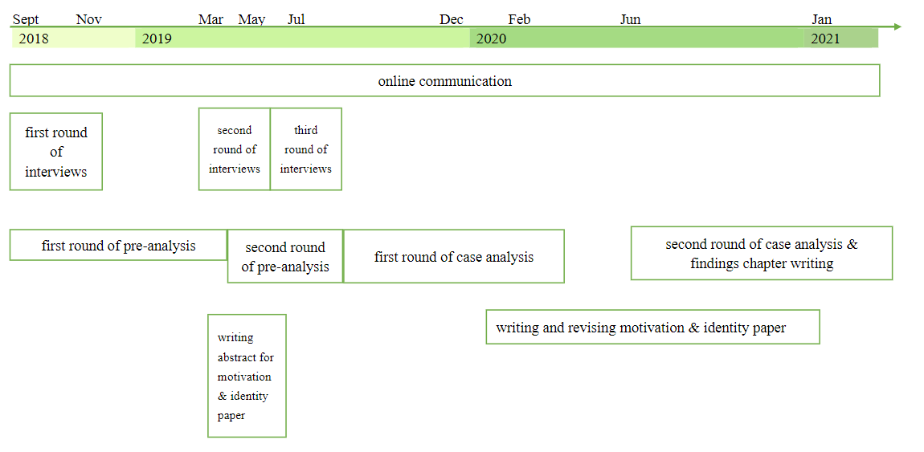
My data collection and analysis timeline (September 2018-January 2021)

Slide 7
My thesis writing timeline (October 2020-September 2021)
October - November 2020: writing findings chapters
January-February 2021: writing discussion chapter
March-April 2021: writing literature review chapters
May 2021: writing methodology chapter
June 2021: revising findings chapters
July 2021: writing conclusion chapter
August-September 2021: writing introduction chapter and finalising and submitting thesis
introduction
literature review
methodology
findings
discussion
conclusion

Slide 8
personal memory, self-observational data, self-reflective data;
allows you to go deep into your emotions and life experiences
(Grbich, 2013).
Autoethnographic data
>250 entries
PhD journal
Social media posts
>50,000 English words
>70,000 Chinese characters

Slide 9

‘You look too happy to be a PhD student’ — Some autoethnographic reflections
Thu.27.09.2018
I finally talked to my flat mate the other day. One interesting thing: when I told her that I am a PhD student, she said, ‘you are a quite happy PhD’. So do other people think that PhD students are always depressed? Hahaha, that’s funny. But I am indeed different. I don’t think that many other PhD students are like me. I am leading too happy and too carefree a PhD life!

Slide 10

36 mentions of cry/cried/tears
Thu. 10.05.2018
I was so stressed that I cried yesterday. It was not a big deal. Just too many things happening in the two weeks. Not only academic stuff, but also social and sports event. My problem is that I want to try everything and that is why I’ve been this busy. Yesterday’s discussion with *** was also too much for me… I was having a headache and I could not hide it from *** and I blamed my speaking too much English for it…

Slide 11
Thu.09.05.2019
I got a rejection letter from EuroSLA early yesterday morning and started a frustrating day because of it (and probably also because of my period). I didn’t want to study or to teach, and was very down. I got another rejection for EuroSLA stipend application. It felt so bad to be told bad news twice in a day. How come no other people think my research is interesting? I have to say it is quite demotivating not getting any more positive feedback. I even cried last night and I blamed my period for me being vulnerable…

Slide 12
Fri.22.02.2019
Sometimes I just want to cry out of no reason during my PhD. I guess it happens to other people as well. Sometimes we stop what we are doing to think and don’t know why we are doing it. I have not been in high spirits recently, probably because I am behind my schedule…

Slide 13



You have 10 minutes to do this.
Padlet activity
Reflect on your down moments.
https://warwick.padlet.org/ziwang11/lvrq3cgtspkip89m

Slide 14
Thu. 10.05.2018
I was so stressed that I cried yesterday. It was not a big deal. Just too many things happening in the two weeks. Not only academic stuff, but also social and sports event. My problem is that I want to try everything and that is why I’ve been this busy. Yesterday’s discussion with *** was also too much for me… I was having a headache and I could not hide it from *** and I blamed my speaking too much English for it. Maybe I was right, because after talking to my flatmate in Chinese, I did feel so much better that I even changed my mind and went back to study.

Slide 15
Thu.09.05.2019
I got a rejection letter from EuroSLA early yesterday morning and started a frustrating day because of it (and probably also because of my period). I didn’t want to study or to teach, and was very down. I got another rejection for EuroSLA stipend application. It felt so bad to be told bad news twice in a day. How come no other people think my research is interesting? I have to say it is quite demotivating not getting any more positive feedback. I even cried last and I blamed my period for being vulnerable. But it’s fine, right? You can’t just be this positive all the time. It is healthy to be upset once in a while, I think.

Slide 16
Fri.22.02.2019
Sometimes I just want to cry out of no reason during my PhD. I guess it happens to other people as well. Sometimes we stop what we are doing to think and don’t know why we are doing it. I have not been in high spirits recently, probably because I am behind my schedule.
Cheer up, Doudou! Everything will be fine and you are the best!
I saw a sentence by Zweig on my calendar: (my rough translation from Chinese) the biggest fortune for a man is that he finds his mission early in his life. I feel lucky that I have found my life mission and I know I am doing what I like. But I also have to bear in mind that the journey will always be full of ups and downs.

Slide 17
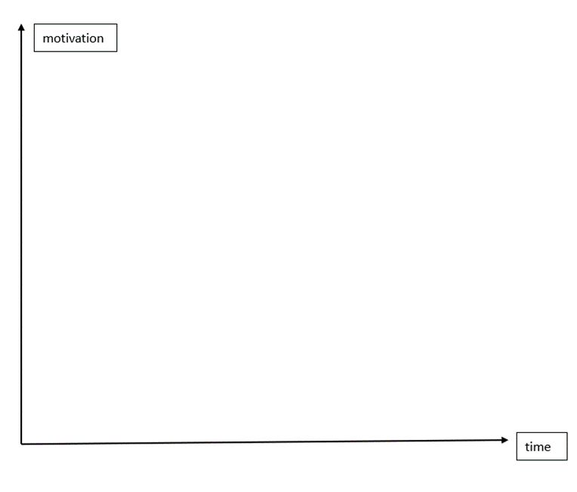

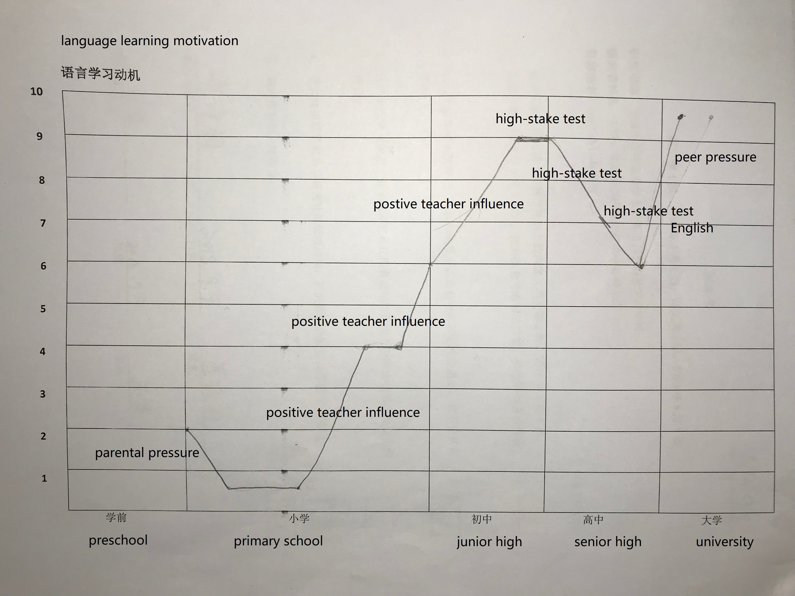

Motigraph activity
What is motigraph?

Slide 18
Motigraph activity
Why motigraph?
A way of stimulating retrospection: inviting language learners to share their experiences and stories, showing awareness of the dynamic nature of motivation
A means of enabling students to consider and evaluate the nature and strength of their current motivation, with the past as a referent (Henry, 2015)
A visual presentation of qualitative data that guides reading (Busse & Walter, 2013)

Slide 19


Motigraph activity
Draw your own motigraph
You have 10 minutes to do this.

Slide 20
You have 10 minutes to do this.
Motigraph activity
Share your motigraph
You will be sent to breakout rooms.
Make sure everyone in your group gets a chance to talk.

Slide 21
Personal strategies
Reflect on negative experience with a positive spin
https://warwick.padlet.org/ziwang11/lvrq3cgtspkip89m

Slide 22
Personal strategies
Make a weekly non-research-related to do list and follow it
If you have to make such a list, what would you list include?
 | Family | Exercise | Journal | Movie | Social | Ukulele | Scrapbook | Backup
13/07/20 | √ | √ | √ | √ | √ | √ | √ | √
20/07/20 | √ | √ | √ | √ | √ | × | √ | ×
27/07/20 | √ | √ | √ | √ | √ | √ | × | √
03/08/20 | √ | √ | √ | √ | √ | √ | √ | √
…
21/12/20 | √ | √ | √ | √ | √ | √ | √ | ×
07/02/22 | √ | √ | √ | × | √ | × | √ | ×
Please go to menti.com

Slide 23

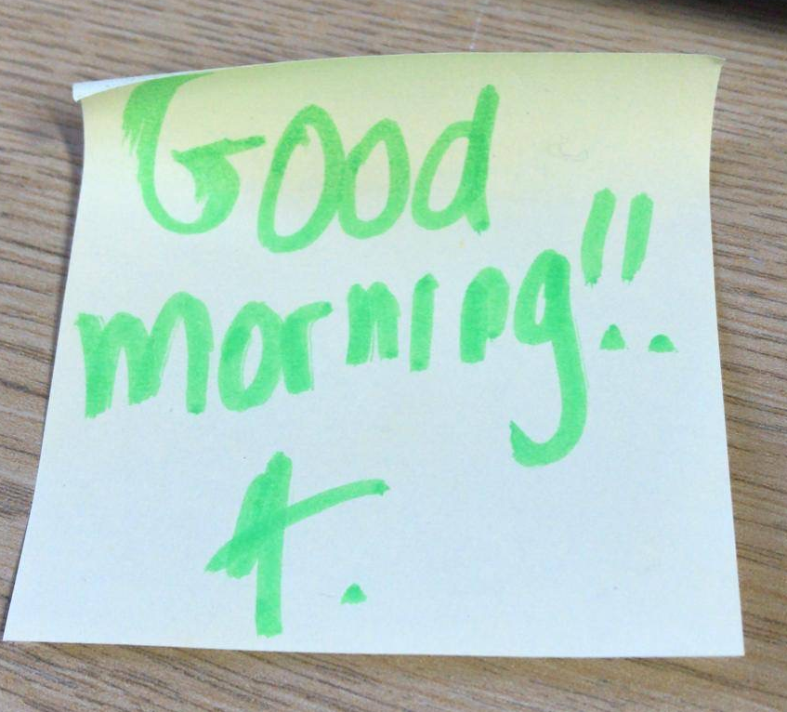
Personal strategies
#10000 things to be happy about
Keep a record of things that make me happy
February 2020
1182. A good morning note (so sweet!)
1184. Helping a colleague with Nvivo (I know stuff, hahaha)

Slide 24
Personal strategies
#10000 things to be happy about
Keep a record of things that make me happy
June 2020
1224. An email from supervisor to say that he asked to many questions and forgot to give positive feedback (so funny and so sweet~)
1226. The sizzling sound of soda

Slide 25
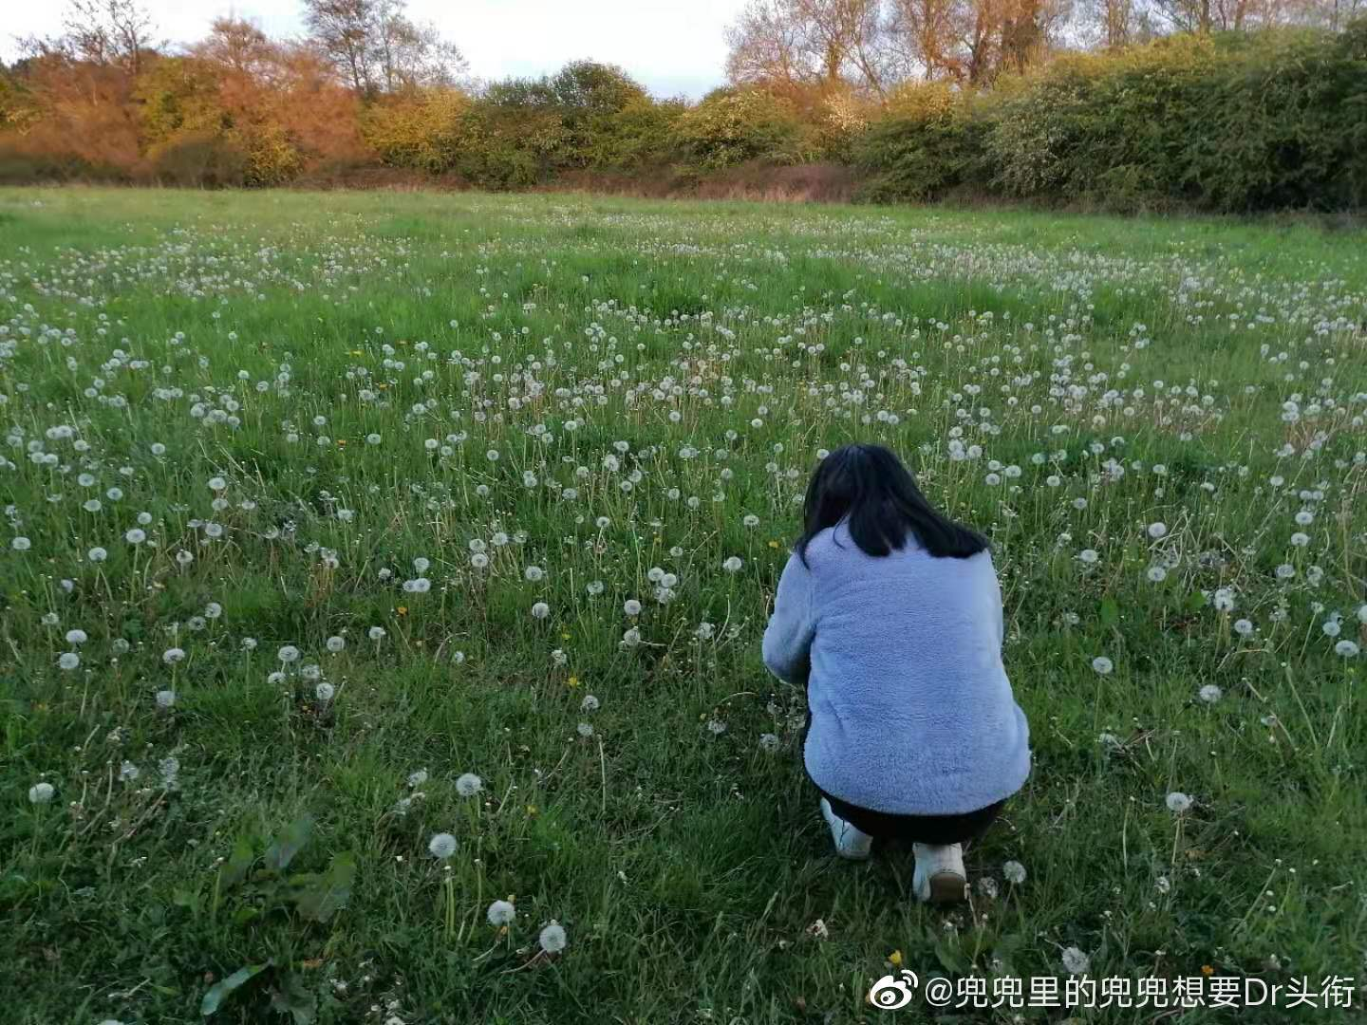
Personal strategies
#10000 things to be happy about
Keep a record of things that make me happy
May 2021
1318. Goodbye from the girl sitting opposite for the entire day in the library
1320. Bumping into the dandelion field on my walk with a friend

Slide 26
Personal strategies
#10000 things to be happy about
Keep a record of things that make me happy
What are the things that have made you smile recently?
August 2021
1352. Feeing so loved while writing my acknowledgements
1353. My favourite matcha tea bag
Please go to menti.com and share with us

Slide 27


Q&A
Any questions?

Slide 28
References
Busse, V., & Walter, C. (2013). Foreign language learning motivation in higher education: a longitudinal study of motivational changes and their causes. Modern Language Journal, 97(2), 435-456.
Grbich, C. (2013). Qualitative data analysis: An introduction (2nd ed.). London: SAGE.
Henry, A. (2015). The dynamics of L3 motivation: a longitudinal interview/observation-based study. In Z. Dörnyei, P. D. MacIntyre, & A. Henry (Eds.), Motivational dynamics in language learning (pp. 315-342). Bristol: Multilingual Matters.

Slide 29
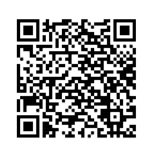
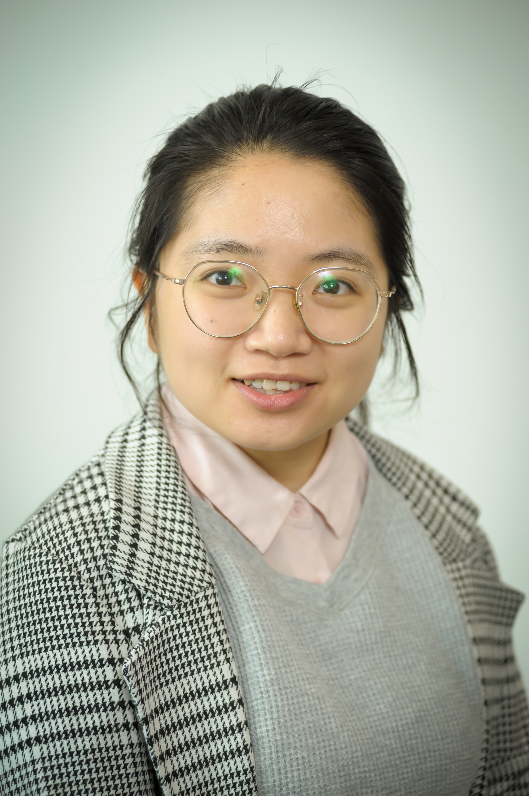
Thank you for your participation!
I would love to hear your feedback!
Please get in touch! ☺
z.wang.52@warwick.ac.uk
Twitter: @ZiWang28

