Slide 1
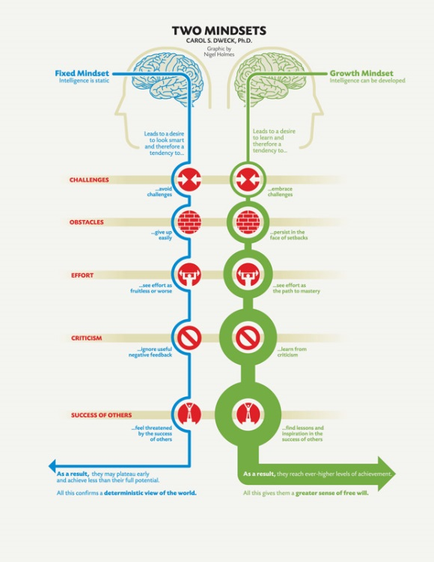
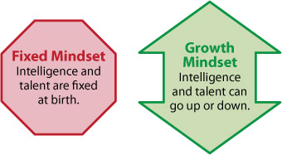
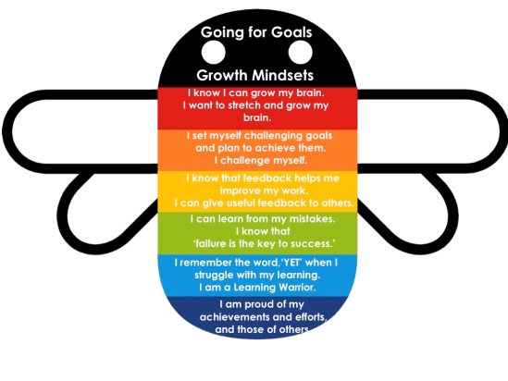

The Growth
Mindset

Slide 2

Connect
Discuss with those on your table the times when you have struggled in Maths. Maybe a specific topic or lesson stands out in your head…
What did/does it feel like? What thoughts run through your head when you are struggling?

Slide 3
Activate
TED VIDEO!

Slide 4
The Growth Mindset
There are two types of mindset that people usually fall into during activities.
This is not specific to Maths, but can be applied to languages, PE, spelling, or almost any activity where learning needs to take place…

Slide 5
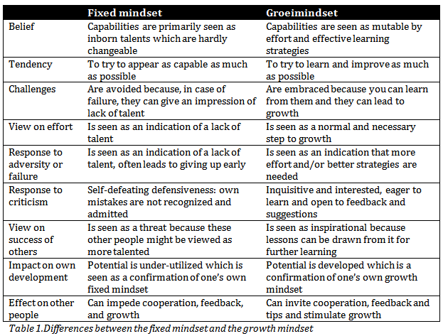
The Growth Mindset
Fixed Mindset
Growth Mindset

Slide 6

The Growth Mindset
Demonstrate
You will be given a set of statements that someone with a fixed mindset might think when attempting a task
Your job in your groups is to come up with a way of rewording them for someone with a growth mindset…

Slide 7
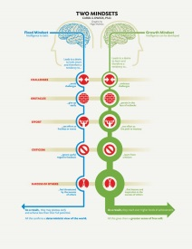
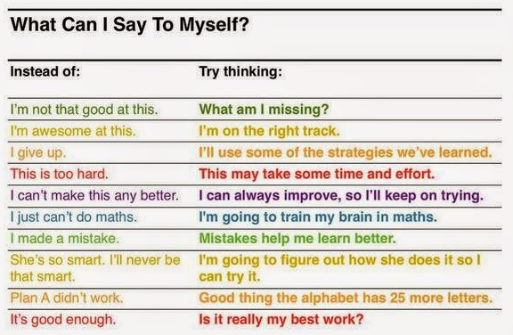
Consolidate
Some possible examples…

