Slide 1
Mathematical Resilience & Further Education
6th March, 2016
Steve Pardoe, Jane Marsh & Karen Walker

Slide 2
Background to FE sector
Diverse sector covering all post-16/adult education outside of HE
Focus on vocational learning for 16-19 year olds
Delivered through FE colleges, independent training providers, adult education services, offender learning … and others

Slide 3
Policy background
Sept 2014: all young people must study maths & English to the age of 19
Sept 2015: all those with grade D at GCSE must re-sit until they achieve a C
Plans to extend maths learning to level 3 for those achieving GCSE A*-C

Slide 4
Historical entry & success rates in FE (2012/13)
% of learners with grade D entered for GCSE maths | 20%
% of those entered who achieved grade A*-C on their resit | 41%
(Data from Statistical First Release Level 1 & 2 attainment in English & maths by students aged 16-18: academic year 2012/13)

Slide 5
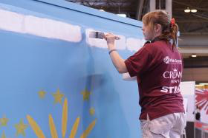
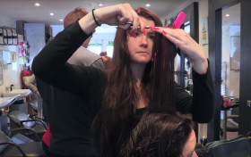
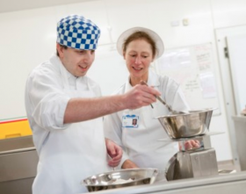
Issues: learner viewpoint
Repeated experience of failure in maths – especially GCSE exams
Dislike, fear, hatred of maths
See maths as boring & irrelevant to them & their aspirations
Fixed mindsets

Slide 6



Issues: college viewpoint
Poor attendance at maths classes
Low engagement by those who do attend (unwilling to complete homework)
Frequent disruptive behaviour
And …
Chronic shortage of qualified maths teachers

Slide 7

Some sector responses: learner engagement
Vocationally contextualise maths
Involve vocational teachers in promoting maths
Emphasise employability & earnings potential
But also …
Rigorous policing of attendance
Disciplinary processes, etc.

Slide 8
Sector responses: staffing
Graduate recruitment (‘Golden Hellos’, bursaries, etc.)
Upskill functional skills & vocational teachers ( … many with maths quals no higher than GCSE themselves!)
CPD programmes – emphasis largely on cognitive & constructivist approaches
And on the fringes ...
Emerging interest in approaches of Dweck, Boaler ... & mathematical reilience

Slide 9
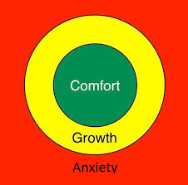
MR interventions
Funded by the Education & Training Foundation (ETF), 2 CPD modules developed by WMCETT:
Introduction to mathematical resilience & the growth zone model (1-day course)
Developing mathematical resilience (4-day course)

Slide 10
Introduction to MR
1-day course aimed at all teaching maths in the sector
Examines affective barriers to maths learning
Introduces growth zone model & construct of MR
Models ‘accessible’ activities & asks participants to reflect on their affective responses
7 courses delivered since December – to over 100 teachers – with more courses arranged

Slide 11
Developing MR
4-day course, co-led by maths specialist & coaching specialist
Targeting particularly teachers with low maths confidence who are being asked to teach maths
MR approaches modeled in a safe & supportive environment
Awareness of coaching approaches included
3 courses started since January – over 40 teachers participated

Slide 12
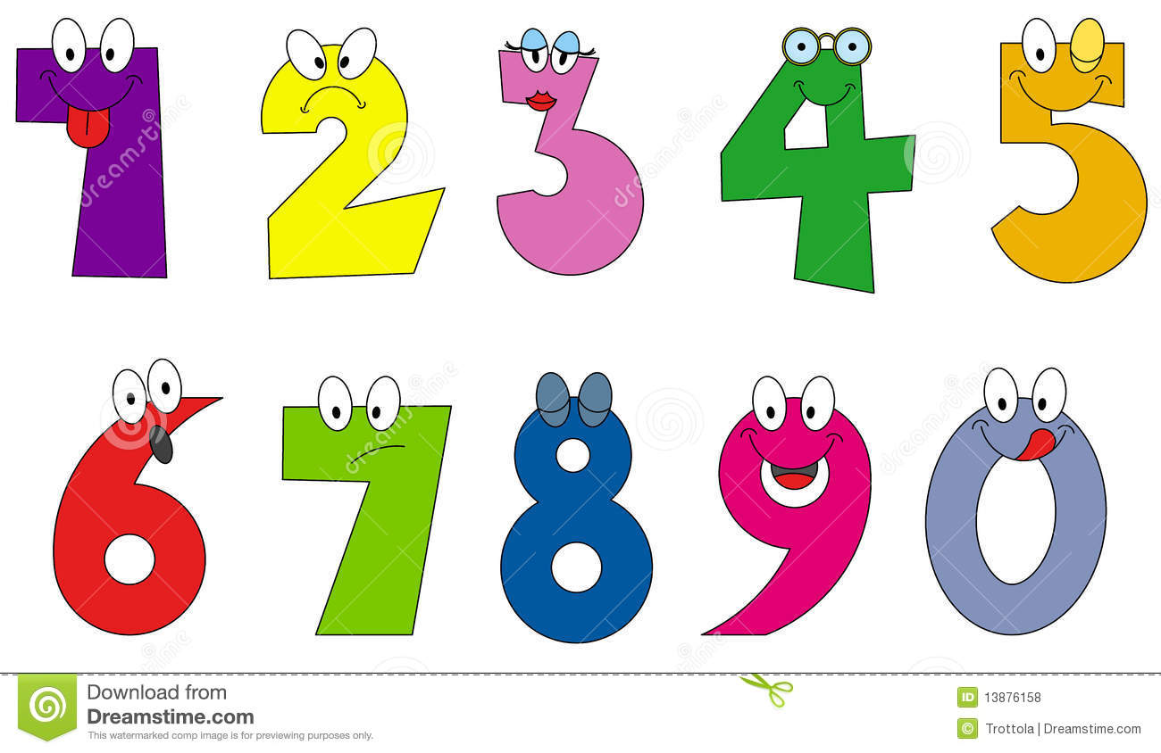
Emotional response to numbers
Individually:
Think of some numbers and place them in the appropriate place in the top half of the table
With the person next to you:
Share your entries and discuss why you placed them where you did

Slide 13
Case studies
Beth (not her real name)
Woman approaching 50
Health & Social Care Assessor
Enrolled on the Maths Resilience course
Self declared - ‘I hate maths’
Clare (not her real name)
Early 40s
Health & Social Care Assessor
Enrolled on the Maths Resilience course
A self declared ‘maths phobic’

Slide 14
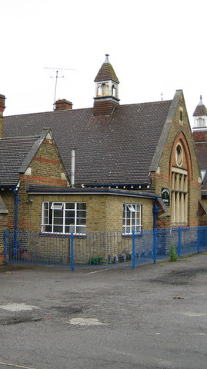
Primary school experience
A. Asked to be shown everything twice
B. Was ‘beside’ herself if she got crosses
B. Was ‘beside herself’ if she got crosses
C. Loved maths from Day 1
D. Can’t remember anything about it

Slide 15

Secondary school experience
A. Mother got her put on report
A. Mother got her put on report
B. Kept a low profile
C. Scared to death of the teacher
D. Sat her GCSE and got a ‘C’

Slide 16

6th Form experience
A. Had a fun time
B. Sat her GCSE and got a ‘C’
C. Knuckled down and worked hard
D. Sat her GCSE and got an ‘E’
D. Sat her GCSE and got an ‘E’

Slide 17

Further Education?
A. Enrolled on a nursing course
A. Enrolled on a nursing course
B. Went from job to job
C. No way would she do further study
D. Decided to take her maths again

Slide 18

Career Path
A. Drifted into office work
B. Went from nursing into care homes
B. Went from nursing into care homes
C. Had a successful nursing career
D. Got married and gave up work

Slide 19

Own Business
A. No maths involved so blossomed
B. Failed due to foreign legislation
C. Sold it to move back to the UK
D. Ended up with overwhelming debts
D. Ended up with overwhelming debts

Slide 20

Life as an assessor
A. Just about managed the maths
B. Left company before maths exams
B. Left company before maths exams
C. Gave limited support on maths
D. Someone else did the maths

Slide 21

Reaction to MR - Day 1
A. Got in her car and cried
B. Could not contribute during the day
C. Need to find a new job again
D. Recognised impact of own negativity
D. Recognised impact of own negativity

Slide 22
Key messages
Acceptance that maths anxiety is real and debilitating
For the first time I felt valued
Those who ‘get’ maths have ownership and can compound feelings of inadequacy
Power must transfer to learner/coachee
Those with maths anxiety are seen as valuable agents in growing the maths community
Resistance of some tutors to change of approach
  MR approaches complicate the situation
  Growth mindset model for teaching approaches
Something similar at the start of every maths course
My first positive experience of maths…. ever

Slide 23
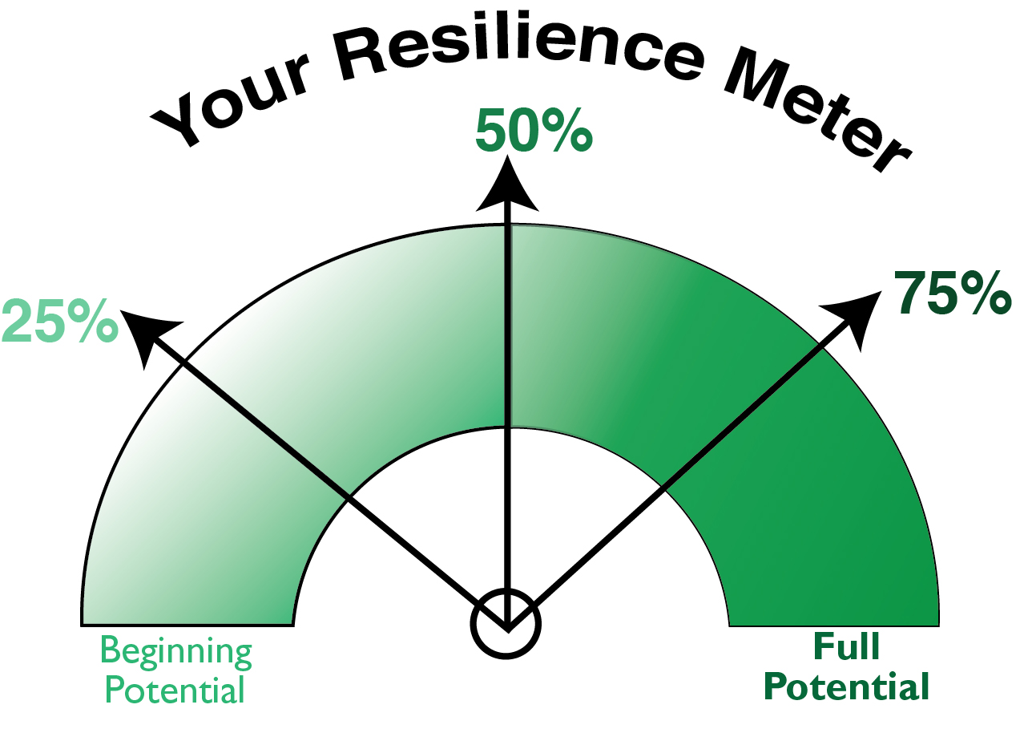
Next Steps
A.
B.
C.
D.

Slide 24
From a participant’s viewpoint …
Expectation
Notes:
Expectation
The course was advertised as :
Aimed at those who do or who will specialise in delivering maths courses.
It said it would help me :
• Teach maths more effectively
• Support my learners to overcome emotional barriers in relation to studying maths
• Use a range of activities which makes maths ALIVE (Accessible, Linked, Inclusive, Values-based and Engaging)
• Develop Maths Resilience in my learners and raise achievement in maths

Slide 25
From a participant’s viewpoint …
Initial Impressions
Notes:
Initial Impressions
Course run over 4 consecutive Fridays
Ten started in the group
• 5 actively taught maths
• 3 demonstrated maths anxiety and had no maths qualification.
In the first hour of introductions it became clear that several members of the group were anxious and uncomfortable with anything considered to be ‘mathematical’. Lots of ‘horror’ stories about their experiences when at school.
I was concerned that the pace would be reduced and the activities ‘simplified’ in order to cater for them. I then questioned what I would get out of the 4 days.

Slide 26
From a participant’s viewpoint …
Incentives to return
Notes:
Incentives to Return
Given my initial concerns I decided to review what I got out of the course at the end of the first day and decide whether it was worth me sticking with it for the other 3 weeks.
Group activities - My experience in the first exercise (rushing ahead, overexcited by the chance to solve a maths problem, keen to work with someone else who enjoyed this kind of activity - ignored the needs of the third team member) was a useful reminder of what team work and approach to problem solving entails. There were definite benefits in having a mixed ability group.
Access to resources - Sarah and Pat referenced lots of publications and websites that I was unaware of. It also prompted discussion and sharing within the course members.
Food for Thought - Since the course was delivered with very much a coaching approach, it gave lots of opportunities for ideas to be thrown in, discussed and developed.
Time to Focus - Having 4 days allocated in my diary to ‘Maths Resilience’ gave me the time to focus on this area. I read through the material we were provided with and looked up some of the documents and websites referenced.
Time to Reflect - in a similar vein, the course was an opportunity to reflect. I thought about my lesson prep, the resources I used and my experience in the classes I had whilst the course was running.

Slide 27
From a participant’s viewpoint …
Reflection
Notes:
Reflection
As I just mentioned, I did take time to reflect after each class but thinking about the whole course now, a couple of weeks after it ended I think :
I found the Growth Model really useful, both for myself and my learners. I have just done a round of one-to-one sessions and discussed this with several of them. With new groups I intend to share it at the very beginning as then we have a common language to share how we are feeling.
I loved the statement ‘Stuck is a noble state’. I’m not sure previously how much I stressed that it was okay to be stuck but now I think it should be a common cry in the classroom.
I could relate to the statement that ‘teachers tend to feel they have failed if their students get ‘stuck’ and seek to provide help promptly. As a consequence students develop ‘learned helplessness’. I am consciously trying to stop myself jumping in too soon to help. I am using some of the coaching techniques to help the learner find a solution themselves.
My lesson plans aways have space for me to identify differentiated activities for my learners but I think at times I may have just been paying lip service to this aspect of my planning. During the course I put more effort into planning and resources for all my learners and I think they got more from the sessions. Definitely an area for me to work on.
Use of sensible/realistic problems - run risk of distraction. This was drawn to out attention during the course but I had, in a similar timeframe, had experience where ‘silly values’ caused the learner to question whether they had understood and loved the problem correctly (temperature in London > 100 degrees )
Need a confident maths tutor - wouldn’t want to have swimming lessons from someone scared to let go of the wall. It’s also important that the tutor can quickly recognise what a learner is saying and relate it to the topic
Resources tailored to the learners. I often put them in the ‘story’ of the problem. Adding personal traits and humour wherever possible. Eg Chris decided he will share his pack of pork pis amongst the whole group etc
These are just a few of the things I found I gained from the 4 day course.
I would say that I was the only tutor in the group of 10 that specialised (with my teacher training) in teaching numeracy to adults and I was the only one to have studied maths to degree level. I think therefore that a lot of suggestions in the course I was aware of.

Slide 28
Aims going forward …
Continue to raise awareness of MR in the sector
Roll-out of courses nationwide
Focus on developing & sharing practical interventions & teaching strategies within organisations
Investigate viability of CfMR programmes for FE staff & students
Evaluate impact on teachers, learners & organisations

