Slide 1
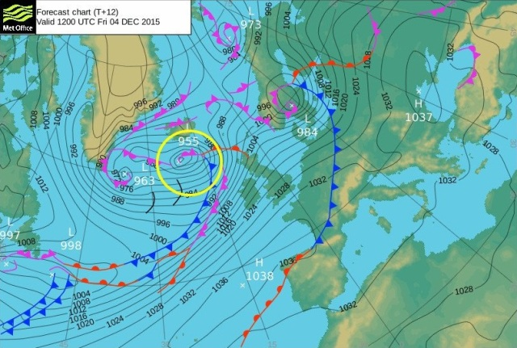
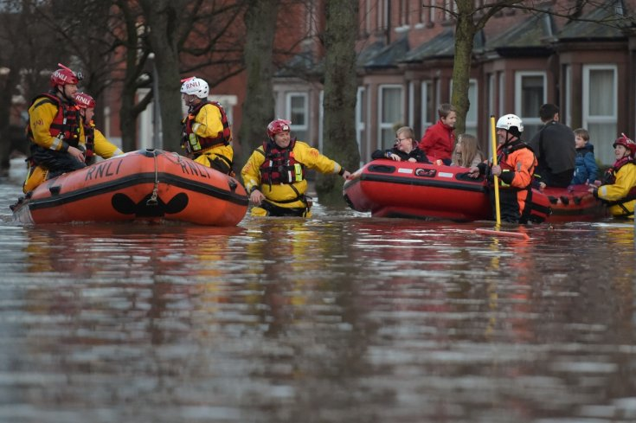
Happy New Year 2016

Slide 2
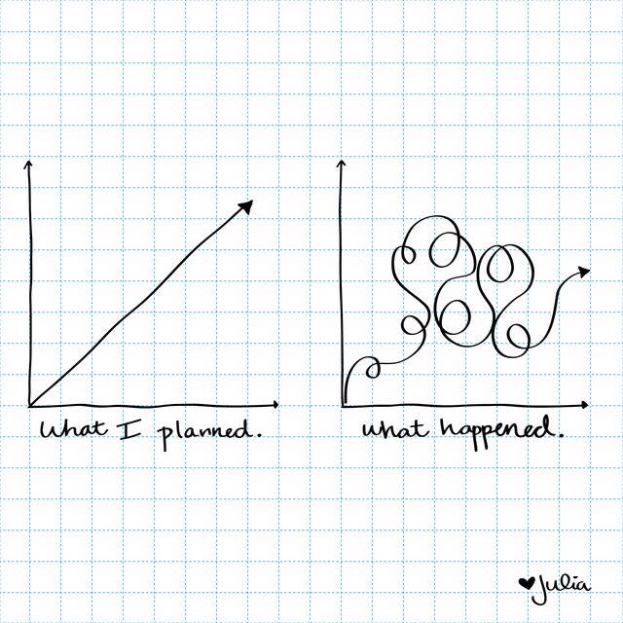
Happy New Year 2016

Slide 3


Mindset and Maths
Fixed Mindset
Growth Mindset

Slide 4
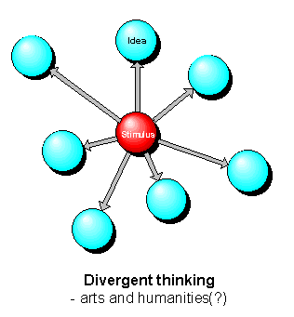
“It’s not always the people who start out the smartest who end up the smartest.”
Alfred Binet

Slide 5
An Excellent Learner grows:
Tries a full range of available methods and strategies to solve problems
Persists with work even when it is difficult
Only asks the teacher to suggest another method or to affirm a method
Takes real care when presenting work
Actively seeks ways in which they can improve and learn
Seeks out challenging tasks and works conscientiously outside school time to improve further
Cares more about what they are learning than their grades which are not the ‘be all and end all’

Slide 6
Achievement and Praise
Taking the initiative
Seeing a difficult task through
Struggling and learning something new
Being undaunted by a setback
Being open to and acting on criticism

Slide 7

“The best teacher is experience.”
Jack Kerouac

Slide 8

When you see the teacher’s hand raised:
1. Raise your hand.
2. Give the teacher your full attention.
3.Signal anyone not yet raising their hand.
4. Wait in silence.

Slide 9

Collaborative Seating
Collaborative learning works best in groups of four.
Think for 30 seconds, pair and discuss for 1 minute, share on your table.
Shoulder partners are adjacent.
Face partners are opposite.

Slide 10

Presentation Matters!
P Write in black pen
R Use a ruler for straight lines and rule off work when finished.
O Oops! Draw a neat line through mistakes using a ruler.
U Underline the date and title
D Draw in pencil

Slide 11
Book work.
Use the front page for Contents; number each right hand page.
Left Hand Side
Key Words
Connect
Model Solutions
Mind Maps /Thinking Hats
Exit Ticket
Right Hand Side
Objectives
Learning Cycle: Demonstrate
Self Assessments (Marks/Faces)
G & I Comments in Purple
Your responses in Green

Slide 12
Thinking in progress
Mini Whiteboards
In pairs
In groups
Show me!
Paper
Jot down ideas
Decide on method
Working out

Slide 13
Highlighting for clearer thinking
Green for Go
Actions
Commands
Instructions
Yellow for Mathematical Literacy
Topic?
Operation?
Accuracy?

Slide 14
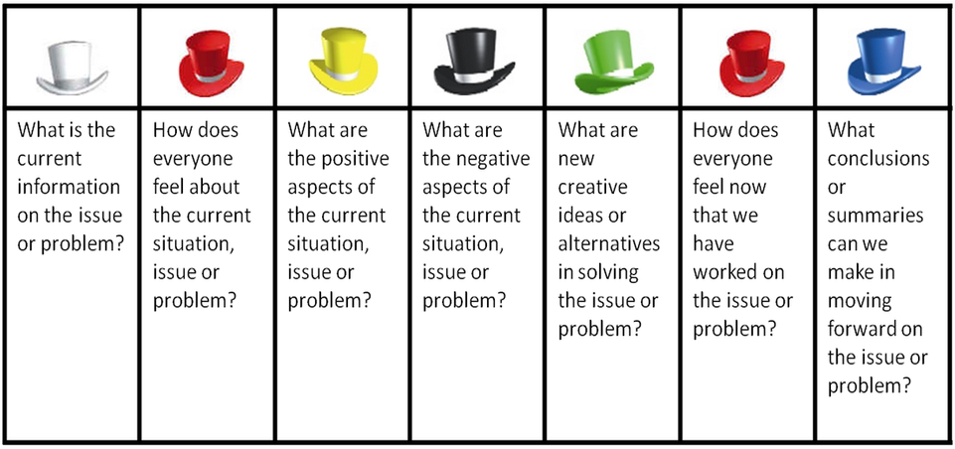
Thinking Hats

Slide 15
Exit Tickets
One entry at the end of each core maths lesson.
Peer assessed using Good and Improvement marking.
Teacher reviewed before the end of each topic.

Slide 16
All: Contents
Y7
Teams and games
Y8
Teams and break out week projects
Y9
Points and tickets with self evaluations and prizes
Numeracy books exit tickets

