Slide 1
Talking for Maths Resilience
Classroom based action research

Slide 2
Introduction
Me: Maths teacher in a special school (KS3-4). Young people with SEMH difficulties.
Why talking?
  Spoken language section of new NC for Maths
  My background in youth work
  A feeling that student communication might not be as effective as first glance may assume (comments by police trainees)
“Spoken language
The national curriculum for mathematics reflects the importance of spoken language in pupils’ development across the whole curriculum – cognitively, socially and linguistically. The quality and variety of language that pupils hear and speak are key factors in developing their mathematical vocabulary and presenting a mathematical justification, argument or proof. They must be assisted in making their thinking clear to themselves as well as others, and teachers should ensure that pupils build secure foundations by using discussion to probe and remedy their misconceptions.” (NC 2014)

Slide 3
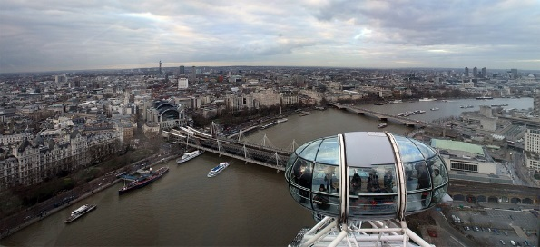
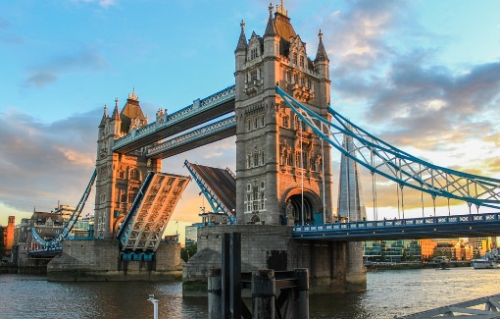

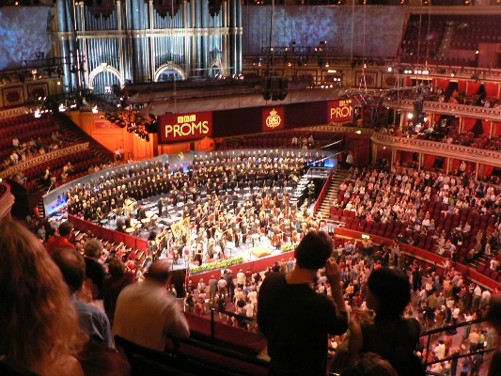
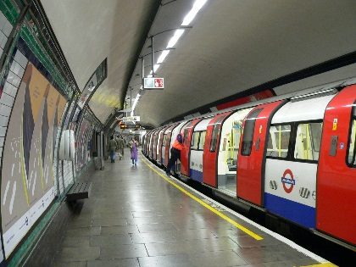
1. Sender encodes message
3. Receiver receives message
4. Receiver decodes message
Talking/Listening
Conversation
2. Sender sends message
5. Check understanding
Amalgamation of ideas from: MAYBO. 2007:30; Lipari, L. 2014:507; Hogg, A.; Vaughan, G. 2002:568; Sargeant, N. 2011:358
Receptive Model
Building of worlds or communities, particularly with evocative language: place names, curriculum topics, love and patriotism (Lipari, K. 2014)
London

Slide 4
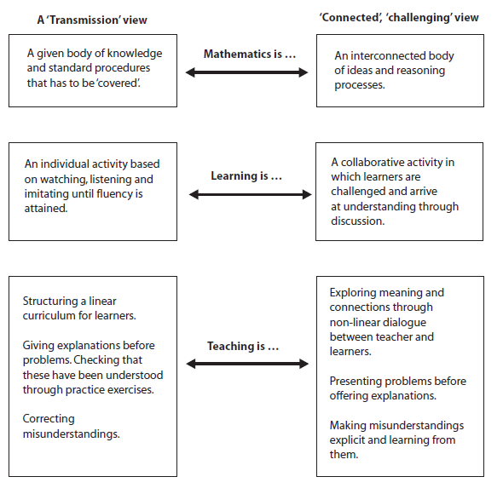
From: Improving Learning in Mathematics (Swan, M. 2005)

Slide 5



Talking/Listening
Conversation
Skinner (1957): Verbal Behavior
Antecedent → Response → Consequence
Co-operative Principle (Paul Grice)
Want something
See/observe something
Someone says something
Mand
Tact
Intraverbal
Conversation can only succeed when all participants believe each other to be co-operating (Hornsby, D. 2014)
Conversation requires:
Quality: Truthful
Quantity: Not too much. Not too little.
Manner: Clear/unambiguous
Relevance: Relevance!
London

Slide 6
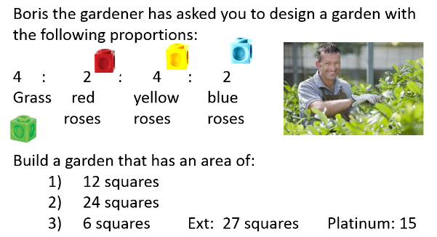
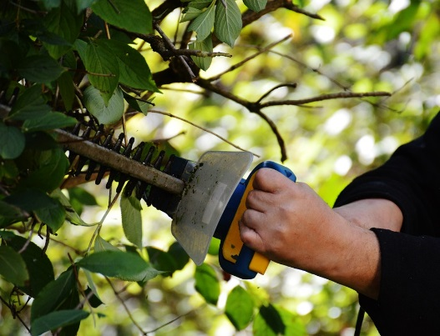
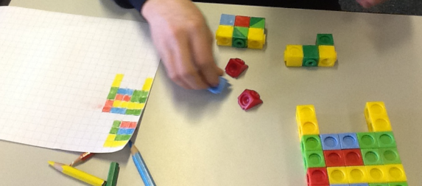
Reconnaissance
Boris the Gardener
Careful analysis of language used whilst participating (successfully) in the task:
X box passwords,
holidays to Spain,
talking about sweets,
computer games
Verbal language was not assessed – so students had no reason to use it to complete the task.

Slide 7
Multiples and Factors
First person to say the phrase. The group gets the point!
Expectation & Tacts
40
20
12
1 point: Multiple of 10
2 points: Multiple of 2
3 points: Factor of 15
4 points: Factor of 24
8
5
1

Slide 8
Questions to move us from red zone to orange zone; green zone to orange zone or to stay in the orange zone.
Some questions from students in KS3-4:
These do not feel (to me) like a student voice
Mands
Green zone:
Can I have harder work?
Red zone:
What can I use? (meaning equipment)
Can I work somewhere quiet?
Could you sit with me?
Please could you tell me a joke and then I can start again?
Can you help me more?
How do I do this?
Please could I have some help?
What is my first question?
Comfort
Orange zone:
Can we work together?
Do you think Silver would be too easy/hard for me?
Do you think I can try Platinum tomorrow then?
Can I explain what I understand?
Learning
Anxiety
Growth zone model from Johnston-Wilder et. al. 2013

Slide 9
Mands
After some discussion with speech and language therapist & English, DT and PE teachers….
Red zone Orange zone Green zone
This is hard This is OK This is easy
This is boring This is boring
What’s my next step? What’s my next step? What’s my next step?
These don’t feel as though they fit neatly with Grice’s maxim of quantity.
It doesn’t feel like quite enough – needs a question mark!(?)……………

Slide 10
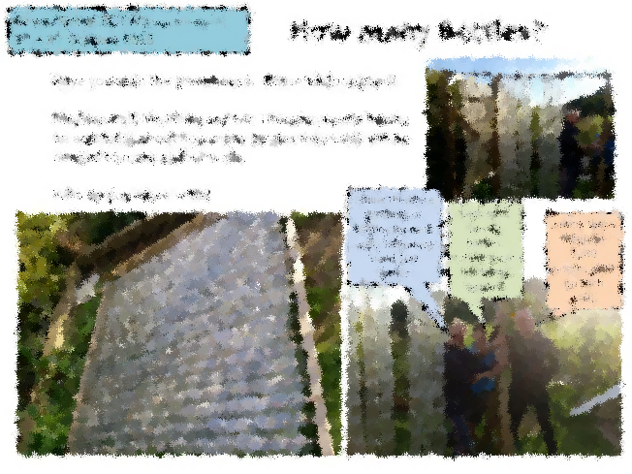
Key Barriers:
  ‘This isn’t proper Maths – I should be writing sums!’
  Knowledge of Maths vocabulary
  ‘Bubble factor’ – paucity of life experiences
  Social factors (disagreements amongst friends)
  Worried about getting it wrong
  Lack of expectation or opportunity to talk
Interthinking
&
Intraverbal
Key Strategies:
  Time to think/IDRF
  Humour
  Teacher modelling/Scaffolding
  Good relevant visuals
  Stuff to hold/use
  Gestures (i.e. sign language)
  Simulation games (LTHC)

Slide 11
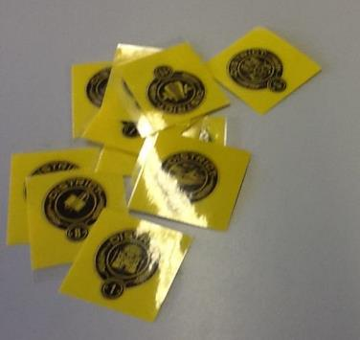
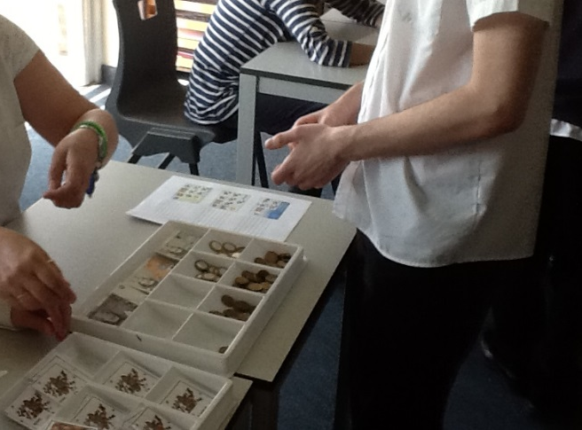
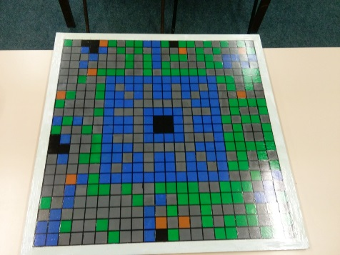
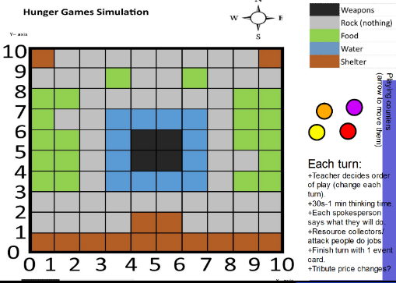
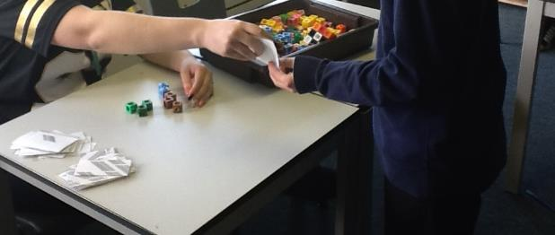
Simulation Games
"It was alright actually" year 10 student.

Slide 12
Conclusion
  As expectation for talk became more embedded in the classroom, Students felt able to get up and collect own equipment
  Flatter power structures (or perception of)
  I enjoy teaching again
“Support for significant mathematical thinking is dependent on teachers who not only hear but listen attentively to the mathematics in students’ talk. A context that supports the growth of students’ mathematical identities and competencies builds on students’ responses, shapes the reasoning and thinking to an appropriate level, and moves ideas and solutions toward a satisfactory conclusion”.
Walshaw and Anthony (2008)

