Slide 1
Mathematical resilience…
The Students’ perceptions.

Slide 2
Intro:
Joyce Nyama
Teacher of secondary mathematics in Birmingham
2nd year phd
This presentation will report on a pilot study I carried out last year

Slide 3
My research interest
I have always been deeply moved by outstanding achievement, especially in the face of adversity, and I have also been saddened by wasted potential.
This research is attempting to address the latter by exploring ways, tools and strategies I can use to help my students’ mathematical learning journey be more successful.
Mathematical resilience using q methodology
*relatively new construct + ‘new’ methodology
Johnston-wilder & lee
mathematical resilience, described as ‘a positive approach to mathematics that allows people to overcome any affective barriers presented when learning mathematics.
Stephenson and brown
Q Methodology studies ‘examine the world from the internal standpoint of the individual being studied.
My influences

Slide 4
Research context + Participants:
Girls school in Birmingham
Wide catchment area
Yr 10 girls
Class of 21 girls

Slide 5
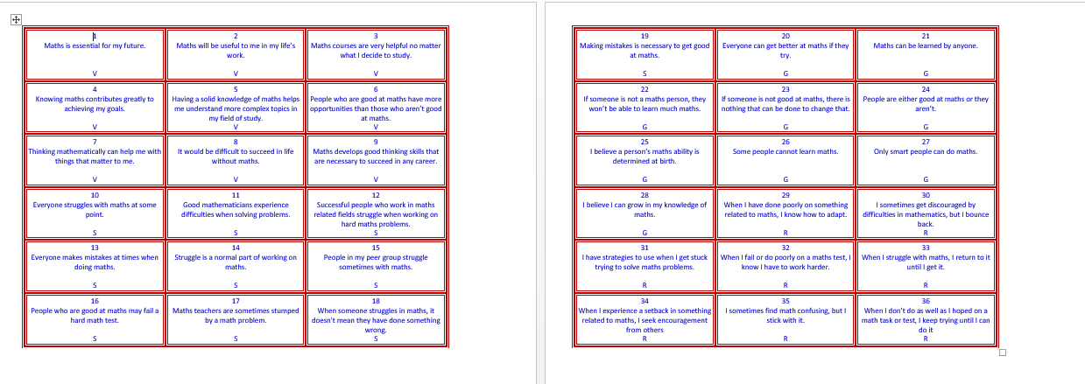
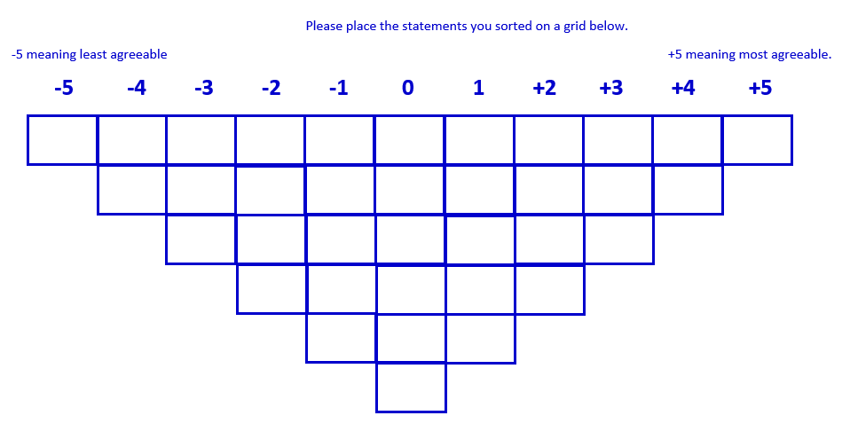
instruments:
36 statements from the mathematical resilience scale by kooken et al
Q frame form -5(most disagreeable) to +5(most agreeable)
Option to add anything they would like to say that has not been said (providing for added voice)

Slide 6
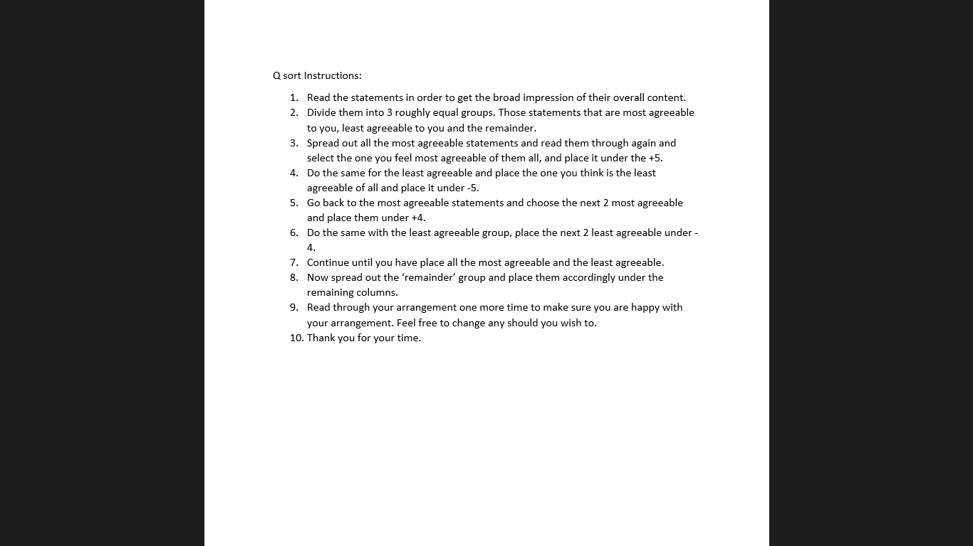
Instructions to participants:

Slide 7
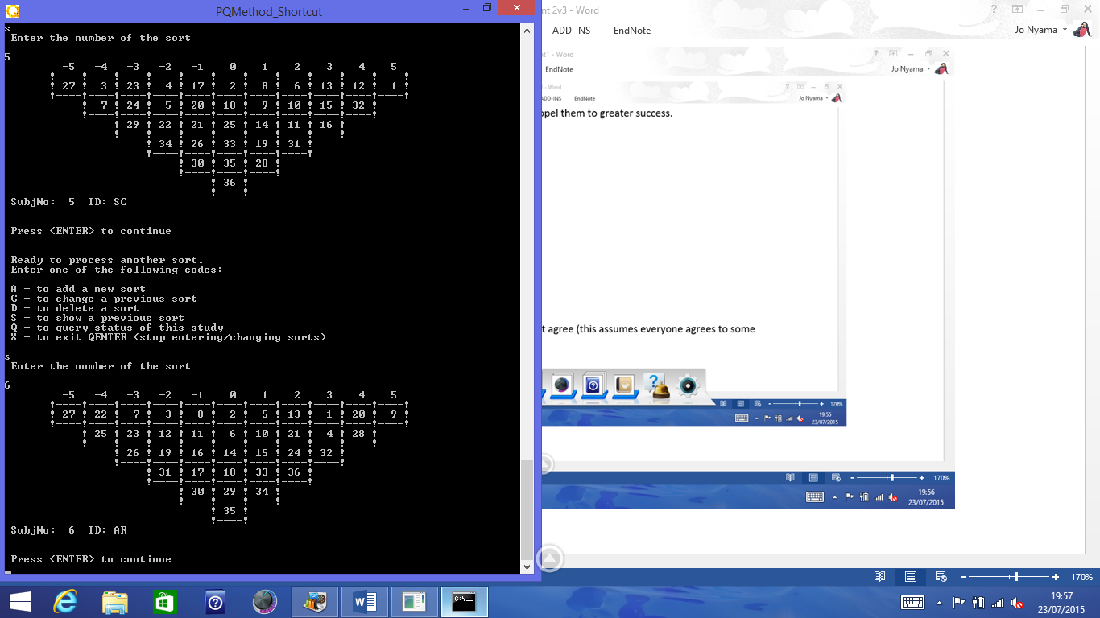
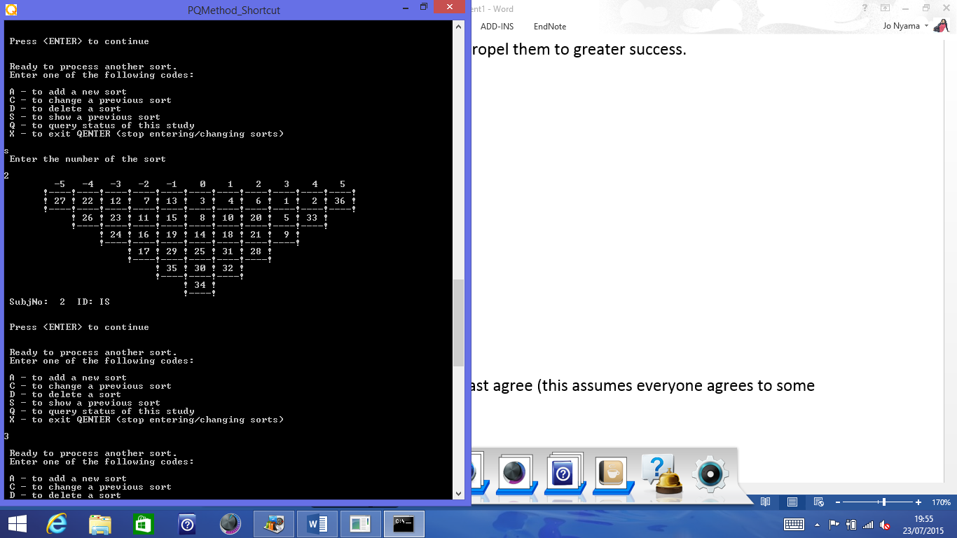
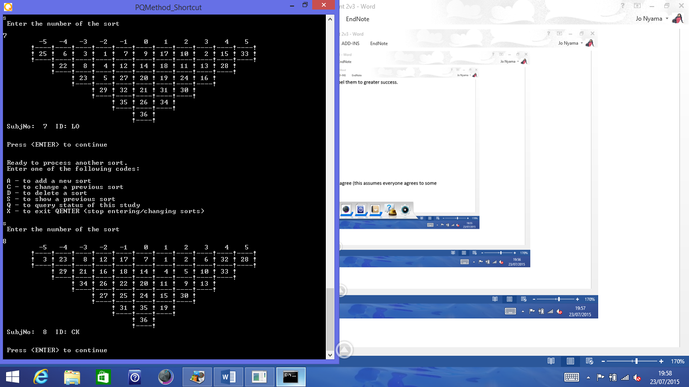
Results : examples of a q sort
Defining sorts for each factor extracted.

Slide 8
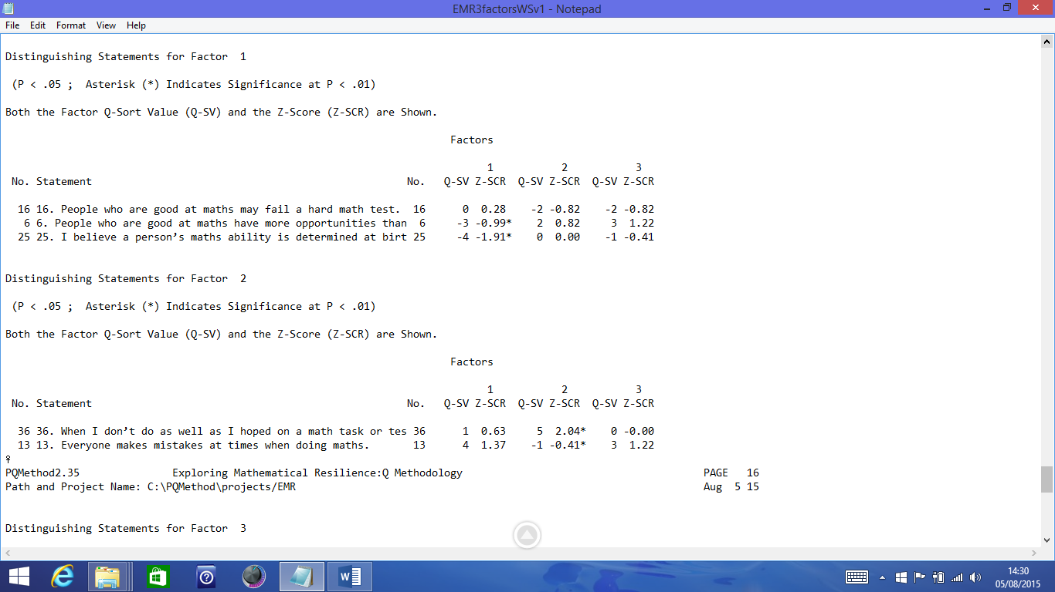
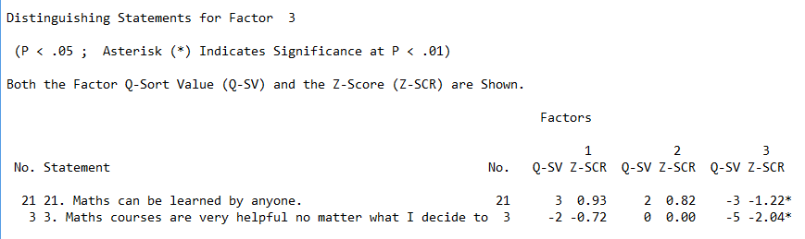
results

Slide 9
Tentative interpretation of results
Who is the factor 1 student?
The distinguishing statements for factor 1 identifies the student who believes a person is born with or without maths ability and that even people who are good at maths have limits but this student still appreciates the value of maths.
Who is the factor 2 student?
Distinguishing statements for factor 2 identifies that student who believes that anyone can make mistakes at maths and that there is value in keeping on trying.
Who is the factor 3 student?
Distinguishing statements for factor 3 identifies that student who values maths and believe that anyone can learn maths.

Slide 10
overview
This pilot study highlighted the very wide range of views held by students
Factors extracted represent three distinct but related views of learning mathematics
There was substantial agreement on the value of mathematics
But
Wide variations on beliefs about ability

Slide 11
What this research brings to the table:
subjectivity - mathematics learning through the eyes of the student
It is This subjective interpretation the student makes about mathematics learning that ultimately influences their participation in the mathematics learning journey.
Understanding this interpretation will enable the development of Tailor-made support strategies

Slide 12
however….
Some limitations
The viewpoints from this pilot study are a product of prevailing conditions at that moment in time.
They may or may not emerge in subsequent studies
Q methodology provides for the study of an individual’s subjectivity
Results produced from such a study may or may not be generalised.
Having said that, Generalisability is not a goal of the q method research.

Slide 13
As mathematics education continues to be plagued with negative coverage from all sectors, researchers and educators need to continually explore ways and provide support to make this successful.
Thank you for your time.
I Will take Questions.

