Slide 1
Five Propositions that Explain Why Schools Struggle to Improve Social Mobility

Slide 2
Education & Social Mobility
Labour, Coalition and Conservative Governments aimed to increase social mobility in the UK by placing a strong emphasis on improving education to ensure more equal life chances for everyone.
As Secretary of State for Education between 2010 and 2014, Michael Gove declared that he was ‘determined to do everything I can to help the poorest children in our country’ transcend their backgrounds and progress to leading positions in the land.
This policy goal is consistent with the widespread perception that a better life depends on working hard at school to gain qualifications and entry to prestigious universities.

Slide 3
Education & Social Mobility
The Policy Claims:
Education is a transformative ingredient that empowers individual effort and mobility through better examination results.
Every dedicated, hardworking individual can move upwards, regardless of personal circumstances. Other variables are not important.
State schools aren’t doing a good job and fail their students.
State schools, converted to academies, can be as good as independent schools, regardless of funding levels.
Tough examinations and excellent teaching will close the gap between the disadvantaged and the rest and so transform our society.

Slide 4
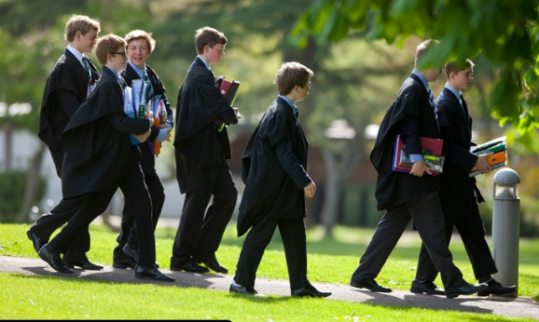
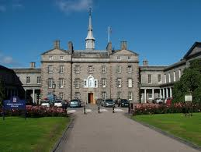
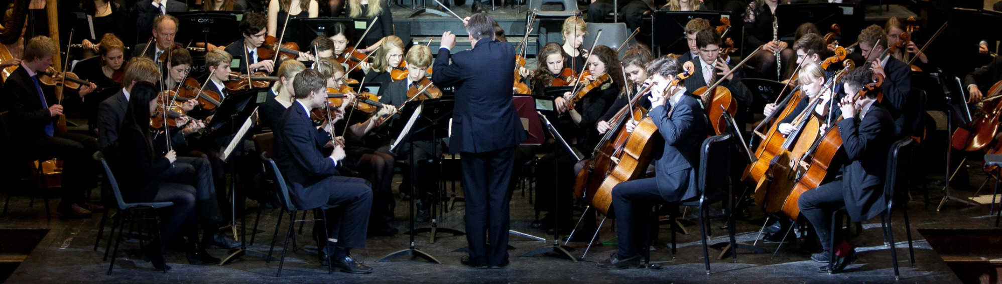
Education & Social Mobility
Schools should be like this, not like…

Slide 5
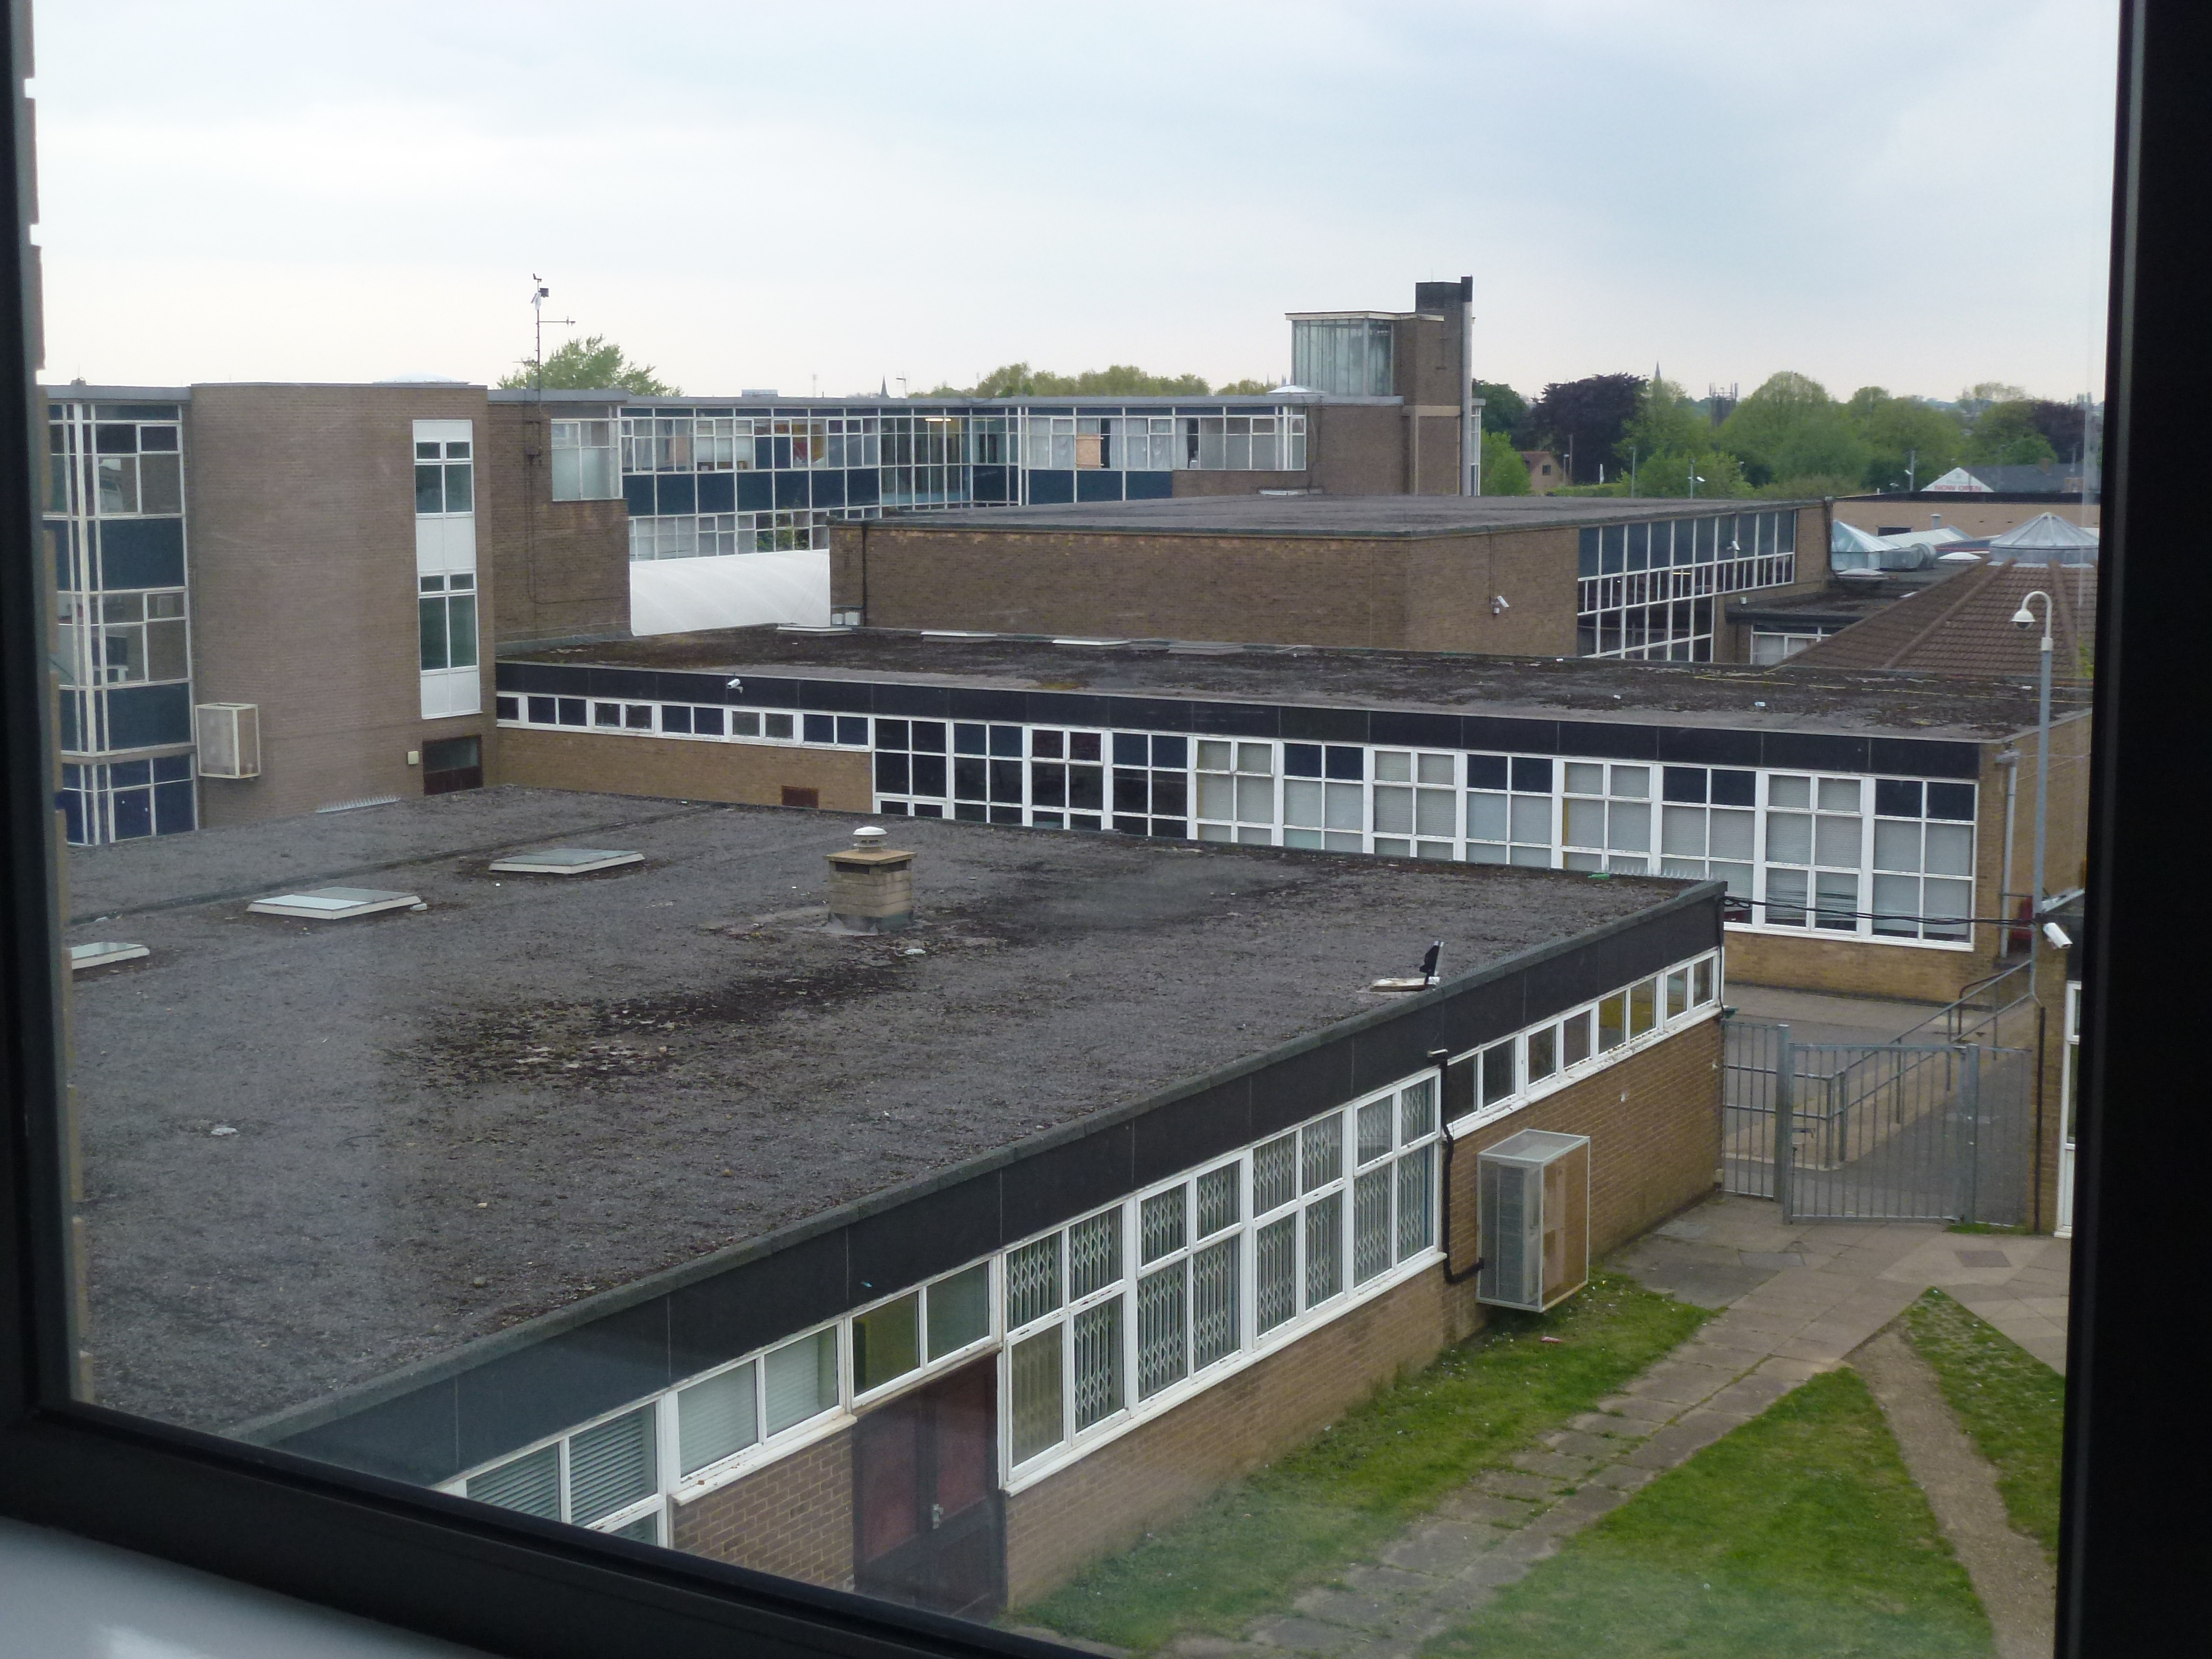
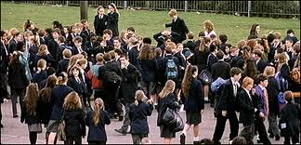
Education & Social Mobility
This!

Slide 6
The Problems of Social Mobility
We challenge this established policy consensus and offer five propositions that raise doubts about these hopes.
1. There has been no significant change in overall patterns of social mobility in the UK despite massive and continuing investment in education.
2. Elite formation, stratification and inequality are features of most human societies, and arise from a mixture of political conflict and economic organization rather than from weaknesses in the school system.
3. Relative family wealth is more strongly associated with educational outcomes than any other variable or combination of variables.
4. Class differences shape how people experience and respond to their circumstances and are instrumental in producing differential outcomes in education and the workplace.
5. Increased inequality since the 1970s is a powerful obstacle to improved rates of social fluidity and mobility.

Slide 7
Education & Social Mobility
Caution – why do we believe what we do?
Competitive individualism works for individuals, but can everyone succeed?
Do success stories mask the advantages of time, place and background that make exceptional cases work?
Are the lessons learned from exceptions the right ones?
Successful, upwardly mobile people are more often divergent unrepresentative individuals at odds with their environment who deviate from norms that shape most people’s aspirations.

Slide 8
Education & Social Mobility
There has been no significant change in overall patterns of social mobility in the UK despite massive and continuing investment in education.
No change in class inequalities or upward/downward mobility in last 100 years (Goldthorpe & collaborators)
Apparent changes in mobility due to shifts in size and distribution of social classes, e.g. demand for professional and managerial personnel during and after WW2.
Permits increased absolute mobility with individuals from lower groups able to secure elite service positions
BUT relative mobility rates unaltered, proportion of individuals in different class positions from those of their families of origin remarkably stable.
More room at the top but no greater opportunity to get there from less advantaged social positions – children of service class 5/6x more likely to obtain service class jobs than those from working class origins (Marshall & collaborators)
DWP report says trends in social mobility resist policy interventions because higher social classes take greater advantage of the opportunities created by government action

Slide 9
Education & Social Mobility
2. Elite formation, stratification and inequality are features of most human societies, and arise from a mixture of political conflict and economic organization rather than from weaknesses in the school system.
Long history of social stability & inequality since the ending of hunter-gatherer societies. Origins in large settled agricultural communities illustrated in Flannery & Marcus’ survey of archaeological and anthropological evidence
Unemployment, rent and debt reinforce the ‘active manipulation of social logic’ – i.e. power and acquisition of wealth follow from social positioning
Studies of Hungary & Russia show that even in extreme conditions where all support removed, the old elites return and social structures are in effect as resilient as in the west where revolution was not experienced
Wealth and power accumulated over time confers powerful advantages that are not easily overtaken and reversed – successive generations better placed than less fortunate competitors
Education not an agent of change but deeply implicated in social structures – clear hierarchies of schools and universities that reflect their social composition (Bourdieu & Passeron)

Slide 10
Education & Social Mobility
3. Relative family wealth is more strongly associated with educational outcomes than any other variable or combination of variables.
The type of neighbourhood where a pupil lives is a more reliable predictor of GCSE performance than any other information held about them (Webber & Butler, using the UK Mosaic Neighbourhood classification and the Pupil Level Annual School Census – PLASC - )
National Performance Data shows a strong correlation between GCSE results and relative wealth
The ‘gap’ between the disadvantaged and the rest may be a statistical illusion derived from FSM and Pupil Premium criteria – there is a curve of advantage correlated with achievement, not a gap

Slide 11
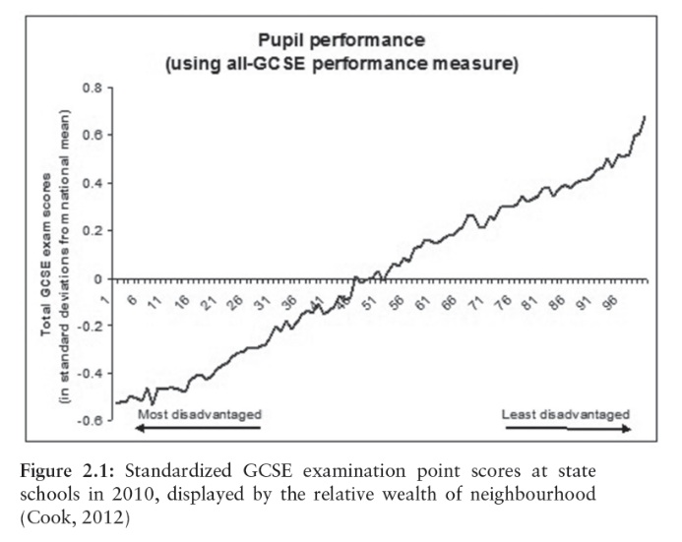
Education & Social Mobility

Slide 12
Education & Social Mobility
Class differences shape how people experience and respond to their circumstances and are instrumental in producing differential outcomes in education and the workplace.
Class remains ‘the hereditary curse of English education’, the ‘zombie’ still stalking our schools and classrooms even after more than twenty years of reform designed to improve their effectiveness (Diane Reay)
The attainment gap between the classes, like relative social mobility rates, is as great today as it was twenty or even fifty years ago
Working- and middle-class life patterns remain sharply different, with class ‘everywhere and nowhere, denied yet continually enacted’ (Reay)
Despite reduced levels of class awareness, class differences continue to be important and class itself is ‘ever present in people’s lived experience’ (Savage, 2000; Archer et al., 2010: 10)
Class background is also closely associated with subsequent occupational destinations. Just 7 per cent of ‘high-ability’ sons of large business owners and managers were in manual employment by the age of 33, compared with 38 per cent of the ‘high-ability’ sons of unskilled manual fathers. By contrast, over half of the ‘low-ability’ sons from professional families join the middle class, compared with 10 per cent of the ‘low-ability’ sons of unskilled manual workers (Savage).

Slide 13
Education & Social Mobility
5. Increased inequality since the 1970s is a powerful obstacle to improved rates of social fluidity and mobility.
Status and the relative steepness of the social gradient have a powerful impact on children’s welfare and life chances (Wilkinson & Pickett)
Health studies show that increased inequality produces
- heightened anxiety
- evaluative threats to the social self
- reduced self-esteem
- greater social insecurity
- more status related shame
Gini-index measures increased inequality across advanced economies – the incidence of problems relates to inequality, not particular levels of disadvantage. The chart below shows that greater inequality spells worse problems
US & UK are world leaders in increased inequality (up 40% since 1970s), and in the associated welfare problems
Inequality reduces mobility because social gaps are wider. When the resources available to poorer families are reduced (e.g. family incomes, educational maintenance allowance, sport partnership, local government facilities) it is harder still to close such gaps, whatever schools may do

Slide 14
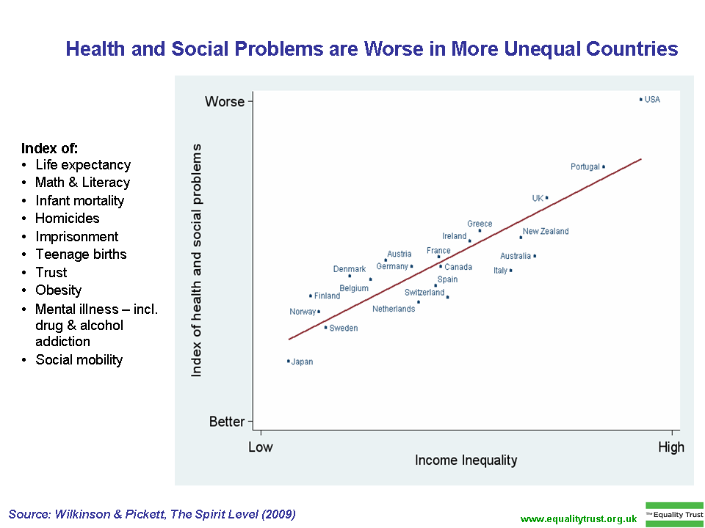
Education & Social Mobility
Income Inequality Compared with Health and Social Problems
(Wilkinson and Pickett, 2010)

Slide 15
Education & Social Mobility
Policy-makers do not wish to hear these 5 propositions; but their policies cannot succeed without acknowledging that the task is immensely more difficult than is currently assumed.
One of the biggest problems is the simplistic model of mobility as a question of individual advancement, measured by comparing father and son incomes at fixed reference points. Women and households are not taken into account as women’s status is believed to be ‘referred’ (to father or husband).
We are working on an alternative, more realistic, more inclusive model that shows the many different dimensions with which policy-makers need to work.

Slide 16
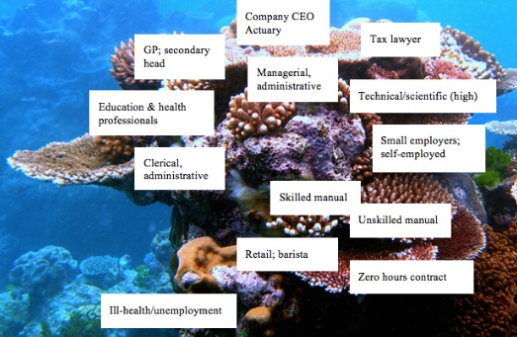
Alternative Model of Mobility

Slide 17
Alternative Model of Social Mobility
Occupational Niche G1
Individuals often see themselves as free agents in making educational and vocational decisions.
Our model balances this sense of personal agency with awareness that people are embedded in families and family relationships to which all household members make important if varied contributions.
These influence and transmit relative status and access to:
Economic capital (income, investments, property)
Social capital (peer group, networks, contacts)
Cultural capital (knowledge, skills, dispositions).
Over time, the historic interactions of family members with these elements tend to produce a spatial distribution that resembles the form of a coral reef:
Layered niches of varying depth and quality provide diverse habitats for myriad creatures in complex relationships with one another.
Each niche, and the creatures within, adapt and evolve continuously in relationship to one another and the wider reef and in response to the changing conditions that shape its context.
Individual trajectories through education and work should be understood in relation to family interactions in the context of occupational genealogies set in a wider historical context.

Slide 18
Alternative Model of Social Mobility
Mobility (up or down) within (intra-generational) and between (intergenerational) G1, G2 and G3
The main sources of upward or downward mobility for families and individuals within and between niches are:
Changes in family & individual assets and dispositions
*small differences compound
over time (e.g. inheritance)
*variations over time in access to
enabling resources (e.g. education)
*adaptation of family culture and
identity to changed conditions within
a niche
Changes in niche environment
*labour market micro fluctuations
impact on competition and rewards for
different occupations/skills
*increased or reduced provision of
enabling resources
Changes in external world impact on reef
*technological and organizational
innovation create, contract or alter
opportunities (e.g. ‘room at the top’)
*increased and/or improved educational
access/quality raise skill levels but
intensify competition
*Cultural shifts, e.g. expectations of
girls and women & their social role

