Slide 1
Education and Social Mobility
Dr Kate Hoskins
Reader in Education

Slide 2
Education and social mobility
Labour, Coalition and Conservative Governments aimed to increase social mobility in the UK by placing a strong emphasis on improving education to ensure more equal life chances for everyone.
As Secretary of State for Education between 2010 and 2014, Michael Gove declared that he was ‘determined to do everything I can to help the poorest children in our country’ transcend their backgrounds and progress to leading positions in the land.
This policy goal is consistent with the widespread perception that a better life depends on working hard at school to gain qualifications and entry to prestigious universities.

Slide 3
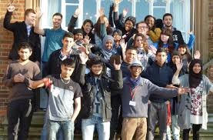
Education and Social Mobility: Dreams of Success
Sample:
Two highly effective schools, with their mixed but above average intakes, were chosen because they match policy-makers’ expectations for the conditions required to foster social mobility. Both are believed to offer capable and committed students, from aspiring families, excellent access to good examination grades, good universities, and good opportunities for social mobility.
South Park, 11-16, 46 year 11 students.
(Ofsted Grade: Good).
Felix Holt, 11-18, 42 year 13 students.
(Ofsted Grade: Outstanding).
Notes:
We chose our respondents from two academies with ‘good’ and ‘outstanding’ characteristics, similar to those that policy-makers wish to see adopted across the country to increase performance and mobility for everyone (HMG, 2011; DfE, 2010a). South Park and Felix Holt both emphasize high-quality teaching, hard work and aiming high.
They have high expectations and set demanding targets. They are prototypes of the new academy regime, expected to emulate top independent schools despite accepting the full ability range and receiving per-pupil funding that is approximately 70 per cent less than at the average private school (Gunter, 2011).

Slide 4
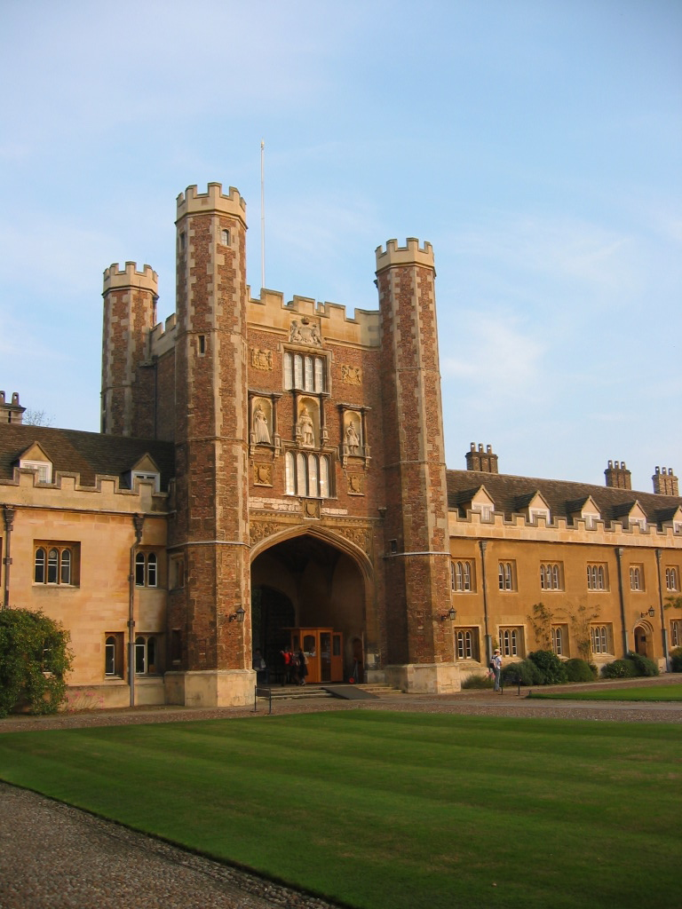
Education and Social Mobility: Dreams of Success
The Policy Problem
Private schools educate only 7 per cent of the nation’s children but provide 70 per cent of high court judges and over half of the membership of other leading professions. Students at independent schools are three times more likely than those at state schools to obtain three A grades at Advanced Level.
A fifth of the school population receives a free school meal (FSM) but only one in a 100 of these disadvantaged students secures admission to Oxford or Cambridge University. Only 25 per cent of boys from working-class backgrounds secure professional or managerial jobs.
Blanden et al (2005) Social mobility in Britain: low and falling, CentrePiece, Spring, 18 – 20. Online. http://cep.lse.ac.uk/centrepiece/

Slide 5
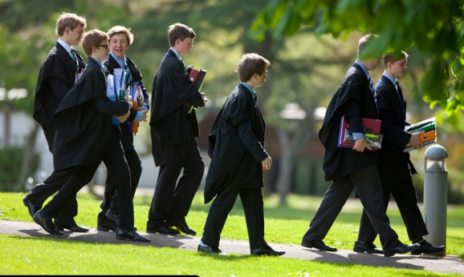
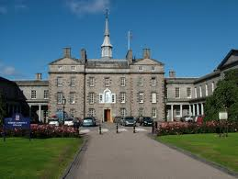
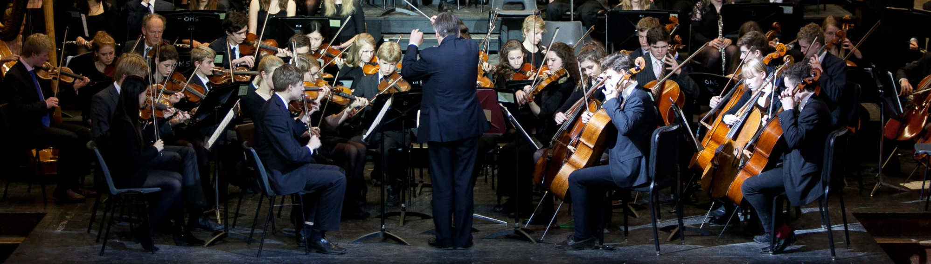
Education and Social Mobility: Dreams of Success
Schools should be like this, not like…

Slide 6
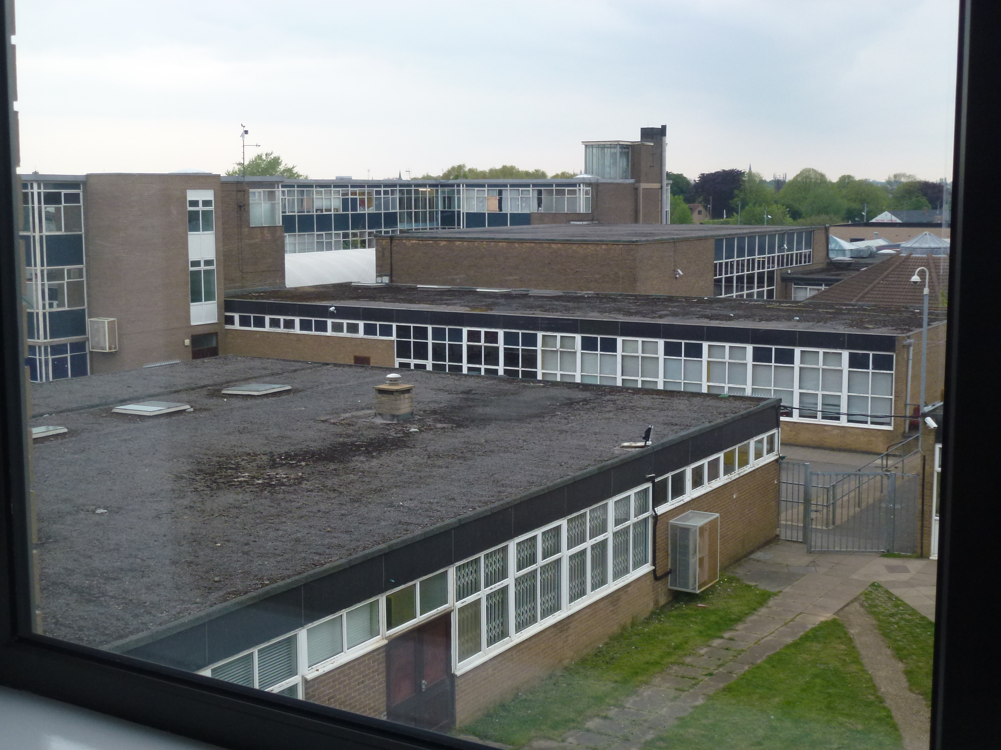
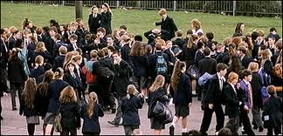
Education and Social Mobility: Dreams of Success
Last Days: Community Comprehensive in
Peterborough

Slide 7


Education and Social Mobility: Dreams of Success
In pairs or threes, take it in turns to tell the others whether your personal history represents an upward, downward or unchanged mobility trajectory.
Then report whether you perceive your family history as an example of mobility (in one direction or another).

Slide 8
The policy claims:
Education is a transformative ingredient that empowers individual effort and mobility through better examination results.
Every dedicated, hardworking individual can move upwards, regardless of personal circumstances. Other variables are not important.
State schools aren’t doing a good job and fail their students.
State schools converted to academies can be as good as independent schools regardless of funding levels.
Tough examinations and excellent teaching will close the gap between the disadvantaged and the rest and so transform our society.

Slide 9
Education and Social Mobility: Dreams of Success
But the policy is far ahead of our knowledge and understanding of social mobility. There are many under-researched obstacles:
Social class , childhood poverty, ill-health
Recruitment bias (e.g. internships, old boy networks)
Family capital (social, cultural, economic), expectations, networks and dispositions
Growing inequality, with social problems closely associated with more unequal
societies
Occupational structures and opportunities – varied by time and place, not
necessarily by hard work and enterprise; is there ‘room at the top’?
Agency/structure, nature/nurture, genetics/synapses
Education – free-standing agent of individual emancipation or one ingredient in
complex processes of social reproduction?
Problematic inter or intra generational male earnings measure; or household (inc.
women); quantitative or qualitative studies?
Reliance on various cohort studies over time – with serious errors introduced each
time, especially when analysis for reasons not originally intended
What about the rise in inequality?

Slide 10
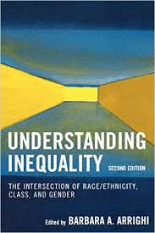
Understanding inequality
Rising levels
Stratification
Social inequality
Notes:
A dramatic rise in inequality in the United States (US) and Britain since the 1970s is now closely associated with growing social problems as well as reduced opportunity for those on middle and low incomes (Stiglitz, 2012). Epidemiological evidence suggests that ‘countries with bigger income differences tend to have much lower social mobility’, and that inequality has negative consequences for everyone, but especially for those placed towards the lower end of the income spectrum. Mathematics and literacy scores are markedly worse in more unequal countries while school drop-out rates are higher in the less-equal US (Wilkinson and Pickett, 2010: 159).

Slide 11
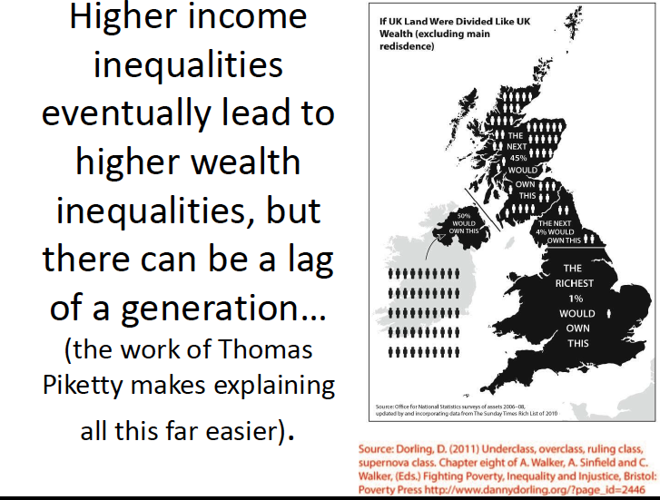
Rise of inequality

Slide 12
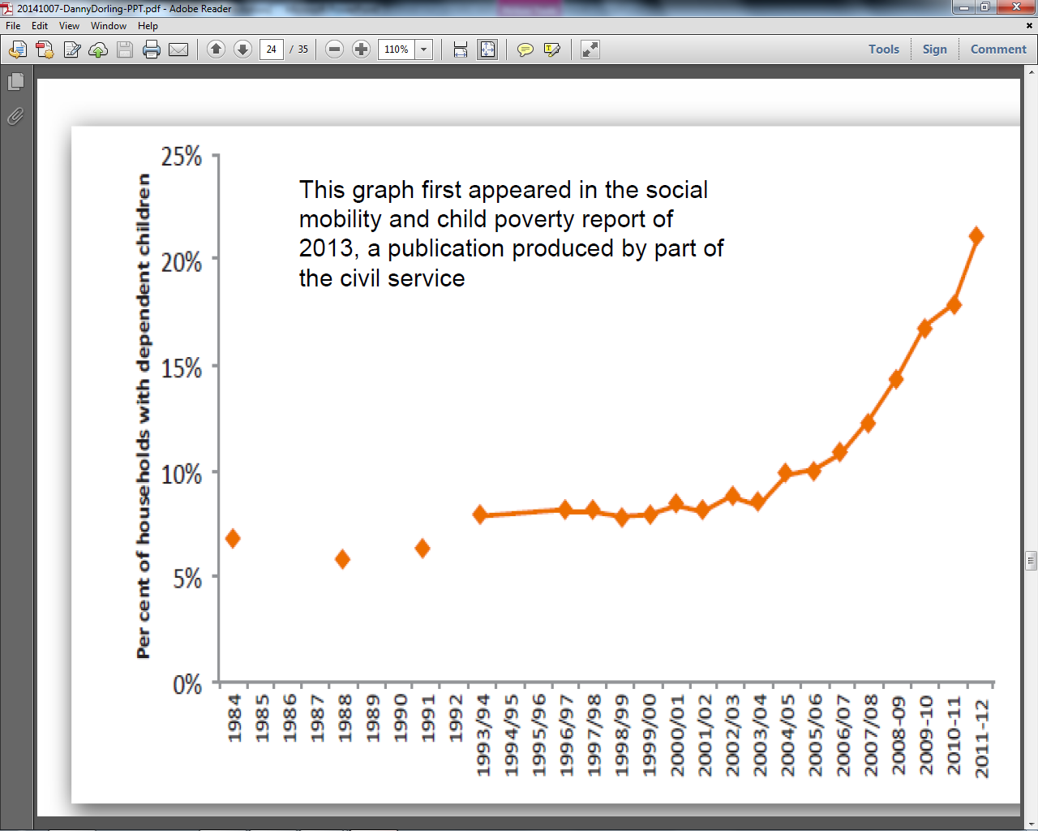

Slide 13
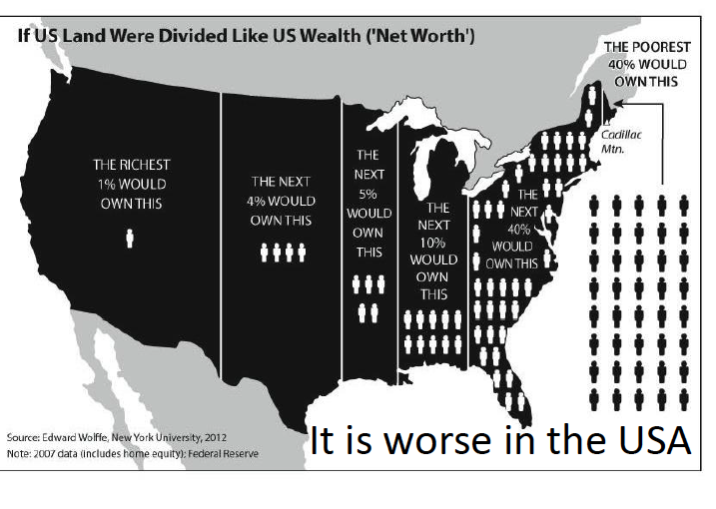
Rise of inequality

Slide 14
Education and Social Mobility: Dreams of Success
Our propositions – what we’d find if outstanding schools improve mobility prospects:
Policy makers articulate a rigorous conceptual framework for competitive individualism and social mobility.
2. High performing schools emphasise excellent teaching, high expectations and achievement. Students believe they are ‘authors of their own lives’ and work hard to reach challenging goals and targets. They are competitive and accept full responsibility for their own relative success or failure.
3. Family background has less influence on student decisions about education and employment. High performing schools are reducing outcome differences between less advantaged students and their peers.
4. Students aspire to high status educational and employment opportunities associated with increased chances of relative social mobility. They seek a degree of power and autonomy in their work, and to accumulate economic security and material advantage.
5. Students have clear, rational understandings of available options, routes and pathways through secondary and higher education, training and the workplace. Future choices and outcomes are based on ‘horizons for action’ that transcend disadvantage and family background.

Slide 15

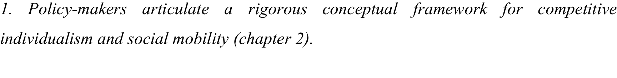
Education and Social Mobility: Dreams of Success
Vaguely expressed aspirations rather than clear and achievable goals, e.g. can everyone who works hard climb the ladder successfully? Won’t exclusive goals (e.g. Russell group admission) either remain exclusive or be devalued by everyone achieving them?
Other explanations (see slide 10) not acknowledged or dealt with – is it right to argue that poverty and ill health have NO impact on achievement? Or that class doesn’t exist and has no consequences?
Should we expect families to have no impact on choices?
Should we ignore The Spirit Level?
Closing the Gap makes no statistical sense – the results are worse and worse as we progress through the wealth deciles; they don’t suddenly get bad at the FSM frontier.
Does the individualistic conception of social mobility make sense?
Notes:
The government’s one-sided, hyper-individualist plans neglect the reality of children’s lives and experience, and over-estimate the extent to which cherished reforms can increase the number of young people obtaining higher-status jobs. These reservations, based on close scrutiny of policy documents and the careful reading of a wide range of studies concerned with social mobility and change, were confirmed by analysis of our student interview data.
Our respondents’ strategies became intelligible only when we began to draw on a wider variety of concepts. Anna and Elijah illustrate the puzzle at the centre of this book: why do similar educational experiences lead to such different lives? These two students attend the same highly effective school, are equally determined and hard-working, and share a strong sense of personal responsibility for reaching the demanding targets they have been set (see chapter 1).
But Anna plans to study childcare at a local college, while Elijah is headed for an elite university. Elijah’s potential income from a career in economics, international relations or aeronautical engineering is likely to be many times greater than Anna’s earnings in childcare. The analysis (in chapters 3–6) uses the concepts of habitus, field and institutional habitus to interpret respondents’ lives, decisions and pathways, and to begin to understand why education leads to such diverse pathways and destinations.

Slide 16
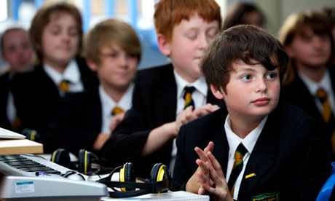
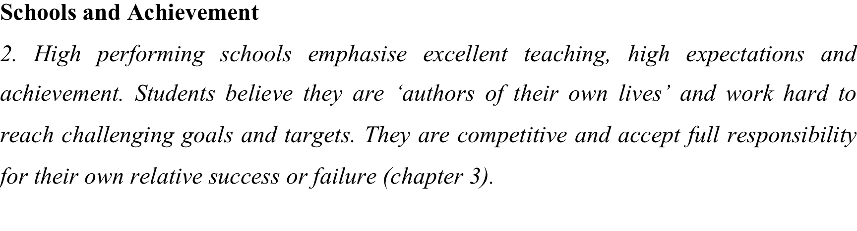
Education and Social Mobility: Dreams of Success
These conditions met to a remarkable extent, with strong evidence of excellent teaching, high expectations and achievement.
Students at South Park critical of less good teachers but embraced school and ethos.
Students strongly felt that the future lies in their hands and their hard work. Did not acknowledge class or background as obstacles. Believed in competitive individualism. Dispositions aligned with formal demands and expectations of the exam system.
Mentoring and target setting part of the schools’ DNA.
Notes:
Overall, the majority of our students presented themselves as astute, highly motivated, and hard-working. Almost all the respondents described clear plans for the future and recognized that they would have to adapt to circumstances, including unfavourable grades. They were acting as the reflexive agents of individualism whose decisions were ‘pragmatically rational’ (Hodkinson et al., 1996). Their dispositions were aligned with the formal demands and expectations of the examination system, and latent individualism led them to pursue opportunities in competition with their peers (Giddens, 1991). Those with professional parents were influenced by the high-status academic milieu in which they had grown up, while others with parents engaged in vocational careers as plumbers, builders and hairdressers were likely to aspire to similar occupations.
South Park and Felix Holt have adopted a wide range of strategies to improve attainment, including mentoring and target-setting, and their students have responded eagerly to the opportunities provided. Both schools promote high expectations and encourage faith in good grades as a passport to future success. Respondents believed that working hard would enable them to reach their targets. Some saw themselves as competitive and aimed to achieve a measure of status and control in the workplace as well as financial security for their future families. Respondents who had experienced family hardship were also more likely to emphasize the importance of employment that would yield a stable, regular income.

Slide 17

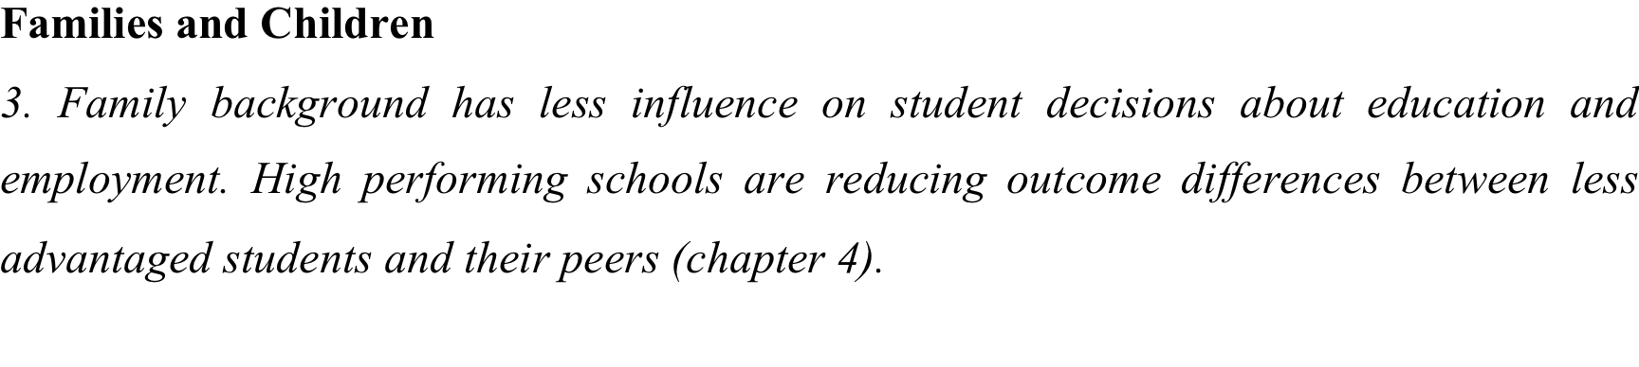
Education and Social Mobility: Dreams of Success
Family culture, networks, resources & dispositions (HABITUS) consistently reported as potent and formative in shaping values, goals and decision-making.
But the students rejected any idea that hardship, illness or other problems influenced them negatively – saw issues as challenges to be overcome.
But less successful students at both schools much more likely to describe themselves as disadvantaged. Stories of ill health, financial stress, unemployment etc. from less successful.
Parental milieu profoundly important, e.g. academic and professional parents at South Park emulated by students; ibid locally employed, trades people etc. produce children with a disposition towards similar employment routes.
Many students perform poorly, even in highly effective schools.
Notes:
Students were also strongly influenced by family values, climate and culture. They often attributed their interests, hobbies and activities to family members, including parents, grandparents and other significant relatives. Faith’s father introduced her to the local youth drama group and she was now contemplating a career in the performing arts. Isaac’s family had always kept animals and he now aspired to work in a pet shop. Our sample provided many examples of rich and diverse family lives that contributed to respondents’ values and interests. Family habitus was important, with interests in art (Louise, Andrew), music (Daniel, Richard), languages (Rachael) and sport (Mary, Carl, Jordan) emulated and developed by the next generation.
This data shows that family antecedents, circumstances and networks have a considerable influence on young people’s dispositions, and long-term implications for their educational and career trajectories. Our respondents’ stories tell of many twists of fortune and illustrate the accumulation of small (and sometimes large) advantages and disadvantages that help and hinder individual progress (Gladwell, 2008). Families play a crucial part in young people’s lives, whatever their background, and in many ways form the essential foundations for formal education.
This conclusion is reinforced by the number of students at South Park (33 per cent) and at Felix Holt (40 per cent) who fail to attain the good GCSE threshold (5 A*–C grades, including in English and mathematics), despite the excellent systems in place to raise standards and improve performance. The poorer results of this significant minority confirm the expectation that poor children are likely to do badly, even in highly effective schools (Cook, 2012).

Slide 18

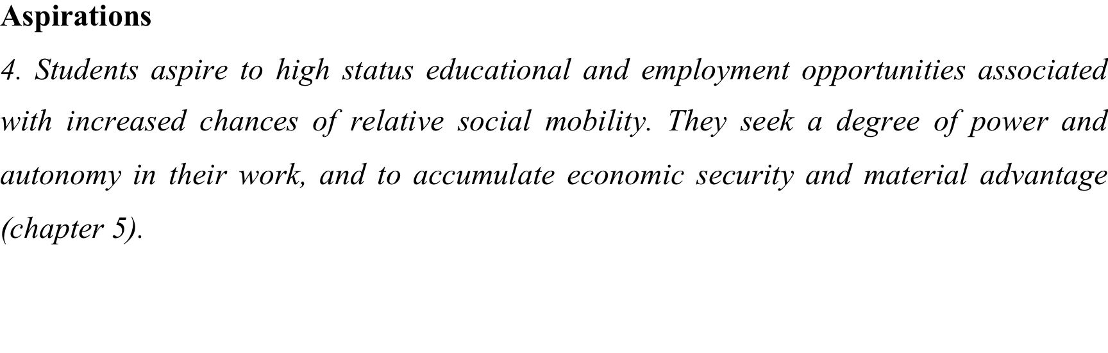
Education and Social Mobility: Dreams of Success
Some students dreamed of climbing ladders and upwardly mobile careers but the most frequently voiced aspiration was to personal and family happiness, and intrinsically rewarding work.
Although concerned to earn sufficient money to live their lives, most stressed job satisfaction as a critical contributor to happiness.
Female students in particular spoke of their desire to ‘make a difference’ in the world – selfless, caring and not very concerned with money and status.
Small male group at South Park did emphasize career, status and power.
Most disavowed the pursuit of material wealth, although some did not, and many were concerned to ensure financial security, especially if they had experienced family money troubles.
Notes:
Although some of our respondents said status and wealth were important for them, our data in general does not confirm the policy assumption that young people are dissatisfied with their lives and families and wish to climb the social and economic ladder. On the contrary, the most frequently voiced areas of aspiration were personal happiness and satisfaction, with family life and intrinsically rewarding work seen as more important to feelings of success and well-being than the pursuit of status and wealth. Noah, for example, commented that ‘pay is much less important than enjoyment of the job’. B group members tended to place an even greater emphasis on a happy family life than their A group counterparts, but students from across the sample explained their keen desire to combine pleasing parents and teachers with securing their own independence and happiness.
Our analysis of the interview transcripts identified five frequently-cited areas of aspiration (personal happiness, job satisfaction, making a difference, status, and wealth) and revealed significant links between students’ dreams of success and their family habitus and capital.

Slide 19
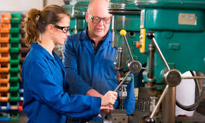
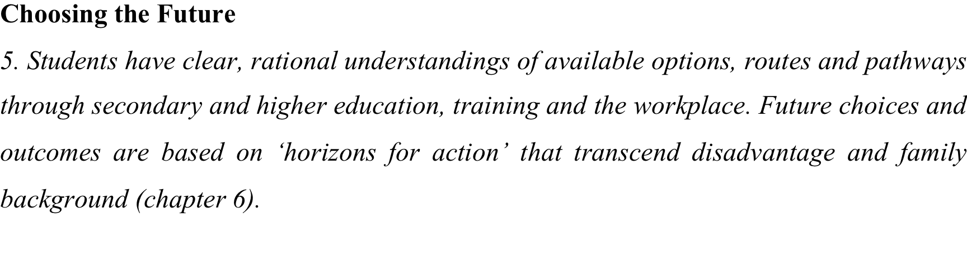
Education and Social Mobility: Dreams of Success
Some encouragement for policy makers in students who see themselves as hard working and competitive, and accept full personal, individual responsibility for their future fate.
Most students were pragmatically rational, understanding what was possible and adjusting expectations in the light of GCSE etc results.
Both schools encouraged mobility, with parents, teachers and students in aligned in pursuit of the best results and outcomes.
The majority are content with family life and have no real desire or aspiration to surpass their parents or enter new worlds above.
Outcomes still closely linked to family backgrounds – schools track and stream by KS2 and CAT scores, reinforcing academic and vocational strands/routes.
Need for family case studies – the dynamics of households, the female role.
Notes:
There are many immensely able students at South Park and Felix Holt who are set to gain outstanding grades. It is too soon, however, to judge the extent to which their academic credentials will translate into upward mobility, or to predict an individual’s success in seizing future opportunities and climbing an occupational ladder. There is clear potential, however, for bright A group students at both schools to secure above-average earnings and future mobility. But this potential may not be realized in the difficult economic environment that has followed the 2007 credit crunch and subsequent banking crisis. Young people from professional, double-income families may struggle to match their parents’ acquisition of resources. These students may obtain better qualifications than previous generations of their families, but increased participation at all levels of education means that advantaged students have to secure very strong credentials to maintain their family’s position, let alone to better it.
The Felix Holt Family Employment History (see chapter 6 and Appendix 2) provides patchy but significant evidence that families, rather than individuals, are the appropriate unit of analysis for studies in social mobility. Students are not isolated individuals in simple pursuit of ever more prestigious credentials, but contributors to evolving family patterns and networks that produce advantages or disadvantages for successive generations. We need to examine family case studies closely to understand the ways in which parents and other relatives contribute to the transmission of skills and resources, and families adapt to opportunities occurring in their local environment (Bertaux and Thompson, 1997).
The Family Employment History also suggests the web of family connections and resources that influence young people’s academic and vocational choices, and reveals the limitations of studies concerned exclusively with male earnings.
Changes in the labour market have made women ever more important players in the household economy and have provided greatly improved opportunities for young women today compared with their mothers and grandmothers. Women now play a vital part in the social and economic standing of their families. This increases the need to assess women’s contributions to social mobility.

Slide 20
Education and Social Mobility: Dreams of Success
Blinkers
Our study also contributes an unexpected insight into the failure of the sociological imagination. Individualist ideas persist, despite their many, obvious limitations, because people very often fail to see beyond their own limited and particular circumstances. Our students did not talk of a pattern, only their agency within it, and were eager to embrace an individualist perspective. They showed little knowledge of the work undertaken by their grandparents, and sometimes know little about the work reality of their own parents. They do not perceive the degree to which their lives are shaped by the transmission of family resources and dispositions, and by the opportunities of their own time and place.
Notes:
Our data suggests that academies are most unlikely to overcome family background or much increase social mobility. On the contrary, they seem to embed differences in family wealth, with successful students invariably describing advantages transmitted through their parents. A different approach is required and we recommend that policy-makers should:
Commission research that recognises the family, including women and girls, as the main influence on social mobility. Policy should be informed by qualitative studies that show the ways in which young people’s dispositions are formed and influenced, and help us understand how small advantages are transmitted between generations.
Provide structured support, especially through the childbearing years, to increase the proportion of women reaching senior professional and managerial positions. Thanks to comprehensive education, large numbers of women are already achieving the qualifications and skills necessary for high level careers.
Provide sustained help for disadvantaged parents and carers so that their children’s levels of nutrition, social engagement and extra-curricular learning match those of more fortunate social groups.
Curriculum, assessment and guidance systems should be designed to encourage all young people and to value their talents and aspirations equally, whatever they are. Excessive testing, negative examination feedback and premature tracking into academic and vocational pathways should be avoided.

Slide 21
Education and Social Mobility: Dreams of Success
On your own, reflect back on your own aspirations in secondary school – who helped you work out what you wanted to do and be? What role did family (including parents, siblings and grand parents), teachers, careers advisors or peers, shape your aspirations for the future?
Share your reflections in pairs – are your experiences similar or different? Why?

