Slide 1
MA in Educational Leadership (Teach First)
How educational philosophy may shape policy
January/February 2016

Slide 2
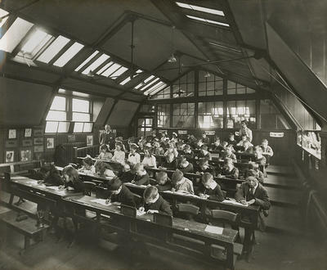
Notes:
The first of 5 photos to promote thinking about educational values and how they change over time. Students might explore time/location/who’s leading the learning?

Slide 3
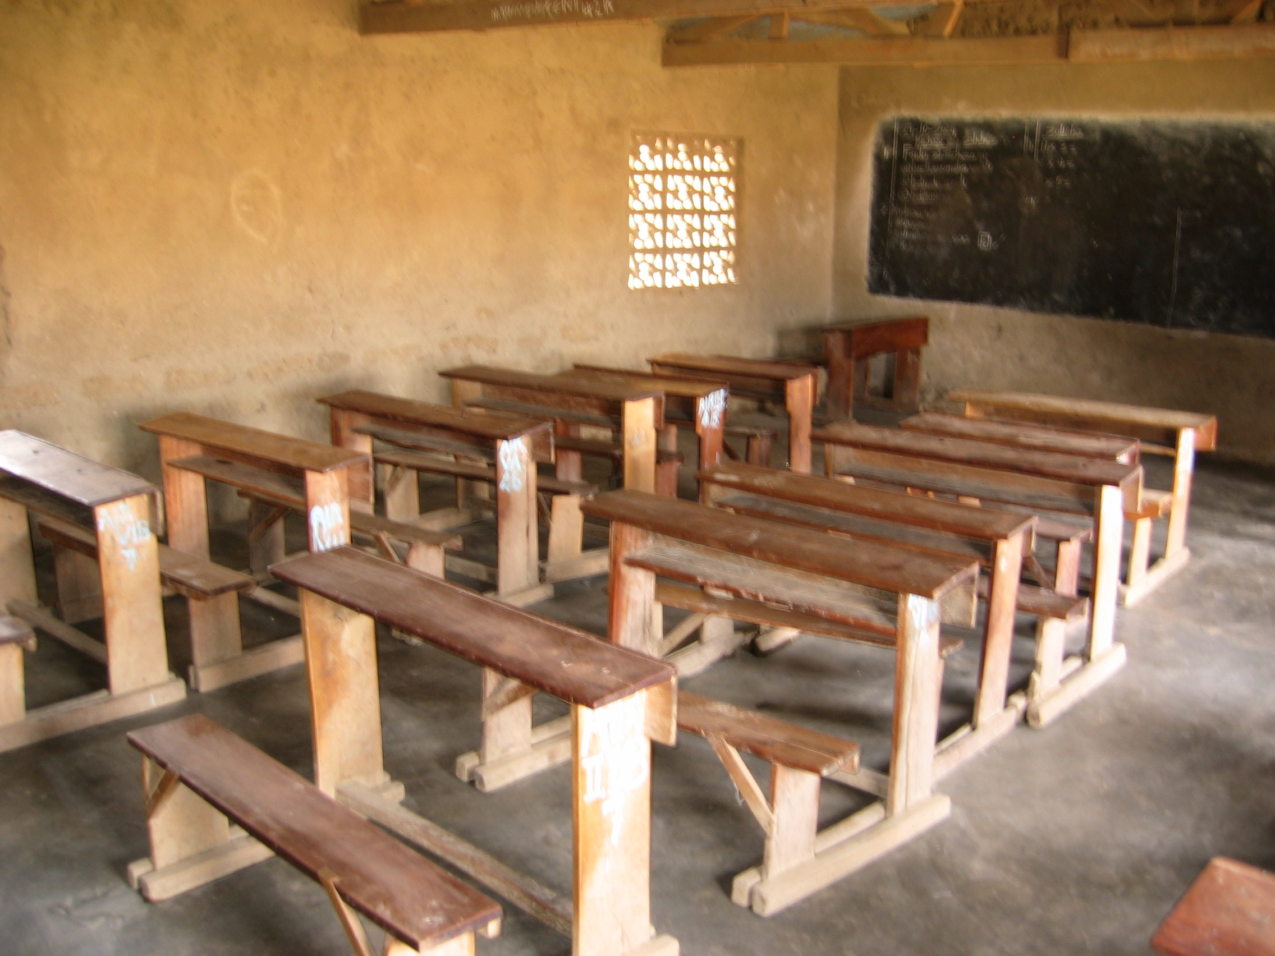
Notes:
This is actually a contemporary classroom – but where?

Slide 4
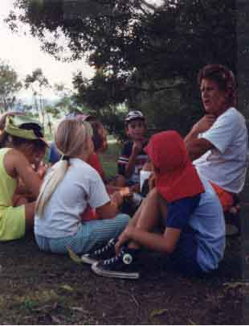

Slide 5
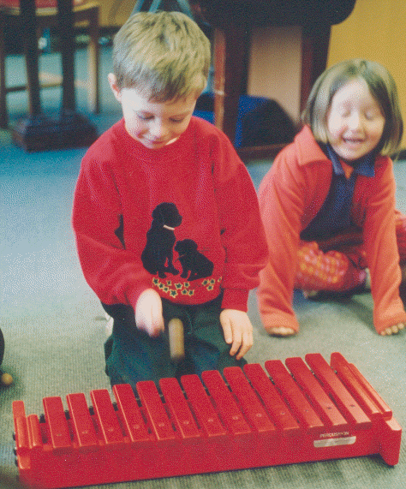

Slide 6
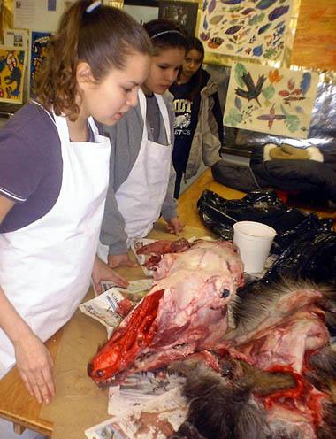

Slide 7
Educational philosophies fall broadly into four categories
1) Cultural transmission code (Classical humanism)
2) Pupil-centred code (Progressivism)
3) Social reconstruction code (Reconstructionism)
4) GNP code (Instrumentalism)
Alternative typology from Morrison and Ridley in Preedy (1989)
Notes:
This is an amalgam of many sources – a broad overview. Bottery (1992) mentions it but the summary is older and impossible to attribute accurately. It’s not literature, therefore, but a thinking tool.

Slide 8
Philosophy: Cultural Transmission Code (CTC)
Knowledge is: Part of cultural heritage
Teaching is: Transmission of knowledge/culture and values
Students are: Passive imbibers of knowledge (and graded as such)
Assessment is: Precise, quantitative, by examination
Management style: Hierarchical, elitist

Slide 9
Cultural Transmission Code / Classical humanism
Emphasis on: Knowledge
Key features:
Academic
Non-vocational
Cultural heritage
High culture
Standards
Competitive
Formal
Intrinsic worthwhileness

Slide 10
Philosophy: Pupil Centred Code (PCC)
Knowledge is: Acquired experientially, interest-based
Teaching is: Open-ended, exploratory, facilitative
Students are: Active, involved, create/construct their own reality
Assessment is: Qualitative, subjective
Management style: Democratic

Slide 11
Pupil-Centred Code / Progressivism
Emphasis on: Individual child
Key features:
Subjects are a vehicle for learning
Process orientated/integrated approach
First hand experience
Discovery learning
Developing individual potential
Teacher as facilitator
Creativity
Equality of opportunity
Questioning of society

Slide 12
Philosophy: Social Reconstruction Code (SRC)
Knowledge is: Solving social issues in need of resolution
Teaching is: Problem-solving, dynamic, fusion of expert teacher and developing student
Students are: Active, critical, interactive
Assessment is: Qualitative, multi-dimensional
Management style: Mixture of guidance and democracy

Slide 13
Social Reconstruction Code / Reconstructionism
Emphasis on: Transforming Society
Key features:
Socially relevant
Problem solving
Vocational
Practical
Catalyst of social change
Flexible
Extrinsic worthwhileness

Slide 14
Philosophy: GNP Code (GNP)
Knowledge is: Requisite for economic well-being
Teaching is: Training, vocational, accountable
Students are: Recipients, though initiative encouraged if it fits with vocational goals
Assessment is: By objective criteria, mostly quantitative but some qualitative (for initiatives)
Management style: Hierarchical, accountability a strong feature

Slide 15
GNP Code / Instrumentalism
Main focus: Skills acquisition
Key features:
Utilitarian
Technological
Training
Practical
Relevant to economic good
Extrinsic worthwhileness

Slide 16
Answer the questions as if you are:
1) The Director General of UNESCO
2) Prof Maryam Mirzakhani
3) The Director General of the CBI
4) Sir Michael Wilshaw
5) The Princess Royal
Your tutor will assign your identity!
Notes:
Emphasise that each group must think in role, so it’s worth checking they know as much as they need about each character (see below). One member of each group must be willing to stand up and, again in role, state the philosophy(ies) which the group thinks its character probably holds and briefly outline why they think this.
1) UNESCO is the United Nations Education Scientific and Cultural Organisation
2) Maryam Mirzakhani is the first woman to have received the Fields Prize for mathematics (awarded to academics under the age of 40). Born in Iran, she is currently professor of mathematics at Stanford University
3) The CBI is the Confederation of British Industries
4) Sir Michael Wilshaw is Her Majesty’s Chief Inspector of schools, and also former headteacher of two schools
5) The Princess Royal has been President of Save the Children since 1970
Possible extras: Aicha Bah Diallo, FAWE Chair. FAWE is the Forum for African Women Educationalists
Nicola (Nicky) Morgan, Secretary of State for Education

