Slide 1
MA in Educational Leadership
(Teach First)
Induction 2014:
Session 4:
Introduction to Case Study Research
Notes:
This session lasts an hour. The students need to complete the Research Design pyramid (slides 2-4), start to understand case study research and recognize the importance of acting ethically and getting appropriate ethical approval (Slide 14).

Slide 2

Recommended reading
Briggs, A., Coleman, M. and Morrison, M.(eds.) (2012) Research Methods in Educational Leadership, Third Edition, London, Sage
Notes:
A good resource to learn more about research design is:
Briggs, A., Coleman, M. and Morrison, M.(eds.) (2012) Research Methods in Educational Leadership, Third Edition, London, Sage

Slide 3
The idiosyncrasies of social science research
Form new groups; try to ensure there is someone in each group who has done empirical research in a social science.
Look back at the paper you read in the second session. What information is given about the methodology? Is it clear and sufficient?
Use it and the expertise around the table to fill in the pyramid.
Notes:
This activity uses the six papers from the previous session on the impact of Teaching Assistants.
15 minutes?
These are the issues which will form a thread through the topics I have outlined
Brief discussion of each: why these priorities?

Slide 4
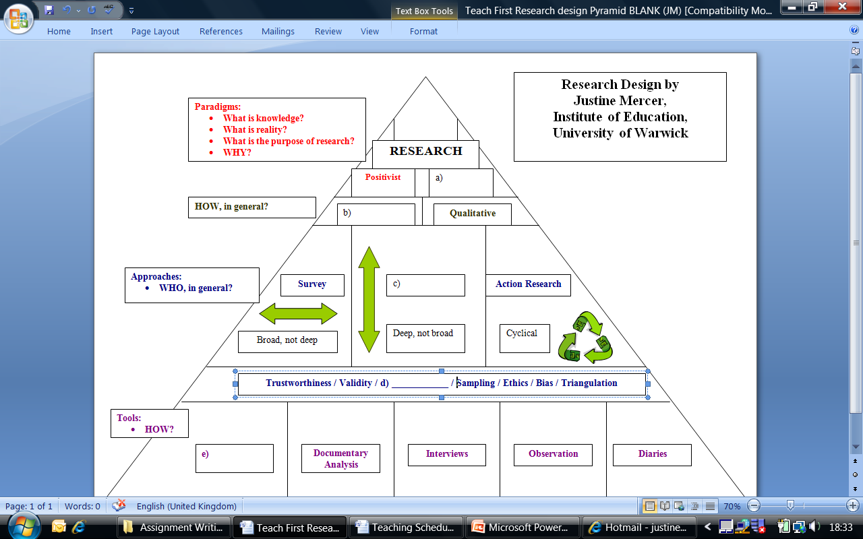
Activity: Confusing Terminology
Notes:
Students should work in groups of about five to see if they can complete the pyramid. Explain that people have come with different backgrounds and that some of the group will be more familiar with small-scale empirical research than others.
If they have trouble guessing the missing words, you can write all of them on the board and then they just have to slot them in.
Talk through the pyramid afterwards. Mention that “questionnaire” and “survey” are sometimes used interchangeably, but it helps to distinguish between them – survey is an approach (like action research or case study) but questionnaire is a data collection tool.
When you write up your small-scale research for the Improving Schools module, you must be able to justify all the choices you make at each horizontal level. You also need to discuss how to increase the validity and reliability of your research (or trustworthiness if you are using a qualitative methodology), as well as acknowledging the potential for bias and adhering to a rigorous ethical framework – not naming anyone and giving your institution an pseudonym; making sure there is strong evidence to support the claims you make etc.

Slide 5
Case Study
‘A case study is an enquiry which uses multiple sources of evidence. It investigates a contemporary phenomenon within its real life context, when the boundaries between phenomenon and context are not clearly evident.’ (Johnson, 1994:20)
The ‘bounded system’ (Cresswell, 1996:36), limited in both time and space.
Notes:
No need to cover slides 5-12 in detail. They are a reference point.
Multiple sources may involve multiple tools: eg interviewing, observation, use of records.
Concerned with the interaction of factors & events over a space of time. Usually studies issues, rather than the situation of individuals (case work)
Naturalistic enquiry. Evidence gathering, not experimentation
Boundaries are permeable. Context may be clear - eg school, or may not - may have wider community context.

Slide 6
Case Study
‘A case study is an enquiry which uses multiple sources of evidence. It investigates a contemporary phenomenon within its real life context, when the boundaries between phenomenon and context are not clearly evident.’ (Johnson, 1994:20)
The ‘bounded system’ (Cresswell, 1996:36), limited in both time and space.
Notes:
Multiple sources may involve multiple tools: eg interviewing, observation, use of records.
Concerned with the interaction of factors & events over a space of time. Usually studies issues, rather than the situation of individuals (case work)
Naturalistic enquiry. Evidence gathering, not experimentation
Boundaries are permeable. Context may be clear - eg school, or may not - may have wider community context.

Slide 7
Bassey (2007:143)
‘A case study is an empirical enquiry which is:
Conducted within a localised boundary
Interesting aspects of an educational activity, programme, institution, system
In its natural context and within an ethic of respect for persons
To inform judgements and decisions of policy-makers and practitioners (or theoreticians)
Sufficient data collected for the researcher to be able to:
Explore significant features
Create plausible interpretations
Test trustworthiness of these
Construct a worthwhile argument or story
Relate argument or story to relevant research in the literature
Convey convincingly to an audience the argument or story
Provide an audit trail for other researchers to validate or challenge findings or construct alternative arguments

Slide 8

Case study is a research approach, not a method
Most common methods are interviews, observation, and documentary analysis
Questionnaires and focus groups may also be used
Methods should be ‘fit for purpose’, not just a personal choice
Multiple methods allow for methodological triangulation

Slide 9
Sources of evidence
Direct observation
Participant observation
Documents
Archival records
Interviews
Physical artefacts

Slide 10
Strengths of a case study
Allows in-depth investigation
Copes with complexity
Provides a ‘rounded’ picture (from the multiple sources of evidence)
Generally qualitative in nature
Methodological triangulation is ‘built-in’
Findings are often easily understood
Good fit with small-scale research and a single researcher in a short period of time
In larger-scale research, can be combined with other approaches (e.g. a questionnaire followed by a number of case studies)

Slide 11
Weaknesses of a case study
Lack of ‘rigour’
Lack of ‘generalisability’ – findings might be unique to the case
May generate a large quantity of data
Access may be uneven
Can be demanding of researcher’s time (in terms of both data collection and interpretation and analysis)

Slide 12
Conclusion
Case studies are very popular and ‘real’
They are complex and require careful planning and field work flexibility
Insider research may be problematic (participant and researcher)
Using more than one method is desirable
Involving several participants is helpful

Slide 13
Activity: Ethics
Think of a time when, as a researcher or a teacher, you faced an ethical dilemma.
What was the dilemma?
How did you resolve it?
On what basis did you decide what to do?
Notes:
5 minute discussion in pairs, if time.

Slide 14
Ethics in educational research
An ethical approach requires a code of conduct
See the BERA ethical guidelines (2011)
http://content.yudu.com/Library/A1t9gr/BERAEthicalGuideline/resources/index.htm?referrerUrl=http%25253A%25252F%25252Fwww.yudu.com%25252Fitem%25252Fdetails%25252F375952%25252FBERA-Ethical-Guidelines-2011
See also the University of Warwick ethical approval form on the website.
You must get ethical approval from your tutor before you start data collection.
Notes:
This is important! Students shouldn’t collect data without obtaining ethical approval. They will be allocated a tutor by the next session.

Slide 15
Bias from Walford (2001)
Walford (2001) describes his research into City Technology College, research that was motivated by a very strong political agenda. He believed from the outset that CTCs were wrong and was hoping to provide data that would help Labour win the next election.
Notes:
The research was biased in the sense that Walford had a particular motivation for doing it. BUT, it wasn’t biased in the sense that he conducted the research as objectively as possible, and when he didn’t get the results he was hoping for, he still published them.

Slide 16
Activity: Informed consent
Respect for dignity and privacy
a) What constitutes “informed consent”?
b) Who asks participants if they would like to take part? Do they feel able to refuse?
c) How much do they need to know about the research in order to give informed consent?
d) What extra precautions are advisable when researching children?
Notes:
There may not be time for slides 16-24. They can be for reference.

Slide 17
Informed consent
Powney and Watts (1987, p. 147) argue that research benefits from interviewees being ‘fully informed from the start of what the researchers and the interviewees are trying to establish’.
More realistically, Bulmer (1982, p. 243) contends that “all field research involves giving misinformation, less than full information or even mild deceit to some extent”.
Researchers need to avoid ‘contaminating’ their study “by informing subjects too specifically about the research questions to be studied” (Silverman, 2000, p. 200).

Slide 18
Informed consent – insider research
“Thus, it seems offensive not to give some honest and reasonably full account of the rationale and purpose of one’s study to such respondents [who are equals] and the account cannot be one that is intellectually condescending. However, it is difficult to do this without inviting discussion of the study rather than getting on with the interview, and without providing so much information that it may bias the course of the interview.” (Platt, 1981, p. 80).

Slide 19
Special issue with children
Increased responsibility on the researcher
Power differential
Child protection issues
Who gives consent
Is it informed?
Issues for teachers? Parents?

Slide 20
Activity: Anonymity
BERA (2011:7) “The confidential and anonymous treatment of participants’ data is considered the norm for the conduct of research.”
What is meant by confidentiality? What is meant by anonymity?
b) Should you always anonymize the institution you are describing?

Slide 21
Anonymity
Not everyone does!
Huberty (2000) Department of Educational Psychology at The University of Georgia.
Hutchinson (1995) University of Ulster.
Miles and Hyle (1999) Oklahoma State University.
Rutherford (1992) University of Birmingham.
Even if you do use a pseudonym, it may be easy for people to guess.
Notes:
Here, you can make your excellent point about using a more imaginative pseudonym than School X.

Slide 22
Anonymity
c) When quoting informants, how much information should you give about them?
At what point do they become identifiable by other participants?

Slide 23
Confidentiality
Data provided by research participants should be kept confidential
Only the researcher should store and use data
Individuals should not be named (anonymity)
Individuals should not be identified in other ways
Participants should have the opportunity to check interview records

Slide 24
Activity: Sampling bias
a) How can you access the voices of those who feel silenced without co-ercing them into taking part?
Research into home-school partnerships relying on questionnaire sent home.
Research into any topic privileging the views of those who share a common language with the researcher.

Slide 25
Activity: Insider research
What are the differences between insider and outsider research? Is this a dichotomy or a continuum?
What are the respective strengthens and weaknesses of insider and outsider research?
What sort of ethical dilemmas are particularly acute for the insider researcher? How might you deal with them?
How do you deal with data that has not been specifically elicited? (Incidental conversations in the staff-room, things overheard in the corridor; material left on the photocopier.)
Notes:
10 minute discussion in pairs, drawing upon the pre-reading (Mercer, 2007). It’s probably worth doing this so that people feel the pre-reading is being utilised.

Slide 26
Insider research
Many part-time researchers are ‘insiders’
Research and professional roles should be separate
‘Casual data should not be used
Assumed knowledge should not be used
‘Inside’ role should be clarified in reports
Knowledge of context versus bias and subjectivity
Mercer, J. (2007) The Challenges of Insider-Research in Educational Institutions: wielding a double-edged sword and resolving delicate dilemmas, Oxford Review of Education 33(1), 1-17.
Notes:
Justine Mercer
R G Burgess (1985) Some Ethical problems of Research in a Comprehensive School

