Slide 1
MA in Educational Leadership (Teach First)
Induction 2014:
Session 2: Introducing the two assignments

Slide 2
Activity: ISS and IS assignments
Look at the two assignment rubrics you were sent last month (for the Independent Self-study assignment and for the Improving Schools assignment).
In pairs, write a quiz for another pair about ONE of the two assignments.
Swap quizzes with another pair. Try to complete it without looking back at the rubric.
Ask your tutor any questions.
Notes:
Depending on how much time Janet Goodall has left for questions, you might want to spend some time getting the students to consider how her presentation applies to her own particular context.
We have 90 minutes for this session, roughly divided as follows:
15 mins – quiz about the assignment rubrics (Slide 2)
5 mins – slide 3-5.
20 mins – reading the article individually
10 mins – working in pairs of people who have read the same article
20 mins – working in groups of six, with one person who has read each article
10 mins – plenary considering how each group has rannked the articles in terms of rigour and relevance.
Slides 9 to 20 don’t need to be covered. The students have already had the Generic rubric.
The title of the Improving Urban Schools assignment has been changed to Improving Schools in Areas of Socio-economic Disadvantage, or Improving Schools for short, since some Teach First schools are not urban any more.

Slide 3
Using scholarship to enhance your own experience
Have you worked with a TA?
Do TAs improve pupil attainment?
Do TAs improve attitudes to learning? (Why do you say that?)
How can TAs be used to best effect?
5 minute discussion with a partner.
Notes:
TA = teaching assistant

Slide 4
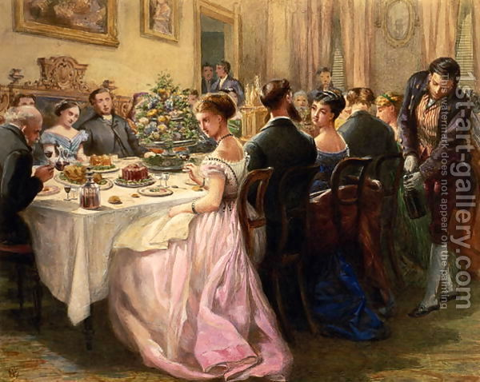
Being selective in what you read/write
How would you find literature to help you augment your own opinion?
How would you decide if a paper is worth reading in detail?
How would you decide if a paper is worth citing?
Notes:
Short (5 minute?) discussion in pairs.
Need to make the point that just because it is available, doesn’t mean they should use it. Need to stick to respectable sources – peer reviewed journal articles, newspaper articles for really recent stuff. Don’t bother quoting conference proceedings more than two years old, because if a conference paper is any good, it gets converted into a journal article shortly afterwards.
British Educational Research Journal (BERJ) is the most widely-respected UK-based peer-reviewed journal. EMAL (Educational Management, Administration and Leadership) is also good, as is SLAM (School Leadership and Management). Practitioner-journals aren’t as rigorously peer-reviewed, but Management in Education is good.
Kamler and Thomson (2006) have written a great book aimed at doctoral students, but it is also suitable for M-level. They liken writing a literature review to hosting a dinner party – read on to find out why ...

Slide 5
Being selective in what you read/write
“We like the domestic, familiar image of the dinner party and its emphasis on conversation with a community of scholars ... The doctoral researcher invites to the table the scholars she would like to join her for a conversation over the evening meal. The emphasis is on the company and the conversation that happens at the table ... She cannot invite everyone because they will not all fit at her table. She is not just a bystander or “reviewer” of the conversation, but a participant. While she may not always comprehend all the conversation or catch all its nuances and complexity, she is present.”
Kamler, B. and Thomson, P. (2006, p. 38) Helping Doctoral Students Write:
pedagogies for supervision, Abingdon, Routledge.
Notes:
Some sources are more recent than others, some are more relevant, some are more credible etc.
A key additional point is that the evidence-base underpinning a source can be very small or absolutely huge. I give the example of two papers dealing with the deployment of teaching assistants.
Kerry, T. 2005. Towards a typology for conceptualising the roles of teaching assistants. Educational Review 57, no. 3: 373–84. This is based on his own experience over 17 years, so he’ll clearly an expert BUT ...
Blatchford, P., Russell, A., Bassett, P., Brown, P. & Martin, C. (2007b) The role and effects of teaching assistants in English primary schools (Years 4 to 6) 2000–2003, British Educational Research Journal, 33(1), 5–26. This is a 5-year study involving 10,000 schools in England and Wales, three phases of data collection, thousands of questionnaire responses, time-logs, observations, interviews, and talking to pupils in 76 schools. These two sources ought not to carry equal weight, though they are both journal articles.
You also need to consider how relevant the original context of the source is to you own. So stuff from England and Wales should be privileged over stuff from elsewhere; stuff from primary over secondary, if you work in primary; stuff from schools in challenging circumstances over schools in the leafy suburbs, if you work in the former, etc.

Slide 6
Evaluating sources
Where has it been published?
By whom? When?
Is there conceptual clarity and comprehensiveness?
If it’s based on empirical work, is the methodology appropriate and rigorous?
Is the context similar to your own?
Read and summarize the paper you have been given; then try to answer the questions above. (20 minutes)
Notes:
The six papers are …
Trevor Kerry (2005): Towards a typology for conceptualizing the roles of teaching assistants, Educational Review, 57:3, 373-384
Emma McVittie (2007): The role of the teaching assistant: An investigative study to discover if teaching assistants are being used effectively to support children with special educational needs in mainstream schools, Education 3-13: International Journal of Primary, Elementary and Early Years Education, 33:3, 26-31
Hilary Cremin, Gary Thomas & Karen Vincett (2005): Working with teaching assistants: three models evaluated, Research Papers in Education, 20:4, 413-432
Peter Blatchford, Paul Bassett, Penelope Brown, Clare Martin, Anthony Russell & Rob Webster (2011): The impact of support staff on pupils’ ‘positive approaches to learning’ and their academic progress, British Educational Research Journal, 37:3, 443-464
Peter Blatchford, Anthony Russell, Paul Bassett, Penelope Brown & Clare Martin (2007): The role and effects of teaching assistants in English primary schools (Years 4 to 6) 2000–2003. Results from the Class Size and Pupil–Adult Ratios (CSPAR) KS2 Project, British Educational Research Journal, 33:1, 5-26
Rob Webster, Peter Blatchford, Paul Bassett, Penelope Brown, Clare Martin & Anthony Russell (2010): Double standards and first principles: framing teaching assistant support for pupils with special educational needs, European Journal of Special Needs Education, 25:4, 319-336
Extension activity for those that finish early (with thanks to Janet Harvey):
Create a single written paragraph summarising findings which also demonstrates effective use of academic citation. It needs to include argumentation and skilful use of appropriate connectives (however, on the other hand, moreover, furthermore etc)

Slide 7
Evaluating sources: Activity
Form a group with the other people who read the same paper. Share your answers to the questions. Have you come to the same conclusions about the article?
Now form new groups of five/six making sure all six papers have been read by someone in the group. Briefly summarize each paper and then try to rank them according to their rigour and relevance.
Notes:
Each group can put its rankings on the board, one column for rigour and one for relevance; then the groups can see if they’ve come to the same conclusions and why. Rigour should be the same for all; relevance might depend on whether there are primary teachers in the audience (in which case the Blatchford article dealing with years 4 to 6, and the McVittie article about primary schools may be more relevant), and whether they have an interest in SEN pupils (in which case the Webster article will be higher up the list).

Slide 8
Has this activity made you change your mind about TAs?
Notes:
This is where “evidence” triumphs over “anecdote”.

Slide 9
Activity: What’s the difference between description and reflection? Can you write two sentences, one that describes something that happened in your classroom this week, and one that reflects on something that happened?
Notes:
Last year, we didn’t do these slides.
Discussion in small groups – 5 minutes

Slide 10
Imagine that last week you set a piece of homework for a class containing two students called Adam and Sophie (pseudonyms). A simple description would be: Adam did the homework and seemed to learn something whereas Sophie didn’t do the homework and didn’t seem to learn anything. But reflection requires you to probe more deeply and, for this assignment, to use previous scholarship and/or government documentation to place what you have observed in your own classroom in a wider policy context.
Notes:
Slides 5 to 24 DO NOT NEED TO BE COVERED ON THE DAY. They are for reference, if students want more help understanding the differences between description and reflection.

Slide 11
Using previous scholarship/literature/research
‘Learning from homework: a case study’ by Martin Hughes and Pamela Greenhough in Louise Poulson and Mike Wallace (2006) (eds.) Learning to Read Critically in Teaching and Learning, London, Sage. pp.85-109.

Slide 12
Hughes and Greenhough (2006) draw on earlier work by Pollard and Filer (1996) which asks five questions … What is being learned (learning content)? When and where does the learning take place (learning context)? Who is learning (learning identity)? What support is available for learning? What are the learning outcomes? But they then use these five questions to generate a conceptual framework encompassing all the factors that influence the learning generated by homework. What factors do you think the framework contained?
Notes:
So, the authors of this chapter began by drawing on the work of Pollard and Filer (1996) – you should also draw upon the work of previous researchers, no point reinventing the wheel!
What is being learned (learning content)?
When and where does the learning take place (learning context)?
Who is learning (learning identity)?
What support is available for learning?
What are the learning outcomes?
But they added value to this list of questions by tailoring it to the learning generated by homework

Slide 13
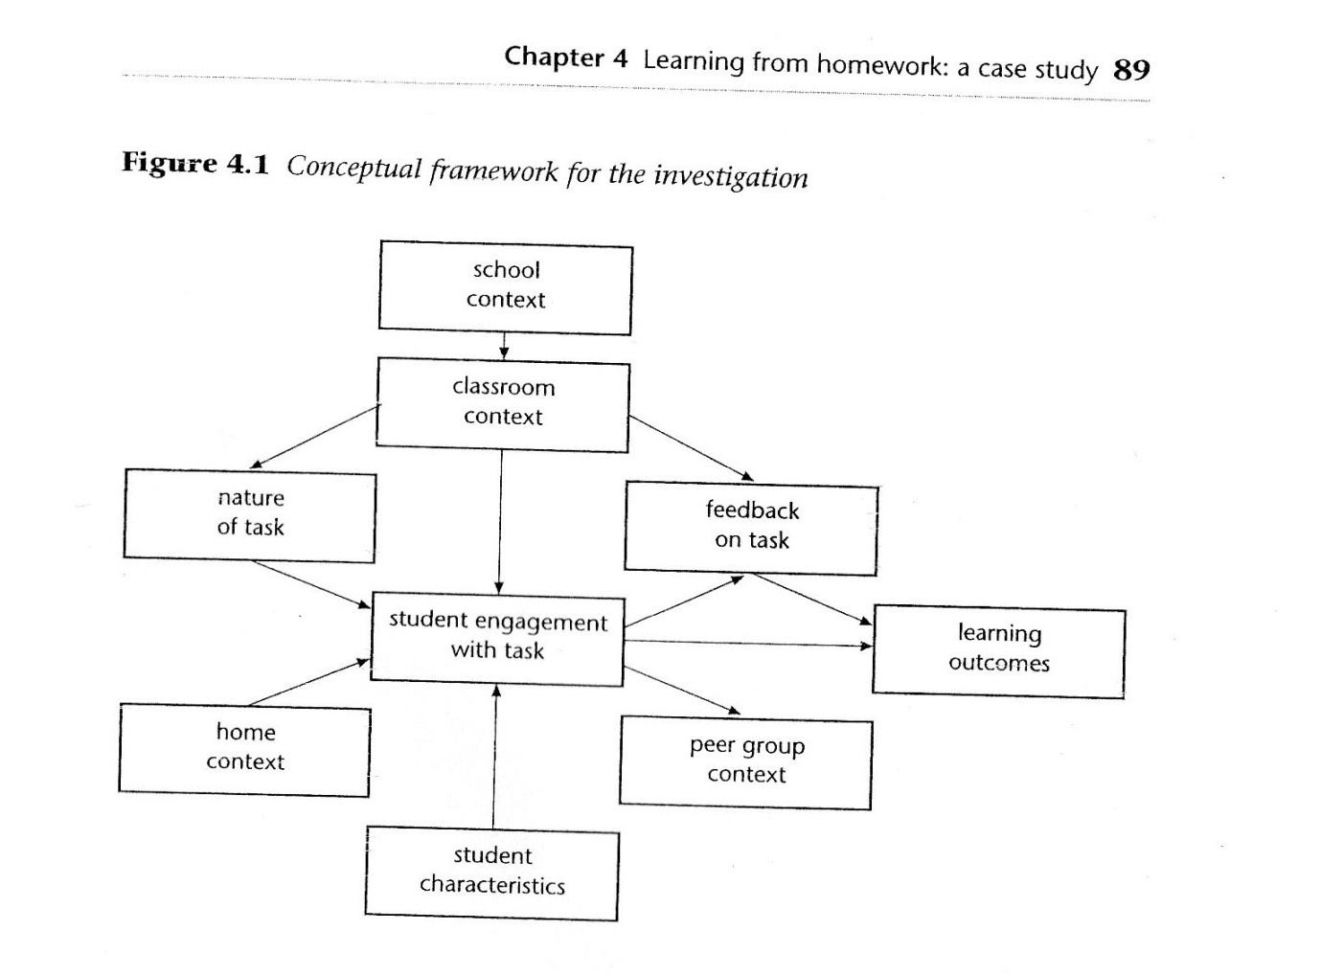
Conceptual Framework
Notes:
A conceptual framework is like a sieve through which you pour your raw data in order to extract the “golden nuggets” representing significant/important information. It is often depicted as a diagram.

Slide 14
“The main advantage is that it can represent, in a visual form, what are regarded as the main elements of the research and how these might be related. As we shall see, this representation can help directly with framing the specific research questions of the study, as well as providing a structure for data collection and analysis. The main weakness is that such a framework is inevitably a simplification of what are likely to be quite complex processes.” (Hughes and Greenhough, 2006, 90).
Notes:
Probably worth drawing attention to the fact that we cite the authors of each chapter in an edited collection, and that if this quote were in their assignment, it would be indented because it’s longer than 40 words, and it wouldn’t then need quotation marks at the beginning and end.

Slide 15
The conceptual framework devised by Hughes and Greenhough (2006) allows the teacher to analyze what is happening in their classroom with greater depth and clarity. For each student, you will need to consider: the home context, the student characteristics and the peer group context of each student.

Slide 16
Adam – Lived with his mum, stepfather and younger siblings. Mother thought homework was “very important”, Father also thought it was useful. Adam’s parents said they were proud of him and thought he was mature and reliable. He described himself as “quite talented”. Thought maths was “quite easy” and wanted to move into a higher set. Friends included people he thought put lots of effort into homework and some who didn’t – this latter group he described as “trouble-makers”. He sometimes asked his friends for help with homework but he never copied their work.
Notes:
Poulson and Wallace interviewed the students and their parents – you aren’t expected to collect data for this assignment, but you are expected to utilize all the information you have at your disposal.

Slide 17
Sophie – Lived with her mum and two sisters. Her mum thought homework was “quite important” and reminded Sophie to do it. She couldn’t help her with maths, but her elder sister could. Her mum said she was quiet. Sophie herself said she was quite shy. She considered herself to be hardworking except if she didn’t like the subject or the teacher. She didn’t like maths and didn’t think homework helped her learn. She knew she could ask the teacher for help but preferred to ask her friends “to save embarrassment”. Sometimes these friends help her out with homework and she thinks they are cleverer than she is.

Slide 18
Homework set: a) To find 10 circular items around the house and measure the circumference and diameter of each. b) To notice how the diameter and the circumference are linked c) At a fairground, a “big wheel” has a diameter of 60 metres. How long do you think the circumference will be?

Slide 19
Adam did this homework straight after school. He found it quite easy, although his stepfather helped him with the last question by drawing a Ferris wheel to help him visualize the problem. Sophie did not attempt the homework. She said it was because “I lost my planner on that day and then I’d put a sheet into my bag but I couldn’t find it anywhere. I still haven’t found it.”

Slide 20
In the follow-up lesson, Adam was able to complete the exercise set by the teacher. Sophie wasn’t, but she gave the impression of being on-task by copying the questions into her book. In terms of the learning outcomes, Adam seemed to have a good understanding of pi and how it could be used to calculate the diameter of a circle if the circumference was known, or vice versa. Sophie did not seem to have learnt much from the homework or the follow-up lesson.

Slide 21
As we saw earlier, a simple description would be: Adam did the homework and seemed to learn something whereas Sophie didn’t do the homework and didn’t seem to learn anything. But reflection requires you to probe more deeply and, for this assignment, to use previous scholarship and/or government documentation to place what you have observed in your own classroom in a wider policy context. Clearly the two students have different attitudes towards maths, but there were other differences. What are they?

Slide 22
Other differences a) The amount of support available at home. Adam’s dad helped him, whereas Sophie’s family did not. b) Peer group support was also different. Sophie sat with a group of students she thought were cleverer than she was and this helped her to hide the fact that she didn’t understand the work. c) Their use of the teacher’s help. Adam felt he could ask his teacher for help, although usually he didn’t need it. Sophie, in contrast, needed help but didn’t like to ask for it. So, the conceptual framework devised at the beginning helped the researchers analyze the data in more depth.

Slide 23
How typical is the case study? The Circles homework task was unusual because it was preparatory work for the next lesson, whereas most other homework tasks were to consolidate the previous lesson. It was also unusual in explicitly linking schoolwork with the home environment. No conclusions should be drawn about gender differences on the basis of just two students and one homework task. So … you’ll need to think about how typical the examples you have chosen to include are

Slide 24
Conclusions 1) There is no such thing as “a good homework task” because all students are different. 2) How well students complete homework may depend upon the amount of support they get at home – explicit help, or just the space and time they need. In this way, homework can actually widen the attainment gap between students who have strong support at home and those that don’t. So it increases inequality.
Notes:
These two conclusions might not have been reached if the authors had stuck to the quite superficial analysis offered by the earlier slide – that Adam did the homework well and learnt a lot, whereas Sophie skipped it and didn’t learn anything. This is where a clear and robust conceptual framework really comes into its own – it helps you analyze your data at a deeper level and uncover the “hidden gems”.

Slide 25
Adding a leadership perspective
What does the government say about this issue? Consult the National College and DfE website.
Homework was being promoted by the newly-elected government ... “Homework is not a punishment and it is not a chore. It is an essential part of a good education” (Blunkett, 1997).
So place your study within the wider policy context by briefly referring to the most up-to-date government information you can find.
Notes:
It’s absolutely vital that students link this kind of classroom-based work to the wider field of educational leadership and/or policy discourse.

Slide 26
The “I” question
“Whether you use first or third person will depend upon your discipline, your politics, your purpose and your audience” (Blaxter, et al. 1996:221)
Your own opinion, unsupported by data, is not valid BUT it will influence the whole of your research. Okay to adopt a stance, but it can’t just be your own opinion, needs to be based on evidence of other literature (for this assignment) or your own findings (for the Improving Urban Schools assignment).
Briggs, A., Coleman, M. and Morrison, M.(eds.) (2012) Research Methods in Educational Leadership, Third Edition, London, Sage.
Notes:
They can read more about positionality in the Briggs et al. (2011) book.

Slide 27
Generic M-level criteria
Notes:
I’ll photocopy a copy of this for everyone, but not as a jigsaw! It will also be posted on the website. It should be enough to distribute it.

