Slide 1
MA in Educational Leadership (Teach First)
Induction & Teaching Day 1: administrative matters and course outline

Slide 2
WELCOME!
We are delighted to welcome our final cohort to the MA in Educational Leadership (Teach First) programme at Warwick University.
The Times and Sunday Times Good University Guide 2018 has ranked the University of Warwick as number 9 of the UK’s top 10 universities and 1st in the West Midlands.

Slide 3
Course personnel: the core team
Dr. Madeleine Findon (Course Leader)
m.findon@warwick.ac.uk
Dr. Justine Mercer (Consultant Course Leader) Justine.Mercer@warwick.ac.uk
Paula Clarke-Bennett (Programme Officer)
Paula.Clarke-Bennett@warwick.ac.uk

Slide 4
Course Tutors
Dr Janet Harvey
Dr Pamela Dettman
Dr Michael Strain
Dr Ray Chatwin
Plus guest speakers from a range of HE institutions.

Slide 5

Communication
Once enrolled, make sure that you use your Warwick address for both for sending and receiving emails.
Central University will not send information to private accounts.
Emails can get mislaid or filtered out when sent from private accounts.
To avoid missing emails, you can forward mail from one account to another (see handbook).

Slide 6
Course information
You should all have received a link to an electronic copy of the course handbook. If not, you need to contact Paula Clarke-Bennett (see slide 3).
All of the handbook information is important but some of it will be needed all the time and some only occasionally. Please keep the handbook in a place (and format) where you can easily find it and use it.
Once enrolled, you will have access to our course web pages that contains forms, materials, activities and additional support.

Slide 7

Assignments = progress towards the MA
All MA degrees require 180 credits.
Dissertation in Year 2 = 60
Assignments in Year 1 (30 each) = 60
The PGCE you have already achieved = 60
There is an upward trajectory in terms of challenge and your further development of the skills you need to complete the dissertation.
The assignments offer practice in those skills.
⬆⬆⬆⬆⬆⬆⬆⬆⬆

Slide 8
Year 1 assignments
1) Independent Self-study Assignment (IE9D5) submission date Monday 30th July 2018 at 11.59pm
2) Improving Schools Assignment (IE9D3) submission date Tuesday 8th April 2018 at 11.59pm
The strange numbering of assignments is explained by the fact that you have to start keeping data for Assignment 1 now even though you don’t submit it until the end of this academic year.

Slide 9
The Independent Self-study assignment
Skills: self-reflection; independent selection and critique of literature; application of theory to practice; academic writing.
You have a hand-out of the rubric for this.
See also the additional guidance sheet, and the pro forma which is offered as one way to keep evidence.
Downloadable copies of all these are on the course website.
Tasks today and the next 2 teaching days will help you develop the critical analysis skills for this assignment.

Slide 10
The Case Study assignment
Skills: in the context of social science, selection and critique of literature; developing a rationale for data collection; actual data collection and analysis; comparison of findings to theory; developing credible judgements; academic writing.
You have a hand-out of the rubric for this, and a copy is also on the course website.
Today and over the next 2 teaching Saturdays we shall be covering the essentials to help you prepare and carry out this enquiry.

Slide 11

Tutor support
The tutor team extends beyond those you meet.
For each assignment you will have a tutor to consult. For the case study assignment your tutor will:
Review your research proposal and give formative feedback to help you improve it;
Approve your ethics form (which must be signed off before you start collecting data – see next slide);
Respond to requests for advice throughout the research process;
If asked, review a chunk of text and give feedback.

Slide 12
Ethics
Ethical issues are taken very seriously. Your work must be ethical. There are two major foci:
Avoiding plagiarism (see course handbook), both the academic theft of the work of others (intentionally, or because you don’t cite them properly) and self-plagiarism (re-using your own work without attribution).
Collecting data ethically, i.e. with official permission (see previous slide) and by taking proper ethical care of research respondents (your students, colleagues etc.)

Slide 13
Where do I go for help? (1)
For whole course issues, to Dr. Maddy Findon (course leader.
For your case study, your assigned tutor. You will be given your first tutor’s name by December so you can send him/her your case study research proposal for feedback by the beginning of January.
For the independent self-study module you will have another tutor to consult as you write up.

Slide 14
Where do I go for help? (2)
Paula Clarke-Bennett can help you with:
Using Tabula
Advising you how to contact University departments, e.g. IT services
Finding University personnel
Navigating the University website
Making sure you get lunch!
If you cannot attend any event you must let Paula know.

Slide 15

BELMAS membership is well balanced between school and college leaders and academics. It is very good value because members receive:
- 6 issues of Educational Management Administration & Leadership (EMAL) and 4 issues of Management in Education (MiE) per year - delivered to the door!
30% discount on all Sage books
Members can join a range of special interest groups
The first year’s membership is FREE: thereafter for students annually £25. https://www.belmas.org.uk

Slide 16
For most…
This will be a very exciting day and the start of a new journey. We look forward to working with you.
For a few…
By tea-time, realisation may have dawned that this course is not right for them now, at this moment, in this place, at this point in their careers. If you turn out to be one of these, don’t worry, but please let us know within the next five working days.
or… Life will throw up problems which hinder your academic progress. We can’t help if we don’t know…

Slide 17
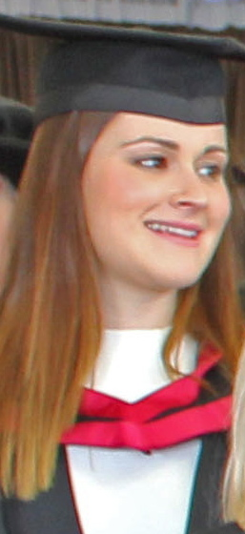
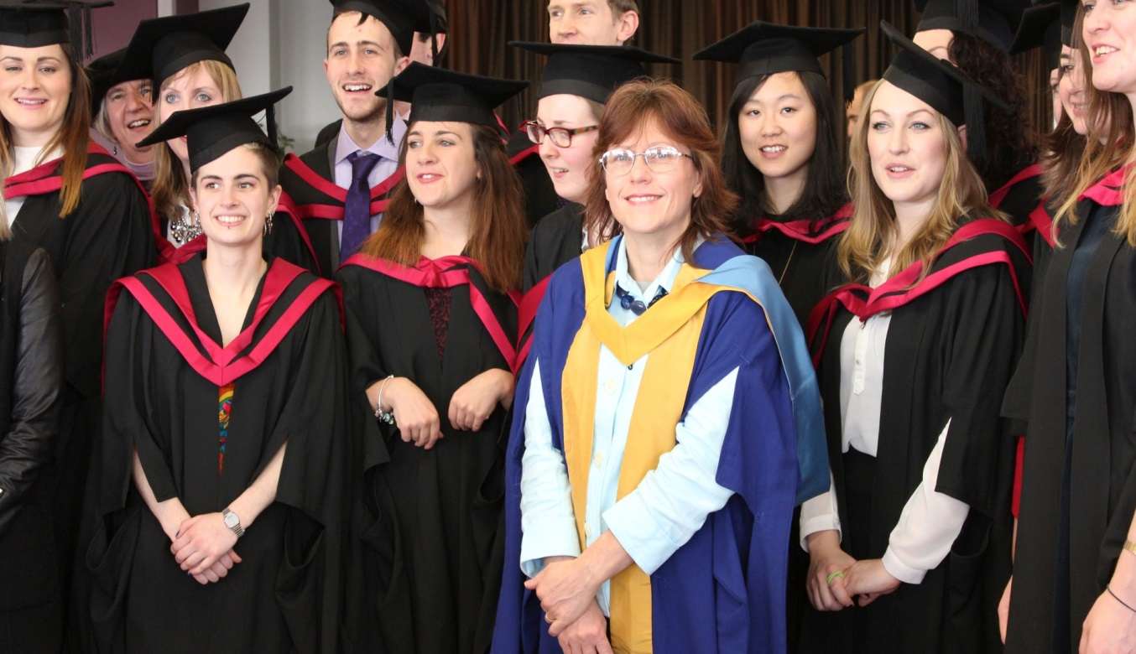
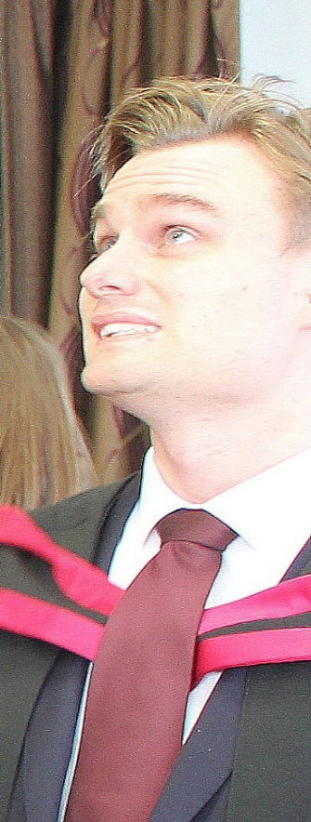
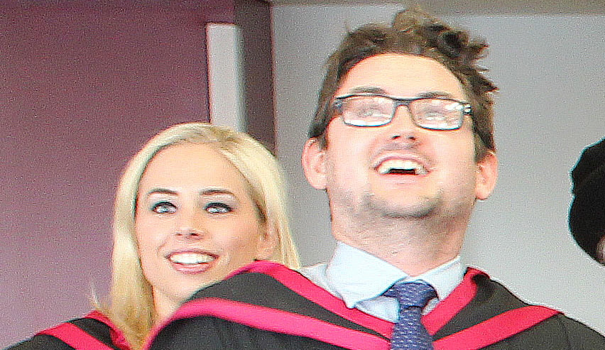
Some former graduates…
… with their eyes on the prize!
Notes:
The first graduation ceremony was in January 2012. Since then, well over 200 ambassadors have graduated with an MA in Educational Leadership (Teach First).

