Slide 1

Narrowing the gap through Parental Engagement
Gap
Dr Janet Goodall Oct 215
“Will no one think of the children?”

Slide 2

Q. 1. Why did you want to go into education in the first place?
Why did you want to teach?
CHANGE

Slide 3
Simple syllogism
The status quo is not optimal
The status quo is amenable to change
Therefore – let us change it!

Slide 4
What is parental engagement?
Talk to the person next to you – what do you think it is, how do you know it when you see it?

Slide 5
As we go through, 3 questions…
What are we already doing?
What can we do better?
What can we start doing?

Slide 6
Why should we care – does it matter?
Child poverty is costly – costing the UK alone around £29 billion a year (Hirsch, 2013)
At least 28% of children in the UK live in poverty (MacInnes, Aldridge et al. 2014)
Cost of educational underachievement in UK estimated at £22 billion over a generation (TPT, 2010)
The Risk

Slide 7
Poverty and underachievement
Children growing up in poverty:
  Are 6x as likely to leave schooling without qualifications
  More likely to leave school early
  Have lower educational aspirations

Slide 8
More problematically
These risks are cyclic
  Children raised in poverty are much more likely to raise their own children in poverty
  Children who do not achieve at school are likely to raise children who also do not achieve

Slide 9
Parental Engagement and
The achievement gap....

Slide 10
EPPE “What parents do is more important than who parents are”
(1997-2008) Findings
The importance of home learning.
  “For all children, the quality of the home learning environment is more important for intellectual and social development than parental occupation, education or income”.

Slide 11
But – what do parents do?
Notes:
The average child in a professional family was accumulating 32 affirmatives and five prohibitions per hour, a ratio of 6 encouragements to 1 discouragement. The average child in a working-class family was accumulating 12 affirmatives and seven prohibitions per hour, a ratio of 2 encouragements to 1 discouragement. The average child in a welfare family, though, was accumulating five affirmatives and 11 prohibitions per hour, a ratio of 1 encouragement to 2 discouragements. In a 5,200-hour year, that would be 166,000 encouragements to 26,000 discouragements in a professional family, 62,000 encouragements to 36,000 discouragements in a working-class family, and 26,000 encouragements to 57,000 discouragements in a welfare family.

Slide 13
EPRA work
Support for the School
Moral Support
Homework
Learning

Slide 14
Parental engagement- involvement continuum
Parental Involvement with the school
Reading in class
Going on trips
Parents’ evenings
Parental involvement with children’s schooling
Helping with homework
Keeping track of coursework
Parental engagement with children’s learning
Moral support Attitude toward learning Model, Guide Discussion

Slide 15
Parental Involvement in schools
What happens in school with parents has little or no effect on achievement
  Why?

Slide 16
Think of the three parents most likely to come into school
Think of the three parents staff would most like to see
What is the overlap?
Parents likely to come in
Parents staff want to see
Usually very small!

Slide 17
What would you expect to be the barriers to parental engagement in children’s learning?
Parental experience of education – which we can’t change
Practical issues – which we can

Slide 18
For your school – do you know…
When important religious holidays are? Ramadan, Eid, Yom Kippur, Easter…?
When does the last bus leave school, that will get the parents who live furthest away home in the evening?
How many of your parents (%) work shifts?
How many have smart phones?

Slide 19
Startling stat….
….by the time they are seven, nearly 80% of the difference in GCSE results between rich and poor children has already been determined.
Save the Children (2013). Too Young to Fail.

Slide 20
Progress - the last 10 years
Gaps between children on free school meals and others at age 11 (Key Stage 2) narrowed in all subjects measured
The number of children on free school meals achieving no GCSE passes fell from 13% in 2002 to just over 2% in 2010 (StC)

Slide 21
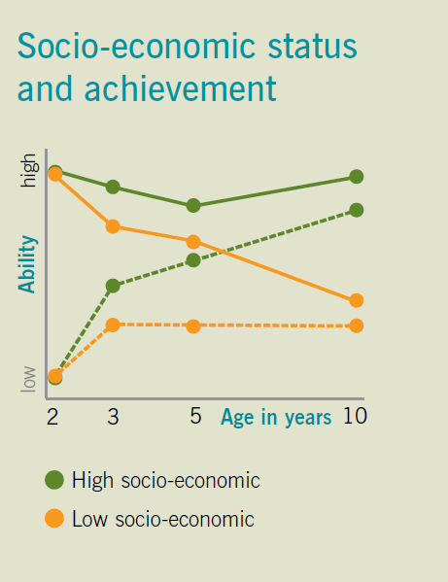
But the gap is still there
It starts early
The Millennium Cohort Study found that at the age of 5 children from the most advantaged groups were over a year ahead in vocabulary compared to those from disadvantaged backgrounds
And the gap continues as children age….
Narrowing the Gap – Cambridgeshire Co. Council

Slide 22
Advantaged children, 5 A-C w M&E
FSM children

Slide 23
The gap
Progress has been made.
But, if we continue as we are…. By 2020:
  480,000 seven-year-olds will be behind in reading
  1 in 8 children who are on free school meals would be behind in reading

Slide 24
Q. 3 What can we do about it?
Clearly, we can’t keep doing the same things and get different results
And just as clearly, we can’t ask schools to do everything

Slide 25
We need to do something different
And we need to stop thinking that it’s all down to the schools to do alone
Research has shown that around 80% of the difference in how well children do at school is dependent on what happens outside the school gates, whether it is in the home or in the wider community.
Save the Children Too Young to Fail (11)

Slide 26
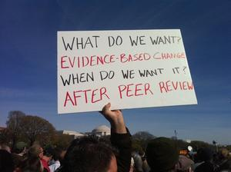

Slide 27
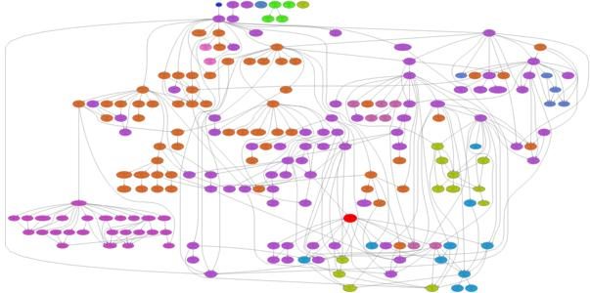
“So much has been added to our existing model of schools in the last few years that we've run out of attachment points for new ideas; we need to stop bolting things on to the outside of what we're already doing and go back and rethink - retool - regrow - the basics. We need to get radical”. (Goodall, 2014)

Slide 28

The missing link in closing the gap....
Parental engagement in children’s learning
“Parental involvement in their child’s learning was the only area reviewed with sufficient evidence to meet the four criteria for a robust causal model....” (Gorard, See and Davies, 2012)

Slide 29
Education is not bounded by the school fence....
This is a very small part of learning and an even smaller part of education
Learning
Education
Schooling

Slide 30
Parental engagement in ‘supporting learning in the home’ is the single most important changeable factor in student achievement.

Slide 31
What can Parental Engagement improve?
Research suggests that improving parents’ engagement with their children’s learning can lead to gains in:
  Behaviour
  Attendance
  Homework
  Self esteem
  Academic Achievement
How?

Slide 32

Helping families support their children’s success at school
How to support children facing challenge….Is now the basis of StC’s educational theme and facilitated a 5 year parental engagement programme

Slide 33
Recommend practices....
Intervention in the early years and preschool
Provide support for parents to assist child’s learning in the home
Bring the home and school closer
Voluntary rather than compulsory engagement in design, delivery and sustainability
Parent up-skilling and focused support for literacy or numeracy
  (What is the adult rate for non-literacy in the UK?)
Emphasis on school transition points and helping parents to support children through the various phases of education

Slide 34
Recommend practices....
Save the Children has now instituted the FAST programme:
“By 2014, we’ll establish more than 430 groups across the UK, improving the life chances of 50,000 children and training more than 8,000 new practitioners.
We’ll prove to UK governments that it’s possible to break the cycle of poverty for good.”
LINK

Slide 35
REVIEW OF BEST PRACTICE IN PARENTAL ENGAGEMENT
Reviews research-based interventions – what has been proved to work, where, when, how and with whom
Includes practitioner-aimed “pull out” section
  Doesn’t cite the research
  Just says what works

Slide 36
Can we narrow the gap?
Perhaps not completely
And certainly not schools alone
“It takes a village….”

Slide 38
Where can we find out more?

Slide 39

Intended for schools and parents and GOVERNORS
Available as an ebook

Slide 40
Harris, A., Goodall, J., (2009) “Helping Families Support Children’s Success at School; Review of the evidence” Save the Children
Harris, A. and Goodall, J. (2007) Engaging Parents in Raising Achievement: Do Parents Know They Matter? DCSF
Goodall, J. and A. Harris (2006). "Removing obstacles: achieving inclusive approach to parental engagement." Curriculum Briefing 5(1): 17 - 19.
Goodall, J., and Vorhaus, J. (2011) Review of best practice in parental engagement. London: Department of Education
Goodman, A., Gregg, P. and Chowdry, H. (2010). Poorer Children's Educational Attainment: How Important Are Attitudes and Behaviour?, Joseph Rowntree Foundation York.
Gorard, S., B. H. See and P. Davies (2012). "The impact of attitudes and aspirations on educational attainment and participation." York: Joseph Rowntree Foundation.
Lindsay, G., S. Cullen and C. Wellings (2011). Bringing Families and Schools Together: Giving children in high-poverty areas the best start at school. London, Save the Children.
Save the Children (2013). Too Young to Fail. London, Save the Children.
Goodall, J., (forthcoming – 2017) Narrowing the Gap: Parental Engagement, Routledge

Slide 41
Crozier, G. and J. Davies (2007). "Hard to Reach Parents or Hard to Reach Schools? A discussion of home-school relations, with particular reference to Bangladeshi and Pakistani parents." British Educational Research Journal 33(3): 295-313.
Goodall, J. (2012). "Parental engagement to support children's learning: a six point model." School Leadership & Management 33(2): 1-18.
Goodall, J. (2013). "Parental belief and parental engagement: how do they interact?" Journal of Beliefs & Values 34(1): 87-99.
Goodall, J. and K. Ghent (2013). "Parental belief and parental engagement in children’s learning." British Journal of Religious Education.
Goodall, J. and C. Montgomery (2013). "Parental involvement to parental engagement: a continuum." Educational Review: 1-12.

Slide 42
Goodall, J. (2015). "Leading Parent Partnership Award Recertification–Results.“ (Available on Bath Website)
Goodall, J. (2015). "Ofsted’s judgement of parental engagement A justification of its place in leadership and management." Management in Education: 0892020614567246.
Goodall, J. and S. Johnston-Wilder (2015). "Overcoming Mathematical Helplessness and Developing Mathematical Resilience in Parents: An Illustrative Case Study." Creative Education 6(05): 526.
Goodall, J., (2015) "Parental Engagement", entry in Encyclopedia of the Social and Behavioural Sciences, 2nd Ed., Elsevier Press
Goodall, J. (2014). "Engaging Parents to Raise Achievement." School Leadership Today 63: 56-60.
(2016) Goodall, J., Johnston-Wilder, S. & Russell, R.“The emotions experienced whilst learning mathematics at home” 2016 Understanding Emotions in Mathematical thinking and Learning. Elsevier Academic Press

Slide 43
Contact me
Janet Goodall
j.s.goodall@bath.ac.uk
@janetifimust

Slide 44
Final comment....
Consequently, schools need to place parental engagement at the centre rather than the periphery of all that they do. Parental engagement in children’s learning makes a difference- it is the most powerful school improvement lever that we have.
Do Parents Know They Matter? p. 70

