Slide 1
Education and Social Mobility: Dreams of Success
Dr Kate Hoskins (Senior Lecturer, University of Roehampton)
Professor Bernard Barker (Emeritus, University of Leicester)

Slide 2
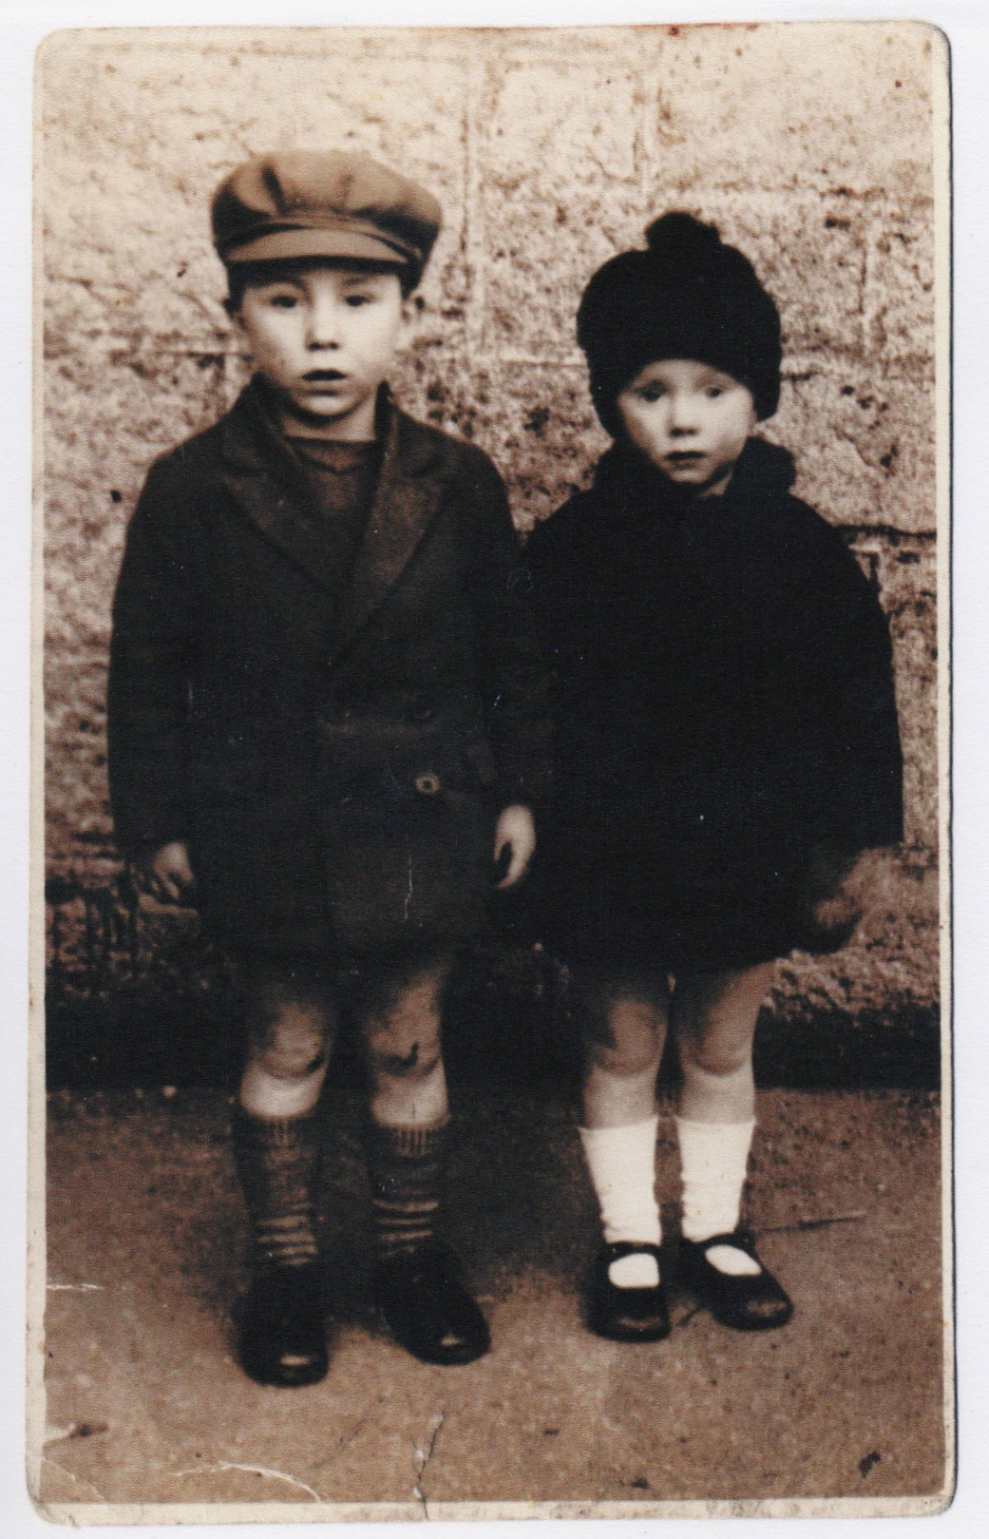
Education and Social Mobility: Dreams of Success
Rex & Win Tregunna at Nanpean in Cornwall, c. 1931.
Their father Howard was a china clay miner and was killed in a work accident in 1929. They were raised by their supplementary teacher mother, Hilda.
Rex won a place at St Austell Grammar School and then at Christs’ College, Cambridge. He became head teacher of two Hertfordshire schools. Winn progressed through nursing to become a midwife in Hemel Hempstead, also in Hertfordshire.
Today it is fashionable to say that grammar schools were an engine of social mobility for talented working class pupils, and that the poor quality of state education since those days has let down bright, less fortunate young people who might have followed in Rex and Winn’s footsteps. Social mobility is stuck and state schools are to blame. Michael Gove’s aim is to put this right.

Slide 3
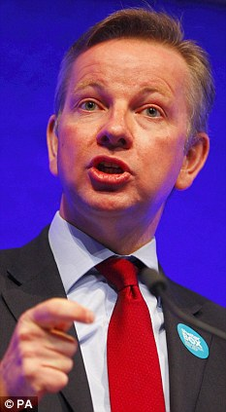
Education and Social Mobility: Dreams of Success
Our book, based on interviews (at two outstanding co-educational schools, newly converted to academy status) with 88 young people aged between 15 – 18, explores the extent to which Coalition reforms can overcome the main obstacles to increased social mobility in England, and challenges basic flaws that compromise the validity and usefulness of official models of social change and mobility.

Slide 4
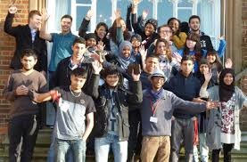
Education and Social Mobility: Dreams of Success
Sample:
Two highly effective schools, with their mixed but above average intakes, were chosen because they match policy-makers’ expectations for the conditions required to foster social mobility. Both are believed to offer capable and committed students, from aspiring families, excellent access to good examination grades, good universities, and good opportunities for social mobility.
South Park, 11-16, 46 year 11 students.
(Ofsted Grade: Good).
Felix Holt, 11-18, 42 year 13 students.
(Ofsted Grade: Outstanding).

Slide 5


Education and Social Mobility: Dreams of Success
In pairs or threes, take it in turns to tell the others whether your personal history represents an upward, downward or unchanged mobility trajectory.
Then report whether you perceive your family history as an example of mobility (in one direction or another).

Slide 6
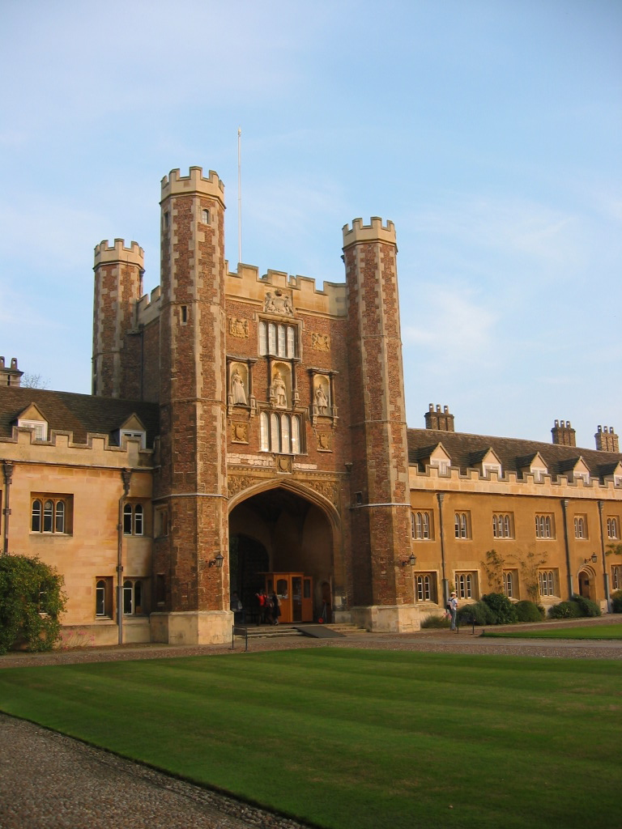
Education and Social Mobility: Dreams of Success
The Policy Problem
Private schools educate only 7 per cent of the nation’s children but provide 70 per cent of high court judges and over half of the membership of other leading professions. Students at independent schools are three times more likely than those at state schools to obtain three A grades at Advanced Level.
A fifth of the school population receives a free school meal (FSM) but only one in a 100 of these disadvantaged students secures admission to Oxford or Cambridge University. Only 25 per cent of boys from working-class backgrounds secure professional or managerial jobs.
Blanden et al (2005) Social mobility in Britain: low and falling, CentrePiece, Spring, 18 – 20. Online. http://cep.lse.ac.uk/centrepiece/

Slide 7
Education and Social Mobility: Dreams of Success
The Coalition’s Plan
Increased school autonomy with no LEA interference – state schools
to increasingly resemble private schools.
Improved school-based training with increased time in the
classroom and elimination of ‘Marxist Blob’ UDEs. Teach First
expanded; also national network of teaching schools.
Emphasis on EBACC subjects, traditional curricula and pedagogy.
Everyone to have access to (Matthew Arnold’s) finest that has been
said and written.
Tougher, more rigorous/difficult examinations to raise standards
(and end grade inflation). EBacc criteria for performance tables, and
new measures of comparability with private sector
Floor standards, not targets, with forced conversion to academy
status for low achievers and non-compliant. New Ofsted categories.

Slide 8
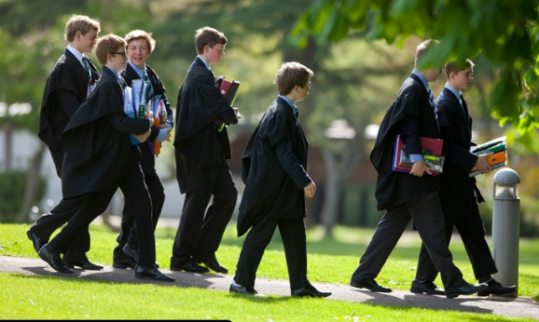
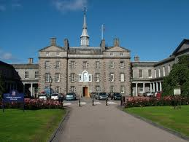
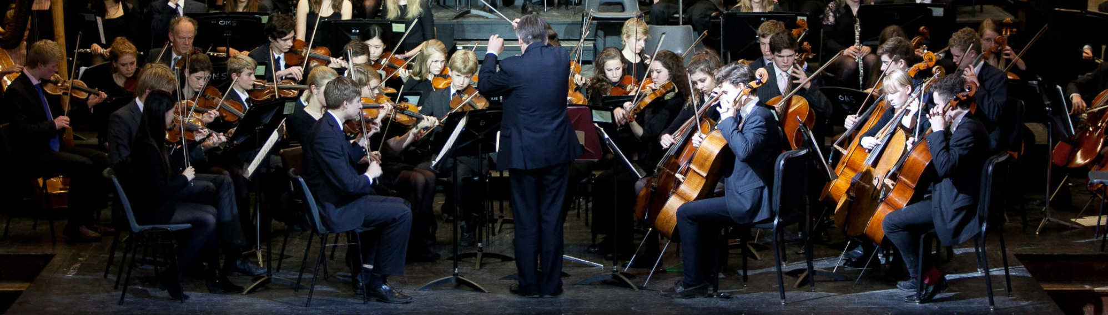
Education and Social Mobility: Dreams of Success
Schools should be like this, not like…

Slide 9
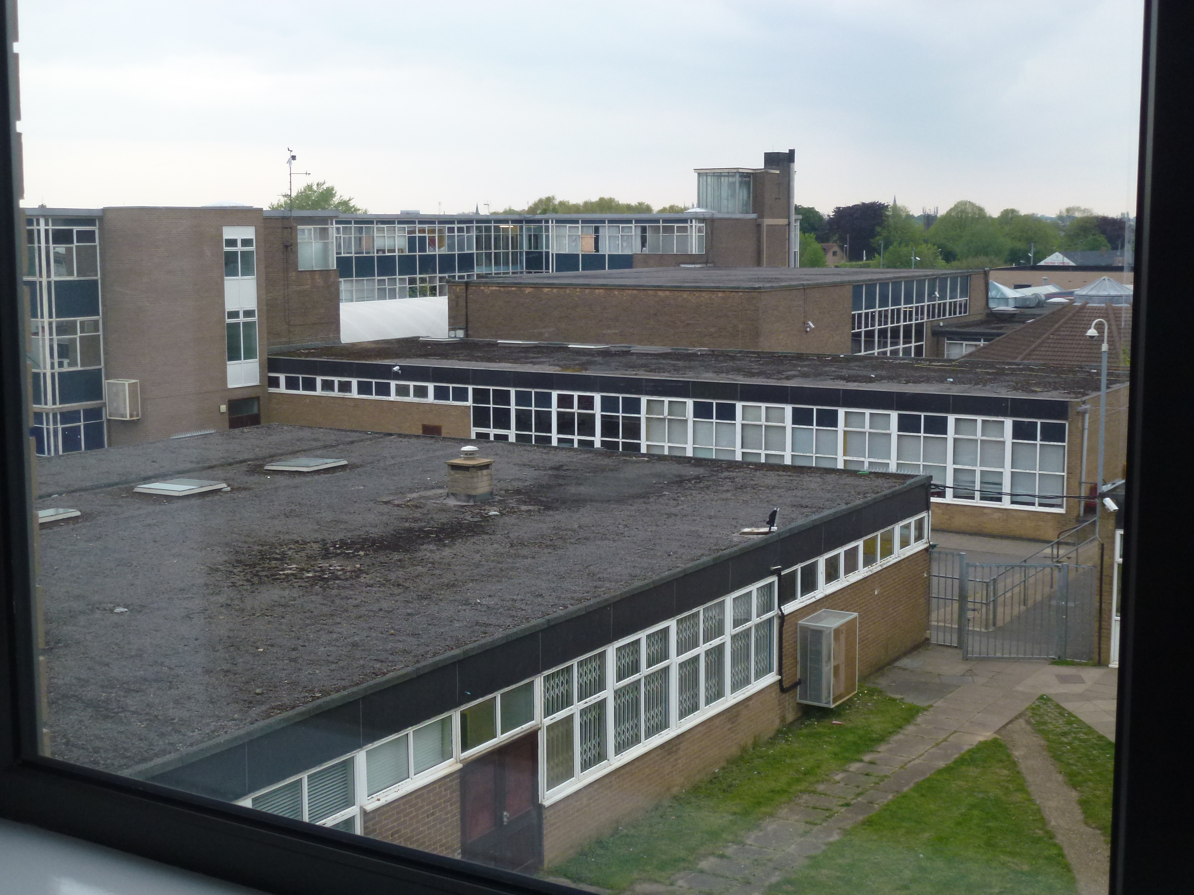
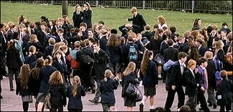
Education and Social Mobility: Dreams of Success
Last Days: Community Comprehensive in
Peterborough

Slide 10
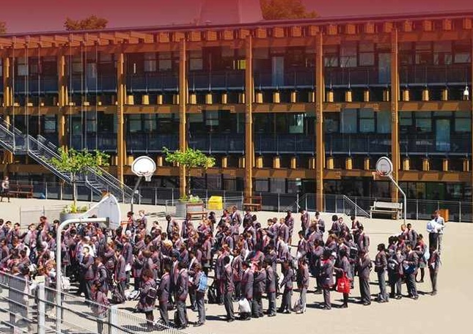
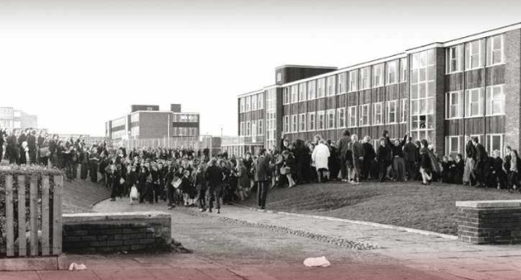
Education and Social Mobility: Dreams of Success
According to Andrew Adonis the choice is obvious…

Slide 11
Education and Social Mobility: Dreams of Success
But the policy is far ahead of our knowledge and understanding of social mobility. There are many under-researched obstacles:
Social class , childhood poverty, ill-health
Recruitment bias (e.g. internships, old boy networks)
Family capital (social, cultural, economic), expectations, networks and dispositions
Growing inequality, with social problems closely associated with more unequal
societies
Occupational structures and opportunities – varied by time and place, not
necessarily by hard work and enterprise; is there ‘room at the top’?
Agency/structure, nature/nurture, genetics/synapses
Education – free-standing agent of individual emancipation or one ingredient in
complex processes of social reproduction?
Problematic inter or intra generational male earnings measure; or household (inc.
women); quantitative or qualitative studies?
Reliance on various cohort studies over time – with serious errors introduced each
time, especially when analysis for reasons not originally intended
Are the figures confirming immobility surprising, a shocking indictment of state schools, or the expected and predictable result of some of the above factors?

Slide 12
Education and Social Mobility: Dreams of Success
Our 5 statements – what we’d find if outstanding schools improve mobility prospects (NB do not confuse with our 5 propositions in the paper you have read):
1. Policy makers articulate a rigorous conceptual framework for competitive individualism and social mobility.
2. High performing schools emphasise excellent teaching, high expectations and achievement. Students believe they are ‘authors of their own lives’ and work hard to reach challenging goals and targets. They are competitive and accept full responsibility for their own relative success or failure.
3. Family background has less influence on student decisions about education and employment. High performing schools are reducing outcome differences between less advantaged students and their peers.
4. Students aspire to high status educational and employment opportunities associated with increased chances of relative social mobility. They seek a degree of power and autonomy in their work, and to accumulate economic security and material advantage.
5. Students have clear, rational understandings of available options, routes and pathways through secondary and higher education, training and the workplace. Future choices and outcomes are based on ‘horizons for action’ that transcend disadvantage and family background.

Slide 13

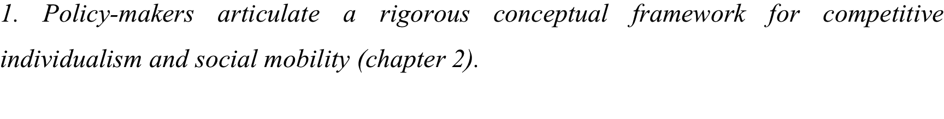
Education and Social Mobility: Dreams of Success
Vaguely expressed aspirations rather than clear and achievable goals, e.g. can everyone who works hard climb the ladder successfully? Won’t exclusive goals (e.g. Russell group admission) either remain exclusive or be devalued by everyone achieving them?
Other explanations (see slide 10) not acknowledged or dealt with – is it right to argue that poverty and ill health have NO impact on achievement? Or that class doesn’t exist and has no consequences?
Should we expect families to have no impact on choices?
Should we ignore The Spirit Level?
Closing the Gap makes no statistical sense – the results are worse and worse as we progress through the wealth deciles; they don’t suddenly get bad at the FSM frontier.
Does the individualistic conception of social mobility make sense?

Slide 14
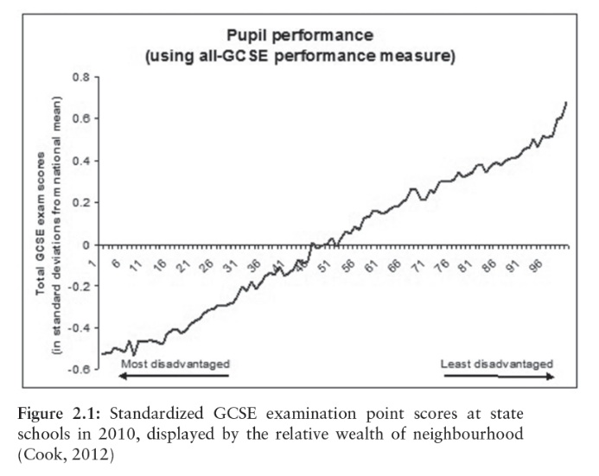
Education and Social Mobility: Dreams of Success

Slide 15
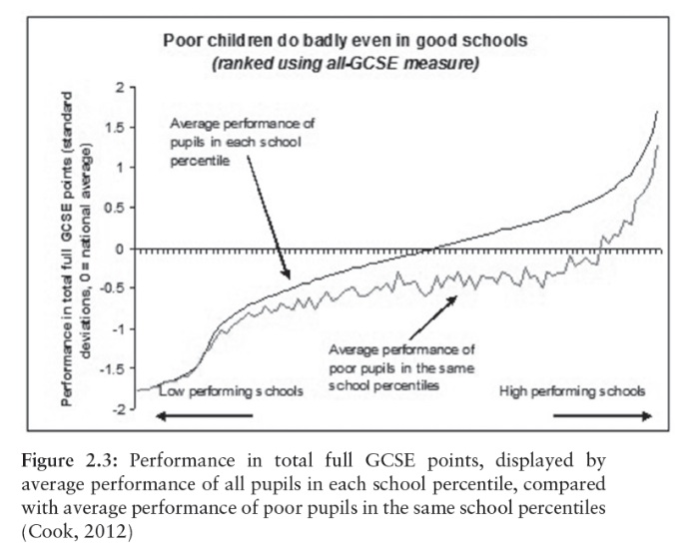
Education and Social Mobility: Dreams of Success

Slide 16
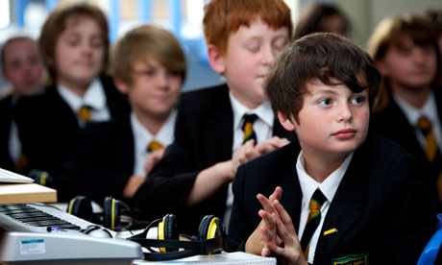
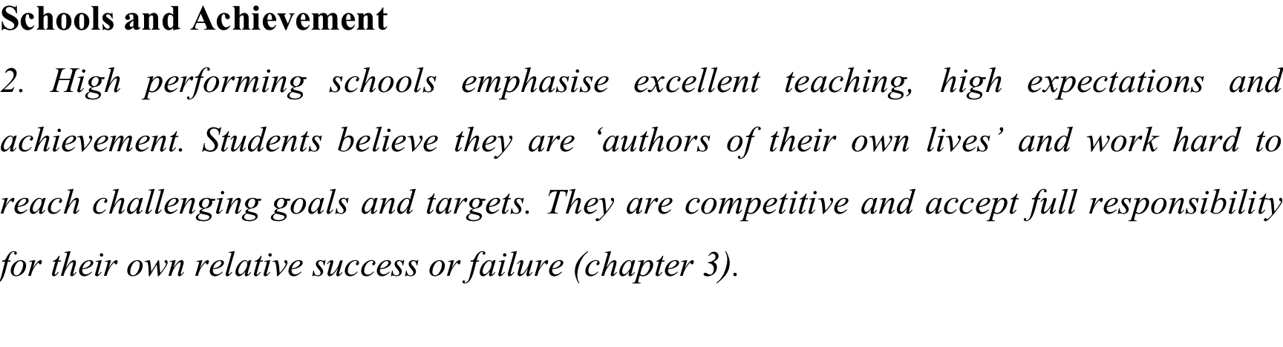
Education and Social Mobility: Dreams of Success
These conditions met to a remarkable extent, with strong evidence of excellent teaching, high expectations and achievement.
Students at South Park critical of less good teachers but embraced school and ethos.
Students strongly felt that the future lies in their hands and their hard work. Did not acknowledge class or background as obstacles. Believed in competitive individualism. Dispositions aligned with formal demands and expectations of the exam system.
Mentoring and target setting part of the schools’ DNA.

Slide 17

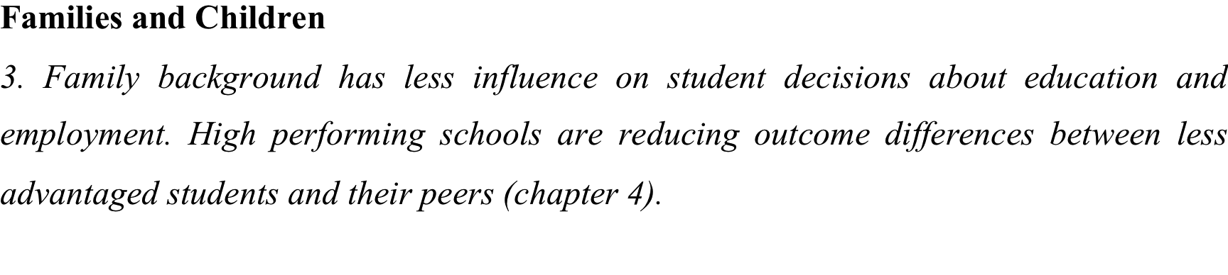
Education and Social Mobility: Dreams of Success
Family culture, networks, resources & dispositions (HABITUS) consistently reported as potent and formative in shaping values, goals and decision-making.
But the students rejected any idea that hardship, illness or other problems influenced them negatively – saw issues as challenges to be overcome.
But less successful students at both schools much more likely to describe themselves as disadvantaged. Stories of ill health, financial stress, unemployment etc. from less successful.
Parental milieu profoundly important, e.g. academic and professional parents at South Park emulated by students; ibid locally employed, trades people etc. produce children with a disposition towards similar employment routes.
Many students perform poorly, even in highly effective schools.

Slide 18

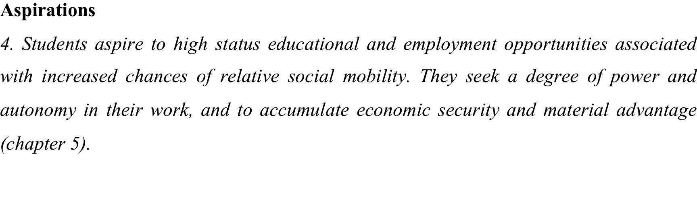
Education and Social Mobility: Dreams of Success
Some students dreamed of climbing ladders and upwardly mobile careers but the most frequently voiced aspiration was to personal and family happiness, and intrinsically rewarding work.
Although concerned to earn sufficient money to live their lives, most stressed job satisfaction as a critical contributor to happiness.
Female students in particular spoke of their desire to ‘make a difference’ in the world – selfless, caring and not very concerned with money and status.
Small male group at South Park did emphasize career, status and power.
Most disavowed the pursuit of material wealth, although some did not, and many were concerned to ensure financial security, especially if they had experienced family money troubles.

Slide 19
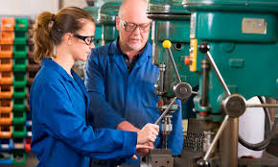
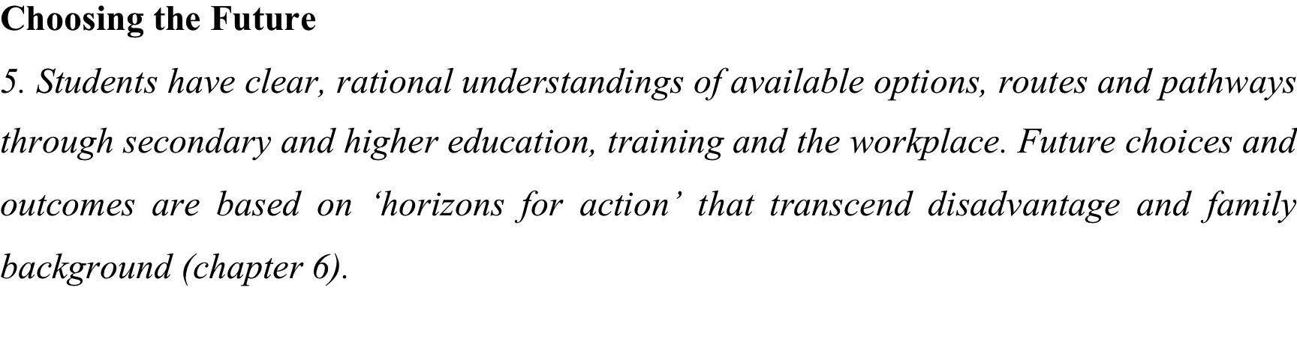
Education and Social Mobility: Dreams of Success
Some encouragement for policy makers in students who see themselves as hard working and competitive, and accept full personal, individual responsibility for their future fate.
Most students were pragmatically rational, understanding what was possible and adjusting expectations in the light of GCSE etc results.
Both schools encouraged mobility, with parents, teachers and students in aligned in pursuit of the best results and outcomes.
The majority are content with family life and have no real desire or aspiration to surpass their parents or enter new worlds above.
Outcomes still closely linked to family backgrounds – schools track and stream by KS2 and CAT scores, reinforcing academic and vocational strands/routes.
Need for family case studies – the dynamics of households, the female role.

Slide 20
Education and Social Mobility: Dreams of Success
Blinkers
Our study also contributes an unexpected insight into the failure of the sociological imagination. Individualist ideas persist, despite their many, obvious limitations, because people very often fail to see beyond their own limited and particular circumstances. Our students did not talk of a pattern, only their agency within it, and were eager to embrace an individualist perspective. They showed little knowledge of the work undertaken by their grandparents, and sometimes know little about the work reality of their own parents. They do not perceive the degree to which their lives are shaped by the transmission of family resources and dispositions, and by the opportunities of their own time and place.

