Slide 1
Inequalities in access to and outcomes from higher education in the UK
Dr. Sally Hancock
Department of Education, University of York
17th June 2017, University of Durham

Slide 2
Key questions
Assumptions about higher education (what is it for?)
Is the expansion of higher education a great equalising project?
Is higher education reinforcing existing inequalities?

Slide 3
What is higher education for?
Does higher education relate to social and economic in/equality? If so, how?
Notes:
Take one minute to jot down your answer, and then discuss in pairs.

Slide 4
Outline
Educational expansion and meritocracy
Rising inequalities (and higher education)
Explaining inequalities
What is the role of higher education?

Slide 5
1. Educational expansion

Slide 6
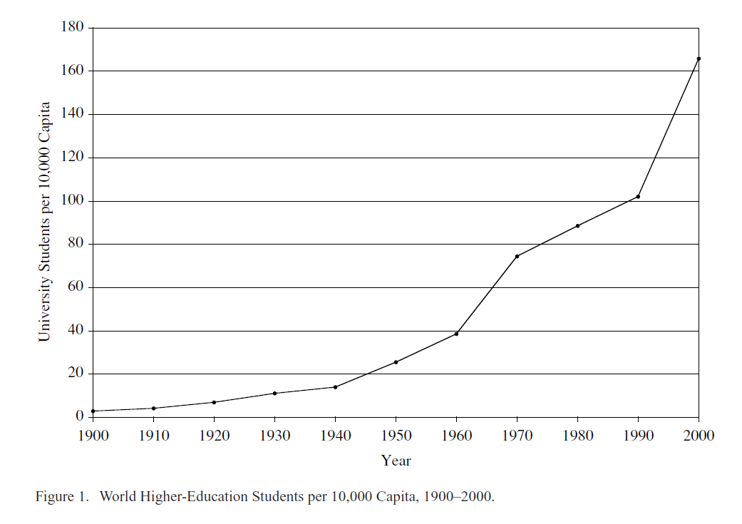
Source: Schofer and Meyer (2005), p. 899.
Notes:
Although I am focusing on the UK today, many of the trends and challenges I will describe are common internationally.

Slide 7
Educational meritocracy
Human capital theory
  Post-war attitudes to research
  Higher education as investment
  Increases to productivity and efficiency
Equality of opportunity
  Social justice (welfare state)
  Social mobility

Slide 8
Translation to policy
“[university places] should be available to all who were qualified for them by ability and attainment”
Robbins Report (1963)
“We believe there is no greater ambition for Britain than to see a steadily rising proportion gain the huge benefits of a university education as school standards rise, meeting our goal of 50% of young adults progressing to higher education by 2010.”
Tony Blair (2001)
Notes:
Translation of ideas to policy. By the late 1950s there was a shortfall of university places due to the increasing number of students leaving school with university-entrance qualifications. The higher education sector needed expanding.
Expansion leads to the relation question of who should pay – can say more about fees if time in discussion.

Slide 9
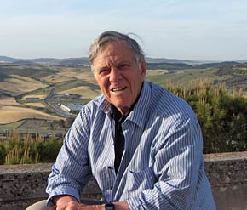
Classification - Trow
Great HE expansion in most advanced economies since 1945
Three ‘ideal types’ of
HE system – elite, mass and universal
Three types of expansion – rate of growth, growth in absolute size (n), growth as proportion of young people entering HE (%)
Martin Trow (1926 - 2007)
Professor emeritus of Public Policy, University of California, Berkeley

Slide 10
Elite, mass, universal
System | Participation (%) | (Some) implications
Elite | < 15 | Graduates enjoy exclusive occupational outcomes, an informal ‘ruling class’
Mass | 16 - 50 | Labour market privilege diminishes, normalisation of ‘academic families’
Universal | > 50 | Labour market privilege diminishes, diversification of student population
Trow, M. (2010). Twentieth-century higher education: elite to mass to universal. Baltimore: Johns Hopkins University Press

Slide 11
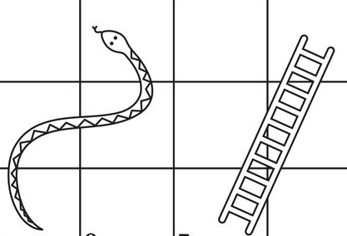
Widening participation
Access to higher education is major focus of policy and resource
Enabling social mobility
Opportunities to improve one’s position in society
Relative and inter-generational
Notes:
Mention Sutton Trust, Realising Opportunities, Aim Higher, Brilliant Club – aspiration and attainment raising.

Slide 12
2. Rising inequalities
Notes:
Misplaced optimism?

Slide 13
Inequality
Not the same as poverty (fewer people are now defined as ‘poor’, globally)
Different aspects – income, capital gains (property or shares), wealth (sum of all goods owned)
  income inequality and wealth inequality correlate highly
Relationship between economic growth and inequality is complex
  But highly unequal societies have low rates of social mobility

Slide 14

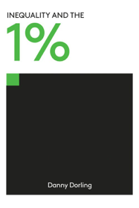
Rising inequalities?

Slide 15
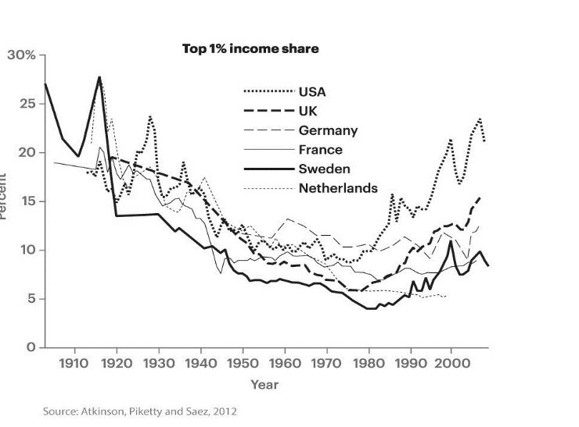
Where the 1% have taken the most and least (income share)

Slide 16
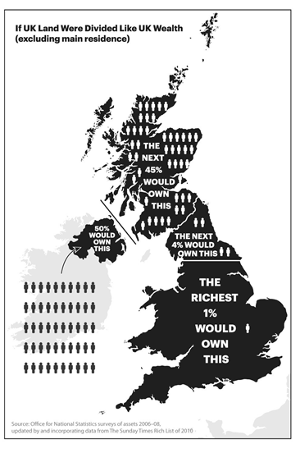

Inequalities in terms of disposable assets

Slide 17
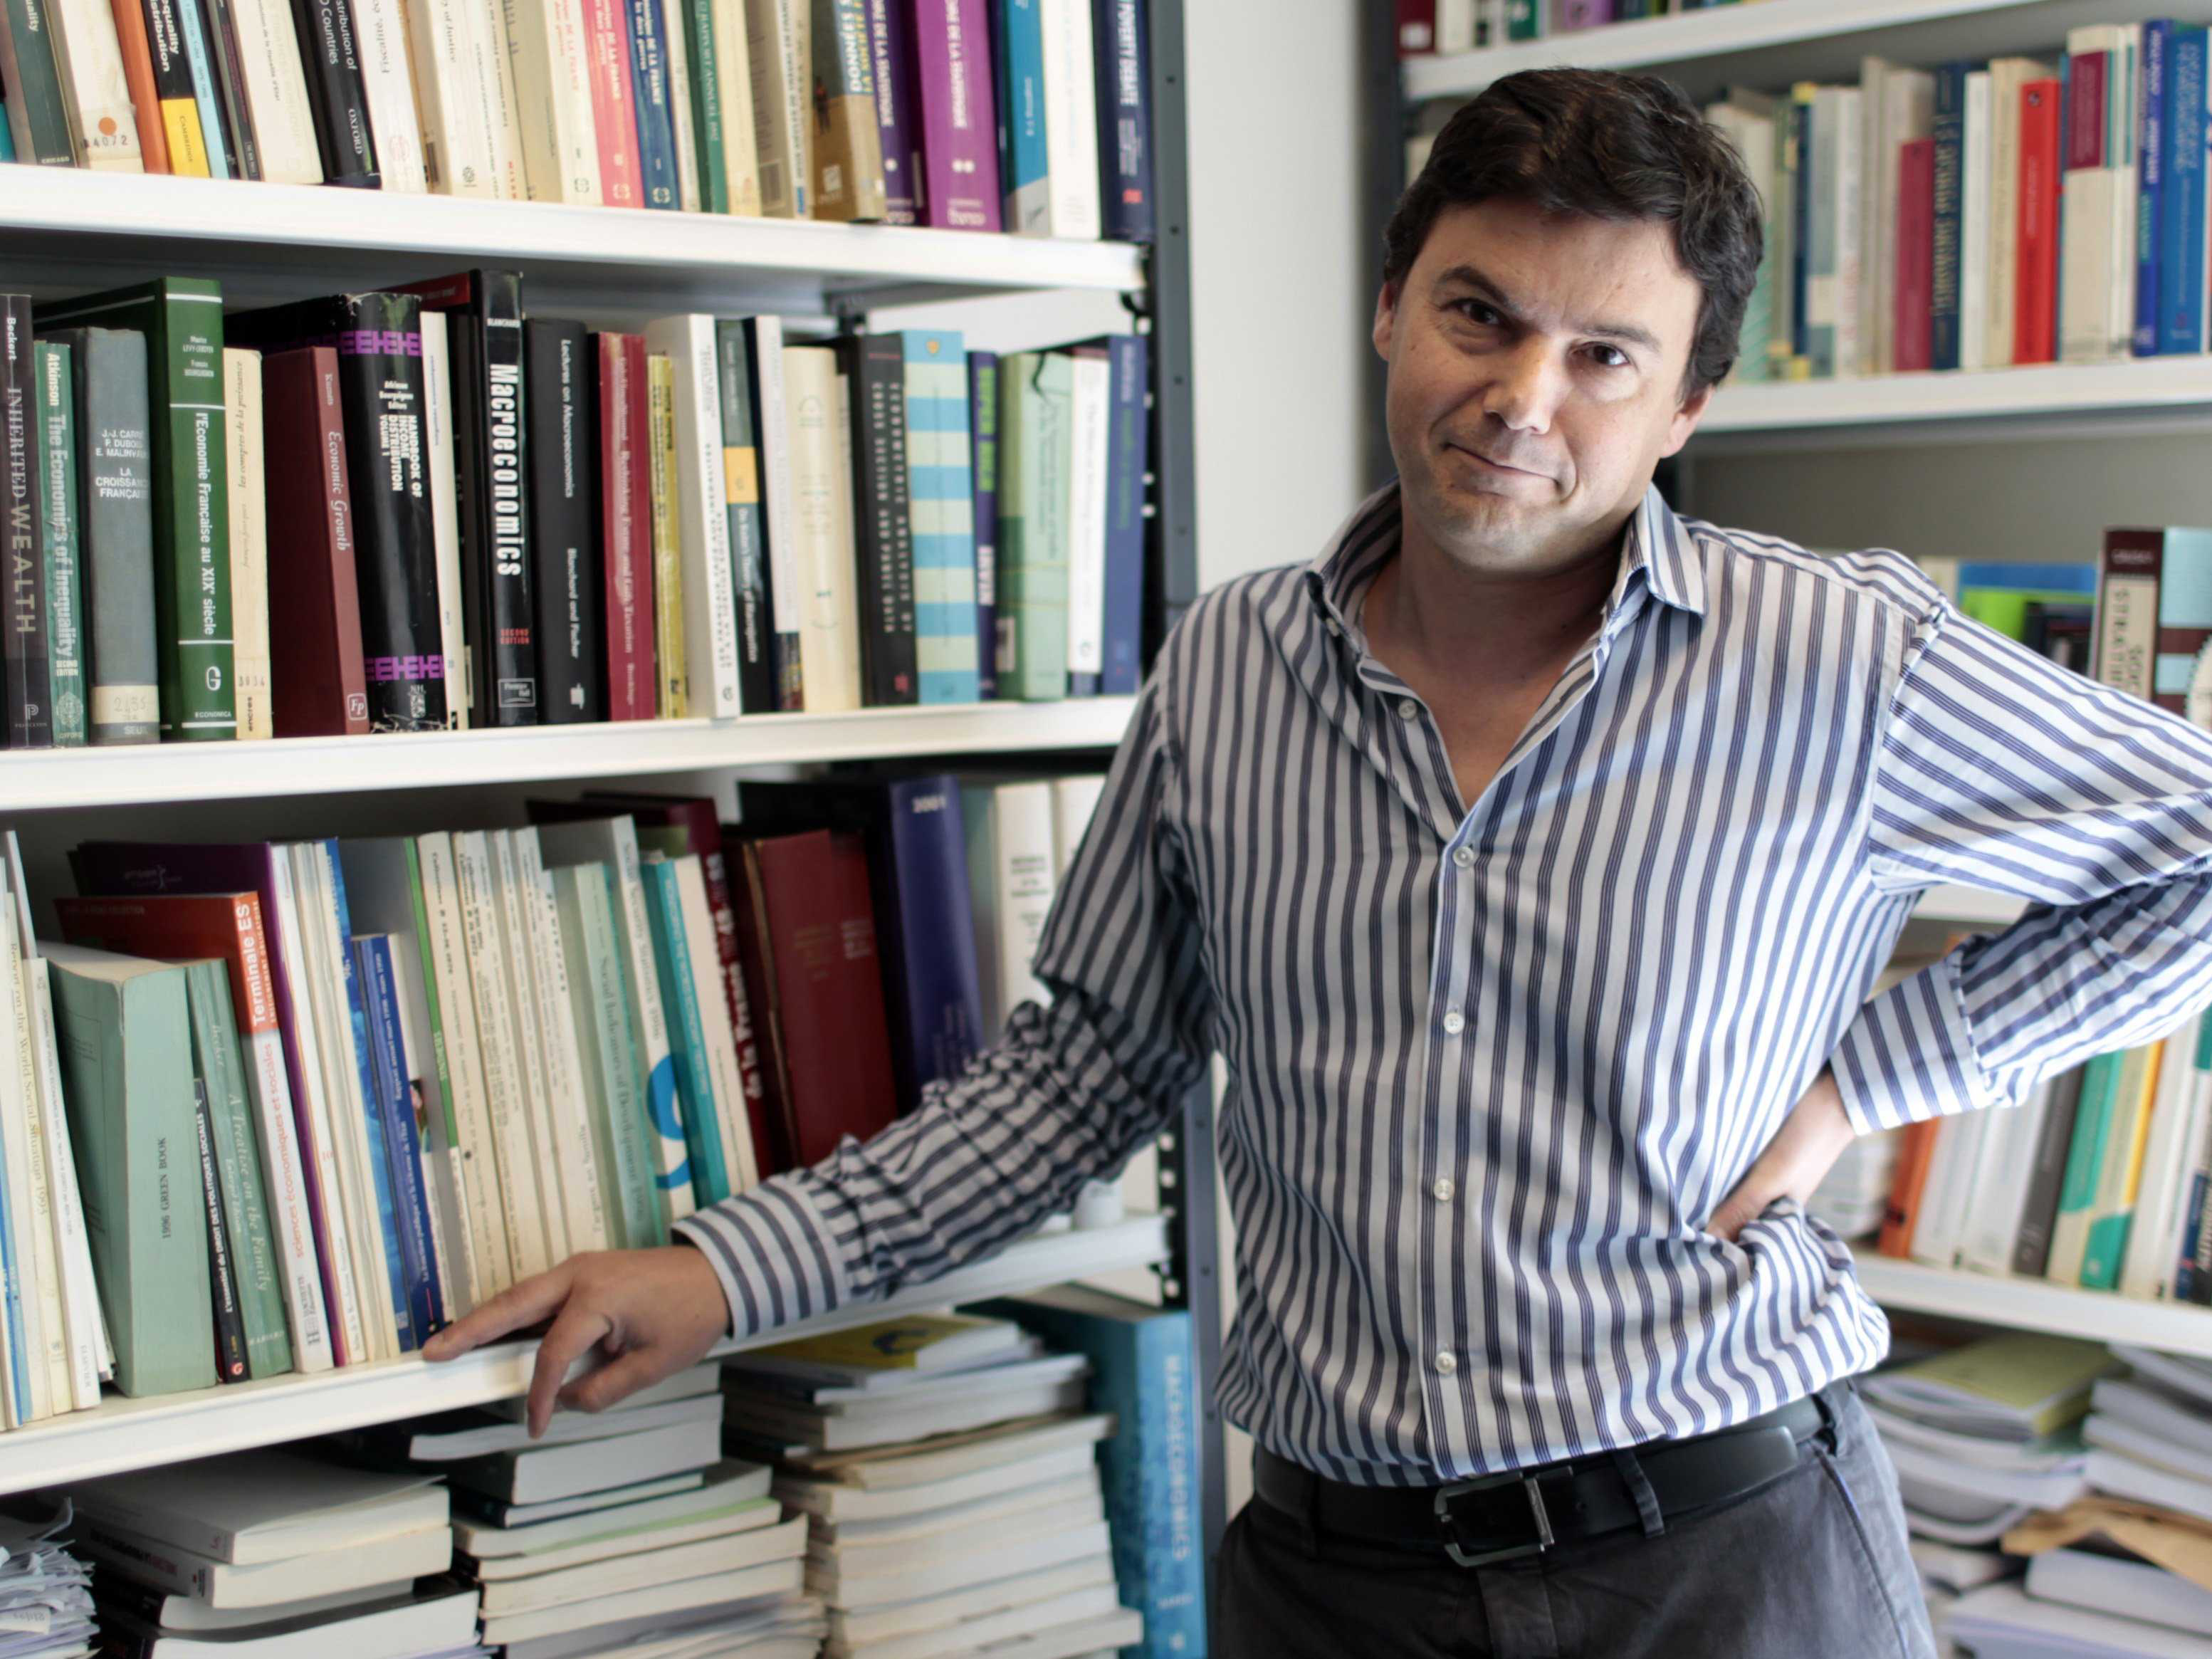
Higher education – the solution?
The best way to reduce inequalities with respect to labour …is to invest in education.
(Piketty, 2014)

Slide 18
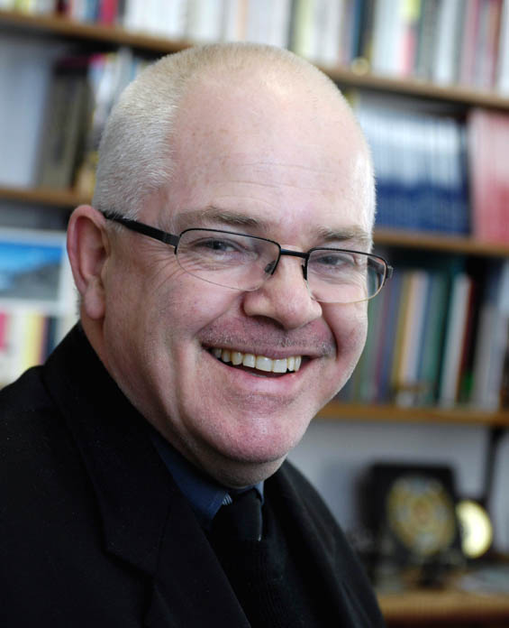
Higher education – the problem?
Human capital theory fails the test of realism… the rapid growth of income inequality in both the US and the UK has coincided with historic highs in educational participation.
(Marginson, 2015)
Notes:
Our research is therefore concerned to examine the extent to which contemporary HE mitigates, reinforces or worsens existing inequalities

Slide 19
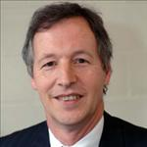
A paradox?
We seem to have a paradox. Mass HE has produced a mass graduate population who are massively compliant with growing massive inequality. Has massification failed?
Rob Cuthbert
Emeritus Professor of Higher Education Management
University of West of England, Bristol
Notes:
Now look at the HE data…

Slide 20
How does higher education relate to in/equality?
Notes:
Misplaced optimism? Let’s look at the evidence.

Slide 21
Principal axes of inequality?
Gender
Ethnicity/ race
Social class

Slide 22
Gender
Almost universal progress across 20th century
From complete exclusion of women to female majority*
  Among undergraduate students
BUT:
  ‘Segregation’ by discipline
  The student experience
  The glass ceiling
*See especially Di Prete and Buchmann (2013) The rise of women: The Growing Gender Gap in Education and What it Means for American Schools

Slide 23
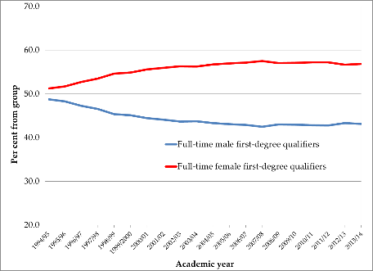
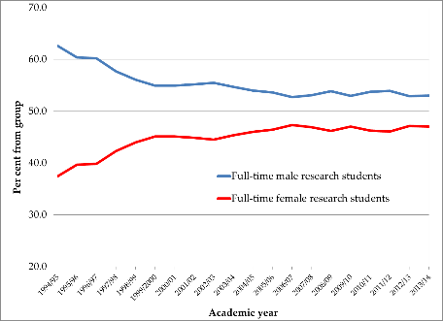
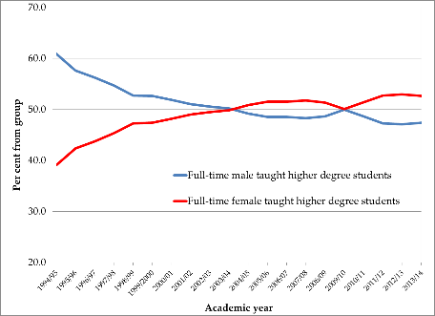
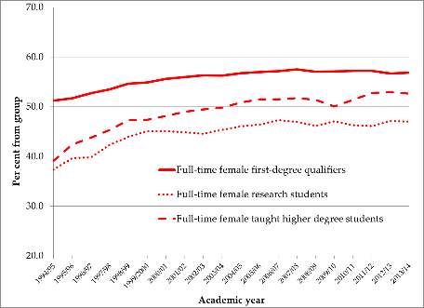
Source: HESA Students in Higher Education Institutions (1994/95 – 2013/14) UK-domiciled students/qualifiers only

Slide 24
Ethnicity
Unlike gender, nature of the differences varies across countries
E.g. compare: China, Turkey, UK, USA
Complex patterns of inequality/advantage

Slide 25
Ethnicity and UK HE
All ‘black and minority ethnic’ groups have higher rate of entry to university than ‘White British’ group
But:
  Differences between groups (e.g. Indian, Pakistani)
  Intersectionality (class, gender)
  Access to ‘most prestigious universities’ (Boliver, 2015)
  Differential attainment and experiences at university (Stevenson 2017)
  Inequalities in outcomes (graduate jobs, postgraduate study) (Social Mobility Commission 2017)

Slide 26
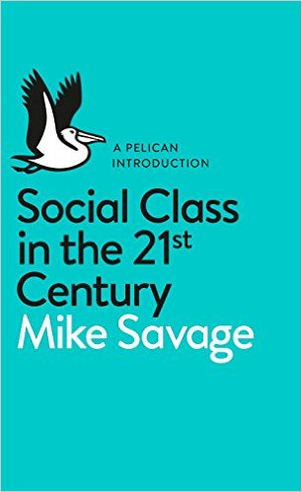
Social class
Different definitions
  Occupation
  Ownership/wealth
  Cultural capital (tastes, activities, education)
  Social capital
  Location e.g. urban/rural
National/international differences
  Global classes?

Slide 27
Origins and Destinations
There is a very longstanding link between social class (of parents) and educational attainment (of children)
The social class gap (unlike the gender gap) has not shifted substantially over time
Again, distinction between absolute and relative changes in educational attainment

Slide 28
HE growth and class inequalities
All social classes have improved their participation rate
BUT social class gap in participation rate has remained
Main beneficiary of expansion: middle-class women

Slide 29
Persistent Inequality?
These patterns are almost universal across the market economies
They appear stubbornly resistant to change, despite massive expansion
Shavit and Blossfeld (1993) studied 13 countries and concluded that massification ≠ reduced inequality

Slide 30
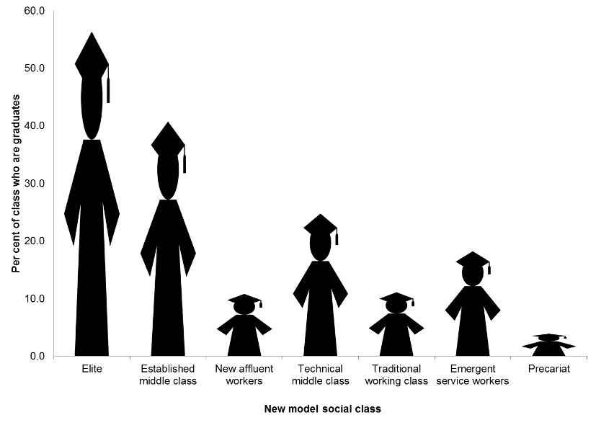
Great British Class survey

Slide 31
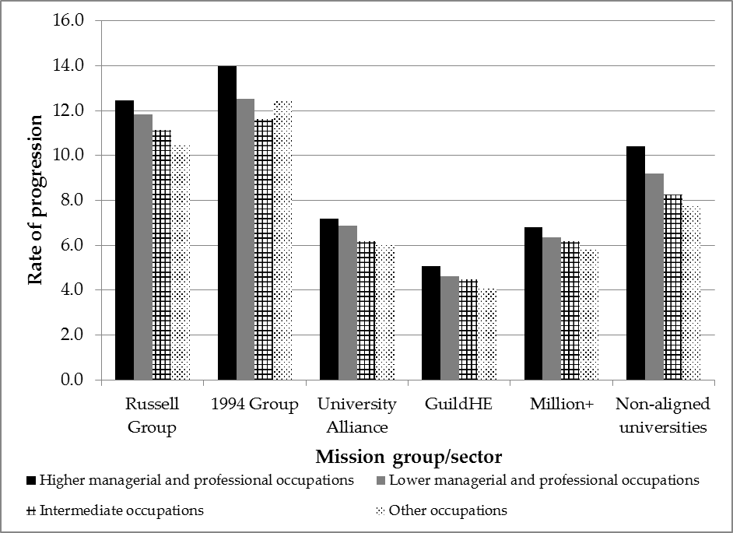
Rate of progression by UK-domiciled first-degree graduates to taught higher degree, by social class and first-degree institution type, 2009/10 – 2010/11
Source: HESA Destination of Leavers from Higher Education Survey 2009/10 – 2010/11.

Slide 32
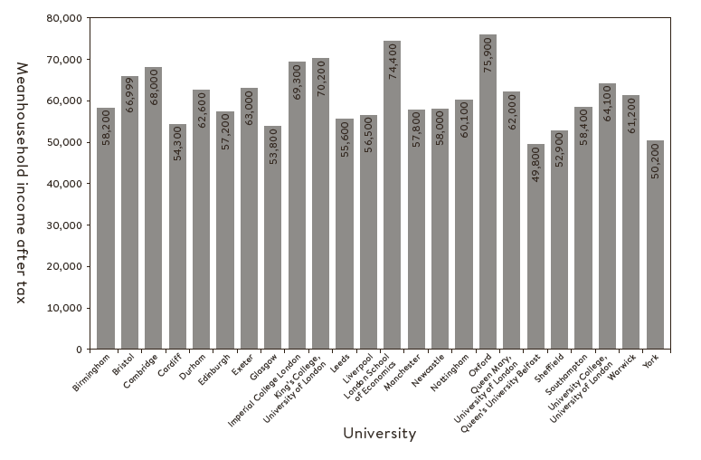
stuff
Household income by first-degree institution
See also: https://www.gov.uk/government/uploads/system/uploads/attachment_data/file/619512/SFR_18_2017_LEO_mainText.pdf

Slide 33
3. Explaining inequalities

Slide 34
Collins and ‘Credential Inflation’
Examines growth in educational qualifications through the 20th Century in USA
Looks at relationship between skill levels actually required to perform jobs and qualifications needed to enter same jobs
Concludes that growth in qualifications is due to competition for jobs, not technical skills they provide
Education is a ‘positional good’ and a tool for social closure
(See also Wolf (2002) – young people have to participate - ‘tipping point’)
Notes:
As teachers you have a view on this… some professions need higher study?

Slide 35
‘Effectively maintained’ inequality
Lucas (2001), looking at USA
Argues that whilst access to a particular level might be equalising, qualitative distinctions emerge within that level
‘Institutional stratification’
Mission groups and league tables (schools too)
Graduate employment

Slide 36
‘Maximally Maintained’ Inequality
Raftery and Hout (1993): inequalities between classes in access to a given level of education persist
However when access approaches ‘saturation’ point, inequalities decline at that level
Inequalities then move to next level
E.g. postgraduate study: Wakeling (2009); Machin and Lindley (2011)
‘Class ceiling’ even within professions (Friedman, Laurison & Miles 2015)

Slide 37
4. What is the role of higher education?
Notes:
Would anyone revise their data on the basis of some of the evidence presented today?

Slide 38
Points for discussion
Inequalities simply passing up? (early years)
Higher education as a panacea for structural inequalities?
Narrow focus on employability and economic outcomes
Information, advice and guidance
Impact of fees: from public good to transaction?

Slide 39
Further reading
Becker, G. (1964). Human capital: A theoretical and empirical analysis with special reference to education. Chicago, IL: University of Chicago Press.
Breen, Richard, Ruud Luijkx, Walter Müller, and Reinhard Pollak Source. 2009. “Nonpersistent Inequality in Educational Attainment: Evidence from Eight European Countries.” American Journal of Sociology 114 (5): 1475–1521.
Britten, J., L. Dearden, N. Shephard, and A. Vignoles. 2016. How English Domiciled Graduate Earnings Vary with Gender, Institution Attended, Subject and Socio-economic Background. IFS Working Paper W16/06. London: Institute for Fiscal Studies. Brown, P. 2013. Education, Opportunity and the Prospects for Social Mobility.” British Journal of Sociology of Education 34 (5–6): 678–700.
Boliver, V. (2013). How fair is access to more prestigious UK Universities?. British Journal of Sociology 64(2): 344-364.
Boliver, V. (2016). Exploring ethnic inequalities in admission to Russell Group universities. Sociology 50(2): 247-266.
Bowles, H., and Gintis, S., (1975) The problem with Human Capital Theory: A Marxian critique, The American Economic Review, 65 (2), pp. 74-82.
Brown, P. Lauder, H., and Ashton, P. (2011) The Global Auction, Oxford: Oxford University Press.
Dorling, D. (2014) Inequality and the 1%. London: Verso.
Marginson, S. 2016. “The Worldwide Trend to High Participation Higher Education: Dynamics of Social Stratification in Inclusive Systems.” Higher Education 72: 413–434.
Piketty, T., (2014) Capital in the Twenty-First Century, Cambridge: Harvard University Press.
Raftery, A. E. and Hout, M., 1993, Maximally Maintained Inequality: Expansion, Reform, and Opportunity in Irish Education, 1921-75, Sociology of Education, vol. 66, issue 1, pp. 41-62.
Roberts, Ken, 2010, Expansion of higher education and the implications for demographic class formation in Britain, Contemporary Social Science, vol. 5, issue 3, pp. 215-228
Schofer, E., and J. W. Meyer. 2015. “The Worldwide Expansion of Higher Education in the Twentieth Century.” American Sociological Review 70: 898–920.
Shavit, Yossi. (2007). Stratification in higher education : a comparative study. Stanford, Calif. : Stanford University Press
Social Mobility Commission. 2016. State of the Nation 2016: Social Mobility in Great Britain. London: HMSO.
Stevenson, J. (2017). University can feel like a hostile place for Muslim students. http://theconversation.com/university-can-feel-like-a-hostile-place-to-muslim-students-74385
Warikoo, N. 2016. The Diversity Bargain: And other Dilemmas of Race, Admissions, and meritocracy at Elite Universities. Chicago, IL: University of Chicago Press
Wilkinson, R., and Pickett, K., (2009) The Spirit Level: Why More Equal Societies Always Do Better, London: Allen Lane.

Slide 40
T H A N K Y O U
sally.hancock@york.ac.uk

