Slide 1
MA in Educational Leadership (Teach First)
Research Methods Training: June
Qualitative Methods
Observation

Slide 2
Systematic Observation
In social research, observation is generally used to record behaviour. It may be employed as a primary method of data collection to provide an accurate description of a situation; to gather supplementary data which may qualify or help interpret other sources of data; or it may be used in an exploratory way, to gain insights which can be tested by other techniques.
(Johnson, 1994: 52)

Slide 3
Types of observation:
Degree of participation in event being observed (Continuum from complete participation to deliberately minimal participation to overt non-participation to covert observation).
Degree of structure in what is observed (Systematic/formal, pre-determined focus, quantifiable data collection versus ethnographic record, less formal, emerging focus, qualitative).

Slide 4
Systematic Observation
An instrument for observation will specify:
The categories of behaviour to be noted
What is classified as an act of behaviour
Time intervals for recording observation
Scales or categories for classifying the behaviour

Slide 5
Problems of systematic/structured observation
Difficulties in defining what types of behaviour correspond to a particular concept
Lack of confidence of observer, and observer fatigue
Distortion of observer’s perceptions - own values intervene
Data may be open to the criticism of lacking checks on reliability (particularly for the single-handed researcher)

Slide 6
ORACLE: An example of highly structured observation
ORACLE = Observational Research and Classroom Learning Evaluation
Galton et al (1976; 1996)

Slide 7
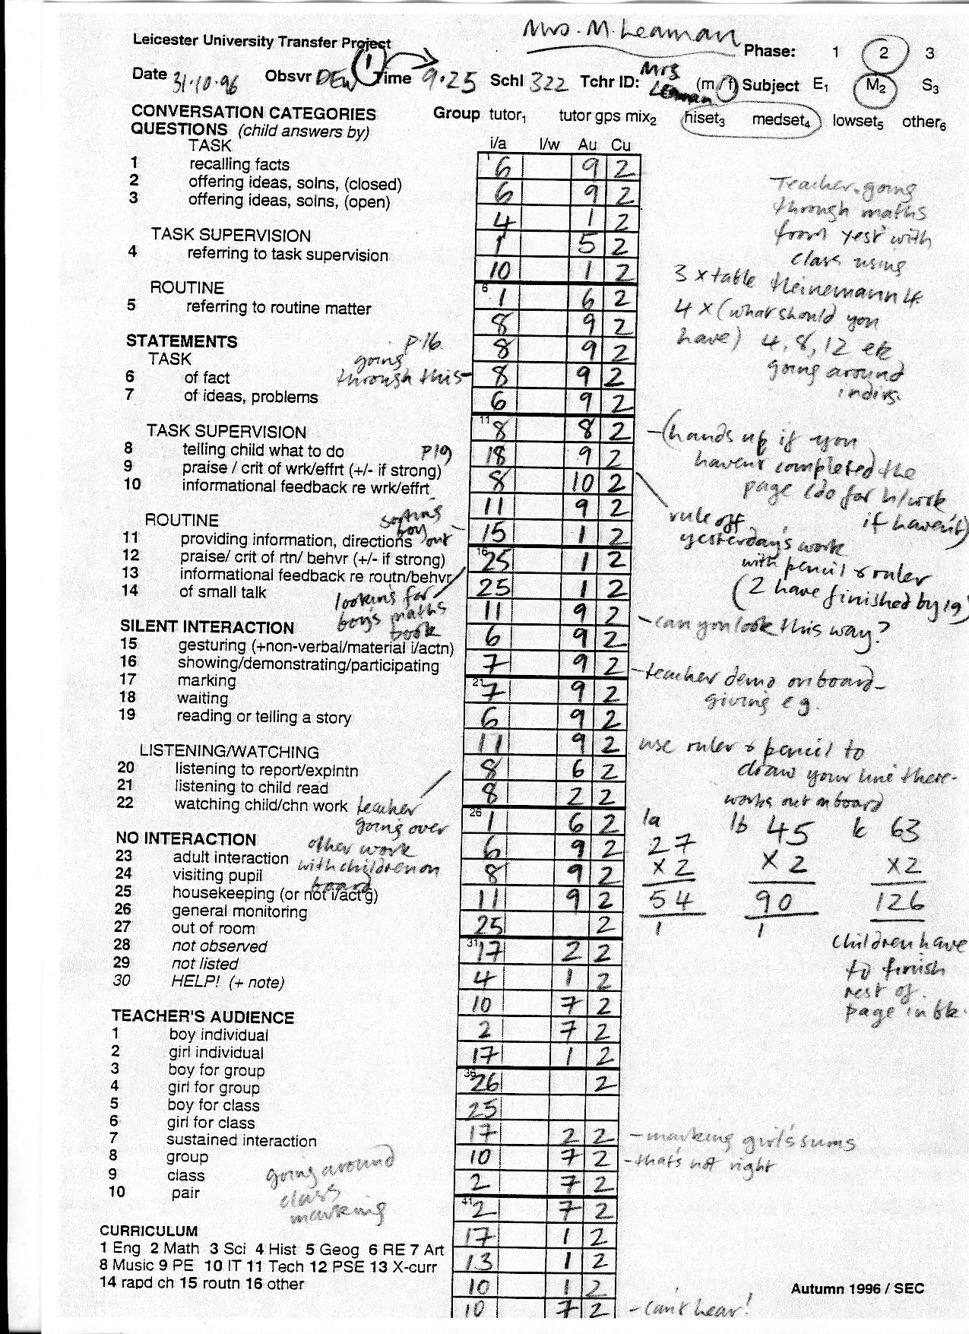

Slide 8
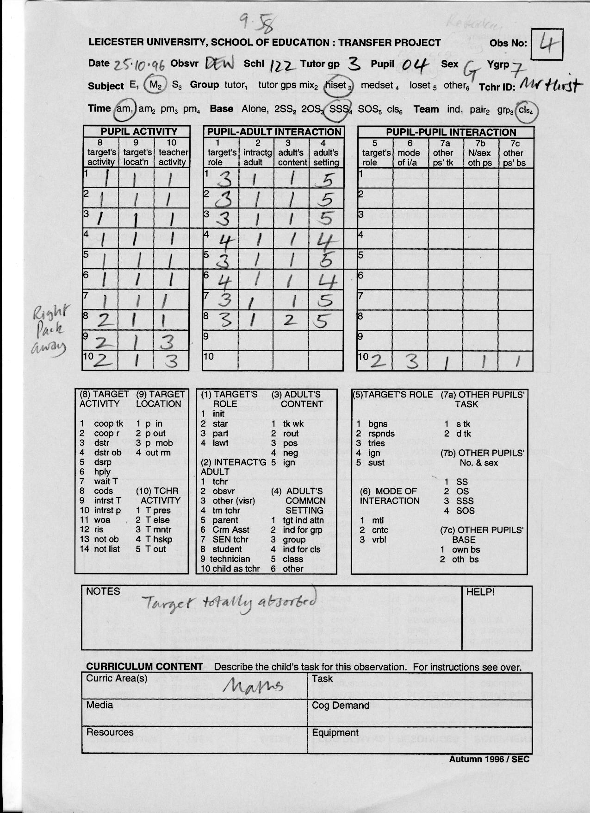

Slide 9
Participant observation
It is generally used to record the behaviour
of a collectivity or group, whether this be in
a meeting or a series of less formal activities,
even to record a "way of life”.
(Johnson, 1994: 54)

Slide 10
Observations lead to very rich data, but …
They make heavy demands on time and resources
They can result in a huge amount of data being collected
There is a limit to how long a researcher can observe in detail
Accuracy can be challenged, particularly in the case of the single-handed researcher

Slide 11
Managing the activity of observing
There are four essential questions for an investigator using observation:
What should be observed?
How should observations be recorded?
How can the accuracy/consistency of observations be ensured?
What is to be the relationship between observer and observed, and how can this be established?

Slide 12
Observation is an intrusive research technique, particularly when one person is being followed and their activities recorded.
Ethical issues and issues of access are important. There are no hard and fast rules for all situations; integrity and sound intentions are the most important guidelines.

Slide 13
Observation of meetings: content and process issues
For each person in turn:
What did they contribute to the discussion?
What was the nature of their contribution?
How did they help in achieving the purposes of the meeting?
How did they hinder the achievement of purposes?

Slide 14
Example of an open observation schedule (from a National College-funded evaluation)
When | What | Who | How | Behaviour | Other

Slide 15
Analysis of qualitative data
This has three stages:
Coding: organisation of data into patterns and categories
Interpretation: looking for relationships and linkages
Focus: relate it back to the original purpose of the study
All three stages may draw on literature cited previously.
Notes:
In other words - the same as you were doing with the quantitative data

