Slide 1
MA in Educational Leadership (Teach First)
Induction
Reflections on the Guest Lecture and the Independent Self-study Module

Slide 2
Reflections on the Guest Lecture
What did you think of Janet’s talk?
Which parts did you agree with?
Which parts, if any, did you disagree with, and why?
How does the content of her talk relate to your own particular school context?
Notes:
Allow at least 15 minutes for this in small groups.

Slide 3
Activity: Introductory Brainstorm
In small groups, pool the information you already have about the Independent Self-study Module; Justine described it in her presentations last May/June.
Length
Due Date
Content
Activity: Assignment rubric jigsaw
Notes:
No need for writing. Discussion in pairs / small groups for 2-3 minutes and brief plenary (2 or 3 minutes).
I’ll supply each group with 6 sets of the rubric, cut into pieces. In groups of 4 or 5, they’ll have to put it together again. I’ll also supply 30 copies of the rubric correctly set out. This activity should take about 10 minutes to do, with 5 minutes for questions.

Slide 4
Activity:
What’s the difference between description and reflection?
Can you write two sentences, one that describes something that happened in your classroom this week, and one that reflects on something that happened?
Notes:
Discussion in small groups – 5 minutes

Slide 5
Imagine that last week you set a piece of homework for a class containing two students called Adam and Sophie (pseudonyms).
A simple description would be:
Adam did the homework and seemed to learn something whereas Sophie didn’t do the homework and didn’t seem to learn anything.
But reflection requires you to probe more deeply and, for this assignment, to use previous scholarship and/or government documentation to place what you have observed in your own classroom in a wider policy context.
Notes:
Slides 5 to 20 can be presented quite briskly in about 20-25 minutes

Slide 6
Using previous scholarship/literature/research
‘Learning from homework: a case study’ by Martin Hughes and Pamela Greenhough in Louise Poulson and Mike Wallace (2006) (eds.) Learning to Read Critically in Teaching and Learning, London, Sage. pp.85-109.

Slide 7
Hughes and Greenhough (2006) draw on earlier work by Pollard and Filer (1996) which asks five questions …
What is being learned (learning content)?
When and where does the learning take place (learning context)?
Who is learning (learning identity)?
What support is available for learning?
What are the learning outcomes?
But they then use these five questions to generate a conceptual framework encompassing all the factors that influence the learning generated by homework. What factors do you think the framework contained?
Notes:
So, the authors of this chapter began by drawing on the work of Pollard and Filer (1996) – you should also draw upon the work of previous researchers, no point reinventing the wheel!
What is being learned (learning content)?
When and where does the learning take place (learning context)?
Who is learning (learning identity)?
What support is available for learning?
What are the learning outcomes?
But they added value to this list of questions by tailoring it to the learning generated by homework

Slide 8
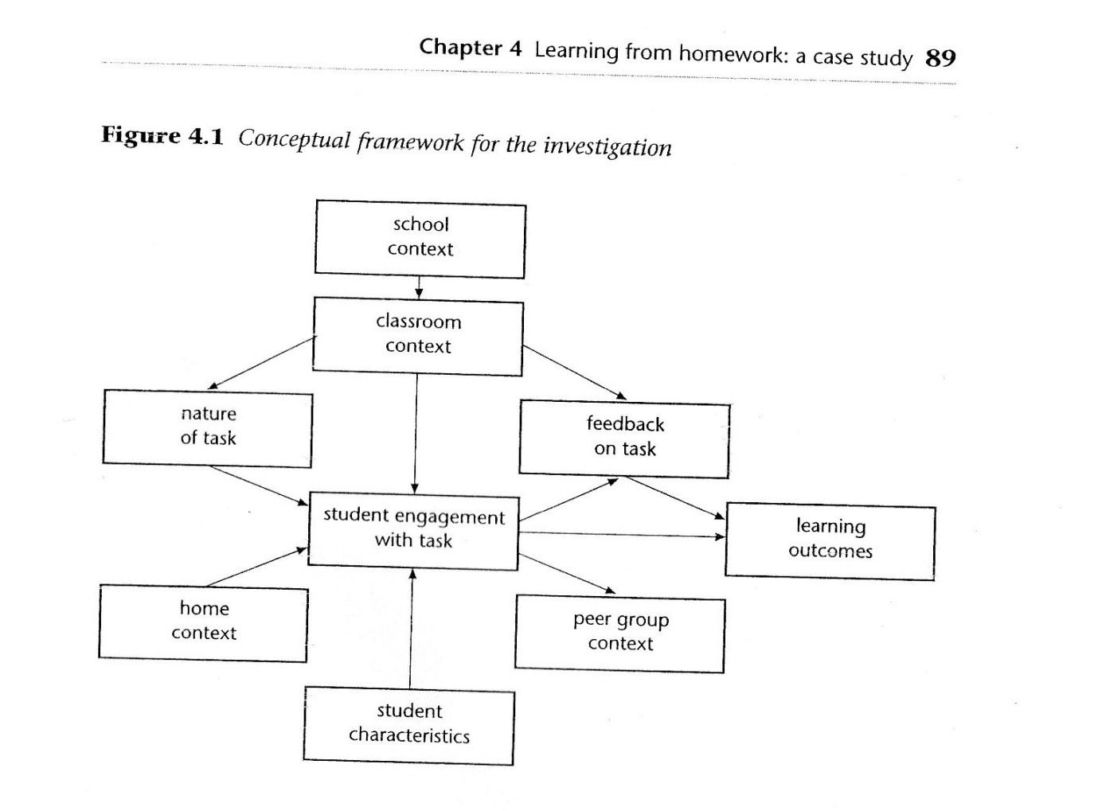
Conceptual Framework
Notes:
A conceptual framework is like a sieve through which you pour your raw data in order to extract the “golden nuggets” representing significant/important information. It is often depicted as a diagram.

Slide 9
“The main advantage is that it can represent, in a visual form, what are regarded as the main elements of the research and how these might be related. As we shall see, this representation can help directly with framing the specific research questions of the study, as well as providing a structure for data collection and analysis. The main weakness is that such a framework is inevitably a simplification of what are likely to be quite complex processes.” (Hughes and Greenhough, 2006, 90).
Notes:
Probably worth drawing attention to the fact that we cite the authors of each chapter in an edited collection, and that if this quote were in their assignment, it would be indented because it’s longer than 40 words, and it wouldn’t then need quotation marks at the beginning and end.

Slide 10
The conceptual framework devised by Hughes and Greenhough (2006) allows the teacher to analyze what is happening in their classroom with greater depth and clarity.
For each student, you will need to consider: the home context, the student characteristics and the peer group context of each student.

Slide 11
Adam –
Lived with his mum, stepfather and younger siblings.
Mother thought homework was “very important”, Father also thought it was useful.
Adam’s parents said they were proud of him and thought he was mature and reliable.
He described himself as “quite talented”.
Thought maths was “quite easy” and wanted to move into a higher set.
Friends included people he thought put lots of effort into homework and some who didn’t – this latter group he described as “trouble-makers”. He sometimes asked his friends for help with homework but he never copied their work.
Notes:
Poulson and Wallace interviewed the students and their parents – you aren’t expected to collect data for this assignment, but you are expected to utilize all the information you have at your disposal.

Slide 12
Sophie –
Lived with her mum and two sisters.
Her mum thought homework was “quite important” and reminded Sophie to do it.
She couldn’t help her with maths, but her elder sister could. Her mum said she was quiet. Sophie herself said she was quite shy.
She considered herself to be hardworking except if she didn’t like the subject or the teacher.
She didn’t like maths and didn’t think homework helped her learn.
She knew she could ask the teacher for help but preferred to ask her friends “to save embarrassment”. Sometimes these friends help her out with homework and she thinks they are cleverer than she is.

Slide 13
Homework set: a) To find 10 circular items around the house and measure the circumference and diameter of each. b) To notice how the diameter and the circumference are linked c) At a fairground, a “big wheel” has a diameter of 60 metres. How long do you think the circumference will be?

Slide 14
Adam did this homework straight after school. He found it quite easy, although his stepfather helped him with the last question by drawing a Ferris wheel to help him visualize the problem.
Sophie did not attempt the homework. She said it was because “I lost my planner on that day and then I’d put a sheet into my bag but I couldn’t find it anywhere. I still haven’t found it.”

Slide 15
In the follow-up lesson, Adam was able to complete the exercise set by the teacher. Sophie wasn’t, but she gave the impression of being on-task by copying the questions into her book.
In terms of the learning outcomes, Adam seemed to have a good understanding of pi and how it could be used to calculate the diameter of a circle if the circumference was known, or vice versa. Sophie did not seem to have learnt much from the homework or the follow-up lesson.

Slide 16
As we saw earlier, a simple description would be:
Adam did the homework and seemed to learn something whereas Sophie didn’t do the homework and didn’t seem to learn anything.
But reflection requires you to probe more deeply and, for this assignment, to use previous scholarship and/or government documentation to place what you have observed in your own classroom in a wider policy context.
Clearly the two students have different attitudes towards maths, but there were other differences. What are they?

Slide 17
Other differences a) The amount of support available at home.
Adam’s dad helped him, whereas Sophie’s family did not. b) Peer group support was also different.
Sophie sat with a group of students she thought were cleverer than she was and this helped her to hide the fact that she didn’t understand the work. c) Their use of the teacher’s help.
Adam felt he could ask his teacher for help, although usually he didn’t need it. Sophie, in contrast, needed help but didn’t like to ask for it.
So, the conceptual framework devised at the beginning helped the researchers analyze the data in more depth.

Slide 18
How typical is the case study?
The Circles homework task was unusual because it was preparatory work for the next lesson, whereas most other homework tasks were to consolidate the previous lesson.
It was also unusual in explicitly linking schoolwork with the home environment.
No conclusions should be drawn about gender differences on the basis of just two students and one homework task.
So … you’ll need to think about how typical the examples you have chosen to include are

Slide 19
Conclusions
1) There is no such thing as “a good homework task” because all students are different.
2) How well students complete homework may depend upon the amount of support they get at home – explicit help, or just the space and time they need.
In this way, homework can actually widen the attainment gap between students who have strong support at home and those that don’t. So it increases inequality.
Notes:
These two conclusions might not have been reached if the authors had stuck to the quite superficial analysis offered by the earlier slide – that Adam did the homework well and learnt a lot, whereas Sophie skipped it and didn’t learn anything. This is where a clear and robust conceptual framework really comes into its own – it helps you analyze your data at a deeper level and uncover the “hidden gems”.

Slide 20
Adding a leadership perspective
What does the government say about this issue? Consult the National College and DfE website.
Homework was being promoted by the newly-elected government ...
“Homework is not a punishment and it is not a chore. It is an essential part of a good education” (Blunkett, 1997).
So place your study within the wider policy context by briefly referring to the most up-to-date government information you can find.
Notes:
It’s absolutely vital that students link this kind of classroom-based work to the wider field of educational leadership and/or policy discourse.

Slide 21
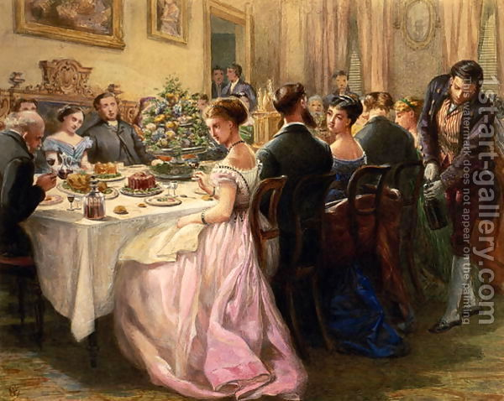
Being selective in what you read/write
How do you decide whether a paper is worth reading in detail?
How do you decide whether a paper is worth citing?
Notes:
Short (5 minute?) discussion in pairs.
Need to make the point that just because it is available, doesn’t mean they should use it. Need to stick to respectable sources – peer reviewed journal articles, newspaper articles for really recent stuff. Don’t bother quoting conference proceedings, because if a conference paper is any good, it gets converted into a journal article shortly afterwards.
Kamler and Thomson (2006) have written a great book aimed at doctoral students, but it is also suitable for M-level. They liken writing a literature review to hosting a dinner party – read on to find out why ...

Slide 22
Being selective in what you read/write
“We like the domestic, familiar image of the dinner party and its emphasis on conversation with a community of scholars ... The doctoral researcher invites to the table the scholars she would like to join her for a conversation over the evening meal. The emphasis is on the company and the conversation that happens at the table ... She cannot invite everyone because they will not all fit at her table. She is not just a bystander or “reviewer” of the conversation, but a participant. While she may not always comprehend all the conversation or catch all its nuances and complexity, she is present.”
Kamler, B. and Thomson, P. (2006, p. 38) Helping Doctoral Students Write:
pedagogies for supervision, Abingdon, Routledge.
Notes:
This just reinforces the work we did at the first teaching day and demonstrates that some sources are more recent than others, some are more relevant, some are more credible etc.
A key additional point is that the evidence-base underpinning a source can be very small or absolutely huge. I give the example of two papers dealing with the deployment of teaching assistants.
Kerry, T. 2005. Towards a typology for conceptualising the roles of teaching assistants. Educational Review 57, no. 3: 373–84. This is based on his own experience over 17 years, so he’ll clearly an expert BUT ...
Blatchford, P., Russell, A., Bassett, P., Brown, P. & Martin, C. (2007b) The role and effects of teaching assistants in English primary schools (Years 4 to 6) 2000–2003, British Educational Research Journal, 33(1), 5–26. This is a 5-year study involving 10,000 schools in England and Wales, three phases of data collection, thousands of questionnaire responses, time-logs, observations, interviews, and talking to pupils in 76 schools. These two sources ought not to carry equal weight, though they are both journal articles.
You also need to consider how relevant the original context of the source is to you own. So stuff from England and Wales should be privileged over stuff from elsewhere; stuff from primary over secondary, if you work in primary; stuff from schools in challenging circumstances over schools in the leafy suburbs, if you work in the former, etc.

Slide 23
The “I” question
“Whether you use first or third person will depend upon your discipline, your politics, your purpose and your audience” (Blaxter, et al. 1996:221)
Your own opinion, unsupported by data, is not valid BUT it will influence the whole of your research. Okay to adopt a stance, but it can’t just be your own opinion, needs to be based on evidence of other literature (for this assignment) or your own findings (for the Improving Urban Schools assignment).
Briggs, A., Coleman, M. and Morrison, M.(eds.) (2012) Research Methods in Educational Leadership, Third Edition, London, Sage.
Notes:
They can read more about positionality in the Briggs et al. book.

Slide 24
Generic M-level criteria
Notes:
I’ll photocopy a copy of this for everyone, but not as a jigsaw! It will also be posted on the website. It should be enough to distribute it.

