Slide 1

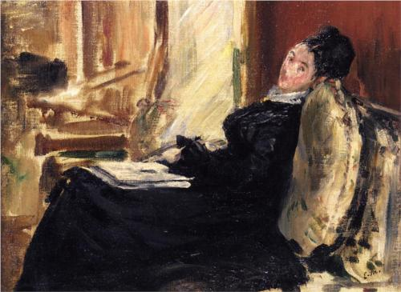
How should we define, measure, compare and improve
Standards?

Slide 4
World Class Paintings?

Slide 5
2. The immediate cause of the outbreak of revolution in 1789 was
a. grinding poverty among all classes of society. b. government oppression. c. the ideas of the philosophes. d. the insensitivity of Marie Antoinette. e. the government's financial crisis.
3. Although the Storming of the Bastille on July 14, 1789 is celebrated as the "start of the French Revolution," the first act of revolution may have been the resolve of the Third Estate to write a constitution. It is of a. the first session of the Estates General. b. the swearing of the Tennis Court Oath. c. the storming of the Tuileries. d. the forming of the National Assembly. e. the public proclamation of the Declaration of the Rights of Man and the Citizen.
4. Choose the correct chronological order:
I. convening the Estates General II. the Declaration of the Rights of Man and the Citizen.
III. formation of the National Assembly. IV. the Tennis Court Oath.
a. I, II, III, IV b. III, I, II, IV c. III, IV, II, I d. II, IV, I, III. e. I, III, IV, II
How valid? How reliable? How stable across time?

Slide 6
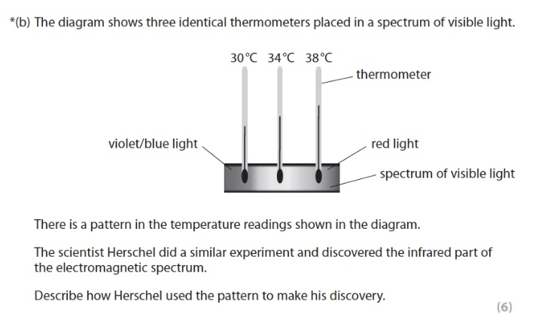
How valid? How reliable? How stable across time?

Slide 7
World Class Qualifications?
What Causes Stress?
Travers and Cooper (1996) classify the teaching profession as one of the top ten high-stress professions. Therefore it is imperative that we understand stressing factors so as to be able to be proactive and reactive as when necessary.
In this section, we will investigate what are the main causes of stress. There can be various causes of stress, and these vary from something that could have happened in the classroom to problems a teacher might have with the school administration’s management and behaviour.
Stress is usually caused due to an imbalance of demands and resources (Mo, 1991). Individuals often feel a sense of powerlessness once external demands and pressures suppress the individual’s resources and abilities. Also, similar feelings can be caused if individuals are not able or willing to adjust to new circumstances, be it demands, innovations, changes. Moreover, in the case of prolonged exposure to stress, one may not be able to cope with a particular circumstance (Mo, 1991).
Various researchers have identified different elements that can cause teacher stress. Fitzgerald (2008) says that “Teaching has a number of specific stressors, such as dealing with disruptive student behaviour, the pressures of school inspections, providing cover for colleagues and large workload” (p.24). On the other hand Kyriacou (2000) has a different opinion on what can cause teacher stress. He locates stressing factors at the personal level, i.e. within each teacher’s personality and their personal life/lifestyle. He therefore, argues that teachers whose personality is impatient, aggressive, striving disposition towards getting things done, and tend to overload themselves with tasks are more stress prone than those who have a more laid- back and relaxed personality. He also argues that stressed teachers may not necessarily be stressed because of the reasons mentioned before, but also because they are experiencing stress in other areas of their lives.

Slide 8
Grade A
Students achieving this grade will have demonstrated that they:
• have a highly developed understanding of work in a school or college and can set it firmly in a
wider context through critical analysis and synthesis of the relevant theories and practices
from the literature;
• can accurately apply concepts and frameworks from the literature to work in their school or
college and successfully evaluate their applicability;
• for research-based assignments, can select and use a range of skills of analysis with a firm
focus on the research objectives;
• for research-based assignments, apply a range of research methods appropriately as part of a
small-scale research investigation concerned with professional/school or college improvement;
• create a clear structure for their work; present arguments that are clear and sound;
• justify their interpretations;
• have insight and originality of thought;
• can communicate in a cogent and economical manner.
Grade B
Students achieving this grade will have demonstrated that they:
• have a good understanding of the work in school or college and can make strong links between
theory and practice through the literature;
• question and explore aspects of their work in school or college using concepts and frameworks
derived from the literature;
• use a limited range of skills of analysis appropriately and generally with good effect;
• for research-based assignments, can carry out small-scale professional/school or college
improvement investigations by applying a range of research methods in their own
organization;
• present arguments that are clear and consistent and show an understanding of some
alternative perspectives;
• can write to communicate clearly for an academic and educational audience.

Slide 9
Grade C
Students achieving this grade will have demonstrated that they:
• can describe some aspects of work in school or college with reference to the literature;
• make some links between practice and theoretical concepts and frameworks presented in the
literature;
• show some ability to use a limited range of skills of analysis;
• for research-based assignments, can plan and undertake a small-scale research project in their
own school or college and provide a limited interpretation of the data in terms of their own
organization;
• can write with structure and reasonable clarity.
Grade D
Students achieving this grade will have demonstrated that they:
• use a limited range of literature to describe aspects of the topic in relation to their own
organization;
• for research-based assignments, apply a narrow range of research methods to a situation in
their own school or college;
• for research-based assignments, generate data of limited value from a research investigation
in their organization;
• demonstrate limited ability to write for an academic audience.

Slide 10
Assignment Moderation
The moderation assignment was taken from the Research Methods module and focused on the use of classroom observation for professional development. Twenty-four tutors and core team members marked the moderation script and thank you to all colleagues for taking the time to review and offer feedback on this assignment. As in previous years, there was a range of grades awarded by the tutors. This year the range was wide, including 3A, 7B, 10C and 4D grades, in relation to the original grade of a B.

Slide 11
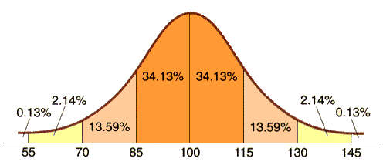
IQ Test Curve

Slide 12
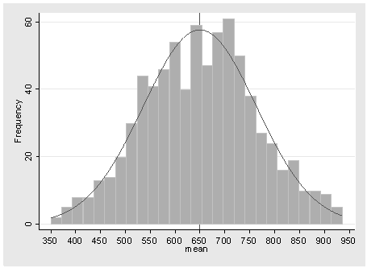
Distribution of Marks

Slide 13
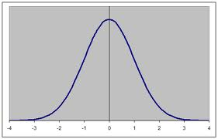
Normal Distribution Curve

Slide 14
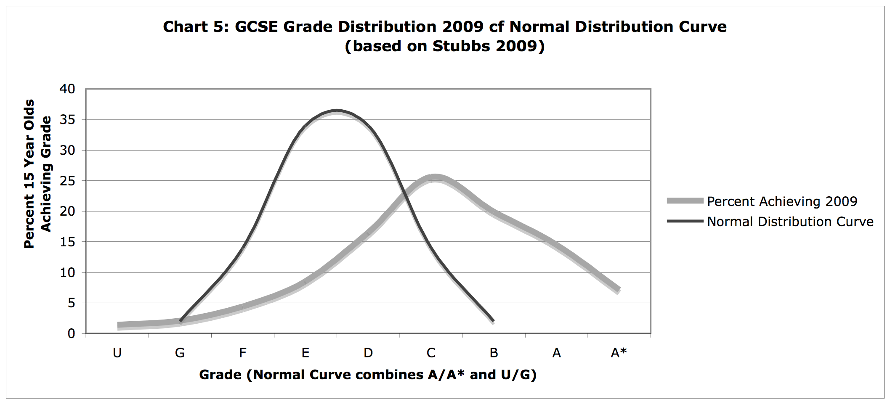
How did the boards achieve this?

Slide 15
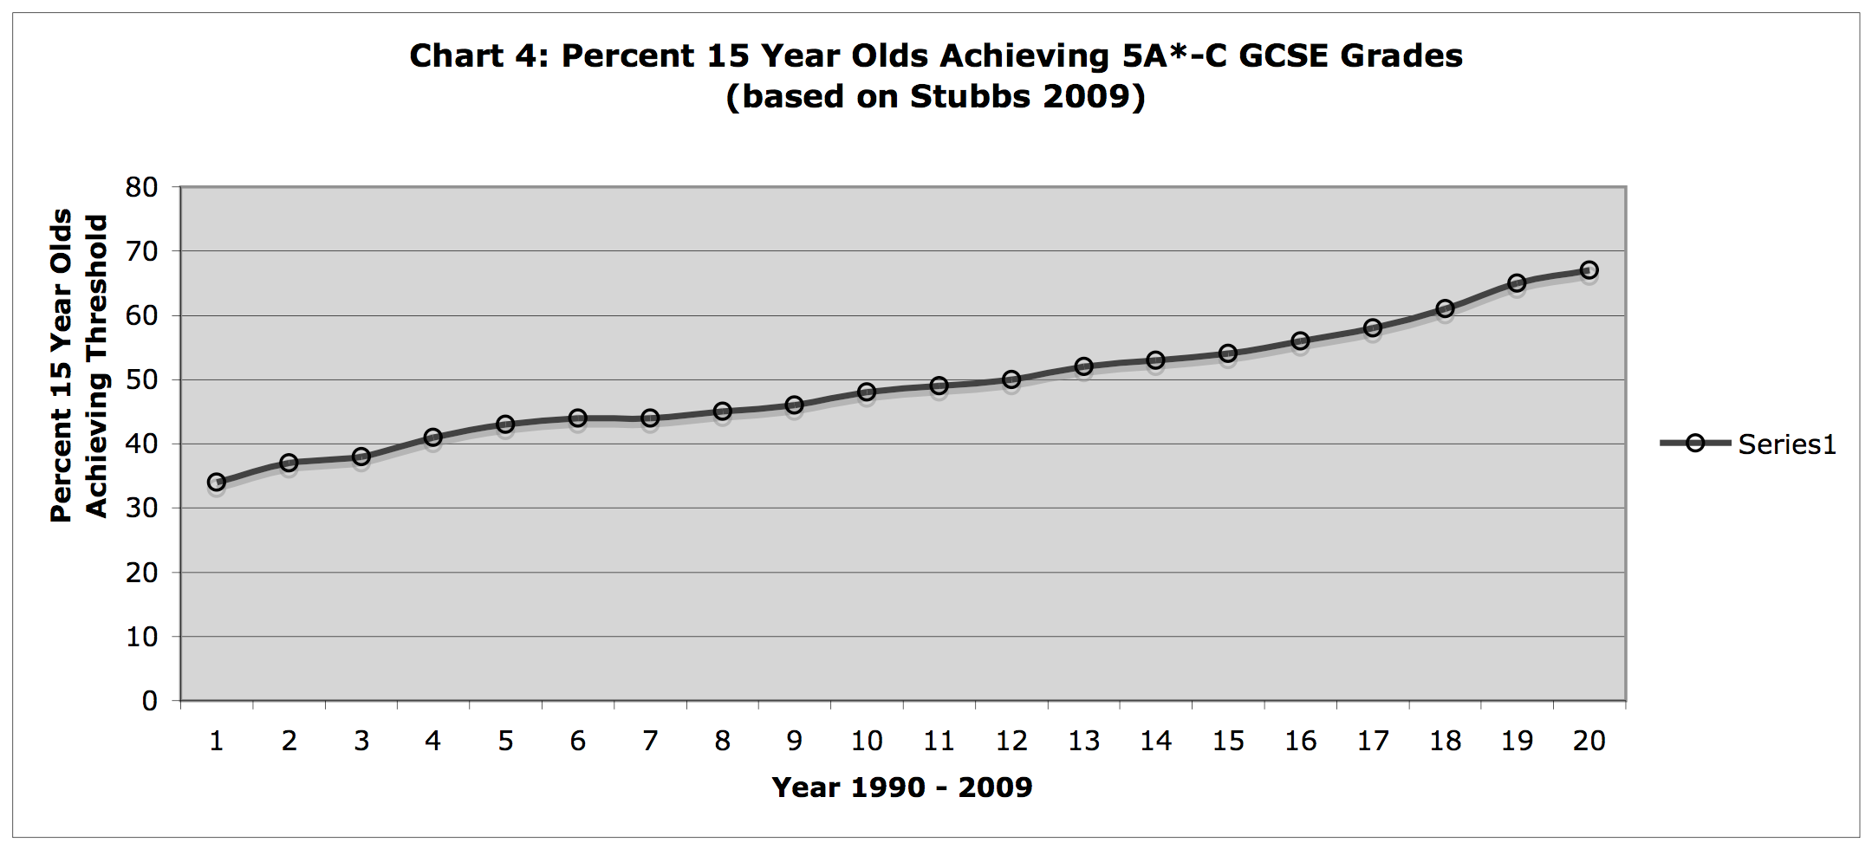
How do we explain this trend?

Slide 16
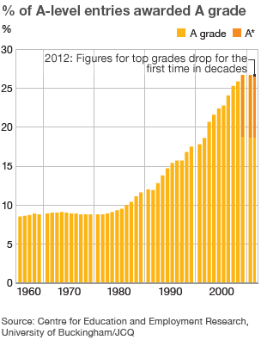
Or this one?

Slide 17
Criteria for Success – What is a ‘standard’ and how measured?
Grade C But what criteria? Mark scheme? Teaching to the test? What mark range? Fixed in advance? Same every year? C in Business Studies same as C in Music or C in
Greek? C counts the same as A?
5 Grades A – C
5 Grades A* - C
5 Grades A* - C including GNVQ equivalents
5 Grades A* - C including English and Mathematics
5 Grades A* - C including E Bacc required subjects; now new curriculum, and new instructions for examiners?
With coursework, without coursework
With spelling/ English requirements, without them
With modules, without modules
Raw data means excluding all other variables
Contextual value added means feeder schools impact on results
FSM means all students in an economic category are presumed similar
Validity across time presumes a stable, standardized, statistically calibrated item bank of questions

Slide 18
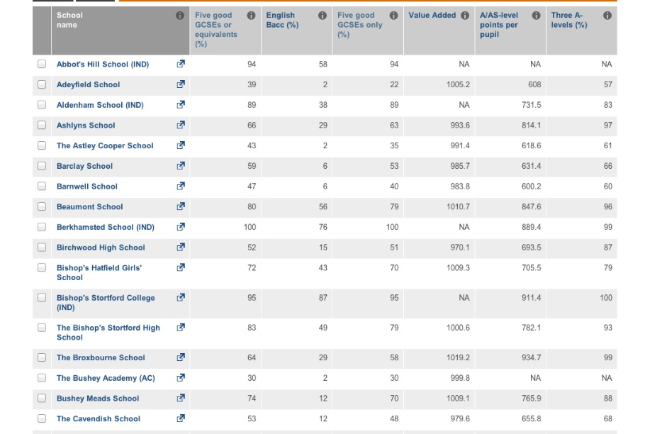
How do you explain the improving trend? And the wide variation between schools?

Slide 19

Some schools are more effective than others (possess characteristics associated with high performance)
Some teachers are more effective than others (producing in-school as well as inter-school variations)
Teaching has improved dramatically in the last twenty years
Students work harder than they used to, especially at good schools
Mixed school level leadership means results have improved more rapidly in some places than others
Compliance with national policies has led to improvement

Slide 20
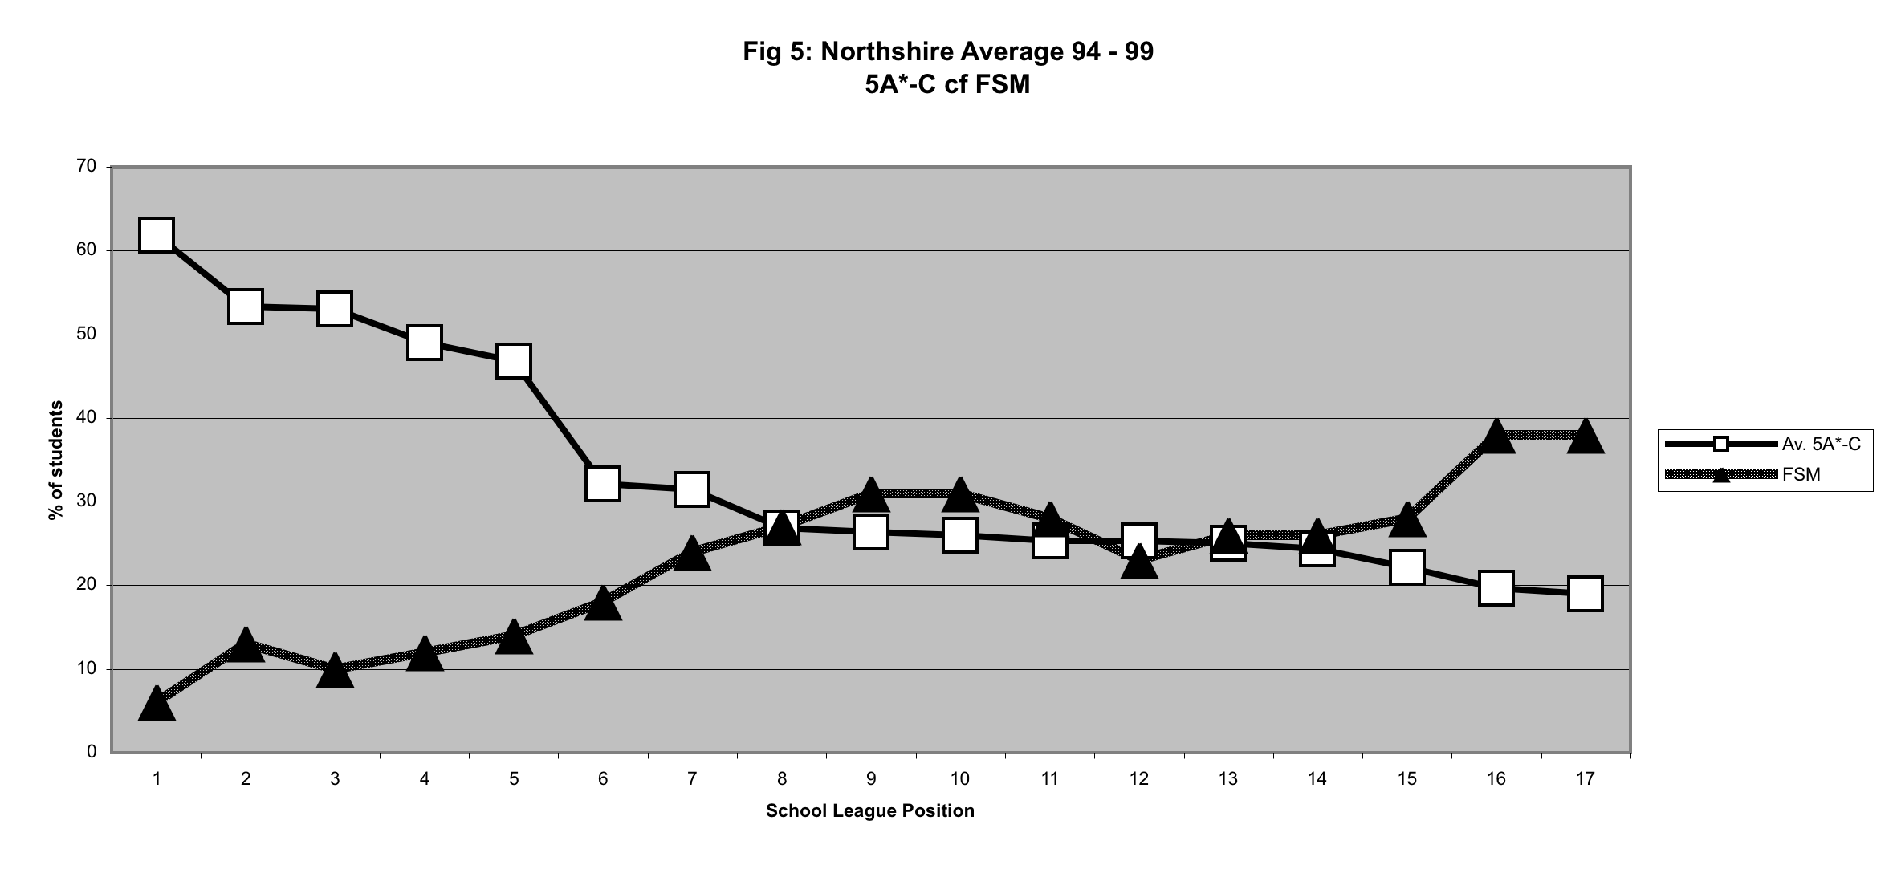
Or does intake mix explain most variation? Is disadvantage the ‘zombie stalking the English classroom’ (Diane Reay)?

Slide 21
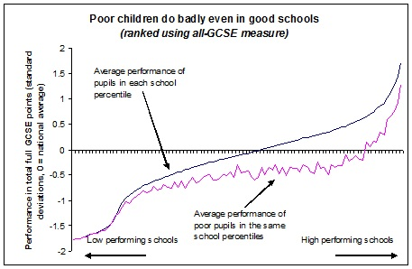
Do effective schools overcome disadvantage?

Slide 22

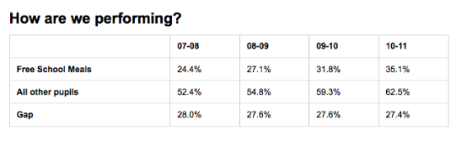
Do better results mean we are closing the gap?

