Slide 1
CeNTRE mini conference
3 March 2010

Slide 2
CeNTRE
We are about the exploration of new technologies and their impact on teaching and learning.
Recent work has looked at deep learning, ITE, learning platforms, robotics, blogs, games , e portfolios, new literacy etc
We run seminars and mini conferences and report in journals

Slide 3
Welcome to the day
The plan is
Andy Townsend: deep learning,
Nick Lee: beyond current horizons
Melanie Pope: what do student teachers believe?
Viv Bailey: blogs and young children

Slide 4
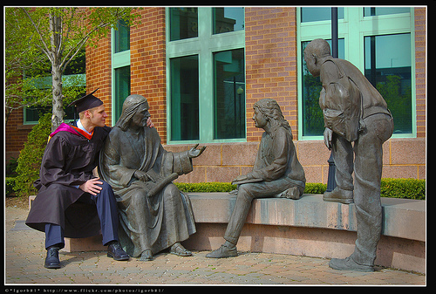
The plan is also to...

Slide 5
tea coffee lunch
Arrangements….

Slide 6
“what’s on your mind?”
computer technology is getting cheaper, quicker, more widespread
is this a good thing? an inevitable thing? a bad thing?
how can we work with others to use technology wisely?

Slide 7
Technology: the background
“the most powerful computer (or other digital device) that you can afford today will cost half as much in two years time .... in two years time for the same money you will be able to buy something twice as powerful.”
Cliff, D. (2009) Socio-Technical Change: Computing, Bioscience, Maths, Bristol, Futurelab

Slide 8
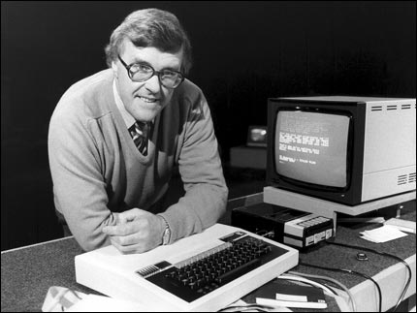
Images of the past
Source: ‘Making the Most of the BBC Micro’
http://en.wikipedia.org/wiki/Making_the_Most_of_the_Micro

Slide 9
Where we are
Technology as:
Networked
Mobile
Immersive
Everywhere

Slide 10
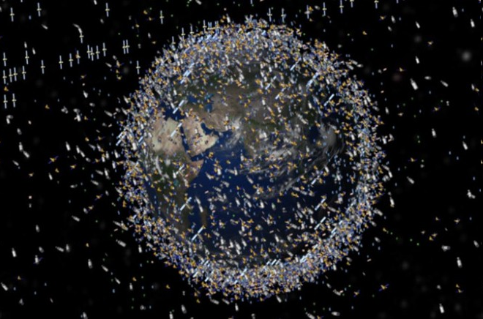
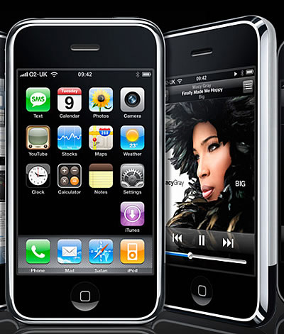
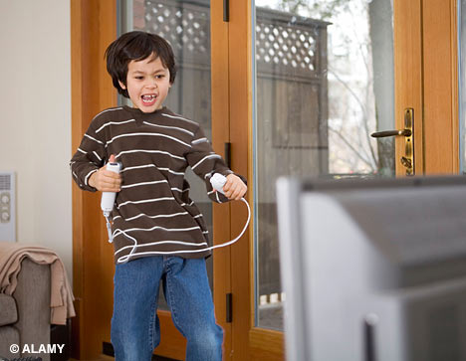
The world as networked

Slide 11
How do we see all this?
Accepting of it…
In awe of it…
Panicked by it…
We want to fashion it…

Slide 12
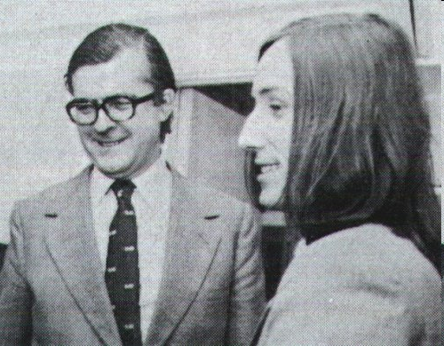
In education
Are we led by technology?

Slide 13
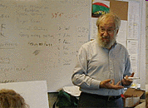
Will it lead us?
But I think we can predict that some things will go away. Age segregation will go away. This fragmentation of the day into periods devoted to different subjects will go away. Curriculum-driven structure of learning, by which I mean you learn something because it is the day in which you are supposed to learn that. As opposed to project- or application-driven learning; you learn it when you've got a need for it.
http://www.papert.org/articles/GhostInTheMachine.html

Slide 14
Can we make it work for desirable ends?
Desirable use of technology | This is because
a challenge, going beyond the routine, giving an element of control | knowledge is personal, it is about making personal meaning
doing something the learner would find purposeful. | making meaning requires purposeful activity
going beyond what is generally taught and how it is taught | knowledge is unbounded
communication | knowledge is not acquired spontaneously it requires reflection
Hammond et al (2009) Voices Project, ITTE http://www.itte.org.uk/node/35

Slide 15
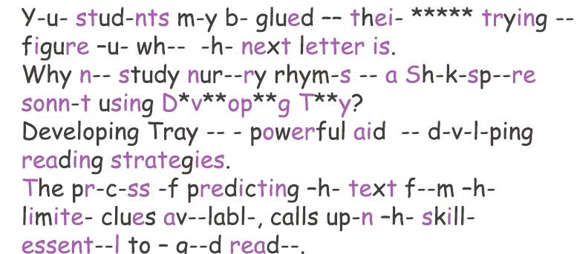
Developing tray

Slide 16
Where does this leave us?
How do we feel about the changing technology?
What do we think about its value in education?
What do we think about its value beyond schooling?
How can we support the wise use of technology?

