Slide 1
Welcome to the Library
MEd programme

Slide 2
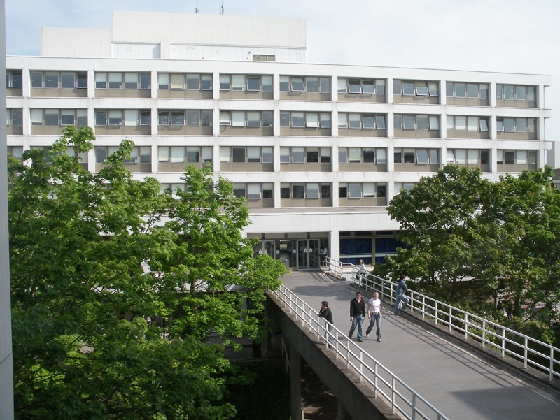
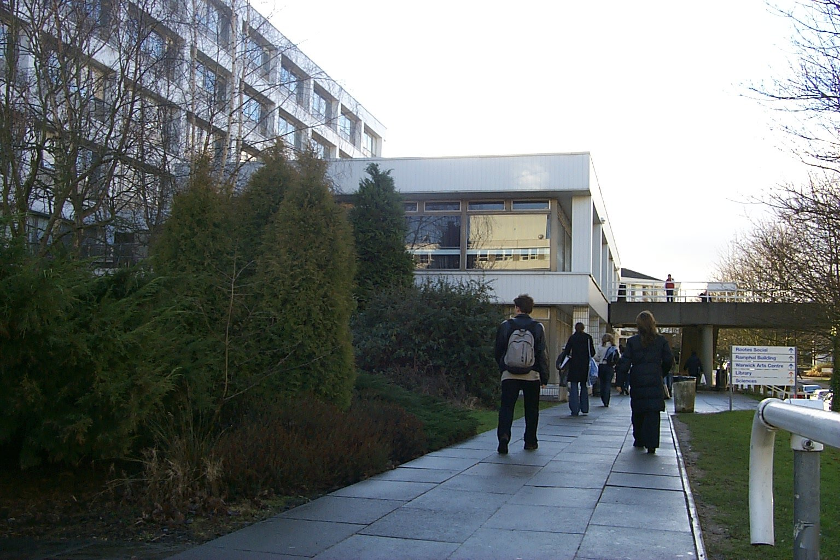

Slide 3
Library facts
Contains over 1.2 million printed volumes
Over 34,000 electronic journals
Under 3,000 printed journal titles
40,000 linear meters shelving
Expenditure over £3.9 million on materials and information systems
Over 26,500 items added each year

Slide 4
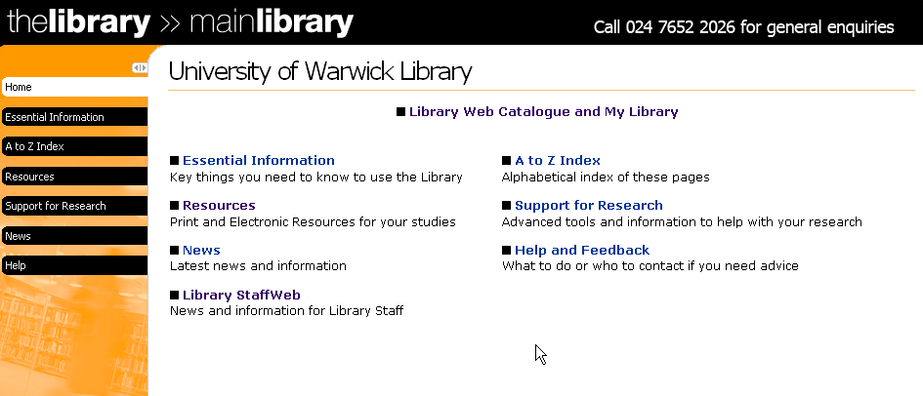
Library Website

Slide 5
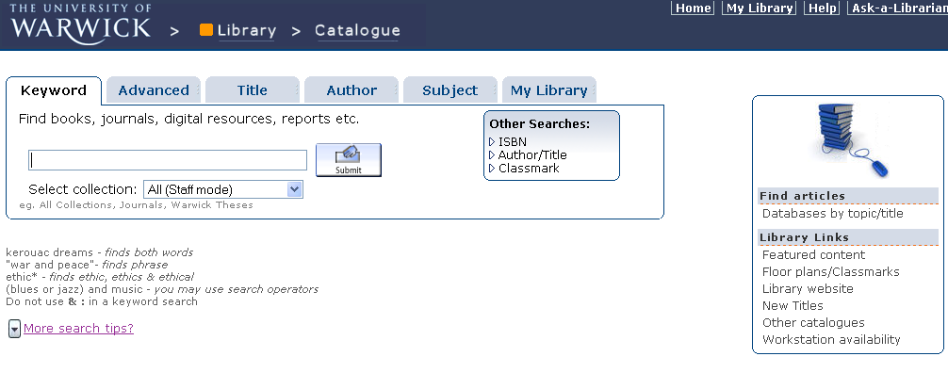
Library Catalogue

Slide 6

Resources for Education
Education book stock is on Floor 4.
370 - 379 class marks for Education
Schools Collection on Floor 4
Printed Journal stock on Floor 5 – alphabetically by title
Databases for journal articles – available from Education WebPages

Slide 7
Anatomy of an article reference
Westin AF (2003), “Social and political dimensions of privacy” in Journal of social issues v.59 n.2 pp.431-453
Journal title
Author Year
Article Title
Vol. Issue Pages

Slide 8
Useful databases for Education
The British Education Index
Education Research Complete
ERIC
Educational Research Abstracts
Sociological Abstracts – via CSA
Web of Science
TES and newspapers via Factiva

Slide 9
Off-campus access
IT Log-in
Access to “My Library”
Access to articles from e-journals from off-campus
Used as ATHENS user name and password for
Databases
E-books
Notes:
Most of our e-resources can be accessed from off-campus. You will need to register with IT Services for an Athens username and password to use many of our databases from home. Details on how to do this are on the library web pages.
For certain e-journals you will be prompted to enter your university barcode number and PIN. This is the PIN you set up under My catalogue. There are leaflets describing how to do this. If you have any problems please ask at the Enquiry desk.

Slide 10
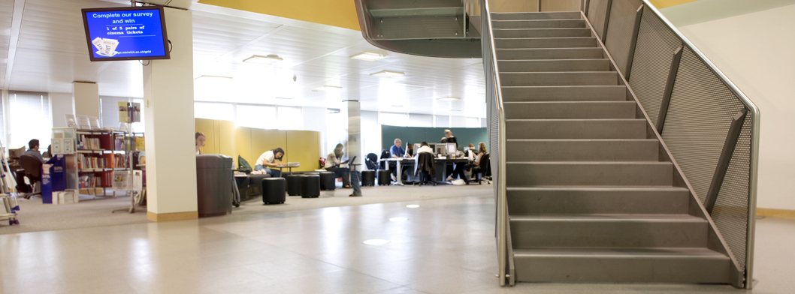
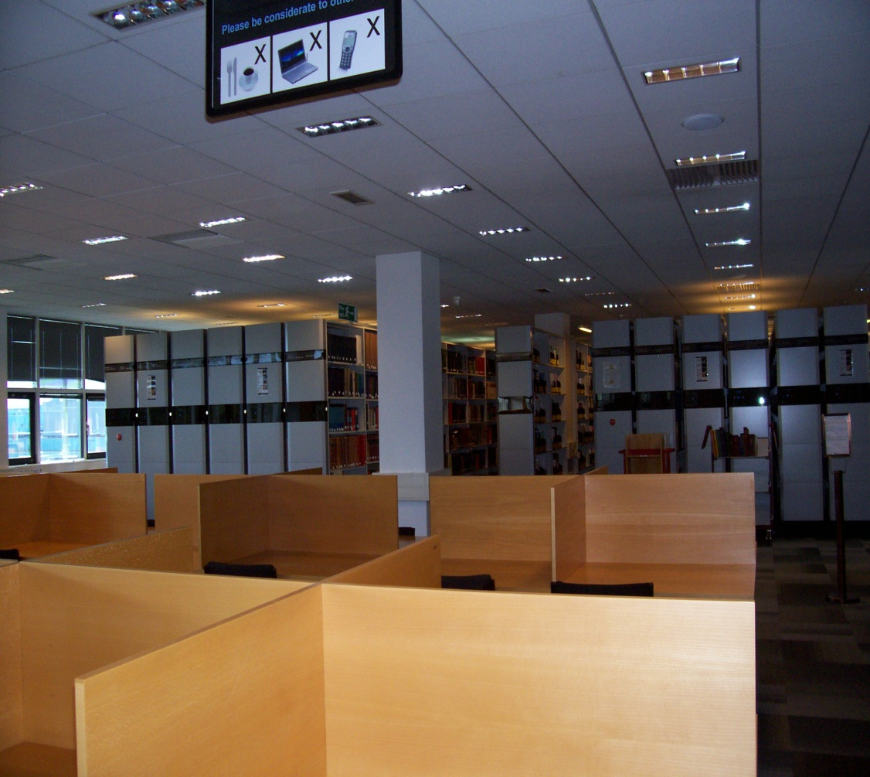
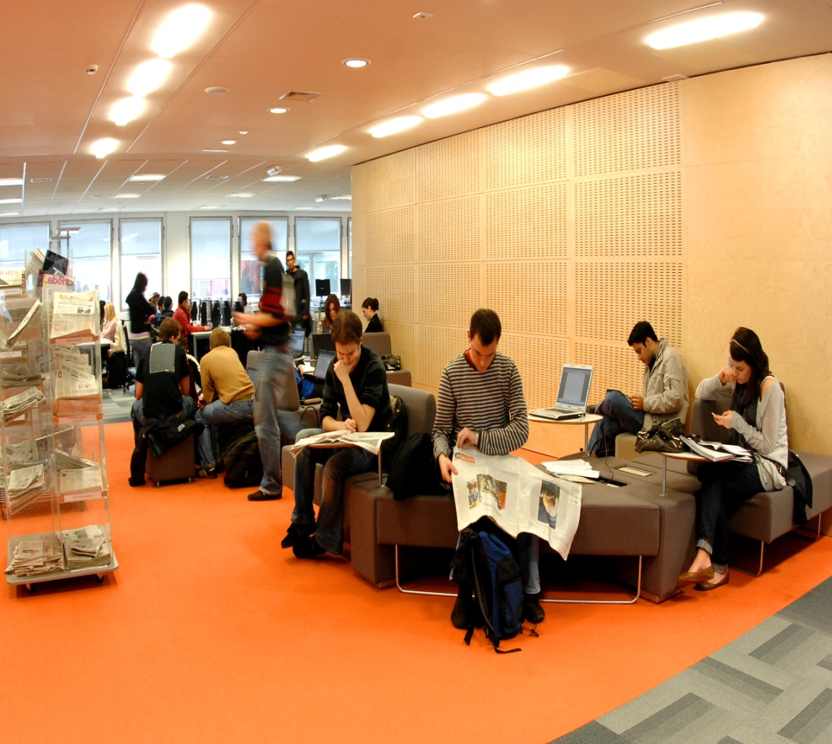
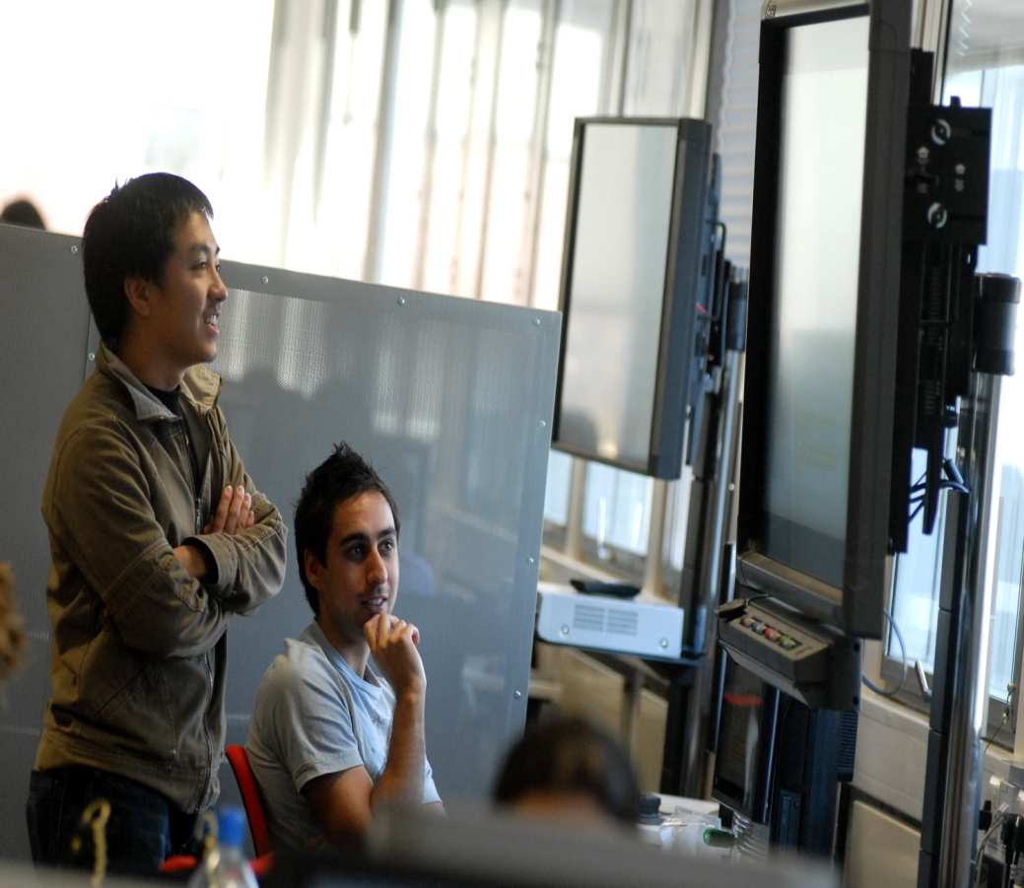

Spaces to learn and research…
Group study
Silent study
Wireless networking
Open access computers
Long opening hours

Slide 11
Beyond Warwick University…
SCONUL Access reciprocal borrowing scheme
Document Supply Scheme
Other catalogues e.g. COPAC http://www.copac.ac.uk
Library suggestion form

Slide 12
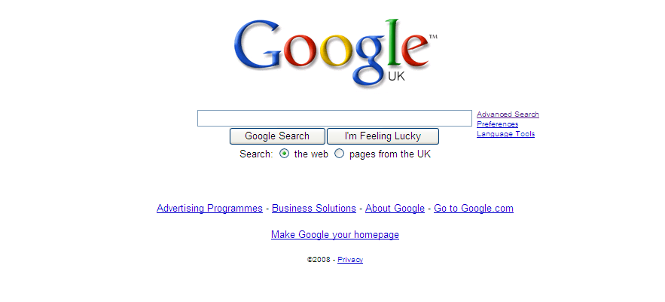

Slide 13



Education Librarian details:
024 765 24476
c.bradford@warwick.ac.uk
http://go.warwick.ac.uk/lib/education

