Slide 1

The maths resilience toolkit
Janet Baker
© Amygdala Coaching Associates

Slide 2
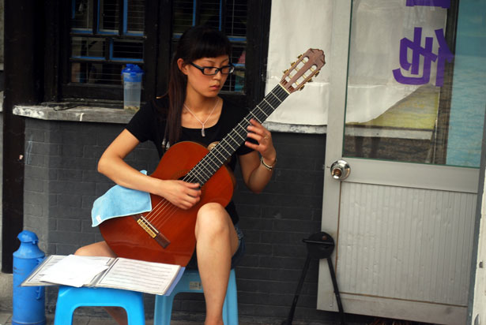
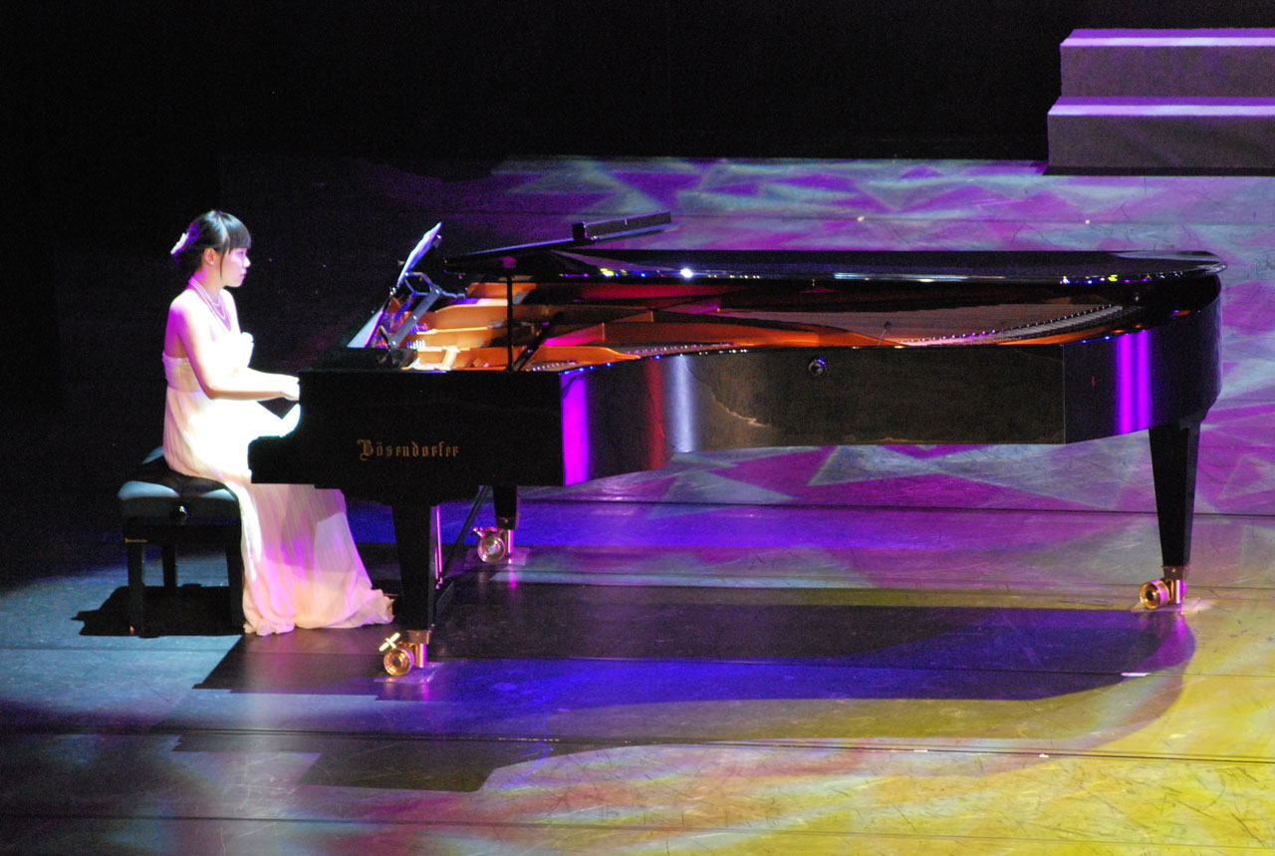
Practice vs Performance
Practice
Take risks
Focus on learning
Outcomes can be rubbish or fantastic – either way you learn
Performance
Play it safe
Focus on getting it right
Outcomes are never your best – aim for 75% of best

Slide 3
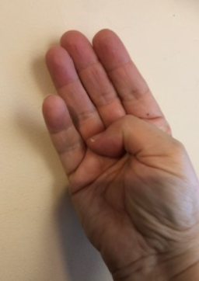
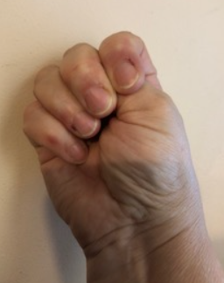
Hand Model of the Brain
Has your mind gone blank?​
Does it feel as if your brain has frozen?​
​
Remember that when you feel confused or panicky or stupid, this is only your brain trying to keep you safe.​
​
You can think more clearly if you reverse the fight, flight or freeze response. This will reconnect your thinking brain.
Janet Baker
Thinking brain and emotional brain disconnected
Thinking brain and emotional brain connected

Slide 4
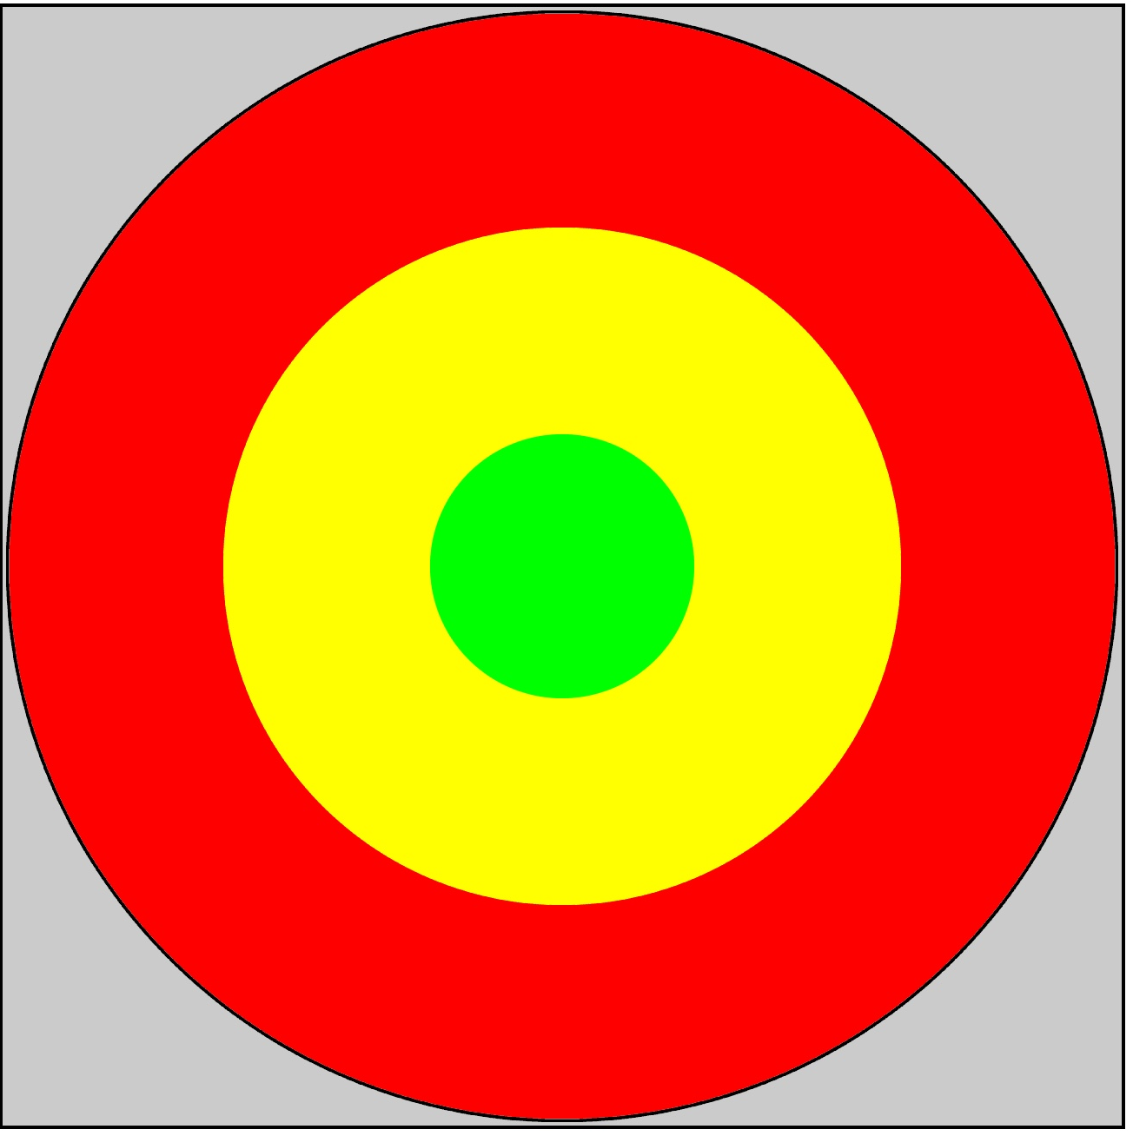
growth zone model
TrJanet Baker
Track your feelings
Green – Comfort zone
Easy, calm, a bit boring
Yellow – Growth
Manageable challenge – the best place to learn
Red - Anxiety
Thinking brain is disconnected

Slide 5
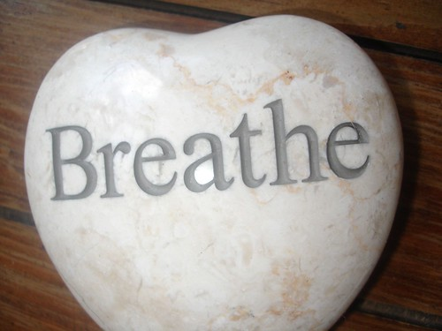
Recovery Breathing
Tt Baker
Breathe in for a count of 7,
and out for a count of 11
Breathe in for a count of 4,
hold for 4,
breathe out for 4,
hold for 4
As you breathe in, think ‘strong’,
As you breathe out, think ’calm’
Cover your face with your hands.
Breathe in and out slowly.
This Photo by Unknown Author is licensed under CC BY

Slide 6
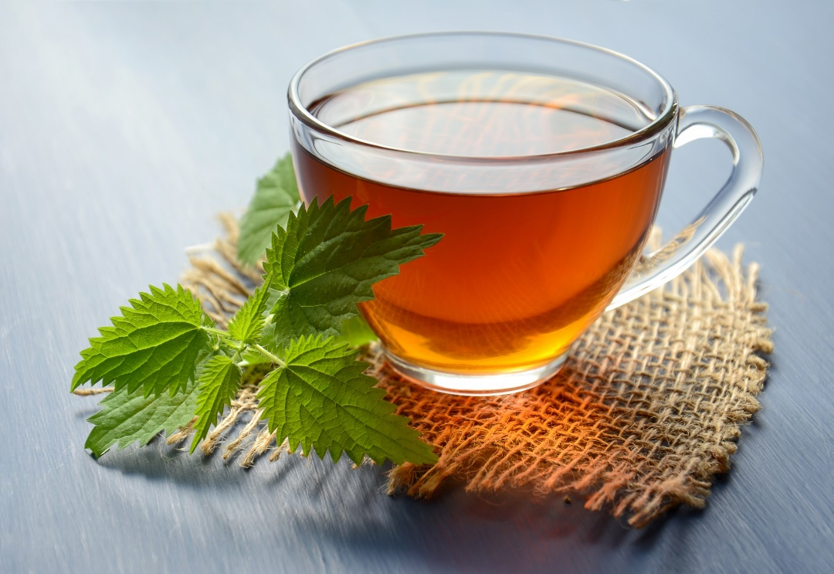
Other calming strategies
Tt Baker
Get up.
Stretch, yawn, shake.
Look out of a window.
Focus on something for 30 seconds.
Hold a pebble in your hand.
Feel it’s weight, texture, temperature.
Close your eyes.
Listen out for 5 different sounds.
Have a cup of tea or a snack.
As you drink or eat, notice its taste, temperature, mouth feel.

Slide 7
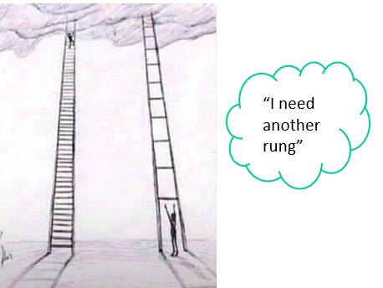
Learning Ladder
Tt Baker
One step at a time
Rungs the right size for you, for now
Go at your own speed (you can rest and catch your breath)
Start at the bottom

Slide 8

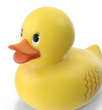
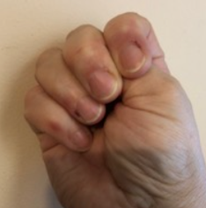
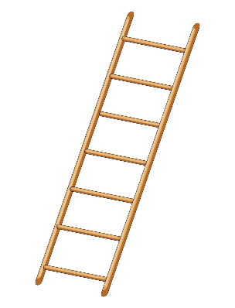
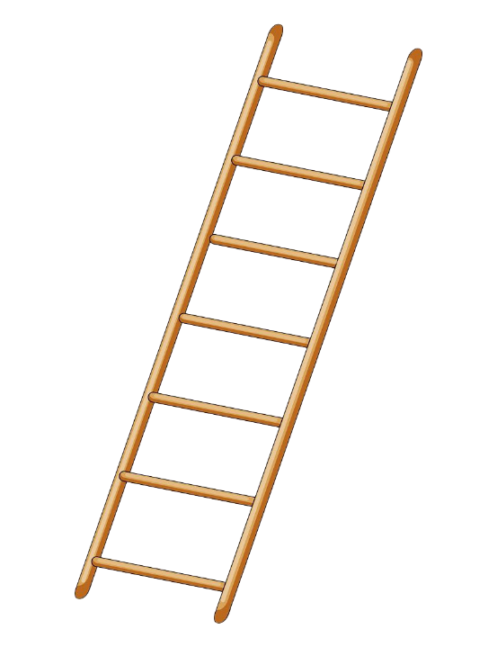
Use your toolkit
How do you feel?
What do you need to do?
Brain freeze?
Check your challenge
Blossoming in growth?
Thinking brain and emotional brain connected
Check your challenge
Cruising in comfort?
Climb back to growth
This Photo by Unknown Author is licensed under CC BY-NC
Janet Baker
This Photo by Unknown Author is licensed under CC BY

