Slide 1
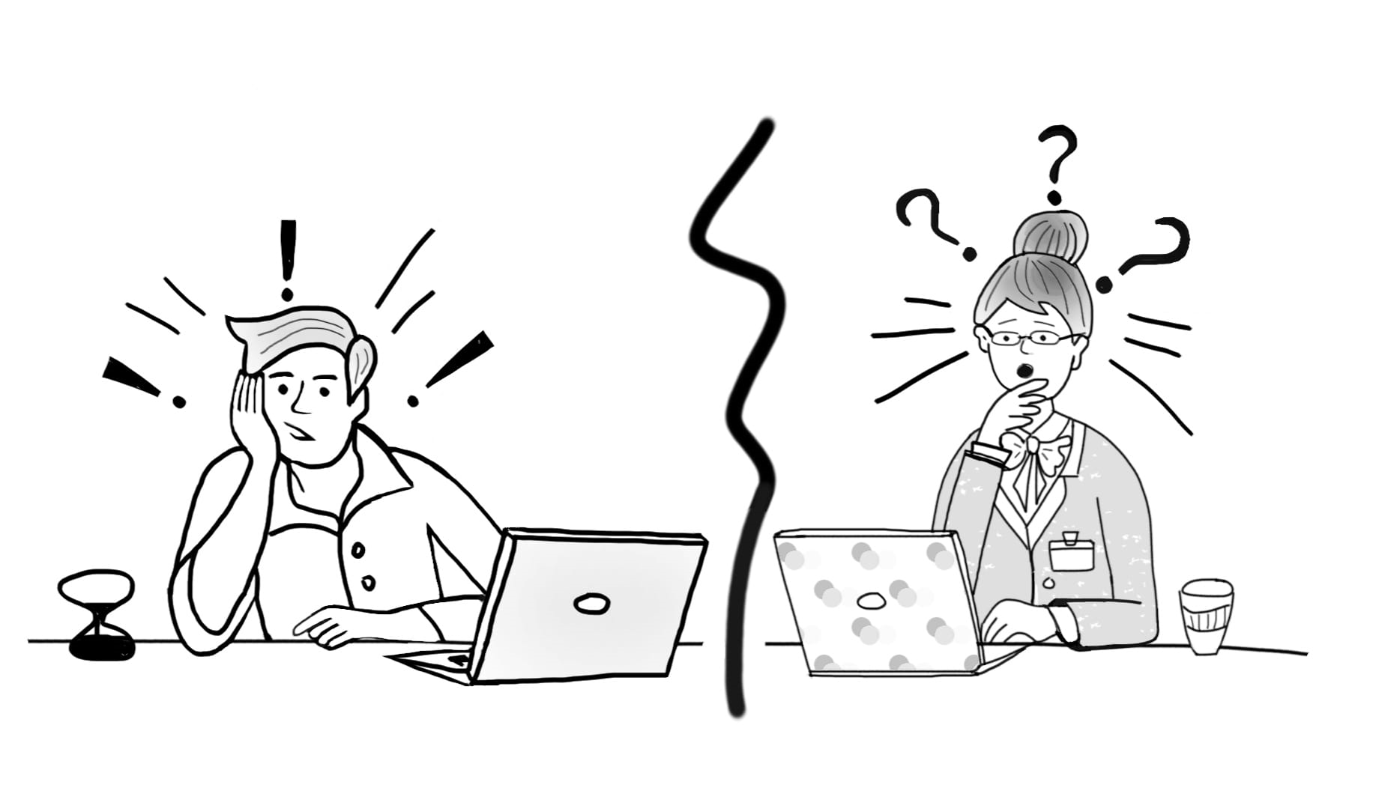

Pre-application Doctoral Communications: Exploring Institutional Gatekeeping in Doctoral Programme Admissions
PI: James Burford
Co-I: Emily Henderson
Department of Education Studies, Warwick University
#PADC_project
Project website: https://warwick.ac.uk/padc
Funded by: Research England Enhancing Research Culture Fund (March-July 2022; January-July 2023)
Illustration by Yara Aboasfour
Notes:
Twitter/illustration/funder/
Follow our researchers on Twitter to receive project updates @jiaburford @EmilyFrascatore @AhmadAkkad @Dangeni_ or follow the project hashtag #PADC_project

Slide 2
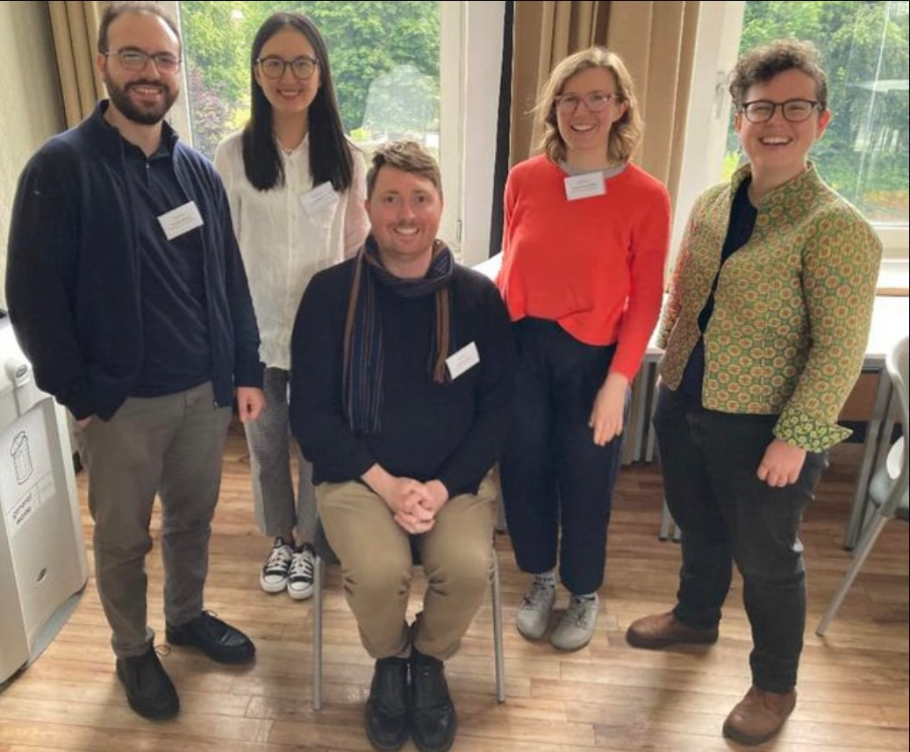
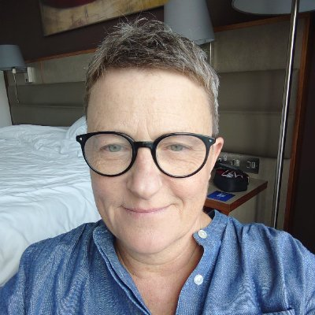
Project Team
PADC Phase 2 Team members:
PI: James Burford
Co-I: Emily Henderson
Post-doc: Sophia Kier-Byfield
Placement student intern: Annum Mahmood
PADC Phase 1 Team members:
PI: James Burford
Co-I: Emily Henderson
RAs: Sophia Kier-Byfield, Ahmad Akkad, Dangeni
Project illustrator: Kate Carruthers Thomas

Slide 3
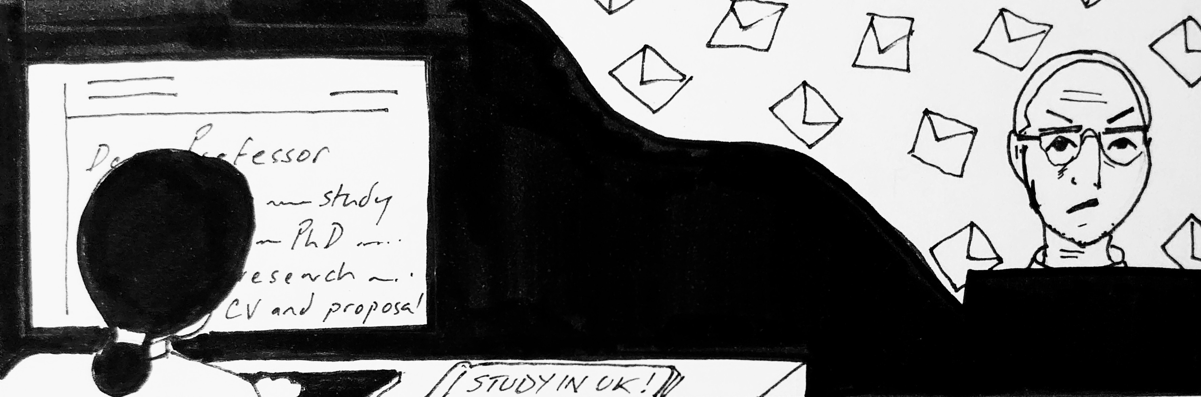
What are pre-admissions doctoral communications (PADC)?
PADC defined as: communications that potential doctoral applicants have with university staff prior to making a formal application to study.
Illustration by Dr Kate Carruthers Thomas

Slide 4
What are pre-admissions doctoral communications (PADC)?
Often emails from applicants to supervisors, Programme Officers (POs) or Directors of Postgraduate Research (DPGRs)
May include other forms too – video/phone calls, dropping by, approaches on social media, at conferences)
May be forwarded communications within departments (e.g. from DPGR to supervisor)
Near ubiquitous in some disciplines in the UK (especially in social sciences and humanities), unheard of in others.

Slide 5

'I have an uneasy feeling about this': Project origins
JB arrived to a new role in a new country - sought advice from EH (DPGR) on how to manage/make judgments about responding to PADC in a context where there are few available places and many potential applicants.
In December 2021, EH organised a fact-finding consultation with supervisors which revealed an appetite for guidance on applying EDI principles within pre-application.
Developed a project proposal for research culture funding titled Opening up the Black Box of Pre-application Doctoral Communications

Slide 6
Broader context: Diversity and the researcher workforce
Limited diversity of the researcher workforce is a site of national concern.
Doctoral education is integral to researcher training, often the ‘gateway’.
Wealth of research on challenges facing minoritised doctoral students in the UK – including women, black minority ethnic (BME) groups, and students living with a disability (e.g. Mattocks & Briscoe-Palmer, 2016).
"The vision for the strategy is: a more inclusive, dynamic, productive and sustainable UK R&D sector in which a diversity of people and ideas can thrive" (R&D People and Culture Strategy, p. 14)

Slide 7
EDI and doctoral admissions
Doctoral admissions: a key point of intervention to develop a more equitable, inclusive, and diverse research workforce.
Much scholarship has a focus on exclusionary nature of admissions criteria (Mountford et al., 2007; Potvin et al., 2017; Cano et al., 2018; Ghost et al., 2018; Miller et al., 2019; Squire, 2020; Roberts et al., 2021).
Further studies on how academic staff identities influence admissions decision-making (Squire 2020)
Many studies are US-focused (GRE, deliberative bureaucracy, holistic admissions), discipline-specific, few take an institutional approach.

Slide 8
EDI and doctoral admissions
As Julie Posselt has argued:
professors play an underexamined role as gatekeepers of the professions, including the professoriate. One context in which this gatekeeping occurs is admission into graduate programs, which entails evaluative processes that are often opaque to outsiders and taken for granted by insiders (2014, p. 482).

Slide 9
Doctoral admissions is a broad field of enquiry (mostly from the US context); relatively little research has been carried out on the pre-application stage internationally.
This stage of admissions is often a source of great unease for applicants; the contact that takes place between applicants and institutions is important for applicants’ sense of security and for the making and acceptance of offers (Kim and Spencer-Oatey, 2020)
A clear link is emerging between EDI concerns and pre-application communications. (Milkman et al., 2015)
The review recognised the wealth of grey literature on pre-application communications, such as YouTube videos, advice pages and guidance from other UK institutions.

Slide 10

Pre-application as a ‘gatekeeping’ moment
Our study focuses on one neglected element of the doctoral admissions process: pre-application communications.
For prospective doctoral applicants from underserved communities, the doctoral application process may be bewildering and difficult to navigate (see wealth of advice texts – YouTube videos, blog posts).
Equally, respondents to inquiries may make snap judgements, perhaps giving limited thought to their gatekeeping function.

Slide 11
Phase 1 objectives: PADC and Warwick staff
1. To understand how supervisors, DPGRs, and POs make decisions about responding to potential doctoral applicants at the pre-application stage and explore how these decisions may negatively impact the recruitment of diverse talent.
2. To evaluate the extent to which Doctoral College/departmental webpages on PGR admissions transparently describe the pre-application stage.
3. To identify changes at institutional and department levels to create a more transparent and inclusive doctoral admissions process, with a particular focus on enhancing inclusivity.
4. To produce a suite of professional development opportunities that facilitate the implementation of these changes.

Slide 12
PADC Phase 2 – Searching for a Supervisor
A key finding of PADC1 was that doctoral supervisors struggle to manage the sheer number of approaches they receive from potential applicants, which leads to a sifting of potential applicants according to those who have more or less access to support and advice.
This revealed the need to explore the connection between supervisors receiving PADC and applicants seeking supervisors
Specifically focused on how students navigate the process of searching for a supervisor, our follow-up project (PADC2) aims to develop resources to make the process more transparent and thus assist students from underrepresented groups to navigate toward potential supervisors with greater confidence
Project runs from Dec 2022-July 31 2023.

Slide 13
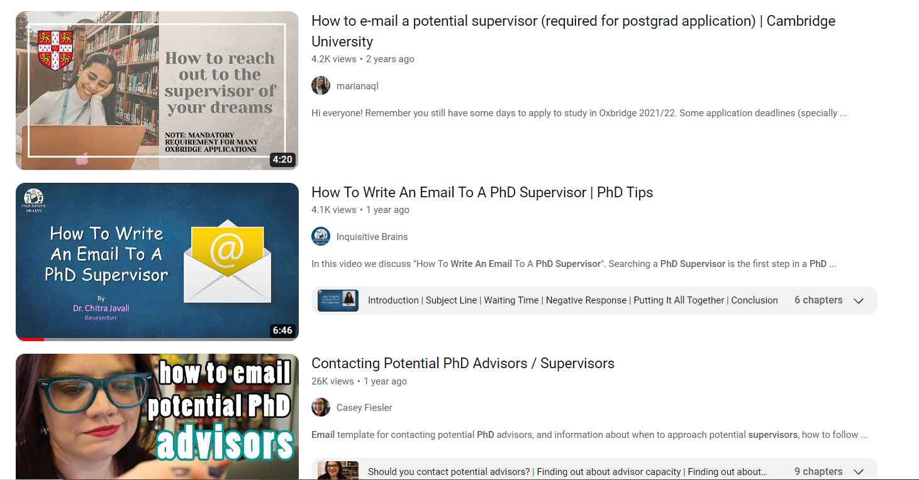
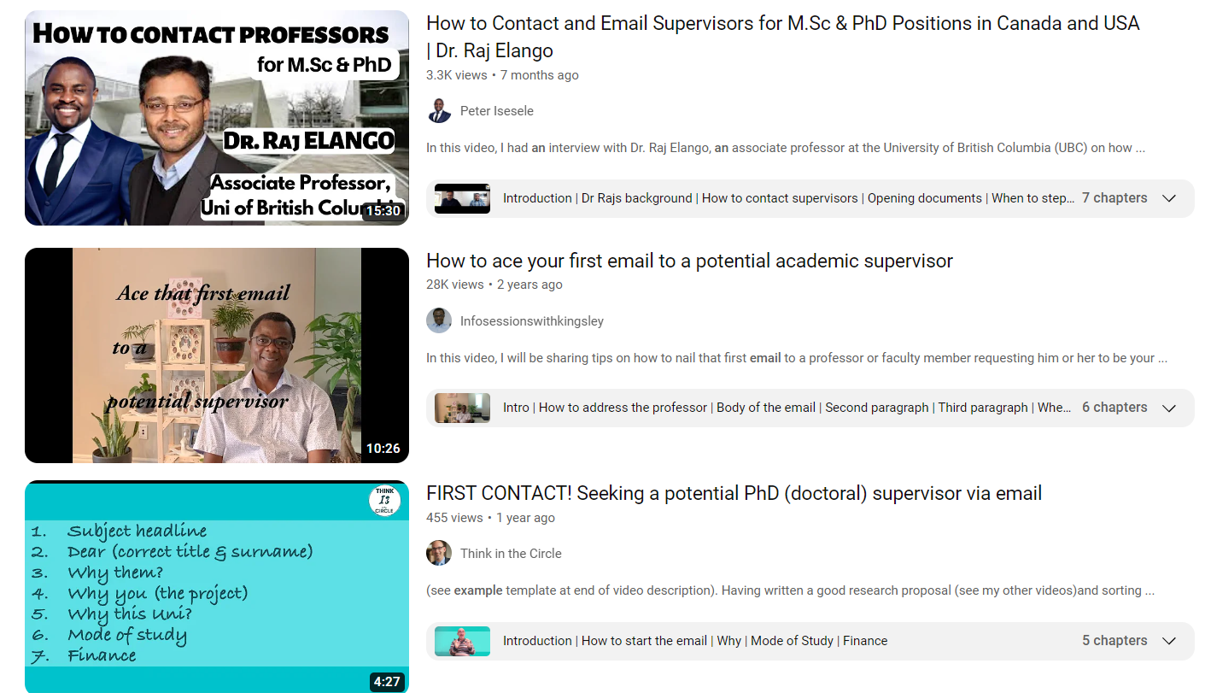
Phase 2 research objectives: finding a supervisor
To undertake empirical research at Warwick to understand how current doctoral students who are members of minoritised social groups navigated locating a doctoral supervisor, identifying potential barriers and obstacles in the process as well as enabling factors. To identify recommendations for change based on these findings.
To undertake a review of existing extra-institutional video resources which inform students about how to approach a supervisor, both at the institutional level and more widely across the UK.
To create a video resource which seeks to demystify the process of finding a supervisor which takes applicants from underrepresented groups as its primary target audience. This video resource will bring together findings from PADC1, findings of the empirical research and video review from PADC2.
To use the findings from the empirical research to further develop the PADC1 pilot workshops, and to deliver PADC workshops to supervisors, DPGRs and POs across Warwick faculties.

Slide 14
Early Findings: Web Review
Looked at PGR programme information, PGR admissions deadlines, details of relevant contacts, research proposal drafting guidance, advice on seeking relevant funding and scholarships.
Good practices identified in several departments:
  clearly explained scholarship details and application procedures
  explicit guidance for applicants to prepare/draft research proposals
  a ‘research degree application checklist’ with essential steps and guidance for applicants prior to their formal application.
However, information on the decision-making process and EDI-related guidance and information have been rarely found on webpages.
Overall impression of highly variable practices institution-wide.

Slide 15
Qualitative study: participants and methods
Multi-method design
Semi-structured interviews | Solicited diaries & FGDs
Design 1-hour semi-structured interviews focus on i) the role in relation to postgraduate research, ii) the role in pre-application stage of doctoral admissions, iii) inclusivity practices Participants 12 DPGRs, 8 doctoral programme officers 15 minoritized doctoral students All participants drawn from across Warwick faculties | Design Solicited diary forms with questions/prompts 6 weeks Online forms via Qualtrics Follow up FGDs Participants 19 doctoral supervisors All participants drawn from across Warwick faculties

Slide 16
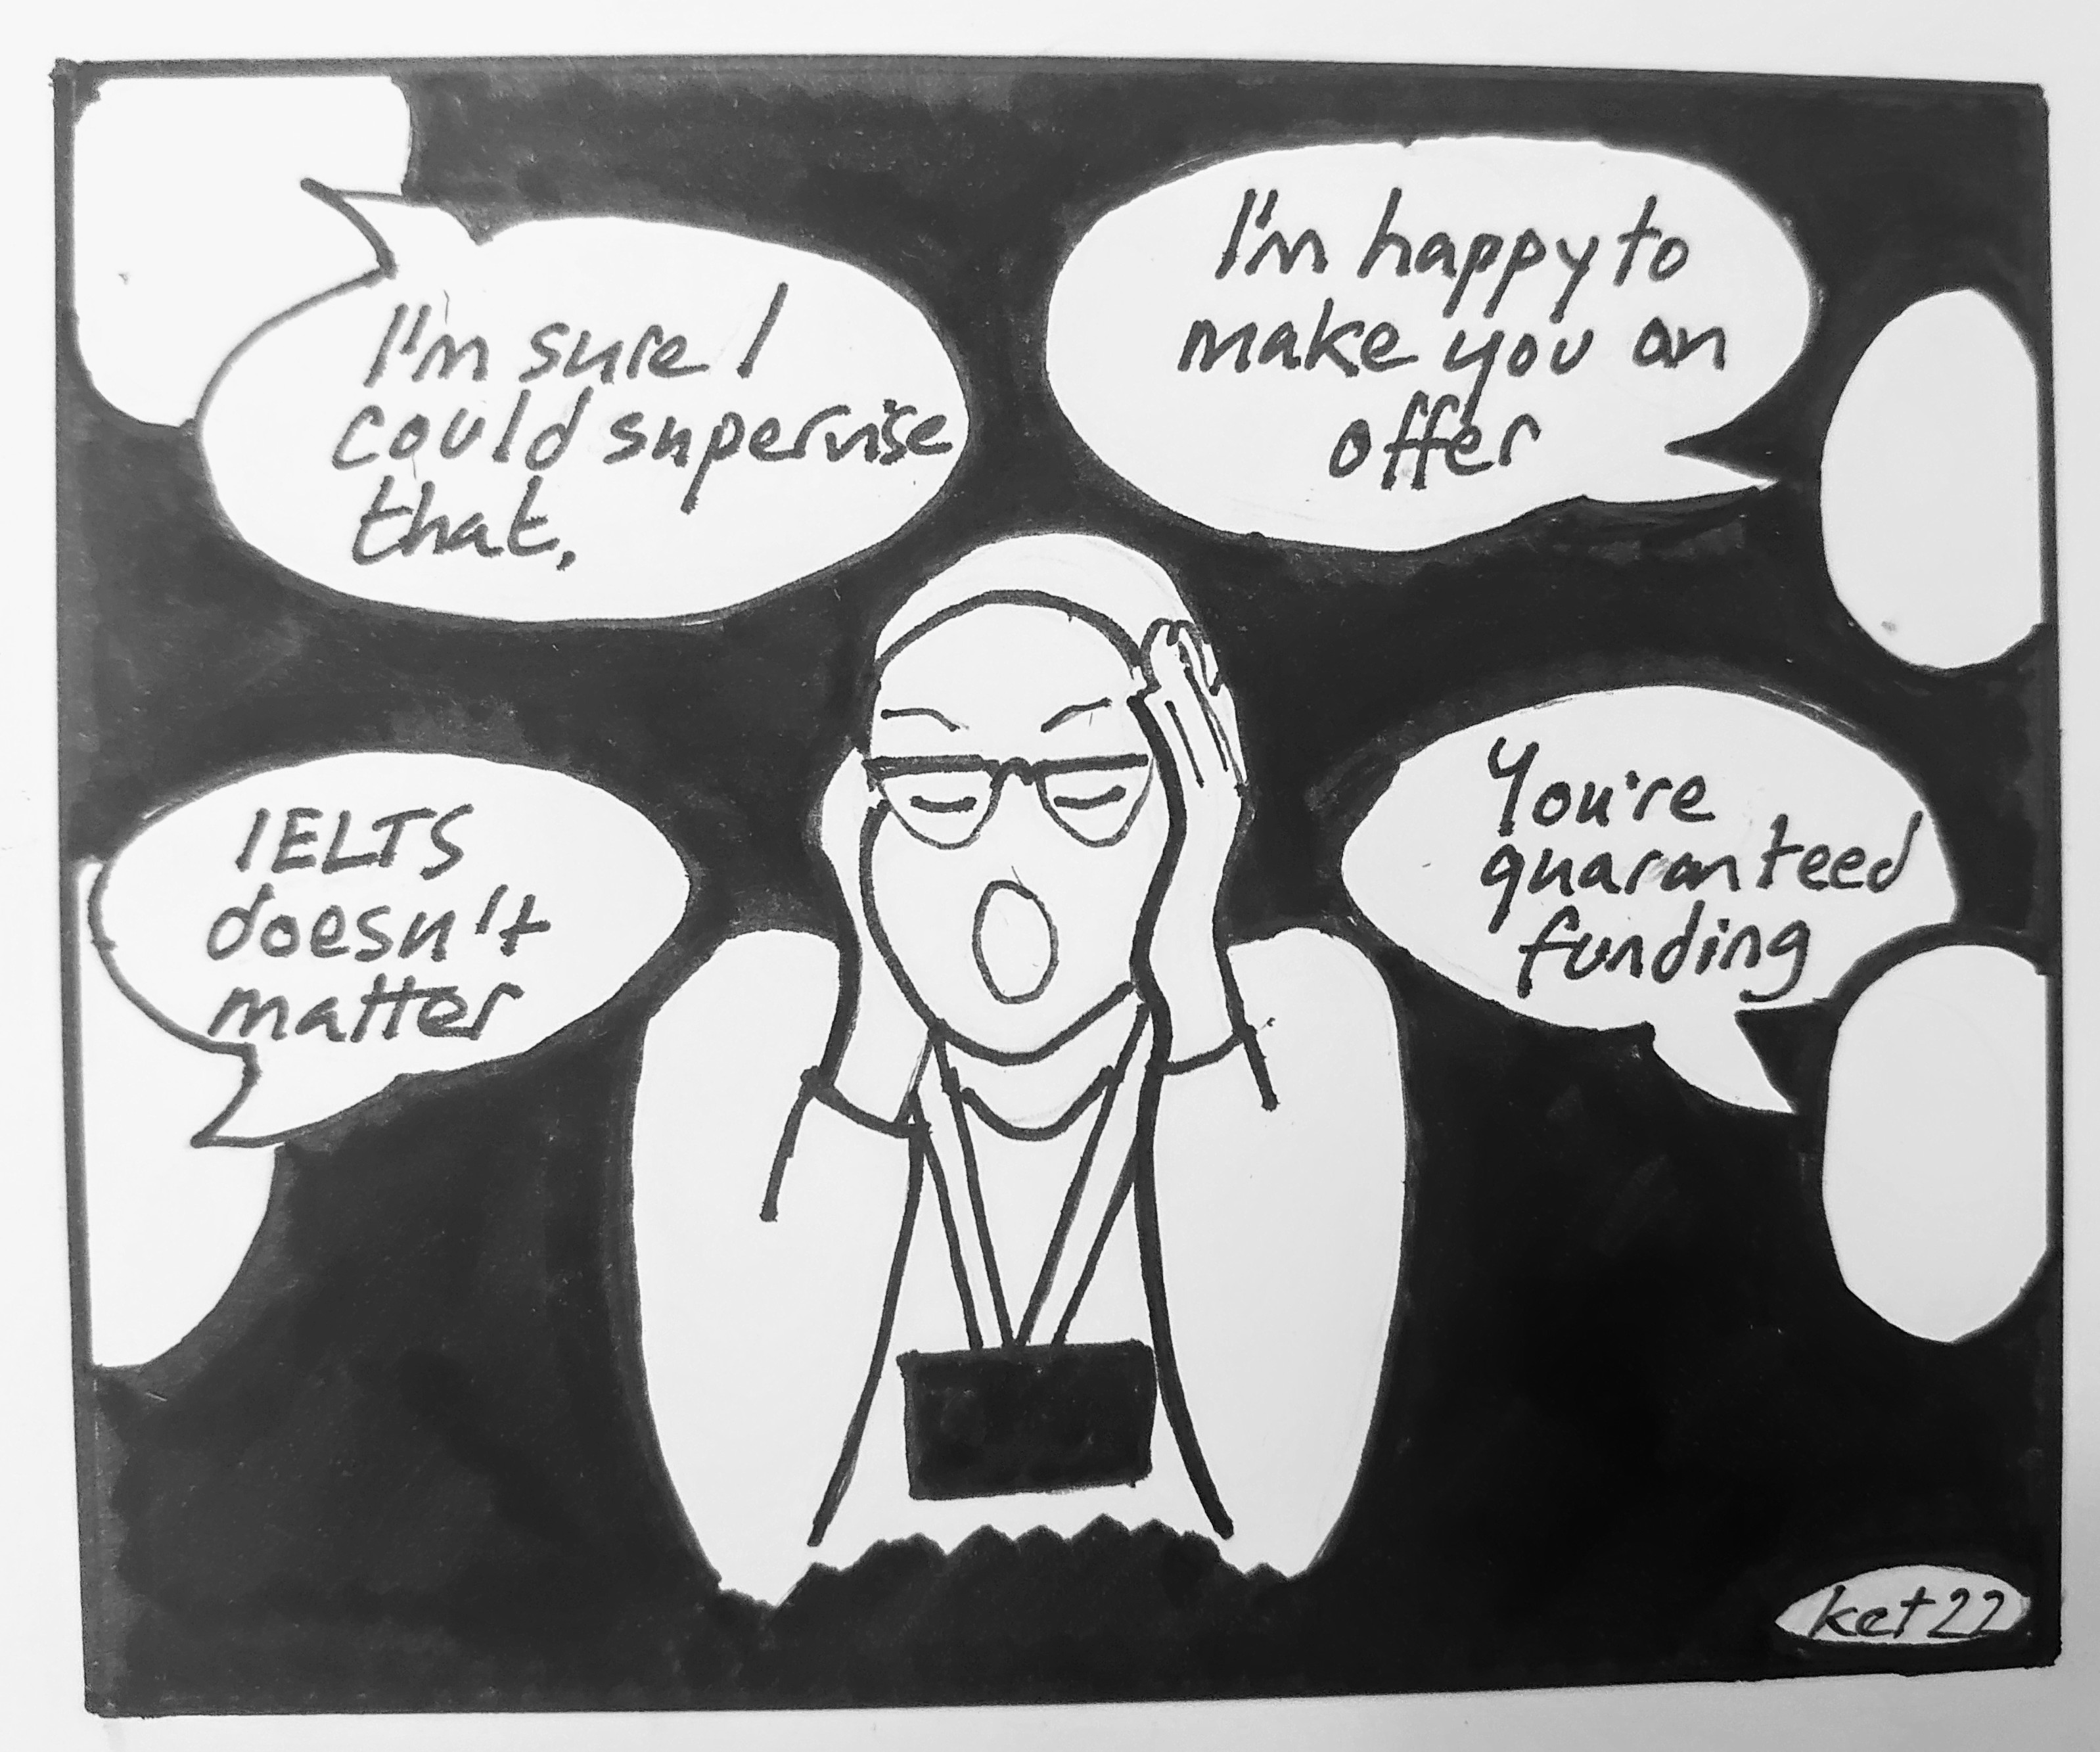
Stakeholders 1 & 2: Directors of PGR and Programme Officers
The role of Director of PGR varies in terms of involvement in gatekeeping (heavy/minimal oversight; other roles: admissions tutors or academic leads; relying heavily on supervisor endorsement rather than process)
The role of Programme Officer varies in terms of gatekeeping, e.g., filtering suitable applicants, sending rejection emails, deciding when to pass something on
POs and DPGRs want to make more inclusive websites; websites are often a site of confusion for staff and applicants
Broadly, POs and DPGRs often emphasised their 'equal' treatment of applicants – limited consideration of differentiated needs for information and communication.
Minimal conversations about widening participation amongst 'non-traditional' domestic students – focus largely on international students
Illustration by Dr Kate Carruthers Thomas
Notes:
Webpage: key site for info

Slide 17
Stakeholder 3: Supervisors
Some understand PADC as a site of gatekeeping and want to know how to enact EDI principles at this stage.
Some are not sure how to think in nuanced ways about applicants who may require additional support (e.g., scholars at risk).
Some worry that some applicants' communications might be privileged (e.g., access to library resources/peers/networks/agents to prepare proposals).
Recruitment capacity/workload an issue: how does it shape supervisor inclination to engage with 'polished' communication over students who may need more support, and therefore enact gatekeeping?

Slide 18
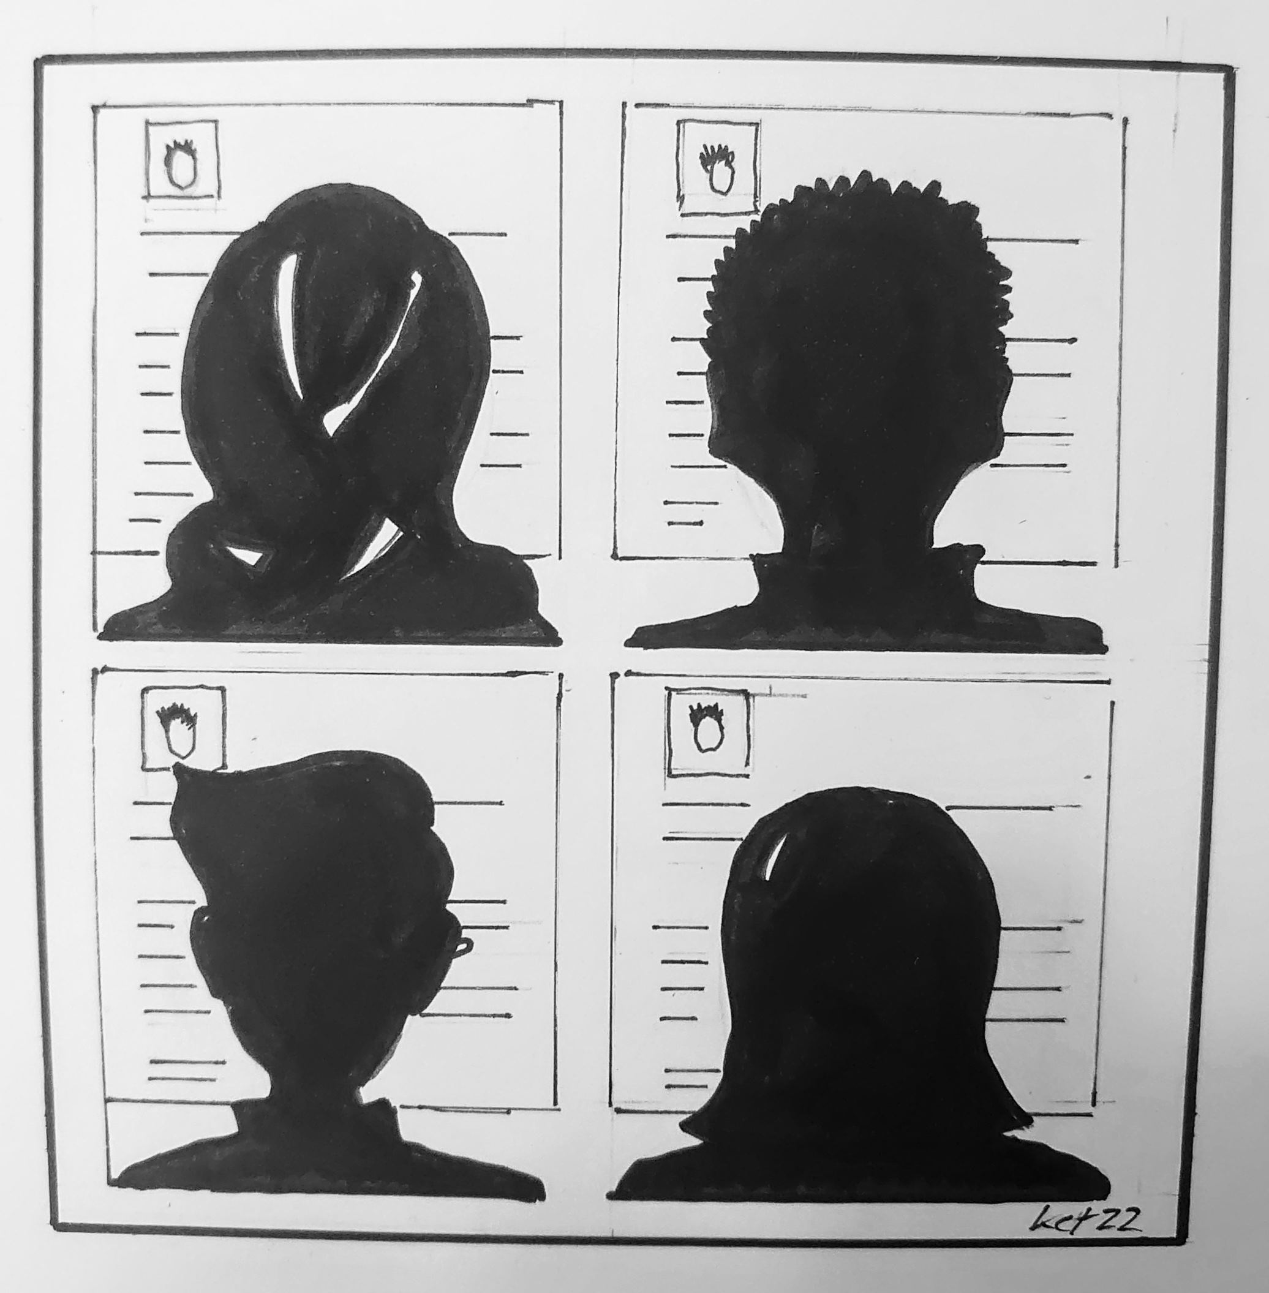
Supervisor Findings – routes and actions
Routes of PADC for supervisors
  As expected, the most common communication form is email from potential applicants (73.8% of applicants).
  The referral of potential applicants from directors of doctoral programmes or programme administrators (23.1% of applicants) was the second most common form.
Actions taken by supervisors receiving PADC
  For 32.2% of the applicants, supervisors initiated next steps (e.g., asking for a proposal or requesting a meeting).
  In several cases, supervisors delayed replying for at least a week (28.8% applicants), which was explained as being due to, for instance, levels of busyness or uncertainty about next actions.
  For 30.5% of applicants, the supervisor replied to decline interest in proceeding further.
Illustration by Dr Kate Carruthers Thomas

Slide 19
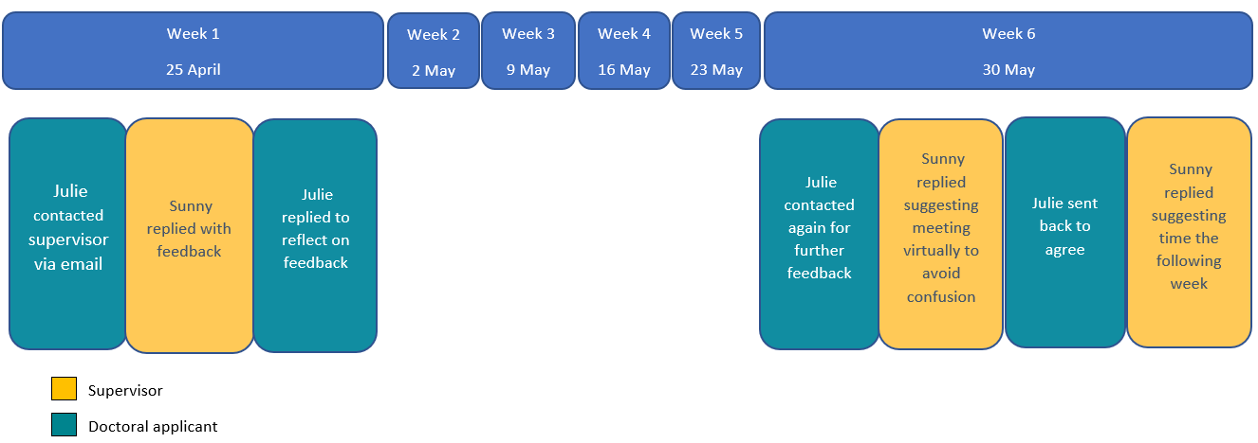
Supervisor Findings – routes and actions – an applicant's journey

Slide 20
Supervisor Findings - reflections
Supervisors’ reflections on their actions:
The data produce a picture of an ideal applicant against which these communications are measured...
The ideal applicant sends an email that...
is neither too long nor too short,
in advanced and consistent English,
identifying a clear topic relevant to the supervisor’s interests but showing evidence of independent thinking,
mentioning previous high-quality academic credentials and experience,
demonstrating an understanding of what a doctorate involves.
“It was a good email and the applicant communicated well in terms of knowledge and interests to pursue a PhD”
(Carol, Social Sciences, Diary form 1, w/c 2nd May 2022)

Slide 21
Cross-cutting themes across stakeholders
PADC are evaluated based on criteria (often informal, by different people at different times) ​
  Style, language, and length of email​
  Qualities like 'seriousness' and 'politeness'​
  Striking a balance of personalisation but not ‘fake’ ​
  Judgement on the quality of any attached proposal​
  As assessment of the applicant's expertise and background​
  Research topic and 'fit' with supervisor​
  The 'sparkle' of an email/proposal​
  Social justice considerations​
  Funding intentions​
Underlying principles for making decisions:​
  Distinctions between professional v academic judgement – but sometimes blurry. ​
  Supervisor autonomy​
  Competing time pressure​
  Capacity to recruit students​
  Department priorities​
  Enactment of care for student/discipline/minoritised community member ​
What appears to be at stake for these decisions: ​
  Time investment, emotional investment, intellectual investment, political investments. ​

Slide 22
Implications
In order to understand doctoral admissions from an inclusivity perspective, it is necessary to explore the role of supervisors, DPGRs and POs in pre-application communications.
This is an important admissions stage where many applicants are deterred from even submitting an application.
There is variation in the role of the supervisor across national contexts and institutional configurations, but the results of our study show that supervisors struggle to manage all the emails they receive from applicants and that they have strong expectations of pre-application communications which may be exclusionary for students who cannot access support.
PADC was often viewed as an ordinary, routine, and unremarkable part of work for most participants. However, some carried significant guilt or shame (e.g. at unanswered emails, disappointed applicants) or associated this practice with overwhelm (e.g. too many emails to keep up).

Slide 23
Stakeholder 4:
Disadvantaged applicant groups?
Currently enrolled students were described as ‘already really familiar with the staff…just really comfortable going and talking to them about applications’ other students are seen as ‘stabbing in the dark’ (Programme officer)
Overseas or displaced vs home
External vs current students
Mature vs recent graduates
First generation vs family with HE background
The majority of the data suggests that pre-application communication is of great importance to the progression of an application and is a site of gatekeeping ​

Slide 24
Briefing 1: Institutions (DPGRs and POs)

Slide 25
Briefing 2: Supervisors

Slide 26
PADC Phase 2 – Searching for a Supervisor
A key finding of PADC1 was that doctoral supervisors struggle to manage the sheer number of approaches they receive from potential applicants, which leads to a sifting of potential applicants according to those who have more or less access to support and advice.
This revealed the need to explore the connection between supervisors receiving PADC and applicants seeking supervisors
Specifically focused on how students navigate the process of searching for a supervisor, our follow-up project (PADC2) aims to develop resources to make the process more transparent and thus assist students from underrepresented groups to navigate toward potential supervisors with greater confidence
Project runs from Dec 2022-July 31 2023.

Slide 27
Questions?

